Slide 1

Will’s Law
Marjorie Cole
State School Nurse Consultant, CHW/School Health

Slide 2
Will’s Law
Governor Parson signed SB710 which included Will’s Law (§167.265, RSMo.) to prioritize school safety for children diagnosed with seizure disorders, including epilepsy.
Three key components required by law for the school nurse or designee:
  School staff training every two years.
  Coordinate care for students with seizure disorder.
  Develop IEHCP and IHCP for students identified for seizure disorder.
Notes:
Three key components:
1. Ensure all school staff are trained every two years on the care of students with epilepsy and seizure disorders
2. Coordinate care for students with seizure disorder
3. Develop an individualized emergency health care plan and an individualized health care plan for students identified for seizure disorder care while in school

Slide 3
School Staff Training
Requires school nurse or designee to ensure staff are trained every two years.
Training required may be online or in-person.
Training must be:
  Approved by the Department of Health and Senior Services.
  Provided by a reputable, local, Missouri-based health care or nonprofit organization, such as Epilepsy Foundation of Missouri and Kansas (www.EFMK.org).

Slide 4
Requires school nurse OR designee to coordinate care of students
Communication is key.
  Emphasis on proper release of information:
    Students’ health care provider(s).
    School administration.
    Parent.
    Student.
  HIPAA /FERPA.
  https://www.cdc.gov/phlp/docs/hipaa-ferpa-infographic-508.pdf

Slide 5
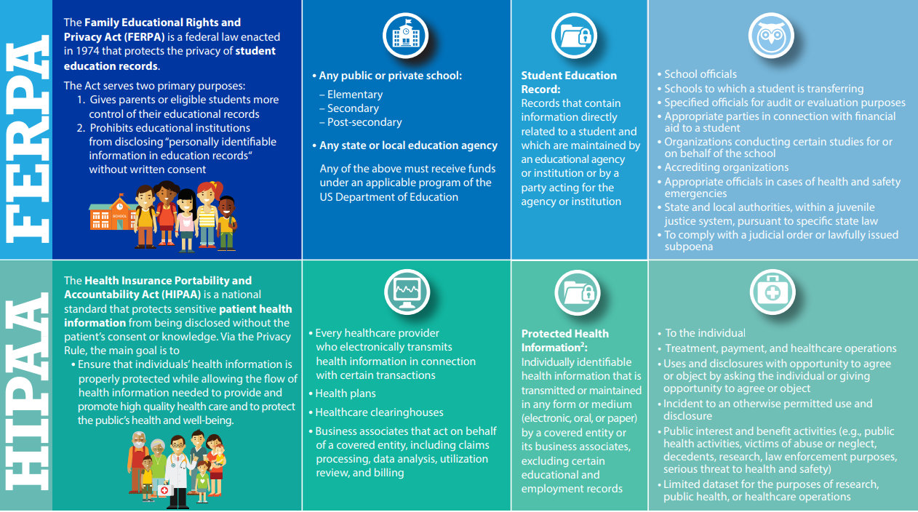

Slide 6
School Nurse is required to Develop an Individualized Emergency Health Care Plan (IEHCP)
Document developed by the school nurse, parent, and other appropriate medical professionals.
Describes procedures and specific directions a person will take in an emergency.
  SN CHAT is a suggested guide school nurses can use when having discussions with student’s families about the child’s unique response to a chronic health condition.
Notes:
An IEHCP is defined in Will’s Law as a document developed by school nurse in consultation with parent and other appropriate medical professionals.
The parent, school nurse and a school administrator sign this form. In the absence of a school nurse, the administrator signs.
SN CHAT is a suggested guide school nurses can use when having discussions with student’s families in person or by phone to gather information about this child’s unique response to a chronic health condition. The school nurse uses this structured interview format to develop plans based on the information gained from these conversations (chats).
An example format for the IEHP is included in the School Nurse Chronic Health Assessment Tool (SN CHAT) is on the next two slides (split in two to make it easier to read)

Slide 7
SN is required to develop an Individualized Health Care Plan (IHCP)
Document developed by the school nurse, parent, and other appropriate medical providers.
Describes the health services needed for the student.
Shall be updated by the school nurse before the beginning of each school year, and as necessary, if there is a change in student’s health status.

Slide 8
The IHCP services include:
Written orders from the student’s physician or advanced practice nurse describing the epilepsy or seizure disorder care.
The symptoms for that particular student and recommended care.
Physical activity restrictions or accommodations.
Accommodations for school trips, after school activities, class parties and other school sponsored/related events.
Information for school employees on how to recognize and provide care, first aid, when to call for assistance and emergency contact information.
Medical and treatment issues that may affect the educational process.
Student’s ability to self-manage, student’s level of understanding of epilepsy or seizure disorder.
How to maintain communication with student’s parent and health care provider.

Slide 9

School Nurse Chronic Health Assessment Tool
SN CHAT
School Health Webpage > Health Office Management > SN CHAT
https://health.mo.gov/living/families/schoolhealth/pdf/sn-chat.pdf

Slide 10
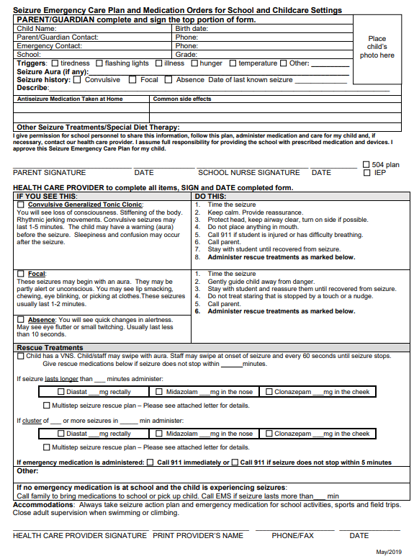
Seizure Emergency Care Plan and Medication Orders for School and Childcare Settings
https://www.cde.state.co.us/healthandwellness/seizureactionplanandmedicationorders-wordmay2019

Slide 11
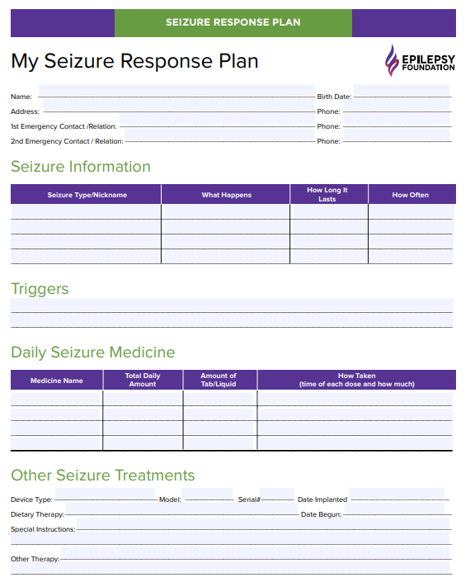
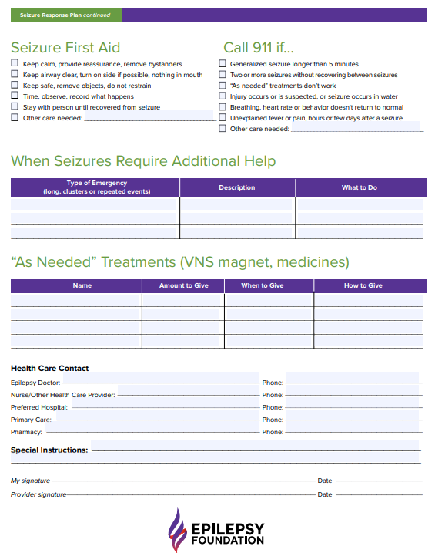

Slide 12
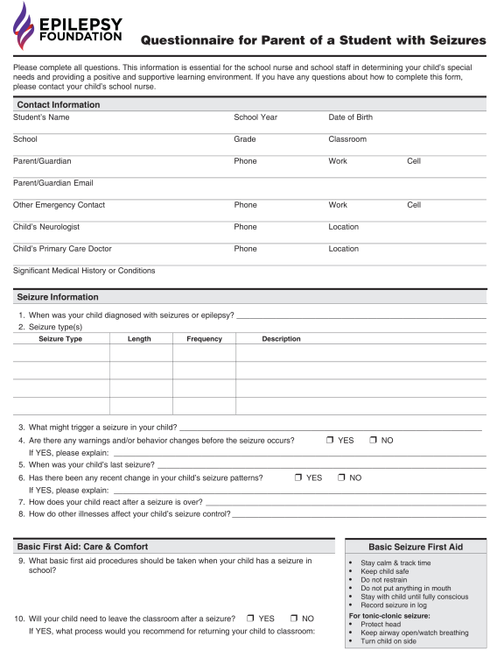
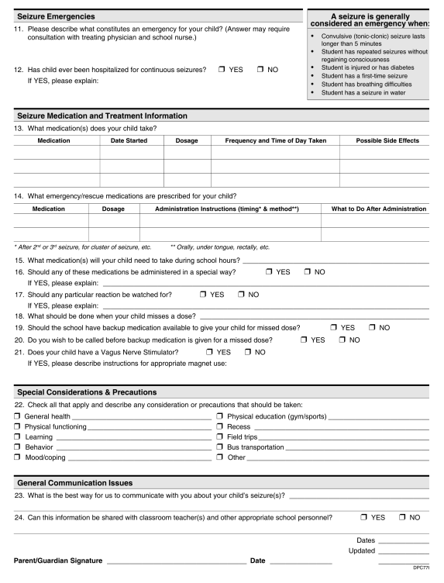

Slide 13
Marjorie Cole, MSN, RN, FASHA
State School Nurse Consultant
Missouri Department of Health and Senior Services
Bureau of Community Health and Wellness
Marjorie.Cole@health.mo.gov

