Slide 1
Healthy Aging and Falls
Prevention Workgroup
Show Me Falls Free Missouri Coalition
Co-Chairs: Jordanna McLeod and Tina Uridge
September 17, 2024

Slide 2
Notes:
In the past, DHSS and the coalition have gotten a proclamation from the governor, done a press release, done a few events, and posted some information to social media. And while we did all of those things this year as well, our goal has been to be far more collaborative. This year for fall prevention awareness month, we have tried to really highlight the work going on across the state. And we hope to continue this work into the future.

Slide 3
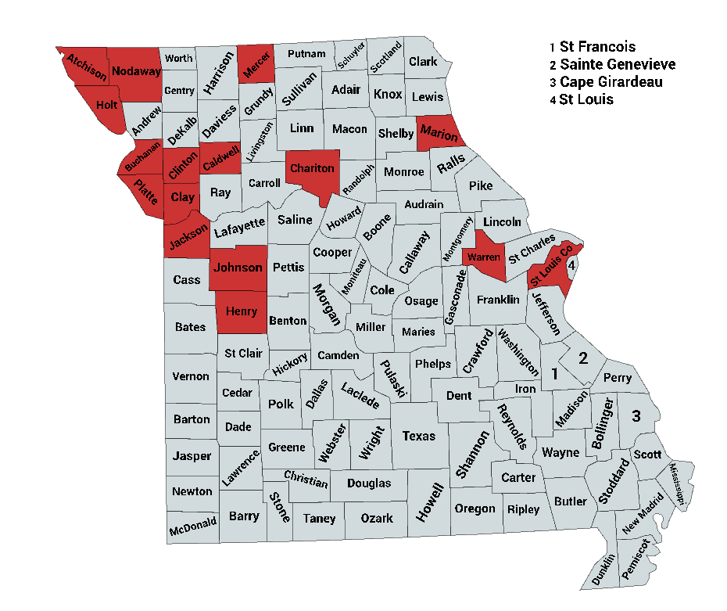
Notes:
https://health.mo.gov/seniors/showmefallsfreemissouri/awareness-month.php
This year we have really worked hard to highlight events, classes, and activities going on across the state. Each of the counties highlighted in red have submitted at least one fall prevention event. It would be great to have events in each of the counties, but I would like to at least get some events from the central and southern part of the state.

Slide 4
Submit events at https://www.surveymonkey.com/r/72MFRXC
Email events to Jordanna.mcleod@health.mo.gov
Find events at https://health.mo.gov/seniors/showmefallsfreemissouri/awareness-month.php
Notes:
Does anyone on the call want to share what they’re doing for fall prevention awareness month? You can come off mute to share or type details in the chat.

Slide 5
Connections
Is anyone looking for
Partners to deliver
Fall prevention programs?
Notes:
John with Young at Heart Resources has a Matter of Balance instructor who is looking for a partner to teach the program. She is located in northwest Missouri but can travel if needed. If anyone is interested, please contact John at 660-240-9400 or jlagoutaris@yahresources.org.

Slide 6
Resources for Awareness Posts
CDC STEADI
https://www.cdc.gov/steadi/index.html
NCOA Fall Prevention Toolkit
https://www.ncoa.org/page/falls-prevention-awareness-week-toolkit/
CDC Still Going Strong
https://www.cdc.gov/still-going-strong/about/index.html
Notes:
https://www.cdc.gov/falls/about/index.html

Slide 7
Future
Notes:
Tina talk about tax levies.
What do we want to focus on for next September and future fall prevention awareness months?
-Missouri specific toolkit?
-Information/education?
-Specific topics?

Slide 8
Home Hazard Checklists
What are they?
How can you use them?
Why does it matter?
Notes:
Home hazard checklists are exactly what they sound like. I checklist that can help you identify safety hazards, typically related to fall prevention, in your home or the home of a loved one.
You can use them to keep yourself and loved ones safer at home. You can share them with participants. You can become familiar with a few common hazards with easy solutions and share that information with others.
I am fairly sure that we all know falls are a big deal, but a 2020 analysis of emergency room visits revealed that a majority of falls occurred in a home setting, with the bedroom, bathroom, and stairs the most common locations. A 2019 survey of community-dwelling older adults found that 62% of reported falls happened indoors. Loss of balance, slipping, or tripping were the most common reasons for falls, followed by uneven floors and navigating steps or stairs. All of these reasons can be addressed using a home hazard checklist.
https://www.helpguide.org/handbook/medical-alert-systems/fall-statistics#:~:text=About%2074%20percent%20of%20falls,due%20to%20tripping%20or%20slipping.

Slide 9
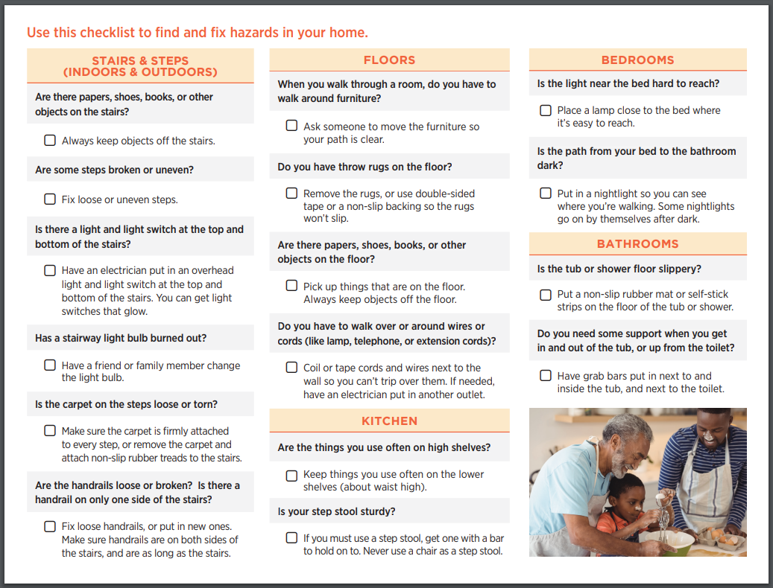
Notes:
https://www.cdc.gov/steadi/pdf/steadi-brochure-checkforsafety-508.pdf
This one-page PDF from the CDC can be printed as a brochure. It has some very basic items to check for in the home.

Slide 10
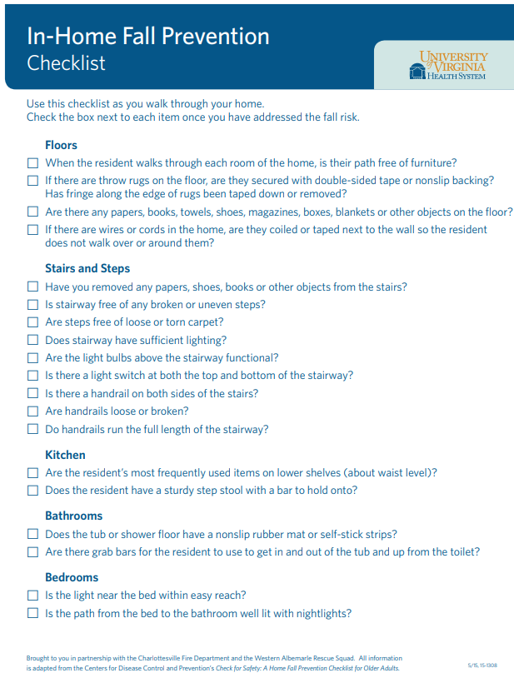
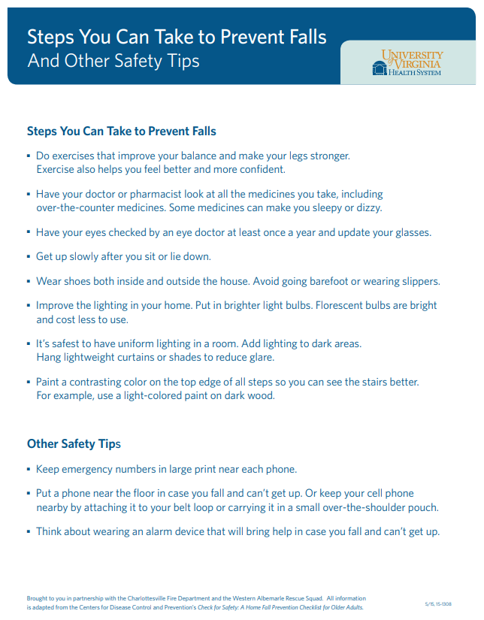
Notes:
https://uvahealth.com/sites/default/files/2018-08/Fall-Prevention-Checklist.pdf
I like that this checklist includes Safety Tips on the back along with a basic Hazard checklist on the front.

Slide 11
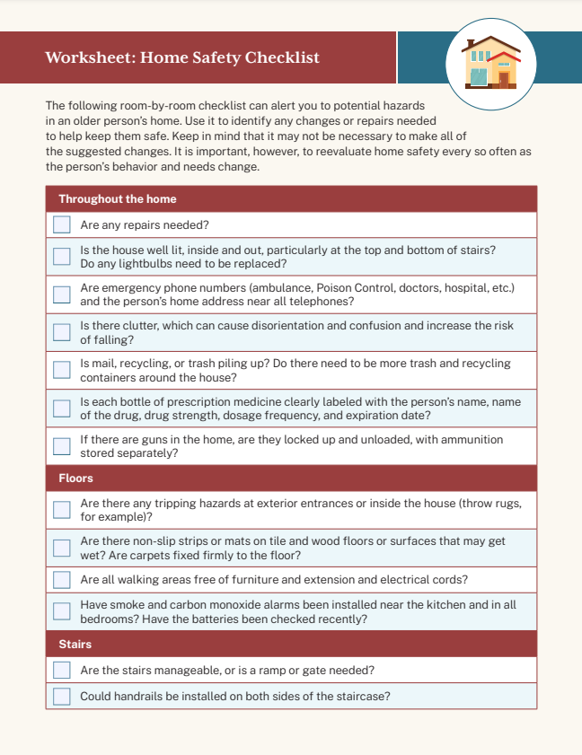
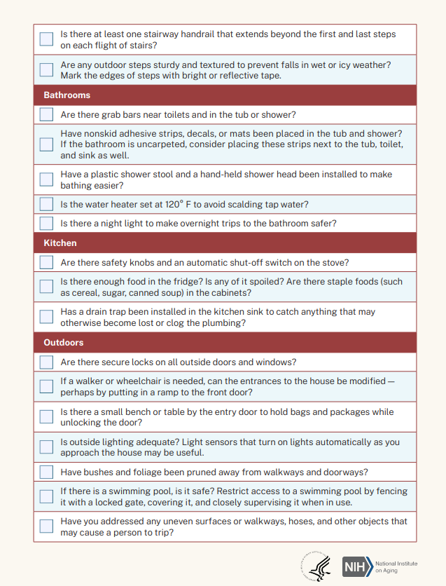
Notes:
https://www.nia.nih.gov/sites/default/files/2023-04/worksheet-home-safety-checklist_1.pdf
The NIH provides this more detailed hazard checklist that still fits on one page.

Slide 12
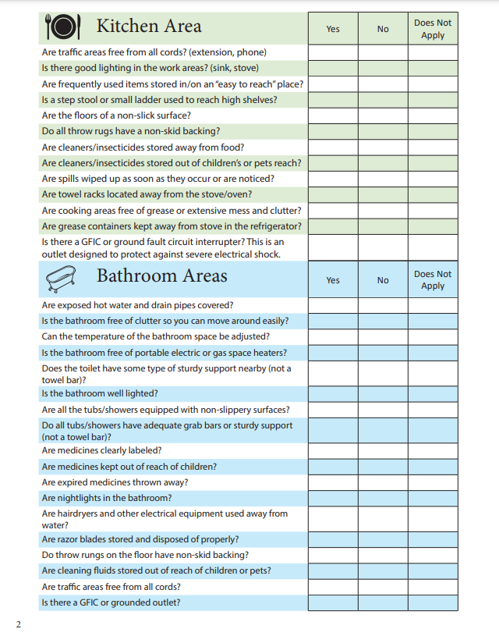
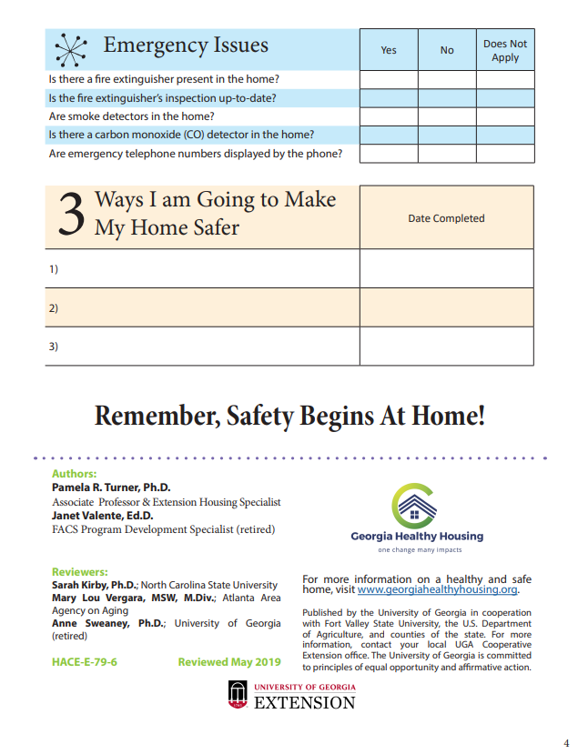
Notes:
https://www.fcs.uga.edu/docs/Home_Safety_CheckList_Print.pdf
This Hazard Checklist is 2 pages and comes from Georgia. I really like that it has a section at the end of goals.

Slide 13
Home Hazard Checklists in Missouri
Notes:
How can this workgroup use existing checklists?
Do we want to create a Missouri-specific checklist?

Slide 14
Strategic Plan
The final draft was submitted on 8/23/24
Missouri older adults will know the benefits of and have access to fall risk screening and assessment as appropriate to their needs.
Goal 1
Missouri older adults living in the community will have knowledge of and access to effective programs and services that preserve or improve their mobility and lower the risk of falls. These programs and services will address a wide variety of risk factors and prevention strategies.
Goal 2
Missouri older adults have access to home and community environments that lower the risk of falls and facilitate full participation, mobility, and independent functioning.
Goal 3
Missouri health organizations and providers will enhance their quality metrics and adopt policies focused on healthy aging and physical activity. This will ensure older adults receive quality healthcare, including proper evaluation, treatment, follow-up, and referrals, ultimately improving their quality of life and reducing the risk of falls.
Goal 4
Strengthen this workgroup through recruitment and collaboration to ensure that the purpose of the Healthy Aging and Falls Prevention Workgroup can be attained.
Goal 5
Notes:
Thank you for all of the discussion and input on the strategic plan. I think we wound up with a document that will serve us well over the next several years. MOCAN will work to incorporate our strategic plan into the strategic vision of the group as a whole. We’ll make sure you all know when the strategic plan is finalized.
As we continue to meet, we will focus on at least one goal during the meeting. Between our statewide meetings, we work together to plan the following meeting or meetings. Is there anyone who would like to be involved in the planning of meetings? Sometimes this is done through a virtual meeting and sometimes it is done through email. If you are interested in being involved, please put a comment in the chat.
Are there any ideas for future meetings? Our next meeting is Tuesday, November 12th at 10 am. We hope to see all of you there. Please also share the invite with colleagues who may be interested in the workgroup or in specific topics as they come up.

