Slide 1

Falls and TBI
January 10,2023
Show Me Falls Free Missouri Coalition
Kelli Barton, PhD
Gerontologist
Director, Heath and Aging

Slide 2
Agenda
What is TBI?
Falls, TBI, and Aging
Resources

Slide 3
What is a Traumatic Brain Injury (TBI)?
A head injury caused by a bump, blow, or jolt to the head or body or a penetrating head injury that results in disruption of normal brain function (CDC)
A major cause of death and disability
Symptoms can range widely
Depending on the severity of the injury, those who get a TBI may face health problems that last a few days or the rest of their lives
In 2020, there were over 64,000 TBI-related deaths in the US or about 176 TBI-related deaths every day
https://www.cdc.gov/traumaticbraininjury/index.html

Slide 4
Mild TBI & Concussion Symptoms
May appear right away or may not appear for hours or days after injury
Typically improve over time, and most people with a mild TBI or concussion feel better within weeks
Sleep
Sleeping less than usual
Sleeping more than usual
Trouble falling asleep
Physical
Bothered by light or noise
Dizziness or balance problems
Feeling tired, no energy
Headaches
Nausea or vomiting (early on)
Vision problems
Thinking & Remembering
Attention or concentration problems
Feeling slowed down
Foggy or groggy
Problems with short- or long-term memory
Trouble thinking clearly
Social or Emotional
Anxiety or nervousness
Irritability or easily angered
Feeling more emotional
Sadness
https://www.cdc.gov/traumaticbraininjury/concussion/symptoms.html

Slide 5


Nearly 30% of adults report having had a concussion in their lifetime.
According to one survey, 42% of respondents with a TBI did not seek medical care.
Source: https://www.ncbi.nlm.nih.gov/pmc/articles/PMC7048626/
Source: https://www.tandfonline.com/doi/abs/10.1080/02699050601111419

Slide 6
Moderate & Severe TBI
Behavior
Trouble controlling behavior
Personality changes
More impulsive than usual
May result in an extended period of unconsciousness (coma) or amnesia
Can lead to long-term or life-long health problems that may affect all aspects of a person’s life
Effects may change over time
Thinking and Learning
Difficulty understanding and thinking clearly
Trouble communicating and learning skills
Problems concentrating
Difficulty remembering information
Emotion/Mood
Feeling more emotional than usual
Nervousness or anxiety
Feeling more angry or aggressive than usual
Sadness, depression
Motor Skills, Hearing, and Vision
Weakness in arms and legs
Problems with coordination and balance
Problems with hearing and vision
Changes in sensory perception, such as touch
https://www.cdc.gov/traumaticbraininjury/concussion/symptoms.html

Slide 7
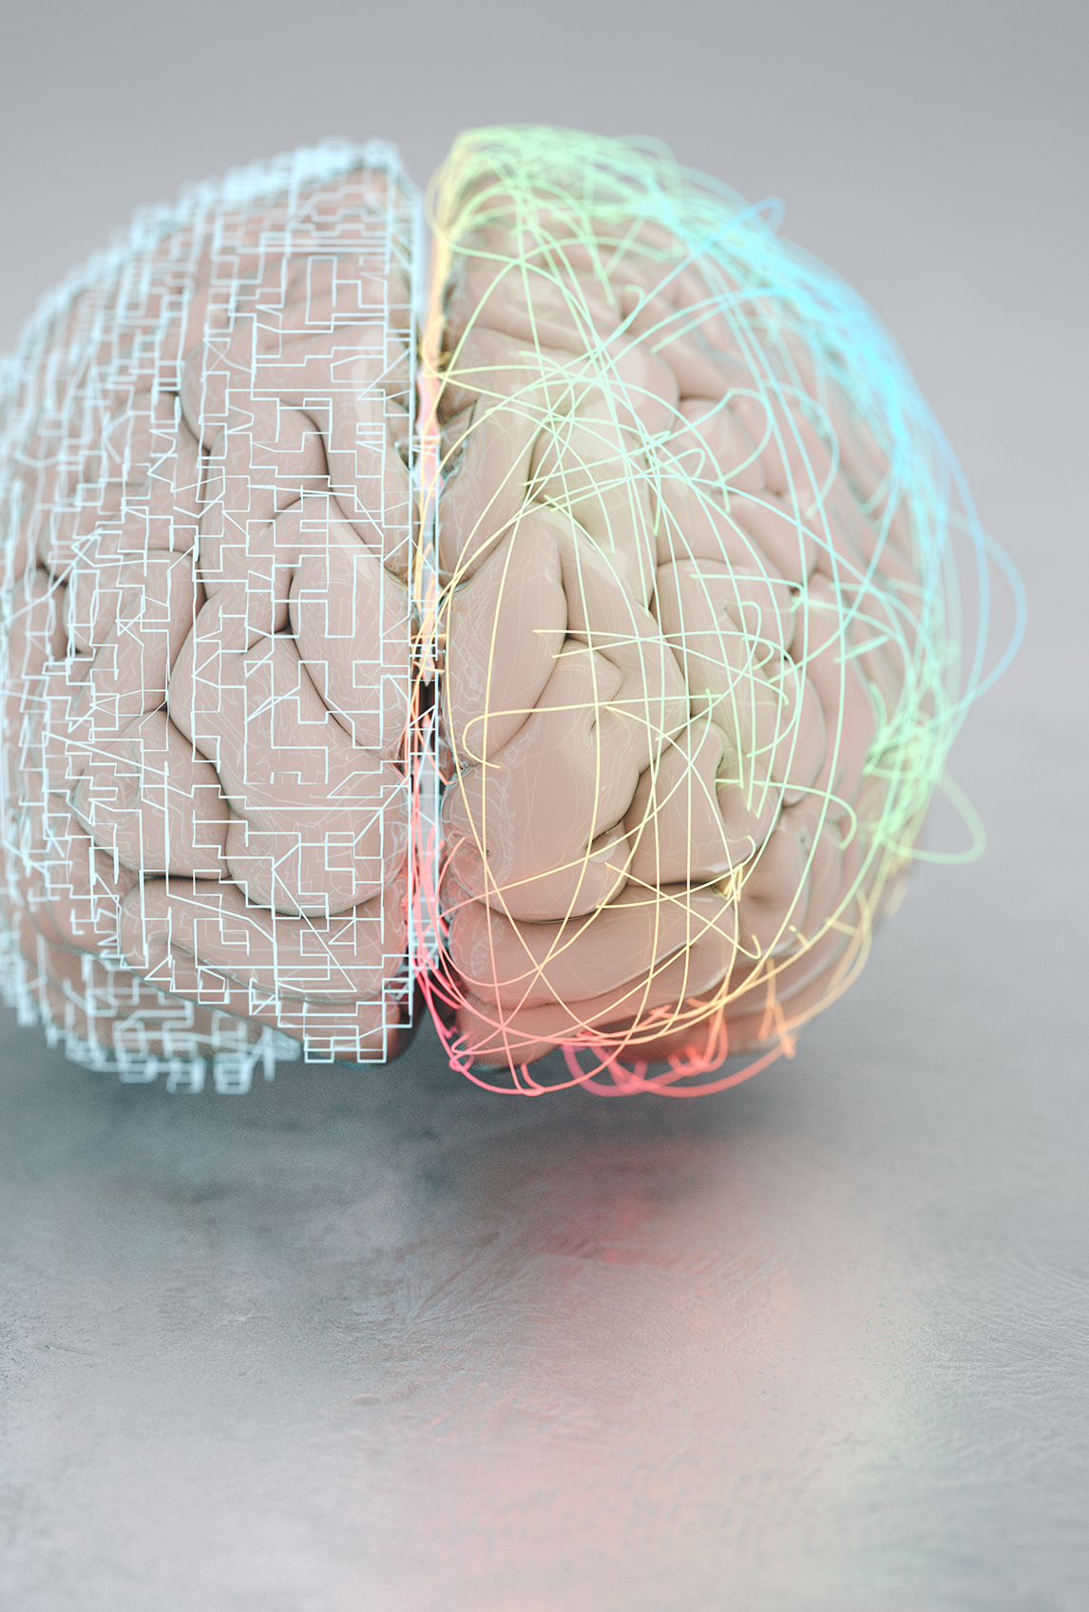
Falls, TBI, and Aging
Falls are the most common cause of TBI, particularly in older adults and young children
TBIs often missed or misdiagnosed in older adults because symptoms overlap with other medical conditions that are common among older adults, such as dementia
Older adults are more likely to be hospitalized and die from a TBI than other age groups

Slide 8
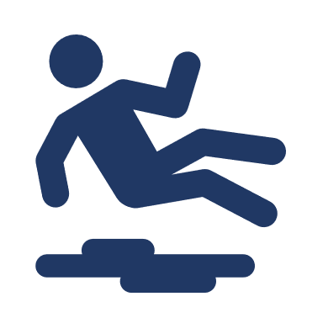
Falls are the most common cause of TBI hospitalizations.
Deaths from Fall-Related TBI, 2008-2017
National rate of fall-related TBI deaths increased by 17% from 2008 to 2017
  Rates increased significantly in 29 states (including Missouri)
In 2017, national rates were highest among persons age 75+ and males
The rate among persons age 75+ was about 8x higher than that among those aged 55–74 years
Source: CDC, 2017 Estimates
Source: https://www.ncbi.nlm.nih.gov/pmc/articles/PMC7367089/

Slide 9
Fall/Jump-Related TBI in MO by Age
Age | n
Under 15 | 1,660
15 - 24 | 891
25 - 44 | 868
45 - 64 | 1,290
65 and Over | 2,737
Total | 7,446
Source: MO DHSS 2015 MICA data
Notes:
MO Information for Community Assessment Data (MICA)

Slide 10
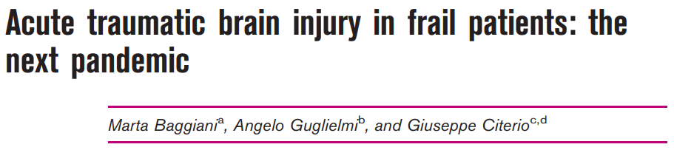

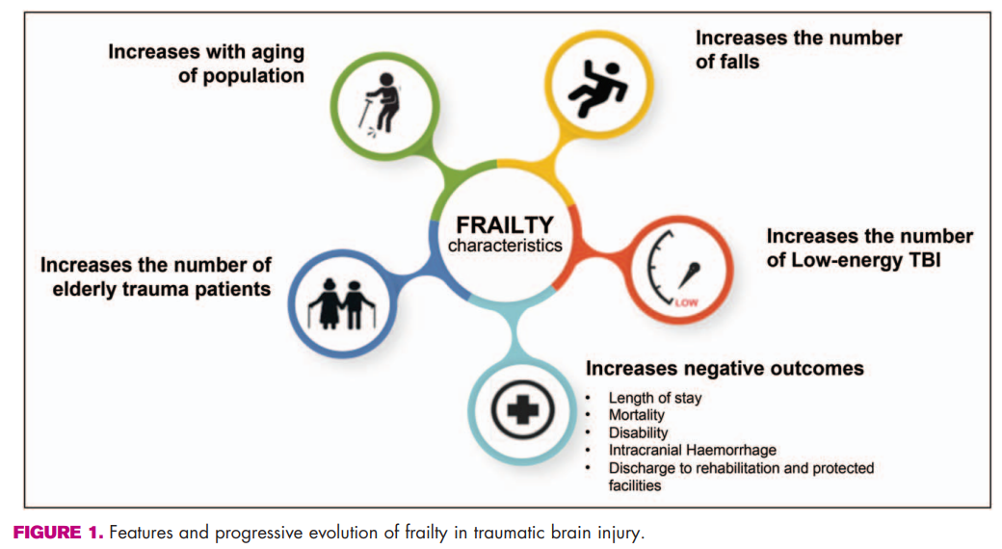
Frailty
Related to increased risk of falls
Not a direct natural consequence of aging
Often results from intersection of age-related decline with chronic diseases and conditions
Ground or low-level (low-energy) falls, which are typical in frail patients, is the major cause for the increasing prevalence of elderly patients with TBI
Source: https://journals.lww.com/co-criticalcare/Fulltext/2022/04000/Acute_traumatic_brain_injury_in_frail_patients_.10.aspx

Slide 11

Healthcare providers should check for signs and symptoms of TBI if an older adult has:
  Fallen or has a fall-related injury, such as a hip fracture
  Been in a car crash
This is especially important among older adults who are taking blood thinners
Source: https://www.cdc.gov/traumaticbraininjury/get_the_facts.html

Slide 12
Resources
Prevention
Area Agencies on Aging (AAAs) disease prevention / health promotion programs: https://health.mo.gov/seniors/aaa/exercise-health.php
  E.g. Matter of Balance, Tai Chi
  Free to anyone age 60+
A CDC Compendium of Effective Fall Interventions: What Works for Community-Dwelling Older Adults: https://www.cdc.gov/homeandrecreationalsafety/pdf/falls/cdc_falls_compendium-2015-a.pdf
TBI
Brain Injury Association of Missouri (BIA-MO): https://www.biamo.org/
DHSS Adult Brain Injury Program: https://health.mo.gov/living/healthcondiseases/tbi/

Slide 13

MO Brain Injury Advisory Council (MBIAC)
Quarterly, next meeting: 1/23/23
Time:10:00 a.m. – 1:00 p.m.
Place: Hybrid meeting in person or using WebEx
  Cedar Conference Room-912 Wildwood Drive, Jefferson City OR
  Join meeting (click on meeting - https://stateofmo.webex.com/stateofmo/j.php?MTID=m3fa44c442d01c29abef83d12e09920cb)
  Meeting ID: 2455 957 4078
  Meeting password: MBIAC
  Call in numbers: (573)751-6351
Notes:
Meet quarterly

Slide 14

Contact:
Kelli Barton bartonkn@umkc.edu
Questions?

