Slide 1
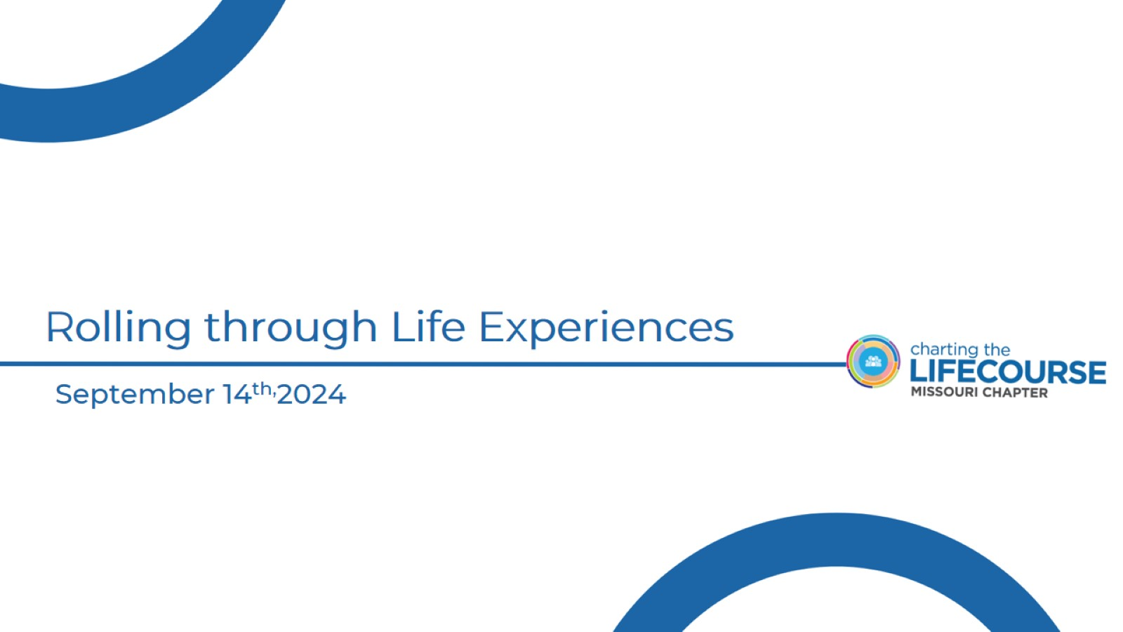
Rolling through Life Experiences

Slide 2
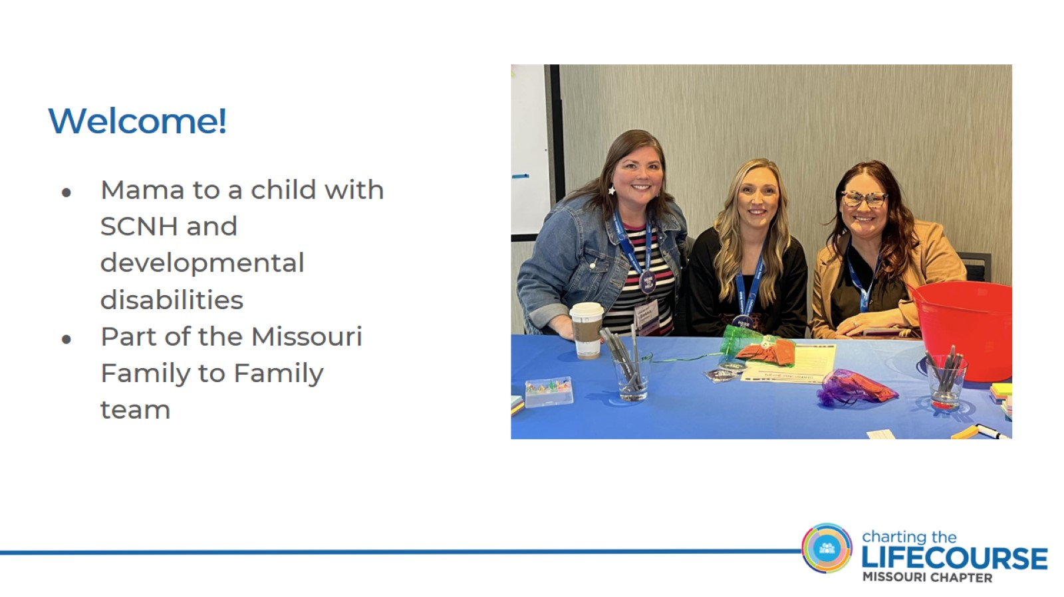
Welcome!

Slide 3
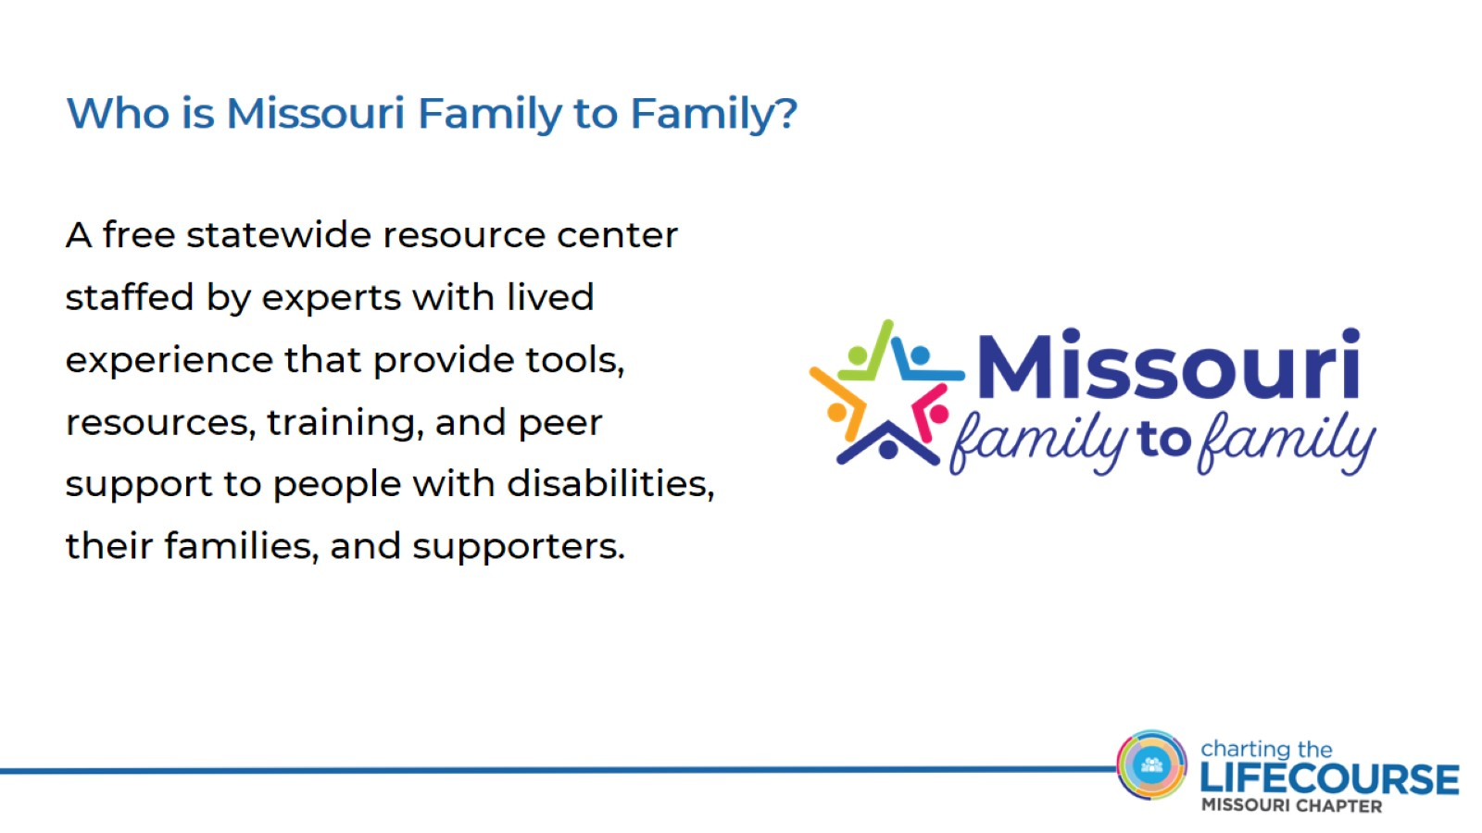
Who is Missouri Family to Family?

Slide 4
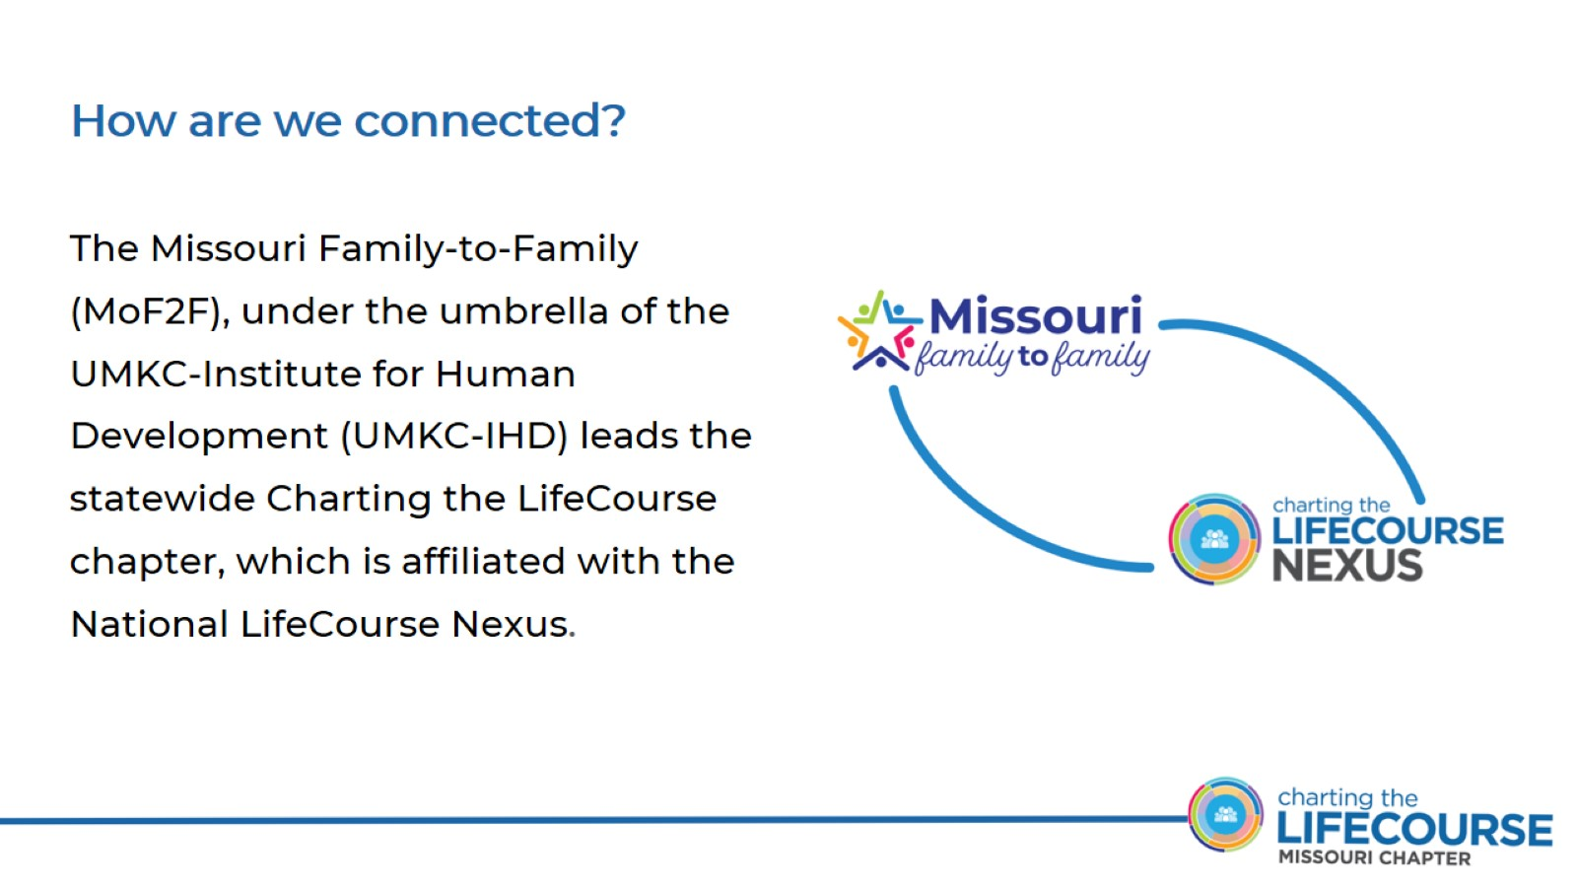
How are we connected?

Slide 5
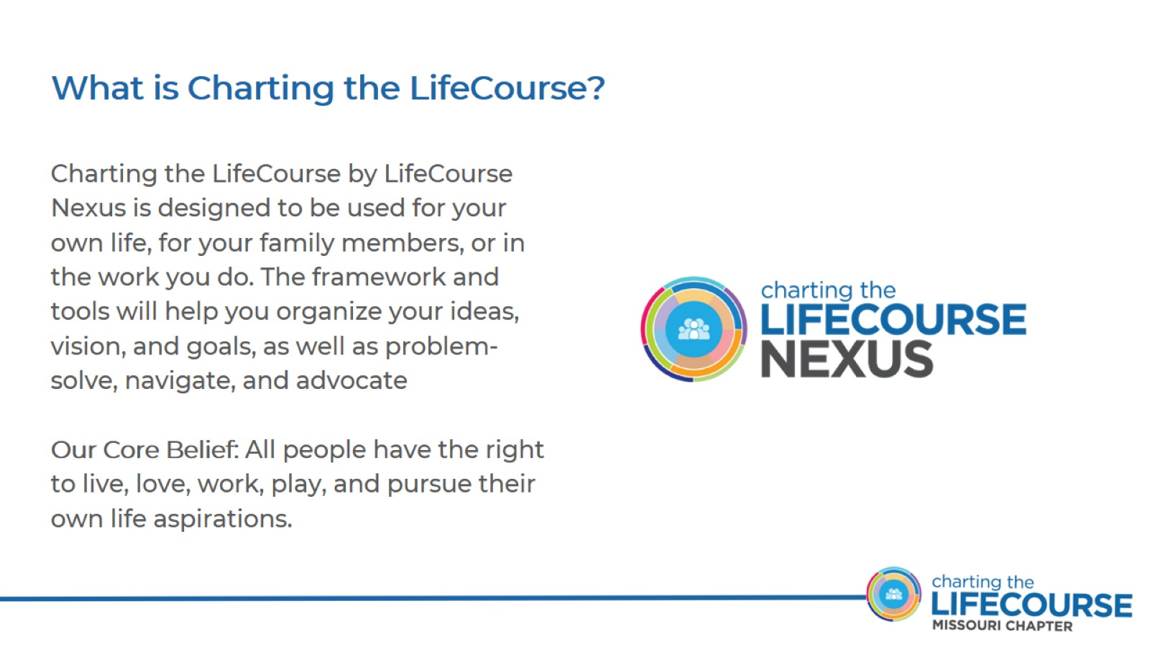
What is Charting the LifeCourse?

Slide 6
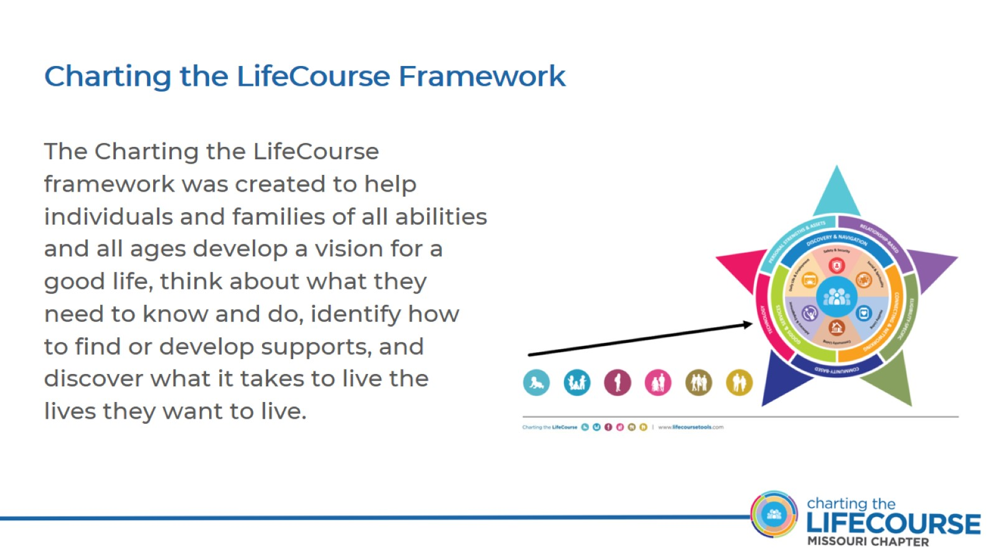
Charting the LifeCourse Framework

Slide 7
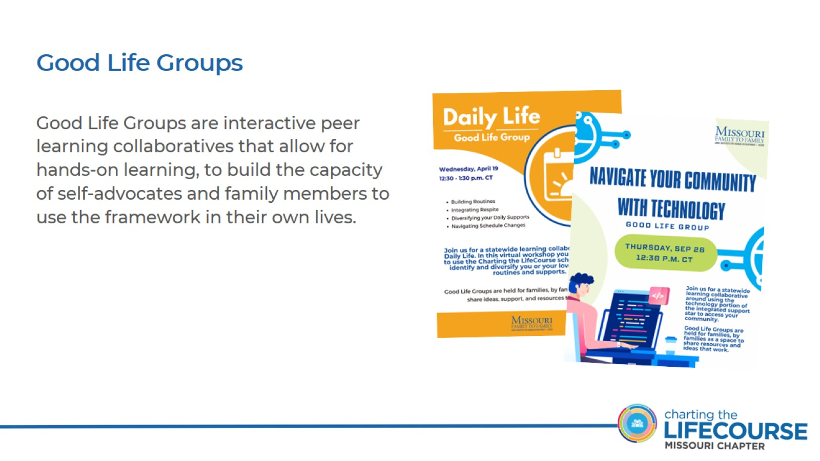
Good Life Groups

Slide 8
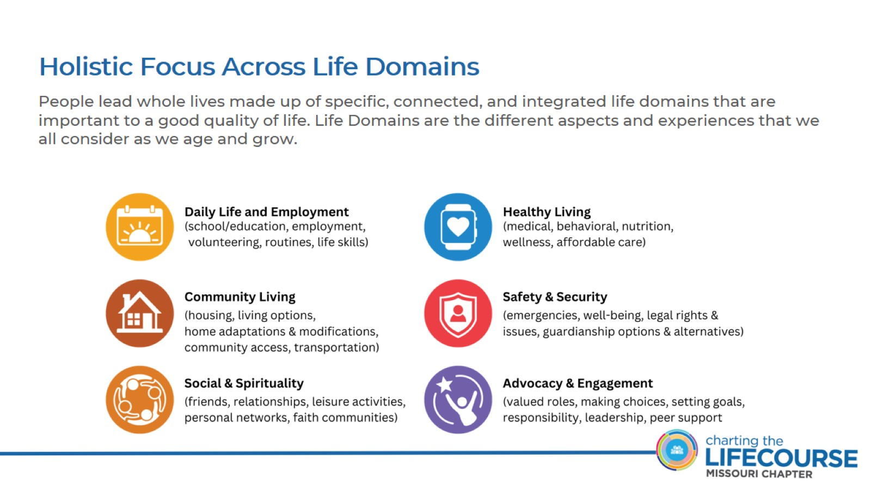
Holistic Focus Across Life Domains

Slide 9
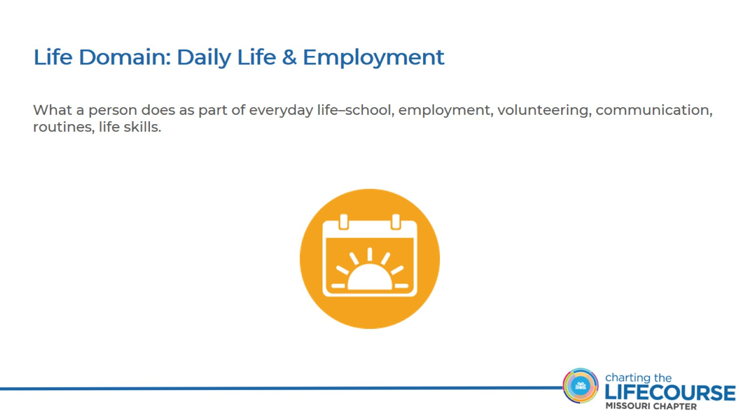
Life Domain: Daily Life & Employment

Slide 10
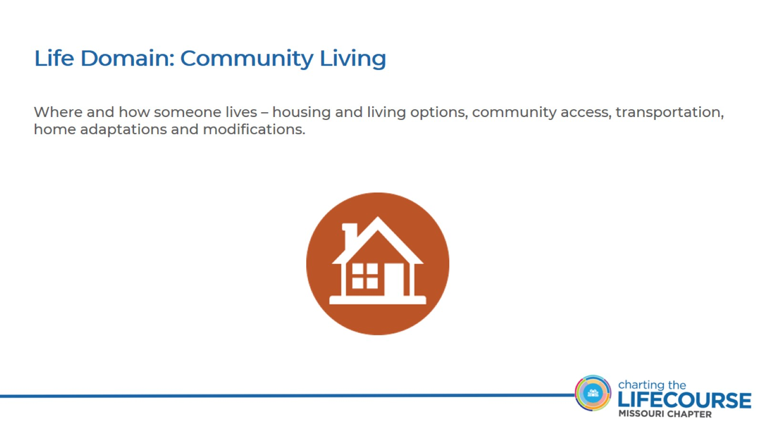
Life Domain: Community Living

Slide 11
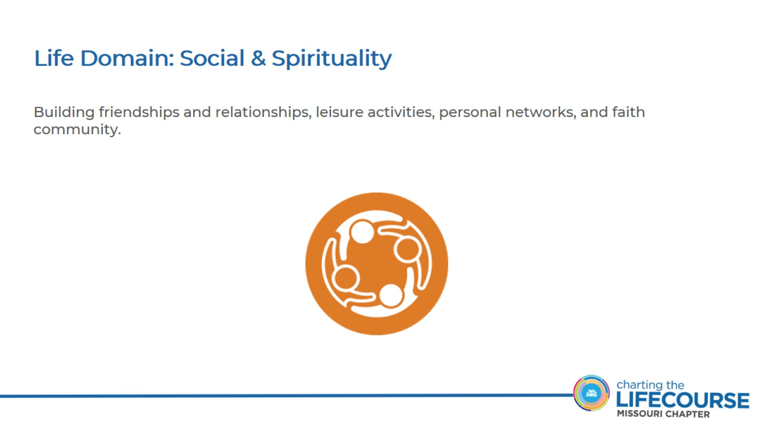
Life Domain: Social & Spirituality

Slide 12
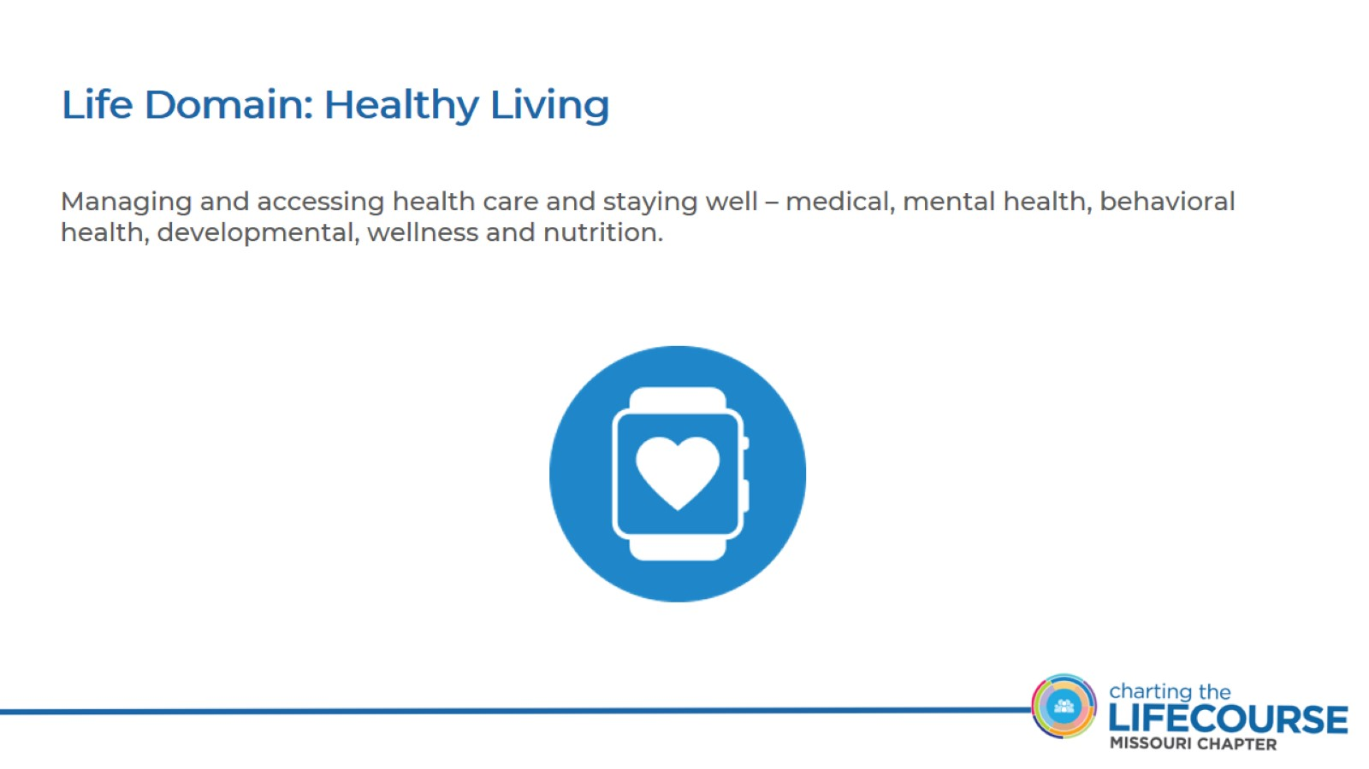
Life Domain: Healthy Living

Slide 13
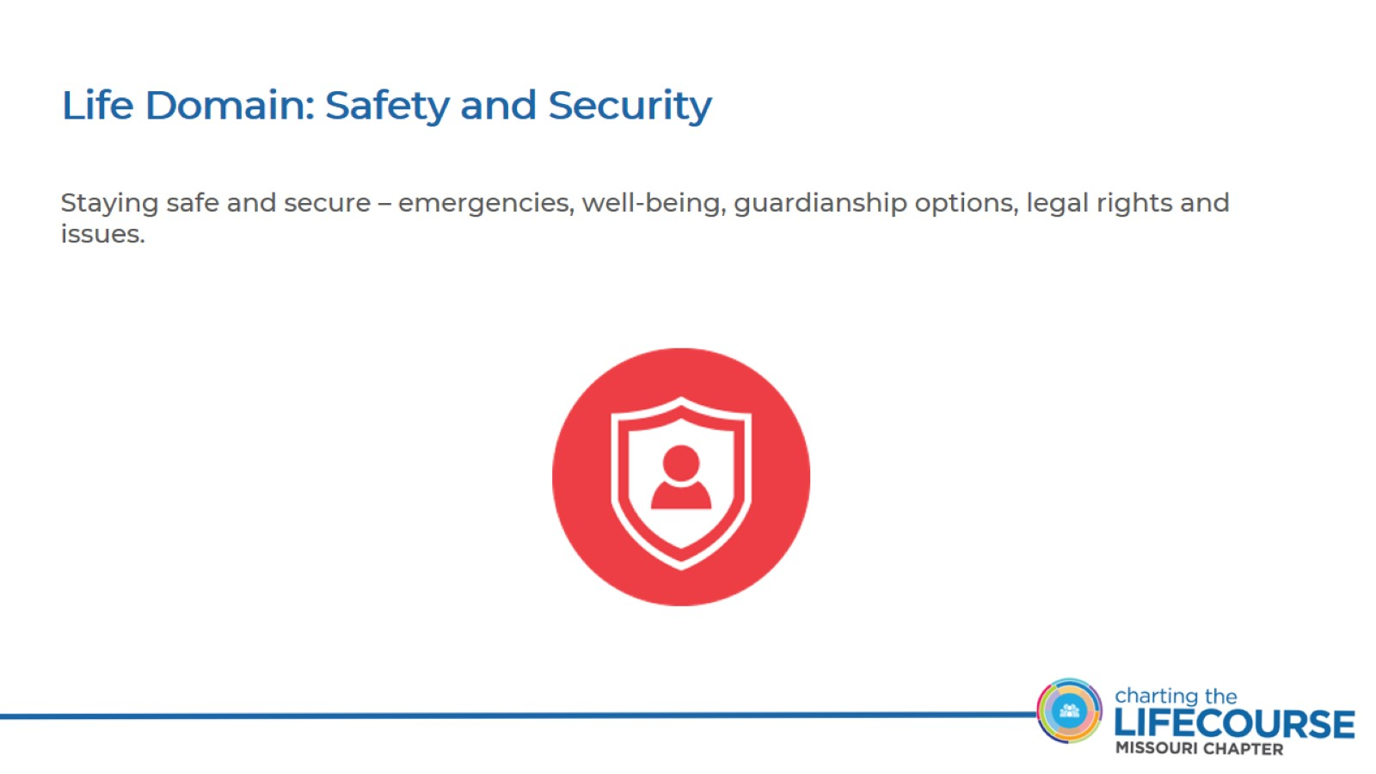
Life Domain: Safety and Security

Slide 14
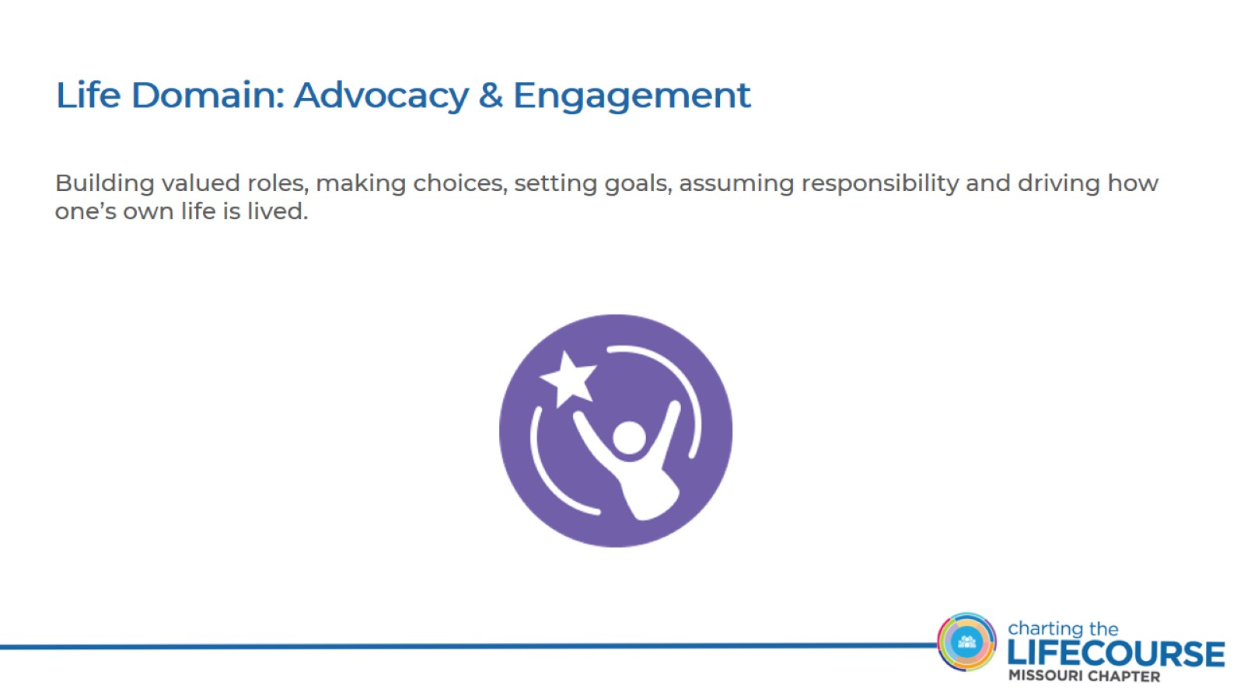
Life Domain: Advocacy & Engagement

Slide 15
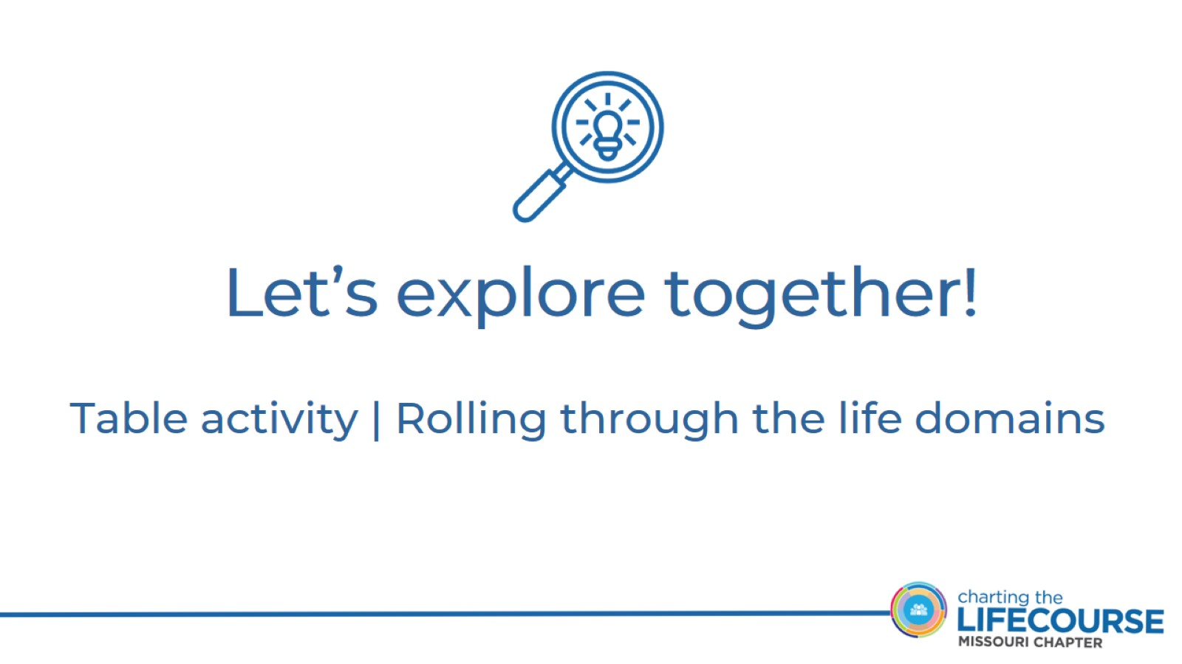
Let’s explore together!

Slide 16
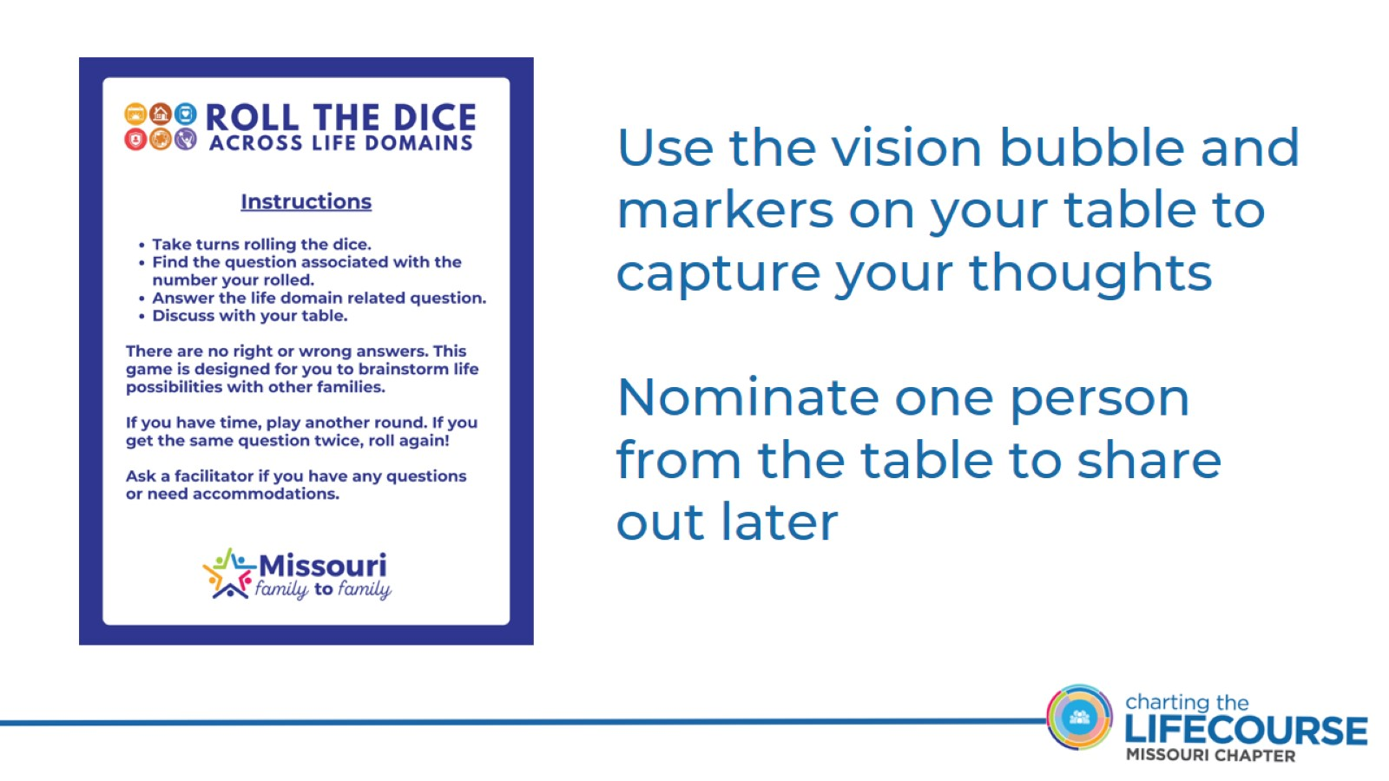

Slide 17
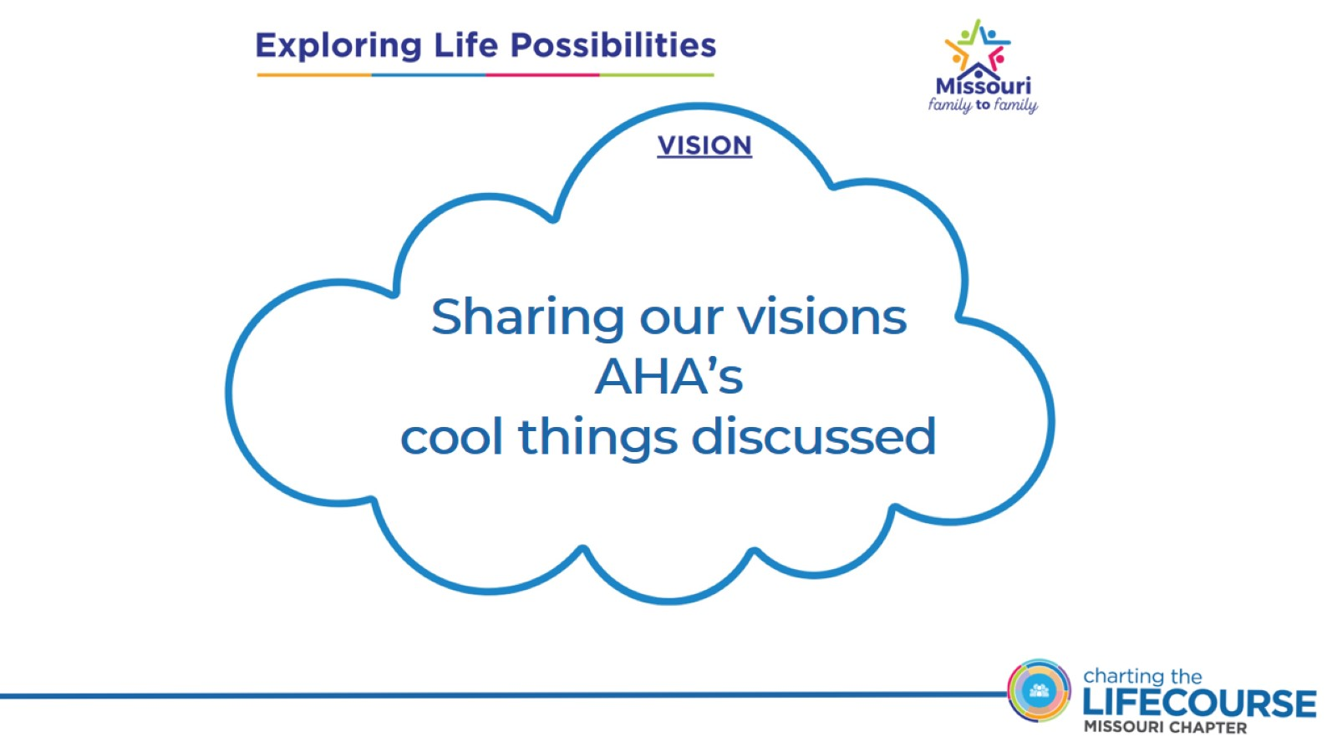
Sharing our visions
AHA’s cool things discussed

Slide 18
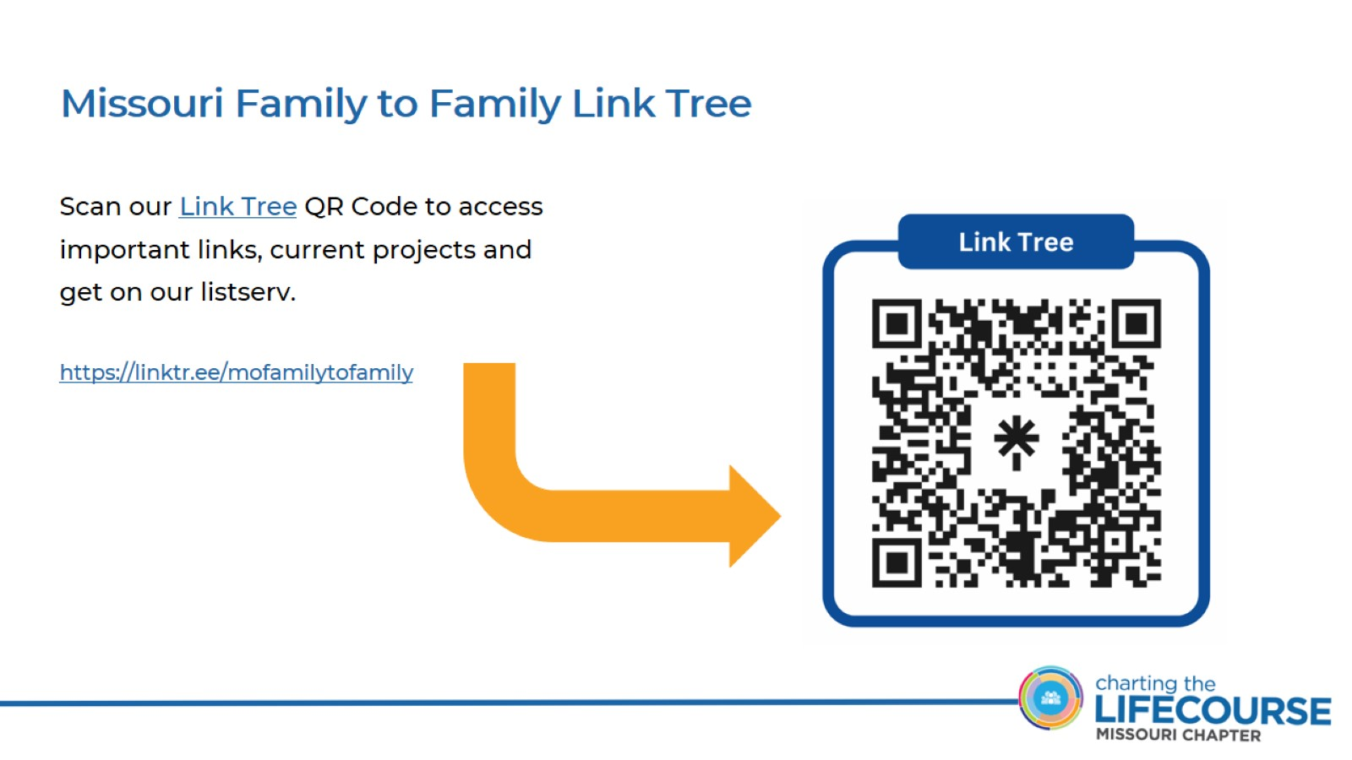
Missouri Family to Family Link Tree

Slide 19
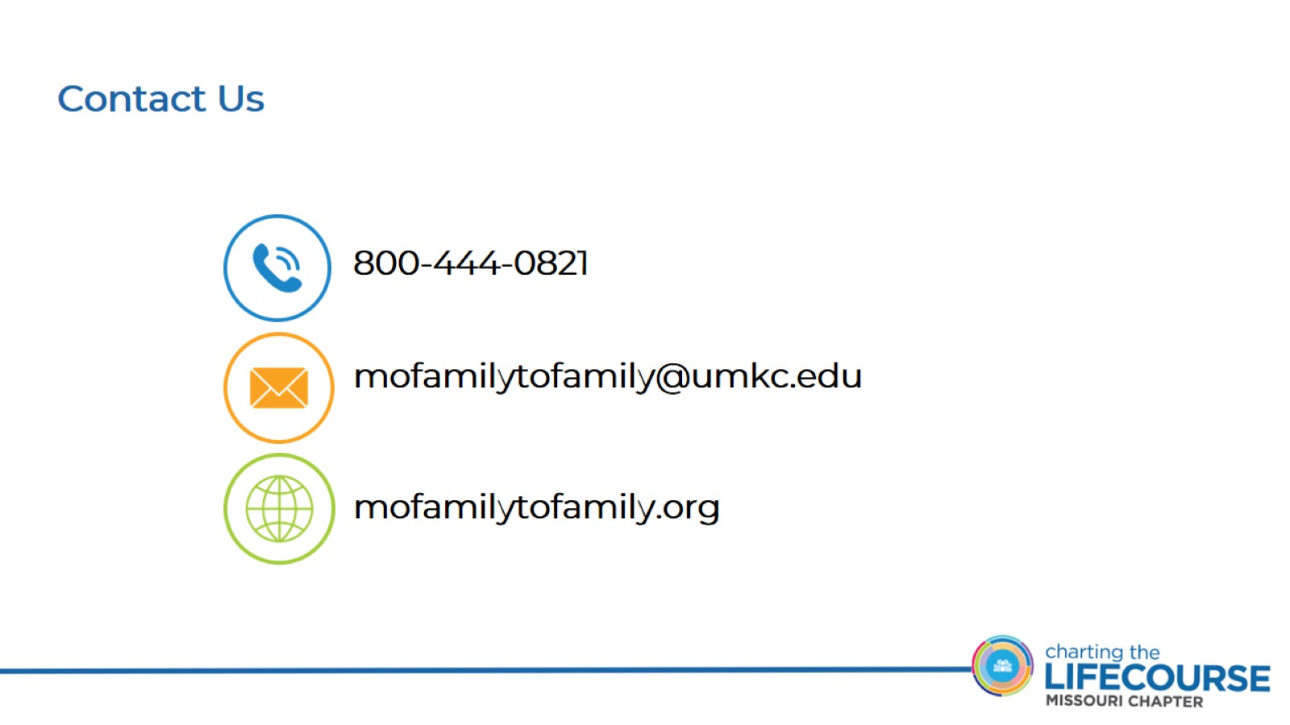
Contact Us

Slide 20
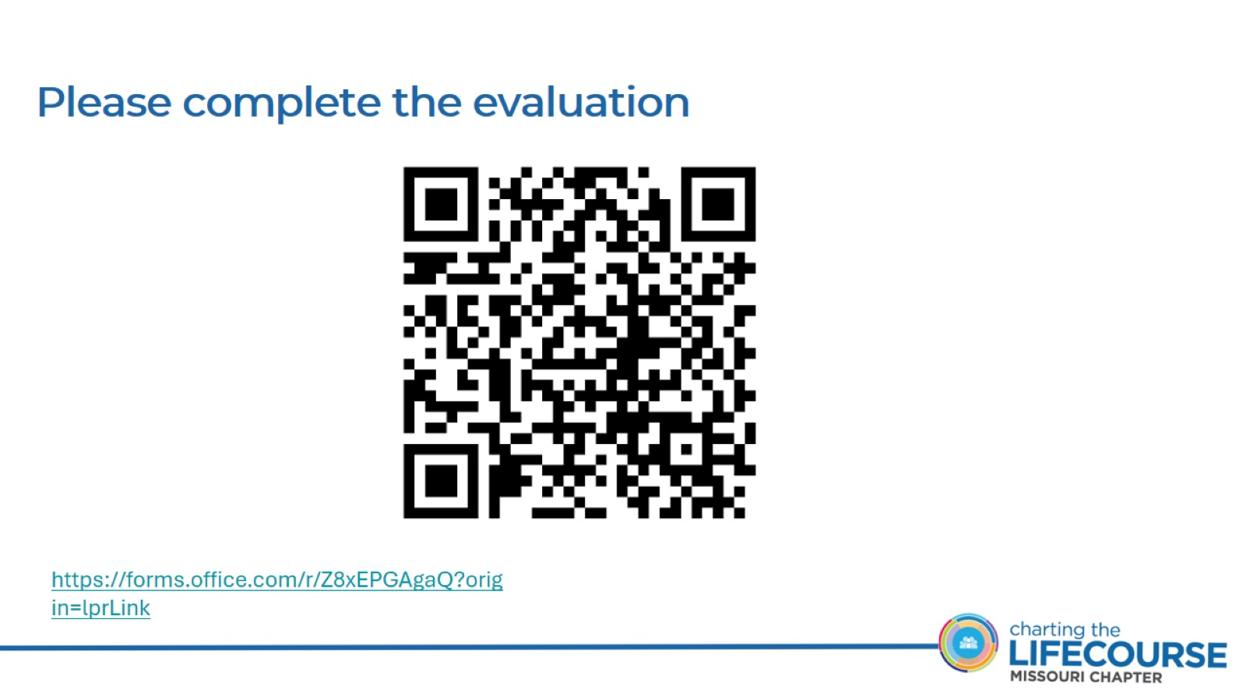
Please complete the evaluation

Slide 21

Connect with your Regional Family Partner

Slide 22

Thank you to our funders

