Slide 1
Glass Children
What It Is Like to Be the Sibling of a Child with Special Needs
Presented by: Mikaela Fox
Notes:
Good afternoon, I’m Mikaela Fox and I am so glad to be here with you today. I will be talking to you this afternoon about what it is like to be the sibling of a child with special needs. I will first talk a little bit about the term glass child and then share my own story, as well as the stories of a few other siblings. To start off, how many of you have heard of the term glass child?

Slide 2
Agenda
Introduction
What is a Glass Child?
Sibling Experience Examples
Resources
Questions
Notes:
Briefly, our agenda for the next 90 minutes…..

Slide 3
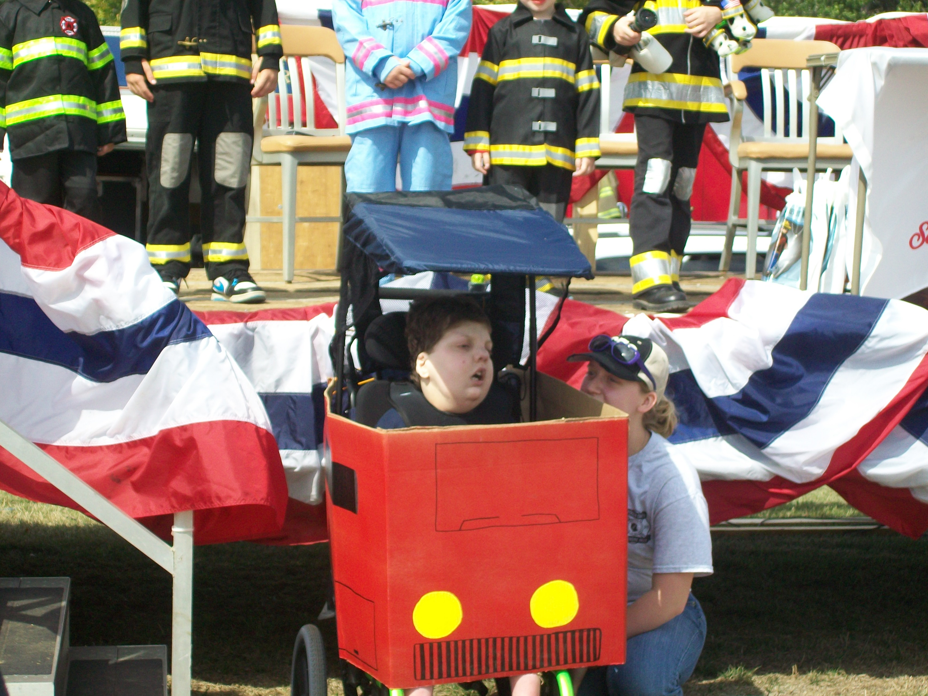
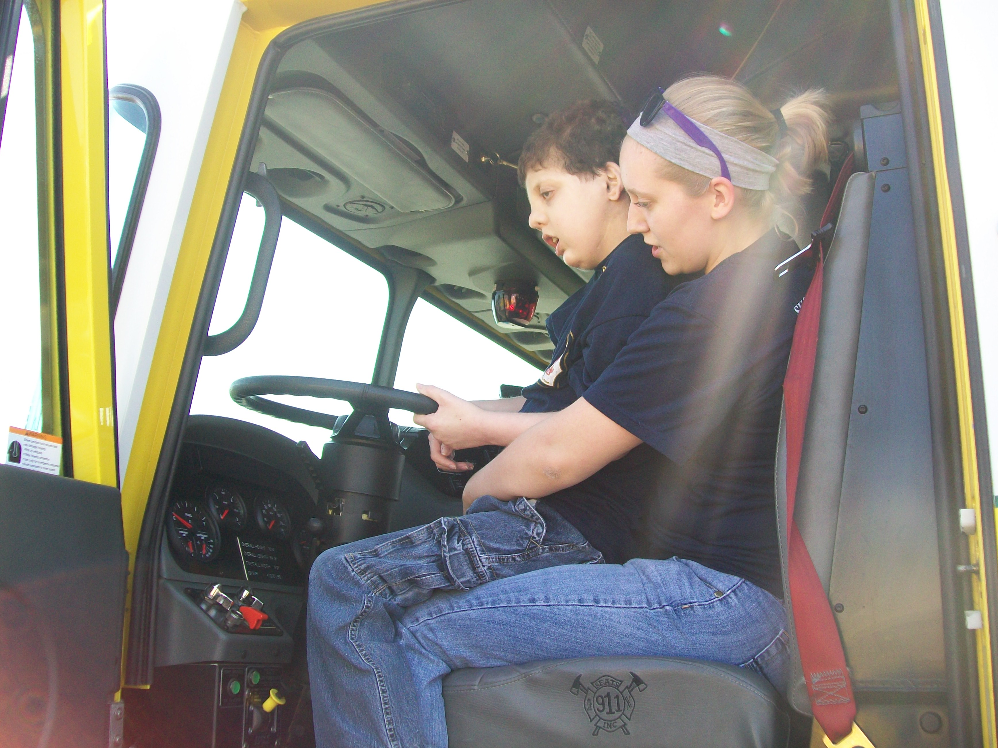
Introduction
Patrick
Trisomy 8 Mosaic
  Tube fed, hearing and vision impaired, non-verbal, non-ambulatory, etc.
Notes:
As I said earlier, my name is Mikaela Fox and I had the gift of being Patrick’s sister for 13 amazing years. Patrick’s diagnosis was Trisomy 8 Mosaicism, which meant he had an extra number eight chromosome in some, but not all, of his cells. Therefore, this diagnosis varies greatly by individual. For Patrick, this meant he was non-verbal, non-ambulatory, hearing and vision impaired, tube fed, and overall pretty medically complex.
Patrick died about 10 years ago but he is still with me in everything that I do. I currently work with individuals with intellectual and developmental disabilities in Houston, TX. I was 4 years old when Patrick was born so I don’t remember much of what childhood was like without Patrick. I don’t even remember much of the first year of being Patrick’s sister.
Patrick spent the first few months of life in the NICU of St. Louis Children’s Hospital. And that was the beginning of St. Louis Children’s Hospital practically becoming a new vacation spot of sorts for my family with as many trips as we made to and from there. (The taste of Pizza Hut pizza still brings me back to the cafeteria of the hospital). I don’t remember exactly when my parents found out Patrick’s diagnosis or when they first explained it to me, but I remember knowing that Patrick was different from me and my other brother, Branson. I don’t remember when I realized that my childhood experiences were going to be different from those of my friends, but I remember having much different family stories than those of my classmates. Because I was what was considered a glass child.

Slide 4
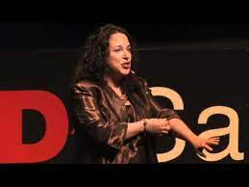
What Is A Glass Child?
2010 Tedx Talk: Alicia Maples-Arenas
  Now trending on TikTok and other social media
Scientific Research
  2010: International Journal of Speech-Language Pathology
  2019: American Journal on Intellectual and Developmental Disabilities
  2022: Journal of Community & Applied Social Psychology
Notes:
Well, what is a glass child. While it is unknown who first coined the term glass child, the term first became well-known after the Ted Talk given by Alicia Maples-Arenas in 2010. Thanks to social media platforms such as TikTok, the term continues to gain popularity.
In her Ted Talk, Arenas explains that many people think of glass children as fragile and easily breakable. However, many times, quite the opposite is true – glass children are extremely strong. Rather the term glass children comes from another property of glass: transparency.
Arenas explains “We are called glass children “because our parents are so consumed with the needs of our brothers and sisters that when they look at us they look right through us as though we're made of glass”
Though current scientific research is limited, it backs the idea of siblings of children with special needs being “glass children”
2010: International Journal of Speech-Language Pathology; 2 individuals from Australia analyzed over 600 Internet sibling support group posts
1) Strangers stare and have negative attitudes towards my sibling with a disability
2) Peers don’t understand what it’s like to be me, use certain words that upset me, say nasty things and tease me about my brother/sister; 3) although my family loves me, they don’t have a lot of time for me, our plans are often disrupted, and they give me a lot of responsibility
2019: American Journal on Intellectual and Developmental Disabilities; surveyed over 1000 adult siblings and over half reported increased feelings of guilt
-Guilt for being able to do things their siblings can’t
-Guilt for feeling angry over the extra attention their siblings require from their parents
-Guilt related to caregiving if something happens to the sibling
2022: Journal of Community & Applied Social Psychology by researchers in the UK; interviewed 16 siblings identified 4 major themes:
(a) feelings of invisibility during social interactions
(b) psychological difficulties due to the internalization of family roles or life conditions
(c) feelings of guilt and self-blame.
(d) social support was central as siblings were sometimes unable to understand their own needs, and support from family and peer groups helped them have their negative experiences validated
Now, I will share the stories of some other siblings, whom you might recognize as the children of your family partners.

Slide 5
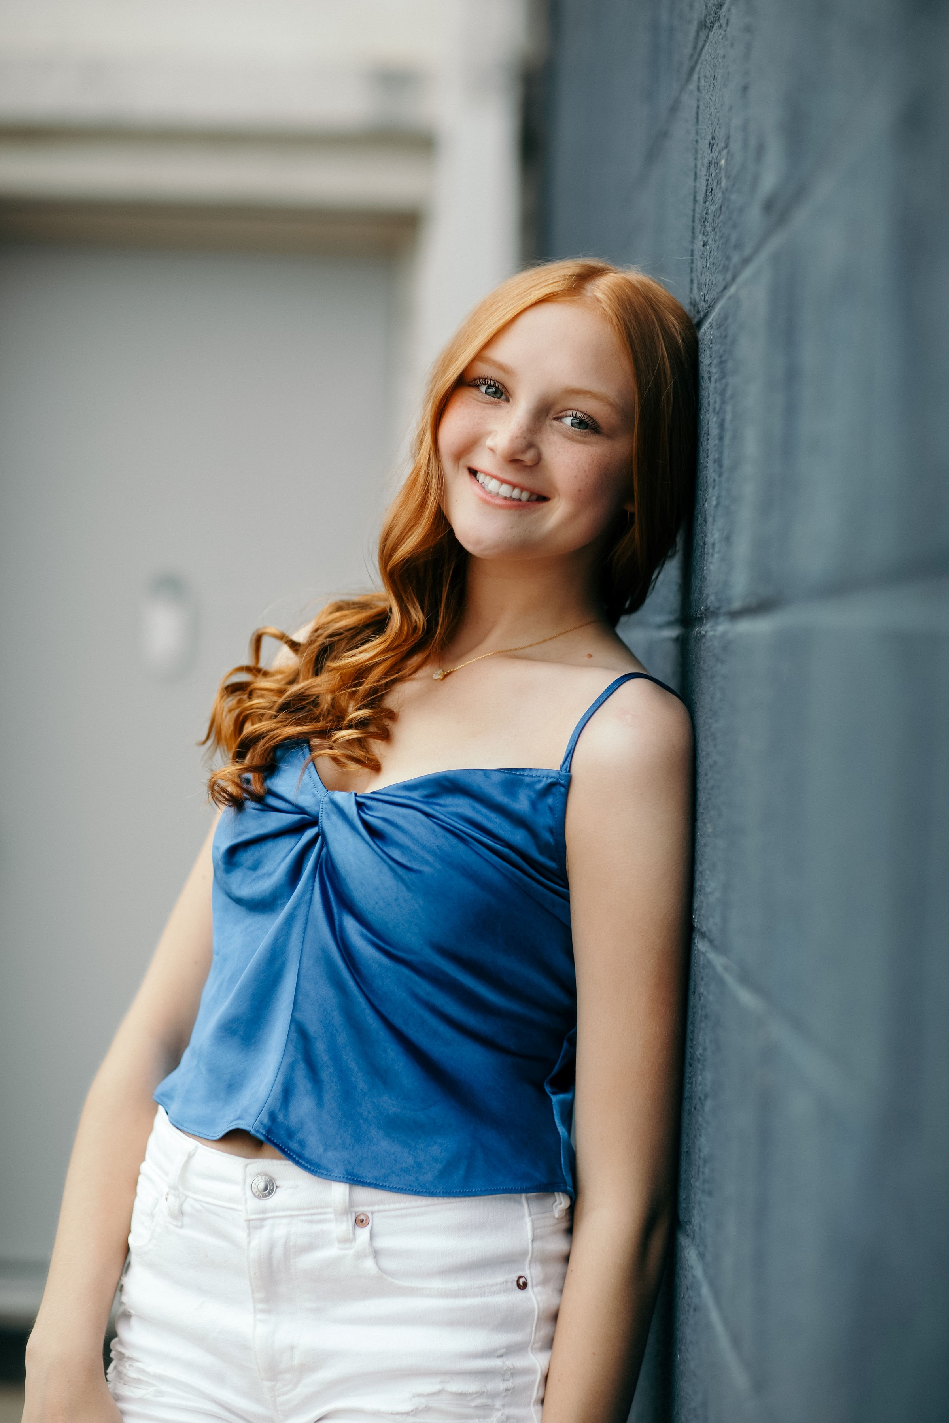
Evee-Kay and Izaac
Izaac’s diagnosis: Achondroplasia
Opportunities and Challenges
  Opportunities: “I have learned that life comes with challenges that sometimes makes things harder and sometimes you won’t always understand but those challenges have been put into your life or happened for a reason to help you become the person you are today.”
  Challenges: “I love having Izaac as a sibling, but it does come with some challenges. A main one was, when I was younger, I didn’t fully understand the complications of everything, and it caused me to feel like a burden or not important: whether not being able to be with my parents as much or going anywhere and being completely overlooked like I wasn’t even there got to me sometimes. Also obviously seeing all of the panic and stress with the whole family and when he would have his codes or very scary incidents, I would be very worried if he would even survive which was very stressful especially at a young age, with also being young feeling useless when things like that would happen.”
Notes:
Evee-Kay is the older sister of Izaac. Evee-Kay was about 2 ½ years old when Izaac was born, which was when she first found out about her brother’s diagnosis. Izaac is diagnosed with achondroplasia, which is a bone growth disorder that results in short stature.
Evee-Kay described many opportunities of being a sibling:
She stated “I have learned that life comes with challenges that sometimes makes things harder and sometimes you won’t always understand but those challenges have been put into your life or happened for a reason to help you become the person you are today. “
She also described learning how to be more independent and more responsible as opportunities of being a sibling.
Evee-Kay even described some unique memories she has had as Izaac’s sister: “Some opportunities that come with it are since the sibling is different, they get more recognition so at least my family because of Izaac have gotten the chance to hang out with celebrities and meet lots of new people at conventions for him”
All siblings, regardless of whether or not they have special needs, experience challenges with their siblings. But siblings of children with special needs often have unique sibling challenges. And for some siblings, challenges of being a sibling may change or evolve as children get older. Evee-Kay explained “I love having Izaac as a sibling but it does come with some challenges. A main one was when I was younger I didn’t fully understand the complications of everything and it caused me to feel like a burden or not important weather not being able to be with my parents as much or going anywhere and being completely overlooked like I wasn’t even there got to me sometimes. Also obviously seeing all of the panic and stress with the whole family and when he would have his codes or very scary incidents I would be very worried if he would even survive which was very stressful especially at a young age, with also being young feeling useless when things like that would happen. “
But now that they are both older, she explained that “The biggest challenge now that he’s older would be just trying to help him go through life. I understand things now because I’m also older, but we go to the same school so just trying to manage helping him while still living a “normal” life”.
Siblings of children with special needs experience many emotions related to their sibling, such as being proud of their sibling, or embarrassed by them. For Evee-Kay, she was really proud of Izaac when he went underwater for the first time after getting his trach taken out. But she also shared that she sometimes used to be embarrassed by home when he was really loud in places and everyone would look at him.
Siblings also may develop an outlook on life different from that of their peers. Evee-Kay explained that she feels like she understands more about how not everything is promised. She also shared that she feels like because of her situation she’s grown up faster and been more responsible, which she said changes her outlook on life in general
She also contributes her role as a sibling to influencing her personality. She stated that there are some traits she has like reacting quickly to things or becoming defensive in conversations that she feels like she’s gotten through being a sibling.
Sometimes young children may even wish they were sick or had a disability so that their parents would pay more attention to them. When Evee-Kay was asked this, she responded that she didn’t necessarily wish for a disability but thought that if there was something wrong with her or she was hurt in some way then yes, she would get some of that undivided attention also.
For some siblings, they would like to be a part of discussions about their sibling, as appropriate for their age and development. Evee-Kay shared that now that she is older, her parents include her in such discussions, and she likes knowing what is going on with her brother.
Being a sibling of a child of complex medical needs can sometimes be scary, especially for younger siblings that may not fully understand what is happening. Evee-Kay shared that she’s been scared lots of times with Izaac: when he had a long hospital stay, when he had surgery, when he coded, when he needed oxygen at home or if his vent unplugged. Evee-Kay even described one specific situation where she felt scared about what was going on with Izaac, but was distracted by helping and contributing to the situation – such as showing the paramedics into the house, talking to Izaac, and bringing the nurse stuff that was needed.

Slide 6
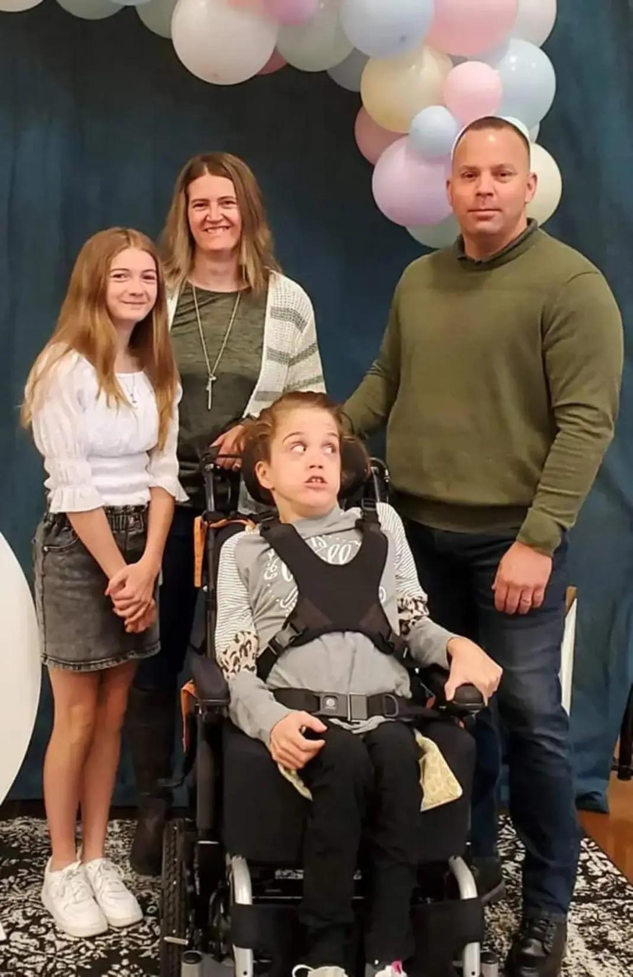
Allie and Kaylyn
Kaylyn’s diagnosis, as described by Allie: “cerebral palsy and a bunch of other things”
Opportunities and Challenges
  Opportunity: “Being exposed to medical stuff and learning how to do things you would normally learn in med school, not having the typical annoying sibling problems”
  Challenge:“not being able to have a normal sibling relationship”
Notes:
Allie is the younger sister of Kaylyn. She doesn’t know how old she was when she found out Kaylyn’s diagnosis, but she described it as “just always there”.
Allie explained that an opportunity for her as a sibling was being exposed to medical stuff and learning how to do things you would normally learn in med school. She also explained that she doesn’t have the typical annoying sibling problems with her sister, which she views as another opportunity. At the same time, Allie stated that a challenge of being a sibling is not being able to have a normal sibling relationship(which as most of us know includes many of those annoying sibling moments).
Besides opportunities and challenges, there are many other emotions that siblings may experience. Allie described being proud of Kaylyn “when she graduated” and being embarrassed by Kaylyn “When she has tantrums or needs suctioned in public”
Many siblings contribute aspects of their personality to growing up with a sibling with special needs. For Allie, she explained “Having Kaylyn as a sibling has made me more self-sufficient, because when I was younger I learned that I was going to have to take care of myself when my parents were busy with Kaylyn.”
Sometimes young siblings may even wish they had a disability so that they could get more attention from their parents. But that is not always true. Allie explained “I never wanted my own disability. To be honest, I was fine with how things were. My parents balanced taking care of her and spending time with me pretty well. Even when they couldn’t really pay attention to me, I was fine with that because I enjoyed having time to myself anyway.”

Slide 7
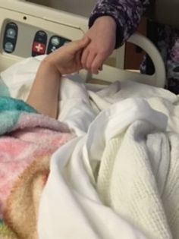
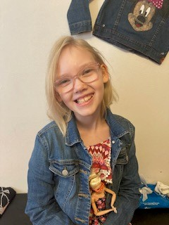
Becky and Ella
Ella’s diagnosis: Kleefstra Syndrome
Opportunities and Challenges
  Opportunities: She gives good snuggles and we go on trips/activities with her.
  Challenges: She bites and hits. I don’t like that.
Notes:
Becky is the younger sibling of Ella, so she has always known her sister’s diagnosis.
Becky likes that her sister gives good snuggles. She also likes getting to go on trips and doing activities with her sister. But Becky doesn’t like when her sister bites and hits.
Becky shared that she is always proud of her sister. She also shared that she didn’t always know that not all kids had a special needs sibling.
Becky likes when her parents include her in discussions about her sister because she likes knowing what is happening.
Becky also described a scary time when her sister had to have emergency surgery in the middle of the night in January 2020. But Becky shared that she was less scared when she went to the hospital to see her sister and she held Becky’s hand and licked her, which is how Ella gives kisses.

Slide 8
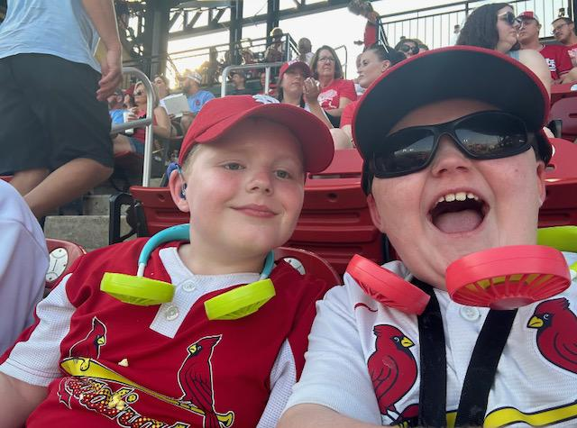
Brennan and Colin
Brennan: “ADHD, trouble sleeping, hard of hearing or deaf.”
Colin: “EVA(enlarged vestibular aqueduct) and ADHD”
Notes:
Brennan and Colin are brothers who both are diagnosed with ADHD and are hard of hearing.
Brennan, who is about a year older than Colin, shared that since he has the same diagnosis as his brother, he gets to feel the same stuff as his brother and share more with him because he knows what his brother is going through. He also shared that he likes that Colin knows how to make him laugh and cheer him up, but doesn’t like when they fight.
Brennan is proud of Colin for standing up for himself when he gets bullied but is embarrassed when he says stuff that makes him sound dumb.
Brennan was scared that Colin would be different once he got his cochlear implant, but talking to him after he got it made Brennan feel better.
Colin described Brennan as the best brother he could have and enjoys playing with him. Like Brennan, Colin doesn’t like fighting with his brother.
Colin was somewhat confused when Brennan was first diagnosed with ADHD. Colin explained that it was confusing that Brennan’s brain works differently and he didn’t understand how it worked differently until he got diagnosed with ADHD too.
Colin and Brennan’s mom shared a story of when Brennan was first diagnosed with ADHD. She shared that when she told Colin that Brennan’s brain was working really fast, Colin said that he wanted to have ADHD too. She explained that this was before Colin’s ADHD diagnosis, as he was diagnosed later.

Slide 9
Key Points
Not every sibling will have the same experience
What is helpful to one sibling may not be helpful to another sibling

Slide 10
Resources
“Glass Children” Handout
Sibling Support Project
  Books/publications
  Sibshop Locator
Contact Your Family Partner

Slide 11
Questions?
Thank you!

