Slide 1
What is Self-Care? Is it possible?
Peggy Welker, LMSW
Notes:
Hello, my name is PW. I wanted to tell you a little bit about me and my family today.
I have been married nearly 34 years – yes, to the same guy! He’s my steady. I’m his Pinterest-nightmare-wife, lol. We have 2 sons – young adults now - and a daughter with 18 disabilities in vision, mobility, osteopenia, developmental delay, anxiety, expressive & receptive language & Autism. As I watched my daughter grow, I recognized early on that we were forging our own path. So I stopped comparing her to other children – just got out of that race from the start.
One of her therapists saw more in me than I did. She urged me to go back to school to get my Masters in Social Work. When my daughter was 10 & I had 2 teen boys in high school, I did just that.
Like I said earlier, I try not to compare myself with others. We all have our own Lived Experiences, right? Our family has experienced every kind of education: I’ve homeschooled my boys and then they went to their local high school. My daughter has been in public and private school. I personally grew up in what we would call just above the poverty line with a single parent in the home. We’ve eaten our share of powdered eggs and run out of WIC (women infant and children) funds, eaten plenty of bologna sandwiches in my growing up years. So being a social worker – I draw from my experiences as well as what I have learned to help all manner of people in my job.
What is a social worker? A social worker’s mission is to empower people and help people to meet their needs. We pay attention to the environmental forces that contribute to a client’s situation. Our core values are having a serving attitude, recognizing the dignity & worth of each person, the importance of human relationships - integrity, competence and justice in our work. But that doesn’t mean I’m here to tell you what to do. Social Workers encourage the work that the participant does. We encourage and empower… and facilitate if necessary.

Slide 2
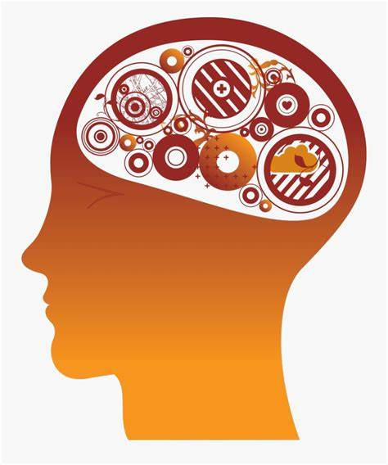
What is Self Care?
People are Complex!
What is self-care?
Why do I need self-care?
Body Mind Emotions Spirit
Notes:
So let’s talk about Self-Care. What is Self Care? That’s what I’m presenting for today’s talk. Let’s start with this – people are complicated!
People are complex: We have a (1) physical body has needs a balance between purposeful stress (like exercise) & rest (2) my mind that needs rest and to be challenged AND my mind has need for MARGIN (down time) (3) my emotions have needs for rest, fun, peace, joy, permission to be sad (4) My spirit needs to think, plan, meditate and dream.
WHAT IS SELF CARE? Nurturing YOU: all 4 areas of you. Redirecting some of your energy to yourself so that you are stronger in these areas to be prepared for the next stage of your child’s life.
WHY DO WE NEED SELF-CARE: (1) I am my child’s lifelong advocate. If I’m not taking care of ME, then I won’t be here as long as I need to be. Who will do the advocating for my child I love so much? (2) I have a duty & gift to nurture the life God gave me – I am unique & I have a unique footprint to impress on this world . We need to nurture the dreams inside of us (even just a teeny bit) or our spirit withers inside us (3) giving MYSELF care means my resentment factor goes down which means my body, emotions and spirit are MUCH HEALTHIER and finally (4) I need to lead-by-example: Giving myself self-care sets a good example for my family & gives them an opportunity to meet the needs of our loved one (here’s my example: bedtime is dad’s job in my house. My husband has a mentally taxing job, tired at the end of the day. But we both work FT. So, I say “Tori, bedtime!” …. If we are both in the TV room & his version of bedtime routine is to yell across 2 rooms at the kid, not effective. And he will keep doing that. But if I leave the room, go into another room to read a book… he steps up!!) I model giving myself self-care and as a result, he steps into his role.

Slide 3
Self-Care means looking at the positive side of life: what is there to be positive about?
Notes:
It’s so easy to think negatively. At least for me, it is. I see all the things that need to be done – and it wears me out!! I feel OLD! I have to make a choice to think … what do I have to be thankful for? What IS something positive in my life?
Basics: I have sunlight. I have clean water. I have the ability to walk out my front door & just take a breath. What else do you have that you’ve taken for granted?
Basics: I have my health – I’ve made some changes over the last 3 years & I feel healthier. Does your child sleep more than 6 hours at a time? THAT IS A GIFT
Basics: I DO have 5 minutes to myself – even if it is in my car in the garage. (the bathroom is not safe anymore!)
THE GENEROSITY OF MY LIFE. What does that mean? (1) FT earners in the United States, on average per capita, their average income is 7th in the world. In other words, the average income of any individual in 93 other countries have less than us. And you live in this nation with all its faults and warts. (worlddata.info/average-income.php). (2) If you live in MO, we can be thankful that we are the 4th LOWEST cost-of-living compared to the other 49 states. (worldpopulationreview.com/state-rankings/cost-of-living-index-by-state). Why do I mention this? When our dollars are not going so far in the grocery store, we STILL have something to be thankful for!
So these 2 areas here – it’s for everyone. It’s something positive in our lives – it is a NET GAIN in he Savings Account of Life.

Slide 4
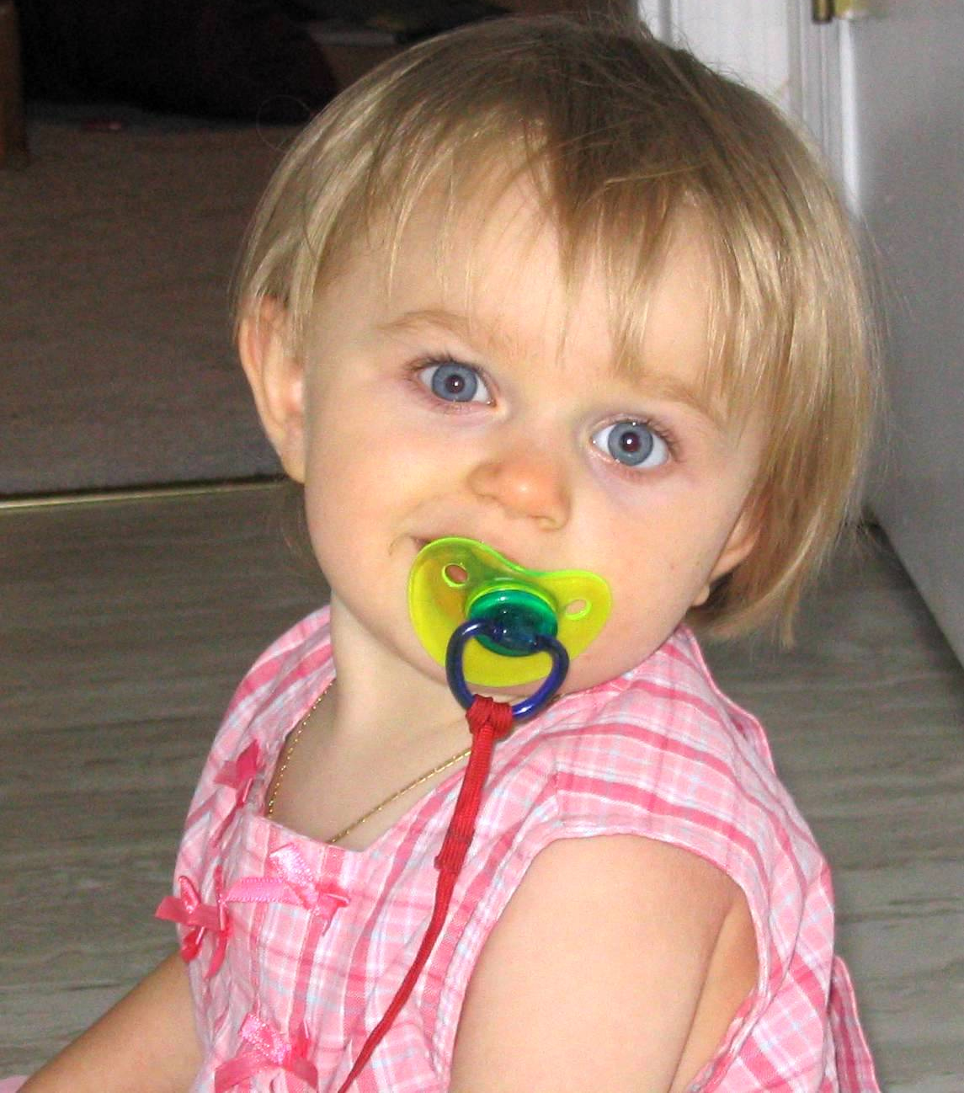
Is being Positive worth it?
An Option
Traps
Notes:
Is being positive even worth it? After all, something negative will just come along & supercede it. Well, we have a free will…. Any 2 year old will show you that! We can choose to live with a positive ouitlook … or keep looking for a negative to wander along – it won’t be long before we see the negative.
IT IS AN OPTION. IT’S A CHOICE. No one commands us to be positive. According to the Mayo Clinic (“Positive Thinking: stop negative self-talk to reduce stress), the benefits of thinking positively are: (1) reduced risk of death from cancer, from infections (2) lower rates of depression, distress & pain (3) increased life span (4) greater resistance to illness. They had more on the list, those are just the big ones.
This is my little girl. The picture on the right is the day before she had surgery to disconnect half her brain matter in order to resolve seizures. And guess what, we are the fortunate family that she had complex partial seizures. This is a picture of generosity that I realize not everyone has.
But we all have our bad moments – just like my cute daughter on the left. We have TRAPS ASSOCIATED WITH NEGATIVE THINKING – my goodness, it’s so easy to get sucked in to the negative these days! What can we do about that? (1st) Filtering. Consider: Are you magnifying the negative aspects of a situation & filtering out all the positive? (2nd) Personalizing: Do you blame yourself – evening out with friends canceled & you assume it’s about you? (3rd) Catastrophizing. Do you routinely anticipate the worst? (4) Blaming. Do you overreact and try to say someone else is responsible for what happened instead of taking responsibility for your thoughts and feelings? Maybe because you’re already emotionally overburdened in another area? I’m not saying its easy to get out of these traps. But these are ways we get trapped into negative thinking. One last one: (5) “SHOULD” LIST. Do you think of all the things you should do & are critical of yourself when you can’t get them all done? WHEW. Several of these hit close to home.

Slide 5
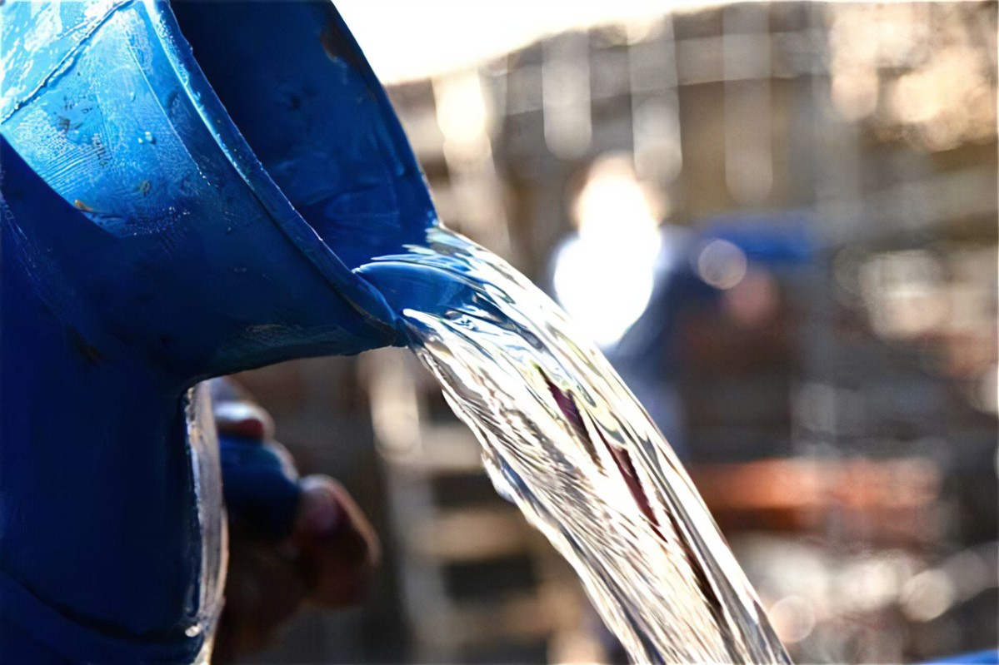
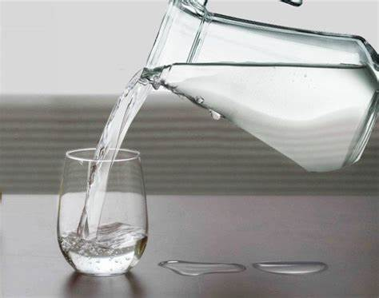
Self-Care NOT A VIRTUE. A NECESSITY.
POURED OUT POURING BACK IN
for our kids for our kids
Notes:
Well let me be real with you. I’m an addict. It’s true. I’m one of you. I’m a workaholic (when it’s done, let’s go over it one more time for just any possible errors) AND I’m a chocolate-a-holic. These 2 actually are comforts to me. But you know what else they are? They are saboteurs of the BETTER things in my life like rest, meditation, community, laughter.
So this is non-negotiable. Yes, you can ignore everything I say. OR you can promise yourself that you will find 3 minutes (at a minimum) some time before noon daily to first place the oxygen mask on YOU. Take care of YOU.
Strengthening yourself is not narcissism. It will give you the strength to do the extra advocacy work.
So enough of this seriousness – let’s really get into some self care and have a little bit of FUN!

Slide 6
Change Is Easy, Right?
Your Goal
to be purposeful & intentional
Notes:
Let’s start with a fun exercise…
REPROGRAMMING yourself. You CAN learn to turn negative thinking into positive thinking. But it means being purposeful. How many days does it take to create a habit? 18 to 254 days. Yeah, so let’s give ourselves an entire month – because let’s face it, we’re an easily distractable bunch. But let’s start RIGHT NOW.
I want you to use your peripheral vision. Look at that person to your right….. Uh huh. They’re definitely suspicious looking. But because you are practicing POSITIVE SELF-THINKING… I want you to PAY IT FORWARD. I want you to think of something REALLY NICE about that person… you admire their outfit, they are a good note taker…. You can’t think of anything? Then ask them what the funniest thing is they have ever done. You know, we’re not going to record this but … did they squirt milk snot out of their nose once? Did they use an inversion table at home & got stuck?
What is their favorite story. Here’s one of mine: I’ve got 3 kids. I think my boys were ages 11 & 9 and my 4 year old daughter had just learned to walk. I brought my boys to our basement for something … I don’t remember. And then it happened. My daughter closed the basement door on us AND she turned the little lock-knob in the middle. Talk about master small motor skills!!!! She was non-verbal until she was 7 so she wasn’t talking. We kept trying to teach her – through the door – to unlock the door. Nope. So I had to take my skinniest son & push him through the window – you know, those old dusty windows with spider webs all around them … yep. Because **I** wasn’t going to fit through that window. That’s my story. Now you turn to your neighbor & share.
HAVE THEM SHARE 3-4 STORIES.
Now there you go – see , you CAN be positive. This little exercise shows that you are all capable of changing. ☺

Slide 7
Ideas for Self-Care
Body
Mind
Emotions
Spirit
Notes:
So, we have defined what self-care is …. Why we actually need it …. The benefits and the traps that keep us from giving ourselves some care.
BUT WHAT ARE THE IDEAS? So, look, I might be a social worker … but I am a wife, a mother, a scrapbooker (okay, I used to be a scrapbooker), a full-time employee, juggling 3 kids & 1 of them does not wipe her own butt. The ideas I am suggesting – I use many of them myself. And remember, I’m a workaholic!
Some of them are a little underhanded so don’t go home and tell your partner my tricks… it might get back to my husband. Remember:
The physical body has needs for a balance between rest and intentional stress
Our mind has need for rest and challenge AND our mind has needs for MARGIN
Our emotions have needs for rest, fun, peace, joy, permission to be sad
our spirit needs to think, plan, meditate, dream.
Let’s start with our physical body.

Slide 8
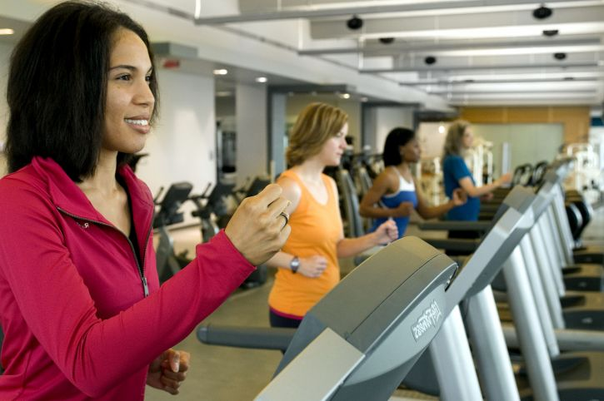
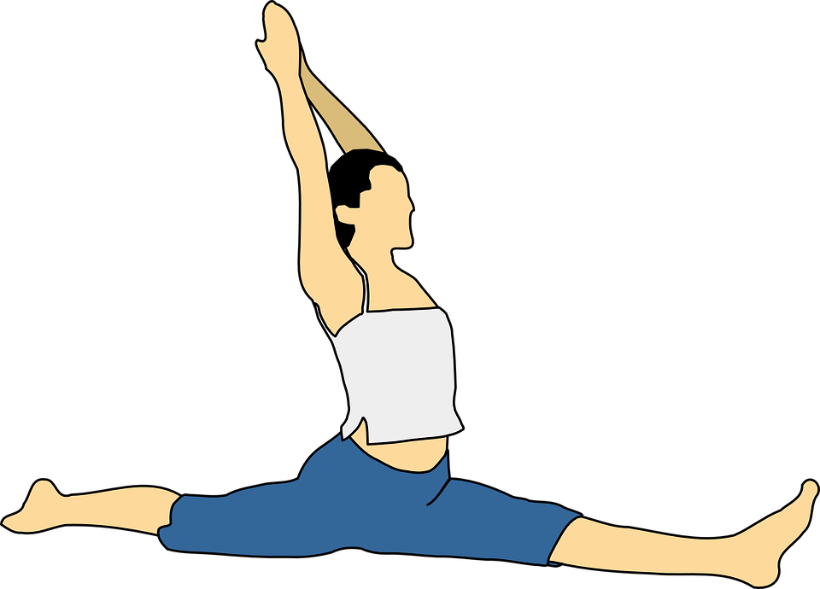
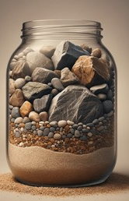
MY BODY
Notes:
BODY
Now, I’m not a doctor & I don’t play one on TV so you need to do your own research but I have found some suggestions from mainstream medical sites that I would like to share:
BODY: Our body’s need a balance in our cortisol hormone. (When I say cortisol – who knows what I’m talking about? Cortisol is the main stress hormone in our body: Fight or Flight. But it also regulates our blood sugar & metabolism. It helps us during our workouts. It needs to be at a healthy level).
How do we do that?
Exercise (which actually raises our cortisol level)
quality sleep. Another words, when you are sleeping, it’s quality sleep
Stretching/ Massage/moving your body in a different way.
Just touching the ground.
Here’s my “trick” for getting better sleep: I have started wearing Blue Light cancelling glasses after 3pm. It reduces eye fatigue, blocks the most harmful blue light from computer, phone & TV. Blue light fools the brain into thinking it’s daytime➔ the body stops releasing a sleep hormone called melatonin. These glasses cost about $10 on Amazon. I’ll show you a picture of these later. My dog has chewed one of the stems but, you know what, that dog is not going to defeat me! I’m still using them! lol

Slide 9
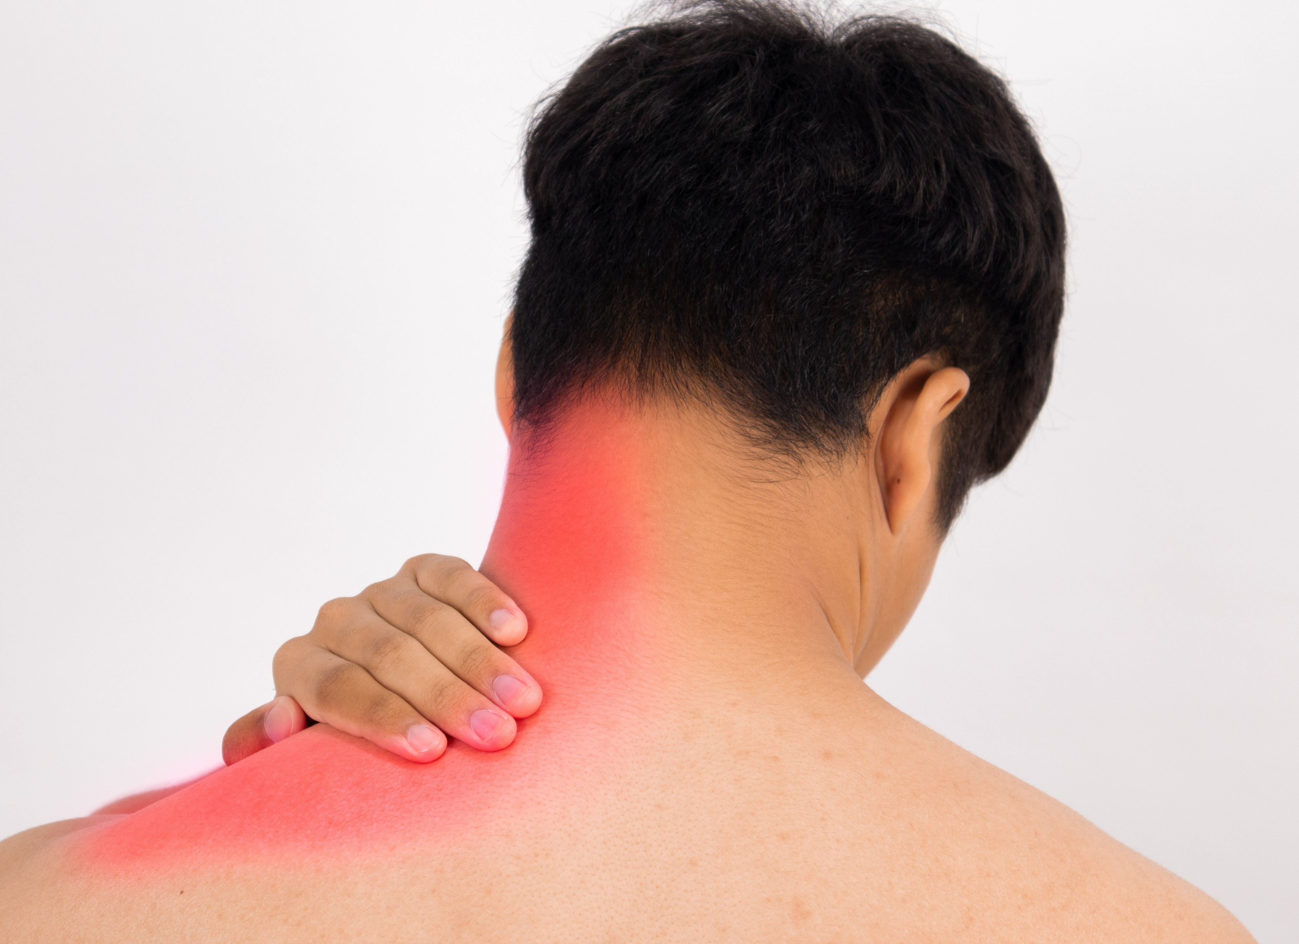
Shoulders
Grounding
Notes:
Shoulders? What?
When you are doing dishes: are you tense? Think about your shoulders. Your neck.
You can do your tasks STRESSED & RUSHED or you can do your tasks PURPOSEFUL & TRUSTFUL… trusting that you WILL get the big things done.
Do we get caught up in the little tasks that seem so urgent? I KNOW IT’S DIFFICULT – can we take 3 minutes after we put our kid on the bus or drop them at the sitters… 3 minutes to listen to a babbling brook on YouTube and breathe in/out. 3 minutes. There’s an entire YouTube channel called TheSilentWatcher that has 3 hours of a babbling brook. It is sooo wonderful!
I listen to the podcast “The Model Health” with Shawn Stevenson. He said that when we touch the earth – the ground, the grass – it reduces our stress level, speeds healing, reduces pain, improves immune system function. Can you believe this? On his website https://themodelhealthshow.com/blog, he has so many articles about sleep. I don’t listen to him religiously but every time I’ve listened, I’ve learned something & it’s made me more thoughtful about my health choices.
Also – in case this doesn’t seem mainstream enough - I searched further & found an article about it in Cleveland Clinic: health.clevelandclinic.org/earthing.

Slide 10
Mental Refreshing
A full night’s sleep boosts your energy, mood, memory and creativity while lowering stress levels.
Have a not-frantic mindset. I tell myself: I cannot get it all done today & that’s OK.
What is your version of a healthy diet?
Sunlight. Fresh Air. Grounding.
Meditation & Gratitude.
Notes:
So, we have defined what self-care is …. Why we actually need it …. The benefits and the traps that keep us from giving ourselves some care.
BUT WHAT ARE THE IDEAS?
SLEEP
NOT-FRANTIC MINDSET
HEALTHY DIET
SUNLIGHT-AIR-GROUNDING
MEDITATION & GRATITUDE
It’s a pretty good list, don’t you think?

Slide 11
Mental Refreshing
Did I mention sleep? How about naps?
Exercise can mean taking a walk with your child watching a video with headsets.
Remember those blue-light-blocking glasses after noon.
$9.99 - 1 pair
Notes:
Before we leave the area of mindful regeneration, let’s review…
For mental refreshing …. Sleep…. How about naps?
Exercise … that can mean taking a walk with your child while they watch a video in a stroller
Remember those blue-light blocking glasses after noon … they have made a significant contribution to this workaholic Mama Bear Advocate.

Slide 12
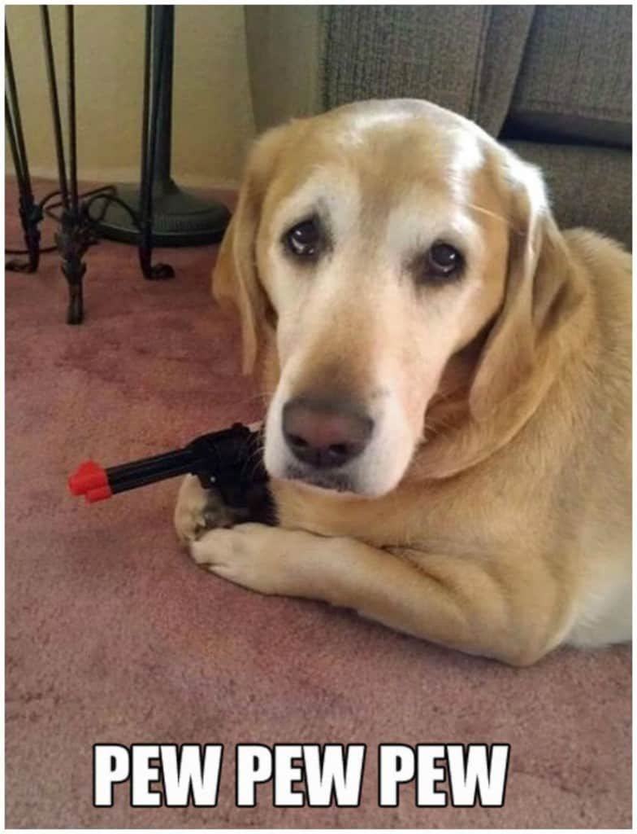
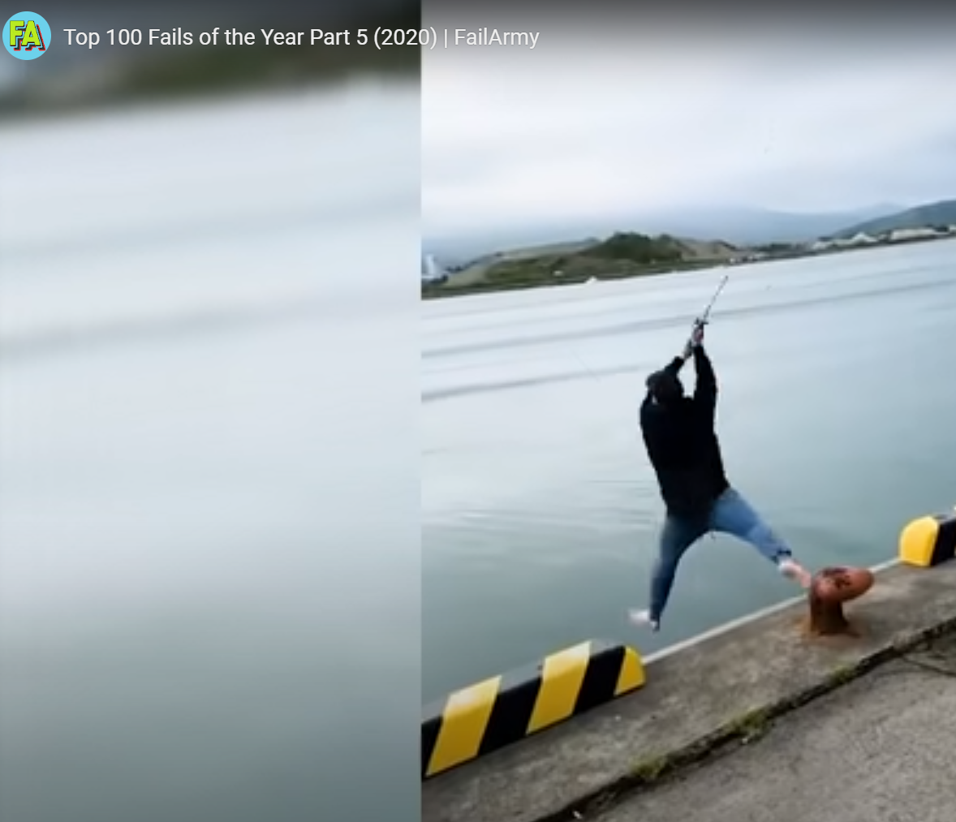
The Path to Positive: Goofiness
Your version of goofy is not to be judged, only enjoyed.
Notes:
Well, let’s move on to being positive, energizing ourselves with joy – laughter – goofiness.
GET OUT OF YOUR RUT. Have you tried these very informative YouTube channels? Fail Army has 17.1 M subscribers for a reason. This guy on the right? He’s very busy throwing the biggest fishing cast EVER. Oops. He ends up in the water!
And then there is THE DODO. OMG! It’s so precious to see these sad little creatures nurtured back to life and happiness.
Have you ever actually gone to your favorite search engine and literally just typed in goofy memes? Yep, that’s where these 2 corny images on the left came from.
Anybody else have a favorite positive time waster? (pause)

Slide 13
Emotional Refreshing
Meet with friends who don’t have children with disabilities
Connect with others online and elsewhere in a support group.
What is a hobby you have loved? How can you pursue that?
$129.99 on sale
Notes:
My husband and I love photography. He’s much better than I am – he’s an engineer. And we have digital cameras. This digital camera is on sale at Target for $129. www.keh.com sells used cameras they have certified. I buy camera products from there. I just looked and they had a Sony Cyber-Shot Digital Camera for $80.
My husband also has a hobby of Legos. He has taught our daughter to do Legos with him. He does 90% of the work & she hands him the pieces that he points to. They are creating together. Then they watch the Lego Masters show on TV. They go to Mod Pizza for dinner out occasionally.
A friend of mine has a daughter with CDK13, a genetic disorder. She is a determined Momma. There are 327 individuals worldwide with this diagnosis. And she found her tribe – in England! So as a family, they flew to meet other families with this same diagnosis. I’ve looked them up briefly – they have a website and a community. I find that absolutely amazing because – I’ve gotta tell you – I don’t have to travel to England to find my tribe. Her determination to find emotional support among an online community is an example for us all.

Slide 14
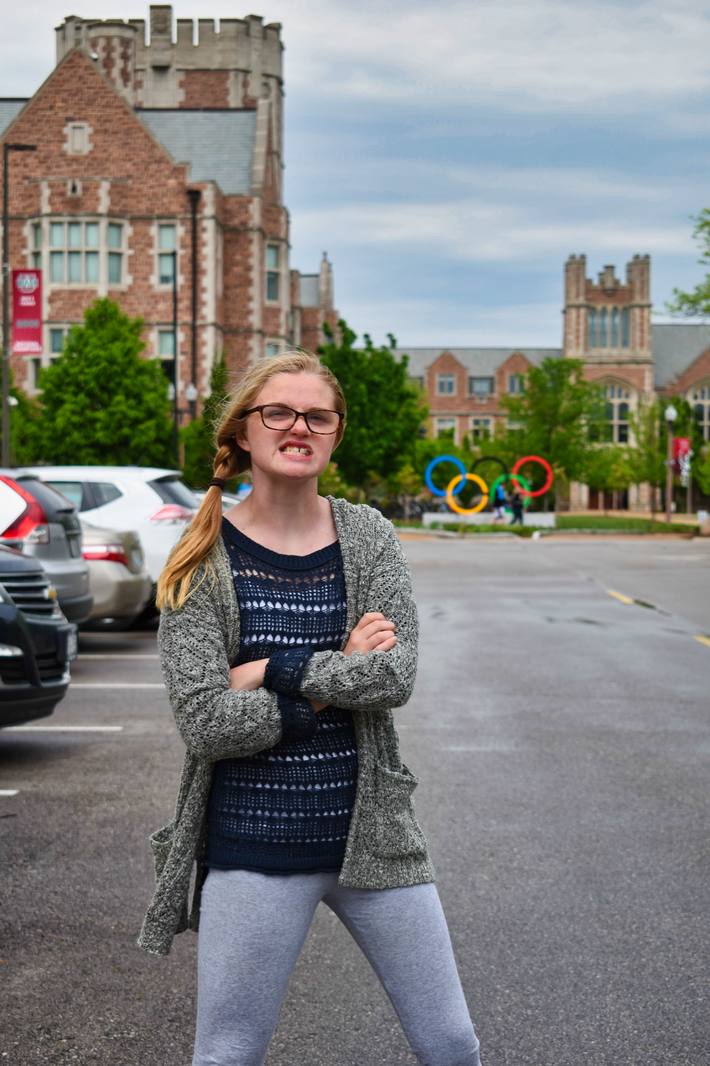
Notes:
EMBRACE the “mistakes” of life & laugh at them.
Can you see that expression on my daughter’s face? She’s is so mad at me. She just didn’t want to have her picture taken – that was my big Parenting Error – she was DONE but I was not. But these pictures … just looking at them bring me joy, make me laugh, help me to SIGH and rest.
This is why I love photography – the challenge and the joy of capturing something that speaks long after the image has been filed away.

Slide 15
Lovely Poetry
Fall Light
AIR
Cool and dry
Drifts down on a breeze
Under a shade of trees.
A subtle hint of change is near.
LIGHT
A fire in the wood
To warm the chill,
And ready yourself for the cold.
The autumn frost will soon be here.
INHALE
A deep breath
Again and again
In just the same way as before.
Kiesha Shepard
Joy seeps
Into my bones
Flooding the
Marrow
Tickling
The cells
Until a slow wide
Smile spreads
Across my face
Juliet Fay
Notes:
TRY SOMETHING COMPLETELY NEW. Look at these lovely poems. Let’s read them out loud – slowly – as a form of relaxation. Close your eyes or can look down while I read them. Immerse yourself in these poems for just a small moment.
(PEGGY READ THEM)

Slide 16
Lovely Poetry
BREATHE
I breathe in. I breathe out. I do not lack.
REST
Sitting in a field, the sun warms my face.
I close my eyes.
I lay back. Breathe In. Breathe Out. Rest. I rest.
STILL
I feel the grass: soft and warm.
I hear the waters: tumbling, bubbling, rushing, slowing.
I lay back: trusting. Breath In. Breath Out. Rest. I rest.
REFRESHED.
I open my eyes. There is more wholeness there.
I am centered. I am a conqueror. I am more ready now.
It’s getting dark. But I’m not afraid. Breath In. Breathe Out. Rest.
As the sun sets, I smile. Sunset brings warmth and hope.
I can walk through tomorrow because I’ve felt the warmth of today.
Peggy Welker
Notes:
I tried a hang at making my own poetry. Then I read it out loud to my husband. I’m pretty sure he rolled his eyes. I think he was expecting Robert Frost or Maya Angelou. Too bad. I read it out loud, made some tweaks. Do you want to hear me read it out loud again, now? Let’s do this again – close our eyes or look down. Concentrate on the words.
Now, I’ve never written a poem in my life. But that wasn’t too shabby, was it? And I actually find strength in taking the time to slow down… I think that took 2 minutes. And I used my creativity, giving my mind a rest from everything pressing around me.

Slide 17
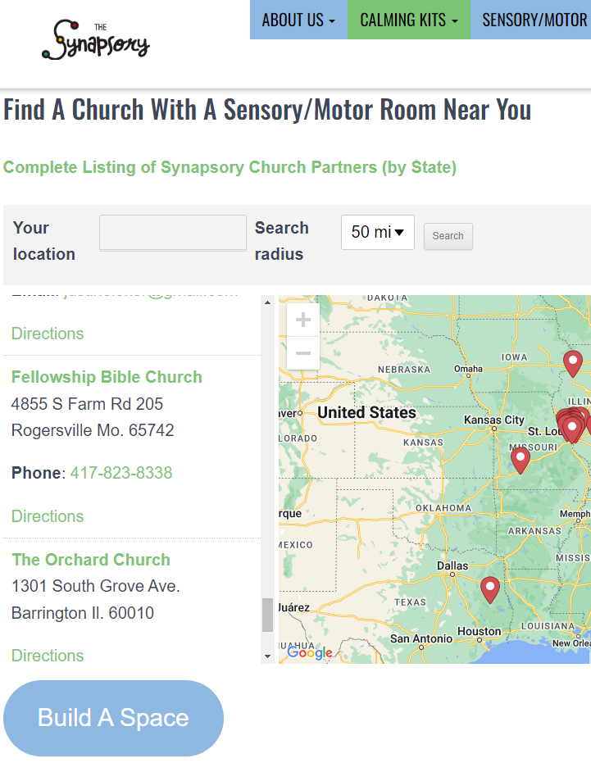
Self Care for My Spirit
______
12 Steps
Faith Community
Mindfulness
Psalm 23
Notes:
Our Spirit. It seems so personal, doesn’t it.
Studies show us that believing there is a higher/bigger power than us – it affects our brain.
(1) Npr.org/2009/05/20/104310443/prayer-may-reshape-your-brain-and-your-reality
(2) Look up the 12 steps of alcoholics anonymous. It’s actually beautiful if you think through the steps.
(3) Did you grow up in a faith? Catholic or Jewish or Evangelical or Muslim… can you look around for a home congregation? I attended 3 different congregations before I settled with a community that felt comfortable and inviting. I hope you won’t give up on yourself – keep trying.
And what happens if you find a loving and accepting faith community but they have no resources for your Special Needs child? There is an organization based in the St Louis Area called The Synapsory that will excitedly install a sensory room in a church or school – all you need to do is contact them. See the button: BUILD A SPACE? They Have one in Fellowship Bible Church in Rogersville MO, a bunch in the St. Louis & Jefferson County area as well. Considering giving them a call and asking them about their program.
Did you notice what my poem was about? It was Psalm 23 – the Lord is my Shepherd. I’ve never written poetry before. This was new for me … and fun! And restful. And spiritual.
My research came from:
Autismspeaks.org/tool-kit-excerpt/taking-care-yourself
Aspirecounselingmo.com/blog/self-care-tips-for-parents-of-special-needs-children
Ohanacare.ca/blog/self-care-special-needs-parents/

Slide 18
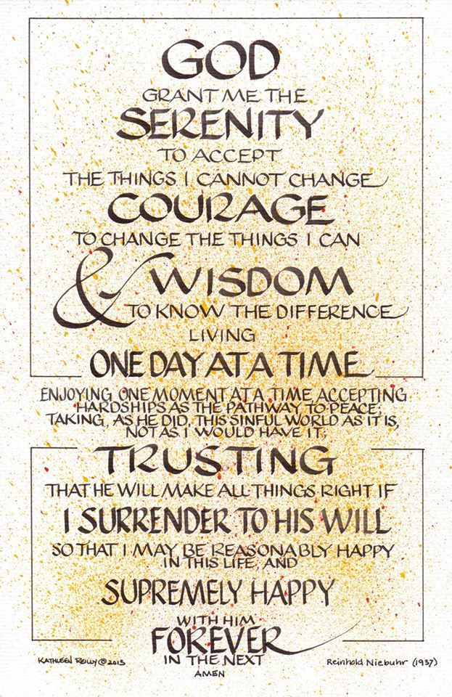
Self Care for My Spirit
Notes:
Here is another thing to remember - Courtesy of Pinterest Shirlene Renshaw’s account. Isn’t it lovely?
We must remember that ultimately we do not have command or control over every aspect of our lives or our loved ones life. I don’t like that very much. But I call this the Trust Poem. You know, compared to the Trust Fall in those team building exercises?
I need to accept the things I cannot change. I need more courage than I have to change what is in my world to change. I need outside wisdom to know the difference and then I am back at accepting.

Slide 19
The Positive Process to Change
Make 1 Goal
(overachievers can have 2)
Check-in with yourself
Permission to smile
Practice positive self-talk
Notes:
So, we have defined what self-care is …. Why we actually need it …. The benefits of seeing the positive and the traps that keep us from giving ourselves some care.
We threw out some ideas for our body – our mind – our emotions – and our spirit… to nurture them for a healthier us.
And I hope you come out of this session calmer & feeling hopeful.
After all, that’s what social workers like to do: Our mission is to empower people and help them meet their needs.
Thank you.

