Slide 1
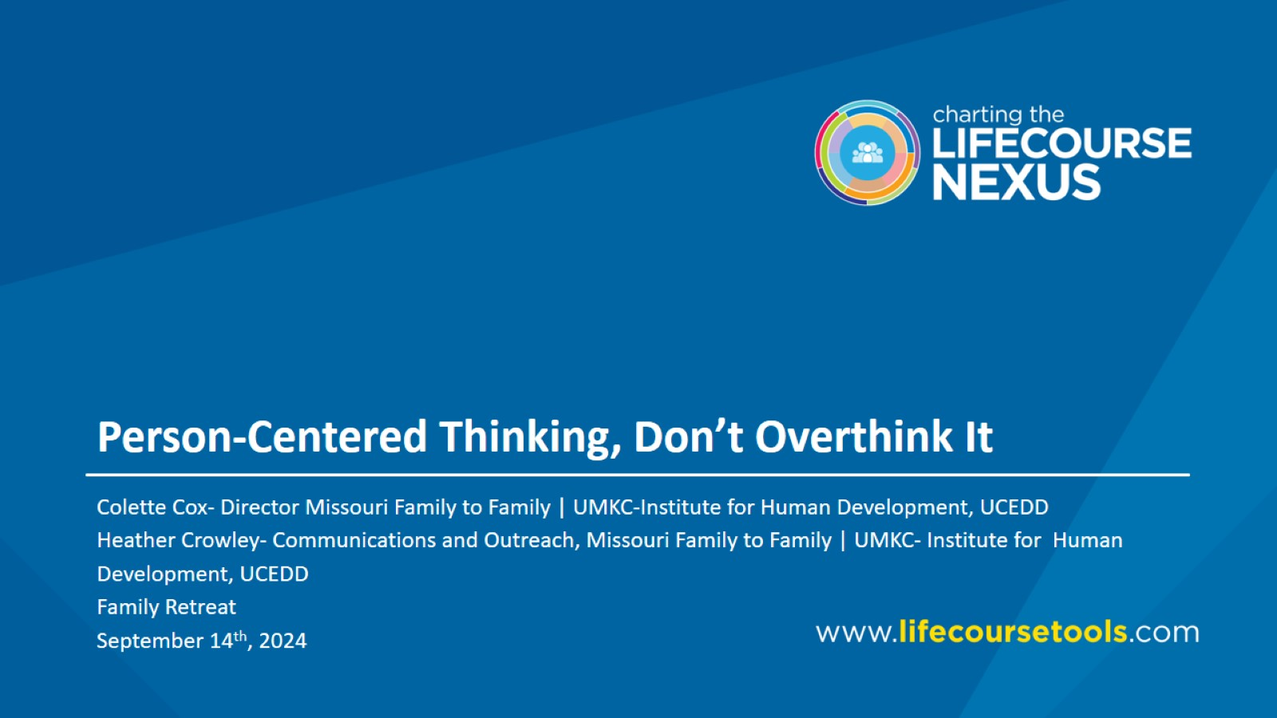
Person-Centered Thinking, Don’t Overthink It

Slide 2
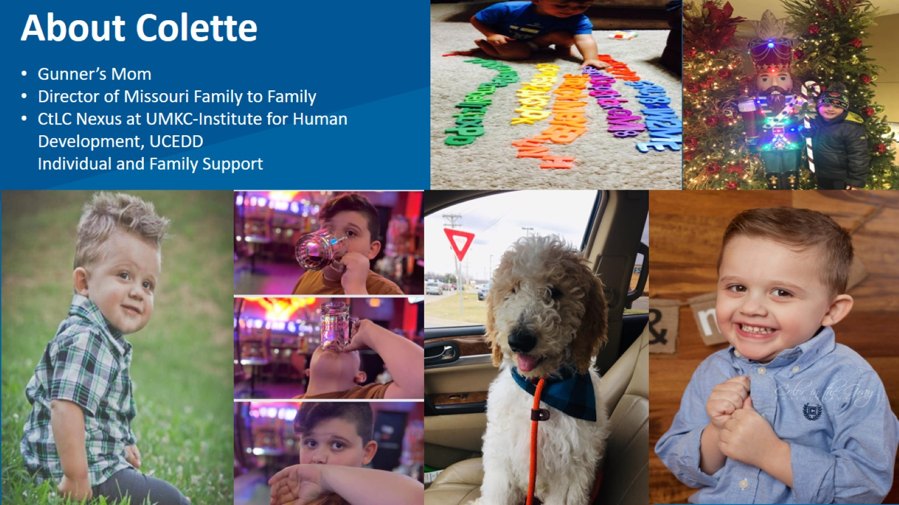
About Colette

Slide 3
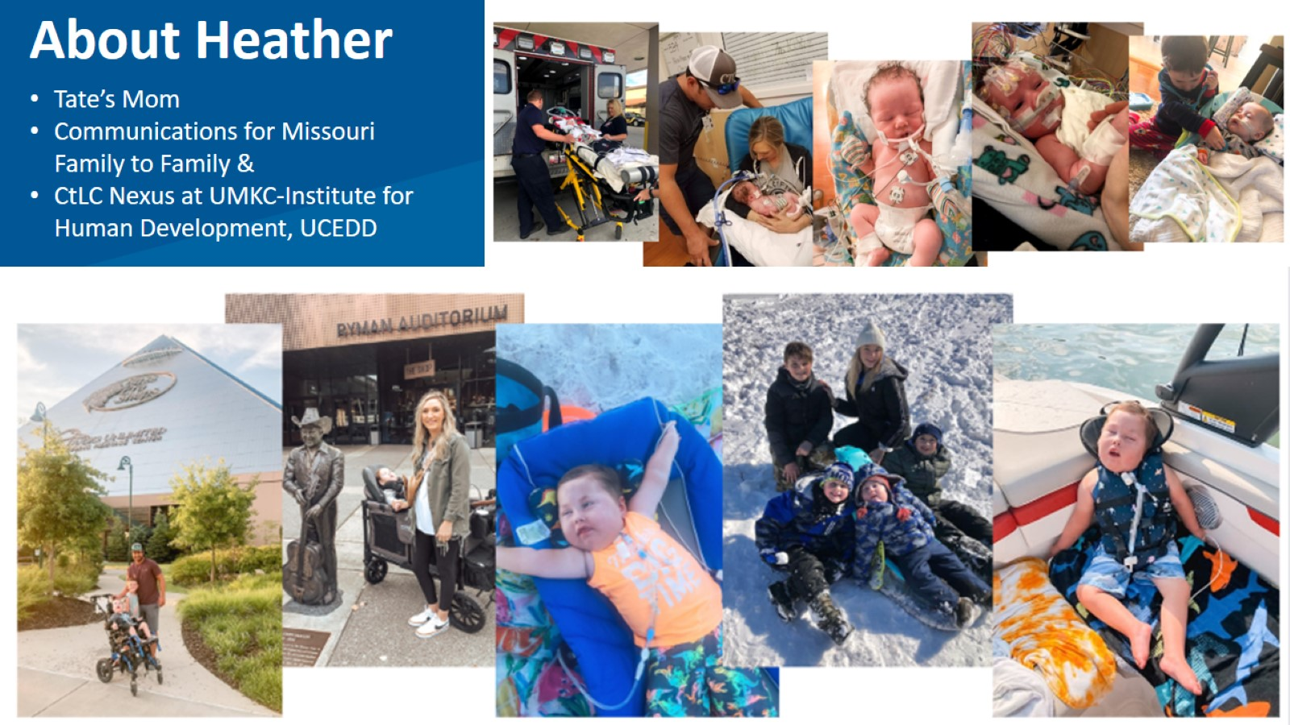
About Heather

Slide 4
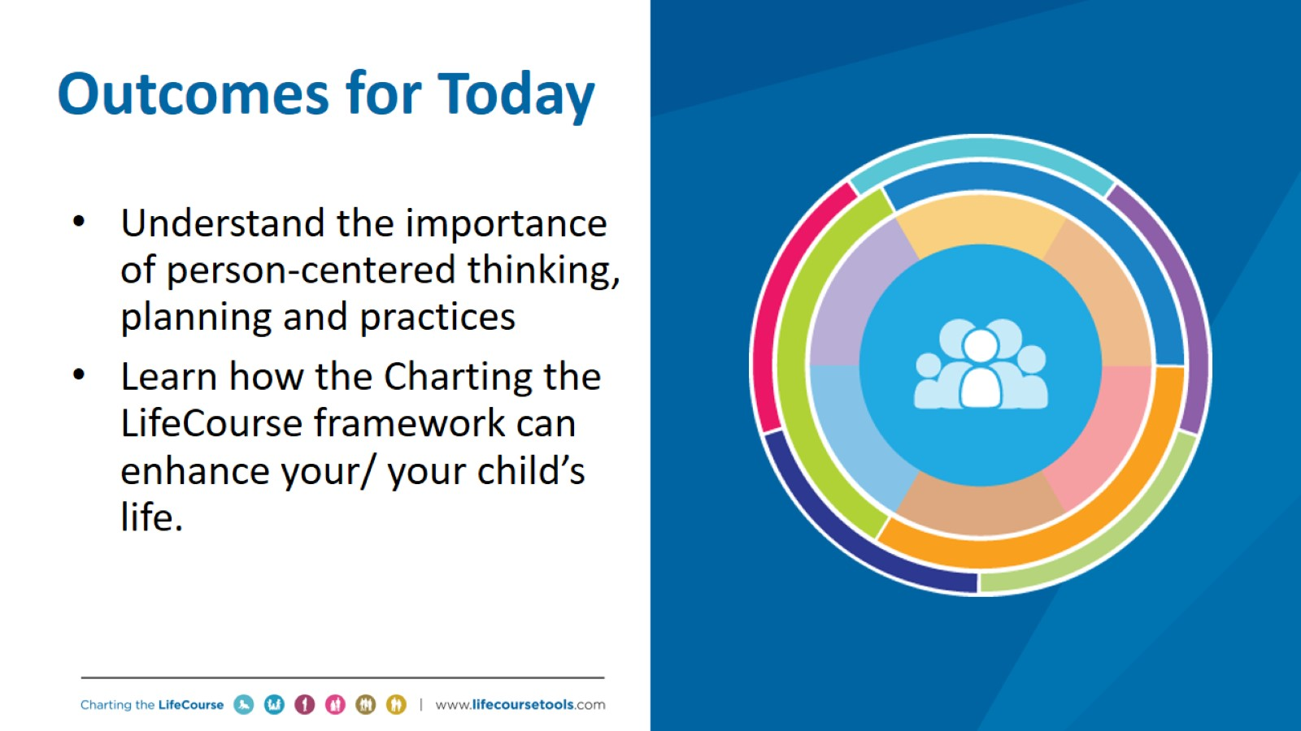
Outcomes for Today

Slide 5

Think About Your Life, Your Favorite Evening Night

Slide 6
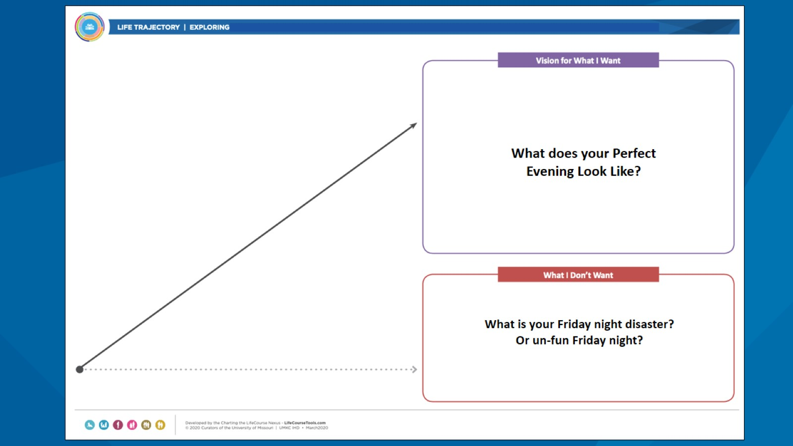

Slide 7
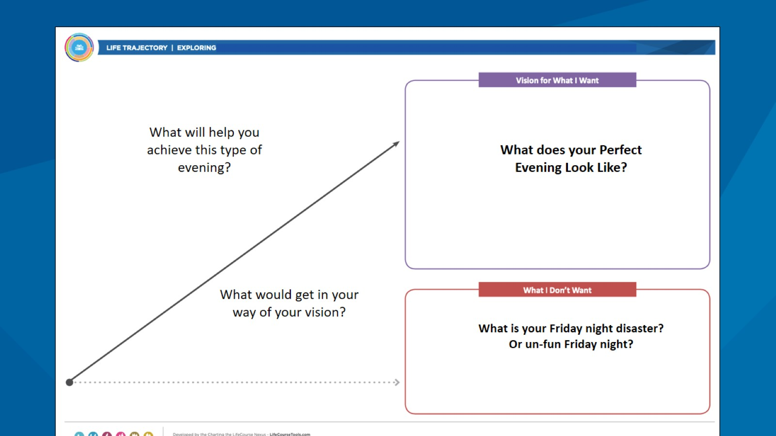

Slide 8
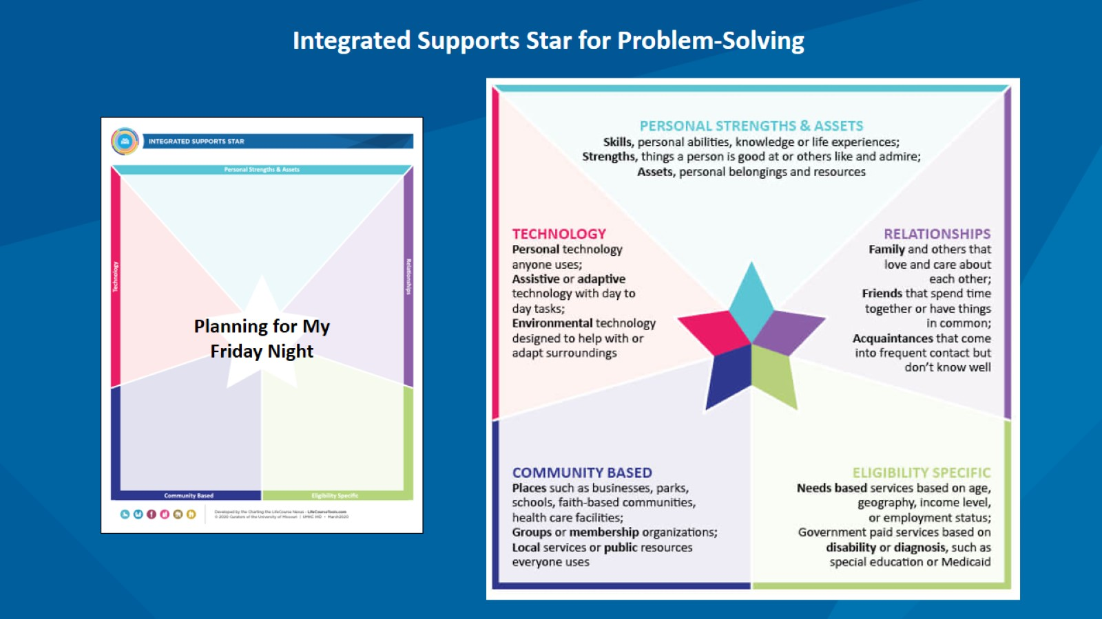

Slide 9
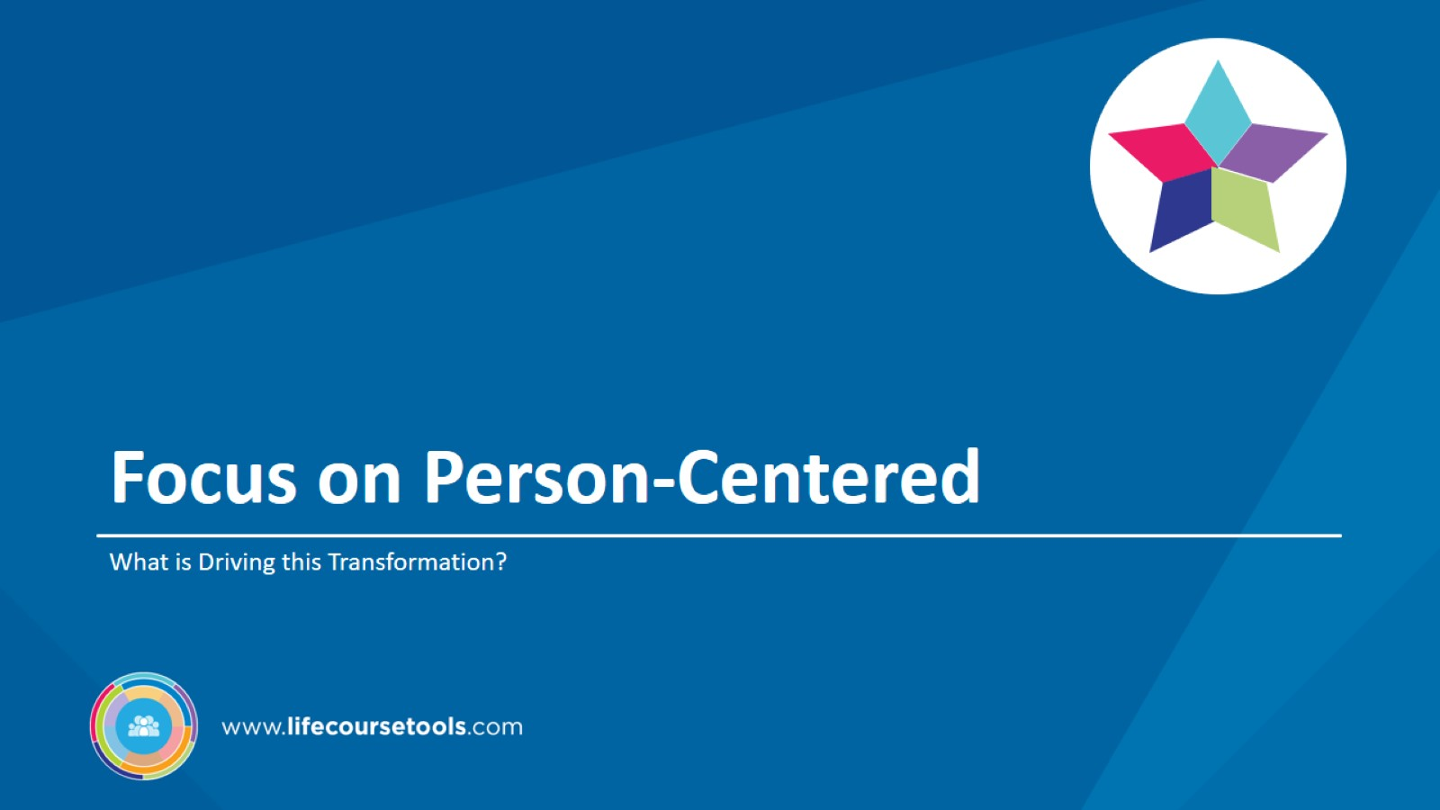
Focus on Person-Centered

Slide 10
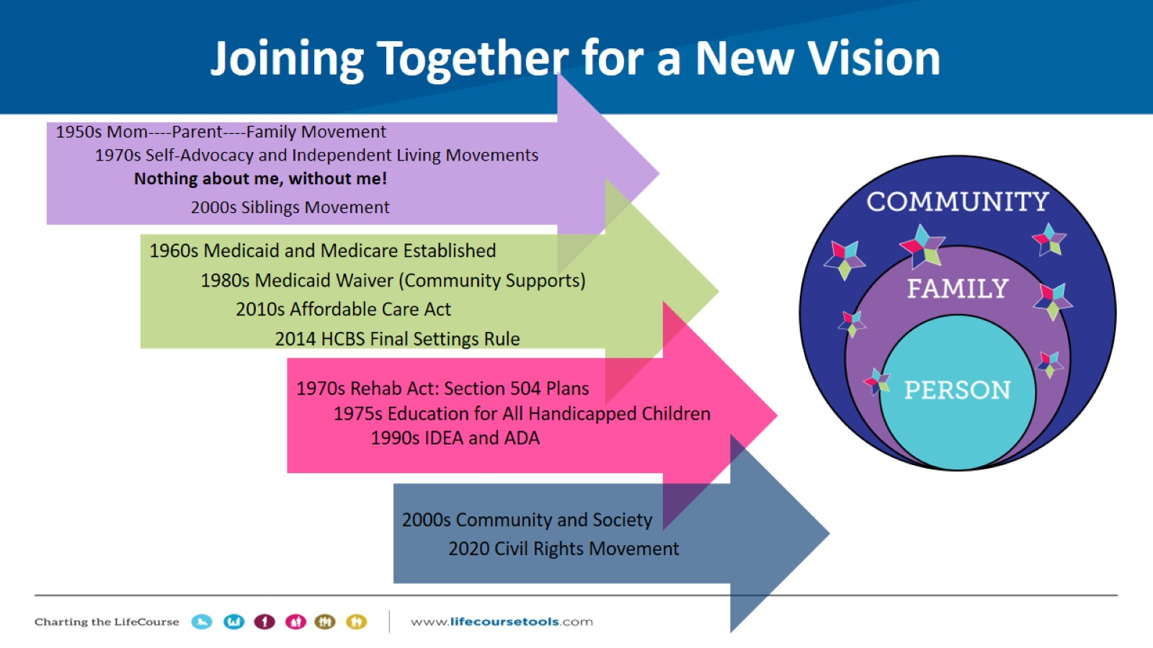
Joining Together for a New Vision

Slide 11
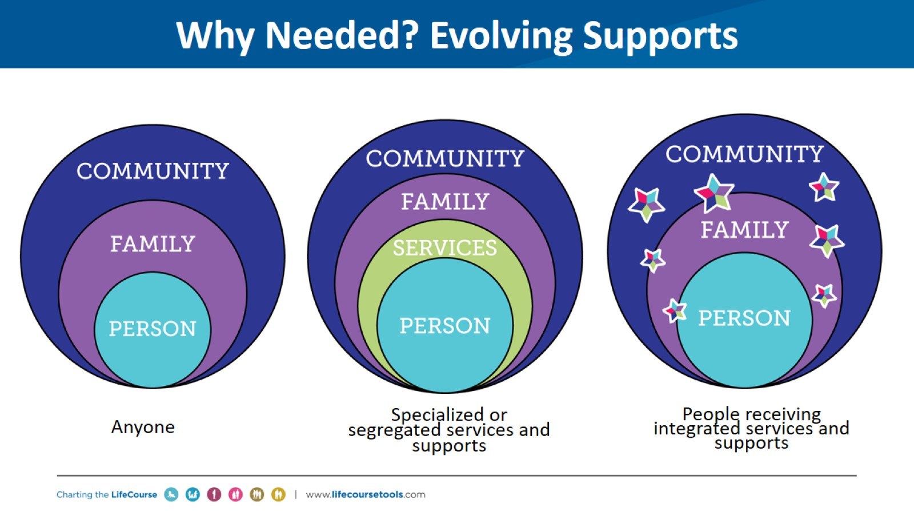
Why Needed? Evolving Supports

Slide 12
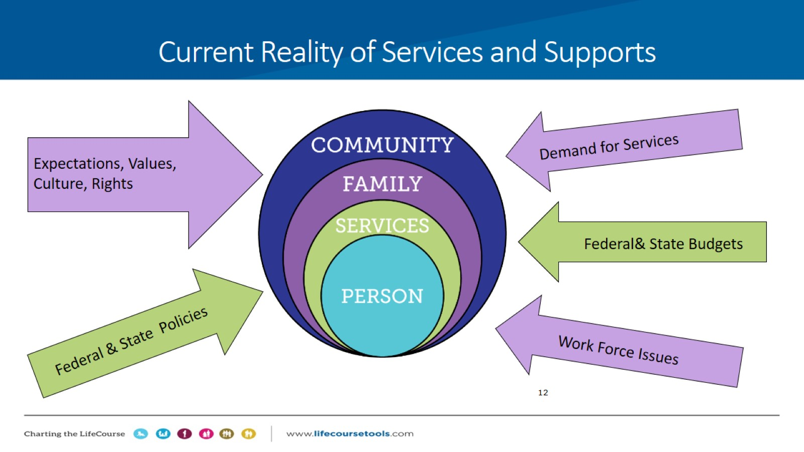

Slide 13
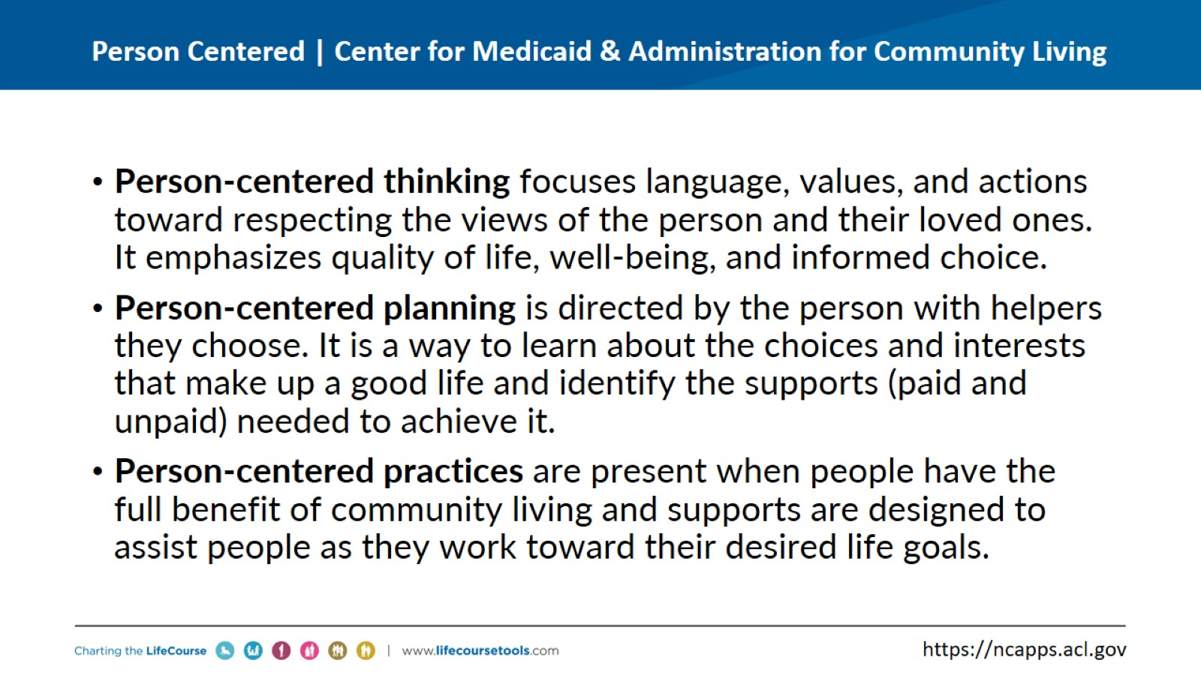
Person Centered | Center for Medicaid & Administration for Community Living

Slide 14
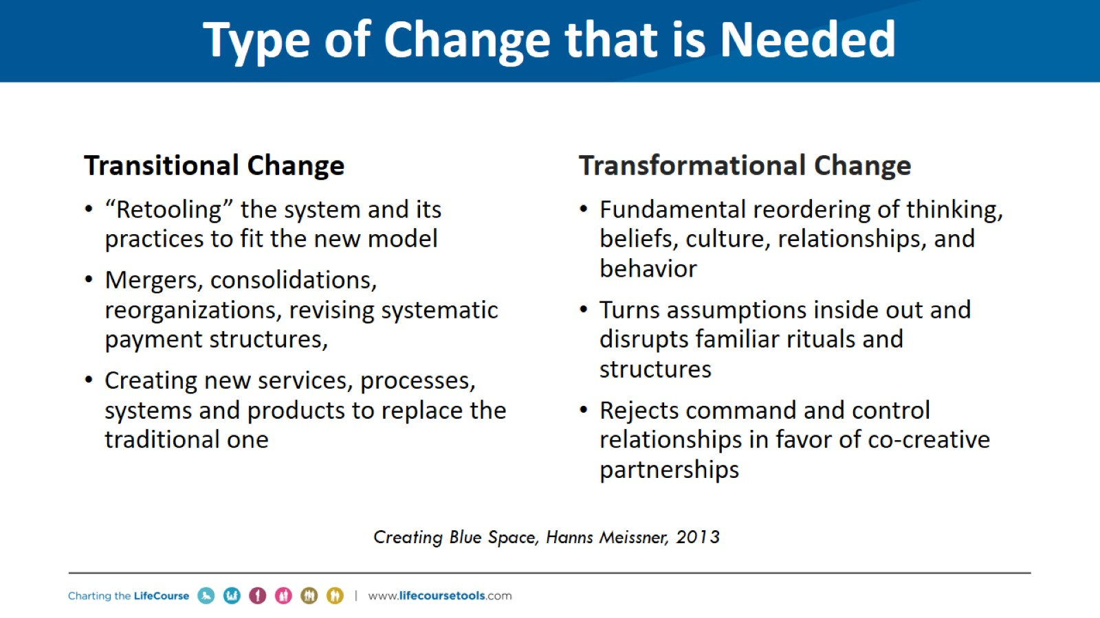
Type of Change that is Needed

Slide 15
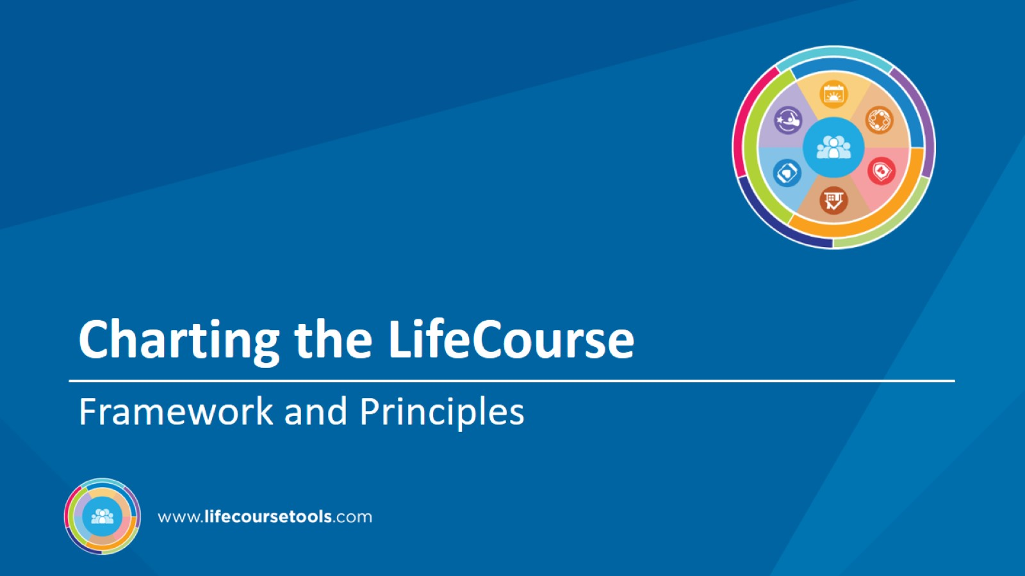
Charting the LifeCourse

Slide 16
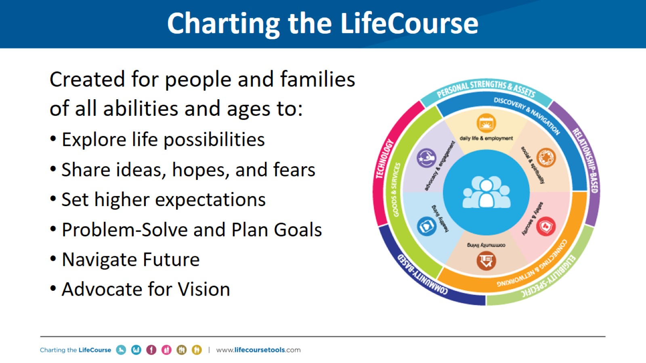
Charting the LifeCourse

Slide 17
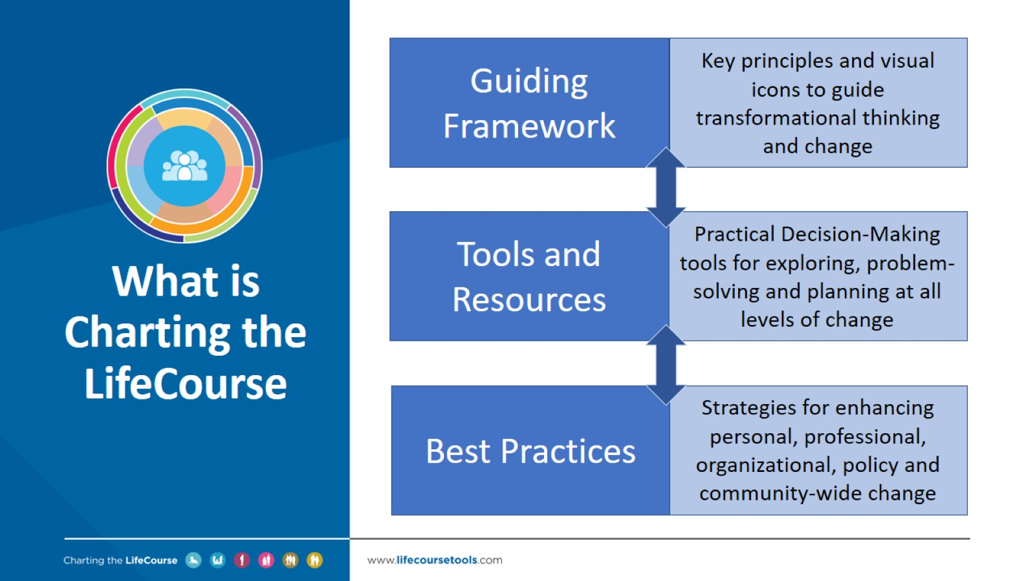
What is
Charting the LifeCourse

Slide 18
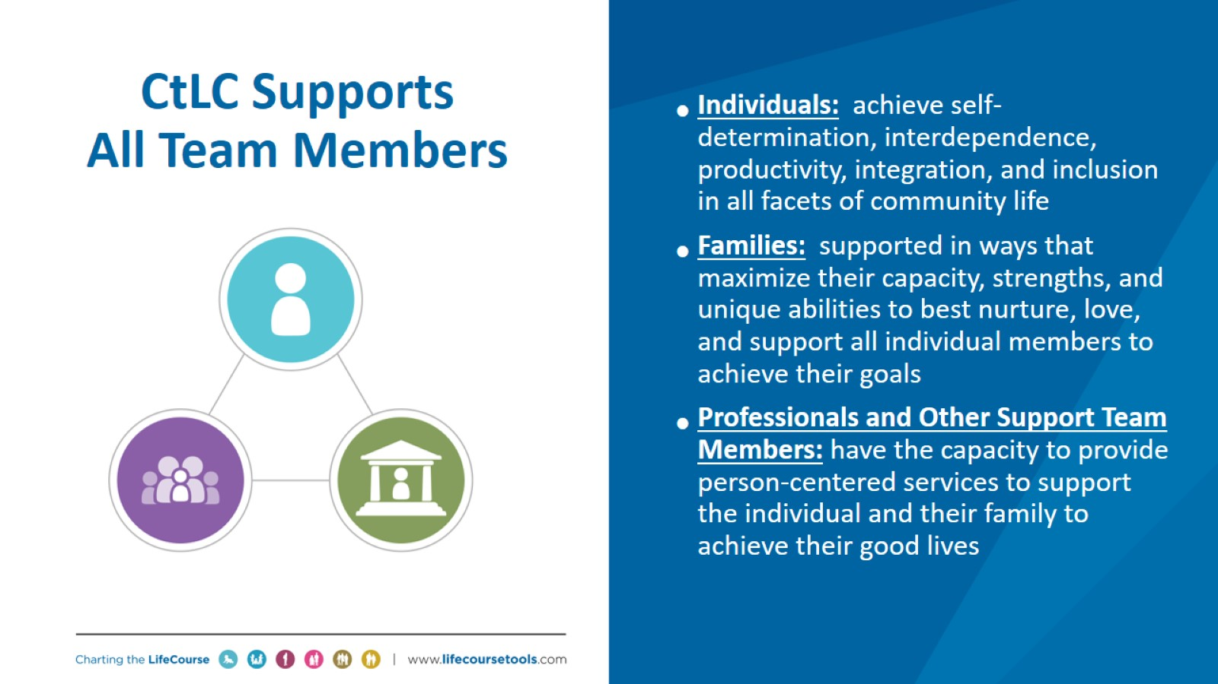
CtLC Supports
All Team Members

Slide 19
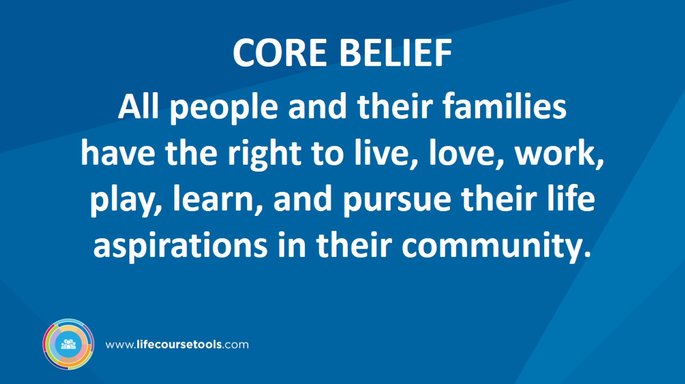
CORE BELIEF

Slide 20
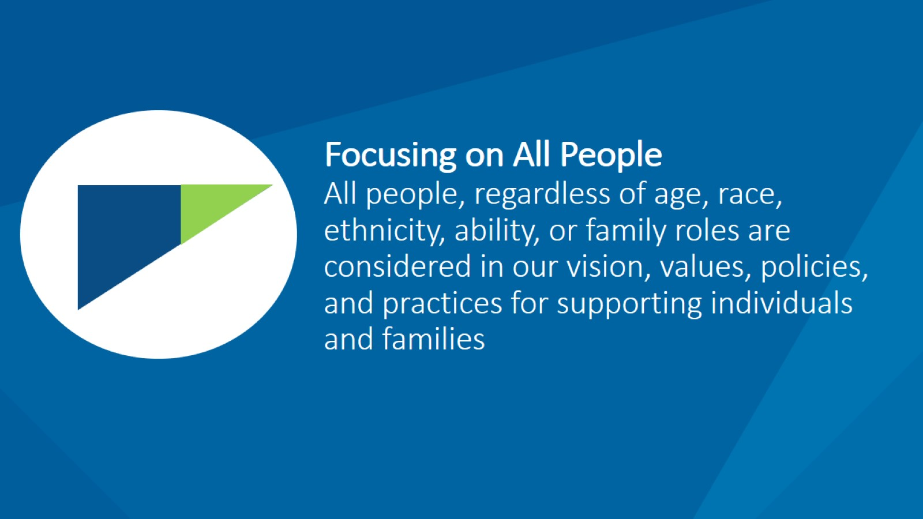
Focusing on All People
All people, regardless of age, race, ethnicity, ability, or family roles are considered in our vision, values, policies, and practices for supporting individuals and families

Slide 21
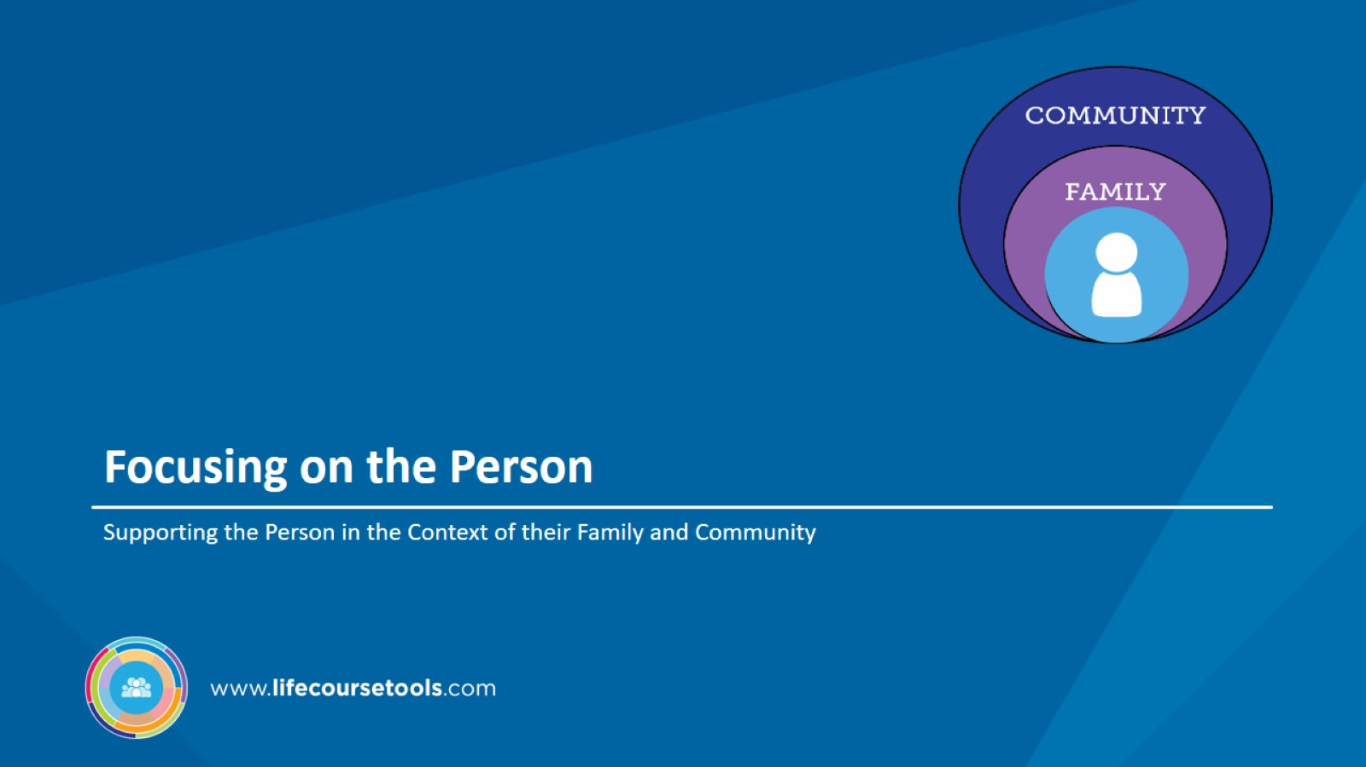
Focusing on the Person

Slide 22
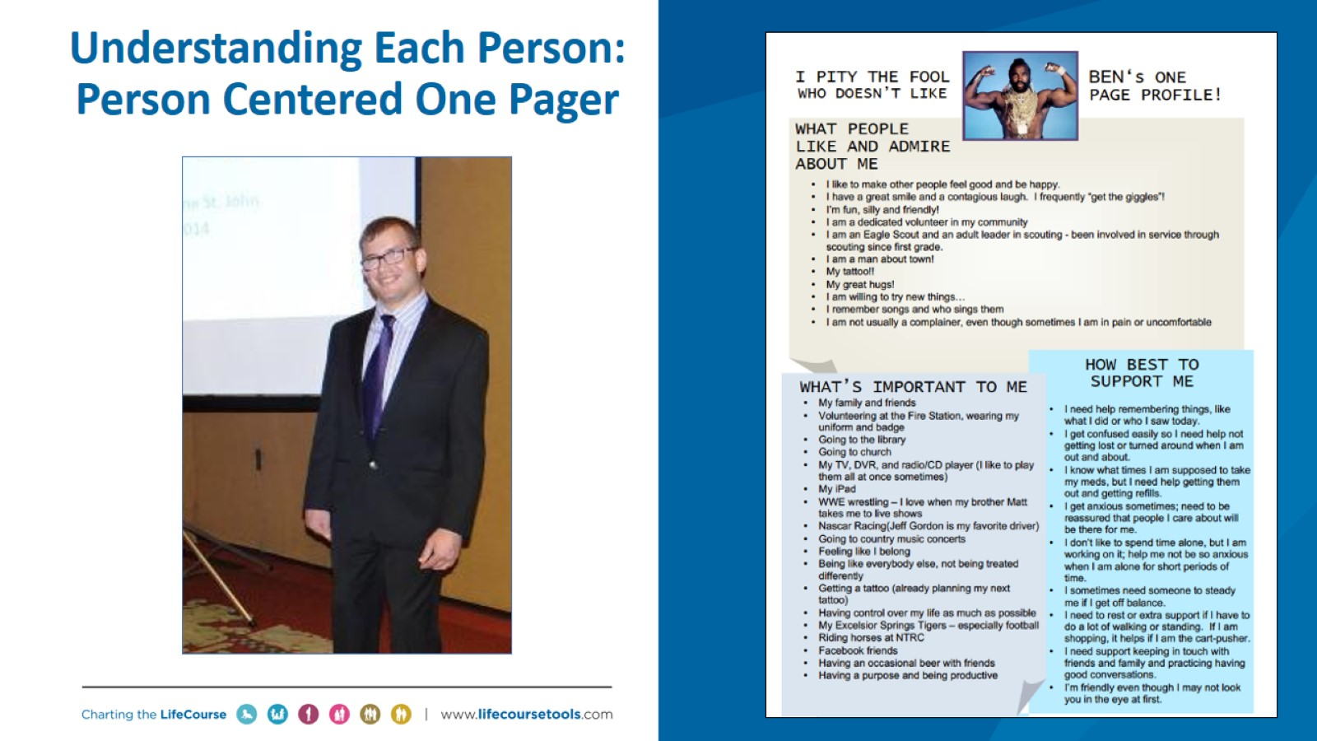
Understanding Each Person:
Person Centered One Pager

Slide 23
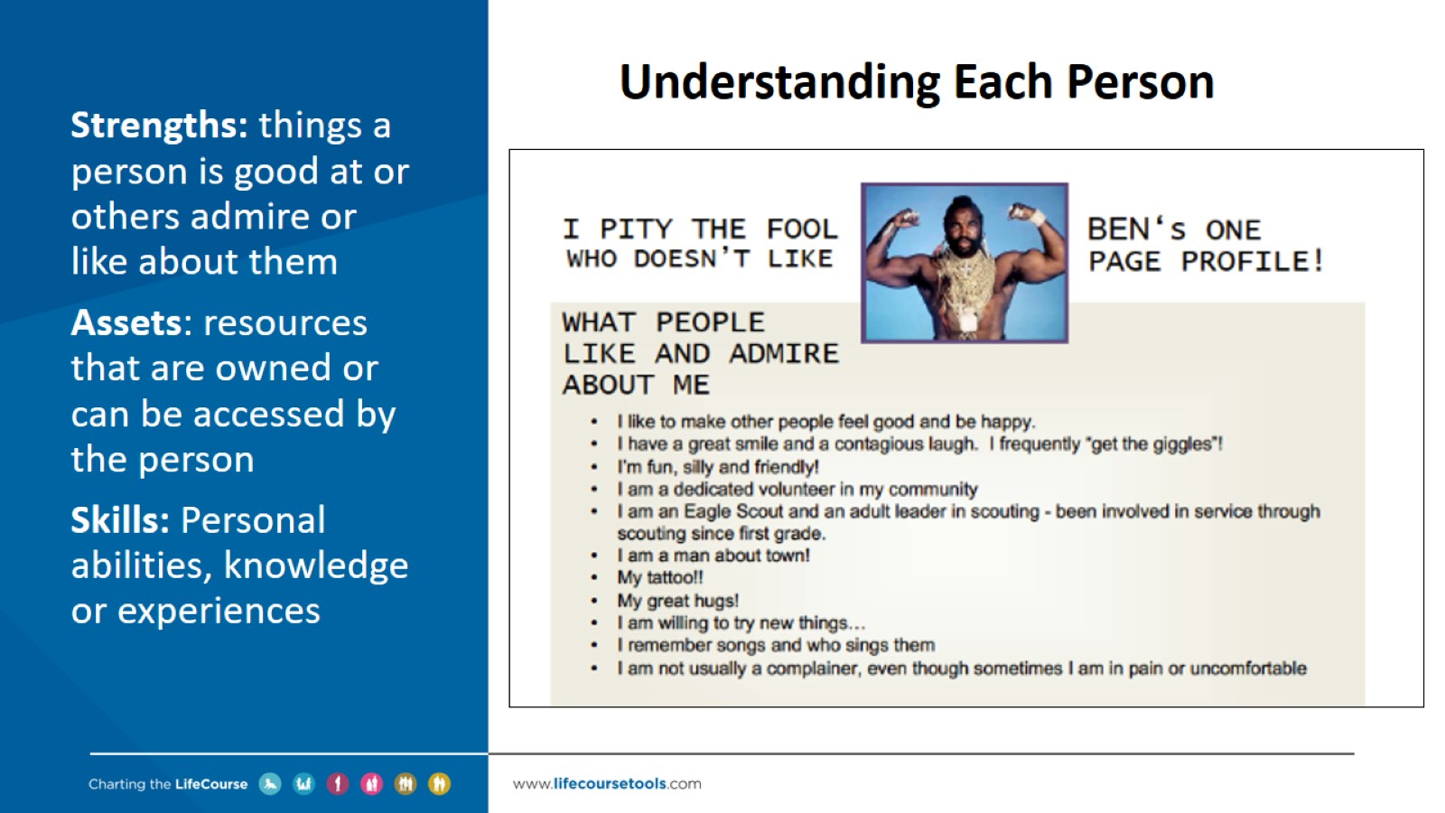
Understanding Each Person

Slide 24
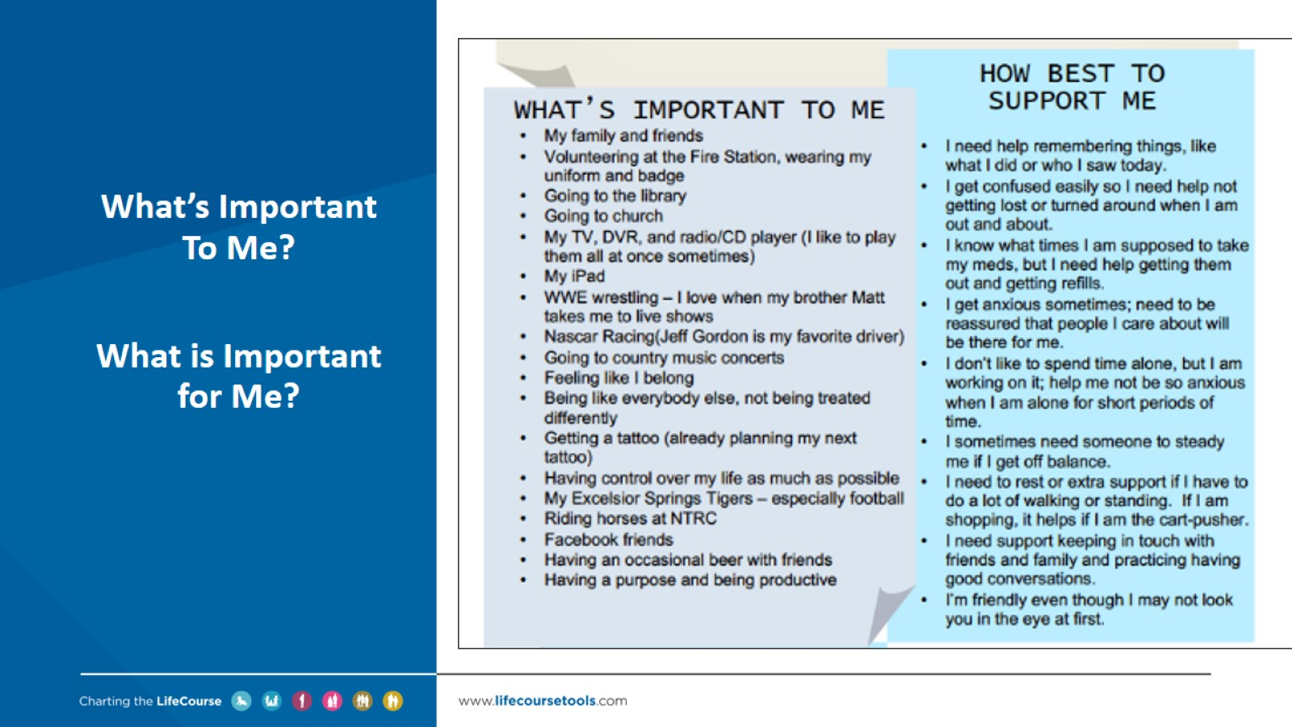

Slide 25
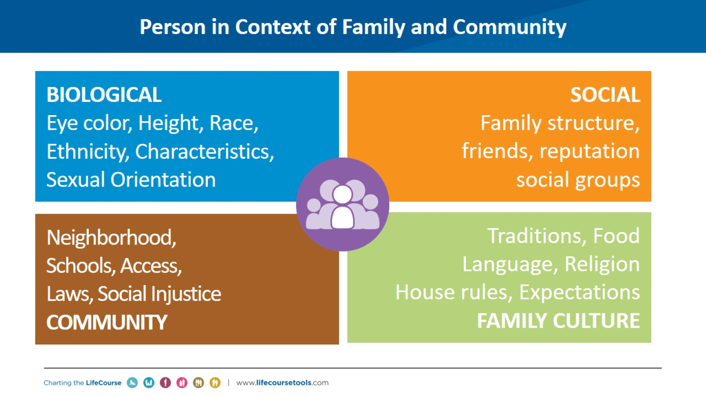
Person in Context of Family and Community

Slide 26
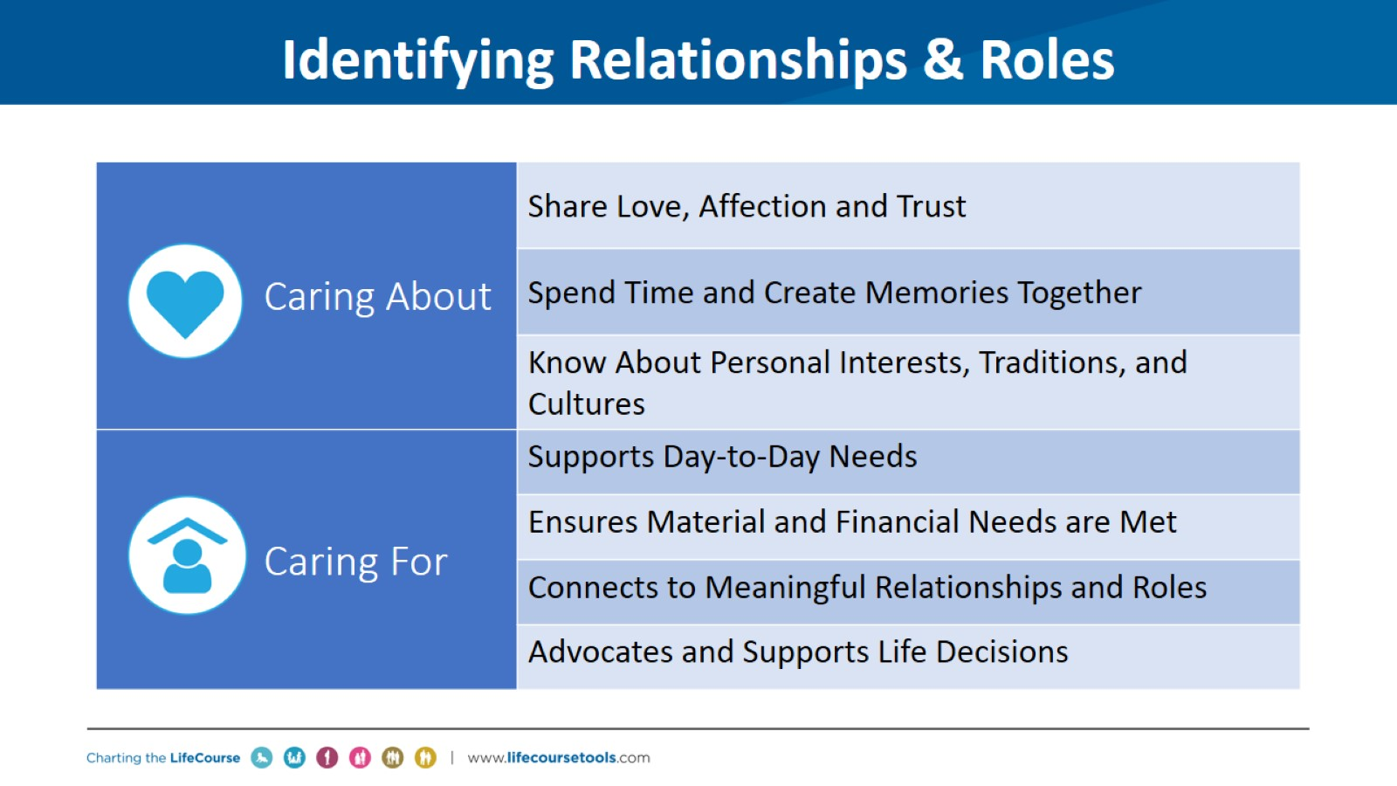
Identifying Relationships & Roles

Slide 27
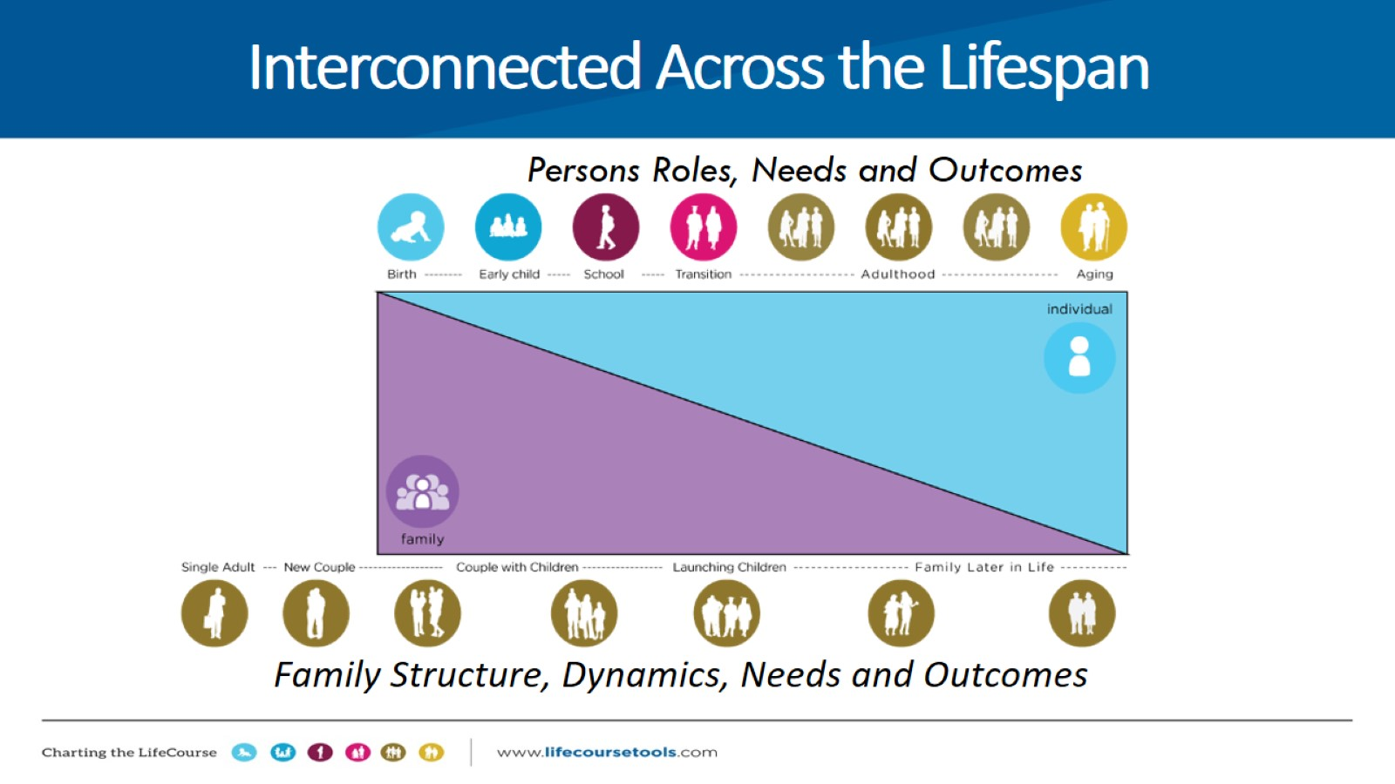
Family Structure, Dynamics, Needs and Outcomes

Slide 28

Focusing on 3 Buckets of Needs

Slide 29
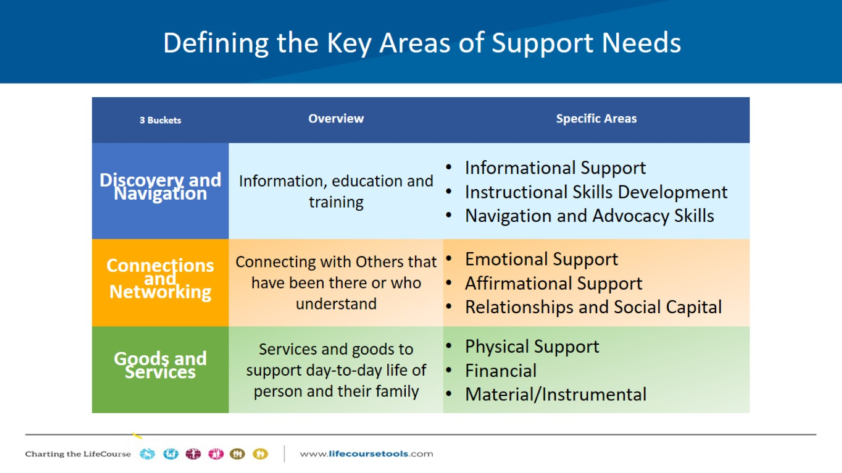
Defining the Key Areas of Support Needs

Slide 30
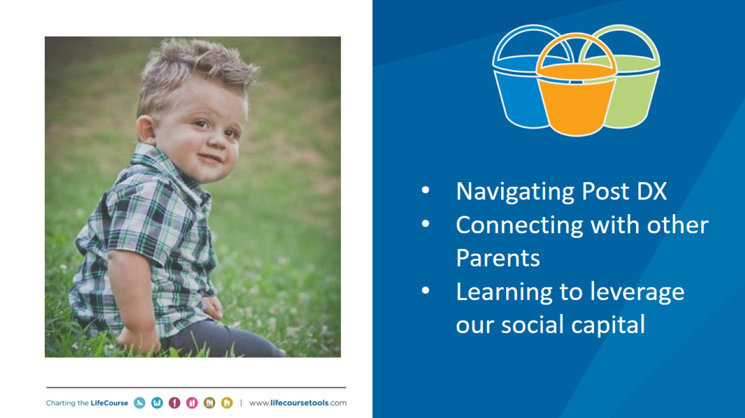

Slide 31
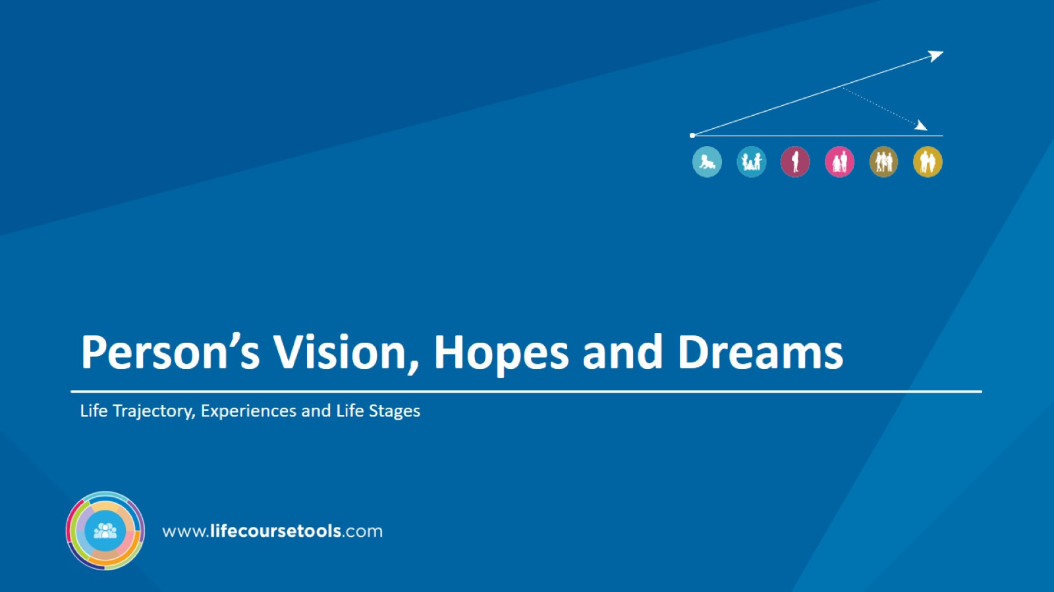
Person’s Vision, Hopes and Dreams

Slide 32
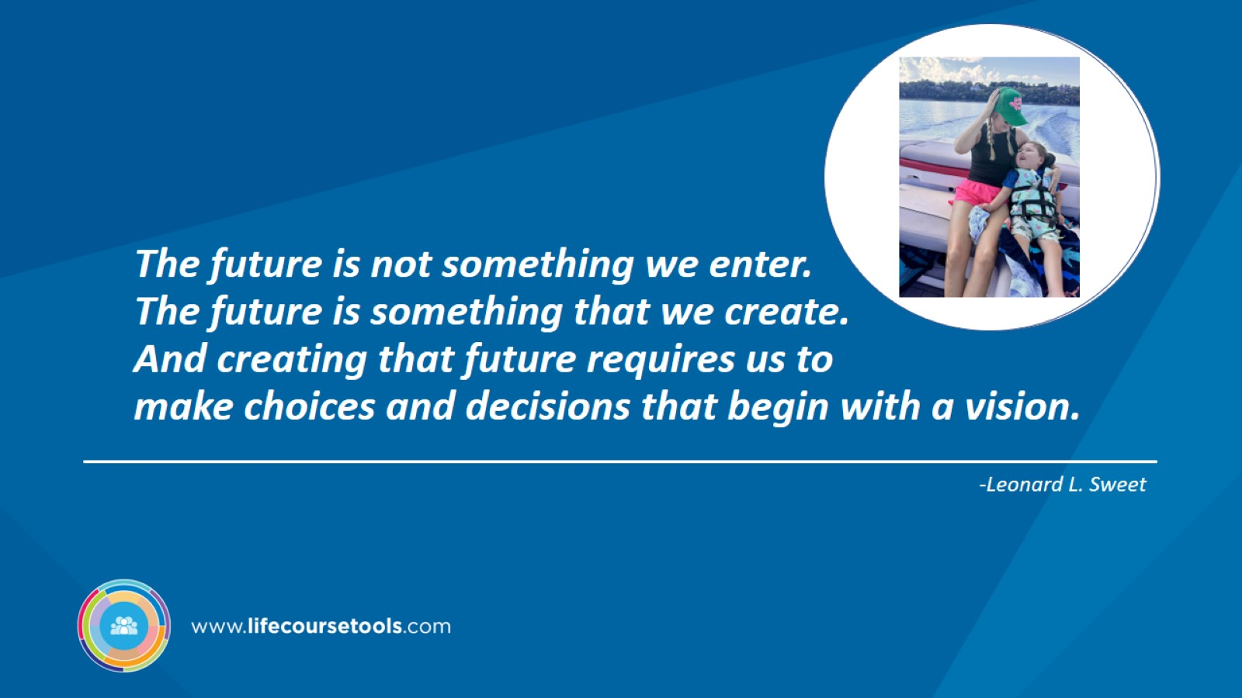
The future is not something we enter.
The future is something that we create.
And creating that future requires us to make choices and decisions that begin with a vision.

Slide 33
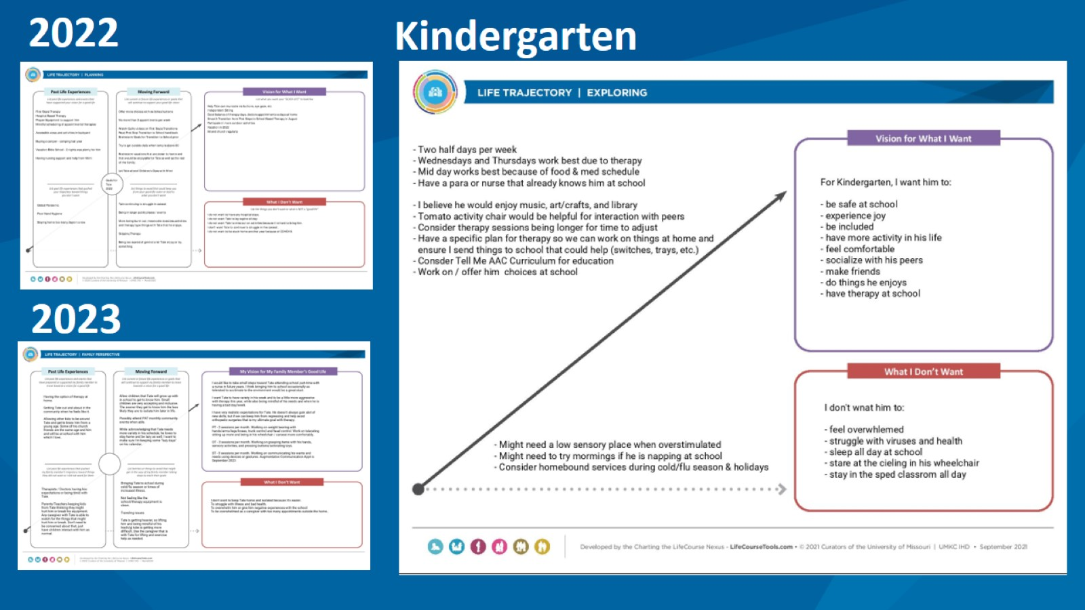

Slide 34
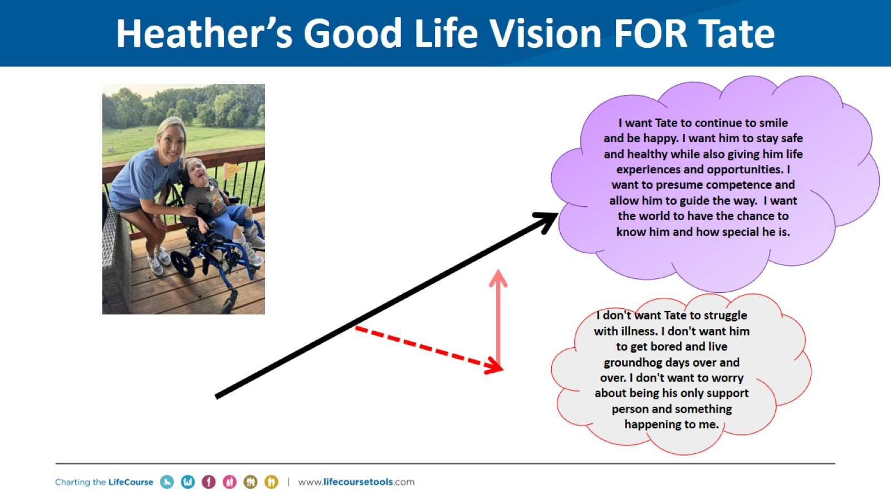
Heather’s Good Life Vision FOR Tate

Slide 35
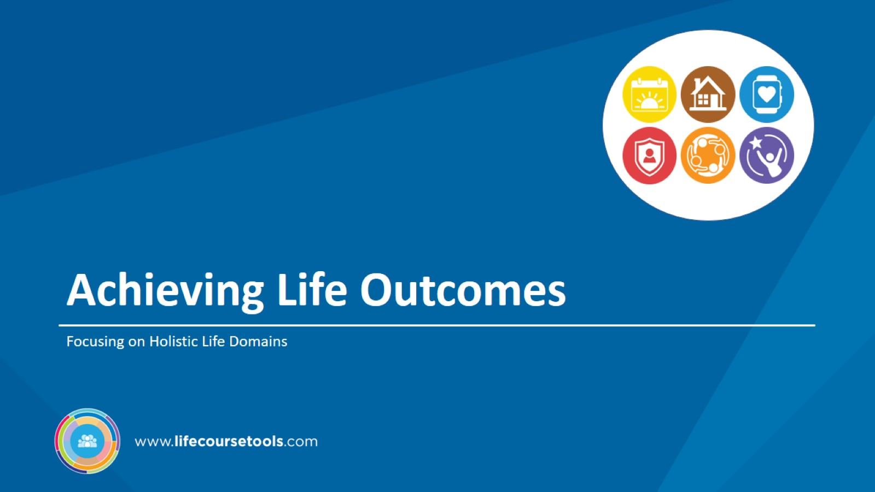
Achieving Life Outcomes

Slide 36
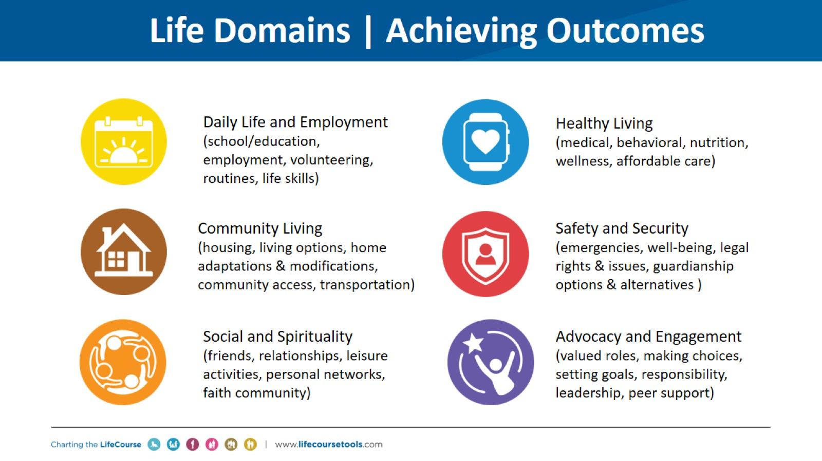
Life Domains | Achieving Outcomes

Slide 37
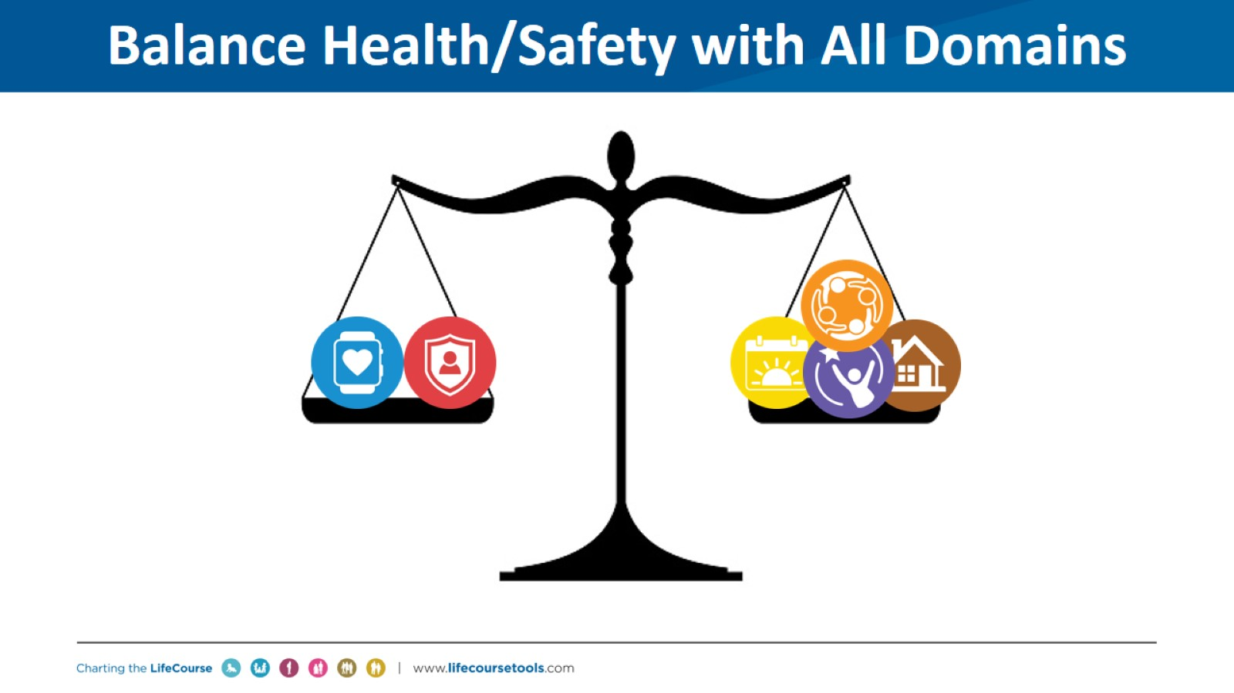
Balance Health/Safety with All Domains

Slide 38
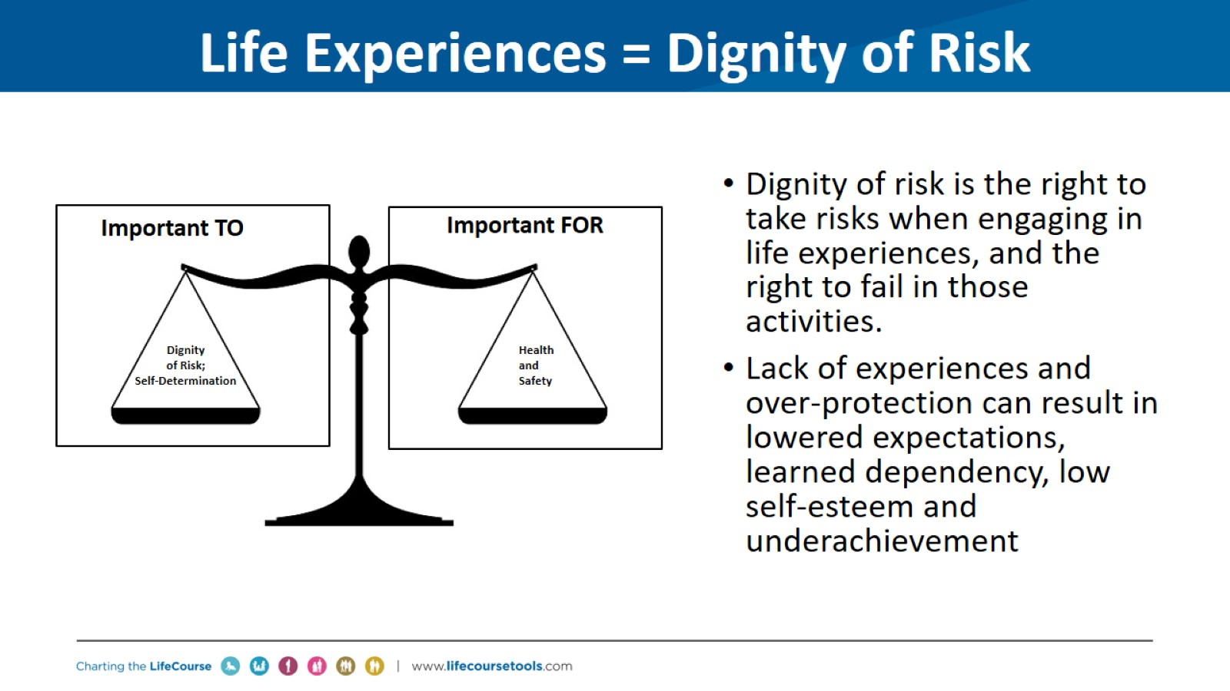
Life Experiences = Dignity of Risk

Slide 39
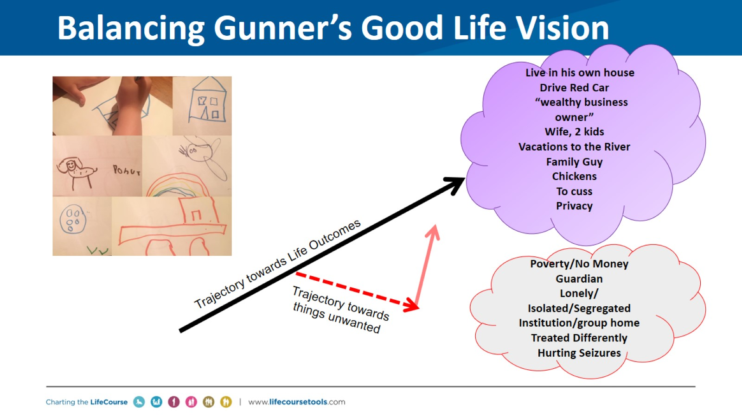
Balancing Gunner’s Good Life Vision

Slide 40
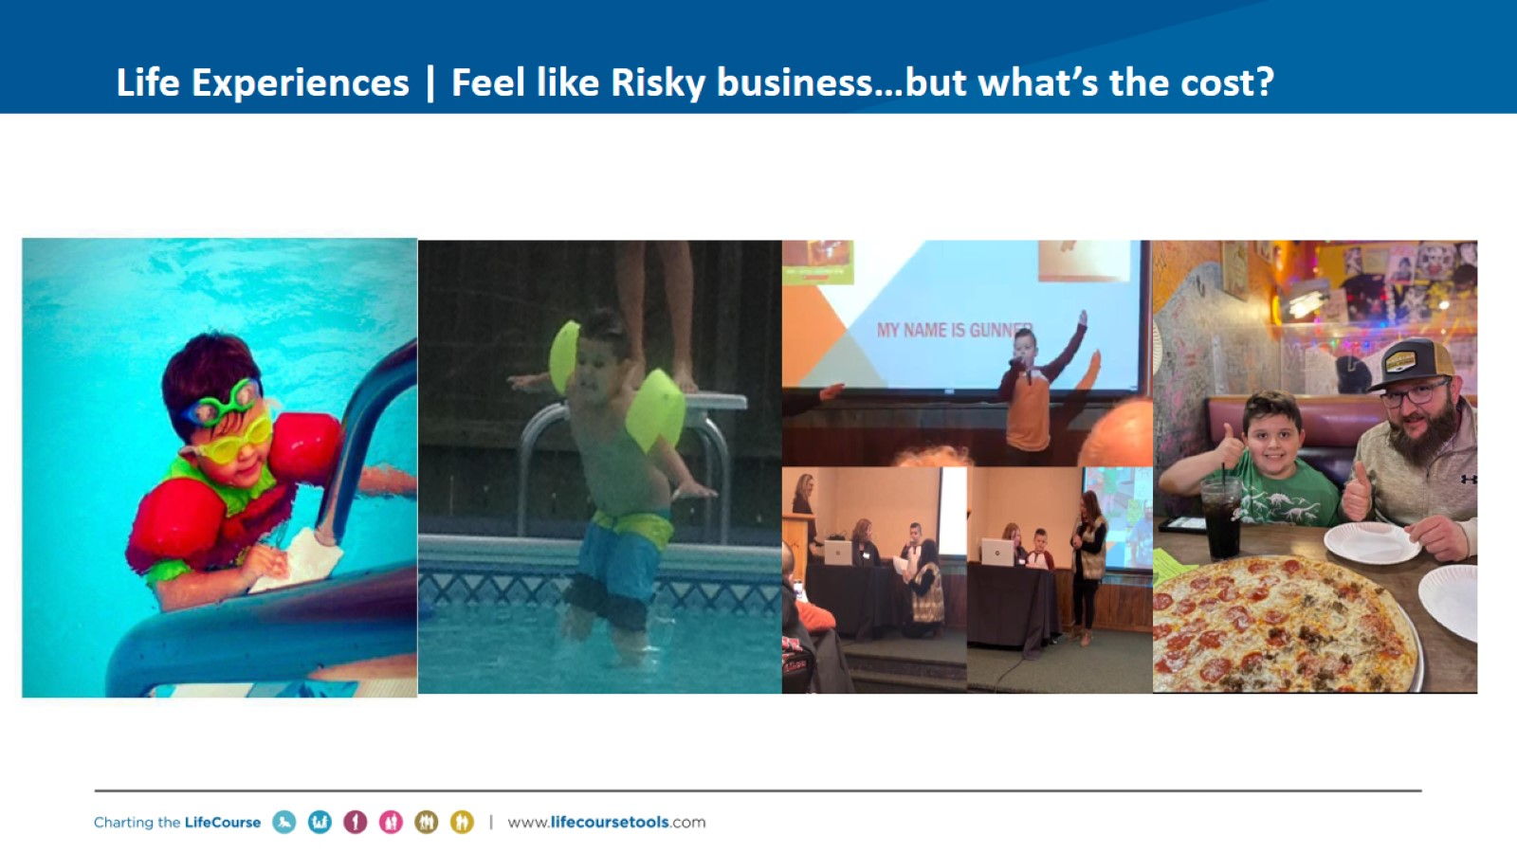
Life Experiences | Feel like Risky business…but what’s the cost?

Slide 41
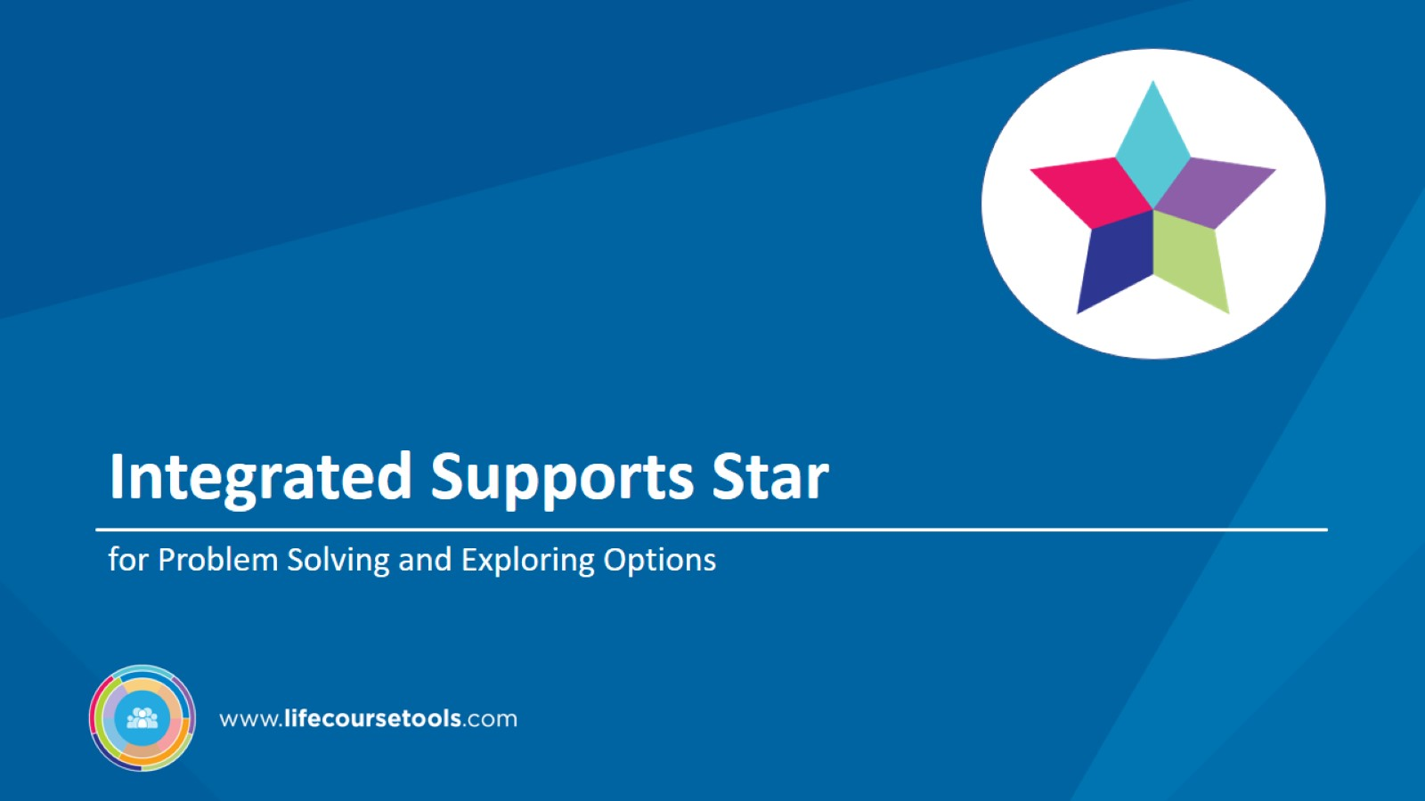
Integrated Supports Star

Slide 42
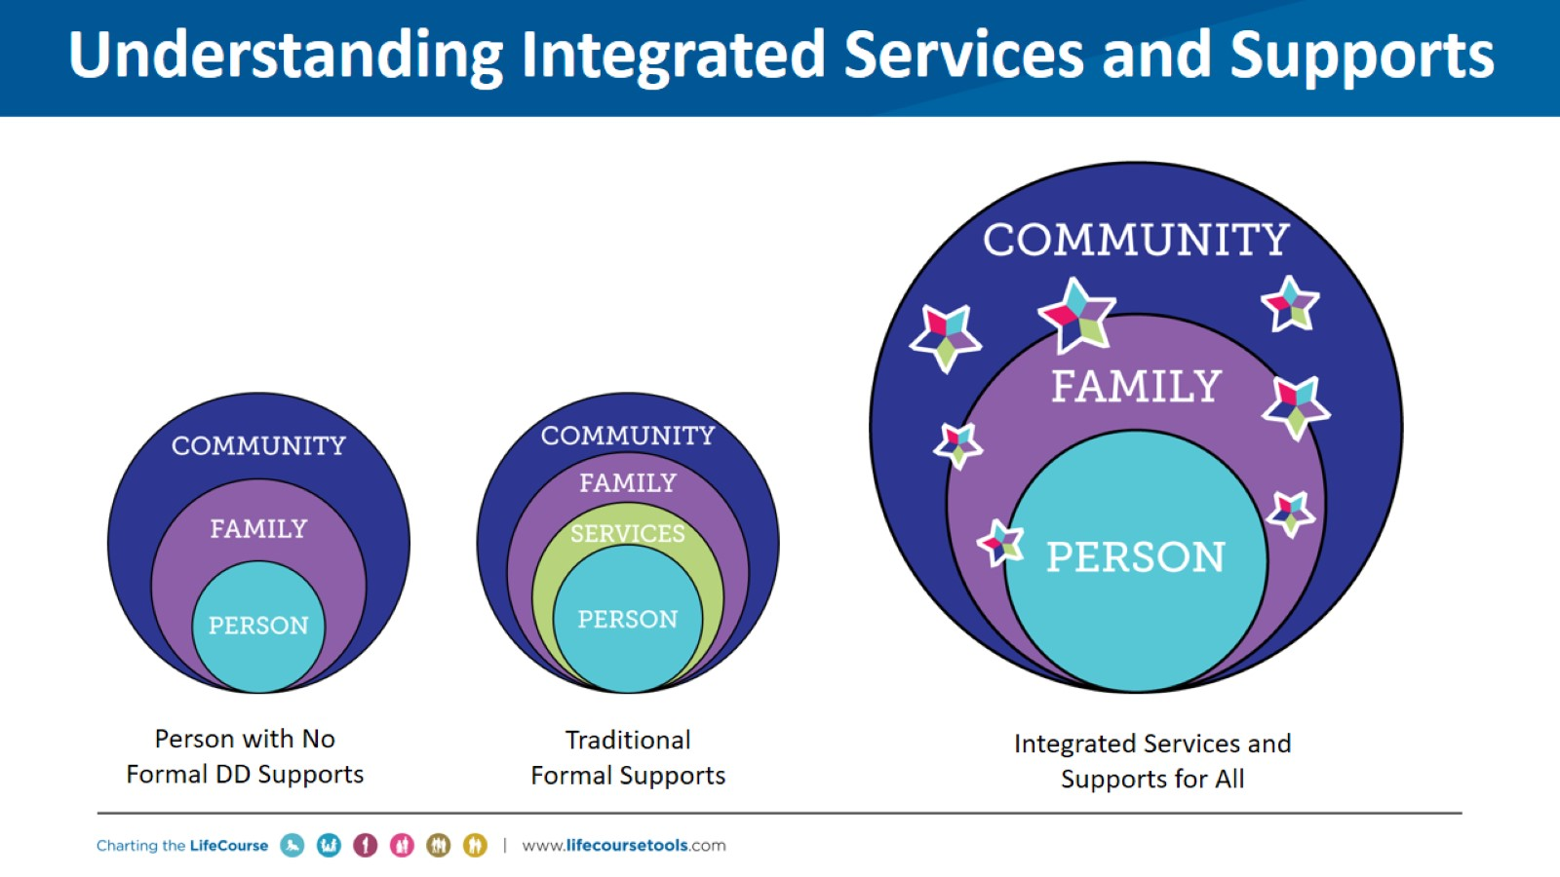
Understanding Integrated Services and Supports

Slide 43
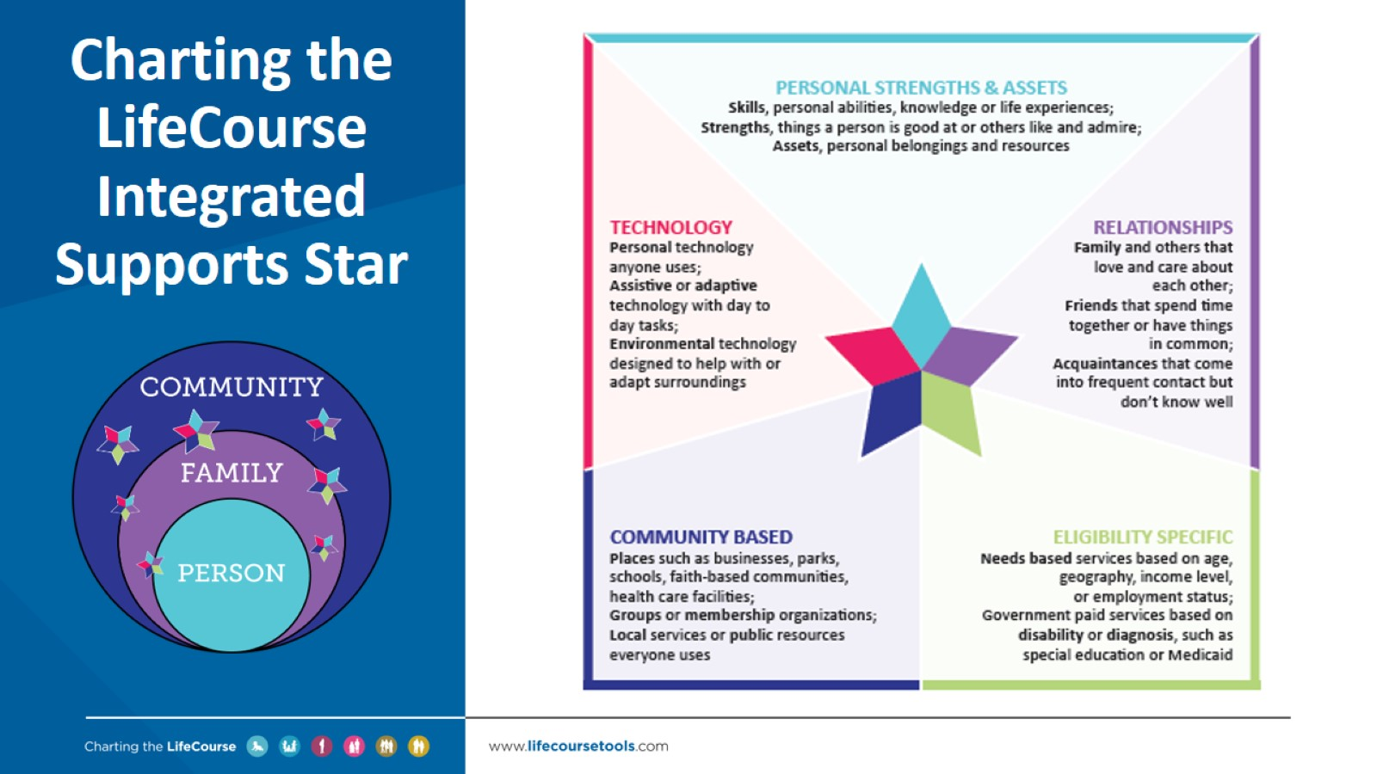
Charting the LifeCourse Integrated Supports Star

Slide 44
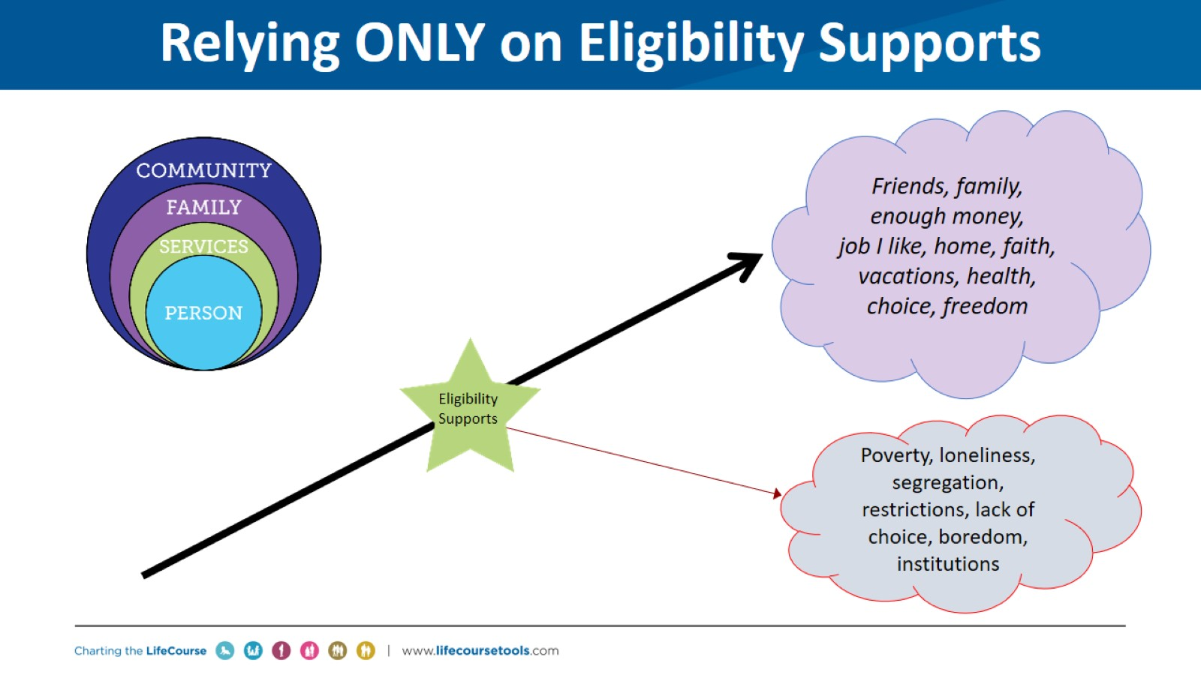
Relying ONLY on Eligibility Supports

Slide 45
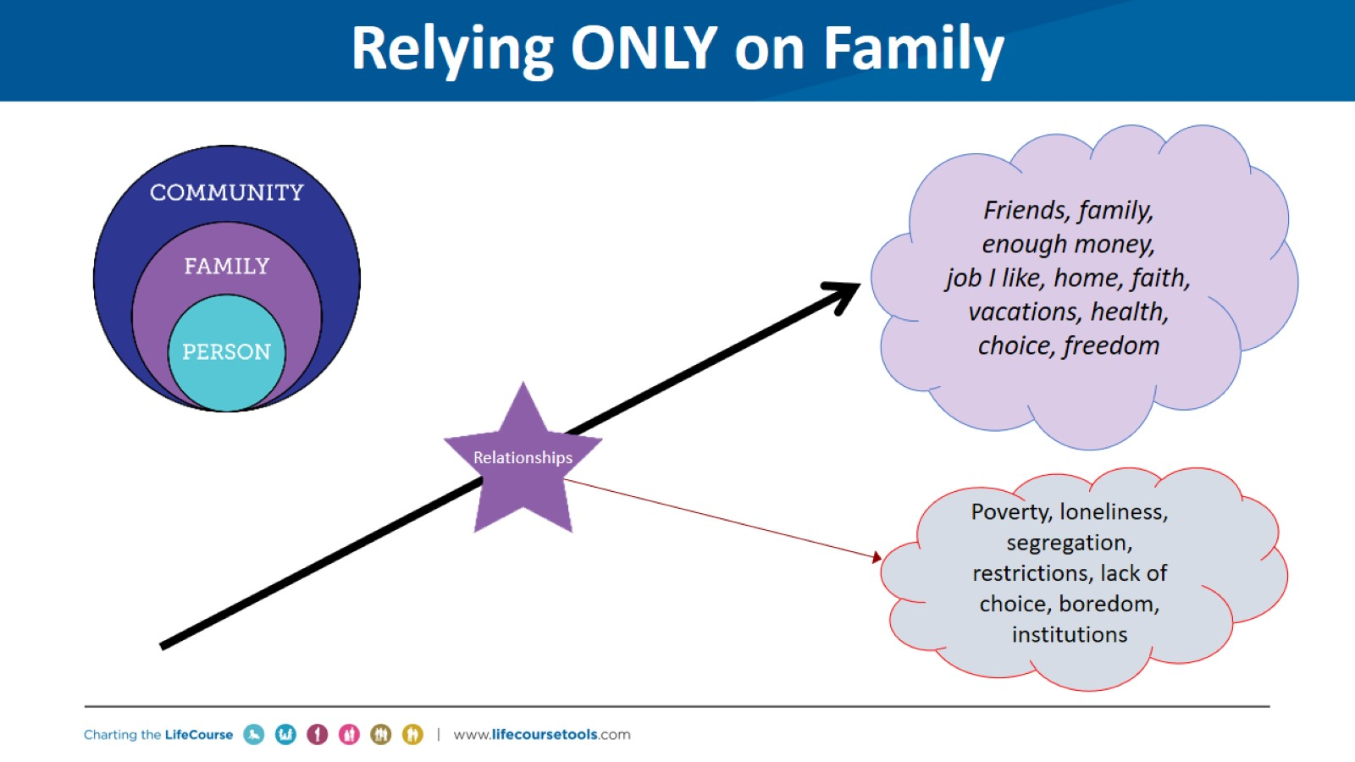
Relying ONLY on Family

Slide 46
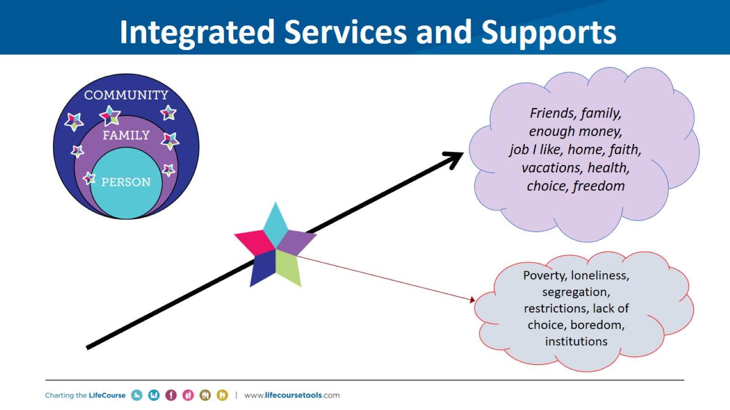
Integrated Services and Supports

Slide 47
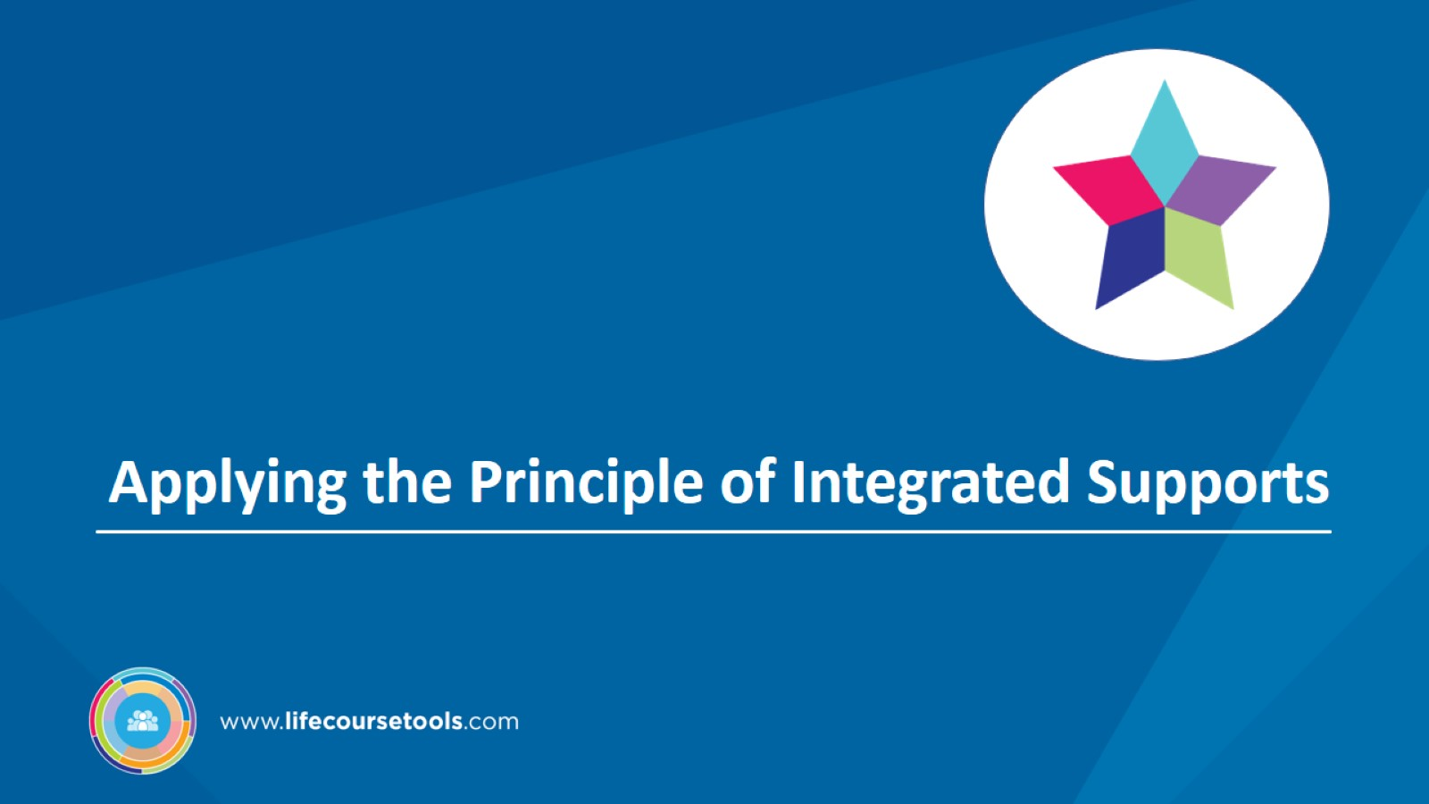
Applying the Principle of Integrated Supports

Slide 48
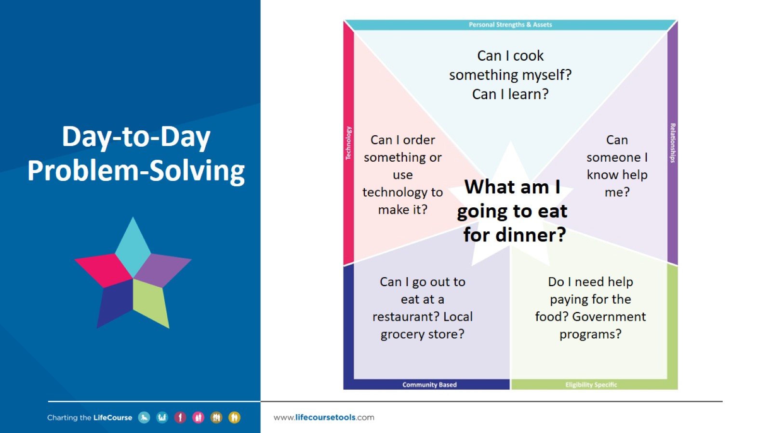
Day-to-Day Problem-Solving

Slide 49
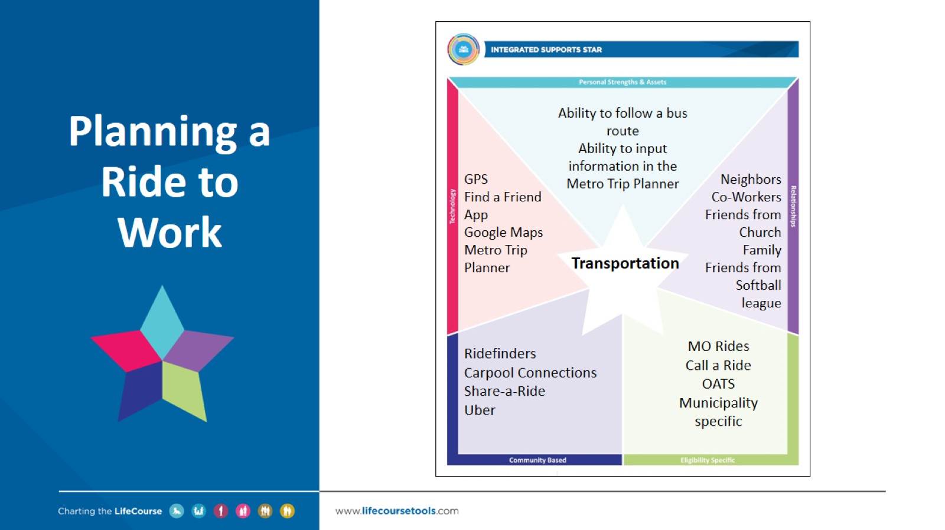
Planning a Ride to Work

Slide 50
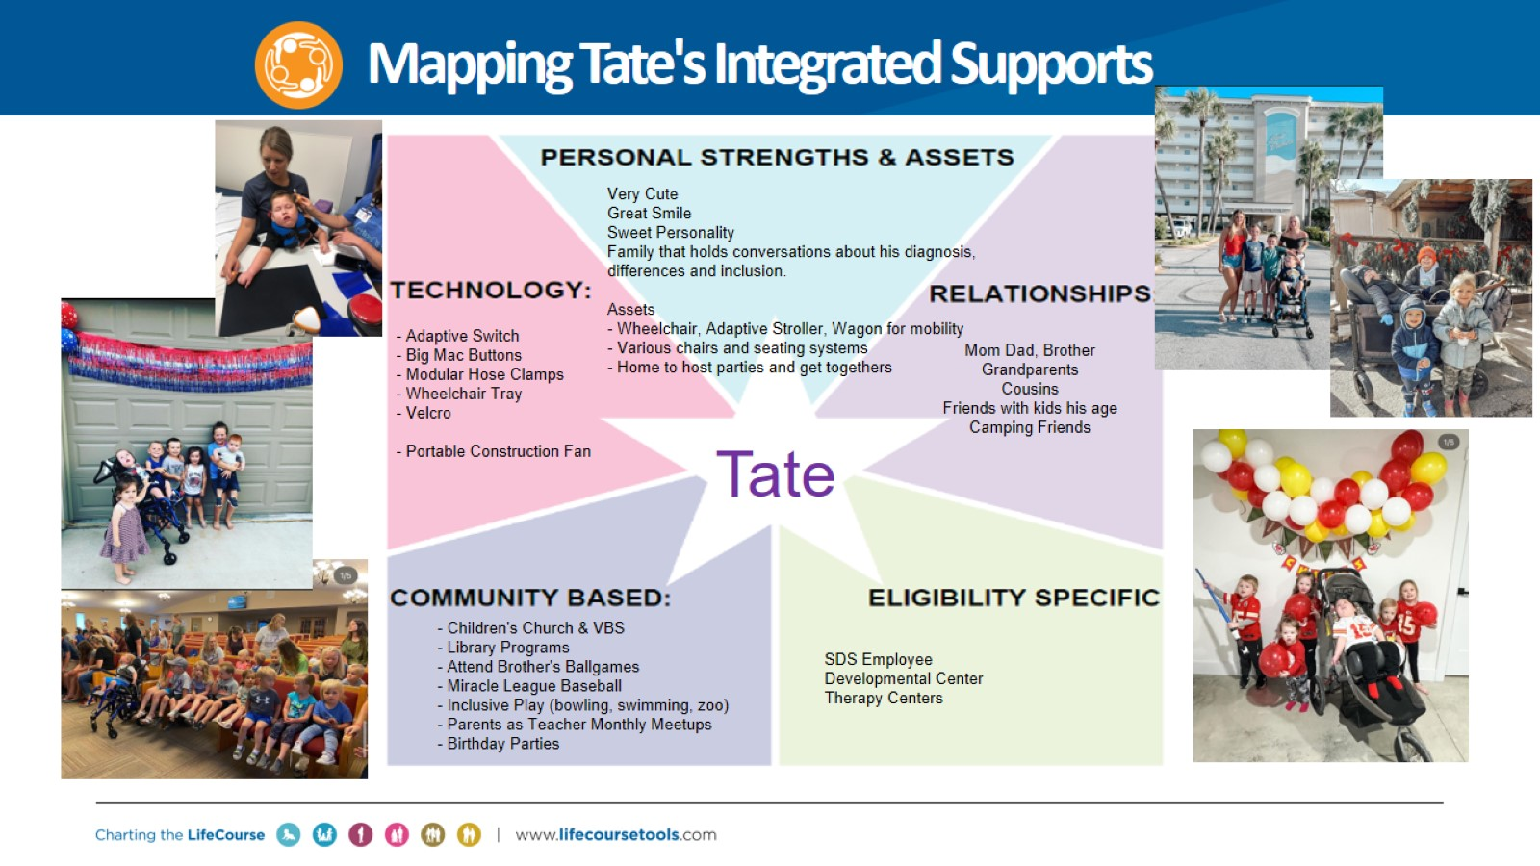
Mapping Tate's Integrated Supports

Slide 51
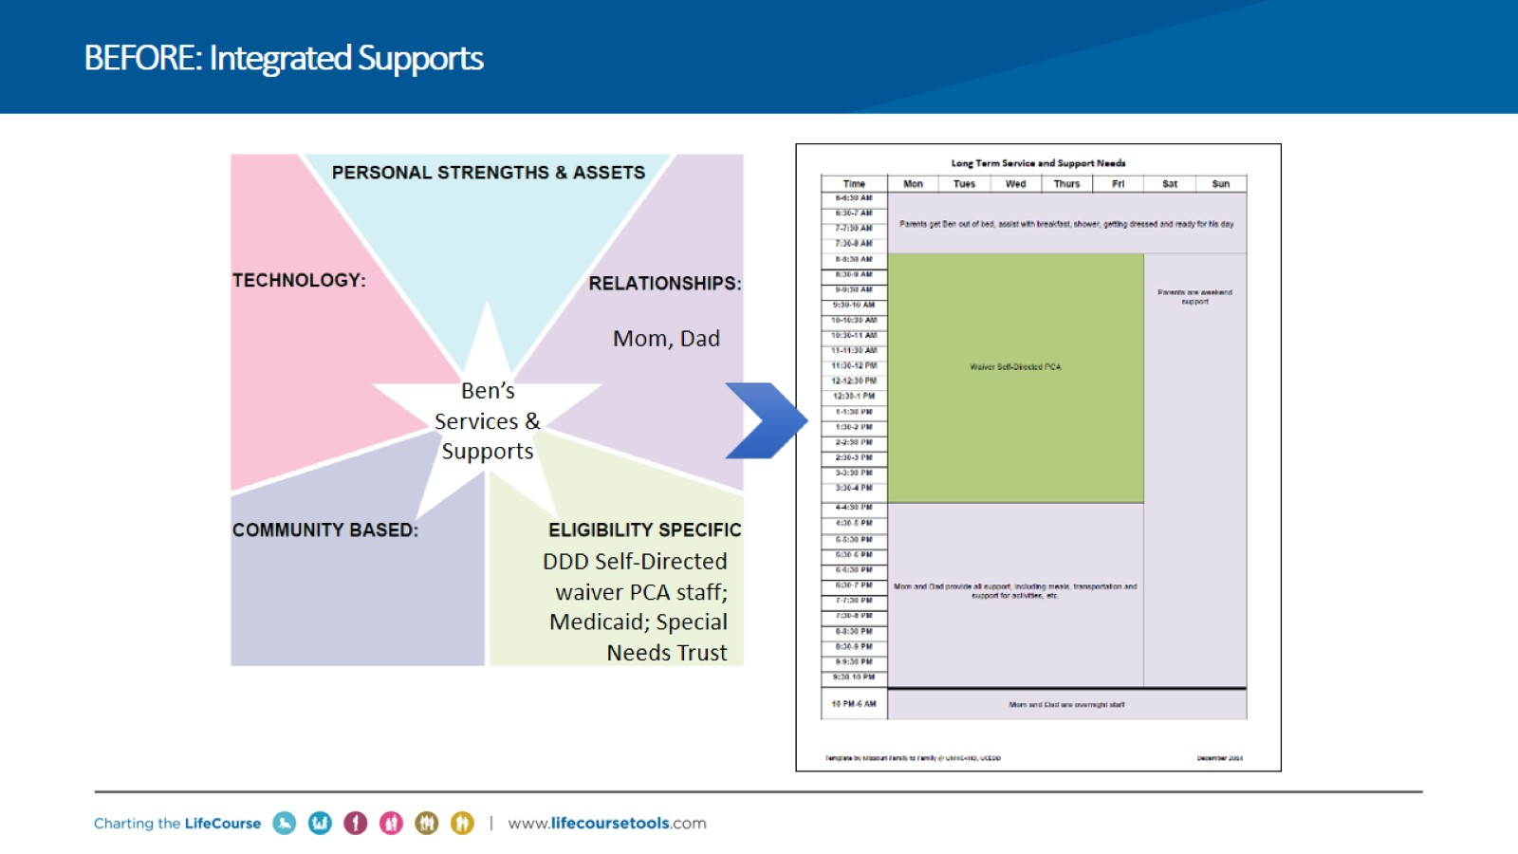
BEFORE: Integrated Supports

Slide 52
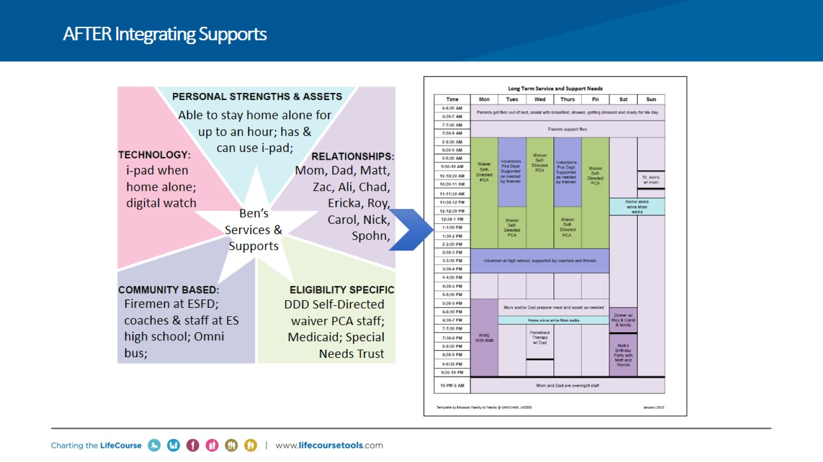
AFTER Integrating Supports

Slide 53

Fostering Transformational Change

Slide 54

Transformation at All Levels

Slide 55

Human-Centric Approach Utilized Across Systems

Slide 56


Slide 57


Slide 58

Reflections, Q&A and Thank You

