Slide 1
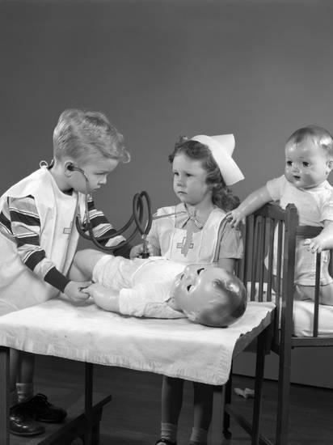

Medical Coverage for Children with Disabilities
2023 Family Partnership Parent & Caregiver Retreat:
Navigating Unchartered Waters

Slide 2
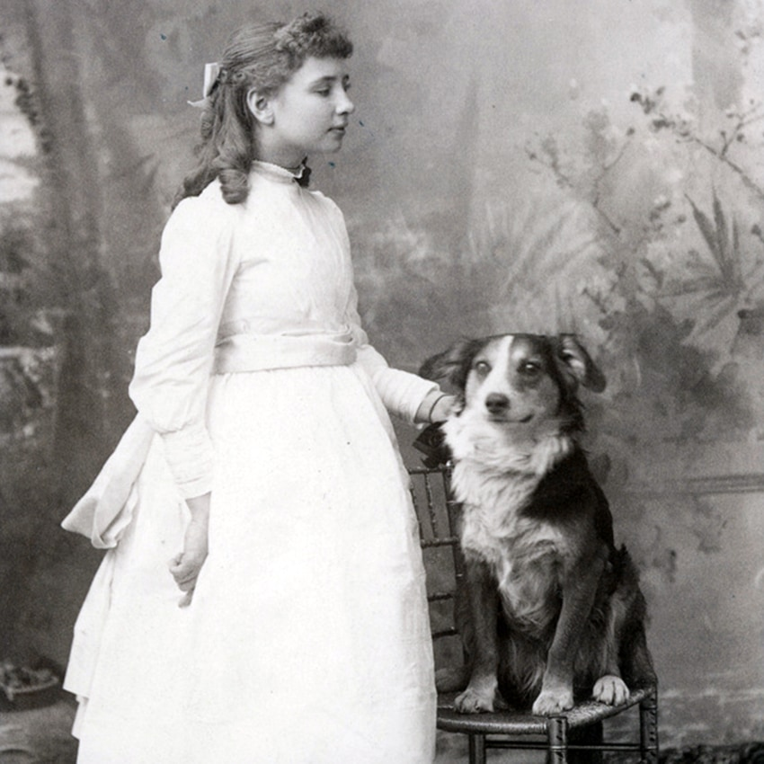
“The best and most beautiful things in the world cannot be seen or even touched-they must be felt with the heart.”
- Helen Keller

Slide 3
Services for children with disabilities
Missouri’s Children with Developmental Disabilities (MOCDD)
MO HealthNet for Disabled Children
  Non-Spend Down
  Spend Down
  Vendor
MAGI Coverage Options

Slide 4
Missouri’s Children with Developmental Disabilities Waiver (MOCDD)
The purpose of this waiver is to enable children with developmental disabilities to remain with their families rather than enter an institution, group home, or other out of home care.
Has a limited number of participants.
Allows the MO HealthNet eligibility requirements of deeming parental income and resources to the child to be waived so children targeted for participation may be determined MO HealthNet eligible. For children in this waiver program, financial eligibility for MO HealthNet is determined based solely on the income and resources of the child.
Establishes a higher income level for all children receiving MOCDD waiver services.
rate-methodology-publc-notice-071123.pdf (mo.gov)

Slide 5
Who is Eligible?
Under age 18
Lives with parents/family
Has monthly income at or below $1,598
Resources less than $5,726
Not otherwise be eligible for MO HealthNet without a Spend Down.
Meets the eligibility factors of disability, citizenship, residency, social security number and transfer of property.
Department of Mental Health (DMH)
  Determines need of an ICF/MR level of care
  Authorizes MOCDD Waiver Services

Slide 6
Services provided through the MOCDD waiver include:
Day Habilitation
In Home Respite
Out Home Respite
Personal Assistant
Support Broker
Applied Behavior Analysis (ABA)
Assistive Technology
Community Networking
Community Specialist
Crisis Intervention
Environmental Accessibility Adaptations-Home/Vehicle Modification
Health Assessment and Coordination Services
Individual Directed Goods and Services
Individualized Skill Development
Remote Supports
Specialized Medical Equipment and Supplies (Adaptive Equipment)
Transportation

Slide 7
MO HealthNet for Disabled Children
Who is Eligible?
Under the age of 18
Permanently and totally disabled (PTD)
Live in Missouri and intend to remain
Be a United States citizen or an eligible qualified non-citizen
Not be a resident of a public institution except a public medical institution
Meets MHABD income and resource limits
  Parental income and resources are deemed if the child meets the definition of living with a parent.
    NOTE: This does not include a stepparent because under Missouri law stepparents are not legally liable for the support of step children.

Slide 8
Defining Living With a Parent
A disabled child is considered to be living with a parent when the child resides in the same home with a natural or adoptive parent (unless the disabled child’s spouse is in the home). A child is also considered as living with a parent:
when the child is out of the home to attend school;
when the child is hospitalized for 30 days or less;
when the child is in a psychiatric treatment facility Joint Commission on the Accreditation of Healthcare Organizations (JCAHO) for 30 days or less; or
during a period of temporary absence.
A disabled child is NOT considered to be living with a parent if:
a natural or adoptive parent is not in the home;
the child is married and living with their spouse, even though a parent may be in the same home;
the child resides in a Nursing Facility or Intermediate Care Facility for Individuals with Intellectual Disabilities (ICF/IID);
the child is the custody of a state agency and placed in Foster Care or a Group Home;
the child is in a hospital or psychiatric treatment facility (JCAHO), and the stay is expected to be for more than 30 days; or
the child and parent are not residing in the same household for a period of time longer than that which is considered a temporary absence.

Slide 9
Understanding Deeming
What is Deeming?
Deeming Income
Deeming Resources
Deeming is defined as “considered in a specified way.”
Meaning some of the parents’ income and resources are considered available to the child.
So the Deeming process consist of determining how much of your income and resources will be considered when determining your child’s coverage.
There are some exceptions: parent or spouse of the parent is on MHSD or parent receiving cash public assistance: TA, SSI, VA, etc. –No Deeming.
For the deeming process the parents earned and unearned income is reviewed and then income disregards are applied to determine to amount that will be deemed.
Exception: if the parent is active MHSD Resources are not deemed.
The entire amount of the parent’s available resources are deemed to the child.
Max Resource for 1 person $5,726
Max Resource for 2 people $11,452

Slide 10
Non-Spend Down
The participant’s eligibility for MO HealthNet coverage begins with the first day of the month of application, as long as they were found eligible.
The non-spend down income maximum is $1,033 for a single individual and $1,397 for a married couple with eligibility based on OAA and PTD criteria. FPL is updated annually in April.
Resource max:
Child: $5,726
Child living with 1 parent: $5,726
Child living with 2 parents: $11,452
*Parental income and resources are deemed if the child meets the definition of living with a parent.

Slide 11
Spend Down
A case is considered a Spend Down if the child’s income plus the deemed income from the parent is over the maximum allowable amount of:
  $1,033.00 for a single person
  $1,397.00 for a couple
    These amounts are adjusted each year in April
The Spend Down has to be met each month in order for the coverage to go into effect for that month(like a monthly deductible). BUT you do not have to pay it each month to keep the case itself active.
The Spend Down can be met by paying it monthly or meeting it with bills.
*Bills or receipts of the document must show the following:
  Date of Service
  Type of Service Provided
  Charge for Service Provided
  Amount of third party liability (amount paid and adjusted/discounted by insurance and/or provider)
  Amount client is responsible to pay

Slide 12
Vendor
Disabled children (under age 18) may receive MO HealthNet Vendor coverage. The same eligibility rules apply to vendor as they do to MHSD and MHND.
If a child is residing in a care facility awaiting on a DHSS determination, other coverage options can be explored. Such as MHSD and MHND.

Slide 13

MO HealthNet for Kids & CHIP
Program Overview
MO HealthNet for Kids is available for those with MAGI household income below the following:
  196% FPL for children under age 1
  148% FPL for ages 1- 18
CHIP children are those with MAGI household income above the MHK income limits up to 300% FPL.

Slide 14
About MO HealthNet for Kids & CHIP
MO HealthNet for Kids
Eligibility Requirements
CHIP Eligibility Requirements
Children must meet the following criteria:
  Under 19.
  SSN.
  Missouri Resident.
  US Citizen/Eligible Qualified Non-Citizen.
  There is no premium for children whose monthly gross family income is under 150% of the federal poverty level.
  Children with family MAGI of:
      • 196% FPL for children under age 1
      • 148% FPL for ages 1- 18
Children must meet the following criteria:
  Under 19.
  SSN.
  Missouri Resident.
  US Citizen/Eligible Qualified Non-Citizen.
  Gross family income less than 300% of Federal Poverty Level (FPL) for household size.
  Children must be uninsured.

Slide 15


A parent/caretaker relative who has a disability and receives Social Security Disability:
AA Parent/ Caretaker Relative is defined as a specified relative that has primary control and care over the eligible child.
MO HealthNet for Kids for the children.
MO HealthNet for the Aged, Blind, and Disabled for the applicant who is disabled.
  MHABD income limits are higher than MO HealthNet for Families.
  Some participants prefer MHABD because it pays on a fee for service basis.

Slide 16

A parent with a disability who receives SSI:
MO HealthNet for Kids for the children.
MO HealthNet for the Aged, Blind, and Disabled for the parent who has a disability.
  The parent who receives SSI may also be eligible for MO HealthNet for Families or MO HealthNet for Kids (if under age 19).

Slide 17
hipp
The Health Insurance Premium Payment Program For MO HealthNet Participants

Slide 18
The Health Insurance Premium Payment (HIPP) Program is a MO HealthNet Program that pays for the cost of health insurance premiums for certain MO HealthNet participants. The program purchases health insurance for MO HealthNet-eligible participants when it is determined cost effective. Cost effective means that it costs less to buy the health insurance to cover medical care than to pay for the same services with MO HealthNet funds.

Slide 19
HIPP - Applications
For questions about the HIPP Program,
contact the MO HealthNet Division, (MHD) at (573) 751-2005
You can email the completed form to MHD.HIPP@dss.mo.gov
hipp-1.pdf (mohttps://dssmanuals.mo.gov/wp-content/uploads/2020/09/hipp-1.pdf.gov)

Slide 20

Application process
Applications can be made:
In person
By mail
By fax
Over the Phone(MAGI)
Online at mydss.mo.gov
Through a third party (relative, authorized representative, hospital, agency)
https://www.youtube.com/watch?v=NnU16ibJD08

Slide 21
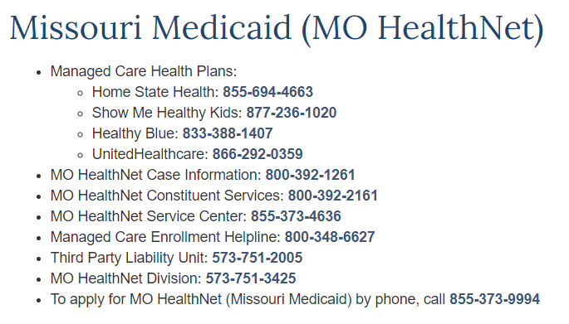
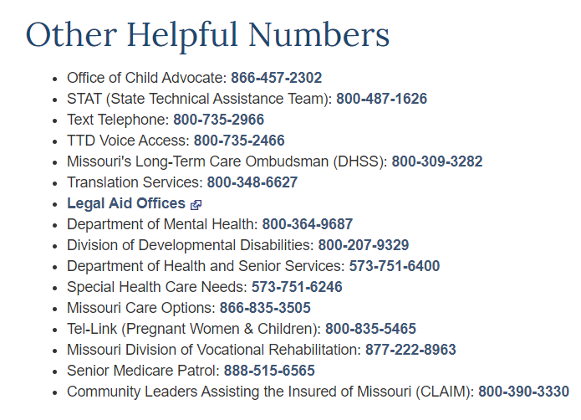
Important Links and Takeaways
Welcome to myDSS | mydss.mo.gov
FSD Benefits Landing - Benefits Portal (mo.gov)
IM-4 Healthcare (mo.gov)
Contact Us (mo.gov)
Health Plan Benefit Table (mo.gov)
Benefit Review Summary (mo.gov)
Customer Service (mo.gov)
Call Center Contact: 855-373-4636
Chat Option for Questions

Slide 22

Thank You

