Slide 1
Assistive Technology

Slide 2
SELF-EFFICACY

Slide 3
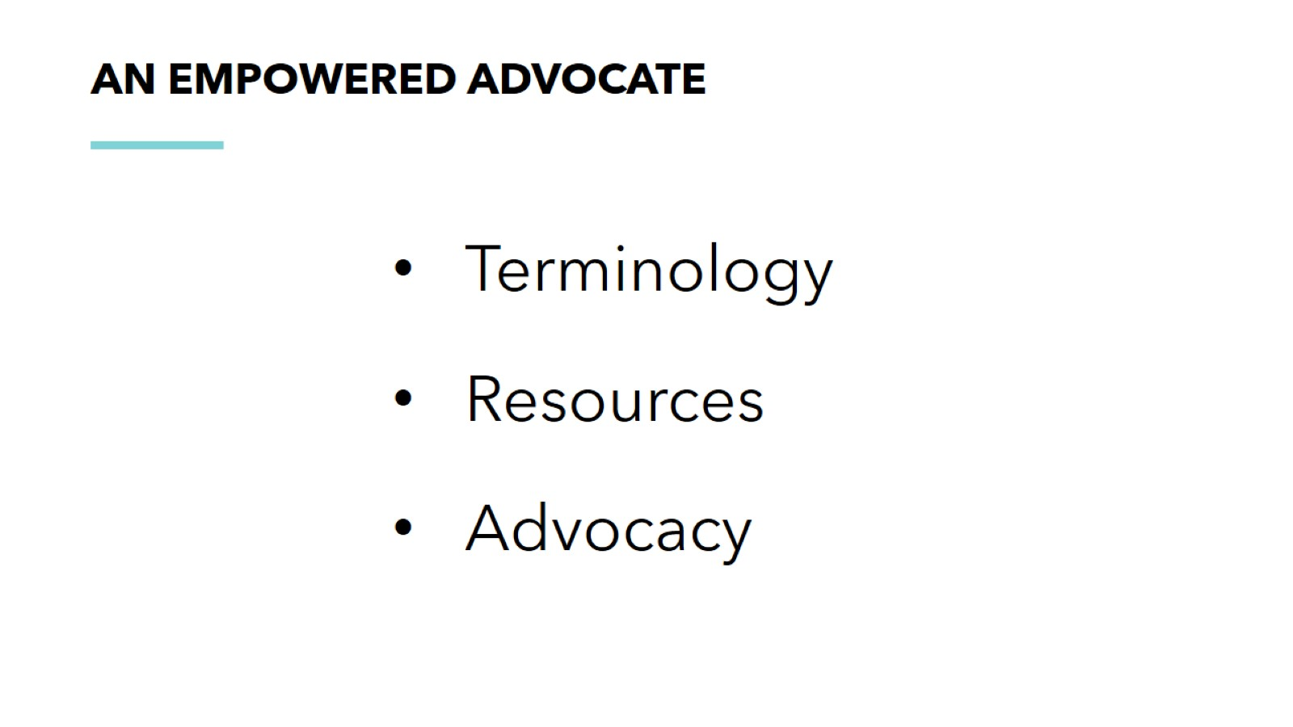
an empowered advocate

Slide 6
Professionals

Slide 7
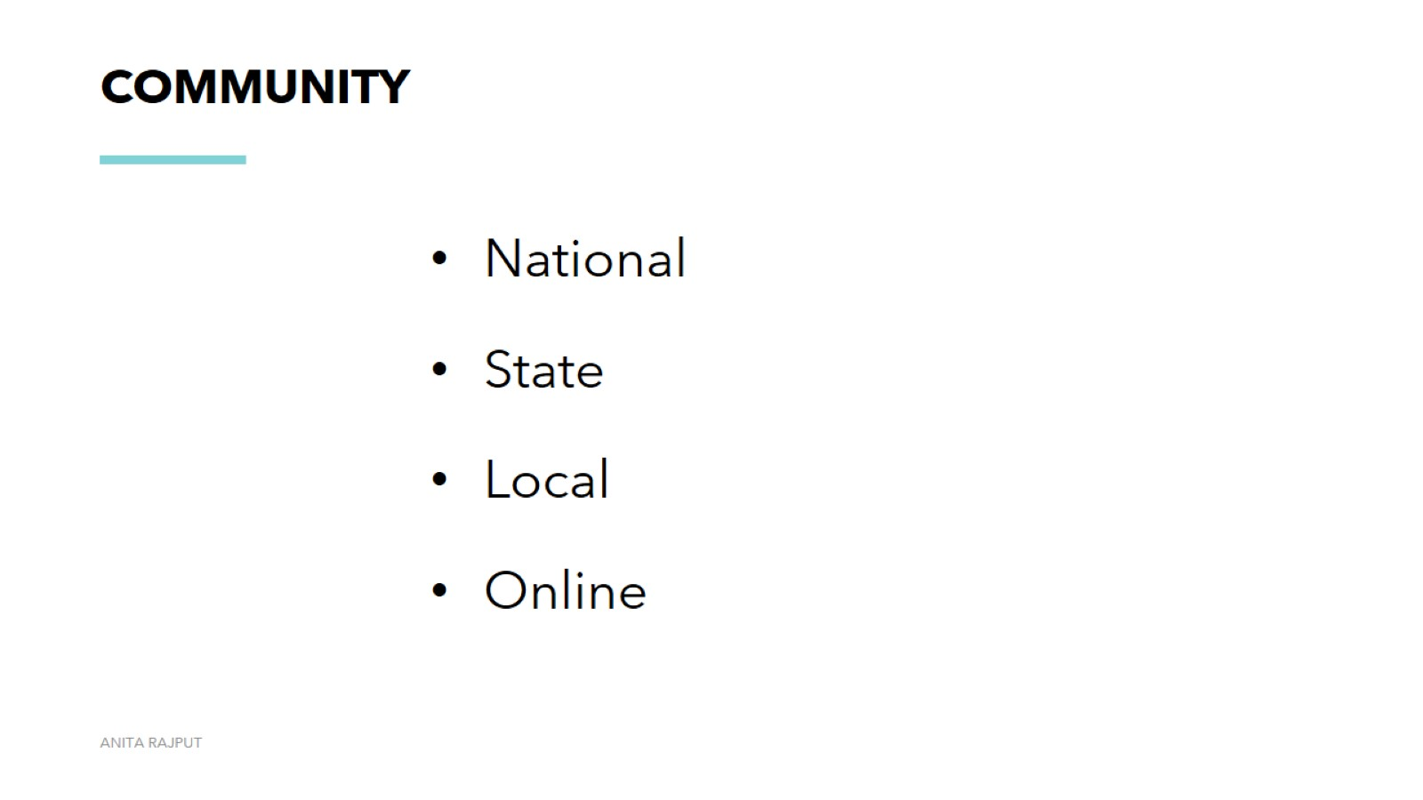
community

Slide 8
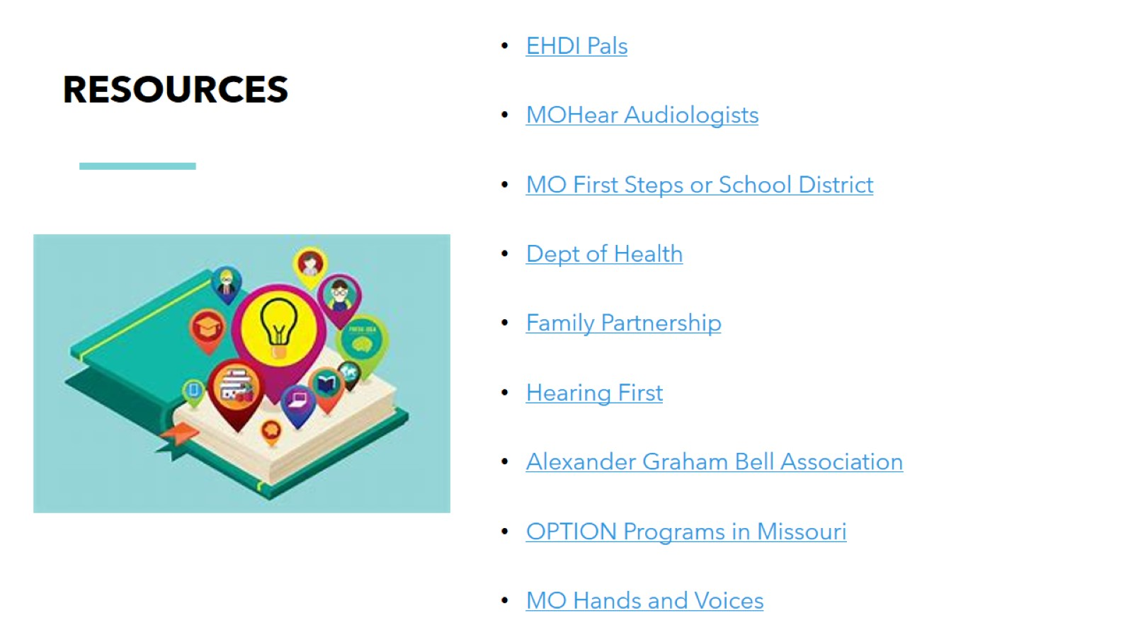
Resources

Slide 9
The Law

Slide 11
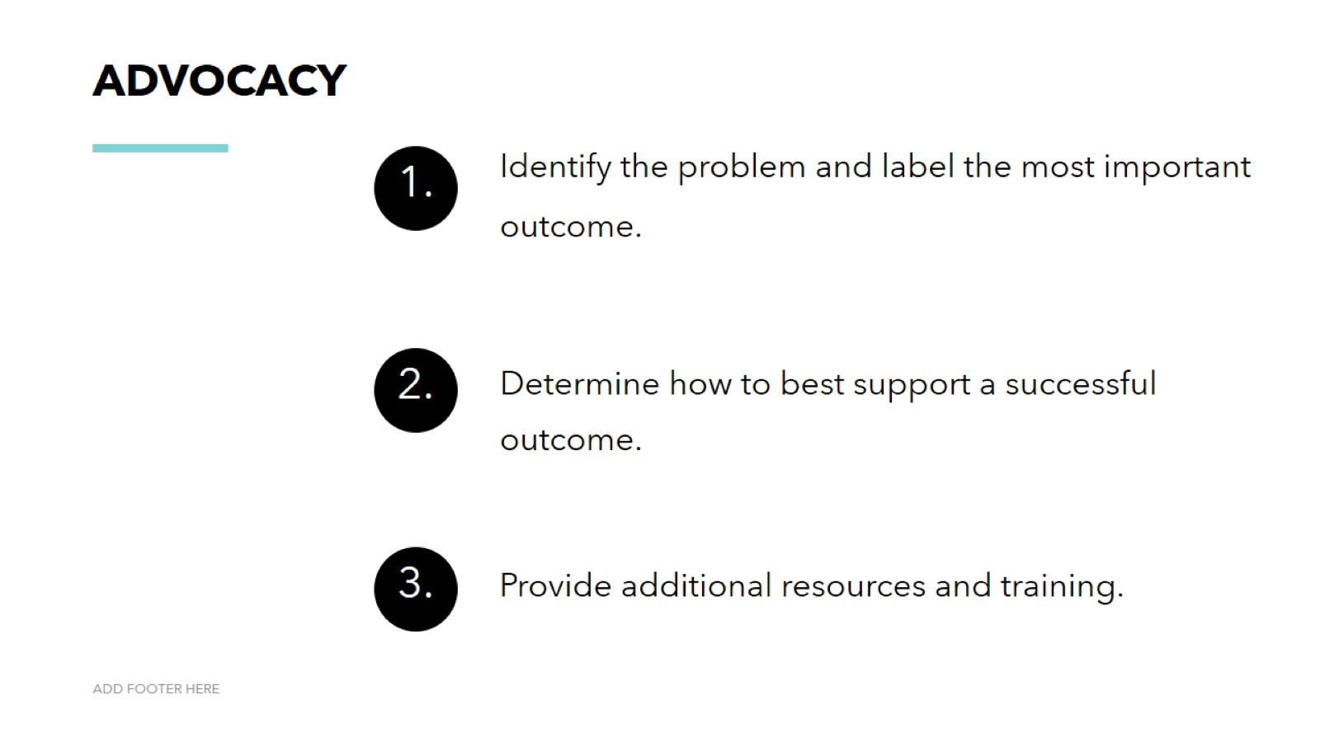
Advocacy

Slide 12
After School Extracurricular Activities

Slide 13
Swim Lessons

Slide 14
Soccer Game

Slide 16
Michelle Graham michellegrahamconsulting@gmail.com

