Slide 1

Special Health Care Needs Family Partnership

Slide 2

Medical Home

Slide 3
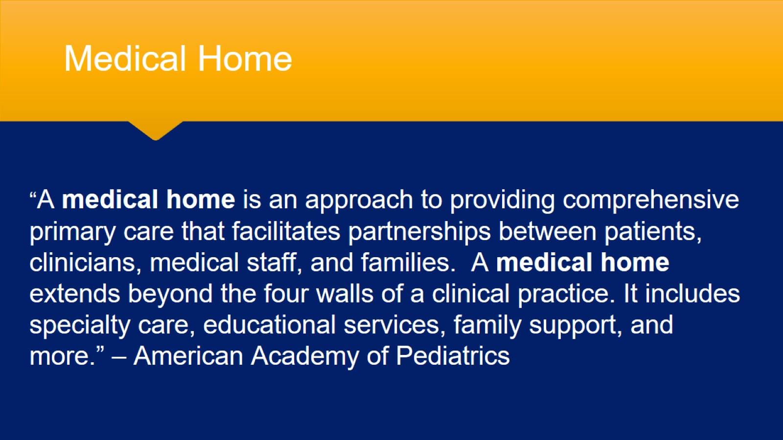
Medical Home

Slide 4
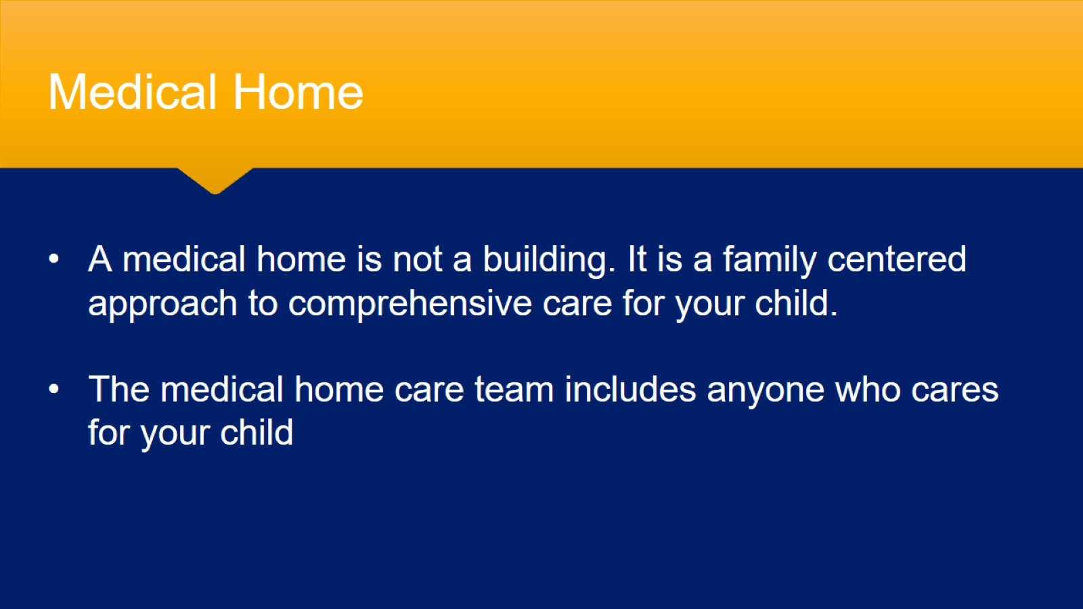
Medical Home

Slide 5
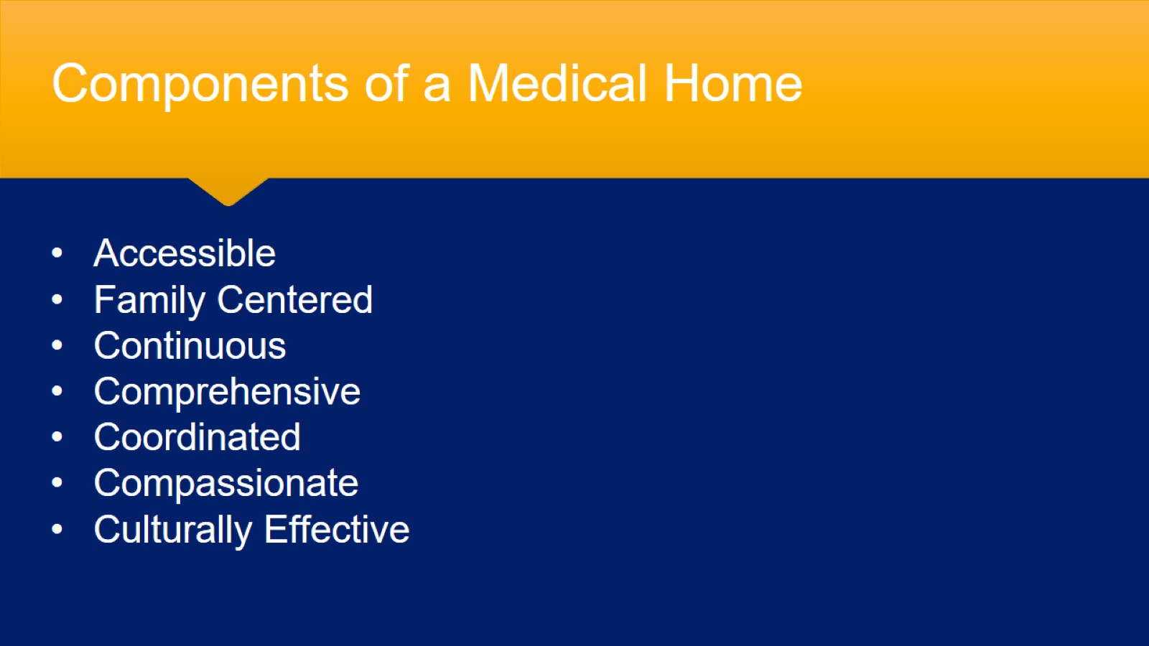
Components of a Medical Home

Slide 6
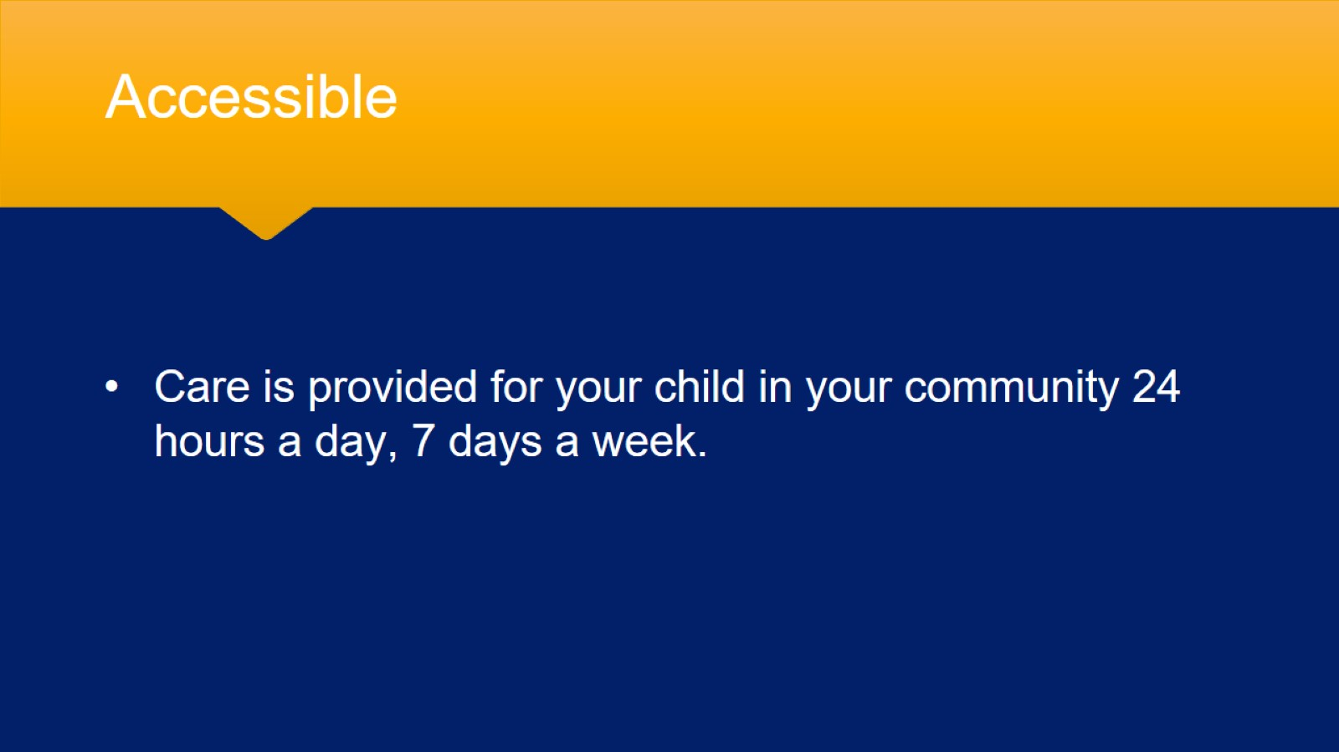
Accessible

Slide 7
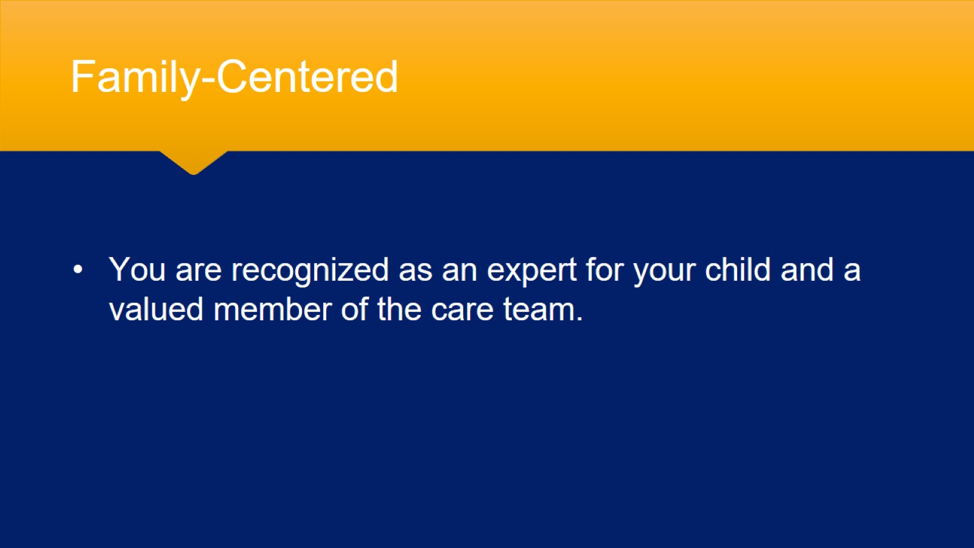
Family-Centered

Slide 8
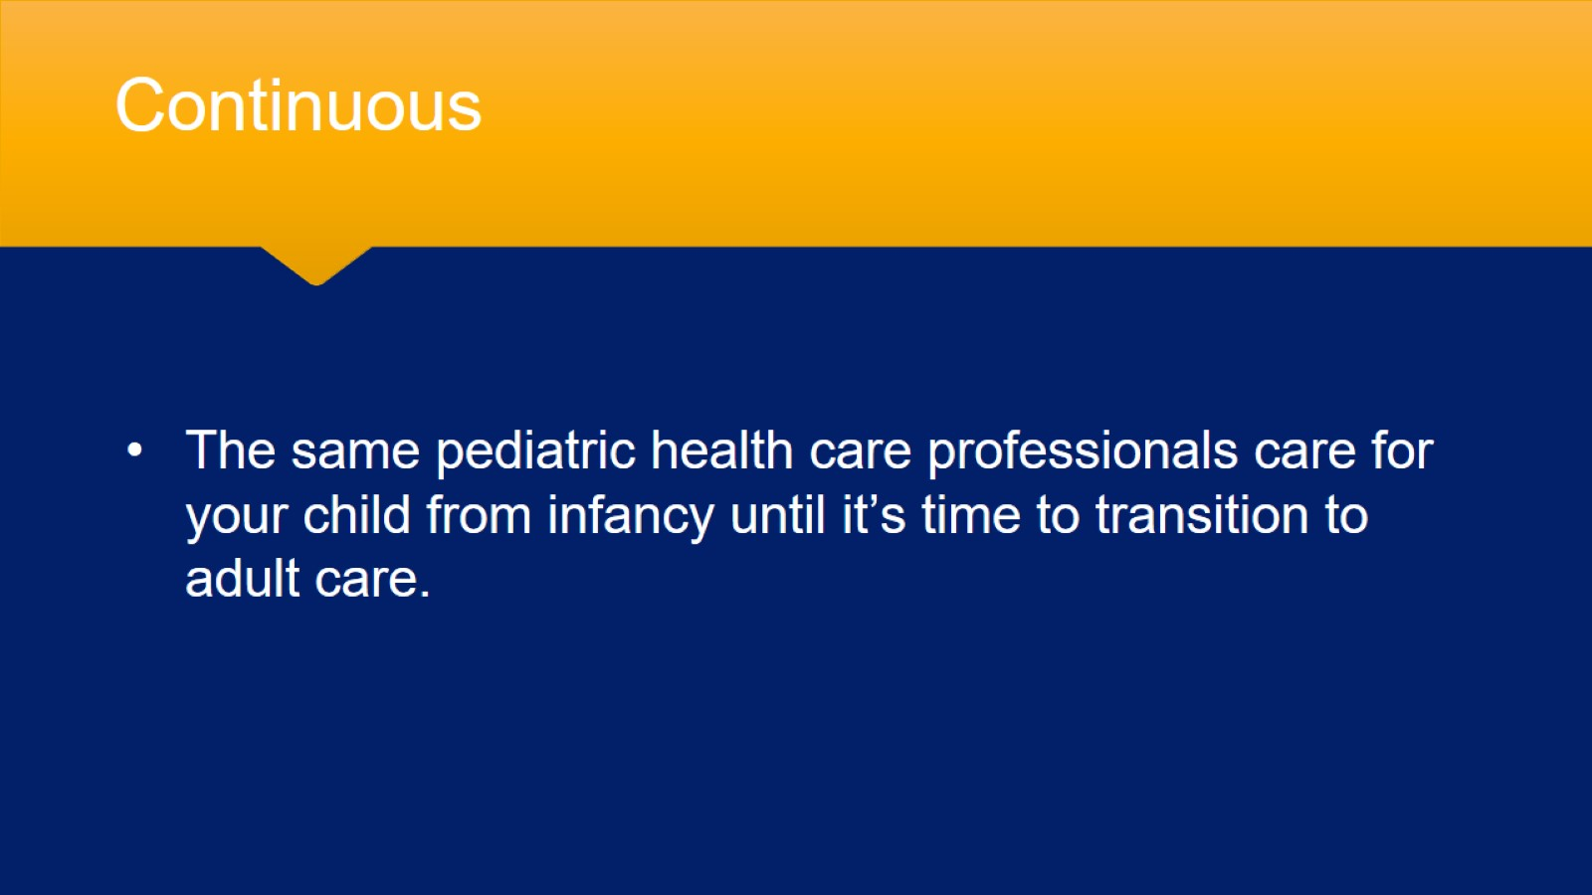
Continuous

Slide 9
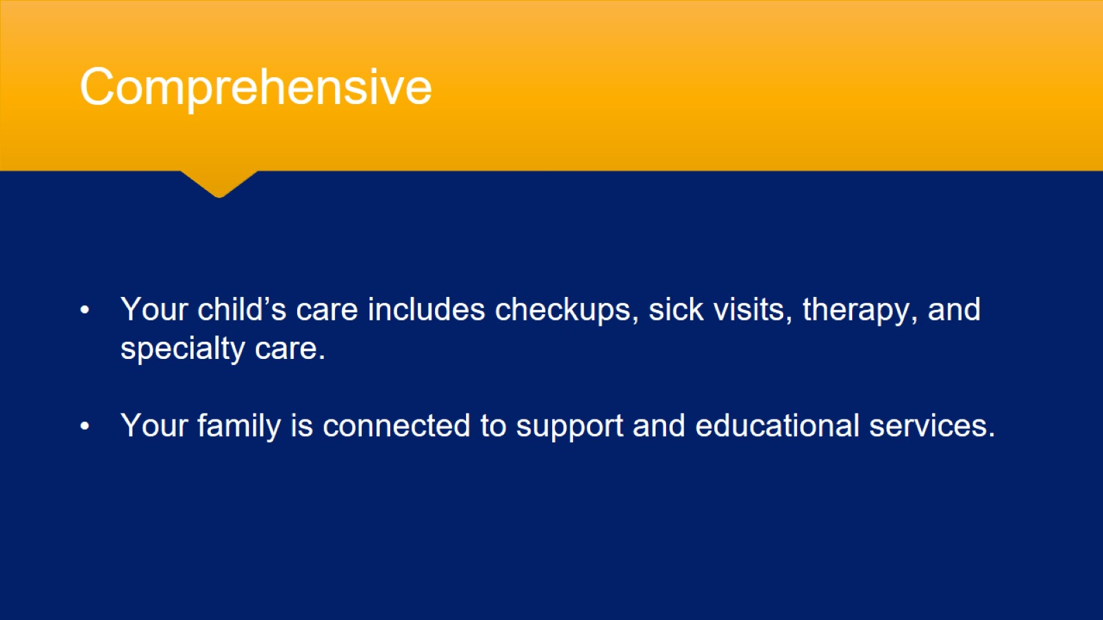
Comprehensive

Slide 10
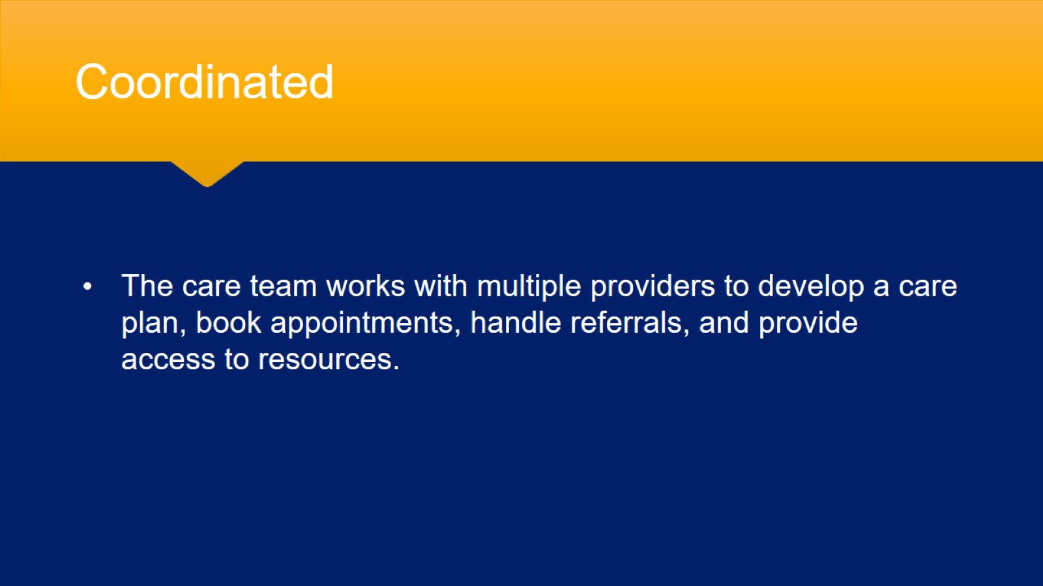
Coordinated

Slide 11
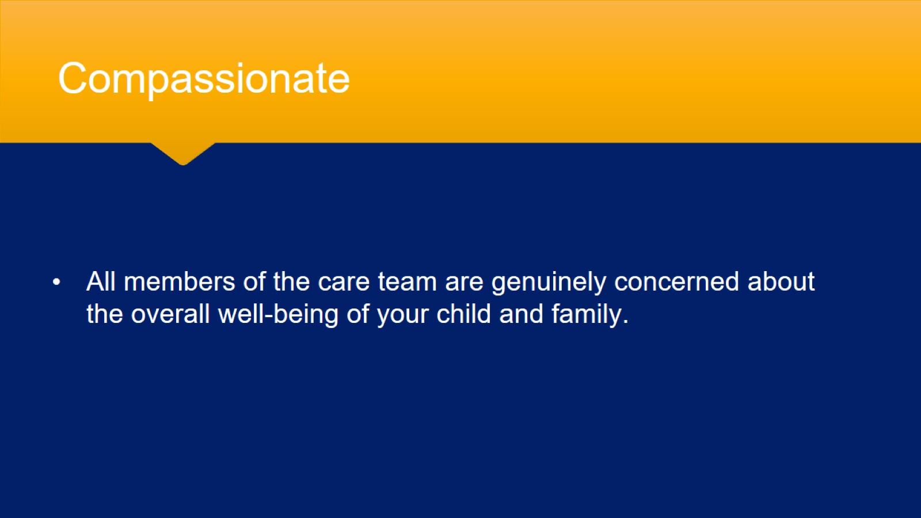
Compassionate

Slide 12
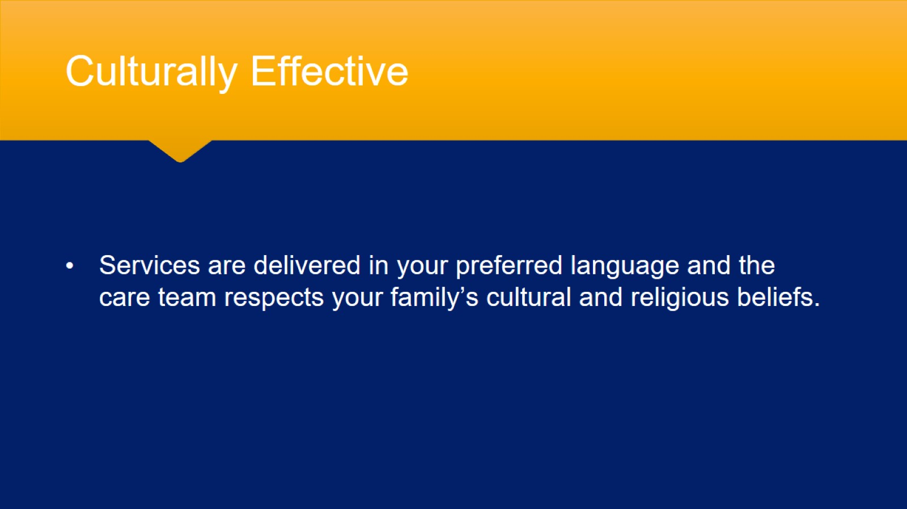
Culturally Effective

Slide 13
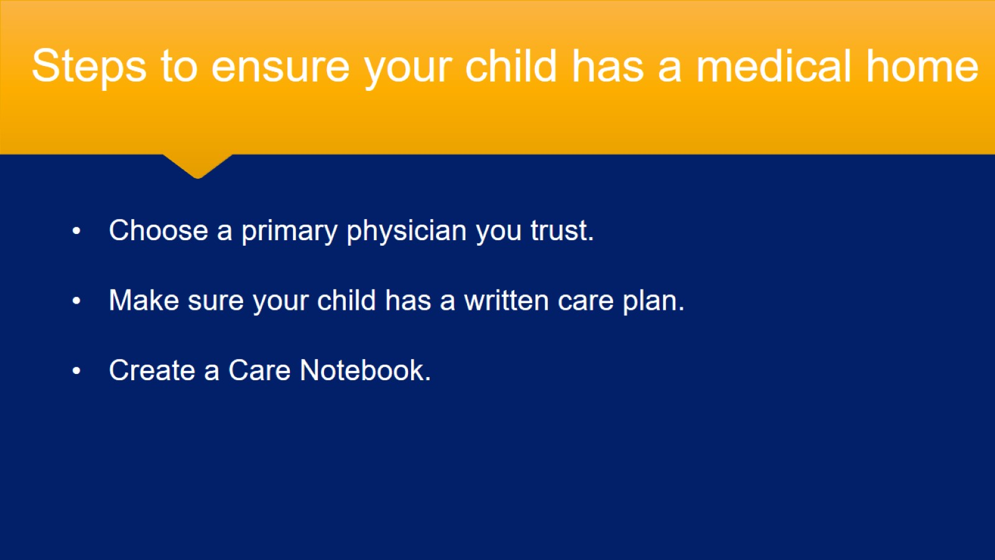
Steps to ensure your child has a medical home

Slide 14
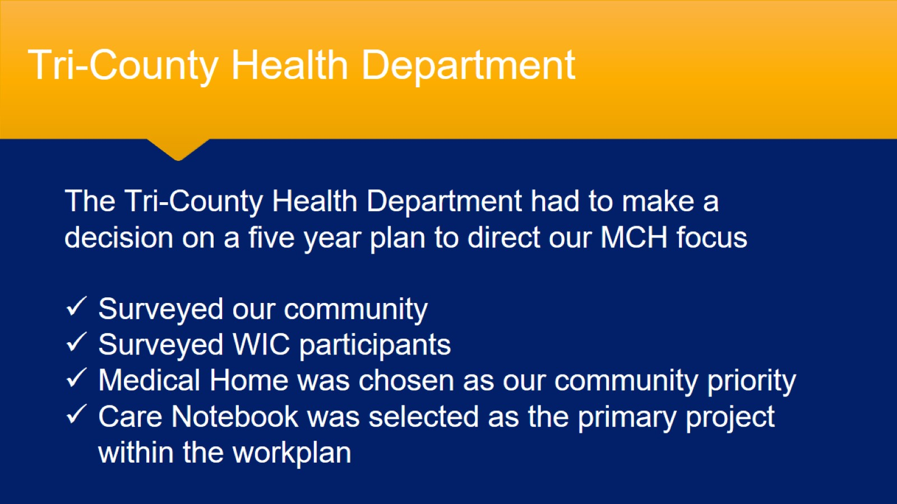
Tri-County Health Department

Slide 15
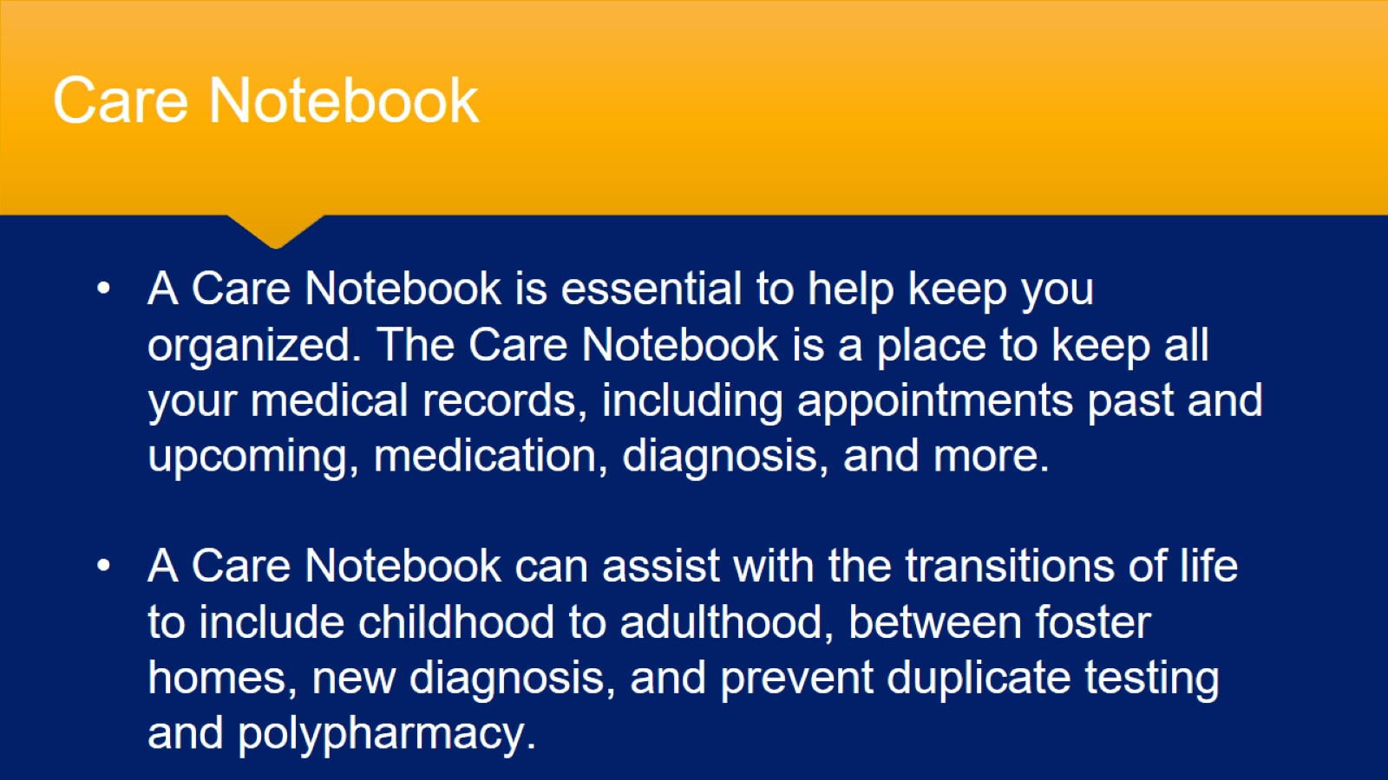
Care Notebook

Slide 16
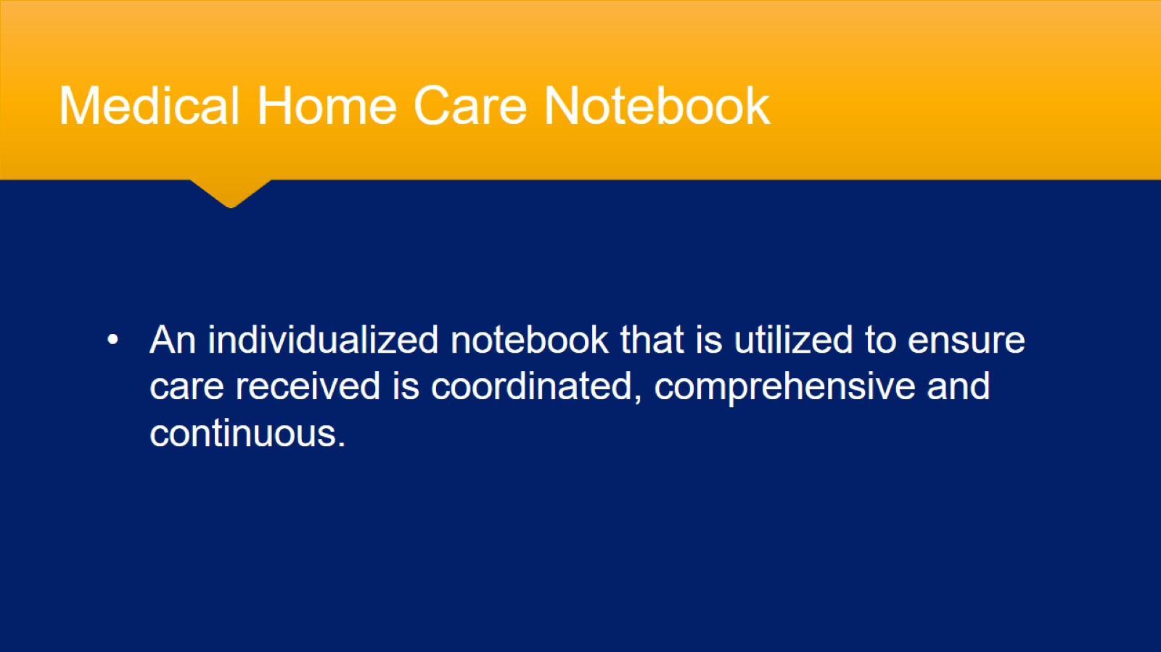
Medical Home Care Notebook

Slide 17
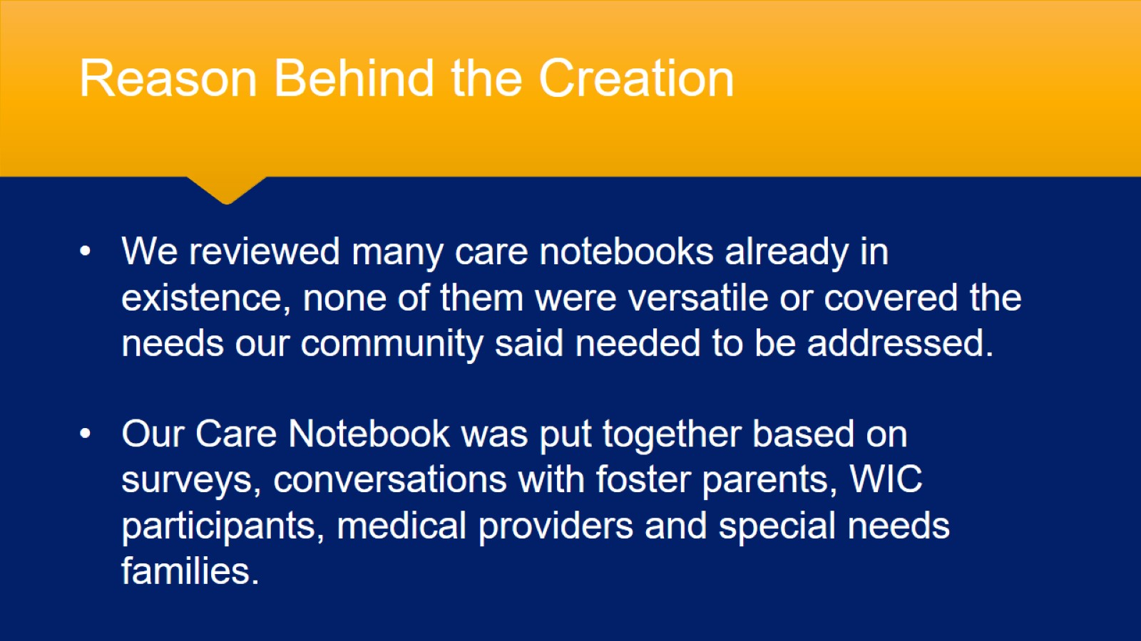
Reason Behind the Creation

Slide 18
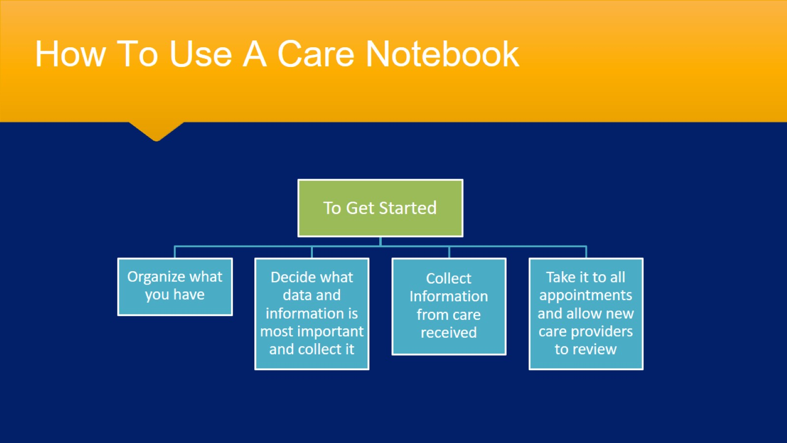
How To Use A Care Notebook

Slide 19
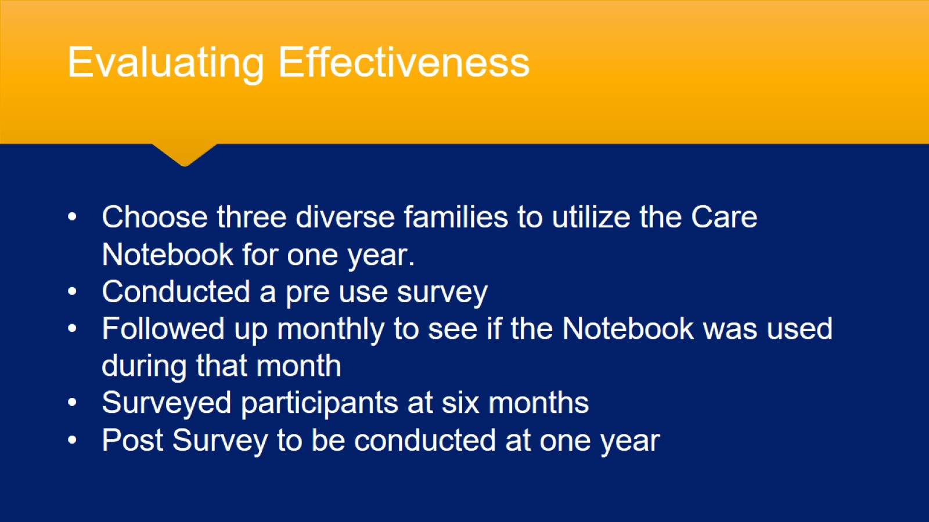
Evaluating Effectiveness

Slide 20
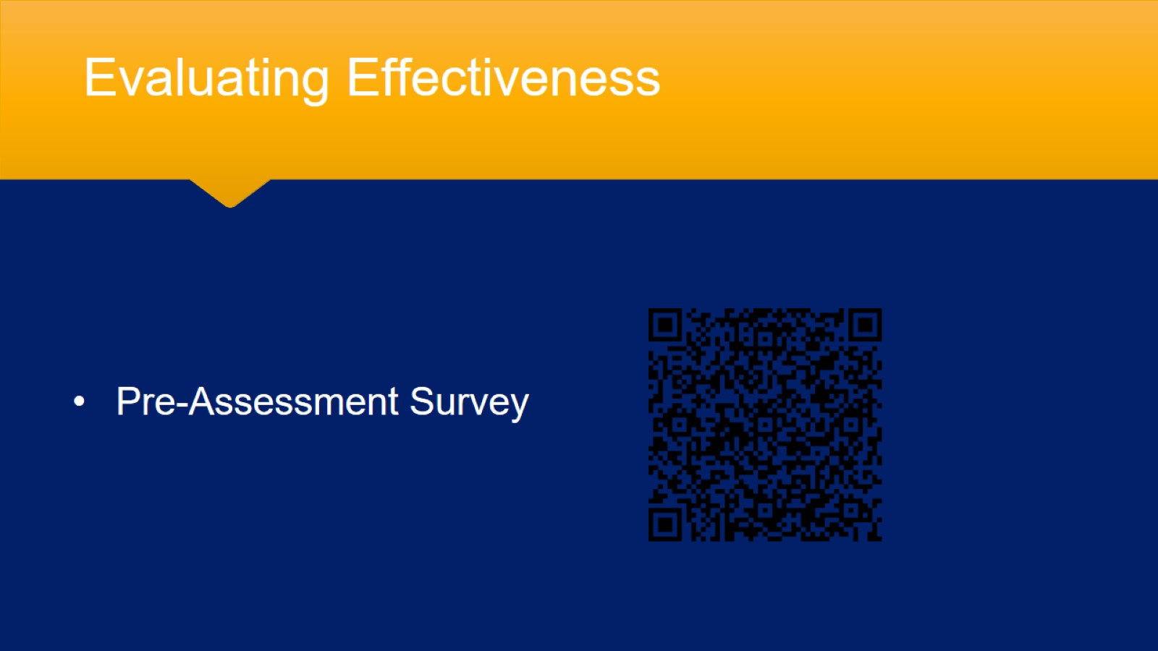
Evaluating Effectiveness

Slide 21
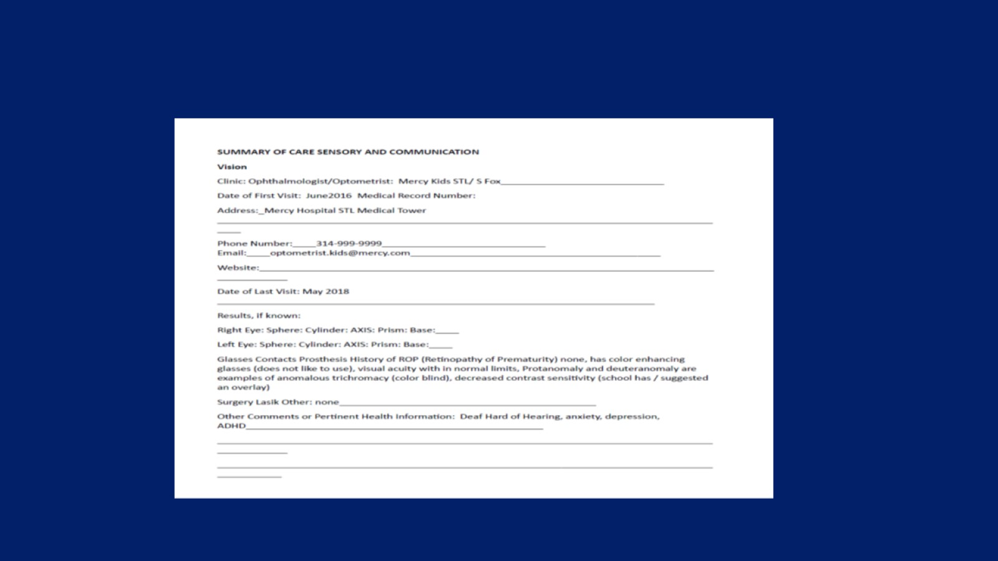

Slide 22
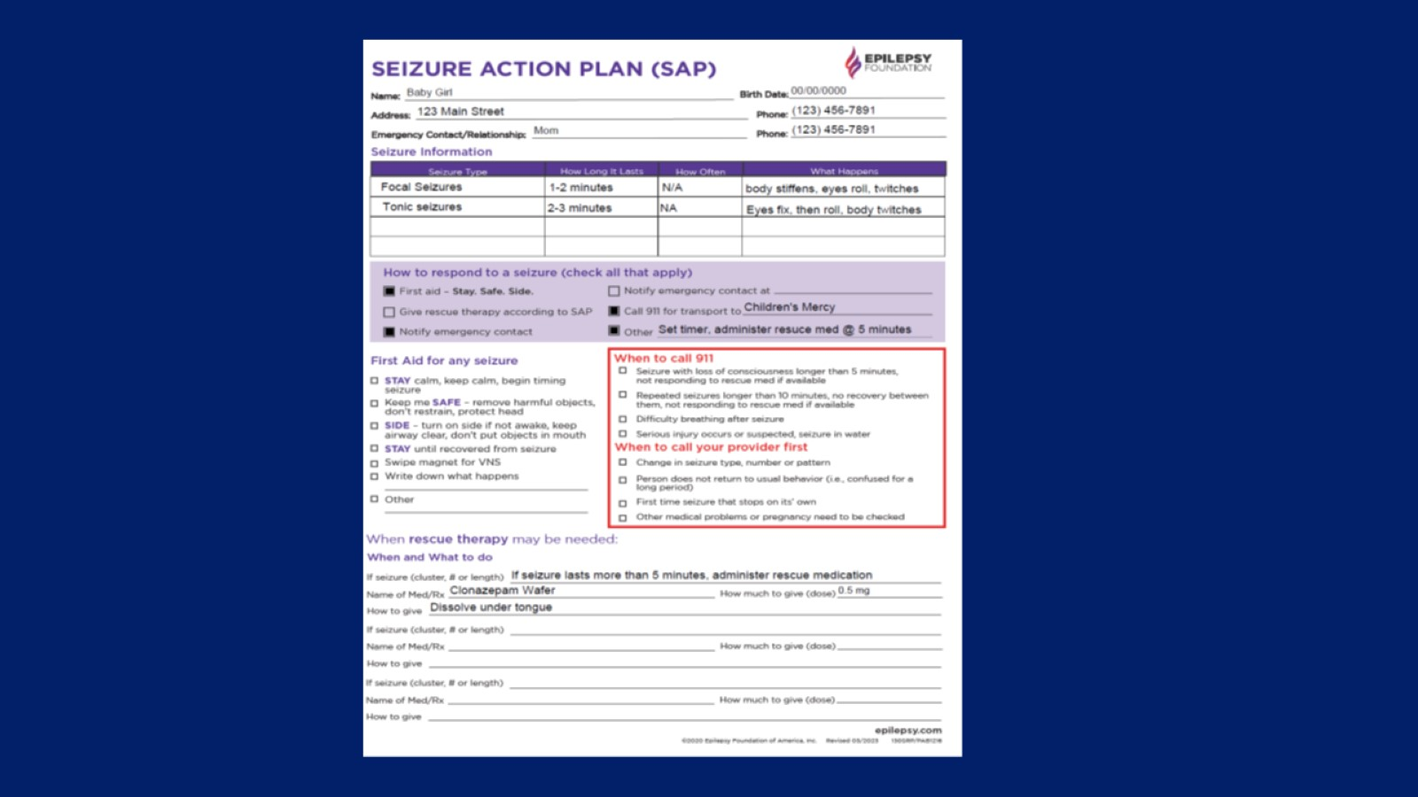

Slide 23
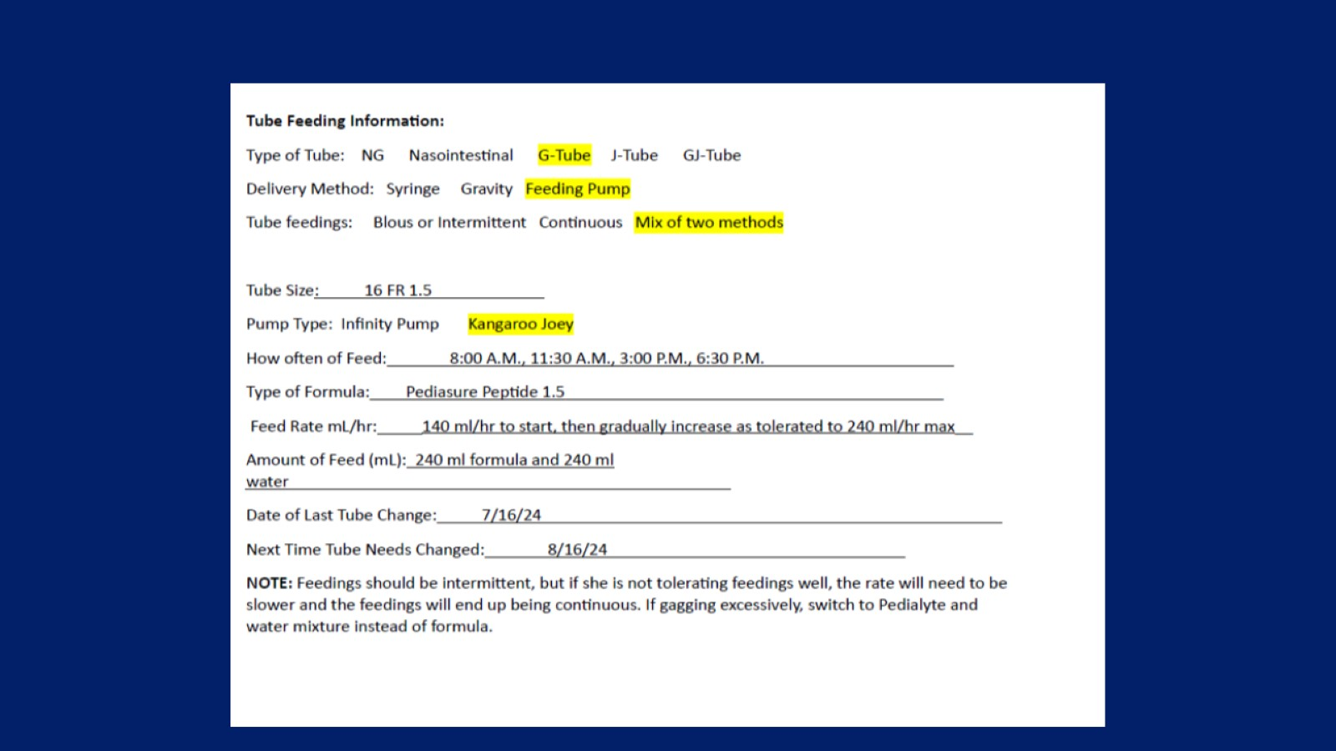

Slide 24
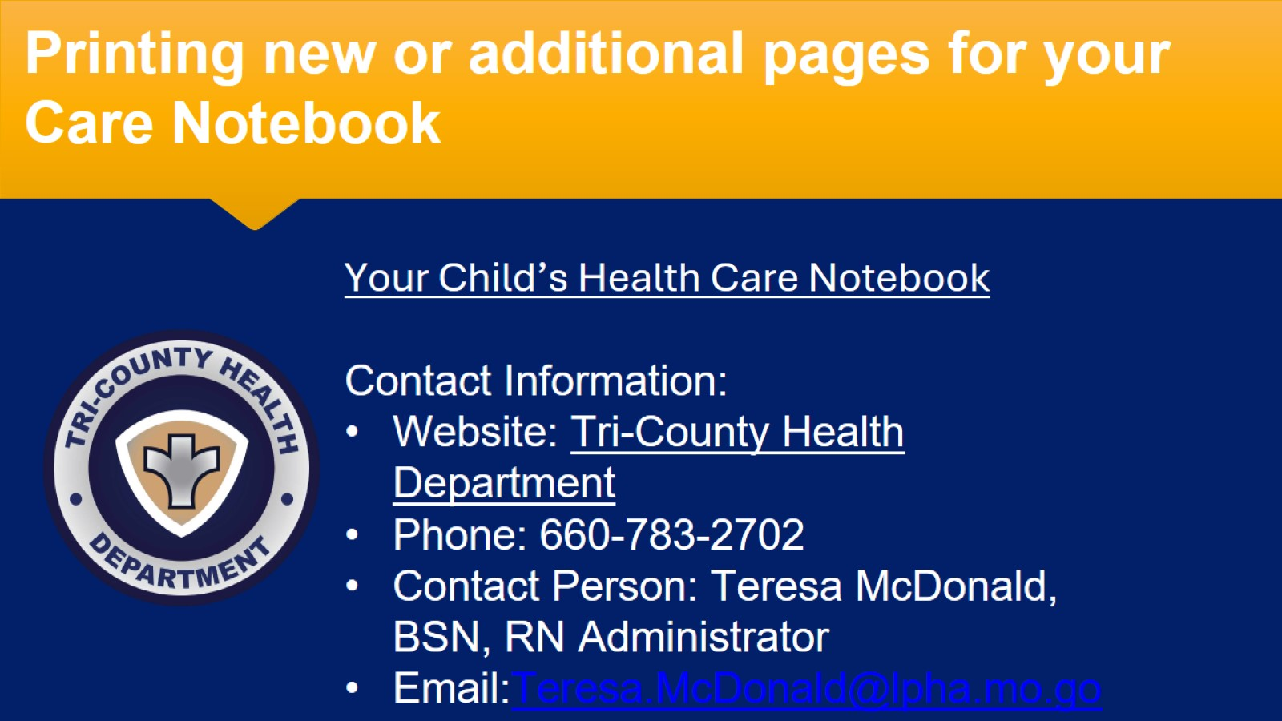
Printing new or additional pages for your Care Notebook

Slide 25
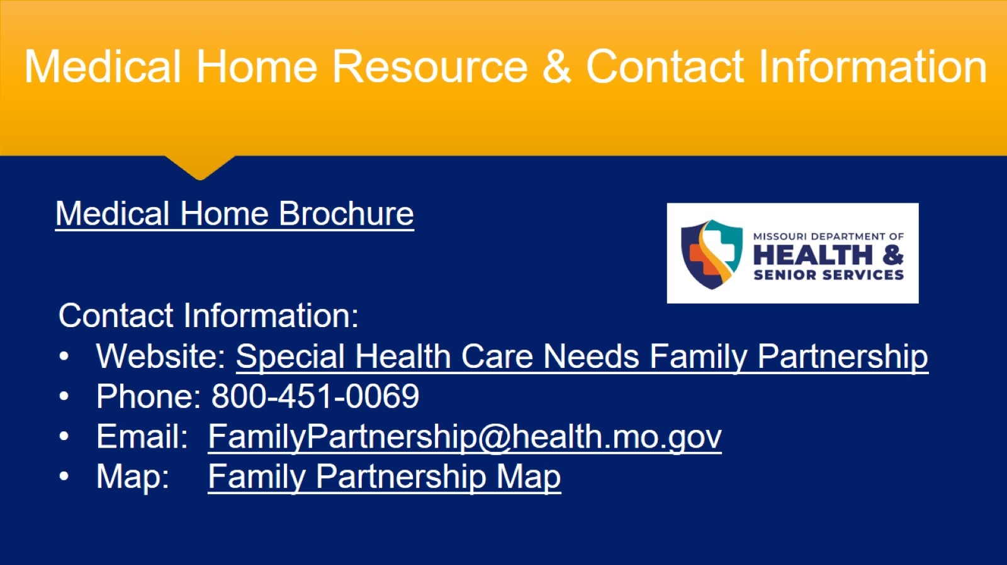
Medical Home Resource & Contact Information

Slide 26

FINAL THOUGHTS
Questions

