Slide 1
2024 Home Care Conference
Bureau of Home Care & Rehabilitative Standards
Michael Fields, RN, Bureau Administrator

Slide 2
Who are the Champions?
Patients.
Home Health Care Team.
Pioneers.
Surveyors ?

Slide 3
Objectives
Describe Home Health Certification and Licensure
Describe What a Survey Looks Like
Identify the Top Five Home Health Deficiencies in MO
Identify the Top Five Hospice Deficiencies in MO
Review Statistics of HH & HO Agencies
OASIS Updates with Robin Swarnes

Slide 4
Describe Home Health Survey / Certification and Licensure
All new home health and hospice providers come into the program (certification) through an initial survey by an accrediting organization (CHAP, TJC, ACHC). Missouri issues a license to operate in Missouri based on this initial AO survey.
Your agency can elect deemed status after CMS grants certification.
Deemed - routine surveys (24-36 month window) completed by an accrediting organization (AO)
Non- Deemed: routine surveys (24-36 month window) are completed by the bureau. (State Agency - SA)

Slide 5
Deemed Providers FYIs (Page 2)
Service area expansion, or adding a branch / multiple location there is a specific process and requirements. (Call our office or email David)
Your agency is required by statute to submit a statistical report about your operations. These reports are due by Feb 28th, on an annual basis.
Change of ownership process (Call our office or email David)
David.Atkinson@health.mo.gov
Missouri specific staff background check requirements: Missouri requires an employee disqualification list (EDL) check to be conducted, as well as a criminal background check through the Missouri state highway patrol, before offering employment to new staff. For home health agencies a family care safety registry (FCSR) check must be completed.

Slide 6
Surveyor 101: Regulations
CMS Conditions of Participation (CoPs)
CFRs (Code of Federal Regulations)
State Operations Manual (SOM)
State Statutes (RSMo)
CSRs (State Rules)
Medicare Benefit Manual
HIPAA
OSHA

Slide 7
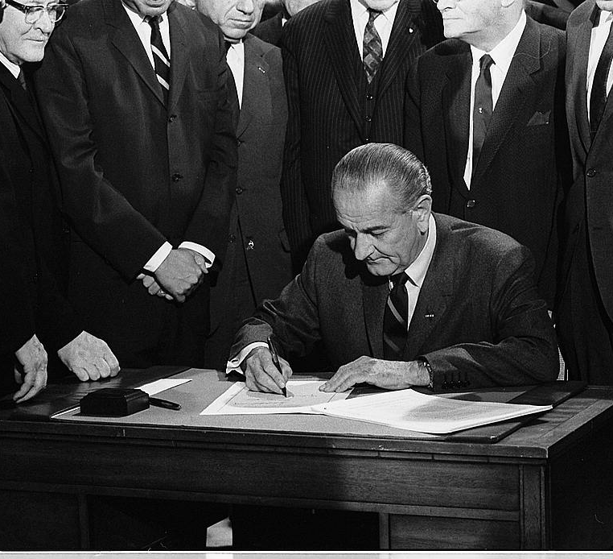
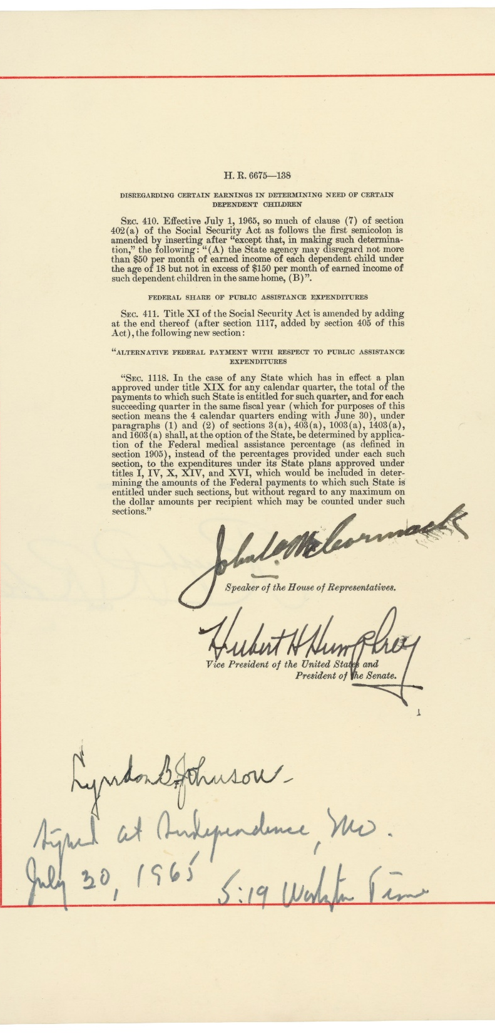
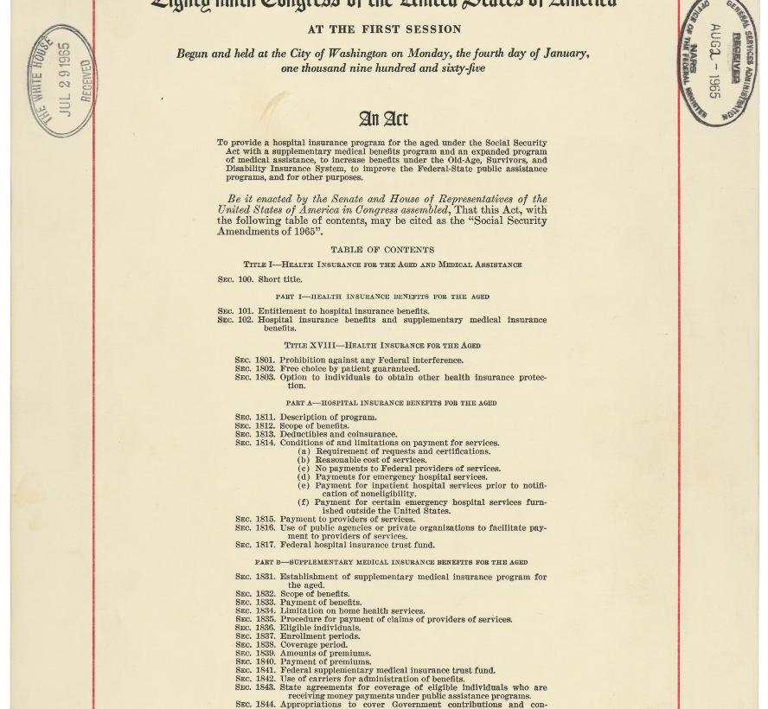
Champion Alert:
Lyndon B. Johnson
1965 - Medicare and Medicaid Act

Slide 8
NEW INFORMATION
On March 15, 2024, the Centers for Medicare & Medicaid Services (CMS) issued a revised State Operations Manual, Appendix B – Guidance for Surveyors: Home Health Agencies (HHAs), commonly referred to as the interpretive guidelines (IGs) to the Conditions of Participation (CoPs). The revised Appendix B begins with survey protocols and adds survey procedures under many of the standards to assist surveyors in assessing compliance with the regulatory requirements.
CMS has identified a select number of standards, called Level 1 standards, most closely related to the agency's ability to deliver quality patient care and services as required under the CoPs. Compliance with these Level 1 standards is associated with positive outcomes for patient care.

Slide 9
Level 1 Standards (Attachment A)
§484.50 Patient Rights | G412, G414, G416, G418, G422, G428, G430, G432, G434, G436, G438, G442, G444, G448, G454, G464, G478, G484, G486, G488, G490
§484.55 Comprehensive Assessment of Patients | G514, G516, G520, G528, G530, G532, G534, G536, G544, G546
§484.60 Care planning, coordination of services, and quality of care. | G572, G574, G576, G580, G582, G584, G588, G590, G592, G596, G598, G602, G604, G606, G608, G610, G612, G614, G616, G618, G620, G622
§484.70 Infection prevention and control | G682, G686
§484.75 Skilled Professional Services | G704, G706, G708, G710, G712, G714, G716, G718, G724, G726, G728, G730
§484.80 Home Health Aide Services | G768, G772, G798, G800, G802, G804, G808, G810, G812, G816, G818
§484.102 Emergency Preparedness | E-0004, E-0013, E-0036
§484.105 Organization and Administration of Services | G982, G984
§484.110 Clinical Records | G1012, G1014, G1016, G1018, G1022, G1024, G1028

Slide 10
SURVEY 101 –
TYPES OF HOME HEALTH SURVEYS
Recertification Survey: Standard survey every three years. Begins as a standard survey, may be converted to partial/or extended.
Standard Survey: Standard survey is a routine, patient-centered survey that gathers information about the quality of service furnished in a agency to determine compliance with the high priority patient centered CoPs (Level 1 Tags – Patient centered)
Partial Extended: After one or more tags are found in Patient centered areas (Level 1 tags), the team will evaluate the remaining tags within the Level 1 condition area. (This ends up being the most common type of survey).

Slide 11
SURVEYOR GUIDE –
TYPES OF HOME HEALTH SURVEYS (cont.)
Extended Survey: The Extended Survey is conducted when the survey team determines substandard care. More evidence is needed to get to the extent of a system problems related to substandard quality of care (patient outcomes). All CoPs will be reviewed.
Abbreviated Survey: Complaint/Revisit- looking at only those CoP’s authorized by CMS during a revisit, deemed complaint, or CoPs related to complaint allegations (focused survey).
*New* Complaint investigation with condition-level non-compliance will result in a full extended survey within 14-days of the complaint.

Slide 12
SURVEYOR GUIDE –
TYPES OF HOME HEALTH SURVEYS (cont.)
Complaint Survey: Looking at the regulatory issue (tags or condition areas) that were identified in the complaint allegations. (A complaint survey always starts as an abbreviated survey).
Validation Survey: CMS Regional office sends notice to SA (BHCRS) to complete a full survey after an AO completes a survey to ‘validate” the findings of the AO. This survey begins as a Standard Recertification Survey.

Slide 13
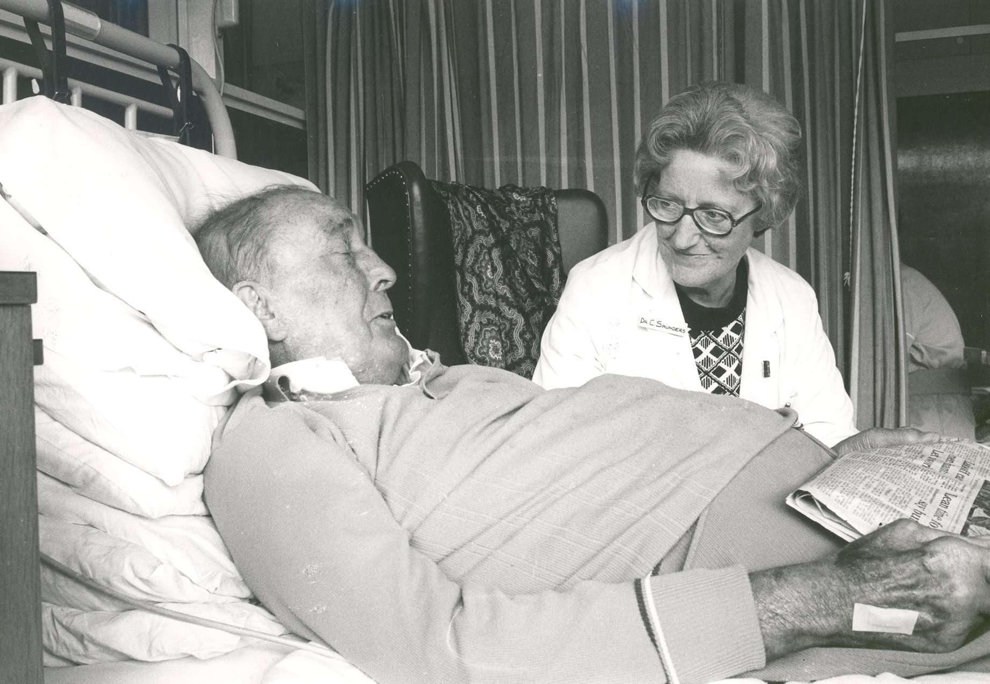
Hospice Champion Alert
Dame Cicely founded St Christopher's Hospice in 1967 as the first hospice linking expert pain and symptom control, compassionate care, teaching and clinical research. St Christopher's has been a pioneer in the field of palliative medicine, which is now established worldwide.

Slide 14
Surveyor 101: survey process flow
Pre-survey (offsite work)
Entrance
Information gathering phase (chart reviews, home visits, interviews)
Findings compiled and reviewed with the agency
Exit
Plan of correction / revisit

Slide 15
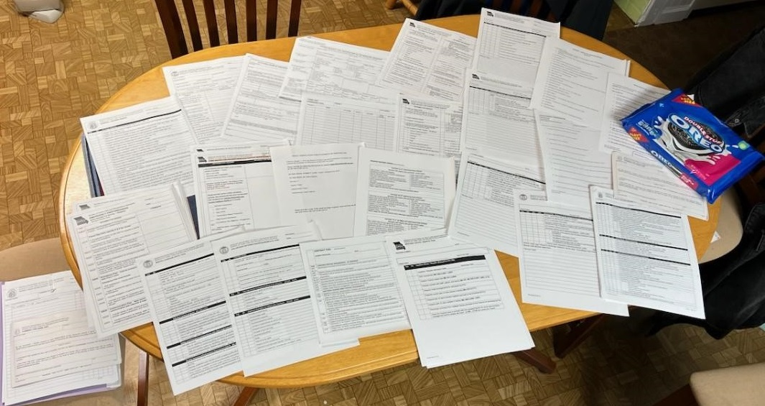
What a survey looks like

Slide 16
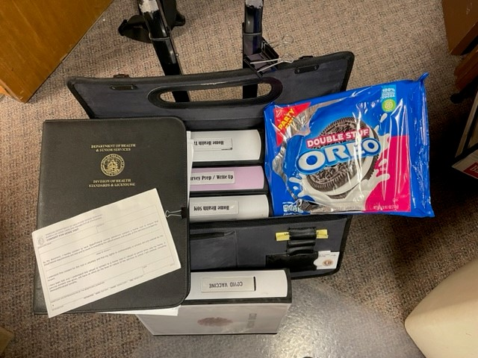

Slide 17
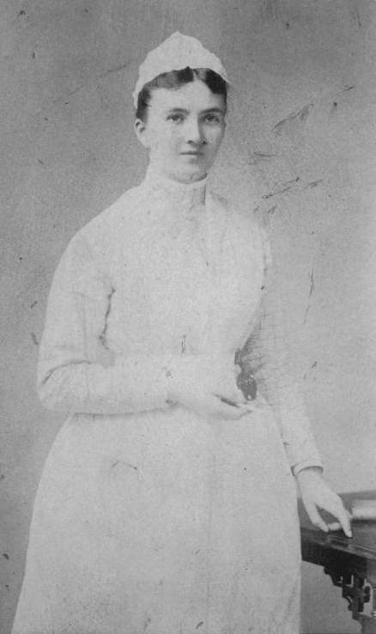
Champion Alert - Glove Use
Caroline Hampton Halsted was one of the first nurses to recognize the importance of rubber glove use to prevent the spread of infection. Caroline worked primarily in surgery. When The Johns Hopkins Hospital opened in 1889, Caroline was appointed chief nurse of the operating room.

Slide 18
Entrance
Roller Bag
Brigade
Entrance Conference

Slide 19
ITEMS NEEDED for Survey: Getting Started 1. Set up home visits – Have clinical manager(s) bring visit schedules for current week for all disciplines and work with surveyor to set up home visits. - Focus on multi-discipline, high skilled nursing need (involved wound care, IVs, unstable diabetes, new CVA, unstable CHF etc)
2. Current Patient List (include start of care date, diagnosis, and services provided)
3. Complaint Log
4. Patient Admission Folder
5. Discharge List – last 3 months (include start of care and discharge dates)

Slide 20
Sample Selecton:
Medically complex patients selected
Patients with multiple disciplines
Treatments (IV therapy, etc)
Patients with wound care
Education requirements
Patients served out of branches
Home Visit Arrangements (call ahead - permission)

Slide 21
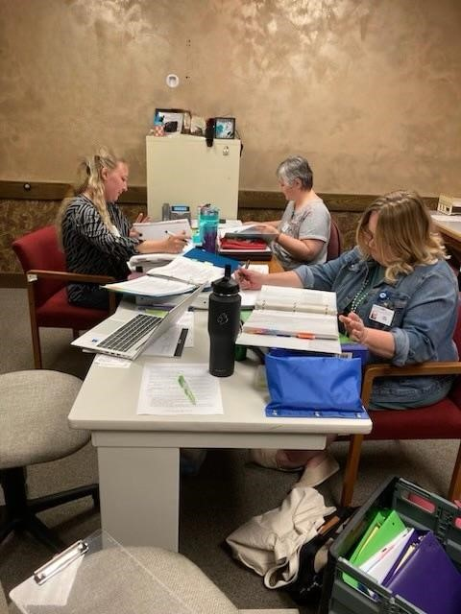
Susan Conner
Kelli Hart
Vikki Henson

Slide 22
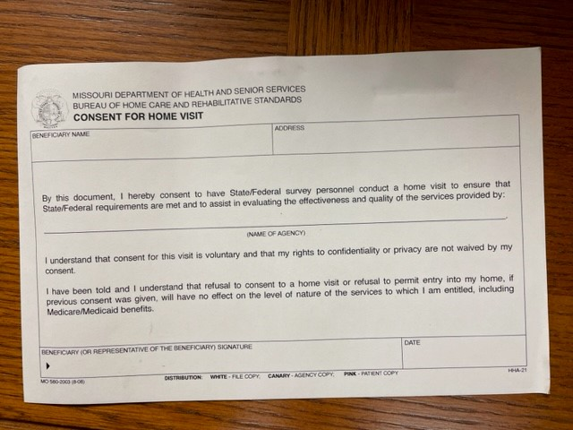

Slide 23
What Do We Observe on Home Visits?
Surveyors review the plan of care before the home visit to get a picture of the expected care.
Interaction with the patient/caregivers?
Staff following the Plan of Care?
DME being used included in POC?
Medication review system?
Infection Control being followed?
Patient educated on the Plan of Care / new interventions?
Assessment of patient relevant to the need?

Slide 24
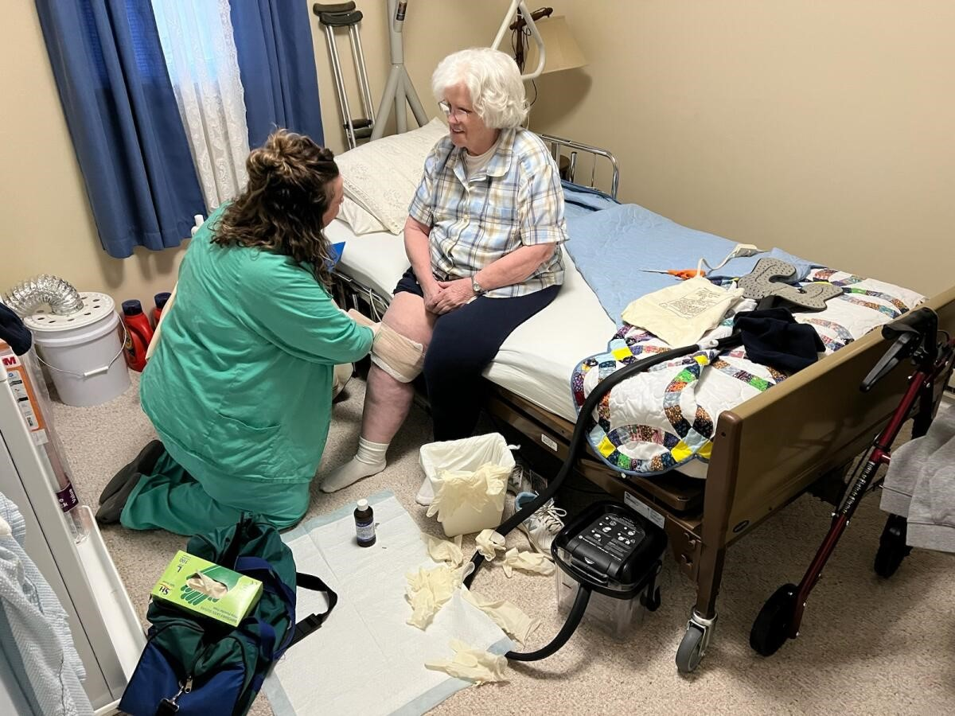

Slide 25
Questions we ask Caregivers/Patients
(after the clinician is finished)
Had any complaints, did you call the agency about it? Did you hear back from someone in the agency about your concern?
Are you involved in your care planning? (Is there verbal or written evidence that the patient is aware of and participates in the plan of care and changes to the plan of care)?
Is the care being provided as you were told it would be? Has the agency met your needs?

Slide 26
Questions we ask Caregivers/Patients
(after the clinician is finished)
Have there been setbacks or problems during your episode of home care and has the agency addressed them? Are you concerned about problems that have not been addressed by the staff to your satisfaction?
Were you instructed about: medications, wound care, treatments, home exercise program, safety, etc.?
Does the agency provide you a home health aide? - Are you satisfied with the aide care provided? - (We review aide assignment with patient/caregiver). Does the aide provide care according to the aide assignment?

Slide 29
Comparison of the National Top 5 Cited Deficiencies HOME HEALTH
Home Health - Nation
536
Home Health - Missouri
574
572*
682
578*
536
574
682
590*
514*

Slide 30
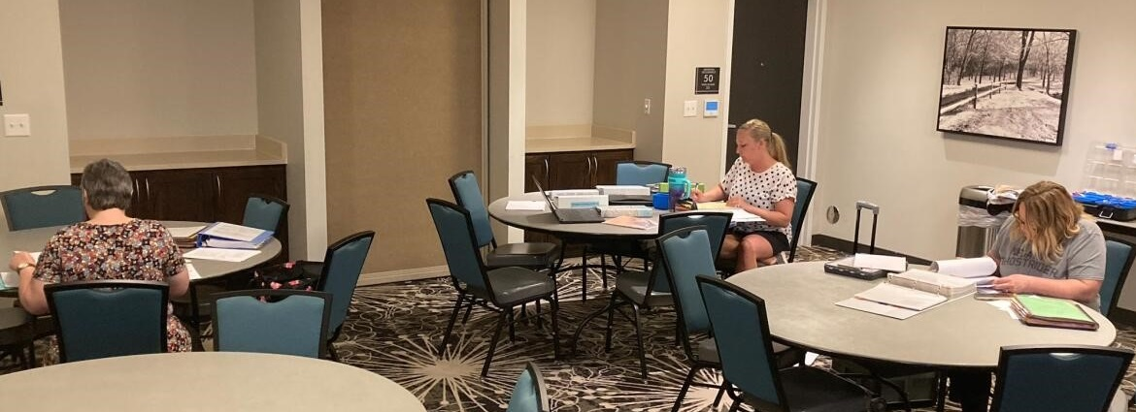
Identify the Top Five Home Health Deficiencies Missouri – 2024

Slide 31
Top Five Home Health Deficiencies (Missouri)
G536 Review of all Current Medications
G574 Individual Plan of Care
G682 Infection Prevention
G590 Promptly Alert Relevant Physician of Changes
G514 Initial Assessment - 48 hours for immediate need

Slide 32
Top reasons why G536 was deficient G536 - Review of all Current Medications
On admission: Med profile discrepancy with meds on discharge instructions, no documentation of physician notification/clarification.
All prescription meds and over-the-counter medications not included on the med profile.
Physician not notified of med discrepancies to obtain med clarification orders.

Slide 33
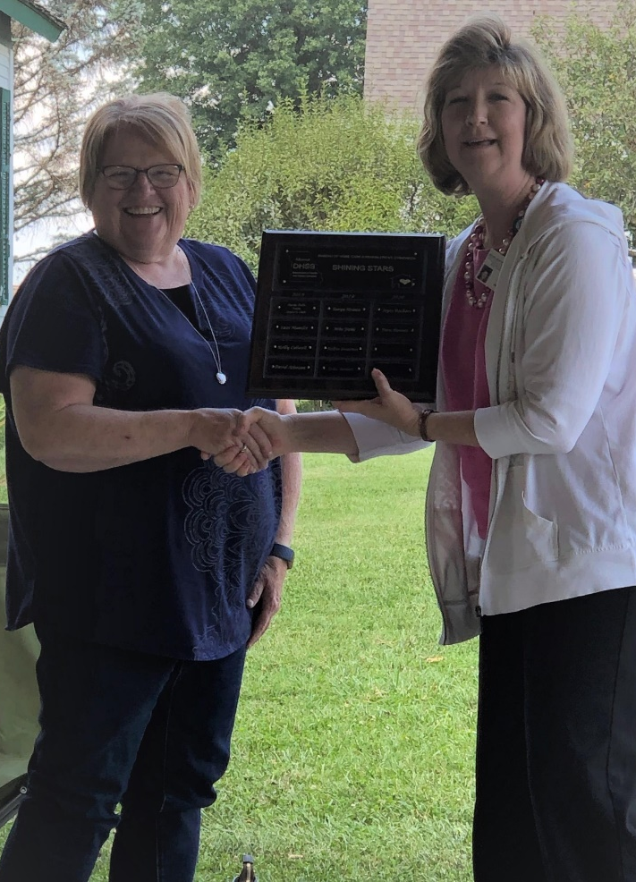
Top reasons why G536 was deficient in HH G536 Review of all Current Medications
Staff ask the patient if there was any medication changes and do not look at the meds to verify, so med profile incorrect.
The patient went to physician, med changes made and the medication profile was not updated to show changes.
Clinicians fail to ask about med regimen, effectiveness after meds were added.

Slide 34
Top Reasons Why G574 was deficient in HH: G574 -Individual Plan of Care
The POC was not addressing the care needs needs identified on assessments.
Example: The assessment shows the patient had 2+ edema in right arm. The POC showed goal was to decrease edema in right arm with no interventions listed. During the home visit OT provided lymphedema drainage (not on the plan of care).
The discharge summaries often include treatments and interventions which are not included on the POC.

Slide 35
Top reasons why G682 was deficient in HH: G682 - Infection Prevention
Real Examples:
Hand hygiene not performed between glove changes, dirty to clean, and prior to entering supply bag.
Removing a dressing from a wound and changing gloves without washing hands.
Placing supply bag on surface without cleansing the surface and/or putting down a barrier. Not following agency policy.
Placing tablet down on surface without cleansing the surface and/or putting down a barrier leave without cleaning it or place back into the supply bag.

Slide 36
Top reasons why G590 was deficient in HH: G590 - Promptly Alert Relevant Physician of Changes
The home health agency must promptly alert the relevant physician(s) to any changes in the patient’s condition or needs that suggest that outcomes are not being achieved and/or that the plan of care should be altered.
Real Examples:
The patient exhibited s/s of UTI, the nurse and OT discussed the possibility of an UTI, the physician was not notified, the patient was admitted to the hospital with an UTI.
The patient reported a fall and sustained abrasions to elbows and the physician was not notified.

Slide 37
Top Reasons Why G514 was deficient in HH: G514 - Initial Assessment by RN within 48 hours for immediate need
Within 48 hours of the patient’s return home, or on the physician or allowed practitioner- ordered start of care date.
Real Examples:
Late assessment, no RN available on to conduct the visit.
Therapy only cases, no therapist working on weekends.
Home Health agency requested a specific SOC date for their convenience, not a patient request.

Slide 38
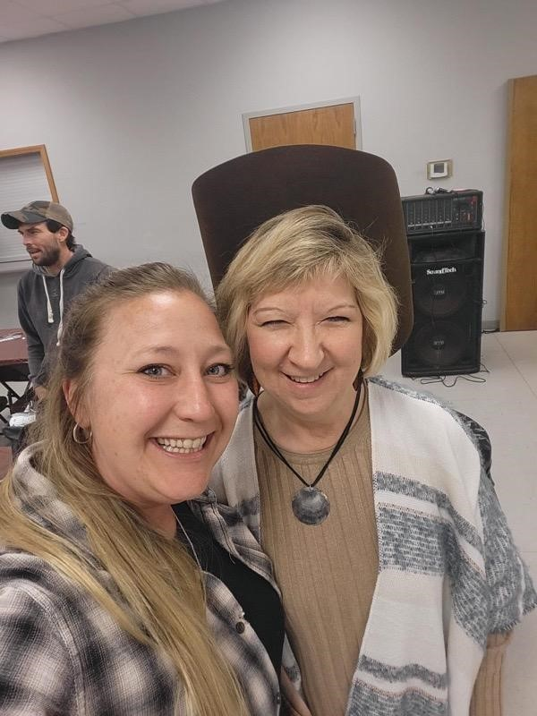
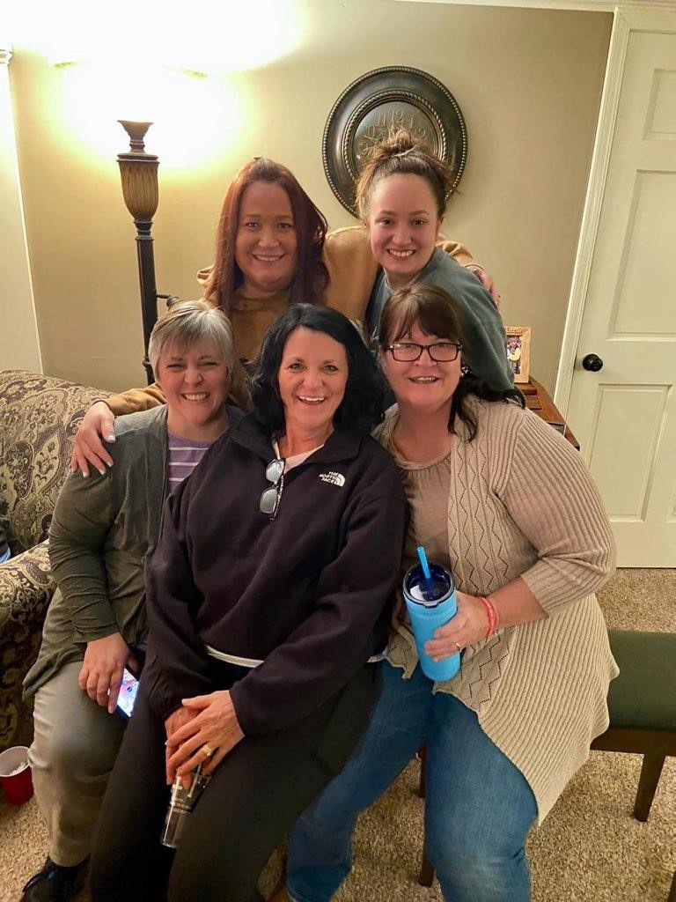
Champion Alert

Slide 39
NIH defines Clinical Champions: Clinical champions are individuals who are dedicated to supporting, advocating for, and spearheading an implementation initiative, and who overcome resistance that may occur at the organizational level. They have an intrinsic interest to implement change and use their position to motivate others. NIH research has referenced clinical champions of a specific topic such as hand-washing champions), discipline, or broadly within an organization or implementation effort.

Slide 40
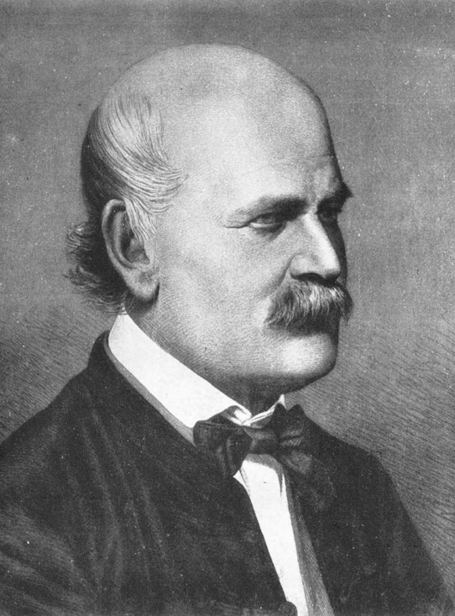
Handwashing Champion: Ignaz Semmelweis was a 19th-century Hungarian physician Ignaz who, after observational studies, first advanced the idea of “hand hygiene” in medical settings. The simple act of hand-washing is a critical way to prevent the spread of germs.

Slide 41
Comparison of the National Top 5 Cited Deficiencies HOSPICE
Hospice - Nation
530
Hospice - Missouri
545
543*
555*
579*
530
545
774*
591*
781*

Slide 42
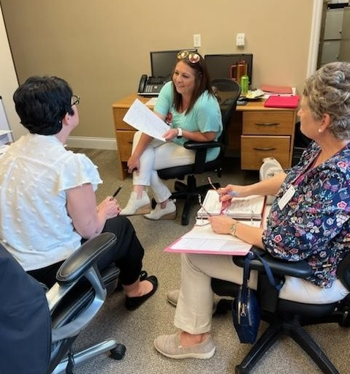
Identify the Top Five Hospice Deficiencies - Missouri 2024

Slide 43
Top Five Hospice Deficiencies (Missouri)
L530 - Drug Profile
L545 - Content of the Plan of Care
L774 - Coordinated Plan of Care
L591 - Nursing Services
L781 - Long-Term Care Facility Documents

Slide 44
Top reasons why L530 was deficient L530 - Drug Profile
Staff failed to check all medications the patient is taking on admission & compare with discharge orders from the hospital, inaccurate profile.
All over-the-counter (OTC) medications are not included on the medication profile (example OTC cough medications that interfered with blood pressure and blood sugars).
Staff failed to notify the physician of medication discrepancies for clarification orders, inaccurate profile.
Staff failed to physically compare medication bottles to the medication profile during visits in homes, and failed to compare MARs in LTC facilities, inaccurate profile.

Slide 45
Top Reasons why L545 was deficient L545 - Content of the Plan of Care
Staff failed to list goals and interventions on the POC related to the patient’s problems to individualize the POC. (example: patient has pressure area on coccyx and uses a low air loss mattress, this was not included on the POC)
Staff failed to list individualized interventions including education on the POC. (example: patient family needed education about med administration, no intervention on the POC for the education)

Slide 46
Top Reasons why L774 was deficient L774: Plan of Care
The hospice plan of care must identify the care and services that are needed and specifically identify which provider is responsible for performing the respective functions that have been agreed upon and included in the hospice plan of care.
Real Examples:
Wound Care responsibility not identified.
Tube care responsibility not identified.
I.V. dressing changes not identified.

Slide 47
Top Reasons why L591 was deficient L591: Nursing Services
Staff failed to notify the patient’s physician with changes in patient’s condition. (Example: Patient had no anxiety or shortness of breath previously, new onset of these symptoms were not reported to the physician)
Staff failed to follow the providers policies (Example: failed to measure wounds and document in the patient’s record according to agency policy)

Slide 48
Top Reasons why L781 was deficient L781 – Long-term care facility documents for coordination
Real Examples:
The hospice failed to provide the SNF with the updated plan of care when meds or interventions changed causing the patient to receive meds and treatments that were not ordered.
The hospice failed to provide the names and contact information for hospice personnel involved in hospice care.
The Hospice failed to provide the certification of terminal illnesss to the SNF.

Slide 49
Preliminary Findings Review
(Agency may provide additional info before exit)

Slide 50
Exit Conference

Slide 51
Champion Alert

Slide 52
Plan of Correction
The Statement of Deficiencies is due by email to the agency from BHCRS within 10 working days
The agency's Plan of Correction (POC) is due by email to BHCRS within 10 calendar days
POC Guidelines:
Address each deficiency (tag) and identify title of the staff member responsible.
Develop corrective actions that address the root cause of the deficient practice. Actions should be specific and realistic, stating exactly how the deficiency will be corrected.
Include monitoring actions to ensure ongoing compliance.
Use the same completion dates for all the deficiencies.

Slide 53
Plan of Correction Cont.
For standard-level survey, the completion date must be within 60 days from exit.
For condition-level survey, the completion date must be within 45 days from exit.
Do not include any patient or employee identifiable information in the POC.
Do not attach forms, policies or other documents with the POC.
Make sure the POC shows the title of the person responsible for implementation.
Sign and date the first pages of the federal and state SODs.
You will receive a survey monkey link to provide feedback on the survey.
We routinely conduct on-site revisit surveys for condition level surveys.

Slide 54
Immediate Jeopardy (IJ)

Slide 55
Immediate Jeopardy (IJ)
-A situation in which an agency’s non-compliance with a Condition of Participation (CoP) has placed the health & safety of patients at risk for serious harm, serious injury, serious impairment or death
-It represents the most severe and egregious threat to the health and safety of the patient
-It carries the most serious sanctions for providers, such as:
CMP : Civil monetary penalty.
Denial of payment for new admission.
Temporary administrator.
Directed plan of correction.

Slide 56
Key Components of an IJ
Non-Compliance: An entity has failed to meet one or more federal health, safety, and/or quality regulations.
And
Serious Adverse Outcome or Likely Serious Adverse Outcome: As a result of the identified non-compliance, serious injury, serious harm, serious impairment or death has occurred, is occurring or is likely to occur.
And
3. Need for Immediate Action: The non-compliance creates a need for immediate corrective action by the provider to prevent serious injury, harm, impairment or death from occurring or reoccurring.

Slide 57
If the survey team Identifies an IJ at your agency
Template – An IJ template will be provided to the administrator describing the IJ. At this point CMS has already had input about the IJ determination.
Removal Plan - You will develop a removal plan that has to be accepted and initiated within 48 hours of the template being provided. This plan is sent to the lead state surveyor and reviewed by the state and CMS.
Follow-up – If the removal plan is accepted then the surveyors will be back before 45th day to revisit all the condition level tags found on the survey. If the removal plan is not accepted, the team will be back ~23 days.

Slide 58
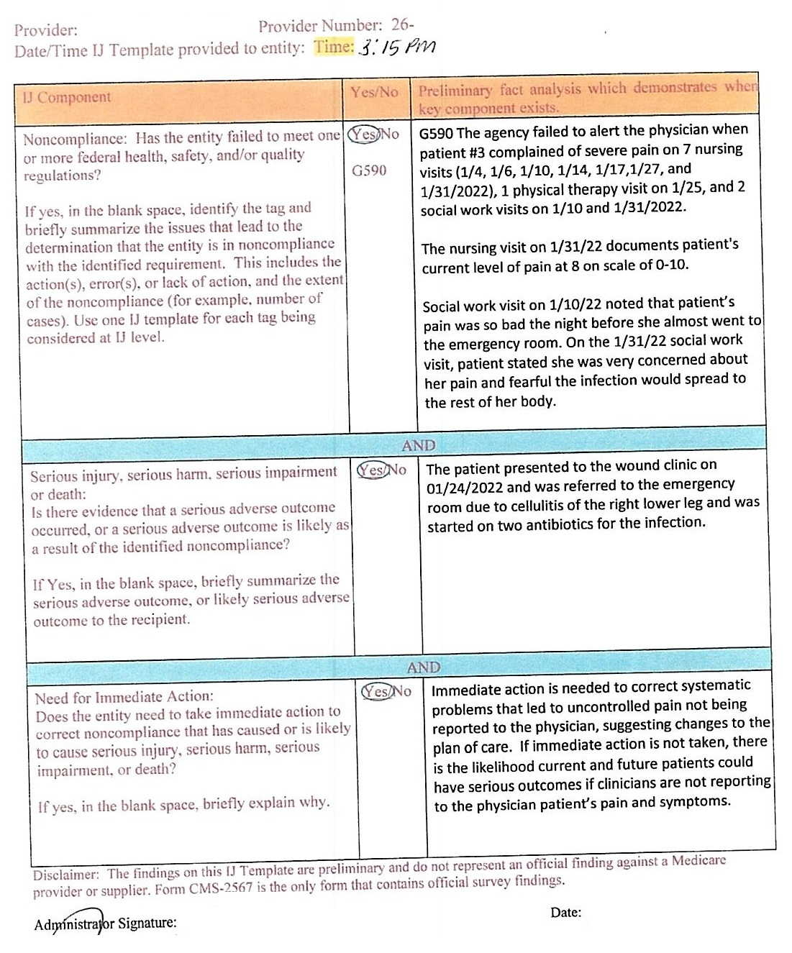

Slide 59
Key Points in Appendix Q (IJ)
An agency may state that they properly train and supervise staff and that it was a (Rogue) employee that violated the regulation; however, an agency cannot disown the acts of its employees and disassociate itself from the consequences of their actions to avoid a finding of non-compliance.
Surveyor accepting the written removal plan does not mean the IJ did not occur.
If the removal plan cannot be accepted and implemented prior to the exit conference, the IJ continues until an onsite revisit is completed.

Slide 60
BUREAU STATISTICS

Slide 67
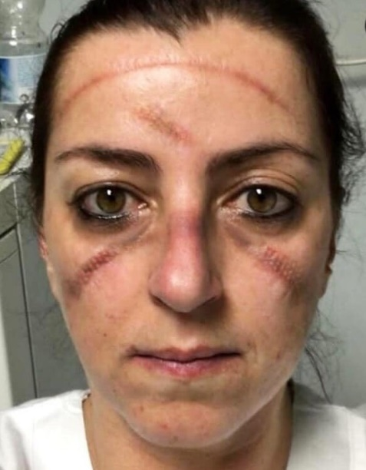
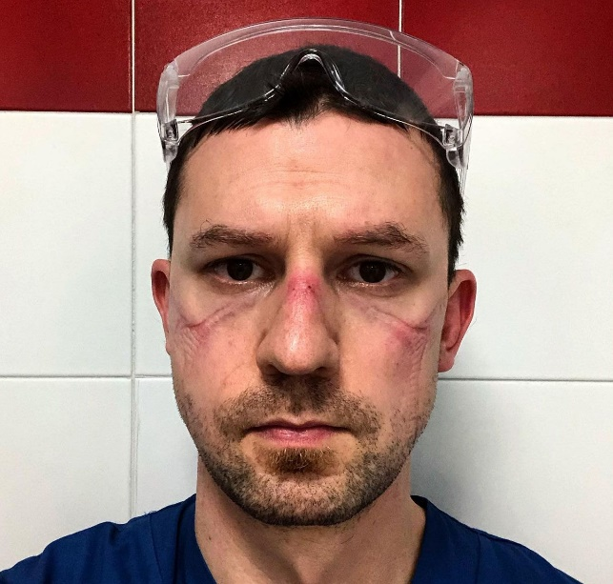
CHAMPION

Slide 76
Robin Swarnes:
Next up to talk about OASIS

Slide 77
Thank you
573/751-6336, option 3
www.health.mo.gov/safety/homecare

