Slide 1
HCBS Settings
Rule
Adult Day Care Facilities and AIDS Pathways

Slide 2
Purpose of the Final Rule
Integrated Community
Living
Quality Services
To ensure that individuals receive Medicaid HCBS in settings that have access to benefits of community living and are able to receive services in the most integrated setting
Two Primary Goals
To improve the quality of services for individuals receiving HCBS.
Notes:
1915 © Waiver Services
Department of Health has 7
Department of Mental Health has 4
Focus is on AIDS Waiver and Adult Day Care Waiver services through Division of Senior and Disability Services

Slide 3
Background and Timeline
2014
2020
2022
2023
Federal Regulation Passed
States required to submit a transition plan and all new providers shall be compliant.
Transition Plan Final Approval
CMS approved MO”s Transition plan.
Final Implementation Preparation
Requirement reminders and updates.
Full Implementation
Required by all states by March 17, 2023.
Notes:
Federal Regulation passed in 2014
States have been given the leniency to move toward implementation since then
All states were required to develop a statewide transition plan
MO’s was approved in 2017 initially then final approval in 2020
March 17, 2023 all states must be compliant with their Setting Rule Transition Plan
State staff, providers, and all provider staff are required to have a thorough understanding of the Settings Rule and ensure it is being implemented for all participants.
CMS audits

Slide 4
General Settings Requirements
Any residential or non-residential setting where individuals live and/or receive HCBS must have the following five qualities by March 2023:
Is fully integrated in and supports access to the greater community
  Provides opportunities to seek employment and work in competitive integrated settings, engage in community life, and control person resources
  Ensures that individuals receive services in the community to the same degree of access as individual not receiving Medicaid HCBS
Is selected by the individual from more than one setting option including non-disability specific settings.
Facilitates individual choice regarding services and supports, and who provides them
Ensures an individual’s rights of privacy, dignity, respect and freedom from coercion and restraint.
Optimizes individual initiative, autonomy and independence in making life choices including but not limited to daily activities, physical environment, and with whom to interact.
Notes:
The setting is fully integrated and supports access to the greater community
How are we going to do that:
Provide opportunities to seek competitive employment
Allow pts to engage in community life
Allow pts to control their personal resources
Ensure individual receive services in the community to the same degree of access as individuals not receiving Medicaid HCBS
This is important to note, the setting rules aren’t requiring you to do more, but they are asking you to give the same opportunities to someone receiving Medicaid
The individual/guardian has selected the setting including from non-disability specific settings
Allow the individual to have choice regarding services, supports and who is providing them
Need to ensure individuals have privacy, dignity, respect, and freedom from coercion and restraint
Want to make sure we allow as much autonomy and independence in making daily life choices
We recognize that some of our participants may not be able to do a lot of these independently but we want to make sure we allow as much as possible.

Slide 5
Residential Requirements (NOT ADC)
Ensure Individuals have:
  Privacy
  Choice of roommates
  Freedom to furnish and decorate their sleeping or living areas within the lease or other agreements
  Freedom and support to control their schedules and activities and have access to food any time
  Freedom to have visitors at any time
Homes have a lockable entrance door with the individual and staff having keys to door as needed
Specific dwelling is owned, rented, or occupied under a legally enforceable agreement
Same responsibilities and protections from eviction as all tenants under landlord tenant law of the county of residence.
Notes:
Provider owned and controlled – AIDS Pathways

Slide 6
Heightened Scrutiny Settings
Any locations that have qualities of an institutional setting are presumed to not be home and community based. Examples include:
Any setting located in a building that is also a publically or privately operated facility that provides inpatient institution treatment
Any setting located in a building on the grounds of, or immediately adjacent to, a public institution
Any other setting that has the effect of isolating individuals from the broader community
Example 01
Example 02
Example 03
Notes:
Settings that are not home and community-based are specified in the Final Rule: – Nursing Facility – Institution for Mental Disease – Intermediate Care Facility for Individuals with Intellectual Disabilities – Hospital – Other locations that have qualities of an institutional setting, as determined by the Secretary
Example 3 – So what do we mean here
The setting is designed to provide people with disabilities multiple types of services/activities on-site such as housing, day services, medical, behavioral and therapeutic services, and/or social and recreational activities
People in the setting have limited, if any, interaction with the broader community
The setting uses/authorizes interventions/restrictions used in institutional settings or deemed unacceptable in Medicaid institutional settings (e.g., seclusion)

Slide 7
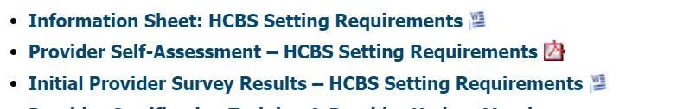
MMAC Website Information
Missouri Medicaid Audit & Compliance » Home and Community Based Services - Missouri Medicaid Audit & Compliance (mo.gov)

Slide 8
Information Sheet
Information sheet currently available refers to the original plan that was set in motion in 2016.
Per CMS requirement, we are working on the updated plan for approval which includes heightened scrutiny for the Adult Day Care programs and AIDS Waiver providers.
The information sheet outlines MMACs responsibilities and expectations to ensure the compliance of providers regarding the rule.

Slide 9
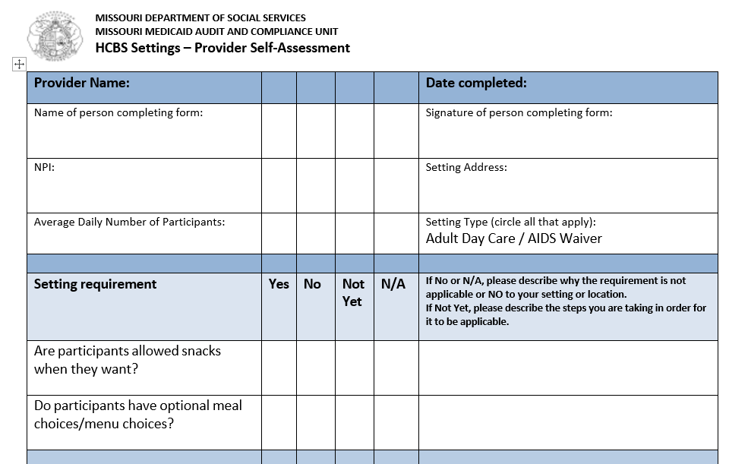
Provider
Self-Assessment
The form provides you with selection to make in regards of the setting requirements.
NOT YET – the provider is not in compliance at the time of filling out the assessment, however, they are taking the necessary step to implement it (in progress).
NO or N/A – the requirement does not apply or the provider is non-compliant; please provide an explanation when using either of these answers
YES – provider is compliant with the requirement

Slide 10
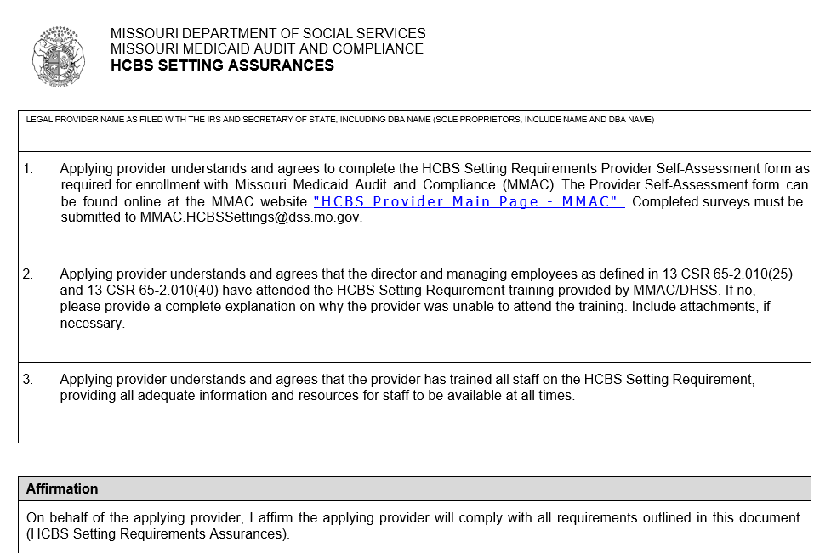
HCBS Settings Assurances Form

Slide 11
Initial Provider Survey Results
This is the collective results of the original survey that was conducted by MMAC in 2016.
It provides an overview of the findings giving the state and provider the overall issues/concerns that needed to be addressed.
It provided the parameters in which the Self-Assessment Tool is based

Slide 12
MMAC Expectations and Requirements
Annual MMAC Training
Deficiencies will be discussed, monitored, & audited by MMAC
Annual submission of Self-Assessment Form
Annual submission of HCBS Assurances Form
Ensure all staff are trained on the requirements
Forms MUST BE submitted to: mmac.hcbssettings@dss.mo.gov

Slide 13
Questions?
Send to:
LTSS@health.mo.gov or
mmac.hcbssettings@dss.mo.gov
Resources:
Check out the DHSS webpage for information as well!
Home & Community Based Services | Health & Senior Services (mo.gov)
MO HealthNet HCBS Settings
https://dss.mo.gov/mhd/waivers/hcbs-transition-plan.htm
MMAC HCBS Provider Main Page
https://mmac.mo.gov/providers/provider-enrollment/home-and-community-based-services/
Centers for Medicare and Medicaid Services
HCB SETTINGS EXCLUDED SETTINGS AND HEIGHTENED SCRUTINY (medicaid.gov)

