Slide 1


Opening Slide
PROMOTING HEALTH AND SAFETY

Slide 2

Hepatitis B and C
6+++++
2023 in Review
        Office of Epidemiology
        Division of Community Public Health

Slide 3

Table of Contents – page 1
Hepatitis B (HBV)
Background . . . . . . . . . . . . . . . . . . . . . . . 6
Missouri vs U.S. . . . . . . . . . . . . . . . . . . . . . . . 7
5-Year Trend . . . . . . . . . . . . . . . . . . . . . . . 8
Age . . . . . . . . . . . . . . . . . . . . . . . 9
Race. . . . . . . . . . . . . . . . . . . . . . . 10
Sex . . . . . . . . . . . . . . . . . . . . . . . 11
Regional. . . . . . . . . . . . . . . . . . . . .12-14
Race . . . . . . . . . . . . . . . . . . . . . . 15
Sex . . . . . . . . . . . . . . . . . . . . . 16
Perinatal Hepatitis B . . . . . . . . . . . . . . . . . . . . . 17
Each Region-Age, Race, Sex . . . . . . . . . . . . . . . . . . . . 18-23
5-Year HBV School Immunization Trend . . . . . . . . . . . . . . . . . . . . 24-25
HBV Summary Points . . . . . . . . . . . . . . . . . . . . . . . 26

Slide 4
Table of Contents – page 2
Hepatitis C (HCV)
Background . . . . . . . . . . . . . . . . . . . . . . 28
Missouri vs U.S. . . . . . . . . . . . . . . . . . . . . . . 29
5-Year Trend . . . . . . . . . . . . . . . . . . . . . . 30
Age . . . . . . . . . . . . . . . . . . . . . . 31
Race . . . . . . . . . . . . . . . . . . . . . . 32
Sex . . . . . . . . . . . . . . . . . . . . . . 33
Regional . . . . . . . . . . . . . . . . . . . 34-35
Race . . . . . . . . . . . . . . . . . . . . . 36
Sex . . . . . . . . . . . . . . . . . . . . . . 37
Each Region-Age, Race, Sex . . . . . . . . . . . . . . . . . . . . 38-43
HCV in Correctional Facilities . . . . . . . . . . . . . . . . . . . . . . . 44
HCV Summary Points . . . . . . . . . . . . . . . . . . . . . . .45
Technical Notes . . . . . . . . . . . . . . . . . . . .46-47
Resources . . . . . . . . . . . . . . . . . . . 48-49
Contact info . . . . . . . . . . . . . . . . . . . . . . .50

Slide 5

Hepatitis B
(HBV)

Slide 6
Hepatitis B Background
Is a liver disease caused by the hepatitis B virus (HBV).
Infection can result in acute (short-term) or chronic (long-term) illness.
HBV can lead to liver damage, scarring, or cancer.
Even if you don’t have symptoms, you can spread HBV through contact with bodily fluids.
The best way to prevent HBV is by getting vaccinated.
CDC recommends all adults get tested for hepatitis B.

Slide 7
Rates of Newly Reported HBV Cases
Missouri* vs US, 2023
*Total confirmed acute and chronic cases reported in Missouri, including those diagnosed in correctional facilities.
U.S. Rate Sources: Acute rate (O.7): Figure 2.2 – Acute Hepatitis B: Case Rates by Jurisdiction | 2023 Hepatitis Surveillance | CDC, Chronic Rate (6.1) : Table 2.5 – Chronic Hepatitis B: Case Rates by Jurisdiction | 2023 Hepatitis Surveillance | CDC

Slide 8
5-year Count Trend of Reported HBV
Cases Statewide, 2019-2023
Notes:
The statewide case counts for HBV decreased in 2020, likely due to the COVID-19 pandemic. Numbers are slowly increasing toward pre-pandemic levels as of 2022. There was a slight decrease in 2023.

Slide 9
Rates of Newly Reported HBV Cases by Age Group, 2023
*Rates based on case counts <20 should be considered unreliable.
Notes:
Age groups 35-44 and 45-54 have the highest rates (11.1 and 11.3), respectively, and together accounted for 44% of all reported cases.

Slide 10
Newly Reported HBV Cases by Race*, 2023
*Race was reported in 77% of the cases in 2023. Race includes all ethnicities.
Notes:
Race was reported for 77% of the HBV cases. This is an 11% improvement in reporting race from the previous year; 66% reported race in year 2022.
In 2023, ethnicity was known for 142 (38%) of the cases, of those, (98%) were non-Hispanic.
In 2023, the case counts of HBV were 1.6 times higher in the white population than black, however the rate is 4 times higher for the black population. Of the 84 cases for which “other” was reported for race, 79% were classified Asian race, and 8% were classified Pacific Islander.

Slide 11
Newly Reported HBV Cases by Sex, 2023
Males made up 61% of the newly reported HBV cases in 2023.
Notes:
Males made up 61% of the newly reported HBV cases in 2023.

Slide 12
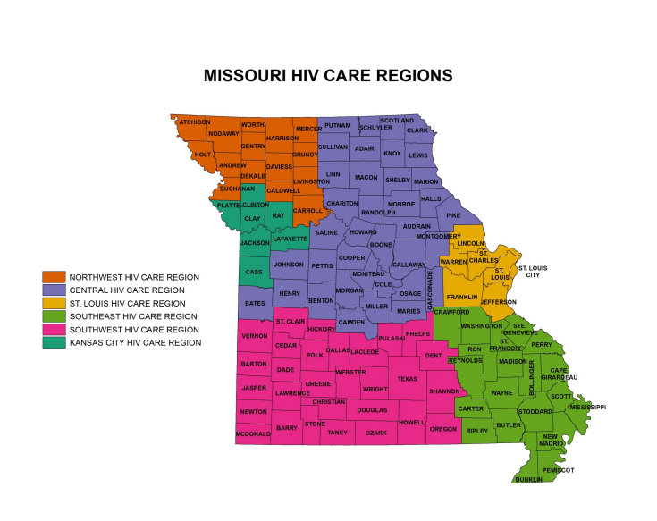
The Viral Hepatitis Program uses the same regions as the HIV program
Notes:
The Hepatitis program uses the same regions and county grouping as the HIV program.

Slide 13
5-year Rate Trend of Reported HBV
Rates by Region, 2019-2023
Notes:
From 2022 to 2023, most regions, except the Central and Southwest regions trended downward. Compared to 2019, the rates for all regions have decreased.

Slide 14
Rates of Newly Reported HBV Cases by Region, 2023
Notes:
In 2023, St. Louis had more cases reported (154) than Kansas City (92), however the rates are the same (7.2).

Slide 15
Rates of Newly Reported HBV Cases by Region and Race*2023
*Race was reported in 77% of the HBV cases.
Notes:
In 2023, 77% of the reported HBV cases included race. This is an improvement from 65.6% reported in 2022. Central, Kansas City, and St. Louis regions had significantly higher rates of “Other” race.

Slide 16
Rates of Newly Reported HBV Cases by Region and Sex, 2023

Slide 17
Perinatal Hepatitis B
Hepatitis B virus (HBV) can be transmitted from mother to baby in utero.
In 2023, there were 84 reported cases of HBsAG (Hepatitis B surface antigen) positive pregnant women; 77 among women previously diagnosed with HBV and 7 new diagnoses.
This is almost a 17% increase from year 2022.
One case of perinatal HBV transmission was reported in 2023.
Notes:
Now we are going to take a moment to talk about perinatal transmission. HBV can be transmitted from mother to baby in utero. In 2023, there were 84 reported cases of HBsAG (Hepatitis B surface antigen) positive pregnant women, 77 among women previously diagnosed with HBV and 7 new diagnoses. This is almost a 17% increase from year 2022. There was one case of perinatal HBV transmission reported in 2023.

Slide 18
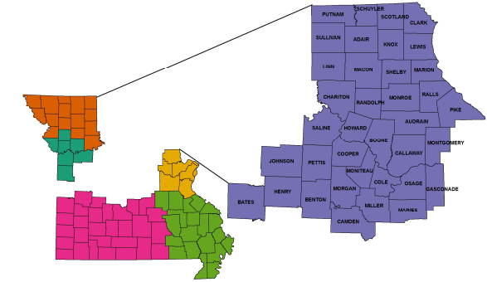
Central Region HBV Rates*, 2023
*Rates per 100,000 population. Race was reported in 77% of the HBV cases.
Notes:
In the Central Region, the age group with the highest rates were the 45-54-year-olds. In the Central Region by sex, the female rate is 2.5; this is lower than the state rate of 4.8. The male rate is 5.2, which is lower than the state rate of 7.6. per 100,000 population. For race, the identification of other has the highest rate in the Central Region at 15.4, followed by Black at 8.5, and White at 1.8 per 100,000 population. [Statewide rates Other: 23.5, Black: 10.9, White 2.5.]

Slide 19
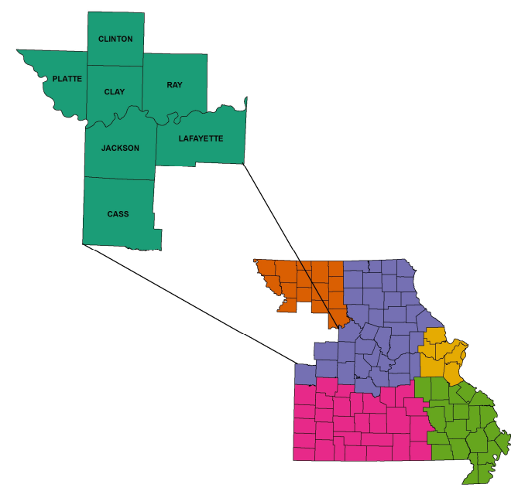
Kansas City Region HBV Rates*, 2023
*Rates per 100,000 population. Race was reported in 77% of the HBV cases.
Notes:
In the Kansas City Region, the age group with the highest rates were the 45-54-year-olds. For the Kansas City Region by sex, the female rate of 5.7 is higher than the state rate of 4.8. The male rate is 8.8, which is higher than the state rate of 7.6. per 100,000 population. For race, the identification of other has the highest rate in the Kansas City Region at 34.7, followed by Black at 7.8, and White at 2.9 per 100,000 population. [Statewide rates Other: 23.5, Black: 10.9, White 2.5.]

Slide 20
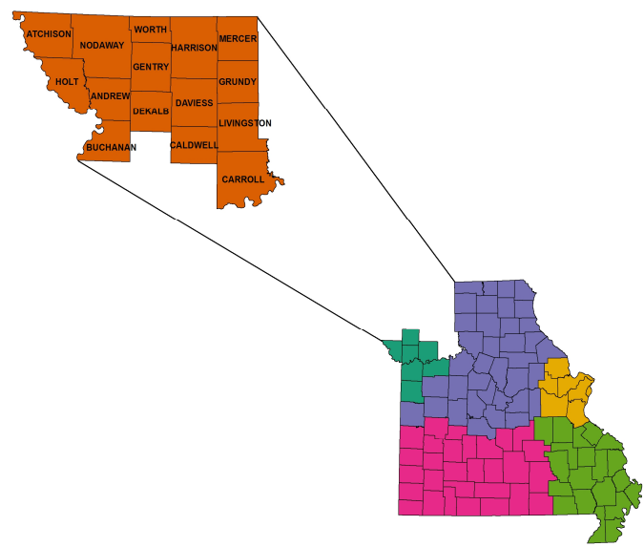
Northwest Region HBV Rates*, 2023
*Rates per 100,000 population. Race was reported in 77% of the HBV cases.
Notes:
In the Northwest Region, the age group with the highest rates were the 35-44-year-olds. In the Northwest Region by sex, the female rate is 3.8; this is lower than the state rate of 4.8. The male rate is 2.8, which is lower than the state rate of 7.6. per 100,000 population. For race, For race, the identification of Black has the highest rate in the Northwest Region at 39.5, followed by Other at 11.0, and White at 1.5 per 100,000 population. [Statewide rates Other: 23.5, Black: 10.9, White 2.5.]

Slide 21
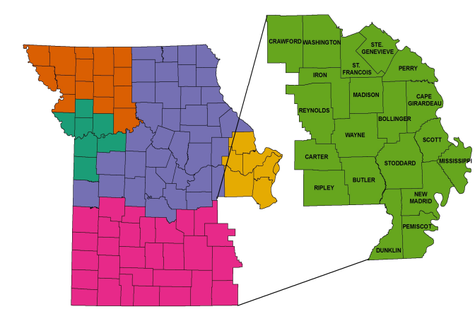
Southeast Region HBV Rates*, 2023
*Rates per 100,000 population. Race was reported in 77% of the HBV cases.
Notes:
In the Southeast Region, the age group with the highest rates were the 35-44-year-olds. In the Southeast Region by sex, the female rate is 6.3; this is higher than the state rate of 4.8. The male rate is 4.2, which is lower than the state rate of 7.6 per 100,000 population. For race, the identification of Black has the highest rate in the Southeast Region at 12.9, followed by Other at 11.07 and White at 3.7 per 100,000 population. [Statewide rates Other: 23.5, Black: 10.9, White 2.5.]

Slide 22
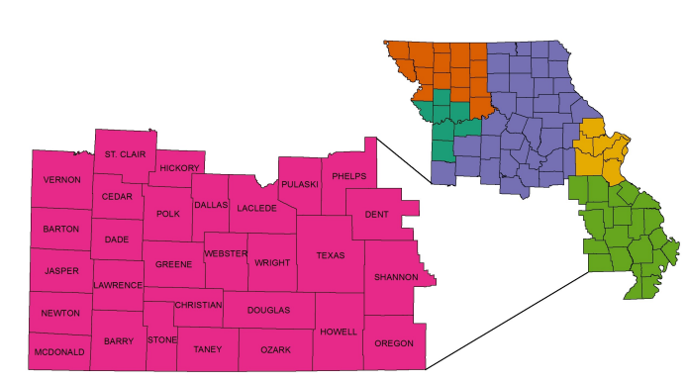
Southwest Region HBV Rates*, 2023
*Rates per 100,000 population. Race was reported in 77% of the HBV cases.
Notes:
In the Southwest Region, the age group with the highest rates were the 35-44-year-olds. In the Southwest Region by sex, the female rate is 4.0; this is lower than the state rate of 4.8. The male rate is 7.6, which is the same as the state rate of 7.6 per 100,000 population. For race, the identification of Black has the highest rate in the Southwest Region at 27.8, followed by Other at 16.8 and White at 3.4 per 100,000 population. [Statewide rates Other: 23.5, Black: 10.9, White 2.5.]

Slide 23
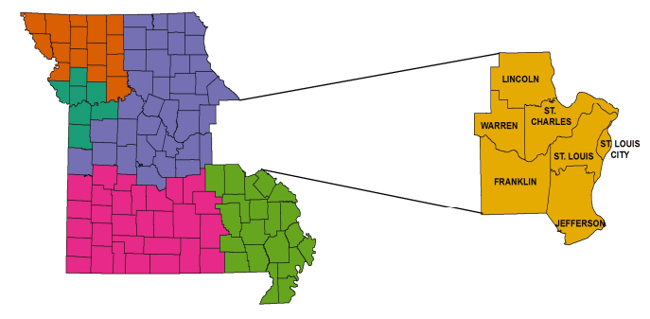
St Louis Region HBV Rates*, 2023
*Rates per 100,000 population. Race was reported in 77% of the HBV cases.
Notes:
In the St. Louis Region, the age group with the highest rates were the 45-54-year-olds. In the St. Louis Region by sex, the female rate is 5.4; this is higher than the state rate of 4.8. The male rate is 9.2, which is higher than the state rate of 7.6 per 100,000 population. For race, the identification of Black has the highest rate in the St. Louis Region at 25.5, followed by Black at 10.8, and White at 1.9 per 100,000 population.
[Statewide rates Other: 23.5, Black: 10.9, White 2.5.]

Slide 24
5-year Trend for Missouri Schools
Reported Immunization Exemptions
2020-2024
Notes:
These charts show the increasing immunization exemption rates for students who have not met vaccination requirements (including the 3-dose hepatitis B vaccine), in Kindergarten and Eighth Grade for religious and medical exemptions.

Slide 25
5-year Trend for Missouri Schools for Reported Hep B Immunization¹
2020-2024
Missouri School Immunization Requirements for Hep B: 3 or more doses of hepatitis B vaccine.
¹Missouri School Immunization Survey Statistics, August 2024, School Immunizations Dashboard | Health & Senior Services
Notes:
These charts show the decreasing immunization rates specifically for Hep B vaccination for students in Kindergarten and Eighth Grade.

Slide 26
Hepatitis B Summary Points
In 2023, there were 382 newly reported HBV cases. Males accounted for 61% of cases. Age groups 35-54 have the highest rates.
Rates for “Other” is 9 times higher than whites, with 79% of “Other” classified as Asian. Rates for Blacks is more than 4 times higher than whites.
There was an almost 17% increase from year 2022 to year 2023 in reported cases of HBSAG positive pregnant women.
There was one case of perinatal transmission reported in 2023.
In 2023-2024 school year in Missouri, 93.6% of students in public schools and 90.7% of students in private schools were fully immunized for Hepatitis B¹. Immunization percentage rates are trending downward.
¹Missouri School Immunization Survey Statistics, August 2024, School Immunizations Dashboard | Health & Senior Services

Slide 27
Hepatitis C
(HCV)

Slide 28
Hepatitis C Background
Hepatitis C can be cured. Treatment that cures hepatitis C is available.
Without treatment, most people with hepatitis C develop lifelong infection.
Early treatment can prevent serious complications, like liver scarring, liver cancer, or death.
If you have hepatitis C, talk to your doctor about treatment right away. Don’t delay.
Learn how you can protect your liver and protect others from contracting hepatitis C.
CDC – Treatment of Hepatitis C: 10-14-2025, https://www.cdc.gov/hepatitis-c/treatment/index.html

Slide 29
Rates of Newly Reported HCV Cases
Missouri* vs US, 2023
*Total confirmed acute and chronic cases reported in Missouri, including those diagnosed in correctional facilities.
U.S. Rate Sources: Acute rate (1.5):, Figure 3.2 – Acute Hepatitis C: Case Rates by Jurisdiction | 2023 Hepatitis Surveillance | CDC Chronic Rate (36.2) : Table 3.5 – Chronic Hepatitis C: Case Rates by Jurisdiction | 2023 Hepatitis Surveillance | CDC

Slide 30
5-year Count Trend of Reported HCV
Cases Statewide, 2019-2023
Notes:
The statewide case counts for chronic HCV have trended downward since 2019. Acute HCV started to trend downward from 2019 to 2021, then rose and stabilized in 2022 and 2023.

Slide 31
Rates of Newly Reported HCV Cases by Age Group, 2023
*Rates based on case counts <20 should be considered unreliable.
Notes:
The 35-44 age group had the highest rates 86.6 per 100,000 population and the largest count number (n=684) comprising of 24% of the newly reported cases, followed by the 55-64 years old group at 21%, and 25-34 age group accounted for 20%.

Slide 32
Newly Reported HCV Cases by Race*, 2023
*Race was reported in 64% of the cases in 2023. Race includes all ethnicities.
Notes:
Race was reported for 1008 (64% ) of the HCV cases.
In 2023, ethnicity was known for 754 (27%) of the cases, of those, (97%) were non-Hispanic.
While the case counts of HCV were 5.3 times higher in the white population than black, the rate is 1.3 times higher for the black population. Of the 44 cases in which “other” was reported for race, 34% were identified as multi-race, 25% were Asian Indian, 11% were classified Asian, and 29.5% fell into “other race”.

Slide 33
Newly Reported HCV Cases by Sex, 2023
Notes:
The HCV cases are split 60/40, with males making up 61% of the cases reported in 2023.

Slide 34
5-year Rate Trend of Reported HCV
by Region, 2019-2023
Notes:
From 2022 to 2023, most regions, except the Southeast and Southwest regions trend downward. Compared to 2019, the rates for all regions have decreased.

Slide 35
Rates of Newly Reported HCV Cases by Region*, 2023
*Region is based on an individual’s residence at time of reporting and align with HIV Care Regions. These rates do not include cases diagnosed in correctional facilities.
Notes:
St. Louis and Southwest regions had the highest number of cases reported in 2023, 809 and 733 respectively, but the rate is nearly 2 times greater for the Southwest region at 67.4 per 100,000 population compared with St. Louis at 34.5 per 100,000 population. The Northwest region has the highest rate of 85.8 per 100,000 population with the lowest number of cases reported (182).

Slide 36
Rates of Newly Reported HCV Cases by Region and Race*, 2023
*Race was reported in 64% of the HCV cases.
Notes:
In 2023, 64% of the reported HCV cases included race. Of those identified, 82% (1468 out of 1790) cases were white, however the rates for the black population are higher in most regions., except the Southeast region where white rates were higher than Black. The Northwest Region had a significantly higher rates for those identified as Black or White., as compared with the statewide rates. The Black rate was 2.7 times the statewide rate for Blacks; the White rate was 2.1 times the statewide rate for Whites.

Slide 37
Rates of Newly Reported HCV Cases by Region and Sex, 2023
Notes:
The rate of males for most regions is between 1.3 to 1.8 times higher than for females. However, in 2023, the Northwest Region case rate for males was 4.8 times greater than for females and 2.5 times higher for males compared with the statewide rate for males.

Slide 38
Central Region HCV Rates*, 2023
*Rates per 100,000 population. Race was reported in 64% of the HCV cases.
Notes:
In the Central Region, the age group with the highest rates were the 35-44-year-olds. In the Central Region by sex, the female rate is 35.2; this is slightly higher than the state rate of 34.5. The male rate is 52,.0, which is lower than the state rate of 56.3. per 100,000 population. For race, the identification of Black has the highest rate in the Central Region at 25.4, followed by White at 24.9, and Other at 4.4 per 100,000 population. [Statewide rates Black : 38.3, White: 28.8, Other: 12.3.]

Slide 39
Kansas City Region HCV Rates*, 2023
*Rates per 100,000 population. Race was reported in 64% of the HCV cases.
Notes:
In the Kansas City Region, the age group with the highest rates were the 55-64-year-olds. In the Kansas City Region by sex, the female rate is 22.8; this is slightly lower than the state rate of 34.5. The male rate is 38.1, which is lower than the state rate of 56.3. per 100,000 population. For race, the identification of Black has the highest rate in the Kansas City Region at 23.4, followed by White at 23.1 and Other at 17.3 per 100,000 population. [Statewide rates Black : 38.3, White: 28.8, Other: 12.3.]

Slide 40
Northwest Region HCV Rates*, 2023
*Rates per 100,000 population. Race was reported in 64% of the HCV cases.
Notes:
In the Northwest Region, the age group with the highest rates were the 35-44-year-olds. In the Northwest Region by sex, the female rate is 29.4; this is lower than the state rate of 34.5. The male rate is 141.2 which is 4.8 times higher compared with females in the region and 2.5 times higher than the state rate of 56.3. per 100,000 population. For race, the identification of Black has the highest rate in the Northwest Region at 105.3, followed by White at 61.4 and Other at 22.0 per 100,000 population. The rate of testing positive for HCV for Blacks was 2.7 times higher than for the Black statewide rate, Whites were 2.1 times the White statewide rate. [Statewide rates Black : 38.3, White: 28.8, Other: 12.3.]

Slide 41
Southeast Region HCV Rates*, 2023
*Rates per 100,000 population. Race was reported in 64% of the HCV cases.
Notes:
In the Southeast Region, the age group with the highest rates were the 35-44-year-olds. In the Southeast Region by sex, the female rate is 55.7; this is higher than the state rate of 34.5. The male rate is 70.1, which is higher than the state rate of 56.3. per 100,000 population. For race, the identification of White has the highest rate in the Southeast Region at 40.3, followed by Black at 32.2 per 100,000 population. [Statewide rates Black : 38.3, White: 28.8, Other: 12.3.]

Slide 42
Southwest Region HCV Rates*, 2023
*Rates per 100,000 population. Race was reported in 64% of the HCV cases.
Notes:
In the Southwest, the age group with the highest rates were the 35-44-year-olds. In the Southwest Region by sex, the female rate is 57.2; this is higher than the state rate of 34.5. The male rate is 77.5, which is higher than the state rate of 56.3. per 100,000 population. For race, the identification of Black has the highest rate in the Southwest Region at 45.2, followed by White at 43.4, and Other at 21.0 per 100,000 population. [Statewide rates Black : 38.3, White: 28.8, Other: 12.3.]

Slide 43
St Louis Region HCV Rates*, 2023
*Rates per 100,000 population. Race was reported in 64% of the HCV cases.
Notes:
In the St. Louis Region, the age group with the highest rates were the 35-44-year-olds. In the St. Louis Region by sex, the female rate is 24.6; this is lower than the state rate of 34.5. per 100,000 population. The male rate is 44.8 which is lower compared with the state rate of 56.3. per 100,000 population. For race, the identification of Black has the highest rate in the St. Louis Region at 46.1, followed by White at 17.1, and Other at 8.3 per 100,000 population. The rate of testing positive for HCV for Blacks was 2.7 times higher than Whites. [Statewide rates Black : 38.3, White: 28.8, Other: 12.3.]

Slide 44
Statewide Correctional Data*, 2023
*Cases include confirmed acute and chronic cases and INCLUDE cases diagnosed in state and federal correctional facilities located in Missouri.

Slide 45
Hepatitis C Summary Points
In 2023, there were 2,798 newly reported HCV cases.
Males accounted for 61% of cases.
Age group 35-44-years-old had the highest rate.
The statewide rate for those identified as Black is 1.3 times higher than those identified as white.
In 2023, there were an additional 625 HCV cases reported while the person was in correctional facilities. This is 18% of the total number of newly reported cases sent to CDC.
From CDC for year 2023, Missouri’s total HCV rate was 1.5 times greater than the U.S. rate. Missouri ranked 12th highest in rates for chronic HCV.
Notes:
In 2023, there were 2,798 newly reported HCV cases, 10 acute, 2,788 chronic.
Males accounted for 61% of cases.
Age group 35-44 have the highest rate, 86.6 per 100,000 population.
Race was reported for 64% of cases. Case counts for white population were 5.3 times higher than black population, however, the rates for blacks (38.3) is 1.3 times higher than whites (28.8). The “Other” category is the lowest rate at 12.3 per 100,000 population.
For region by race, the category “Black” had the highest rates, except in the Southeast region. The category “White” had the highest rate.
Ethnicity was reported in 27% of cases. Of the 754 reported cases, 97% were non-Hispanic.
The Northwest Region had the highest rate of 85.8 per 100,000 population with the smallest number of cases (182). The Southwest Region had the second highest rate 67.4 with the largest number of cases (809).
There is a more than 8% decrease in newly reported cases of HCV from 2019 to 2023.
From 2022 to 2023, most regions’ rates trended downward or stayed level, except the Southwest region that went from 5.0 to 5.5, a 10% increase in rate.
In 2023, there were an additional 625 HCV cases reported while the person was in correctional facilities. This is 18% of the total number of newly reported cases sent to CDC.
According to the latest data available from CDC for year 2023, Missouri’s acute HCV rate of 0.2 was the second lowest rate of newly reported acute HCV. However, Missouri ranked as the 12th highest in rates for newly reported chronic HCV (55.6) per 100,000 population.

Slide 46
Technical Notes – page 1
In many instances, the first report of HBV or HCV infection does not occur until several years after the initial infection, so at best, the trends in reported cases can only approximate actual trends in new infections.
The data presented in this report are current as of publication. However, the data may differ from previous reports as new information is received. Limitations to data collection do exist, such as incomplete race, ethnicity, and risk information and underreporting. Missouri currently does not have the capacity to conduct investigations on all viral hepatitis conditions, which impacts the collection of risk factors and associated data.
Rates have been calculated per 100,000 persons. Unless otherwise noted, the denominator for calculating rates is based on the population data, extracted from MICA for the period reported. The numerator is the number of cases reported during the period. This number is divided by the population estimate and multiplied by 100,000. Rates where the numerator is less than 20 cases should be interpreted with caution due to unreliability.

Slide 47
Technical Notes – page 2
Case counts and rates exclude persons reported while in state and federal correctional facilities, unless otherwise noted.
Age categories are based upon age at the time of reporting.
Race data excludes those with unknown or missing racial category.
Sex is based on sex reported at birth.
Region is based on an individual’s residence at time of reporting and align with HIV Care Regions. State and county of diagnosis do not change even if a person moves to a different county or out-of-state.

Slide 48
Resources – page 1
Missouri Viral Hepatitis Epidemiological Profile, 2017 – 2021.
Data Sources
Hepatitis Case Data Source: WebSurv pulled 1/31/2025 for confirmed acute and chronic Hepatitis cases.
Population Data Source: MICA. Population pulled 2/4/2025. Missouri’s population was estimated at 6,177,957 in 2022.
Hepatitis B (HBV)
Hepatitis B, acute (historical version) 2012 Case Definition | CDC
Hepatitis B, chronic (historical version) 2012 Case Definition | CDC
Hepatitis B, Perinatal Infection 2017 Case Definition | CDC
Figure 2.2 – Acute Hepatitis B: Case Rates by Jurisdiction | 2023 Hepatitis Surveillance | CDC
Table 2.5 – Chronic Hepatitis B: Case Rates by Jurisdiction | 2023 Hepatitis Surveillance | CDC

Slide 49
Resources – page 2
Hepatitis C (HCV)
Hepatitis C, Acute 2020 Case Definition | CDC
Hepatitis C, Chronic 2020 Case Definition | CDC
Figure 3.2 – Acute Hepatitis C: Case Rates by Jurisdiction | 2023 Hepatitis Surveillance | CDC
Table 3.5 – Chronic Hepatitis C: Case Rates by Jurisdiction | 2023 Hepatitis Surveillance | CDC
Latest Revision 10/06/2025 3:20pm

Slide 50

Health.Mo.Gov

