Slide 1
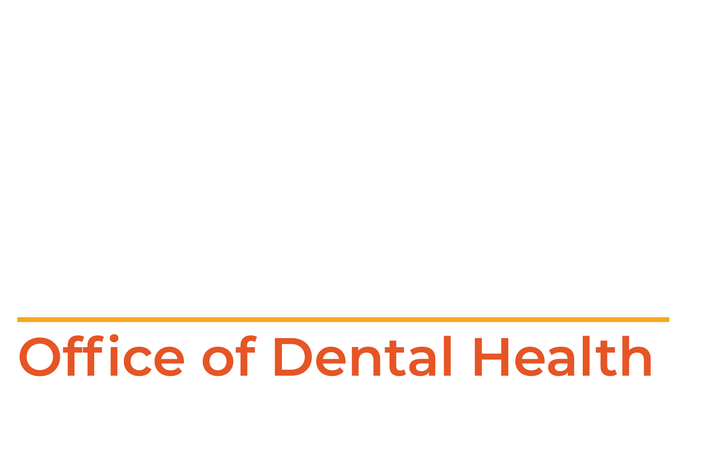
What is the ODH, What we do, and
How we can help you!
Jacqueline Miller DDS MS MPH, Dental Director
Julie Boeckman, Project Manager
Notes:
Good Morning, I am Dr. Jacqueline Miller, Missouri’s State Dental Director for the Office of Dental Health, and would like to tell you all about the ODH, office of dental health, what we do and how we can help you!

Slide 2
Office of Dental Health Mission
We are committed to improving the oral health of all Missourians through education, prevention and leadership.
Notes:
Here at the department we are committed to improving the oral health of all Missourians through education, prevention and leadership.

Slide 3
Notes:
I would like you to meet our Office of Dental Health team: On the back row from left to right, is Julie Boeckman our public health program manager, Gwen Sullentrup, our public health program specialist with community water fluoridation and dental sealant coordinator, Molly McBride-Mooty an oral health consultant with our preventive services program, Clark Oelrichs our data analysist, Dione Snitker, the lead administration support assistant, Kally Kline, public health program specialist, Jeffrey Bellamy OHC, Ann Hoffman, OHC, and on the left front Audrey Hendee OHC, myself and Kelsey Siegel OHC.

Slide 4
SUMMARY
1.
MISSOURI ORAL HEALTH SURVEY OF VULNERABLE ADULTS, 2022
2.
REVIEW HRSA GRANT WITH ODH PILOT PROJECTS
3.
REVIEW HIGHLIGHTS OF ODH WORKFORCE SURVEY
4.
REVIEW THE THREE MAJOR BARRIERS TO PROVIDING CARE TO UNDERSERVED AREAS OF MISSOURI
5.
FUTURE PROJECTS and HOW WE CAN HELP YOU!
Notes:
Here is a quick summary of what we will be covering in this presentation. First we will be reviewing the highlights of the Missouri Oral Health Survey of Vulnerable adults, next we cover the latest Health Resources and Services Administration grant. Third, we will review the highlights of the ODH workforce survey, next we will review three major barriers to providing care to underserved areas of Missouri. Finally, we will look at future projects and how we can help our local public health clinics.

Slide 5
THE ORAL HEALTH OF ADULTS LIVING IN MISSOURI’S SKILLED NURSING FACILITIES
SEPTEMBER 2022
Notes:
Hot off the press, The Missouri Oral Health Survey of Vulnerable adults, the survey included 254 residents with the mean age of 75, from 22 skilled nursing facilities. We found 73% of residents had fewer than 20 teeth that we consider severe tooth loss and 38% of residents were completely edentulous. 40% had untreated decay and 29% had gum disease in need of periodontal care. Almost half of the residents in long term nursing homes have poor oral hygiene. Unfortunately in this population, Medicare does not cover most dental care.

Slide 6
Teledentistry Pilot Project
Notes:
The survey of the Oral Health of adults living in Missouri’s Skilled Nursing Facilities has bolstered support for the a newly awarded grant. With the securing of a Health Resources and Services Administration grant to investigate the use of teledentistry as a method for dentists to supervise hygienists and assistants extend into nursing homes and other underserved high-risk populations including veterans. We are hoping to expand EFDA training and remove bottlenecks to make training more accessible which could increase productive capacity 15-25%.

Slide 7
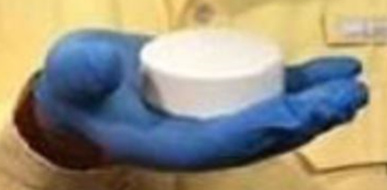
NEW WAVE COMMUNITY WATER FLUORIDATION
Notes:
Another innovative way the ODH is helping Missouri is with the first ever, New Wave Community Water Fluoridation program.
ODH was approved for a $825,000 grant for piloting this project which has developed this pellet fluoride technology, this is the first new CWF technology in 40 years, it is intended for small, rural water districts (<8000) people. We are actually having a Fluoride Summit next week near Popular Bluff, Missouri, about the new technology which is drawing interested parties from all over the US and Canada.

Slide 8
DENTAL WORK FORCE SHORTAGE
Notes:
On a different note, lets talk about the dental work force in Missouri. The oral healthcare workforce was inadequate and strained before Covid-19. Team members were lost in all positions in oral healthcare facilities. This is more than just a dental hygienist shortage. A 2021 workforce survey was undertaken.

Slide 9
States ranked by shortage of dental providers — California is No. 1
The U.S. is in need of 11,742 dental practitioners to relieve shortage areas, according to data from the Health Resources and Services Administration.
Here are all 50 states and Washington D.C. ranked by number of HRSA-designated shortage areas in 2022:
1. California: 513
2. Missouri: 341
https://www.beckersdental.com/benchmarking/39153-states-ranked-by-shortage-of-dental-providers-california-is-no-1.
Notes:
According to the online publication: Beckers dental plus DSO, Missouri is 2nd in the nation for HRSA-designated shortage areas of dental practitioners.

Slide 10
ESTIMATED LOSS
1-3%
Dentists
5-8%
Hygienists
3-5%
Administrative
5-12%
Dental Assistants
Notes:
In Missouri, we estimate: 1-3% dental practitioners lost, estimated between 25-70 dentists retired or left the field. 5-8% of hygienists were lost, an estimated 200-280. Dental assistants lost about 350-600 or 5-12% of the workforce and front office lost 3-5% about 75-150 administrative.

Slide 11
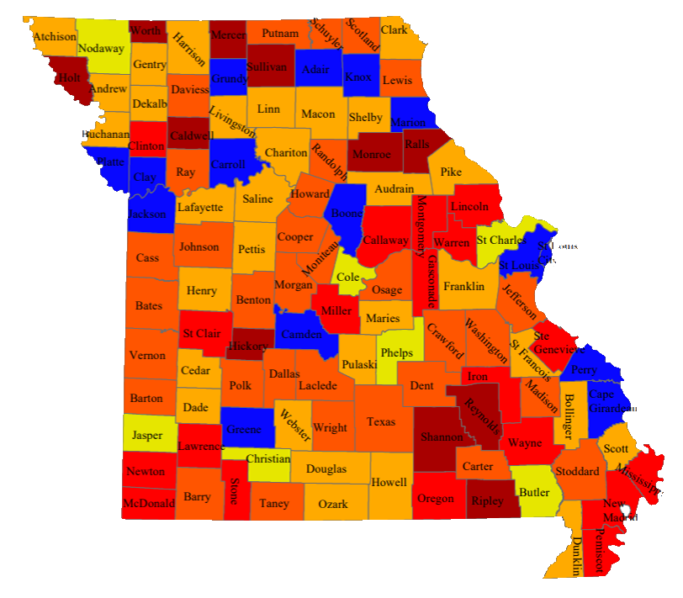
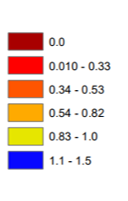
HRSA Dentists Shortage Area
All counties NOT colored blue
Notes:
General dentists’ numbers indicate a negative trend where there were 2,763 in the year 2014, and
current reports show 1,498. This decrease in the number of practicing general dentists can be attributed to the access to health care issues that certain counties are affected by. All areas NOT colored blue are dentist shortage areas. Overall 99/114 counties have shortages of dentists. In summary there is an estimated 2 million Missouri citizens in these underserved populations.
There are several barriers to providing care to the underserved populations: these include Medicaid remuneration, workforce issues (1-10% workforce attrition due to Covid) and rules of Supervision which were developed before telehealth which prevents extending care to underserved populations.
Since the last report conducted in the year 2014, there has been a marked decrease in the number of practicing dentists, including specialists, from 3,274 to 2,104 in 2021. This opens avenues for further analysis and measures to improve these numbers.

Slide 12
DENTAL MEDICAID
REMUNERATION
FEE SCHEDULE HAS INCREASED
FROM 38% TO 80% OF UCR
Notes:
Here is the good news, the number 1 barrier to addressing dental access for underserved populations is Medicaid remuneration. Previously the remuneration was 38% of usual and customary rates leading to poor uptake of Medicaid by Missouri dental providers. With the most recent budget, Medicaid remuneration has increased by 120%. The Medicaid dental budget will be increasing from $1.065 million to $3.49 for 2022 and in 2023 the budget will be $8.79 million.

Slide 13
ADULT EXPANSION ENROLLEES AT A 10% UTILIZATION: 17,000
LONG TERM HEALTH CARE FACILITIES AT 20% UTILIZATION MAY INCREASE UTILIZATION BY 12,000
HIGH RISK CHILDREN FROM K THROUGH 8TH GRADE AT AT 20% UTILIZATION INCREASE OF 48,000
INCREASED CARE LOAD IS A TOTAL OF 77,000
Notes:
What are the estimated numbers of new patients?
According to MOHealth Net for adults there are 170.000 enrolled with 275,000 newly eligible
Additionally there is an estimated additional Medicaid dental patients at a 10% utilization
Estimated number of patients in long term care facilities is 65,000 in the 1183 Missouri facilities, unfortunately only an estimated 6% or 61,000 are receiving care, so if there is a 20% utilization rate, an additional 12,000 patients might receive care.
An estimated kindergarten through 8th grade with a high risk of caries in DHCSA (36% decay rate) at a 20% utilization rate may add an additional patients of 48,000.
This is an increased care load which needs to be handled by a dwindling dental workforce

Slide 14
Expand EFDA training and remove barriers to practice to the full scope of practice
Pilot program dental assisting programs in high schools
Notes:
What are some ways to address this work shortage? Besides expanding EFDA training and working to allow hygienists to practice at the top of their scope, we are also investigating, with another pilot project, the possibility of high school students training as dental assistants and graduating with both a diploma and a certificate in dental assisting. Nevada has been working on this program and we are hoping to start a program with a career center in Farmington.

Slide 15
Notes:
Some other actions to increase the workforce include, Support an increase in dental education funding for state-supported dental education programs. Also KCU is starting a dental school in Joplin with a class of 80 starting in 2023.

Slide 16
Dental professionals serving in shortage areas
Notes:
Advocate for expanding and funding the tuition rebatement program for dental professionals who serve in dental high need (Health Professionals Shortage Areas) areas after graduation.

Slide 17
Notes:
Encourage dialog between the MDA and the MDHA on acceptable workforce agreements and improve the culture that has inhibited collaboration.

Slide 18
Pregnant Moms Need Dental Care Too
Contracts with three LPHAs
Provide Oral Health Education
Make Dental Appointment at Clinic
Educate Obstetricians on importance of dental care during pregnancy
Notes:
Some other ways we serve the Missouri population is with our contracts with three LPHAs to specifically provide oral health education, to help make appointments at the associated dental clinic and to educate OBGYNs in their area on the importance of dental care during pregnancy. Which leads me to the next slide on incorporating oral education in our training of health care providers, called the 100 Million Mouths Campaign.

Slide 19
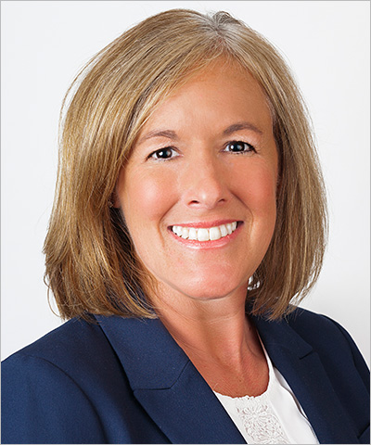
100 Million Mouths Campaign
Melanie Simmer-Beck at simmerbeckm@umkc.edu
Notes:
The One Hundred Million Mouths Campaign (100 MMC) is a project which will create fifty oral health champions over the next decade. This program seeks to help non-dental health profession programs integrate oral health into their curriculum. Missouri was one (out of only 14 states) in the U.S. targeted for this program because residents in the state have some of the most significant oral health problems. The goal of the program is to train as many medical, physician assistant, nursing, and nurse practitioner learners as possible to realize that the mouth affects overall health. 100 MMC is recruiting medical, physician’s assistant, nursing, and nurse practitioner educational and residency programs, located in Missouri, who are interested in integrating oral health into their curriculum. If you or someone you know is interested in participating, please contact the Missouri 100 MMC Champion, Melanie Simmer-Beck at simmerbeckm@umkc.edu.

Slide 20
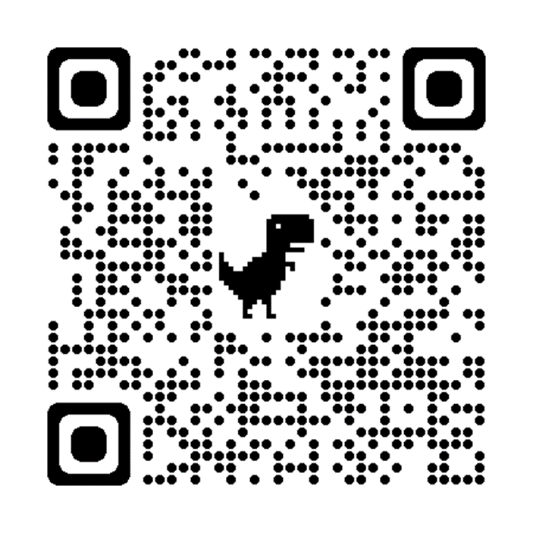
WHAT CAN THE OFFICE OF DENTAL HEALTH DO FOR OUR LOCAL PUBLIC HEALTH CLINICS?
Notes:
Okay before I start talking about all the awesome things the Office of Dental Health and our website can do for our LPHA members, let me start with a QR code for all the high tech audience members out there that do not want to take the time to write down the following our website.

Slide 21
health.mo.gov/oralhealth
A few items available on webpage-
Oral Health related videos
HPV Vaccination Information
Literature/Education available
Water Fluoridation Information
Oral Health Data
Notes:
On Office of Dental Health (ODH) webpages have videos relating to oral health, information about dental sealants, head and neck cancer, community water fluoridation, It has information about the HPV vaccination and how it can prevent head and neck cancer. There is a page for professionals that provides Missouri oral health statistics, information about the oral health of children and adolescents, diabetes and oral health, dental diagnosis codes and the relationship between oral health and overall well being. Did you know there is a health professional financial incentive programs that include loan repayment programs for health care professionals? A link to information is on our website. You can use our website to locate low-cost dental services for your patients, you can investigate oral health and of course utilize oral health statistics to apply for grants for your area.

Slide 22
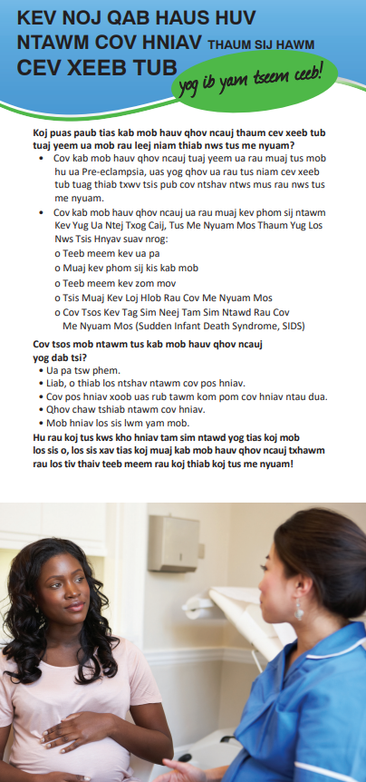
Oral Health Education page - Oral health literature, all available to download and in multiple languages!
Notes:
There is a page with a wealth of oral health literature for all ages and in multiple languages, including Spanish, Bosnian, Dari, and French, just to name a few.

Slide 23
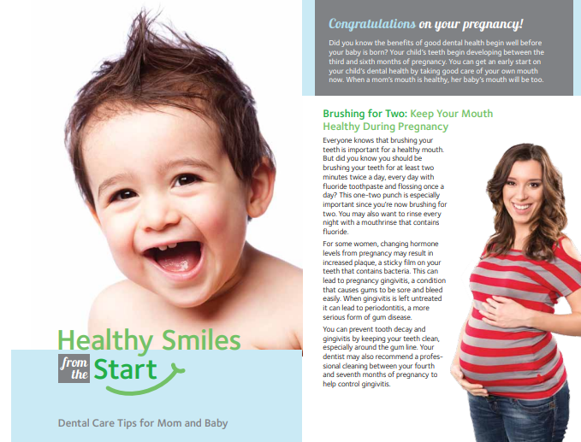
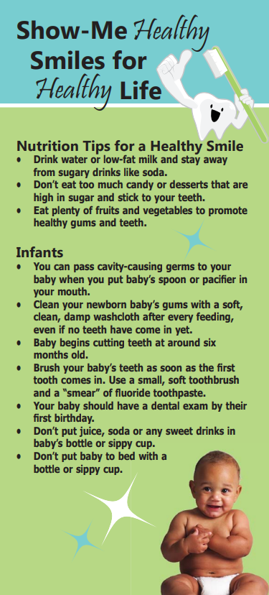
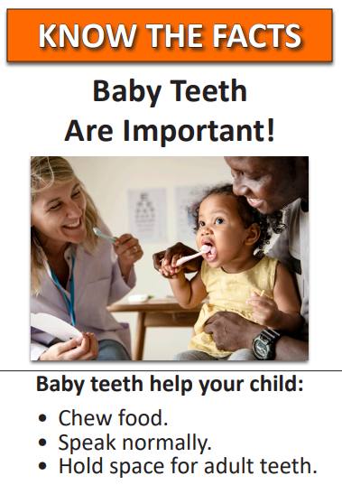
Notes:
There are printable brochures to print out and post in your clinic or hand out to your patients, they are also available in our warehouse for you to order at no charge.

Slide 24
COMMUNITY WATER
FLUORIDATION (CWF)
Notes:
The ODH is supportive of all community water fluoridation in the state. CWF achieves 25% decay reduction in all citizens regardless of income or other socio-economic factors. CWF has a very low cost of $.05 per day per person and can save
One dollar in CWF returns in $25 in averted dental care. CWF helps you in your clinics to decrease dental decay.

Slide 25
Notes:
We work with local communities that are fluoridating and ensure they are fluoridating and ensure they are meeting the public health recommended range of 0.6-1.0 ppm. If they are not, then we work with them to find out what might be causing the issue—faulty equipment, not accurate training and education or maybe they stopped without following Missouri statute RSMo 640.136. We work with funding from Delta Dental, PHHS and ARPA to upgrade and replace equipment. Work with communities that have initiated rollbacks (cessation) to educate and keep them fluoridating, work on new initiations to fluoridation and provide dental education to dental providers, decision makers and the general public about water fluoridation. These are all ways the ODH can help the LPHAs to improve medical and oral health in their areas.

Slide 26
Preventive Services Program (PSP)
Oral Health Education
Oral Health Screening
Fluoride Varnish Application (2)
Referrals
Community Based
Notes:
The Preventive Services Program (PSP) is a community based oral health program dedicated to promoting healthy smiles for all of Missouri’s children through education and preventive treatment. Local schools can sign up and receive information on our website. It consists of local dental providers administering an oral health screening, which includes a fluoride varnish application on the day of the screening and a follow up application at a later time. It also includes oral health education and toothbrushes and toothpaste all at no charge. It also provides a referral, which consists of a note going to the school nurse and parent that the child requires treatment and a time frame as to when the treatment needs to be sought. Many times the dental professional conducting the screening is affiliated with a local dental clinic and will give priority to a child they saw through a PSP event so they can receive treatment.

Slide 27
WIC Fluoride Varnish
11 LPHAs are participating
Contracts end February 28, 2023
938 Medicaid children received varnish since 2019
$12,663 Reimbursed from Medicaid (under the remuneration rate of $13.50/application)
New remuneration rate is $36
938 x $36 = $33,768
Notes:
There are 11 LPHAs that are participating in our Fluoride Varnish program. As a result of the program 938 Medicaid children have received Fl varnish, which strengthens the teeth and makes them more resistant to decay acids that cause cavities. Each fluoride varnish application could be reimbursed at $13.50 per application. New remuneration rate is about $36. Either a nurse or hygienist needs to apply the varnish in order to be reimbursed through Medicaid. Under that rate, LPHAs could have been reimbursed $33,768. Expenses for this program are the fluoride varnish (36 cents/unit under state contract), PS for person educating/applying varnish or if you want to give toothbrushes, toothpaste, (which can also be purchased through state contract) etc. or any equipment you may want to purchase, which is minimal since varnish can be applied while both you & child are seated at a typical chair.

Slide 28
How do I order varnish for my clinic?
Contact/Ordering information:
Nanova Biomaterials, Inc.
orders@nanovabio.com, 573-875-6682
Contract # CC211820001.
Mention your affiliation with DHSS ODH when ordering
Order minimum - 1 case = 8 boxes of 200 applications per box at $72.00 per box ($0.36 per application)
Notes:
All LPHAs can purchase Fluoride Varnish at DHSS Office of Dental Health Prices from Nanova Biomaterials, Inc., Liang Chen, Director of Dental Department – chenliang@nanovamed.com and Vickie Yang – yangvickie@nanovabio.com; or orders@nanovabio.com, 573-875-6682. Contract # CC211820001. Please mention your affiliation with MO DHSS ODH when placing an order. Order must be for 1 case, 8 boxes of 200 applications per box at $72.00 per box or $0.36 per application.

Slide 29
How do I order oral health supplies?
Zion Miracle Products DBA Zdental
orders@zdental.com, 888-228-7706
Contract #CC202367001
Mention your affiliation with DHSS ODH when ordering
Toothpase 17.5 cents/tube
Floss 19 cents/item
Tootbrush 20-21 cents/brush (depends on size)
Notes:
All LPHAs can purchase dental supplies (toothbrushes, toothpaste and floss) at DHSS ODH contracted prices from Zion Miracle Products DBA ZDental, Paul Zajas – p.zajas@zdental.com or orders@zdental.com, 888.228.7706. Contract # CC202367001. Please mention your affiliation with MO DHSS ODH when placing an order. You can order toothpaste as low as 17.5 cents a tube, floss for 19 cents a tube and toothbrushes range from 20-21 cents per toothbrush.

Slide 30
Thank you for your time!
Any questions?
Jacqueline.Miller@health.mo.gov
Julie.Boeckman@health.mo.gov
Notes:
Thank you for allowing me to share all the wonderful things the Office of Dental Health can do for you, are there any questions.

