Slide 1
A Vision for Tomorrow:
The Future of Missouri’s Public Health Workforce
John Thomas
Chief People Officer/Workforce Director

Slide 2
Role of Workforce Director is broadly distributed in 3 slices
Coordinator
Collaborator
Conductor
Manage various aspects of grant and report to DHSS Acting Director
Oversee development of learning paths and curriculum development
Serve on grant evaluation advisory committee
Coordinate leadership academy
Coordinate internship program
Coordinate academic partnerships
Promote organizational change through lens of Trauma-Informed Approaches
Primary liaison between DHSS and DHEWD
Identify and recruit SME’s for leadership development program

Slide 3
Why should there be any hope?
Unprecedented turnover
Strained relationships
Tired and demoralized teams
Multiplied stress and anxiety

Slide 5
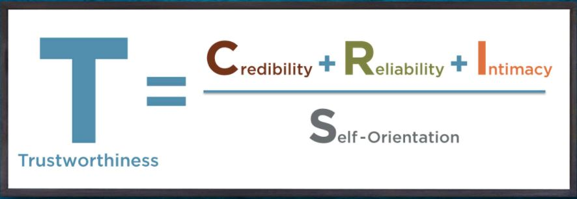
The trust equation provides a blueprint
Charles Green, www.trustedadvisor.com

Slide 6
Individually, list as many 3-letter body parts as you can think of in 30 seconds.
Self-select small groups of people around you. Combine lists as a group and name as many as many as you can.
Notes:
Eye
Hip
Arm
Leg
Ear
Toe
Jaw
Rib
Lip
Gum

Slide 7
“The whole is greater than the sum of its parts.”
-Aristotle

