Slide 1
Saving Lives. Reducing Hospitalizations. Keeping Us Safe.

Slide 2
Agenda
Introduction
Priority Distribution Phases
How to Get the Vaccine
Information Resources
Next Steps

Slide 3
Key Messages
This plan prioritizes saving lives and protecting our most vulnerable citizens.
We are and have been implementing our plan, which we established in the fall and submitted to the federal government.
Today, we are activating Phase 1B – Tier 1, and on Monday, January 18, we will activate Phase 1B – Tier 2. We will continue to vaccinate the 1A population as we move into the next phase.
Until there is enough vaccine for everyone who wants one, we have to prioritize the exceptionally limited supply we have.
Even though we are activating the next tier, there are currently not enough vaccines for everyone in them. Based on new federal guidance, we anticipate additional vaccine supply. We are activating the next tier to ensure the greatest coverage as the supplies arrive and to allow vaccinators and organizations to plan for the next phases.
1A vaccinators who have available supply can begin vaccinations for Phase 1B – Tier 1 today and 1B – Tier 2 on Monday.
Citizens should contact their local pharmacy or healthcare provider or visit MOStopsCovid.com.

Slide 4
COVID-19 Vaccine Priority Distribution Phases

Slide 5
How It All Works
Pharmaceutical companies manufacture the vaccine.
Federal government’s “Operation Warp Speed” ships to states based on population, but new guidance also emphasizes vaccination uptake among priority populations.
Each state sets its own priorities and distribution plan.
Vaccinators request that the state approves their vaccine shipment order.
State monitors progress and makes redistribution decisions.
Citizens receive their vaccination.
Notes:
This could be a graphic

Slide 6

Missouri’s Plan Prioritizes Saving Lives.
Missouri Priorities, in Order
Saving lives, reducing hospitalizations, and keeping us safe
Preserving the essential functions of society
Accelerating equitable economic recovery

Slide 7
Missouri’s Plan Prioritizes Saving Lives.
Reality of the situation
Eventually, everyone who wants a vaccination will get it. This plan does not determine if someone can get a vaccine or not.
Until there is enough vaccine for everyone who wants one, we have to prioritize the exceptionally limited supply we have.
Our first priority is to save lives by protecting our highest risk citizens because they are the most vulnerable.
What we can do now
Plan: Make a plan based on your organization’s needs.
Basics: While we are waiting for additional supply, continue taking the basic precautions as you have during the pandemic.
Adapt: Many organizations have figured out how to operate and adapt. They need to keep doing this a little longer.

Slide 8
Missouri’s Plan Prioritizes Saving Lives.
Missouri’s plan is a statewide approach, ensuring that all citizens will have the opportunity to receive the vaccine, regardless of where they live.
We understand that everyone wants to know when the vaccine will be available to them.
Unfortunately, there is no way to predict the timeline.
The timeline is entirely based on the availability of the vaccine and when we receive the shipments.

Slide 9
Sequential Vaccination Rollout
Phase 1A
Healthcare
Phase 1B
High Risk & Critical Infrastructure
Emergency services, public works, public health and first responders (Tier 1)
High-risk individuals (Tier 2)
Phase 2
Equitable Economic Recovery
Remaining critical infrastructure
Phase 3
Remaining Unvaccinated
Initial critical infrastructure & continuity of government (Tier 3)
Higher education
Anyone who has still not been vaccinated but wants to do so
Disproportionately affected populations
Long term care facilities patients and staff
Hospital workers
Home health
Urgent care
Vaccinator staff
Congregate healthcare settings
EMS/EMT/Paramedics
Each phase/tier will be activated sequentially when supply is available.
1A
1B – T1
1B – T2
1B – T3
2
3

Slide 10
We Must Prioritize Because of a Limited Supply and a Large Population.
Anyone that is a High Risk Individual is eligible in Phase 1B – Tier 2, which is about 40% of our total state population.
Estimated Size of Each Priority Phase
Priority Population | Phase/Tier | People
Healthcare & Long Term Care Settings | Phase 1A | ~500,000
First Responders & Emergency Services | Phase 1B – Tier 1 | ~200,000
High Risk Individuals | Phase 1B – Tier 2 | ~2,500,000
Critical Infrastructure Equitable Economic Recovery Remaining Unvaccinated | Phase 1B – Tier 3 Phase 2 Phase 3 | ~2,950,000
Total Population of Missouri |  | ~6,150,000
Notes:
Update population data

Slide 11
A Note about Essential Employees
This plan will not distinguish between essential and nonessential personnel within an organization in a priority phase.
Any employee at organizations within the priority phases listed below is eligible for vaccination at the time that phase or tier is activated.
Notes:
Does this make sense

Slide 12
A Note about Definitions
Any priority that is listed below as “Sector” (E.g. Energy Sector) is defined by the U.S. Cybersecurity & Infrastructure Security Agency, an independent agency within the U.S. Department of Homeland Security.
Priorities that are not specifically listed as a Sector are defined below or as noted on MOStopsCovid.com.
Notes:
Add website

Slide 13
COVID-19 Vaccine
Phase 1A

Slide 14
Phase 1A: Activated December 14, 2020
Healthcare and Care Facilities Saving lives, reducing hospitalization, and keeping us safe
Group A | Hospitals, long-term care facilities and residents, including Department of Mental Health (DMH)-operated facilities.
Group B | Home health, hospice, dialysis centers, urgent care.
Group C | Vaccinator staff and those administering COVID testing.
Group D | Congregate community healthcare settings staff and residents, including DMH contracted settings and adult day cares.
Group E | EMS and high-risk non-congregate healthcare, including clinics, physicians, and home care providers.
Group F | All remaining patient-facing healthcare providers, including but not limited to health care workers in emergency shelters, dental offices, school nurses, pharmacies, public health clinics, mental/behavioral health providers, and correctional settings.

Slide 15
COVID-19 Vaccine
Phase 1B & 2

Slide 16
Phase 1B – Tier 1: Activated January 14, 2021
First responders, Emergency Services, and Public Health Infrastructure Saving lives, reducing hospitalization, and keeping us safe
Non-Patient Facing Public Health Infrastructure | Administrators and staff at federal, state, or local public health agencies and other healthcare workers who carry out functions necessary to the operation of Missouri’s healthcare infrastructure that were not included in 1A.
First Responders | All federal, state, and/or local first responders beyond EMS/EMTs in 1A, including law enforcement, fire services, corrections, and certain social service agencies.
Emergency Management & Public Works | Federal, state, or local government employees in emergency management and public works agencies, including identified nonprofit organizations designated as partner voluntary agencies.
Emergency Services Sector | Employees defined in the emergency services sector not otherwise listed, including law enforcement, fire and rescue services, emergency medical services, emergency management, and public works.

Slide 17
Phase 1B – Tier 2: To Be Activated January 18, 2021
High-Risk Individuals Saving lives, reducing hospitalization, and keeping us safe
Anyone aged 65 and older | 1,227,983
Any adult with certain comorbidities: | 1,254,955
 | Cancer Chronic Kidney Disease COPD Intellectual and/or developmental disabilities such as Down Syndrome Heart Conditions Weakened immune system due to organ transplant Severe obesity (BMI >40) Pregnancy Sickle Cell Disease Type 2 Diabetes Mellitus
Initial population estimate: Approximately 2.5 million Missourians.
Notes:
Update with final comorbid and size

Slide 18
Phase 1B – Tier 3: Activated TBD
Critical Infrastructure Preserving the essential functions of society
Education | Teachers, faculty, and staff in public, private, and nonprofit pre K – 12.
Childcare | Faculty and staff in a DHSS and DSS-licensed facility providing basic care to children.
Communications Sector | Employees at public, private, or nonprofits that provide communications services.
Dams Sector | Employees at public, private, or nonprofits that provide services in the dams sector related to water retention and control services.
Energy Sector | Employees at public, private, or nonprofits that provide energy services, regardless of the energy source.
Food/Agriculture Sector I | Employees of food production and processing facilities, distribution, and retail sales, including grocery and convenience stores; includes veterinary services.
Government | Elected officials in any branch of government at any level required for the continuity of government; Employees designated by the federal government; other personnel required for the continuity of government.
Information Technology Sector | Employees at public, private, or nonprofits that provide IT services.
Nuclear Reactors, Materials, and Waste Sector | Employees at public, private, or nonprofit organizations that work in this sector.
Transportation Systems Sector | Employees in the transportation systems sector including aviation, highway and motor carriers, maritime transportation systems, mass transit and passenger rail, pipeline systems, freight rail, and postal shipping.
Water and Wastewater Systems Sector | Employees at public, private, and/or nonprofits that provide drinking or wastewater services.

Slide 19
Phase 2: Activated TBD
Equity & Economic Recovery Accelerating equitable economic growth
Chemical Sector | Employees engaged in the manufacture, store, use, and transport of chemicals and other diverse products in the chemical sector.
Commercial Facilities Sector | Employees engaged in activities related to the eight subsectors within the commercial facilities sector.
Critical Manufacturing Sector | Employees in critical manufacturing engaged in the production of certain goods.
Defense Industrial Base Sector | Employees that contribute to products and services that are essential to mobilize, deploy, and sustain military operations and national defense.
Financial Services Sector | Employees within the financial services sector.
Food/Agriculture Sector II | Remaining populations within the sector not included in 1B, including restaurants.
Government | Other state and local government designated personnel required to provide essential services.
Higher Education | Faculty and staff at public, private, and/or nonprofit institutions.
Disproportionately Affected | Populations at increased risk, with emphasis on racial/ethnic minorities.
Homeless | Populations at increased risk of acquiring or transmitting COVID-19.

Slide 20
How to Get the Vaccine

Slide 21

Vaccine Comes to You
1
2
3
Alignment to Priority Phases
Phase 1A
Phase 1B – Tier 1
Phase 1B – Tier 2
Phase 1B – Tier 3
Phase 2
Phase 3
Employer Initiated
Employer contracts with an approved 3rd party vaccinator
Vaccinator schedules vaccinations with employees
Employees receive vaccination
Employees are protected
5
4

Slide 22


You Go to the Vaccine
1
2
3
Alignment to Priority Phases
Phase 1A
Phase 1B – Tier 1
Phase 1B – Tier 2
Phase 1B – Tier 3
Phase 2
Phase 3
Individual Initiated
Individual makes an appointment with provider or pharmacy, or contacts their local health agency
Provider or Pharmacy screens and approves individual according to phase
Individuals receive vaccination
Individuals are protected
5
4

Slide 23

Community Events
1
2
3
Alignment to Priority Phases
Phase 1A
Phase 1B – Tier 1
Phase 1B – Tier 2
Phase 1B – Tier 3
Phase 2
Phase 3
Individual Initiated
Individual finds an event
Individual signs-up online and is screened and approved according to phase
Individual receives vaccination
Individuals and communities are protected
5
4

Slide 24
Information & Resources

Slide 25
Eligibility Screening
Anyone seeking a vaccination must provide a verification of their eligibility when their phase/tier is activated.
A screening form will allow citizens to be vetted into their phase and tier. This screening process will be the only requirement for verification.
We ask citizens to do their part, self-indicate their eligibility, and attest that their selection is truthful.
Forms will be available at MoStopsCOVID.com, at their vaccinator, or integrated into their vaccinator’s electronic registration system.
If signing up directly with a provider or pharmacy, citizens will not need to complete a separate screening form on the state’s website unless directed by their provider or pharmacy.

Slide 26
Information for Citizens: MoStopsCovid.com
MOStopsCovid.com
  Get the facts about the vaccine.
  Find out when you will be eligible to receive the vaccine based on the phased approach.
COVID-19 Hotline
  (877) 435-8411
When your phase is activated
  Contact your healthcare provider or pharmacy to learn about additional requirements and other details about receiving your vaccine.
  This may include community vaccination events.

Slide 27
Information for Businesses: MoStopsCOVID.com
Submit inquiries related to:
  Volunteering your services to help
  Moving to a different priority phase
  Questions about your vaccine priority phase
Enroll as a vaccinator if you have an on-site licensed doctor or nurse, or other authorized vaccinator, to conduct your own on-site vaccination for your employees. You may also consider contracting with a third party provider.
Review the Employer Playbook to learn more about what you should be doing now to prepare for when your phase is activated.
Learn about community vaccination events.

Slide 28
Next Steps

Slide 29
After today’s announcement, we will work through the next planning steps.
Continued planning with providers and pharmacies to expand access across the state.
Establishing community vaccination events, as needed.
Determining when to activate the next phases.
Continued outreach and communications with citizens.

Slide 30
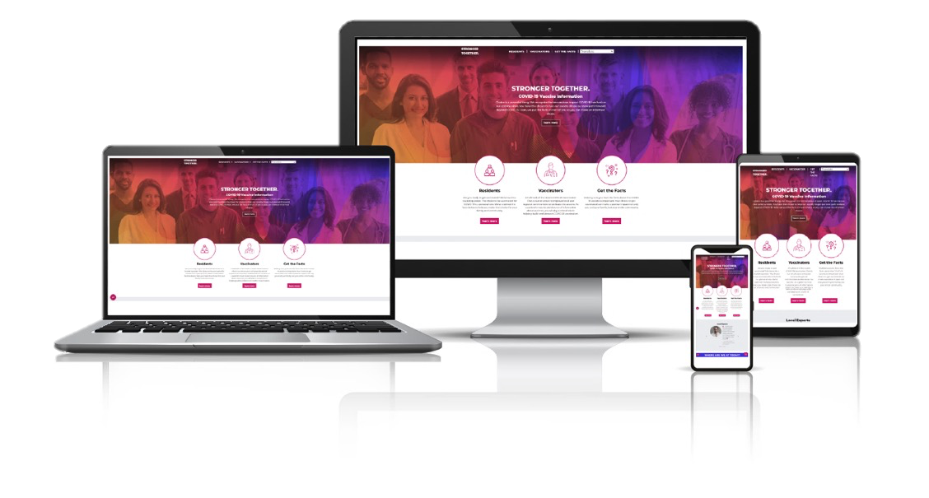
STAY IN TOUCH
1
Directly
Tell us today
2
Online
MOStopsCovid.com
3
Email
CovidVaccine@health.mo.gov

Slide 31
Key Messages
This plan prioritizes saving lives and protecting our most vulnerable citizens.
We are and have been implementing our plan, which we established in the fall and submitted to the federal government.
Today, we are activating Phase 1B – Tier 1, and on Monday, January 18, we will activate Phase 1B – Tier 2. We will continue to vaccinate the 1A population as we move into the next phase.
Until there is enough vaccine for everyone who wants one, we have to prioritize the exceptionally limited supply we have.
Even though we are activating the next tier, there are currently not enough vaccines for everyone in them. Based on new federal guidance, we anticipate additional vaccine supply. We are activating the next tier to ensure the greatest coverage as the supplies arrive and to allow vaccinators and organizations to plan for the next phases.
1A vaccinators who have available supply can begin vaccinations for Phase 1B – Tier 1 today and 1B – Tier 2 on Monday.
Citizens should contact their local pharmacy or healthcare provider or visit MOStopsCovid.com.

