Slide 1
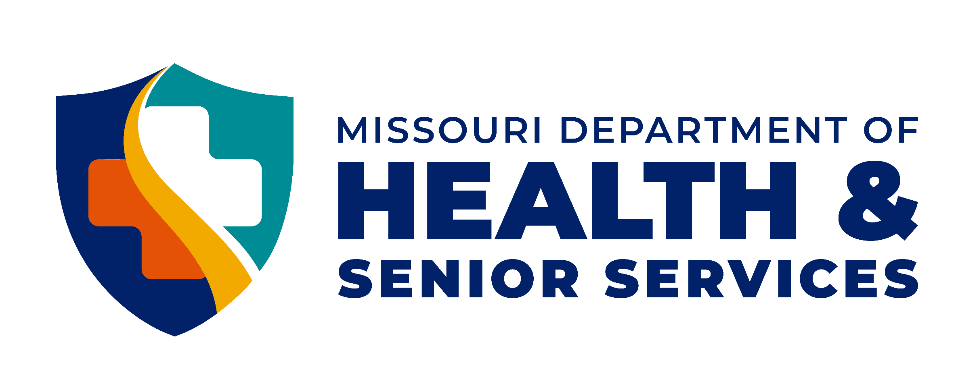
Health.Mo.Gov

Slide 2
Oral Health Is Overall Health
Notes:
Good morning. My Name is: I am a ……. In the Office of Dental Health.

Slide 3
Importance of
Oral Health Care
Oral and overall health, and disease are closely interconnected
Oral infections make other disease processes worse
Chronic disease very often has oral signs occurring early in the disease process which is very helpful in diagnosis
Notes:
Oral and overall health, and disease are closely interconnected
Oral Infections make other disease processes worse
Chronic diseases very often has oral signs occurring in the disease process which is very helpful in diagnosis. In the study “Poor oral health status and adverse COVID-19 outcomes: A preliminary study in hospitalized patients¹,” results showed that there was an association between poor oral health especially with periodontal disease and severe COVID-19 outcomes in hospitalized patients.
1. Costa CA, Vilela ACS, Oliveira SA, et al. Poor oral health status and adverse COVID-19 outcomes: a preliminary study in hospitalized patients. J Periodontol. 2022;1-13. https://doi.org/10.1002/JPER.21-0624

Slide 4
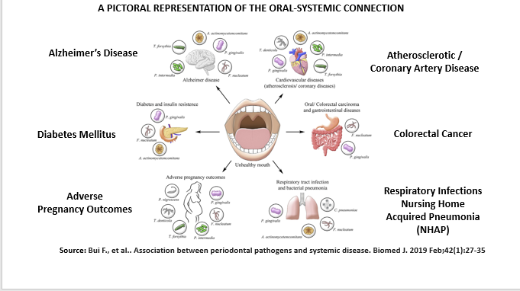
Notes:
Oral health is related to Alzheimer's disease, coronary artery disease, diabetes, colorectal cancer, respiratory infections and adverse pregnancy outcomes. It’s bad enough that we can have cavities, losing our teeth or suffer from gum disease.
According the American Heart Association, poor oral health could increase your chances of developing heart disease. The exact link is unknown but they think the bacteria, or the inflammatory response from the bacteria, might cause inflammation of the heart and more plaque buildup in the vessels. The cause and effect has not been established so we are waiting for more research to be done.
Diabetes is one area we do know can have a direct impact on the infections in the bones and gums around teeth. Diabetes and your mouth have blood sugar in common. If blood sugar levels are out of control in the body, it is also out of control in the mouth. With the sugar to feed on the bacteria levels grow and thrive. With the bacteria levels so high, gum disease is prevalent. And because diabetes lowers a person’s resistance to infection, managing gum disease is not easy. Frequent professional dental cleanings and good oral care habits at home are a must in helping to control blood sugar levels.
Osteoporosis may lead to tooth loss as well because the density of the bone supporting the teeth may be decreased. Recent studies have suggested a link between osteoporosis and the onset and progression of gum disease. Although more research is needed to understand this link; the risk of tooth loss is three times greater for women with osteoporosis than for women who did not have the disease.
Researchers have found that the bacteria that grows in the oral cavity can be aspirated into the lungs and cause respiratory diseases such as pneumonia, especially in people with gum disease. Pneumonia is one of the most common causes of death among the elderly in hospitals and nursing homes. The bacteria in the oral cavity are found in dental plaque and can form on natural teeth as well as partials and dentures.

Slide 5
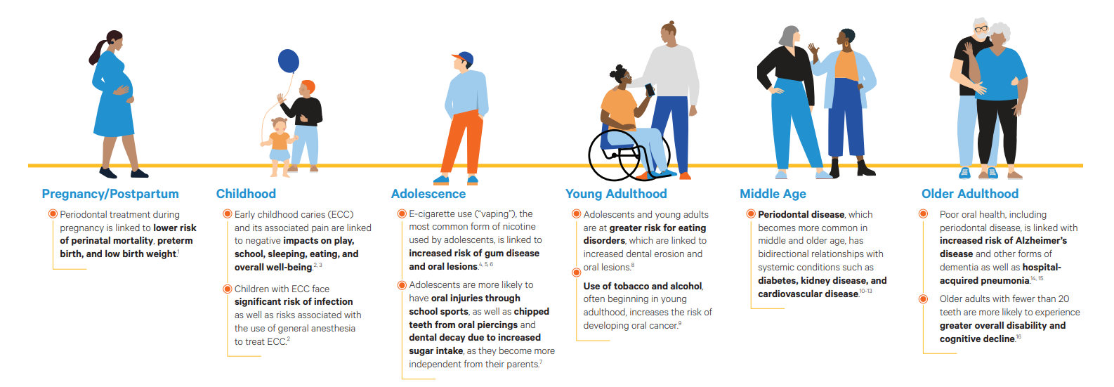
The Oral-Systemic Connection Across the Lifespan
CareQuest Institute for Oral Health. The Oral-Systemic Connection Across the Lifespan. Boston, MA; June 2023. Copyright © 2023 CareQuest Institute for Oral Health, Inc.
Notes:
Regardless of age, oral health is integral to overall good health. It is an important, but often overlooked aspect of a child or adult’s general health. Daily oral hygiene, the ability to access routine professional oral health services, and oral health education are all key factors that can improve the oral health of all Americans.
CareQuest Institute for Oral Health created this infographic about Oral health through all stages of life.
Good daily oral health habits and regular dental visits for women before and during pregnancy are linked to a lower risk of perinatal mortality, preterm birth, and low birth weights for baby.
Early childhood caries (ECC) and the pain ECC causes negatively impacts play, learning, sleeping eating, speech and overall health.
Adolescents who use e-cigarettes have an increased risk of gum disease and oral lesions. Adolescents are move likely to have increase dental decay from sugar intake, chipped teeth from oral piercings, and school sports related oral injuries.
Young adults are at a great risk of dental erosion and oral lesions due to eating disorders. Tobacco and alcohol increase the risk of development of oral cancers.
Middle-aged adults see an increase in periodontal disease which increases risk of diabetes, kidney disease and cardiovascular disease.
Older adults with poor oral health, including periodontal disease, is linked to increased risk of Alzheimer’s disease, other dementias and hospital or nursing home acquired pneumonia. Older adults with less than 20 teeth are more likely to experience greater overall disability and cognitive decline.

Slide 6
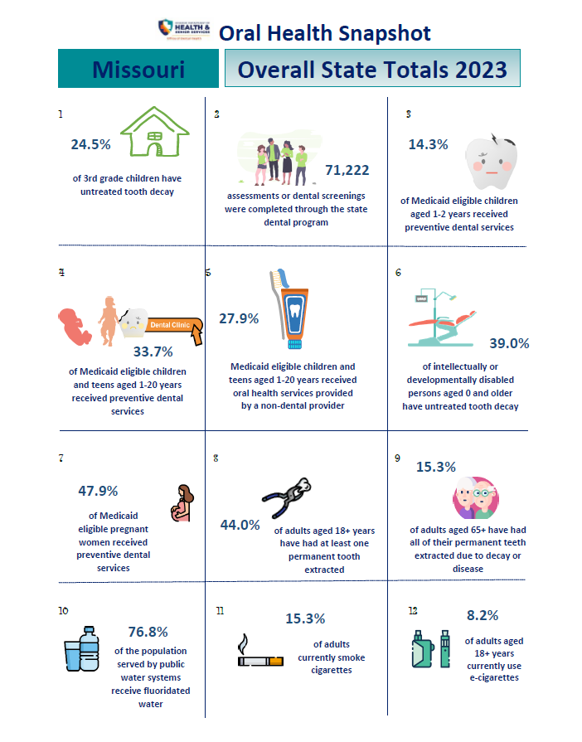
Snapshot of Oral Health in Missouri
Notes:
Let’s look at a snapshot of Missouri’s oral health overall in 2023 before we look at our efforts at ODH to address these public health issues. As you can see with these statistics, we have some work to do to decrease dental decay rates in Missouri.
25% of 3rd grade children have untreated decay
71,222 dental screenings were completed through the state dental program
14.3% of Medicaid eligible children 1-2 years old received preventive dental services
33.7% of Medicaid eligible children and teens 1-20 years old received preventive dental services
27.9 % of Medicaid eligible children and teens 1-20 years old received oral health services provided by a non-dental provider (that is you)! This number increased drastically from 2022 t- 2023 (7.6% to 27.9%).

Slide 7
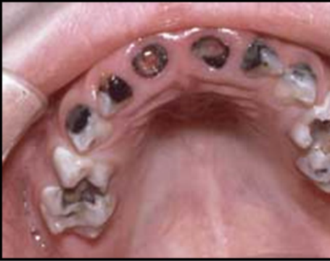
Tooth decay is the most frequent childhood disease, but it’s also the most preventable.
Notes:
The CDC reports 46% of children ages 2 – 19 years old have untreated or restored dental decay in one or more primary or permanent teeth between 2017 and 2020. The CDC also reports more than 51 million school hours are lost each year because of unplanned or emergency dental care.
The National Institutes of Health (NIH) report on Asthma shows asthma affects 1 in 12 children nationwide. In 2019, asthma affected 8.6% of school-age children 5 – 19 years old.
American Diabetes Association (ADA) reports about 352,000 Americans under age 20 are estimated to have diagnosed diabetes, approximately 0.35% of that population.

Slide 8
Dental Caries Statistics
Prevalence of Dental Caries
Most common chronic disease in children
5 times more common than asthma
7 times more common than hay fever
Rate of Dental Caries
Age 2-5 years: 28%
Age 6-8 years: 52%
Age 12-17 years: 59%
80% of decay found in 20-25%of children
Notes:
The Surgeon general report on oral health, written in 2000, reported that Dental Caries was the most common chronic disease in children 5X more common than asthma and 7 times more common than hay fever. Although the rate of dental decay is decreasing, a 2019 CDC report found that dental disease was present in 28% of 2-5 years old and 52% of children 6-8 years old. The fact that 80% of the decay is found in 20-25% of the children means that many children will not develop dental disease. Our goal as health educators is to identify that 20-25 % of the population that will experience dental decay, and education the families on ways to change their current eating and oral hygiene habits.

Slide 9
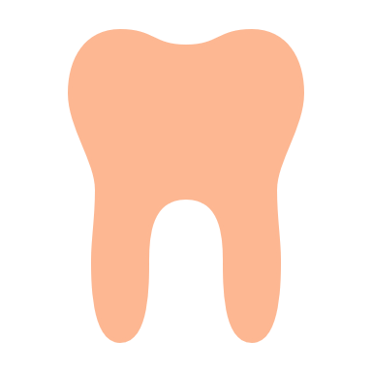
School-Based Caries
Prevention, Tooth Decay, and the Community Environment
Living in a dental-shortage area and a higher proportion of children receiving free or reduced lunch were significantly related to an increased risk of dental caries.
Notes:
For the school and community, living in a dental-shortage area and the proportion of children receiving free or reduced lunch were significantly related to an increased risk of dental caries at baseline.
Caries prevention was more effective in children who had prior dental care at baseline and in schools with a higher proportion of low socioeconomic status students.

Slide 10
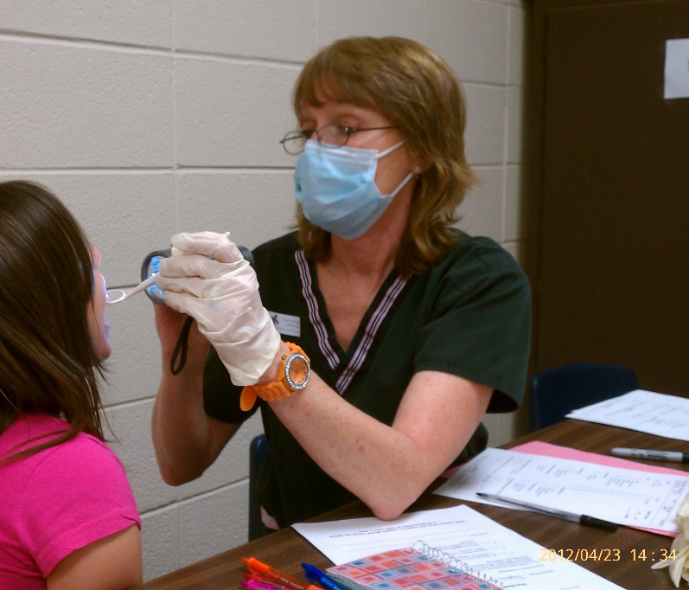
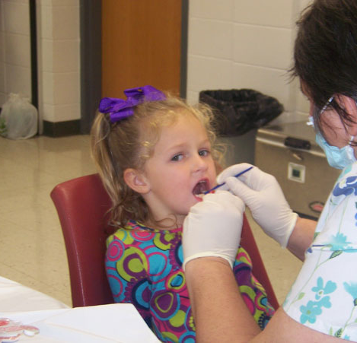
Preventive Services Program (PSP)
Oral Health Education
Oral Health Review (0-18 years of age)
Fluoride Varnish Application (2)
Free toothbrush, toothpaste, and floss
Referrals
Notes:
Our Preventive Services Program (PSP) is one children’s dental health initiative you have can engage in. The PSP is a community based oral health program dedicated to promoting healthy smiles for all of Missouri’s children through education and preventive treatment. PSP was started in 2005 and consists of local dental providers administering an oral health screening, which includes a fluoride varnish application on the day of the screening and a follow up application later. PSP includes oral health education, age appropriate toothbrushes and toothpaste all at no charge. It also provides a referral, which consists of a note going to the school nurse and parent that the child requires treatment and a time frame as to when the treatment needs to be sought. Many times, the dental professional conducting the screening is affiliated with a local dental clinic and will give priority to a child they saw through a PSP event so they can receive treatment.

Slide 11
From 2014 until 2022, overall reduction of dental decay = 4%.
Identification of schools and areas that are having problems accessing dental care by the Untreated Decay rate.
Fluoride Varnish dramatically reduces children’s dental decay
No fluoride treatments - more than twice as likely to have decay as those who received a yearly application of fluoride varnish and
Almost four times as likely to have decay as those who received fluoride varnish applications at six-month intervals.
Impact of PSP
Notes:
PSP from 2014 to 2022 has seen an overall reduction of dental decay down by 4%
PSP also helps us identify schools and area that are having problems accessing dental care by the untreated decay rate.
Fluoride varnish dramatically reduces children’s dental decay. A child that receive no fluoride varnish treatments is more than twice as likely to have decay as those who receive a yearly application of fluoride varnish, and 4 times more likely to have decay than those who receive fluoride varnish applications at 6-month intervals.

Slide 12
Preventive Services Program (PSP)
71,222 children took part in PSP for 2023-2024 school year
Allowing more people to conduct oral health review
Will assess impact at end of year
THANK YOU
for helping with PSP
Screenings at Missouri State Schools for Severely Disabled (MSSD)
ODH Hygienist conducts screening for MSSD
Students receive 2 varnish applications, education, and oral care supplies
Notes:
We have recently extended the professions that can perform Oral Health Reviews to include Certified dental assistant (or passed a Missouri Dental Assisting Basic Skills exam and/or has a min. of two years chairside experience, licensed medical professionals (nurses, doctors, etc.), medical professional students, and community health care coordinators/workers.
In the 2023-24 school year, 71,222 children took part in PSP. Thank you for helping with PSP.
The ODH state hygienist conducted screenings at all of the MO Schools for the Severely Disabled. The children receive the same PSP supplies as children in other schools.

Slide 13
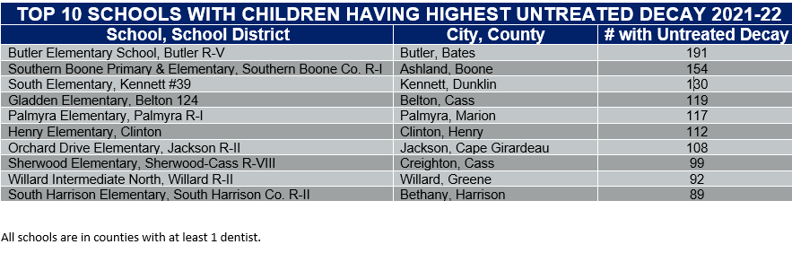
Schools in counties with a shortage of dentists:
PSP helps to identify children that need dental care and help them find a dental home.
Notes:
Our top ten schools having the most untreated decay are all in counties with shortages of dentists with only 1 dentist in the county. Missouri currently has 11 counties without any dentist.

Slide 14
Pregnant Moms Need Dental Visits Too Impact
Notes:
The Pregnant Moms Need Dental Visits Too program is helping to educate moms on the importance of her and her child’s oral health. In this table, the blue bars indicate the number of women seen at WIC. The orange bars indicate the women who received education. The green bars indicate the number of dental screenings. The data is from the first LPHAs that started this program. Audrain, Tri-County and Wright Health Departments total numbers are from 2022 to 2024. Mississippi CHD is in its 2nd year with the program and 4 more LPHAs have started the program with ODH for 3 years of education data collection. Thank you to Audrain, Tri-County and Wright counties for participating in the program.

Slide 15
How do I order varnish for my clinic?
Sentry Dental Products
Order Minimum: 1 case of 8 boxes of 200 applications per box at $72.00 per box ($0.36 per application
Contact Office of Dental Health for more information on ordering.
Notes:
All LPHAs can purchase Fluoride Varnish at DHSS Office of Dental Health Prices from Sentry Dental Products. Order Minimum is 1 case, 8 boxes of 200 applications per box at $70.90 per box or $0.3545 per application. If you are not able to purchase a full case, ODH recommends that your agency and another share the box and the cost. There can be as many agencies share a box as desired. Please contact ODH for more ordering information.

Slide 16
How do I order oral health supplies?
Zion Miracle Products DBA Zdental
Current pricing is good until 6/6/2025
Toothpaste $0.195 per tube
Floss $0.20 per item
Toothbrush $0.22 per brush
Contact Office of Dental Health for more information on ordering.
Notes:
All LPHAs can purchase dental supplies (toothbrushes, toothpaste and floss) at DHSS ODH contracted prices from Zion Miracle Products DBA Zdental. This contract will expire 6/6/2025. You can order toothpaste for 19.5 cents a tube, floss for 20 cents a tube and toothbrushes in three sizes, Infant Teether ages 0-3, Child (Small) ages 0-8, and adult ages 8 and up for 22 cents per toothbrush. ODH expect the prices to go up with new contract. I recommend if you order before June if you have the funding. Also, Zdental requires a minimum order of $1000.00 for free shipping. Again, the order can be for multiple LPHAs and shipped to one LPHA.

Slide 17

COMMUNITY WATER
FLUORIDATION (CWF)
CWF achieves 25% decay reduction in all citizens regardless of income or other socio-economic factors.
Notes:
Last year, ODH personnel was able to counter fifteen (15) attempted and three (3) full rollbacks (discontinuation of fluoridationIn the 2023-24 school year, 71,222 children took part in PSP. Thank you for helping with PSP.
The ODH state hygienist conducted screenings at all of the MO Schools for the Severely Disabled. The children receive the same PSP supplies as children in other schools.

Slide 18
Community Water Fluoridation
National Toxicology Program (NTP) Report
Conclusion based studies where fluoride levels exceeded 1.5 ppm and the report excluded other known contributors to lower IQ (socioeconomic status, genetics, nutrition, etc.).
Report and addendum “do not address whether water fluoridation as in the U.S. and Canada (0.7 mg/L) is associated with a measurable effect on IQ.”
EPA federal case
The ruling refers to fluoridated water as having an “unreasonable risk” based on the NTP report (referenced over 120 times).
The judge said he “did not conclude fluoridated water is harmful”.
He tasked EPA to take “action” to further evaluate potential health risks.
The EPA has filed an appeal against the judge’s decision.
Cochrane Report
CWF may not be as helpful as previously thought, especially if not done on optimal level.
Excluded more recent studies as they were approved for publication after the report’s cutoff date for inclusion.
Co-author, Dr. Anne-Marie Glenny said, “Contemporary studies are showing that water fluoridation is beneficial.”
Department of Natural Resources
No changes in Missouri.
Continue as normal until more information is received from the EPA that would change statute or other regulatory functions.
90-day notification rule remains in place and all current regulatory requirements stay the same.
Will refer all questions to ODH that are not regulation based.
NTP Report: https://ilikemyteeth.org/troubled-government-report-finally-sees-the-light-of-day/, EPA Case: https://adanews.ada.org/ada-news/2024/September/judge-orders-epa-to-address-impats-of-fluoride-in-drinking-water/, Cochran Report: https://adanews.ada.org/ada-news/2024/october/research-review-contends-fluoride-in-water-is-less-effective-than-in-1970s/
Notes:
In 2024 and so far in 2025, water fluoridation has been in the news almost daily. There were three key pieces of information that were released in late 2024 and we will take a quick look at that information. The NTP report was released in August 2024. This report looked at 74 other studies and did an analysis of those 74 studies. Takeaways:
All of the studies were from outside of the US and had fluoride levels in the water at 1.5 ppm or higher, which is more than double what the US uses (0.7 ppm).
The report did not pass the National Academies of Science, Engineering, and Math (NASEM’s) peer-review process due to the low quality of 62 of the studies – this means they were not considered viable for analysis.
The NTP report also states it should not be used to address water fluoridation at the levels used in the US or Canada.
The EPA TSCA lawsuit was filed in 2017 and the judge waited until the NTP report was released before making his ruling in September 2024. The judge referenced the NTP report over 120 times. Due to the fact the ruling was based almost solely on the NTP report, which leading scientific experts have said is not valid, the EPA has filed an appeal of the judgement.
Cochrane Report – this report is released by the Cochrane Review which is a British based organization. The study said water fluoridation may not be as helpful as previously thought because since water fluoridation was put into practice, fluoridated toothpaste and mouth wash have been developed and are widely used. However, the co-author, Dr. Anne-Marie Glenny said “contemporary studies are showing that water fluoridation is beneficial” and “they do not recommend stopping water fluoridation”.
What does this mean for water fluoridation in Missouri? There are no changes in water fluoridation in Missouri. Water systems should continue to fluoridate as they always have.. It is a local decision and remains a local decision. The Missouri Revised Statute, RSMo 640.136 has to be followed to start, stop, or modify any water fluoridation programs in Missouri.

Slide 19
OH-11: Increase the proportion of people whose water systems have the recommended amount of fluoride
Target: 77.1%
Baseline: 72.8% of persons were served by community water systems with optimally fluoridated water in 2016
Status: 23 states have met the target (2022)
Data source: CDC Fluoridation Census, CDC, NCCDPHP https://odphp.health.gov/healthypeople/objectives-and-data/browse-objectives/health-policy/increase-proportion-people-whose-water-systems-have-recommended-amount-fluoride-oh-11
Healthy People 2030: Water Fluoridation
Notes:
Public Health for the United States is overseen by the U.S. Public Health Service. They draft health people initiatives every 10 years. One of the Healthy People 2030 oral health initiatives is to increase the proportion of people whose water systems have the recommended amount of fluoride to 77.1%. This means any water system that is fluoridating should be adding fluoride within the recommended range of 0.6 ppm to 1.0 ppm, targeting for 0.7 ppm.

Slide 20
Missouri’s Current Fluoridation Statistics
Missouri has 392 water systems that either have natural fluoride levels at 0.6 mg/L or higher or that participate in a local water fluoridation program.
There are 96 primary water systems that have a local water fluoridation program.
These primary systems sell water to 166 consecutive systems.
Missouri has 130 naturally fluoridated water systems. These systems have natural fluoride levels ranging from 0.61 to 3.81 mg/L.
Of the 76.8% (4.2 million people) who have fluoridated water, only 66.4% (3.6 million people) have optimally fluoridated water in Missouri.
The population served by these water systems is over 4.2 million people or 76.8% of the total Missouri population.
https://nccd.cdc.gov/DOH_WFRS/Reports/Default.aspx
Notes:
Missouri’s fluoridation statistics.
Missouri has 392 water systems that either have natural fluoride levels at 0.6 mg/L or higher or have a local fluoridation program where they adjust the level of fluoride in the water targeting for 0.7 mg/L.
Missouri has 96 primary water systems that have local fluoridation programs. A primary water system is the system that makes and treats the water supply
These 96 primary systems sell fluoridated water to 166 consecutive systems. A consecutive system is a system that buys water from another water system and doesn’t make or treat their own water.
Missouri has 130 naturally fluoridated water systems which means their fluoride levels range from 0.6 mg/L to 3.81 mg/L. None of these systems remove fluoride from their water supply – they use it as is.
All of these systems serve just over 4.2 million people or 76.8% of Missouri’s total population.
Out of that 76.8%, only 66.4% or 3.6 million people have optimally fluoridated water (between 0.6-1.0 mg/L, targeting for 0.7 mg/L).
ODH is working to get this to 100% of systems providing optimally fluoridated water and have increased this number from 17.1% to 66.4% over the last five years.

Slide 21
Voted to begin fluoridation
Camden Co PWSD 4 – Horseshoe Bend August 2023
Voted to continue fluoridation
Lake Winnebago November 2023
Voted to stop fluoridation
Branson November 2023
Sarcoxie November 2024
Initiated 90-day notification process
Rolla February 2025
Hannibal February 2025
Potential initiations
North Central Wholesale Water Commission
Conversations on-going
Missouri’s Current Fluoridation Status
Notes:
Over the last five years, ODH has faced 24 potential or full rollbacks (cessation attempts) and all have continued fluoridating except for Branson and Sarcoxie.
One community initiated water fluoridation – Camden Co Public Water Supply District #4 – Horseshoe Bend in August 2023.
Rolla, MO voted to start the 90-day notification process in January 2025. This was initiated by city council with a 6-5 vote to start the process. This process allows for public input and the city council will make a final vote in May 2025.
Hannibal, MO voted to start the 90-day notification process in February 2025. This was also initiated by the city council in the form of a recommendation to the Hannibal Board of Public Works. The BPW is set to have a vote in June 2025 and is currently actively seeking input from anyone living in that community.
ODH is having conversations with North Central Wholesale Water Commission to begin fluoridation. This is a long process, often over the course of a 1-2 year period, including the 90-day notification period. This water system provides water to over 35,000 people in 10 communities.

Slide 22

The Oral Health Toolkit
Oral Health Toolkit
Two dental visits, cleanings preventive services each year,
Brush your teeth 2x per day and floss 1x per day,
Eat a well-balanced, low-sugar diet, and
Drink fluoridated water.
Notes:
Water fluoridation is just part of the preventive oral health toolkit. All components of the toolkit are needed to improve the oral health of Missourians. The toolkit includes having two dental cleanings each year, having fluoride varnish and dental sealants applied, brushing your teeth 2x per day and flossing 1x per day, eating a balanced, low-sugar diet, and drinking fluoridated water.

Slide 23
Office of Dental Health’s Mission
ODH’s mission is to:
Promote optimal oral health,
Improve access to dental care, and
Reduce all forms of dental disease for Missourians.
With your help, we will be able to continue to move the needle in a positive way, improving oral and overall health for Missourians.
Notes:
ODH’s mission is to promote optimal oral health, improve access to dental care, and reduce all forms of dental disease for Missourians. With your help, we will be able to do just that!

Slide 24
OralHealth.Mo.Gov
oralhealth@health.mo.gov
573.751.5872
Notes:
The ODH webpage is at oralhealth.mo.gov. Our email address is oralhealth@health.mo.gov and our phone number is 573-751-5782.
Thank you! Do you have any questions?

