Slide 2
Missouri PHIG Evaluation Monitoring Assessment Guide
Welcome to the Missouri Public Health Infrastructure Grant Evaluation Monitoring Assessment Guide (Version 2).
The purpose of this document is to offer guidance on completing the Missouri Public Health Infrastructure Grant Evaluation Monitoring Assessment.
The Public Health Infrastructure Grant or “PHIG”, requires reporting to the CDC on how Missouri public health is improving in the strategies of Workforce and Foundational Capabilities. The questions in the assessment are designed to collect this required CDC data. All information provided by LPHAs in the assessment will be reported to the CDC in an aggregated format (agency contact information will not be reported).

Slide 3
PHIG Evaluation Monitoring Assessment Reporting Periods
The assessment reporting periods and submission due dates for the assessment are as follows:
Year | Reporting Period | Dates | LPHA Assessment Submission Date
Year 1 | 1 | 12/1/2022-5/31/2023 | NA
 | 2 | 6/1/2023-11/30/2023
Year 2 | 3 | 12/1/2023 – 5/31/2024 | 7/15/2024
 | 4 | 6/1/2024 – 11/30/2024 | 1/15/2025
Year 3 | 5 | 12/1/2024 – 5/31/2025 | 7/15/2025
 | 6 | 6/1/2025 – 11/30/2025 | 1/15/2026
Year 4 | 7 | 12/1/2025 – 5/31/2026 | 7/15/2026
 | 8 | 6/1/2026 – 11/30/2026 | 1/15/2027
Year 5 | 9 | 12/1/2026 – 5/31/2027 | 7/15/2027
 | 10 | 6/1/2027 – 11/30/2027 | 1/15/2028

Slide 4
Accessing the PHIG Evaluation Monitoring Assessment
The link to the assessment was sent out to Missouri LPHA Administrators & Directors on 3/18/24. Here is the link: https://redcap.link/Missouri_PHIG_Evaluation_Monitoring_Assessment
Another option for access is to go to the Missouri LPHA Resources webpage and click on the Public Health Infrastructure Grant (PHIG)/Contract Information dropdown subheading. This guide, the link to the assessment, and other items designed to help in completing the assessment are located here. The link to the LPHA Resources webpage is here:
https://health.mo.gov/living/healthcondiseases/communicable/novel-coronavirus-lpha/

Slide 5
Missouri PHIG Monitoring Assessment Page 1
Select the date range of the reporting period you are submitting the assessment on

Slide 6
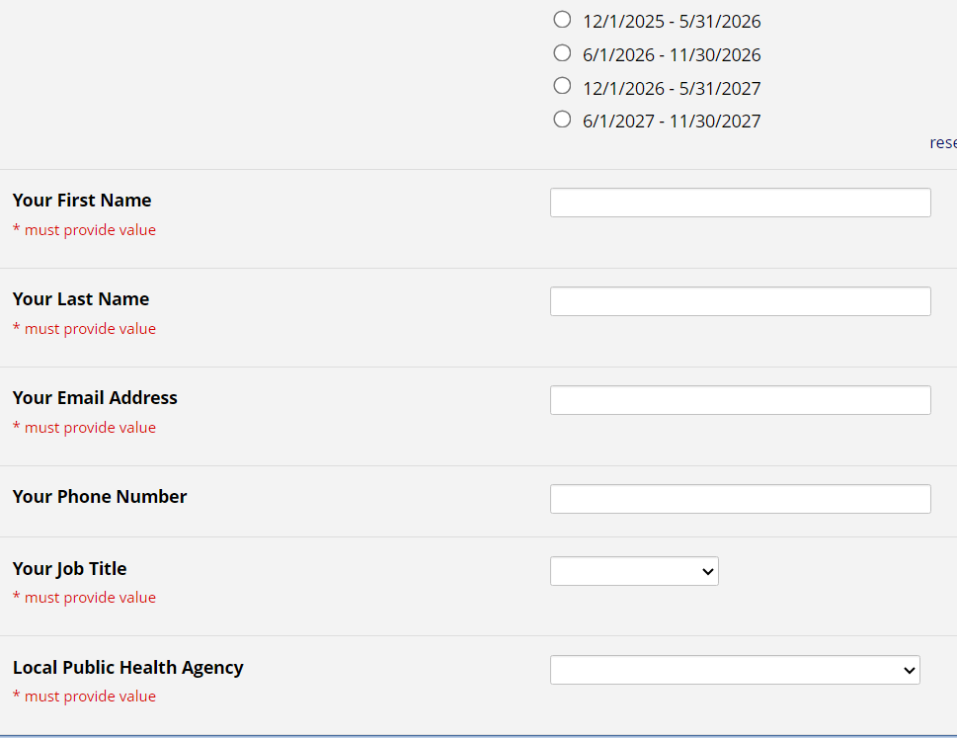
Missouri PHIG Monitoring Assessment Page 1
The person completing the assessment or the preferred contact for the assessment should input their contact information

Slide 7
Missouri PHIG Monitoring Assessment Page 1
For the next section, enter the total number of existing/current staff at your agency on day 1 of the reporting period
Include all staff that were employed by your agency on day 1 of the reporting period no matter their funding source
Do not include staff employed by other agencies that are contracted to work for your agency
Count part-time staff the same as full-time staff (*part-time should be counted as 1)
The count should include all staff actively employed by your agency on day 1 of the reporting period
Example: for the first assessment that covers the reporting period of 12.1.23-5.31.24, you would put in the count of all staff present on 12.1.23
If unsure of the exact count on day 1 of the reporting period, estimate as close as possible

Slide 8
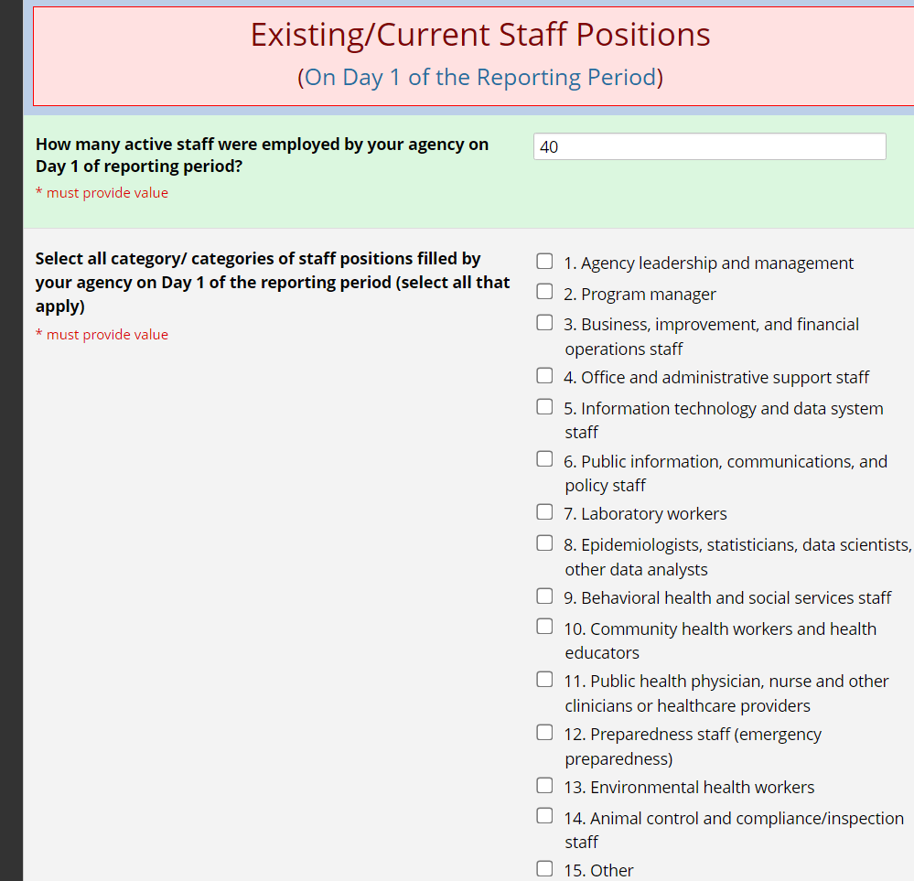
Missouri PHIG Monitoring Assessment Page 1
Once a number is input for the existing staff count on day 1, the job categories selection titles will populate below
Check the boxes for each job category staff from your agency were actively working in on day 1 of the reporting period
If unsure if you had staff actively employed under a job category, refer to Appendix A at the end of this PowerPoint, or you may refer to the Optional PHIG LPHA PHIG Evaluation Assessment Template for reference

Slide 9
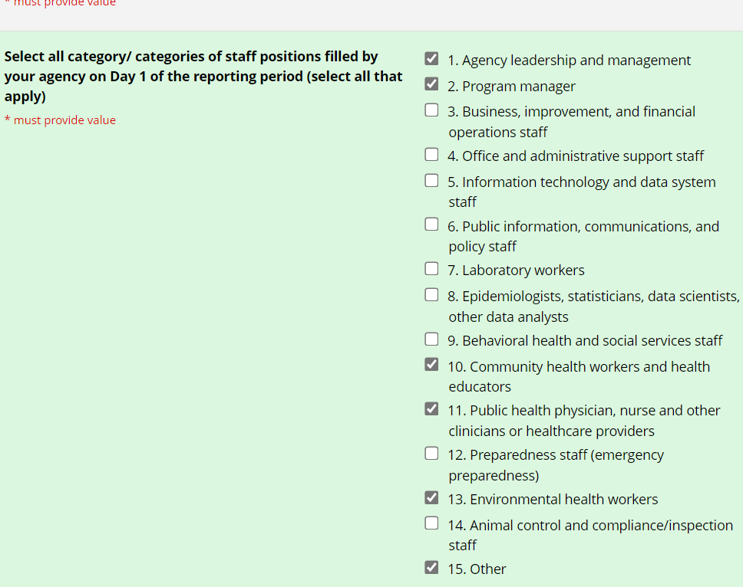
Missouri PHIG Monitoring Assessment Page 1
The job categories selected as having active agency staff within them on day 1 of the reporting period will shape the flow of the assessment
If unsure if you had staff working under a job category on day 1 of the reporting period, refer to Appendix A of this PowerPoint or the Optional PHIG Evaluation Assessment Template for guidance

Slide 10
Missouri PHIG Monitoring Assessment Page 1
The next step is to input the count of staff employed by your agency that left during the entire reporting period
Include in your count all staff that left agency employment for any reason during the reporting period
Example: If for the first reporting period from 12.1.23-5.31.24 you had 4 staff leave your agency’s employment in the 6-month span, you would put 4 in the Staff Lost box

Slide 11
Missouri PHIG Monitoring Assessment Page 1
The final step for this page is to select “Yes” if your agency hired anyone to new positions in your agency during the reporting period.
Include internal staff hired to new positions within your agency
Only include staff employed by your agency (e.g., if a person is doing contractual work on behalf of your agency but is employed by another agency/organization, they should not be considered as a newly hired position
Only select “Yes” if staff began working in newly hired positions during reporting period

Slide 12
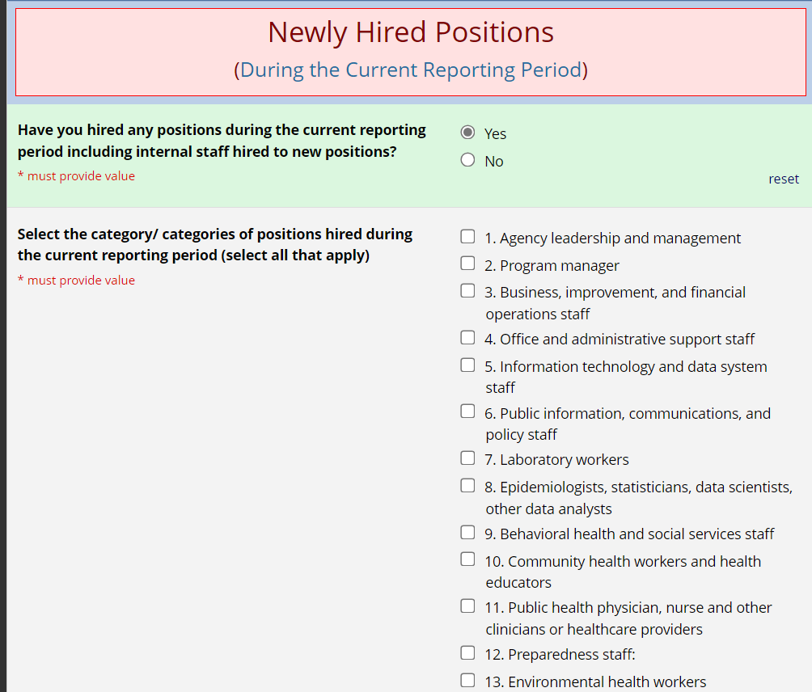
Missouri PHIG Monitoring Assessment Page 1
If newly hired positions did occur during the 6-month reporting period and “Yes” is selected, a drop-down list of job categories will show
These job categories are identical to those in the Existing/Staff Positions section
Only select job categories that newly hired positions began working under during the entire reporting period
Refer to Appendix A of this PowerPoint for further clarification on what job titles fall under the shown job categories as well as additional criteria for selection, or use the Optional LPHA Assessment Template document for guidance
The selections made on this first page will shape the flow of the assessment for the respondent

Slide 13
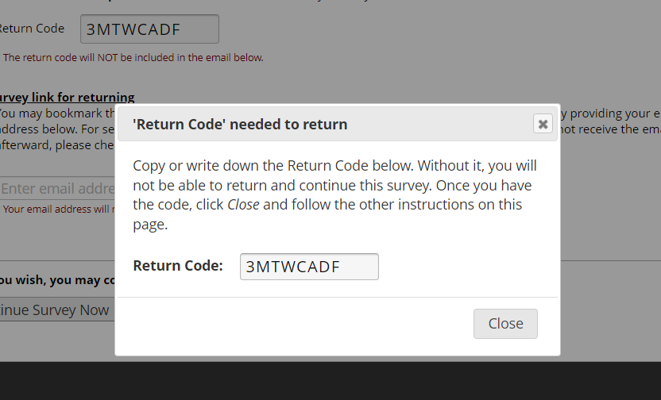
Missouri PHIG Monitoring Assessment Page 1
At the bottom of the first page of the assessment is a Save & Return Later button.
It is recommended you save at this point as the first page will determine the flow of the assessment
After saving you will get a pop-up box with a return code
Record the return code so that you can return to this point if needed or select to have a return link sent to your email (option available after closing the pop-up box)
After closing the box, you can elect to continue the survey

Slide 14
Missouri PHIG Monitoring Assessment Page 1
Hitting the “Next Page >>” button will take you to Page 2 of the assessment

Slide 15
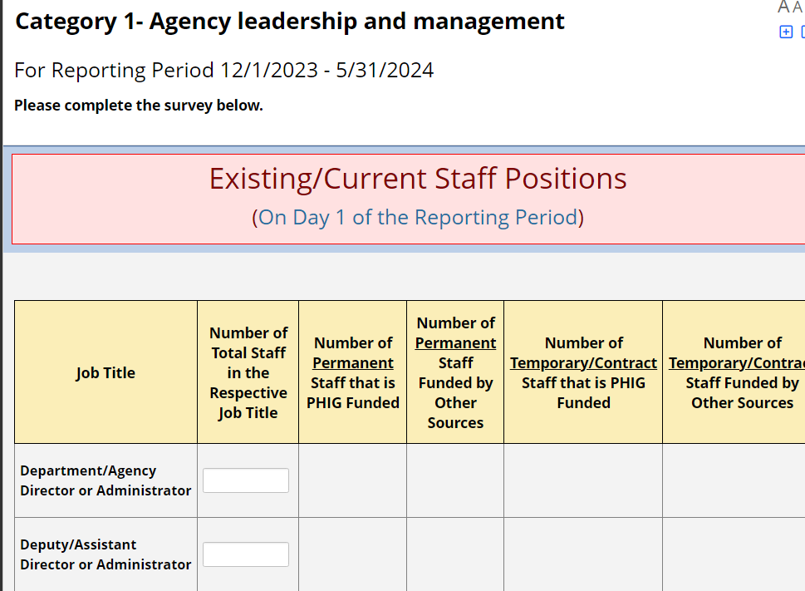
Missouri PHIG Monitoring Assessment Job Categories Pages
The next page will start with a selected job category from page 1
If on page 1, Agency leadership and management was selected under the Existing/Current Staff Positions section, then you will see what is pictured below
The job category (determined by selection on page 1) will dictate what job titles appear in the table
Job titles that appear depend on the job category that is represented

Slide 16
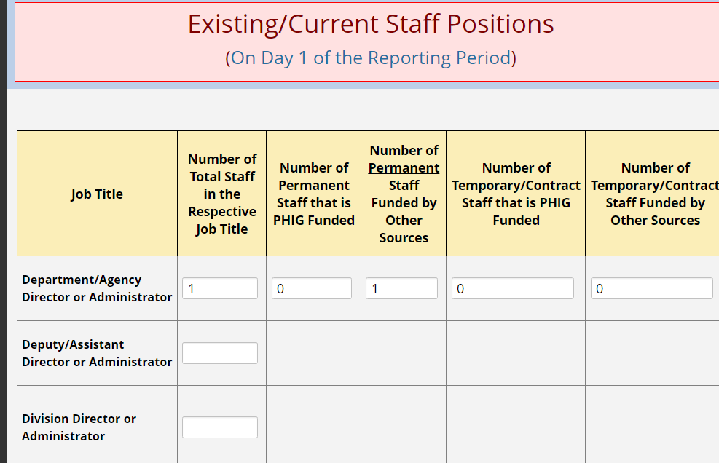
Missouri PHIG Monitoring Assessment Job Categories Pages
On the Existing/Current Staff Positions table, input the correct numbers for each respective job title that was occupied on day 1 of the reporting period
For the Number of Total Staff in the Respective Job Title column, input the total number of employed staff in that job title within your agency for day 1 of the reporting period

Slide 17
Missouri PHIG Monitoring Assessment Job Categories Pages
For the remaining 4 columns, list the counts of how many staff are Permanent/PHIG Funded, Permanent/Funded by Other Sources, Temporary/Contract PHIG Funded, or Temporary/Contract Funded by Other Sources respective to each job title on day 1 of the reporting period
Refer to Appendix A of this guide or the Optional PHIG Evaluation Assessment Template for guidance on which columns existing staff should be counted under
The counts under these 4 columns should equal the total count input into the Number of Total Staff in the Respective Job Title column

Slide 18
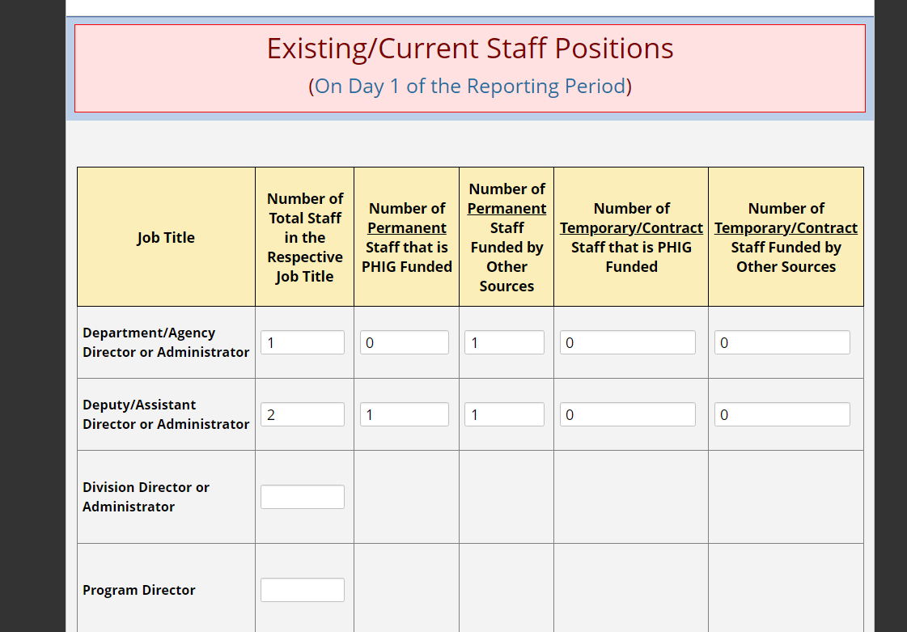
Missouri PHIG Monitoring Assessment Job Categories Pages
Continue to input counts for each job title row that your agency had existing staff in on day 1 of the reporting period
If you did not have existing staff on day 1 of the reporting period for a particular job title, leave the field blank (example circled in red)

Slide 19
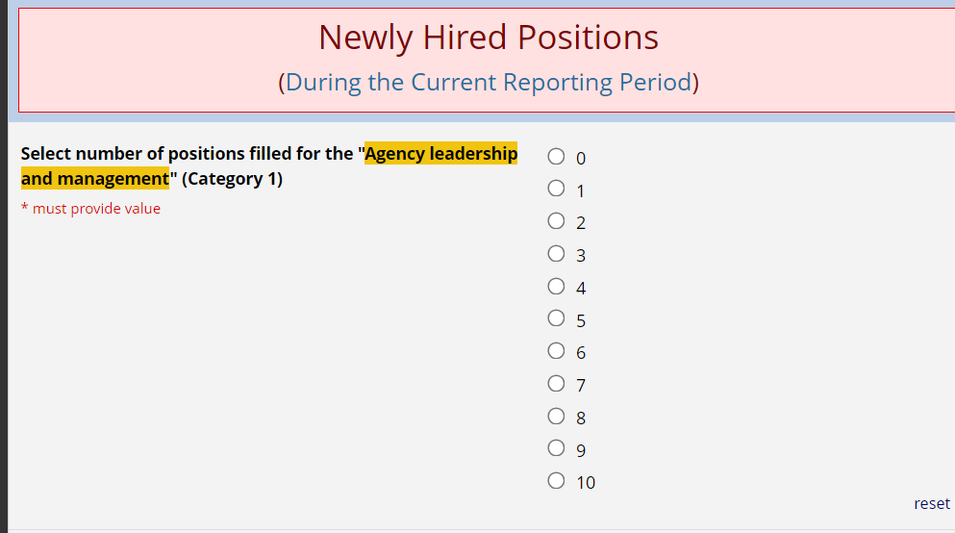
Missouri PHIG Monitoring Assessment Job Categories Pages
After completing the table for the Existing/Current Staff Positions, you must scroll down to find the Newly Hired Positions section
This section is for submitting all newly hired positions in the job category of the page that started working in their new position during the entire reporting period
It pertains to the same job category displayed at the top of the page and highlighted in the section (just like the Existing/Current Staff Positions table)
First, select the number of new hires that started working in the job category during the reporting period
Include all new hires whether they are par-time or full-time (this assessment does not differentiate between the two)
Include internal hires that started working in their new position during the reporting period
Additional guidance provided in Appendix A

Slide 20
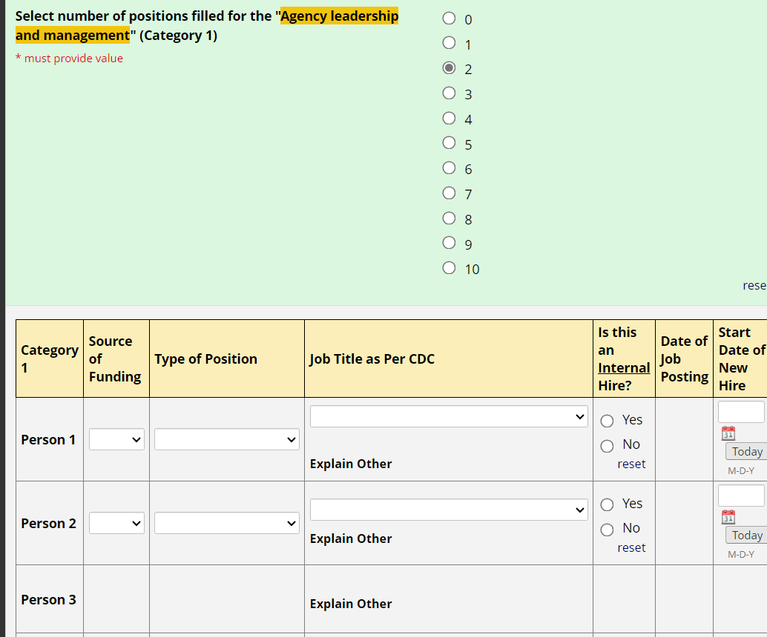
Missouri PHIG Monitoring Assessment Job Categories Pages
The number of newly hired positions selected for the job category during the reporting period will result in the corresponding number of rows appearing in table below
Notice in the example below you can only fill in two rows for new hires in this job category because only 2 was selected above
A maximum of 10 newly hired positions for each job category can be input for each reporting period

Slide 21
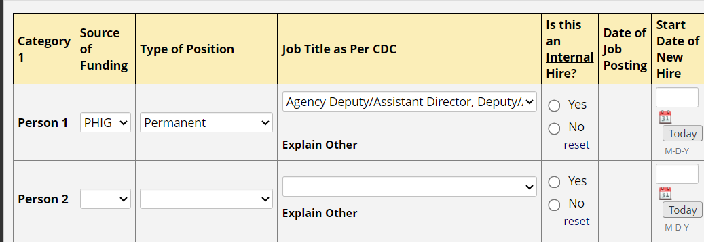
Missouri PHIG Monitoring Assessment Job Categories Pages
For the Source of Funding column, select “PHIG” or “Other”
If any amount of the position’s regular salary or wages are from PHIG funds, select PHIG
Count staff supported by the PHIG Accreditation and PHIG Internship funds as PHIG funded
Do not count bonus pay from PHIG funds distributed in pay checks over a set period of time
Refer to Appendix A for additional guidance

Slide 22
Missouri PHIG Monitoring Assessment Job Categories Pages
For the Type of Position column, select whether the position is for a “Permanent” or “Temporary/Contract” employee
Permanent Staff
Permanent staff are part-time and full-time employees of your agency
Permanent staff are regular employees, typically eligible for benefits, and do not have a defined duration of employment
Temporary/Contract Staff
Temporary/contract staff have a defined duration of employment
Temporary/contract staff are not typically eligible for benefits through your agency
Includes limited-term employees (LTEs)
Does not include staff employed by another agency/organization contracted to do work on behalf of your agency (staff fitting this specific definition are not counted in this assessment)

Slide 23
Missouri PHIG Monitoring Assessment Job Categories Pages
Next, select the job title of the new hire
The job titles available will depend on the job category the page represents
Job titles selected should reflect the new positions official title (For more guidance on selection of a job title including a complete list of job titles per job category, refer to Appendix A)
If no job title accurately reflects the newly hired positions title, select “Other” as the job title
Doing so will result in a box populating beneath the “Explain Other” heading
Type in the job title of the newly hired position

Slide 24
Missouri PHIG Monitoring Assessment Job Categories Pages
For the Is This an Internal Hire? column, select “Yes” if the person was a current staff member employed by your agency before transitioning to the new position
Select “No” if the person occupying the new position was not a current employee before taking on the role

Slide 25
Missouri PHIG Monitoring Assessment Job Categories Pages
If “No” is selected for the internal hire question column, the Date of Job Posting column will need to be completed
For the Date of Job Posting column, select the date the newly hired position was posted
For jobs that have a continuous ongoing posting (often times over the span of a couple of years), select the date of the original posting for that position that is now occupied
In some instances, an estimation of the job posting may be needed, but a value must be input into the box if the newly hired position was occupied externally

Slide 26
Missouri PHIG Monitoring Assessment Job Categories Pages
For the Start Date of New Hire column, input the date the new hire started working in the position
If the person has not yet started working in the new position, then the person should not be counted at all in this section
The start date will need to be completed for both internal and external new hires

Slide 27
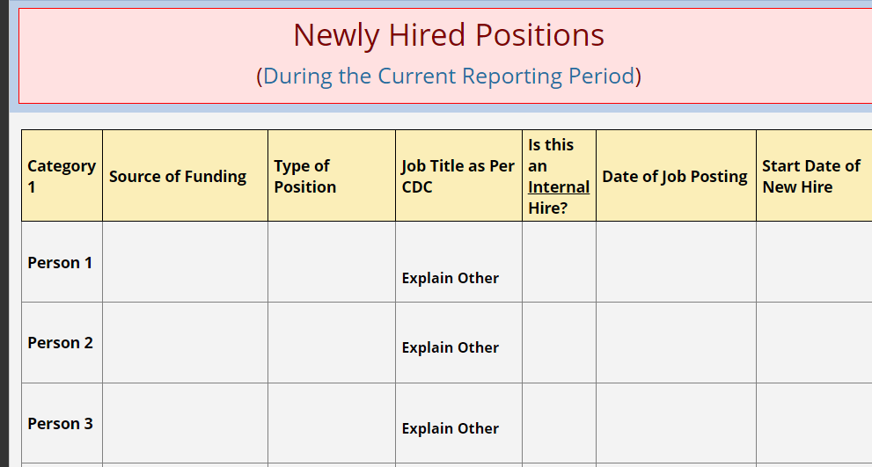
Missouri PHIG Monitoring Assessment Job Categories Pages
If you did not select newly hired positions for a specific job category on page 1, then there will not be input boxes available for each column and you will not be able to input data in the table for the job category *You can change this by going back to page 1 and selecting the job category under newly hired positions

Slide 28
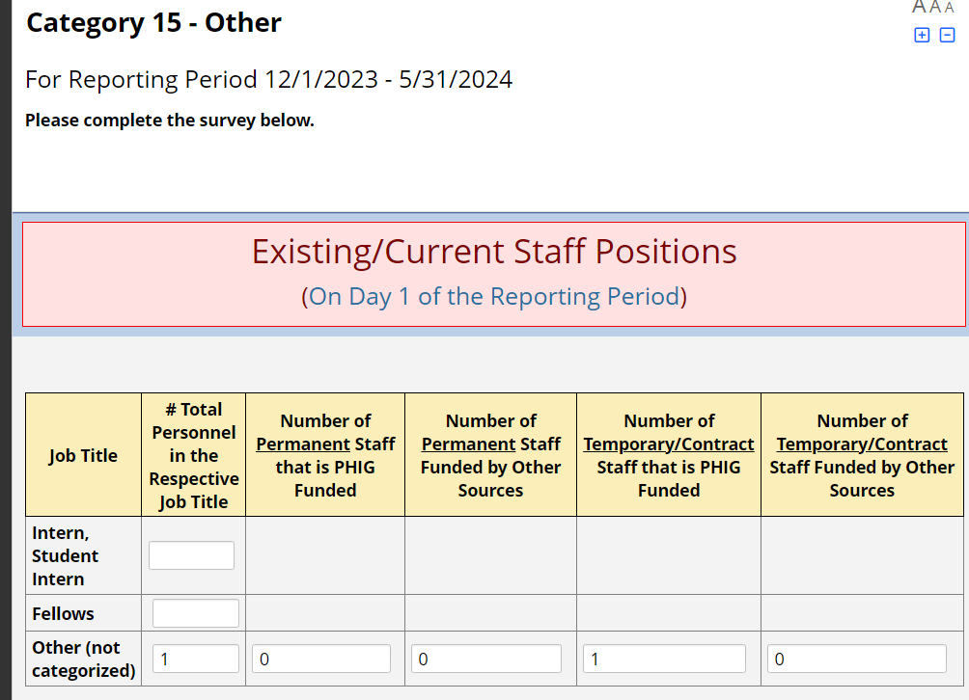
Missouri PHIG Monitoring Assessment Job Categories Pages
In all, there are 15 job category pages to input counts for existing/current staff positions and newly hired positions for
Depending on your selections on page 1, you may or may not have to fill out existing/current staff positions and newly hired positions for each job category
It is recommended you use the Optional PHIG Evaluation Assessment Template to assist you in tracking data throughout each reporting period
If none of the job categories accurately capture an existing staff member on day 1 of the reporting period or a newly hired position during the reporting period, you may select “Other” for either section on page 1 of the assessment
If “Other” is selected on page 1 for either existing staff positions or newly hired positions then there will be a page similar to the examples we just used whereas you can select “other” as a job title as well
The “Other” job category selection also allows you to capture interns and fellows as a job title within the Existing/Current Staff Positions table and Newly Hired Positions table

Slide 29
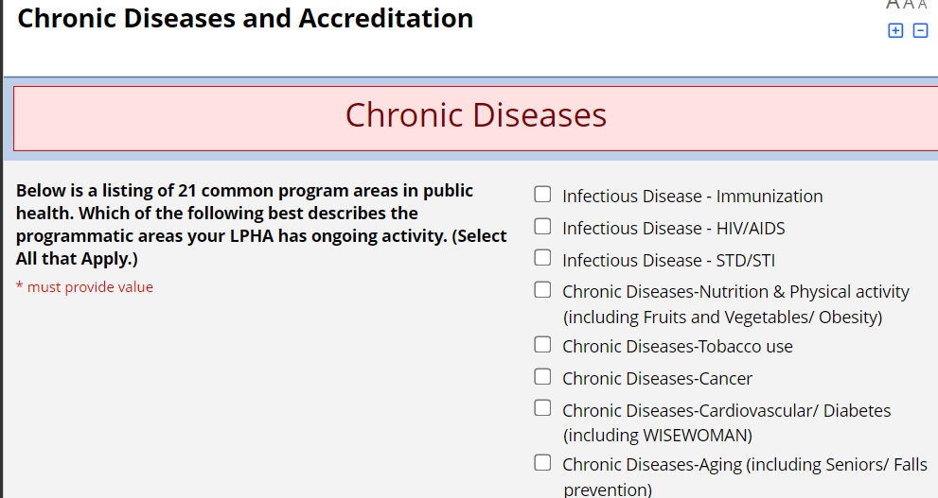
Missouri PHIG Monitoring Assessment Chronic Diseases and Accreditation Pages
After working through listing existing staff positions and newly hired positions across all job categories, you will come to the Chronic Diseases and Accreditation Section page

Slide 30
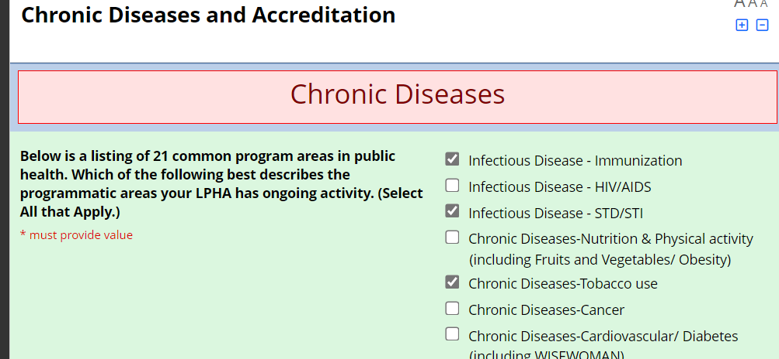
Missouri PHIG Monitoring Assessment Chronic Diseases and Accreditation Pages
For the Chronic Diseases section, check all program areas your agency has activity in
Check the box if you have any ongoing activity in the program
If you do not currently have activity in a program area but plan to, leave the box blank
It does not matter if you have staff officially employed in a program area, only if there is activity in it from your agency

Slide 31
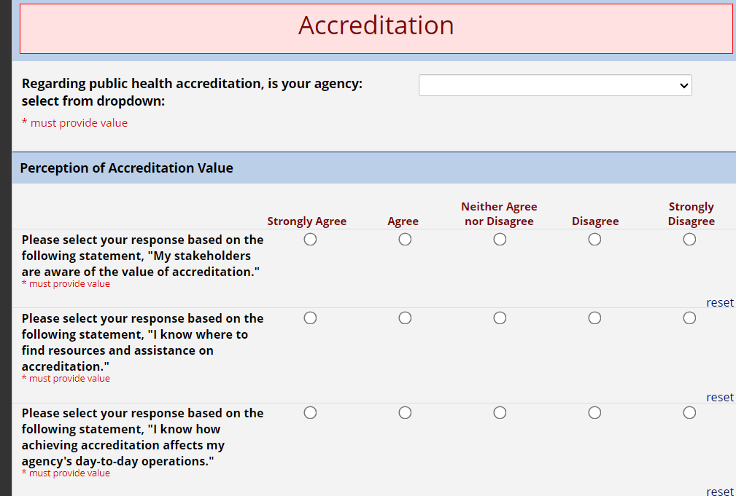
Missouri PHIG Monitoring Assessment Chronic Diseases and Accreditation Pages
Following completion of the Chronic Diseases section, scroll down to complete the Accreditation section
The Accreditation section will ask your agency’s public health accreditation status
It will also ask a series of questions on perceptions, barriers, and expectations regarding accreditation
This portion should be completed by LPHA leadership, preferably an agency Director or Administrator
Once a value has been input for every question, hit submit at the bottom of the page

Slide 32
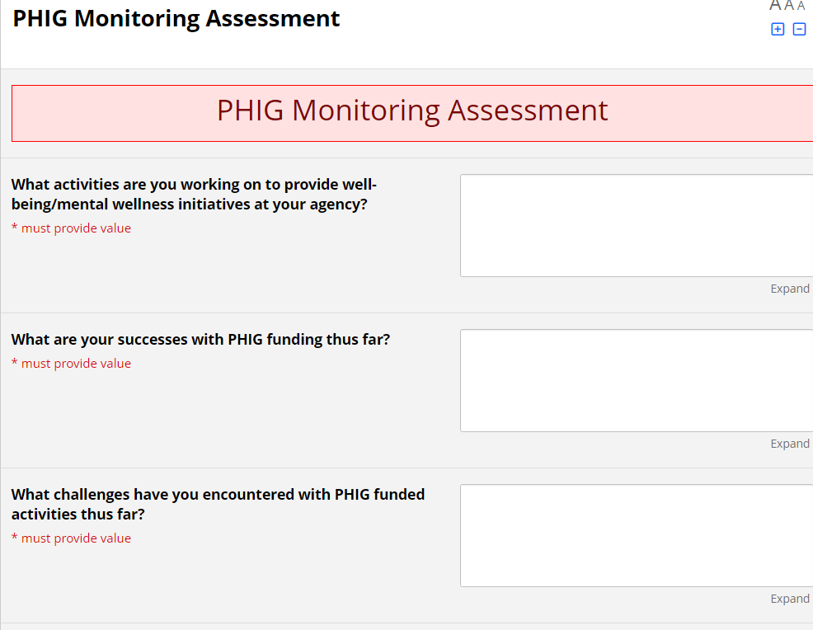
Missouri PHIG Monitoring Assessment Progress Report Page
For the final page of the assessment, the progress reports mentioned in agency PHIG contracts have been incorporated into the assessment
For the first part, input answers into the narrative boxes in response to the progress questions

Slide 33
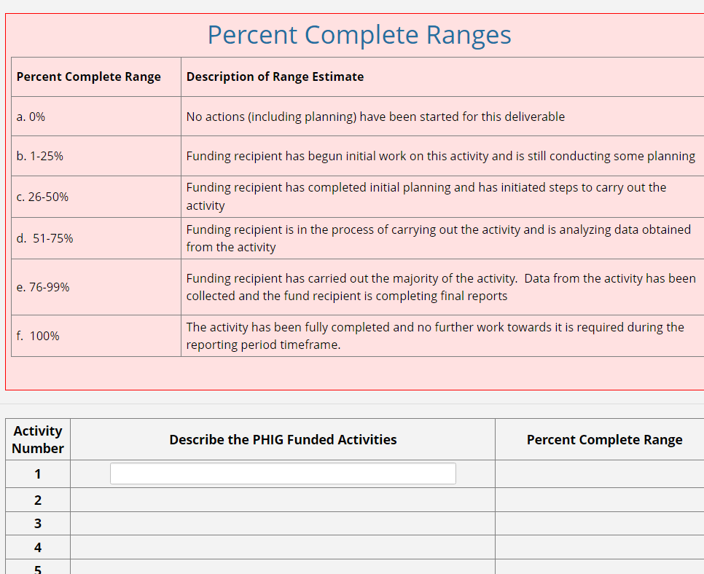
Missouri PHIG Monitoring Assessment Progress Report Page
The second part of this page asks to list PHIG funded activities and input the percent complete range as it pertains to the activity listed
PHIG funded activities will need to be typed in by the respondent and will be unique to the agency
Use the description of percent complete ranges above to determine what percent range is appropriate for the activity

Slide 34
Appendix A
How to classify staff under the Existing/Current Staff Positions and Newly Hired Positions sections
Staff can be counted under 15 different job categories
Each job category has a prescribed selection of job titles to select from
On page 1, if no job category accurately classifies an employee, select “Other” as a job category
On the subsequent pages, if no job title within a job category accurately reflects a staff member’s position, you can select “Other” as a job title as well
Staff counts under the Existing/Current Staff Positions section should be of existing staff active on day 1 of the reporting period the assessment is covering
Staff counts under the Newly Hired Positions section are to include all newly hired staff and internal staff that moved to a new position that either started working or moved to their new position during the entire reporting period (Do not count staff that has not yet started actively working)
If a staff member works under multiple job titles, categorize them under the job title they are officially given
If there is no matching job title, count them under the job title that best describes the area they spend most of their work time on
Do not count a staff member in more than one job title
Do not count staff employed by other agencies that are doing contract work on behalf of your agency
Part-time staff are to be counted the same as full-time staff (this assessment does not differentiate between the two)

Slide 35
Appendix A
Additionally, staff is to be identified as:
Permanent/PHIG Funded
Permanent/Funded by Other Sources
Temporary-Contract/PHIG Funded
Temporary-Contract/Funded by Other Sources

Slide 36
Appendix A
Permanent Staff
Permanent staff are part-time and full-time employees of your agency
Permanent staff are regular employees, typically eligible for benefits, and do not have a defined duration of employment
Temporary/Contract Staff
Temporary/contract staff have a defined duration of employment
Temporary/contract staff are not typically eligible for benefits through your agency
Includes limited-term employees (LTEs)
Does not include staff employed by another agency/organization contracted to do work on behalf of your agency (staff fitting this specific definition are not counted in this assessment)
PHIG Funded Staff
A staff member is considered PHIG funded if any part of their salary is funded by PHIG, no matter how little the amount is (e.g. if $1 of PHIG funding supports a staff member’s wages, they are PHIG funded)
Staff funded by the PHIG Accreditation and PHIG Internship funds count as PHIG funded
Do not count staff as PHIG funded if they only receive PHIG funds through a hiring/retention bonus distributed into paychecks over a set period of time
Funded by Other Sources
Staff member’s salary/wages are funded by sources that does not include any PHIG funding

Slide 37
Appendix A
Job Category | Job Title
Agency Leadership and Management: | Agency Director, Administrator
 | Agency Deputy/Assistant Director, Deputy/Assistant Administrator
 | Program Director
 | Chief Medical Officer, Health Officer
 | Other
Program Manager: | Public Health Program Manager
 | Other

Slide 38
Appendix A
Job Category | Job Title
Business, Improvement, and Financial Operations Staff: | Attorney, Legal Staff
 | Business Support Services including Business Office Administrators and Coordinators
 | Grants or Contracts Specialist
 | Human Resources Personnel
 | Community Health Planner
 | Quality Improvement Staff
 | Training/Development Manager
 | Workforce Development Staff
 | Accreditation and Performance Improvement Staff
 | Other
Office and Administrative Support Staff: | Clerical Personnel including Administrative Assistants, Secretaries
 | Customer Service/Support Personnel
 | Custodian, Facilities and Operations Worker
 | Implementation Specialist
 | Medical/Vital Records Staff
 | Other

Slide 39
Appendix A
Job Category | Job Title
Information Technology and Data System Staff: | Information Systems Manager, Information Technology Specialist, IT Support Staff
 | Informatics Staff
 | Web Developer/Computer Programmer
 | Other
Public Information, Communications, and Policy Staff: | Public Health Information Staff, Communications Staff, Web Content Writer/Content Developer
 | Policy Analyst
 | Other

Slide 40
Appendix A
Job Category | Job Title
Laboratory Workers: | Laboratory Technician
 | Laboratory Scientist/Medical Technologist
 | Laboratory Aide or Assistant
 | Other
Epidemiologists, Statisticians, Data Scientists, Other Data Analysts: | Epidemiologist
 | Statistician
 | Economist
 | Data or Research Analyst
 | Other

Slide 41
Appendix A
Job Category | Job Title
Behavioral Health and Social Services Staff: | Behavioral Health Professional
 | Contract Tracer
 | Counselor
 | Health Navigator
 | Social Worker/Social Services Professional
 | Other
Community Health Workers and Health Educators: | Health Educator
 | Community Health Worker
 | Other

Slide 42
Appendix A
Job Category | Job Title
Public Health Physician, Nurse and Other Clinicians or Healthcare Providers: | Physician Assistant, Public Health/Preventive Medicine Physician
 | Registered Nurse-Public Health or Community Health Nurse, Unspecified
 | Licensed Practical or Vocational Nurse
 | Other Nurse-Clinical Services
 | Nursing and Home Health Aide
 | Nutritionist or Dietitian
 | Oral Health Professional, Dentist
 | Pharmacist
 | Emergency Medical Technician/Paramedic, Emergency Medical Services Worker
 | Other Health Professional/Clinical Support Staff
 | Physical/Occupational/Rehabilitation Therapist
 | Public Health Veterinarian
 | Other
Preparedness Staff: | Emergency Preparedness/Management Worker
 | Other

Slide 43
Appendix A
Job Category | Job Title
Environmental Health Workers: | Environmental Health Worker, Environmental Health Technician, Environmental Health Scientist, Environmental Engineer
 | Other
Animal Control and Compliance/Inspection Staff: | Licensure/Regulation/Enforcement Worker
 | Sanitarian or Inspector
 | Animal Control Worker
 | Medical Examiner
 | Other

Slide 44
Appendix A
Job Category | Job Title
Other: | Interns/Student Interns
 | Other (Type In)

Slide 45
This work is supported by funds made available from the Centers for Disease Control and Prevention (CDC) of the U.S. Department of Health and Human Services (HHS), National Center for STLT Public Health Infrastructure and Workforce, through OE22-2203: Strengthening U.S. Public Health Infrastructure, Workforce, and Data Systems grant. The contents are those of the author(s) and do not necessarily represent the official views of, nor an endorsement, by CDC/HHS, or the U.S. Government.
Please reach out with questions or to schedule an individual appointment for assistance in completing PHIG Evaluation Monitoring Assessments
travis.fisher@health.mo.gov

