Slide 1
Public Health Accreditation Overview & Updates from the Public Health Accreditation Board
Paul Kuehnert, DNP, RN, FAAN | President & CEO
Marita Chilton, MPH | Director of Accreditation
Jessica Kronstadt, MPP | VP, Program, Research & Evaluation
May 2022

Slide 2
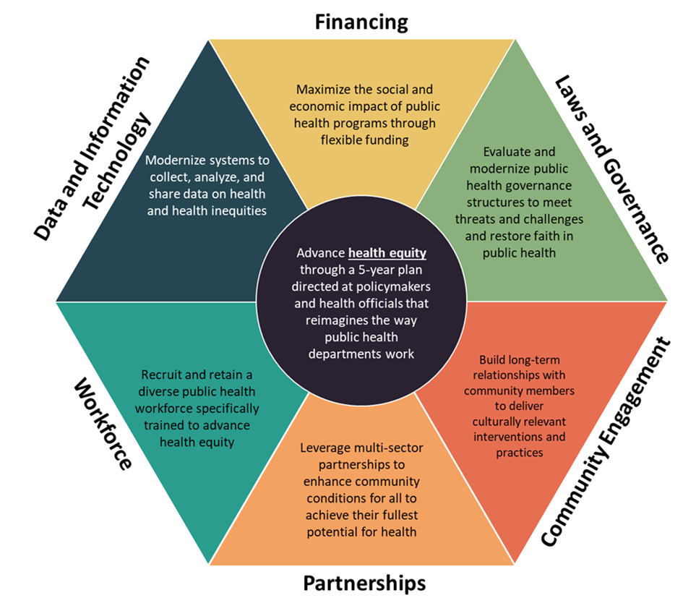
Transform & Modernize Our PH System
https://bipartisanpolicy.org/report/public-health-forward/

Slide 4
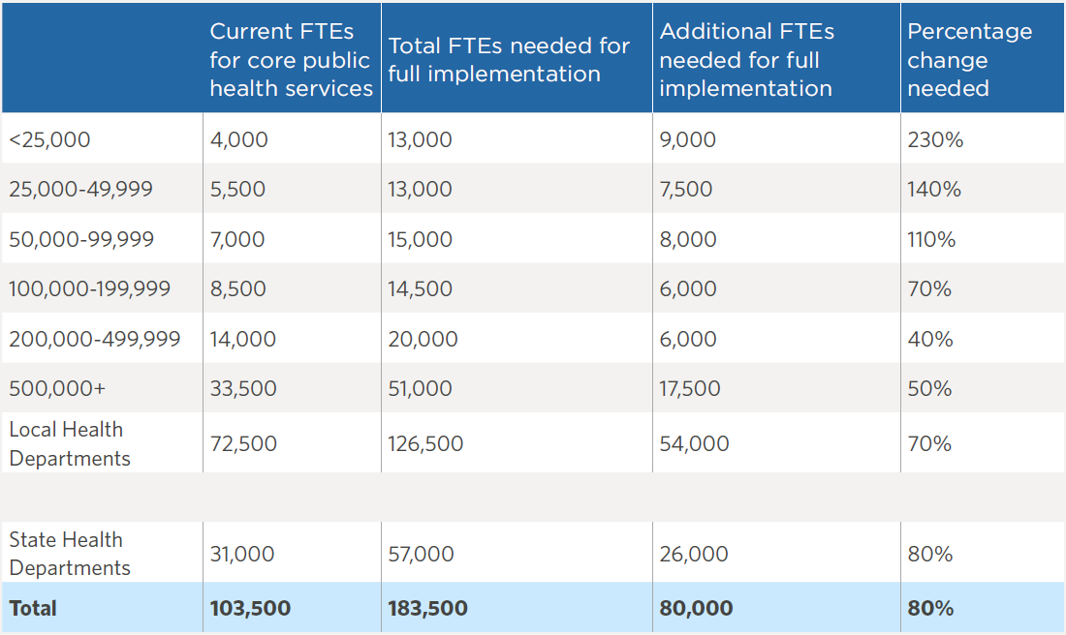
Currently: developing a Public Health Workforce Calculator for LHDs to estimate their workforce needs to provide the FPHS.
phnci.org/national-frameworks/staffing-up

Slide 5
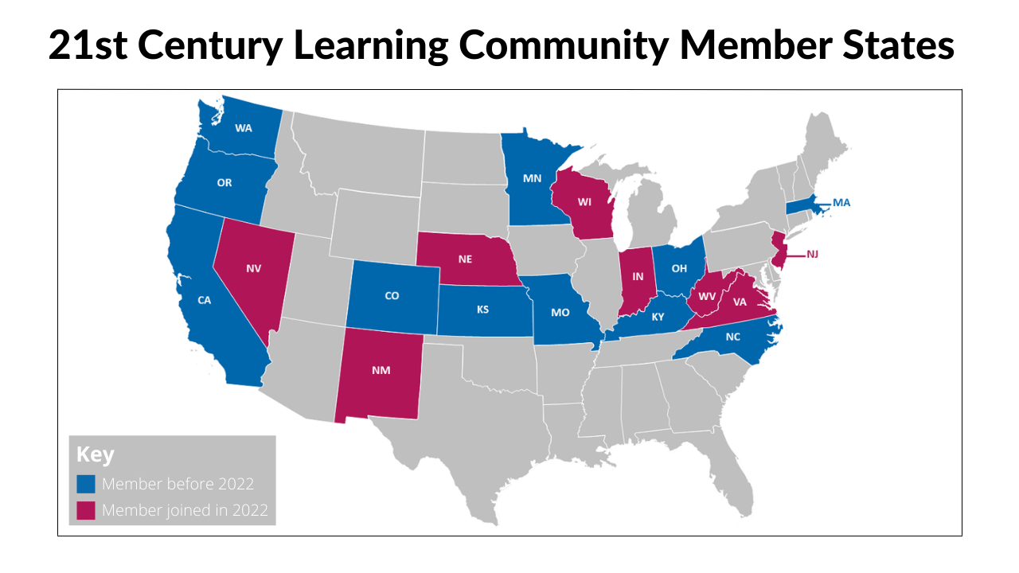

Slide 6
21st Century Learning Community Expansion
Learning, technical assistance, affinity groups
Convenings
Communications
3-4 convenings hybrid or in-person convenings for peer sharing, learning
Regular virtual meetings – through affinity groups or focus areas
Enterprise-wide and customized TA: workforce, data, service sharing, costing/assessment, etc.
Three states deep dive on data modernization: data summits and stakeholder & power mapping
Learnings on public health modernization and transformation
Developing products and tools
Developing state synopses
Dissemination & Diffusion
Guiding Committee is steering programming

Slide 7
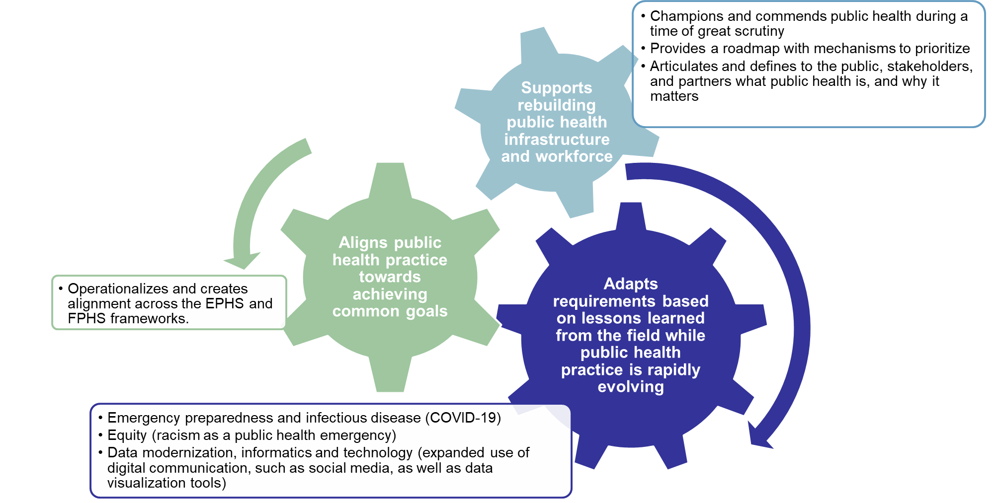
Importance of v2022

Slide 8
What are the headlines for Version 2022?
I: Incorporate key lessons from practice
--Equity in every domain
--Alignment on preparedness & response
II: Clarify & simplify
--Removed redundancy
--Reduced required documents
III: Promote accountability
Foundational Capability measures

Slide 9
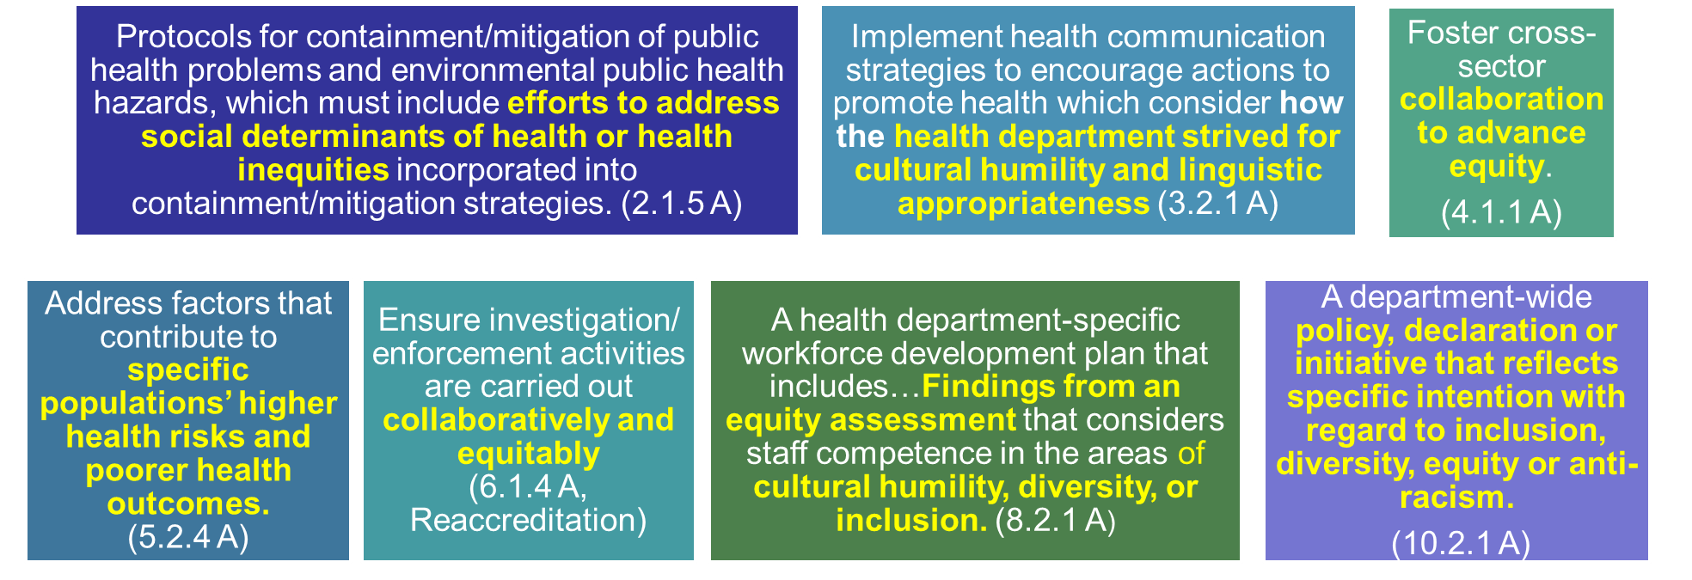
Equity in Version 2022
https://phaboard.org/wp-content/uploads/Focus-on-Equity-One-Pager-6.pdf

Slide 10
Foundational Capabilities in Version 2022
Identifies specific measures as “Foundational Capability Measures”
Matches the spirit of the FC, not necessarily each detail

Slide 11
7-Steps of Accreditation
Preparation
Review education resources
Submit Readiness and Training Fee
Complete Readiness Assessment
Application
Documentation Selection & Submission
Review
(Site Visit)
Initial
or Pathways
Accreditation Decision
Additional Reporting
(Annual Reports)
Reaccreditation
Pathways Recognition Program

Slide 12
Purposes of Pathways
Support performance improvement efforts, strengthen infrastructure, and facilitate public health system transformation, including state-based improvement efforts.
Serve as a performance improvement milestone for local, Tribal, and territorial health departments not yet ready for accreditation.
Facilitate accreditation readiness for those intending to seek accreditation
For more info & updates: https://phaboard.org/pathways/

Slide 13
Pathways: Two Tracks
Equity

Slide 14
Getting Started: Readiness Assessment

Slide 15
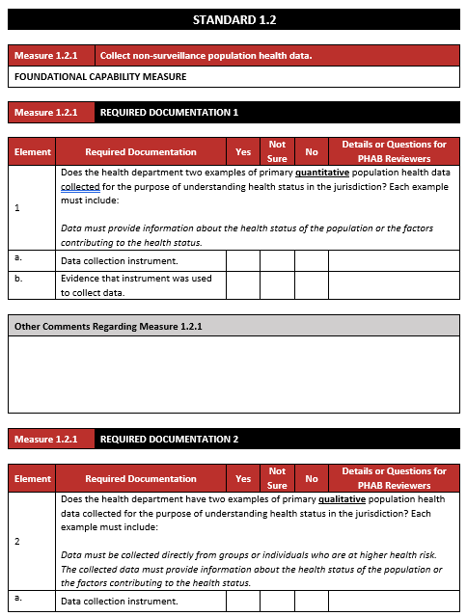
What is it?
Steps through the Standards & Measures and asks about each requirement
Can focus on Foundational Capabilities Measures only

Slide 16
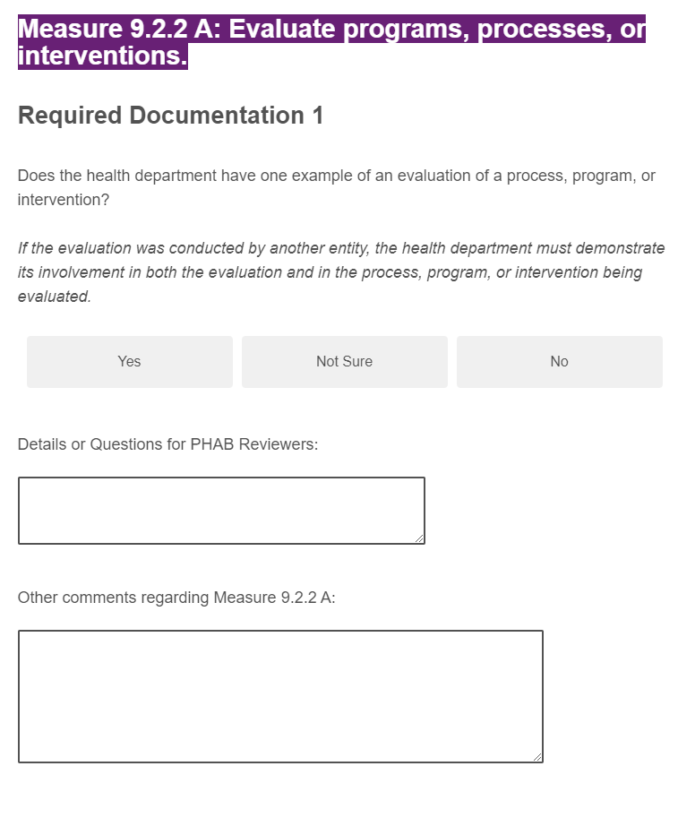
How does it work?
Fill out online
Option to work on it in Word first
Encouraged to engage staff throughout department
Opportunity to ask questions of PHAB about Measures
Providing candid responses will result in more useful results
Expect at least a solid day’s effort

Slide 17
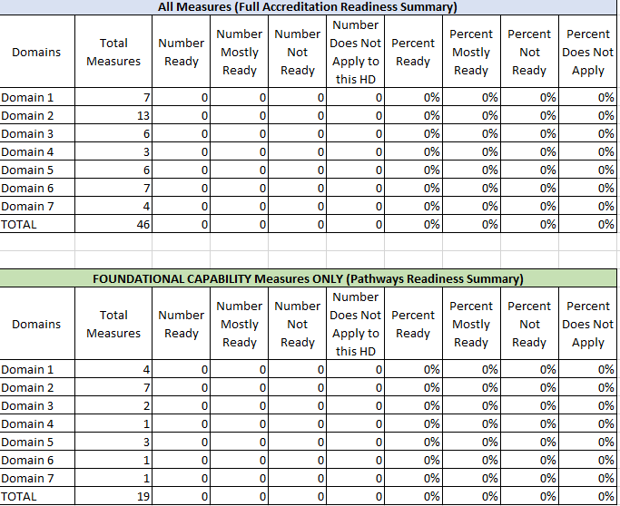
What feedback will a HD receive?
Responses to questions and tips about Measures
Breakdown showing which Measures appear to be ready (FC and full set)
Overarching recommendation about readiness

Slide 18
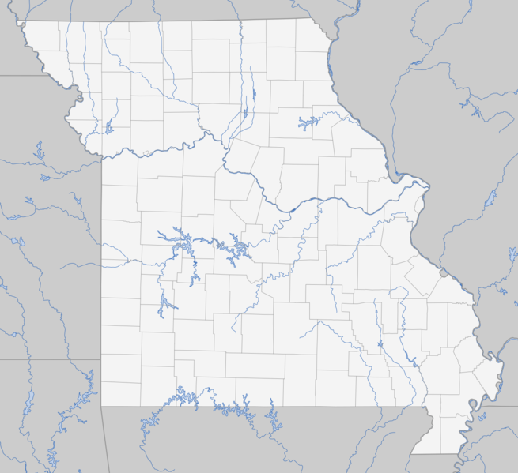
What could you learn as a state?
Strengths and gaps across the state
By domain/measure or theme
Cohorts of HDs facing similar challenges
This Photo by Unknown Author is licensed under CC BY

Slide 19
What could next steps be?
Learning communities and technical assistance to build capacity
Pathways
Accreditation

Slide 20
Thank you!
Questions: email info@phaboard.org

