Slide 1
LPHA OFFICE Hours
9/15/2022

Slide 2
Agenda
Bivalent vaccine
Standing order review
Products
Influenza Vaccine
317 new policy
Increasing adolescent and Pediatric vaccination

Slide 3
What is the difference between vaccines
Monovalent vaccine
Contains the original or ancestral strain of SARS- CoV-2
These vaccines include
Pfizer-BioNTech, Moderna, Janssen, Novavax
Bivalent booster
Contains the original strain of SARS-CoV-2 and the Omicron BA.4 and BA.5
The authorized vaccines include
Pfizer-BioNTech Bivalent 12 years and older
Moderna Bivalent 18 years and older

Slide 4
Standing orders
The standing orders for both Pfizer and Modern 12 years and older have been revised to
Monovalent primary series
Moderna ( 12 years and older)
Pfizer (12 years and older)
Novavax (12 years and older)
Janssen (18 years and older)
Bivalent Booster
Moderna (18 years and older)
Pfizer (12 years and older)

Slide 5
Pfizer-BioNTech Standing order 12 years and older
Booster Vaccination
f. A single dose of the Pfizer-BioNTech COVID-19 Vaccine, Bivalent (Original and Omicron BA.4/BA.5) is FDA-authorized for use in individuals 12 years of age and older as a single booster dose administered at least 2 months after either:
i. Completion of a primary vaccination with any authorized or approved monovalent* COVID-19 vaccine or
ii. Receipt of the most recent booster dose with any authorized and approved monovalent COVID-19 vaccine
*Monovalent refers to any authorized and approved COVID-19 vaccine that contains or encodes the spike protein of only the original SARS-CoV-2 virus

Slide 6
Pfizer-BioNTech Standing order 12 years and older

Slide 7
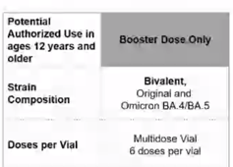
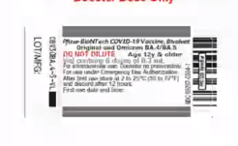
Pfizer-BioNTech Bivalent COVID-19 vaccine
Vaccine contains the original strain of Co-V-2 and the Omicron BA.4 and BA.5 variant
The vaccine will not need to be diluted
The Bivalent booster looks identical to the monovalent vaccine
Make sure vaccinating staff are reading the label to insure that they are administering the right vaccine

Slide 8
Pfizer-BioNTech Bivalent COVID-19 vaccine
Store in Ultra Low Freezer (up to 12 months) or Refrigerator (up to 10 weeks)
DO NOT store in the regular freezer
Discard 12 hours after first puncture
Dose volume is 0.3mL
No Dilution
A single dose administered at least 2 months (8 weeks) from the last dose in the monovalent series

Slide 9
What about Pfizer BioNTech COVID-19 vaccines for children 11 and younger ?
Pfizer-BioNTech SARS-CoV-2 (Monovalent) vaccine is authorized for
Primary series for children 5-11 years of age
0.2mL/10 mcg = 2 primary doses spaced at least 3 to 8 weeks apart and 1 monovalent booster 5 months from last dose
Moderately to severely immune compromised
0.2mL/10 mcg = 3 primary doses ( dose 1 and 2 spaced at least 3 weeks apart and dose 2 and 3 spaced at least 8 weeks apart) then one monovalent booster 3 months from last dose
Primary Series for children 6 months – 4 years of age
Pfizer-BioNTech SARS-CoV-2 (Monovalent) Primary vaccine is authorized only (3 primary doses)
0.2mL/3 mcg dose 1 &2 spaced 3-8 weeks apart
0.2mL/3 mcg

Slide 10
Moderna Standing Order
Booster vaccination
f) A single dose of the Moderna COVID-19 Vaccine, Bivalent (Original and Omicron BA.4/BA.5) is FDA-authorized for use in individuals 18 years of age and older as a single booster dose administered at least 2 months after either:
• Completion of a primary vaccination with any authorized or approved monovalent* COVID-19 vaccine or
• Receipt of the most recent booster dose with any authorized and approved monovalent COVID-19 vaccine
*Monovalent refers to any authorized and approved COVID-19 vaccine that contains or encodes

Slide 11
Moderna Standing order

Slide 12
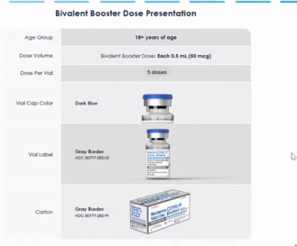
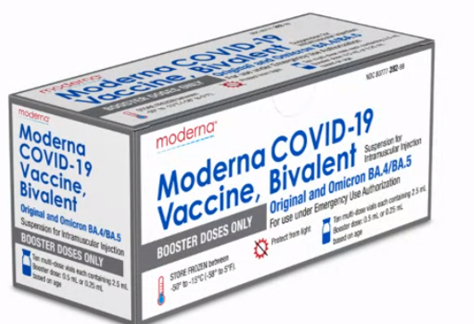
Moderna Bivalent COVID-19 Booster
Moderna Bivalent Booster vial
Dark Blue Cap
Gray border on label
Authorized for 18 years and older only
5 doses in the vial
Dose is 0.5mL/ 50mcg
Label Discrepancy
Two amounts for the booster dose are labeled on the box and vial
18 years and older should receive 0.5mL

Slide 13
Moderna Bivalent COVID-19 Booster
Can keep in the regular Freezer for up to date of expiration
Can keep in the refrigerator for up to 30 days
Once punctured vial must be discarded after 12 hours
A single dose administered at least 2 months or (8 weeks) after the last dose in the primary series or the last monovalent Booster dose

Slide 14
Moderna SARS-CoV-2 for Children under 12 years of age
Children 6-11 are authorized to receive primary doses only
Children who are not moderately to severely immune compromised should receive
2 doses of monovalent Moderna spaced 28 days apart
Children who are moderately to severely immune compromised
3 doses of monovalent Moderna spaced at least 28 days apart
Children 6 months -5 years are authorized to receive primary doses only
Children who are not moderately to severely immune compromised should receive
2 doses of monovalent Moderna spaced 28 days apart
Children who are moderately to severely immune compromised
3 doses of monovalent Moderna spaced at least 28 days apart
NO BOOSTER DOSES ARE AUTHORIZED for these age groups with Moderna

Slide 15
Expiration Checkers
Moderna https://modernacovid19global.com/en-US/vial-lookup
Janssen https://vaxcheck.jnj/
Pfizer https://lotexpiry.cvdvaccine.com/
Novavax https://www.novavaxcovidvaccine.com/

Slide 16
Influenza Vaccine Season 22-23
Bi directional borrowing of VFC influenza is no longer allowed
Individuals 65 years and older are recommended to receive a high-dose flu vaccine
Section 317 adult influenza vaccine
Should be targeted to uninsured and underinsured adults 19 years and older
Additional doses have been released
Additional flu for adults is available if interested let VFC OPS know ASAP
(For this flu season only you may administer 317 flu to adults regardless of insurance status as long as you prioritize uninsured and underinsured adults first)
You will still need to screen them

Slide 17
Why screen for 317 Eligibility
It is required
It can help you with figuring out how much flu to pre-book for adults the next season
It can also assist in determining
Number of uninsured or underinsured who would be eligible for adult 317 vaccines

Slide 18
Section 317 Vaccine Policy
New policy started 9-1-2022
Highlights
Uninsured adult 19 years and older
Underinsured adult 19 years and older
Has insurance but insurance does not cover vaccines
Shingrix was made available – age dependent
HPV made available - age dependent
Hepatitis A
Hepatitis B
MenACWY
Men B
MMR
PPSV23
Tdap
Twinrix
Varicella

Slide 19
Additional funding
80% of funding must have already been spent
Open from now until 12/31/2022
Must be used by 1/31/2024
Notify Lana Hudanick or Afra Hussain if interested
Anyone who has received a template
We will be providing Office hours once a month to help you with the template and budgets

Slide 20
What Questions do you have
?

