Slide 1
OFFICE HOURS
7-29-2021

Slide 2
Agenda
Marketing and campaign materials available
Update on ACIP call
Overview of timeline due dates
Overview of billing
Additional funding
OPEN discussion

Slide 3
Marketing and Campaign materials

Slide 4
Update on ACIP Call

Slide 5
ACIP updates
You do not need to restart any vaccination series even if later than the 42 days
If patient receives a COVID vaccine overseas
People who have received all recommended doses of a COVID-19 vaccine that is listed for emergency use by WHO do not need any additional doses with an FDA-authorized COVID-19 vaccine
People who have not received all the recommended doses of a COVID-19 vaccine listed for emergency use by WHO may be offered a complete, FDA-authorized COVID-19 vaccine series
People who received all or some of the recommended doses of a COVID-19 vaccine that is neither authorized by FDA nor listed for emergency use by WHO may be offered a complete, FDA-authorized COVID-19 vaccine series

Slide 6
ACIP updates
At this time Boosters are still not recommended for any population if knowingly giving booster vaccines (that are not covered under the EUA) then you are not protected under the PREP ACT should something happen
Myocarditis and Pericarditis
Not much more information, committee still felt the benefit of vaccination outweighs the risk of COVID-19 disease
GBS
The committee still felt that the benefit of vaccination outweighs the risk of COVID-19 disease

Slide 7
Time line and due dates review

Slide 8
Time line
Last date to sign the contract will be September 2021
All contracts need to be executed before you may invoice
All invoices are due between 5th and the 15th of the month
All initial Baseline reports are due August 5th through the 15th
Logic models and first monthly report due September 5th through the 15th
Final reports due no later than 30 days after 1/30/2024

Slide 9
invoicing

Slide 10
Common questions on Invoicing
Can we invoice for onsite office walk-in immunization clinics for COVID19 or Adult immunizations?
Yes, Personal cost, maybe covered for onsite walk-in immunization clinics for COVID-19 starting with August invoice. You may not back bill from February to July for this type of clinic. Also as long as non-traditional or off-site vaccination clinics continue. As this is a courtesy, DHSS reserves the right to deny reimbursement if the contract requirements are not met.

Slide 11
Common questions on invoicing
Do I have to submit invoices for every month starting with the February 2021 invoice? Yes, This helps with tracking invoices and payments to ensure that nothing was missed
What if I have nothing to bill for? Still submit a dh38 with a zero balance and invoice template does not need to be submitted with the Dh38
Why do I have to use your invoice numbers on our dh38? This helps our office of finance track your invoice and payment. You may find this number on your contract or you may also find it on the faq.

Slide 12
Common questions on invoicing
When may I start billing? Once all of the following are completed
your contracted is executed
you have a contract number and
You have a state vendor id number
Both your contract number and your state vendor id number must be on your dh38 for us to process the invoice

Slide 13
Common questions
Who do I send invoices to? You need to send them to Tanya Mcmillan at Tanya.mcmillan@health.mo.gov prefers that you email them
How do I figure the 10% amount for underserved populations on my invoice template?
If your entire county is high svi as designated on the cdc/atsdr social vulnerability index you may find that map here https://svi.cdc.gov/prepared-county-maps.html if your county is dark or light blue you may count all funds toward underserved.
If your county is not considered high it will have a value between 0.01-0.5 you may count that percentage on your invoice for underserved populations
If you are working in a zip code that is designated high svi all activities in that zip code may be counted toward the underserved population

Slide 14
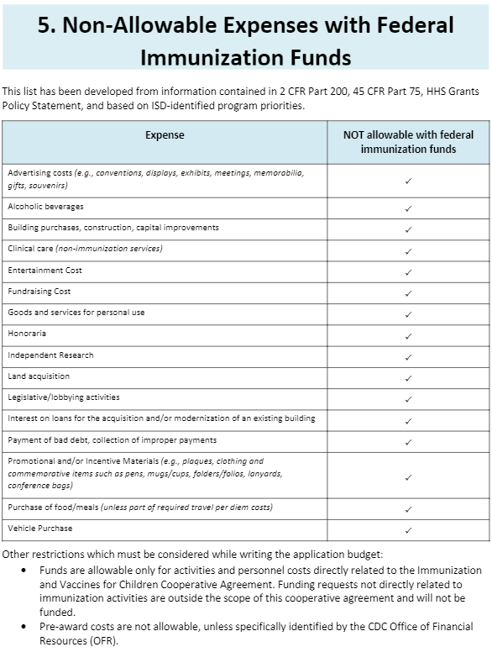

Slide 15
Other common questions
Where do I find the data for my county? Contact your regional public health nurse
Do I have to do a community assessment? Yes, unless you do not have a recent community assessment however you do not have to turn it in. You will need it to complete your logic model

Slide 16
Where may I find resources for this contract
https://health.mo.gov/living/healthcondiseases/communicable/novel-coronavirus-lpha/
Recordings for the calls
Templates for the contract
resources

Slide 17
Additional funding

Slide 18
Questions????

