Slide 1
OFFICE Hours COVID-19 & adult Immunization Contract
4-21-2022

Slide 2
Agenda
Clinical Updates
Billing and Spend Down

Slide 3
2nd Booster doses

Slide 4
Overview of 2nd Booster dose product
Must be either Pfizer-BioNTech or Moderna product only
Janssen is not authorized for 2nd dose boosters
Immune compromised individuals 12-17 years of age should only receive a Pfizer-Biontech product
Dose
Pfizer - .3ml (30MCG)
Moderna 0.25ml (50 mcg)

Slide 5
Vaccination Schedule by product and age

Slide 6
Vaccination Schedule for Moderately to severely immune Compromised

Slide 7
How many doses total?
Moderately to severely immune compromised individuals
5 doses of an MRNA vaccine (12 years and older only)
3 doses of Janssen and 1 dose of an MRNA (4 total)

Slide 8
Myocarditis and Pericarditis
mRNA vaccines
12-39 years of age within 7 days of the 1st booster dose
Males 40 years of age and older within 21days of booster dose
Males are more likely TO HAVE S/E
RISK NOT AS HIGH WITH 2ND BOOSTER DOSE

Slide 9
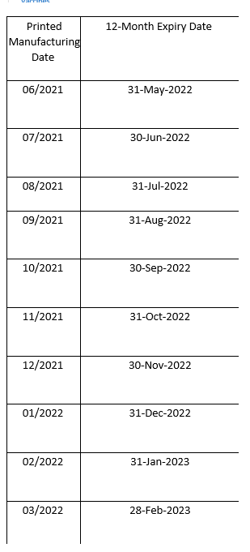
Pfizer Updates
2nd Booster dose
Expiration date extensions
Gray(TRIS)and Orange cap Pfizer COVID-19 products
Extended to 12 months expiration from date of manufacturer if kept in Ultra Low temperature freezer unit
Expiration dates are not printed on the boxes or vials- It is the date of Manufacture

Slide 10
Pediatric update
Moderna and Pfizer submitting data for
6 months to 4 years of age
Mid- may decision
Deployment June
What can be done now- (can use contract funds for this activity)
Reach out to Pediatricians in your area
Assess if they are enrolled providers
See about collaborations
LPHA order and distribute in county
All providers must be enrolled in COVID

Slide 11
INVOICING
New template
Due the 5th-15th of each month
Monthly report due at the same time
No money spent- still send 0 balance invoice

Slide 12
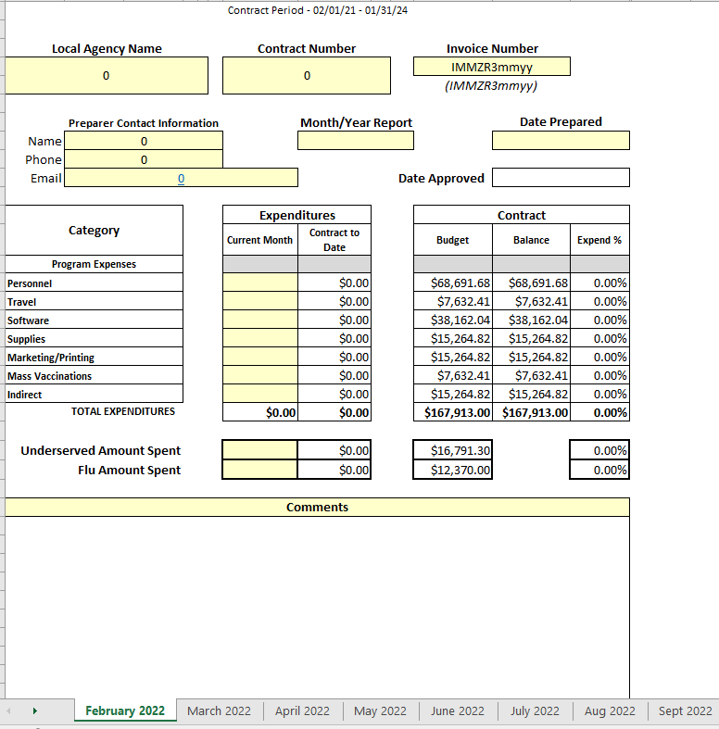
Invoice is customized to each LPHA
If you have not gotten this new type of invoice please let me know
Make sure when completing you are using the correct month

Slide 13
Spending
25-30% of contract funds should have been spent
If you have spent less than 2%
Have a plan
Send plan to your regional nurse
Any personnel time spent on – bill to this contract
This contract
COVID-19 vaccine planning activities
Implementing activities
overtime for vaccination efforts
Contract staff
Homebound visits – travel time and mileage

Slide 14
Spending
Supplies- prior approval needed for any one supply item over $1000.00
Software/ EMR/EHR
Cost maybe billed during the time frame of this contract
Ends 1/31/2024

Slide 15
Questions

