Slide 1
Office Hours COVID-19 and Adult Immunization Contract
3-17-2022

Slide 2
Agenda
Clinical Vaccine Updates
COVID-19
Other ACIP vaccines
Invoicing update
Develop and implement Community Engagement activities
Discussion

Slide 3
4th dose Pfizer
Pfizer recently applied this week for approval to administer a 4th dose
Adults 65 years and older
Currently this request is with the FDA
At this time the only individuals that should be receiving 4 total doses are
Moderately to severely immune compromised individuals 12 years and older

Slide 4
Clinical Guidance Updates
Standing order updates
Expiration dates for Pfizer’s COVID-19
Myocarditis and Pericarditis updates
Janssen vaccine expiration date update
EUI updates

Slide 5
Booster doses for moderate to severely immune compromised individuals
CDC approved the following clinical guidance changes:
Booster dose for moderate to severely immune compromised individuals changed to 3 months for both mRNA vaccines
These individuals will get a total of 4 doses for the mRNA vaccines
These individuals will get a total of 3 doses of Janssen

Slide 6
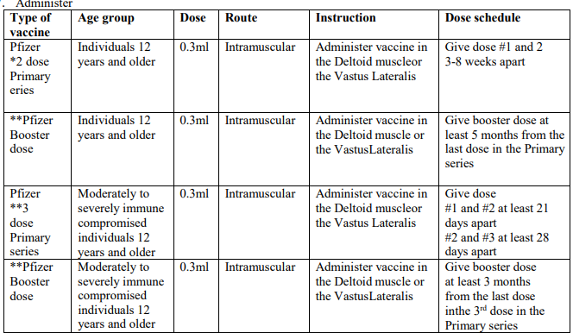
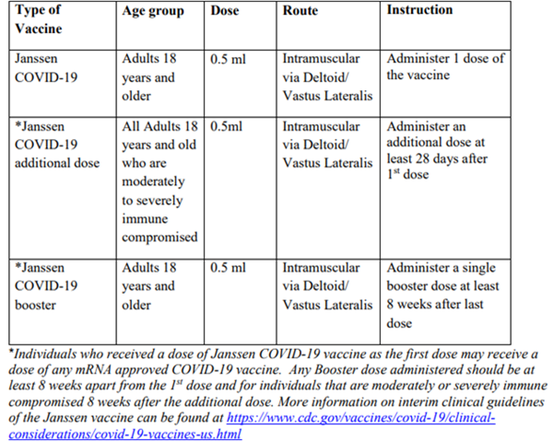
Updated orders
Pfizer Vaccine
Janssen Vaccine table
Please make sure you have the current standing orders saved they are dated 2/24/2022

Slide 7
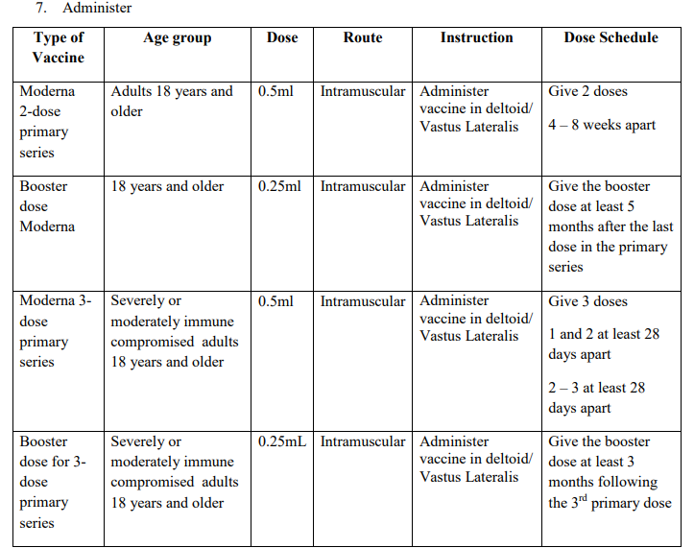
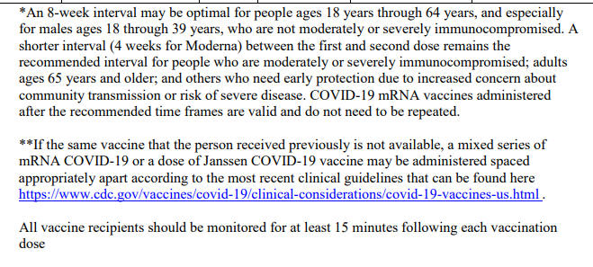
Updated order
Moderna
New spacing

Slide 8
Spacing update for mRNA vaccines
Moderna (Spikevax and PfizerBioNTech (8 week interval)
Recommendation is to increase the interval up to 8 weeks
May decreases risk of vaccine induced myocarditis/pericarditis
May increase the immune response to dose 2
Moderna (4 weeks) and PfizerBioNTech (3 weeks) interval
Recommendation is to remain at the shorter interval for the following populations
Moderately to Severely immune compromised individuals
Children under 12 years of age
Adults 65 years
Others who need rapid protection due to increased concern about community transmission or risk of severe disease

Slide 9
Janssen (J&J) COVID-19 vaccine
Expiration date extended for J&J set to expire on 3/7/2022 or later
Shelf life has been extended for this vaccine to 9 months for un-punctured vials in a refrigerator at 36° to 46°F
Vaccine expiration date checker
https://vaxcheck.jnj/

Slide 10
Other reminders
Update your hours in SMV when you are going to be closed- we cannot update for you
VFC has over 650 providers
COVID-19 over 600
Make sure you are updating Vaccine finder
Make sure that if you do not need the ancillary kit you indicate this
Pfizer pediatric 5-11 comes with the diluent (do not cancel this one)

Slide 11
Other reminders
Pediatric Pfizer 5-11 can be ordered in quantities of 100
Can be stored for 10 weeks in the refrigerator
That works out to be 10 doses a week
It is okay to open a COVID-19 vial to administer a dose or 2 if no one comes in the time frame waste the rest- this is okay you will not be punished
If you need to redistribute try working with your RIT team
Reach out to Long Term Care Pharmacies who are enrolled providers

Slide 12
Emergency Use Instructions (EUI)
PfizerBioNTech
https://www.cdc.gov/vaccines/covid-19/eui/downloads/pfizer-HCP.pdf
Moderna
https://www.cdc.gov/vaccines/covid-19/eui/downloads/Moderna-HCP.pdf
WHO approved COVID-19 vaccines may be boosted now with Moderna
On a case-by-case basis, providers of moderately or severely immunocompromised patients may administer the COVID-19 vaccine by Moderna or PfizerBioNTech outside of the FDA-authorized or FDA-approved labeling and CDC recommended
dosing intervals based on clinical judgment when the benefits of vaccination are deemed to outweigh the potential and unknown risks for the recipient.

Slide 13
Myocarditis and Pericarditis
What does this mean for you?
If you are vaccinating a male that has had a history of myocarditis and pericarditis
Excellent way to use up Janssen doses for males 18 years and older
If an error has been made and the dose needs to be repeated
Vaccinators may choose to repeat the dose 21 days to 8 weeks after the dose given in error for males12-29 years of age due to the increased risk of myocarditis and pericarditis

Slide 14
Errors with COVID-19 vaccine
Vaccine dose administered before the recommended interval
If administered within the 4-day grace period- do not repeat
If Primary dose administered before the recommended time frame including grace period the dose should be repeated
Expired vaccine administered
Contact the manufacturer for guidance
Pfizer 1-800-438-1985 https://www.pfizermedicalinformation.com/en-us/medical-request
Moderna – 1-866- 663-3762 MedInfo@modernatx.com
Janssen – 1-800-526-7736 https://www.askjanssenmedicalinformation.com/step1-contact-information

Slide 15
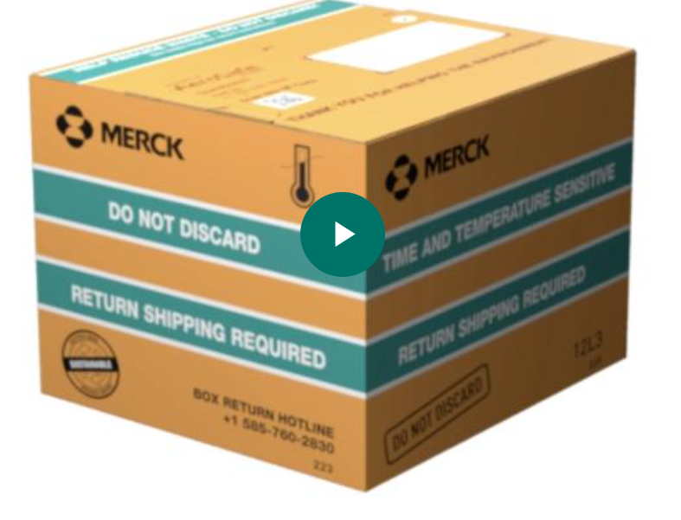
Vaccine update (not Covid)
Merck shippers will now be reusable
Merck will include how to handle and return these containers
Contact AeroSafe with any questions at 585-660-3166
Video available https://players.brightcove.net/1905768940001/default_default/index.html?videoId=6144763377001

Slide 16
Hepatitis B Adult Vaccine
Adults 19-59 years of age should receive the Hepatitis B vaccine series if they are not already vaccinated
Adults 60 years and older who have risk factors should receive the Hepatitis B vaccine if they are not already vaccinated
Adults 60 years and older who have not received the Hepatitis B vaccine may be vaccinated it they wish

Slide 17
Shingles RZV
Individuals 19 years and older that are or will be immune compromised
Space 2 doses at least 2-6 months apart
May be administered at the same time as COVID-19
If administering Shingrix and flu try to not administer FLUAD and Shingrix at the same time due to the adjuvant in the vaccine
Exception is if FLUAD is the only flu vaccine available then go ahead

Slide 18
Adult Pneumococcal vaccine update
Adults no longer need to repeat a dose of PPSV23
Adults who only received a PCV13 may receive a dose of PCV20 or PPSV23 spaced out by 12 months
All Pneumococcal vaccines may be co-administered with COVID-19

Slide 19
Adult Pneumococcal vaccine update
All adults 65 years of age and older who have not received a pneumococcal vaccine or whose history of vaccination is unknown should receive a dose of PCV 20 or PCV15
If PCV15 If PCV15 is administered person should receive a dose of PPSV 23 in 1 year
Adults 19-64 years of age with certain medical conditions or other risk factors who have not had a pneumococcal vaccine or if history is unknown should receive a PCV 15 or a PCV 20
If PCV15 is administered person should receive a dose of PPSV 23 in 1 year unless
Person is immune compromised, has a CSF or cochlear implant then in 8 weeks between doses of PCV15 and PPSV23

Slide 20
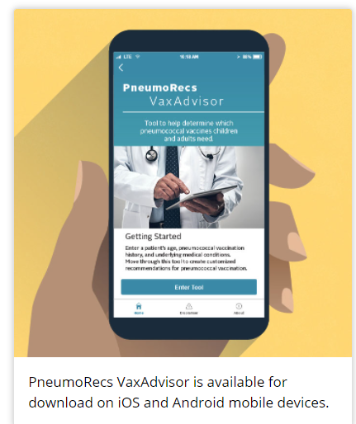
PneumoRECs app
Download from the app store
Apple App Store
Google Play
Enter a patient’s age.
Note if the patient has specific underlying medical conditions.
Answer questions about the patient’s pneumococcal vaccination history.

Slide 21
What Questions do you have?

Slide 22
Ideas on who to partner with
Schools
Offer other vaccines adolescents need such as Tdap, MCV along with COVID-19
Other areas Offer COVID-19 testing and COVID-19 vaccination
Businesses
Churches
Shelters
Food Banks
Senior Centers
YMCAs or Community centers

Slide 23
Collaborating with physicians and other healthcare providers
Most individuals will be open to vaccination if they receive the recommendation from their own provider
Make sure that you reach out to the providers in your county
Are they recommending the COVID-19 vaccine
Share resources on why they need to recommend the vaccine
Are they vaccinators if not see if they will refer patients to you
Provide a referral flyer with your information including office hours
Foster Collaborations

Slide 24
Helpful tips on Invoicing
Due the 5th through the 15th each month along with Monthly report
Personnel Cost
Staff time spent on COVID-19 vaccination efforts
Contract can pay for overtime for COVID-19 vaccination efforts- only
Not contract tracing or case investigation – bill ELC
Any single item of $1000.00 needs prior approval except for
EMR/ EHR
Software

Slide 25
HRSA uninsured and underinsured
This program has run out of money and is not accepting any more applications for payment
Remember you can bill
Personal staff time for administering the COVID-19 vaccine to this contract
Supplies to vaccinate may be billed to this contract

