Slide 1
OFFICE HOURS
12-2-2021

Slide 2
Agenda
Review of booster doses and Update on Vaccine
Mosio Text messaging pilot
Invoicing/ monthly report questions
Developing your campaign and social media
Measuring success

Slide 3
COVID Vaccine Updates
Orders will not be shipped Christmas EVE, Christmas day, New Years Eve or New years day
Moderna 10 orders will include 2 ancillary kits to support booster doses (if you do not need ancillary kits you may opt out)
It is best to order vaccine before scheduling a clinic

Slide 4
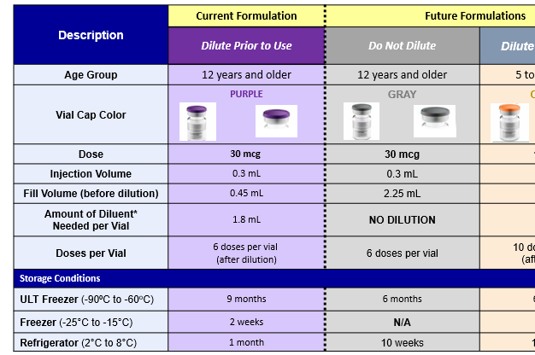
COVID Vaccine Updates
Comirnaty - Ordering sheet will be updated once we know it is available- Do not try to order before
Gray Cap
12 years and older
Minimum order will be decreased
The product will not need to be diluted prior to use
Dose will remain the same at 30 mcg/ 0.3mL
6 doses per vial
Storage will be
Ultra low for 6 months
Refrigerated for 10 weeks

Slide 5
COVID-19 Vaccine updates
Remember new formulations require staff training
CDC has updated trainings for Pfizer products or please attend one that is listed in the next slide
You must report to Vaccine Finder at least every 5 days
If you redistribute vaccine you also need to redistribute ancillary kits
6 month Booster doses of Moderna and Pfizer or a booster dose of Janssen do not require a self-attestation

Slide 6
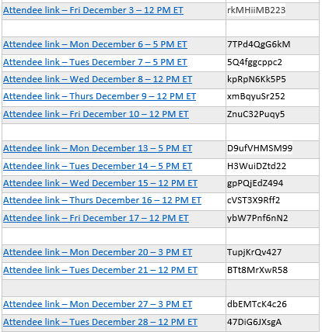
COVID Vaccine Updates
If conducting school located clinics please let us know
We have been asked to keep track
Upcoming trainings
Pfizer trainings pfizer training link

Slide 7
Vaccine errors
50% of the VAERS reports involving children are due to errors
Check at least 3X before administering the Vaccine
Any adult dose of
Pfizer administered to a child 11 years or younger needs to be reported to VAERS
Do not repeat dose
If 2nd dose is needed administer age appropriate dose
Moderna or Janssen administered to a person 17 years or younger needs to be reported to VAERS
2nd dose should be Pfizer (if Moderna given)
Janssen – no further vaccines

Slide 8
Developing Campaigns, Social Media
Danielle Blakely

Slide 9
Text Based Reminder Recall PILOT
Overview
Purpose: Increase series completion
We are looking for 6 more providers to participate in a text based reminder recall pilot project
6 month commitment
Providers need to be able to regularly communicate with BI staff
The provider will need to share appointment dates with BI staff
BI staff will use SMV to gather patient phone numbers
Patients will be sent an appointment reminder for vaccine type
3 reminders total
Patients will be re-directed to provider’s office to reschedule appointments
Appointment reminders will look like they came from the provider’s office

Slide 10
Invoicing and Reporting
Invoicing
If you have met your 10% for underserved you no longer need to keep track
Reports are due the 15th of each month
This allows us to complete our report to CDC
If you have not submitted your logic model or baseline report please do so ASAP
Each participating county will be scheduled a virtual visit in Jan 2022 with their regional Nurse to discuss
Spend down
Challenges

