Slide 1
LPHA OFFICE Hours
12/14/2022

Slide 2
Agenda
Vaccine Updates
Lot expiry extensions
Bivalent updates
Moderna- 6 months through 5 years
Pfizer-BioNTech - 6 months through 4 years
Standing Orders
Highlights from LPHA events for vaccination
Warren County
Pike County
Budgets for remaining project year
Reminders
Invoices due date

Slide 3
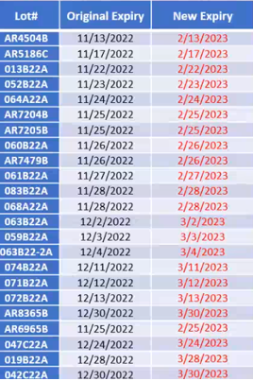
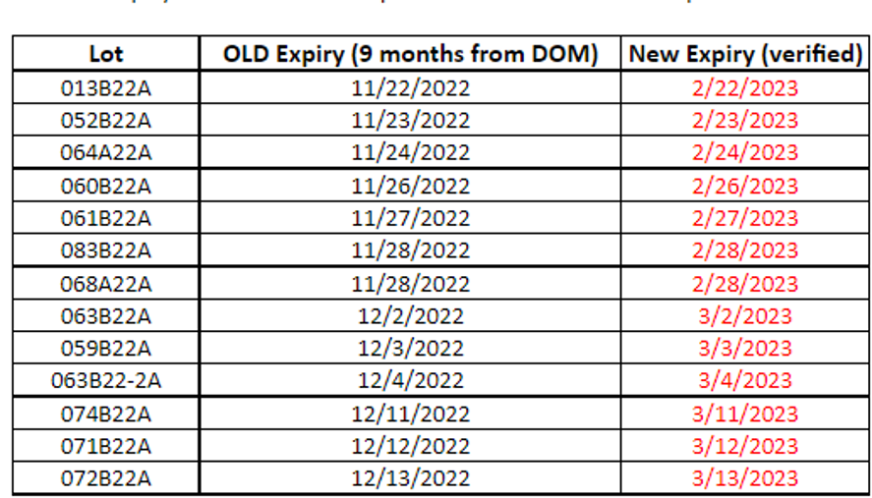
Vaccine Updates
Lot Expiry Extensions: Moderna Monovalent
https://modernacovid19global.com/en-US/vial-lookup
Should carry some Monovalent but not a lot
Distributors may ship vaccines with Less than 30 days shelf-Life

Slide 4
Vaccine Updates
Pfizer Lot Expiry Extensions
https://lotexpiry.cvdvaccine.com/
All of the TRIS products now expire 18 months from Date of Manufacture (DOM) if kept in an ULT Freezer
Should carry some Pfizer Monovalent
Distributors may ship vaccines with less than 30 days shelf-life

Slide 5
Expired COVID-19 vaccines in SMV
If the vaccine is no longer showing in SMV
You will need
Go into vaccines on hand
Change status to depleted/expired vaccine and search for lot numbers
Change the expiration date and it will move back into vaccines on hand
If the vaccine is still in SMV
You will need to go in and adjust the expiration dates

Slide 6
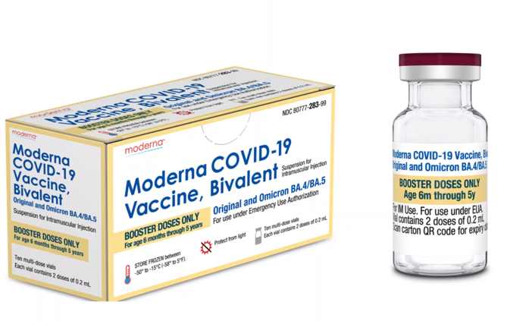
Moderna Bivalent Booster for children 6 months through 5 years of age
Dose is 0.2mL/ 10 mcg
2 doses per vial
Stored in freezer for up to 12 months
Stored in refrigerator for 30 days
Store at room temperature for up to 24 hours
Once punctured discard after 8 hours
Do not refreeze unthawed vials
If the fluid in the vial is discolored or has particles do not use

Slide 7
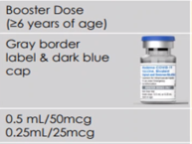
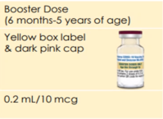
Moderna Schedule for 6 months through 5 years of age
Monovalent Monovalent Bivalent
4-8 weeks later 8 weeks later
Individuals that received a Pfizer product are not eligible for the Moderna Bivalent

Slide 8
Pfizer-BioNTech Bivalent Vaccine for 6 months through 4 years of age
This is not a booster dose but part of the primary series
10 doses in the vial
Dose is 0.2mL (3 mcg)
Dilute with 2.2mL of accompanying diluent
Discard after 12 hours of dilution (cap puncture)
Store un-punctured vaccine vials
UTL Freezer up to 18 months
Refrigerator up to 10 weeks

Slide 9
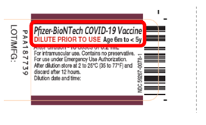
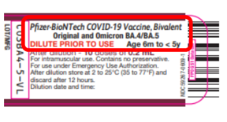
Pfizer-BioNTech Bivalent Vaccine for 6 months through 4 years of age
Please not the vaccine vials for the Pfizer-BioNTech Monovalent and Bivalent is identical the only difference is the word Bivalent
This is a 3 dose series
The new schedule is:
Dose 1 Pfizer-BioNTech Monovalent COVID-19 Vaccine (4-8 weeks later dose 2)
Dose 2 Pfizer-BioNTech Monovalent COVID-19 Vaccine (8 weeks later dose 3)
Dose 3 Pfizer-BioNTech Bivalent COVID-19 Vaccine
Pfizer-BioNTech COVID-19 Vaccines are not interchangeable with the Moderna COVID-19 vaccines for this age group

Slide 10
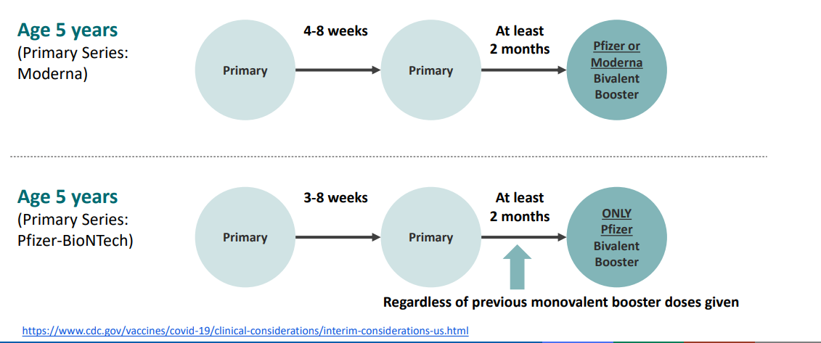
Pfizer-BioNTech Bivalent Vaccine for 6 months through 4 years of age
If a child in this age group has already received their Primary Pfizer-BioNTech vaccine series
At this time they are not eligible for any further doses including the bivalent
As soon as they age up they may receive a bivalent booster for the new age group

Slide 11
Mixed Series for children 6 months – 4 years

Slide 12
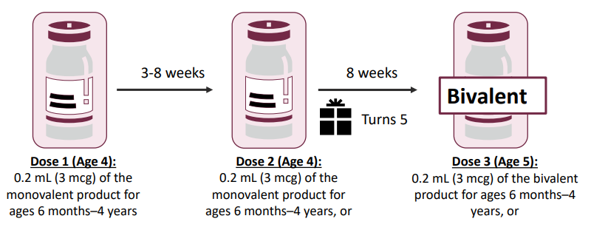
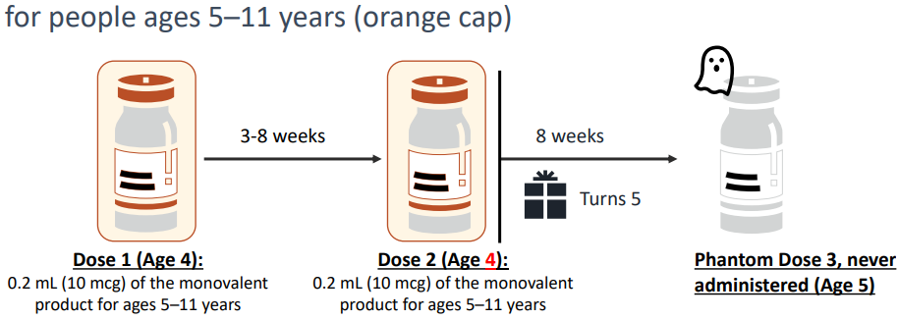
Pfizer-BioNTech: Children aging up during the primary series
May receive either
The 3 dose primary series for children 6 months through 4 years of age
The 2 dose primary series for children 5 – 11 years of age and a bivalent booster

Slide 13
Standing Orders
Revised Standing Orders Pfizer-BioNTech COVID-19 vaccines for children 6 months-4 years of age and Moderna vaccines are being updated and should be posted this week
Please Note
Once the vaccine is available commercially the standing orders will be rescinded
Start now working with your medical providers to start the process of creating your own standing orders
Need assistance let me know

Slide 14
Vaccine Errors

Slide 15
Vaccine Errors
Remember you must report all Errors regarding COVID-19 vaccine to VAERS
Develop a plan for storing the vaccines
Clearly label all individual syringes containing the vaccine
Check
Right Patient
Right Vaccine
Right Time
Right Dose
Right Documentation
Right Route

Slide 16
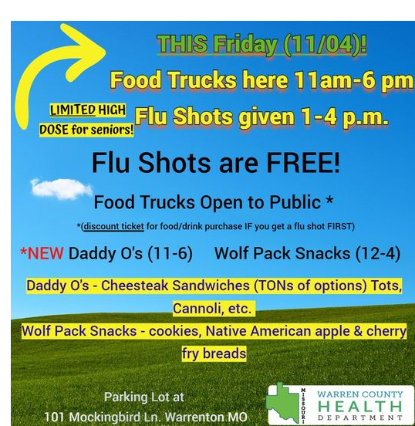
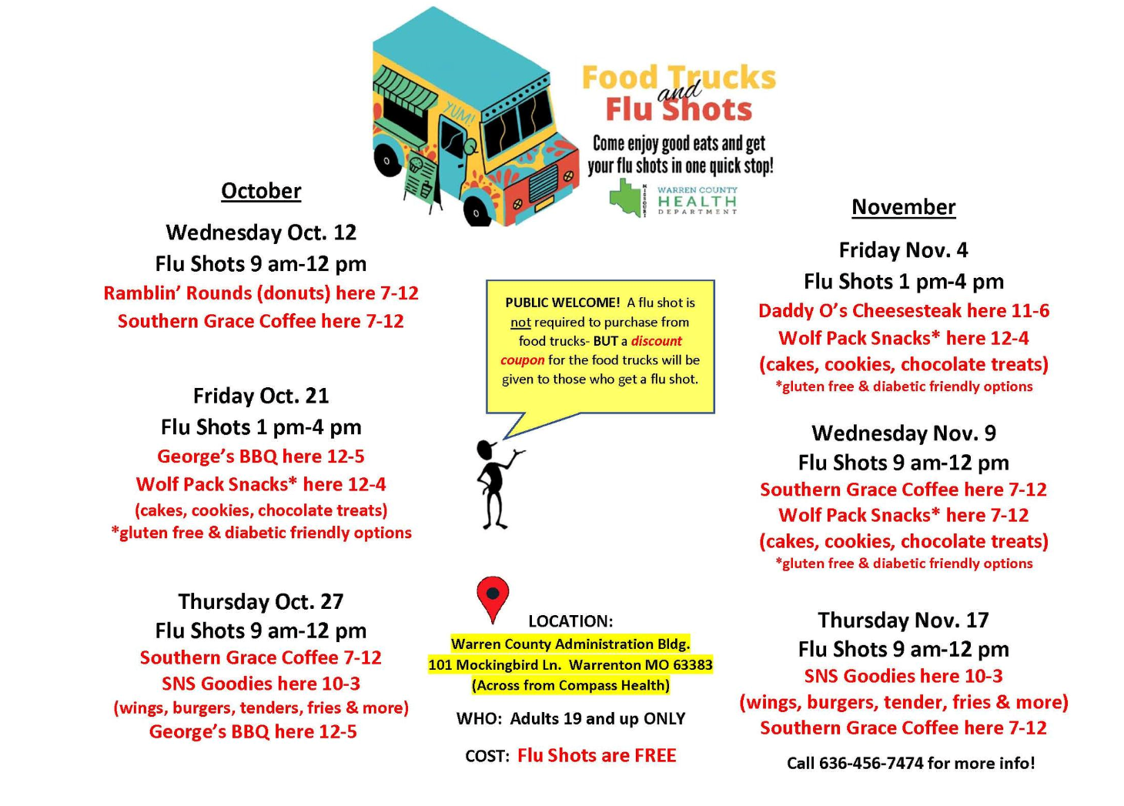
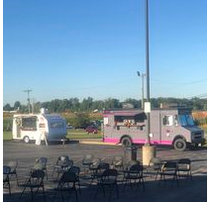
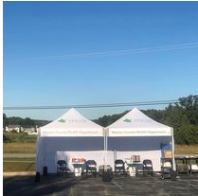
Highlights from LPHA events for vaccination
Warren County Health Department
Food Truck Flu Events
8 dates ( held during morning of afternoon)
Different Food Trucks were on the lot
Participants were given a $2 coupon to use at the food trucks for anyone receiving a flu shot who was 19 years and older
Participants who wanted a COVID-19 vaccine were given the opportunity to make an appointment during the event
380+ adult flu vaccines were administered

Slide 17
Highlights from LPHA events for vaccination
Pike County
Migrant worker outreach
Andrew County
Outreach efforts to local communities

Slide 18
Budgets for Remaining funds
For your remaining funding
Put together a 12 month budget
Personnel and Fringe
Supplies
Software
Mass Vax
Indirect
Send this budget into Tanya McMillan along with your January invoice on 2/5/23-2/15/23
She will then send you a new invoicing template

Slide 19
Budgets for Remaining funds
Remember
Purchases of $1000.00 or more for a supply item must be preapproved by myself or Afra
Quotes with the email
Our response will also be sent to Tanya

Slide 20
Additional Funding Request
To be eligible
You must have spent at least 80%
Apply on or before 12/31
You will receive a Project Narrative Template
Activities should be slated to begin Jan 1, 2023- Jan 31, 2024
Submit the Completed Narrative to myself and Afra
We will score you submission
After you submit your Narrative Afra will send the budget template
Submit the budget template back to Afra

Slide 21
Calls going forward
Project Narrative Offices hours will be held through January 2023
To help with questions regarding budgets and narrative
This call will end unless a major change occurs with the Vaccine
Your regional nurses still are here to answer questions
Nina Nation
Nikita Hargrove
Steve Burrows
Val Seyfert ☺ (retiring 12/15/22) – Contact Lana Hudanick and Afra Hussain with questions
as well as
Lana Hudanick
Afra Hussain

Slide 22
What Questions do you have
?

