Slide 1
LPHA OFFICE Hours
10/20/2022

Slide 2
Agenda
Bivalent vaccine
Standing order review
Products
Pediatric vaccine
Errors
Frequently Asked Questions
Current Funding
Additional Funding

Slide 3
Bivalent Booster: Pfizer Pediatric
Who is eligible
Children 5-11 years of age who have completed a primary monovalent COVID-19 vaccine series
New Fact Sheet for recipients https://www.fda.gov/media/162250/download
Dose
A single 0.2mL injection administered Intramuscularly
Spacing
At least 2 months (8 weeks) from the last monovalent dose or the last dose of the primary monovalent series

Slide 4
Pfizer Pediatric
Preparation
Must be diluted with the accompanying diluent (1.3mL)
Label the vial with the date and time of dilution
Once diluted must be discarded after 12 hours
Each vial contains 10 doses (if using a standard syringe and needle you may not get 10 doses)
Storage and handling
Store in refrigerator for up to 10 weeks
If stored in an Ultra Cold Freezer vaccine must be discarded at 12 months from the date of manufacture

Slide 5
Update on Comirnaity
Several updated EUA fact sheets for
https://www.fda.gov/media/161327/download Bivalent booster EUA
https://www.fda.gov/media/153715/download Primary Doses & Bivalent booster EUA
You will notice that single dose vials are mentioned in this EUA at this time all doses are still multi dose vials
Dose still remains 0.3mL for primary doses
Dose still remains 0.3mL for bivalent booster doses

Slide 6
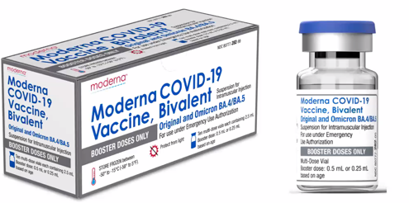
Bivalent Booster: Moderna Adolescent and Pediatric
Who is Eligible
Individuals 6 years and older who have completed their primary monovalent series
Dose
0.5mL for individuals 12 years and older
0.25mL for individuals 6-11 years of age
Spacing
A single bivalent booster dose is recommended 2 months (8 weeks) after the last dose in the primary series or last monovalent booster dose

Slide 7
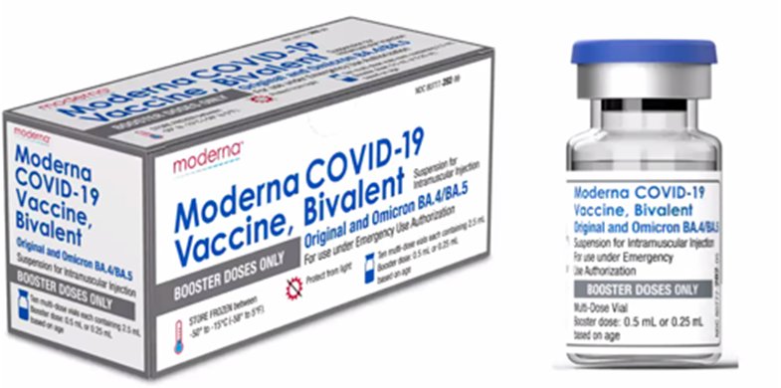
Bivalent Booster: Moderna Adolescent and Pediatric
Order in quantities of 100
Preparation
Record the first puncture date/ time on vial
20 punctures per vial only
Storage and Handling
Unopened vials may be stored up to expiration date
Refrigerated unopened vails may be stored up to 30 days before discarding
Intact vial may be stored at room temperature for up to 24 hours
Once punctured discard after 12 hours

Slide 8
Moderna Bivalent Booster vail and SMV
The Moderna Bivalent Booster vial contains a total of 5 doses
Each vial enters SMV inventory as 5 doses
If administering pediatric 0.25mL & you are an inventory user simply adjust your inventory add doses as needed
Wastage
If you need to waste an entire vial it is a total of 5 doses
If you need to waste a vial and you gave only 1 pediatric dose you waste 4 doses

Slide 9
Bivalent Booster COVID-19 Vaccines
All monovalent boosters are no longer authorized
If a monovalent booster is administered inadvertently and you want the person to receive a bivalent booster wait 2 months and administer the booster
Report the error to VAERS
A bivalent booster was administered as a dose in the primary series- differs according to brand
Pfizer product- do not repeat
Moderna – administer 1 dose of monovalent vaccine due to dose lower than authorized for primary series
While you do not need to wait you may delay for 8 weeks to decrease the chance of Myocarditis/pericarditis in males 12-39 years of age

Slide 10
Bivalent Booster COVID-19 Vaccines
If a bivalent booster is inadvertently administered as a primary dose
Pfizer ( Do not repeat primary dose)
mistake Bivalent (primary) + 21 days -8 weeks Monovalent Pfizer (primary) then 2 months later Bivalent Booster
Monovalent (1st primary) + Bivalent mistake (2nd primary) then 2 months later Bivalent Booster
All spacing minimal guidelines must be met between all primary doses
Moderna
If a bivalent booster vaccine is administered as a primary dose then you must revaccinate with a Monovalent Moderna primary dose since the bivalent booster is a lower than authorized
You may revaccinate immediately or space up to 8 weeks apart
Another bivalent booster should be administered 2 months after the last dose in the primary series

Slide 11
Monoclonal antibodies and vaccination

Slide 12
Vaccination after disease
At minimum defer vaccination until patient has recovered from acute illness and criteria to discontinue isolation have been met
May delay up to 3 months following positive test or symptom onset
If community level of disease is high, person is at risk of severe disease and predominant strain of COVID-19 strain should be taken into account

Slide 13
Updated Standing Orders
The Bivalent boosters are included in the standing orders for the primary series
All orders have been updated and are posted at
https://covidvaccine.mo.gov/vaccinators/
If you have issues, clear your cookies and try again
At this time there are no boosters authorized for children under 5 years of age

Slide 14
NOVAVAX Update
A Booster dose of Novavax has been authorized for (limited situations)
Are not able to get a bivalent booster or will not get the mRNA bivalent booster
This is the same formulation as the primary series vaccine
People 18 years and older who have completed a primary series
Dose #1 ( 3 weeks later) Dose #2 then (6 months later) booster dose
Dose 0.5mL
Orders will be updated along with clinical guidelines. This just announced 10/19

Slide 15
Errors
All errors regarding COVID-19 vaccines must be reported to VAERS
Any expired vaccine or BUD vaccine administered needs to be reported to VAERS
If you administer expired vaccine or BUD vaccine
Contact the manufacturer
Get the recommendations in writing – email is fine
Make sure your staff is trained to prevent errors

Slide 16
Avoiding Errors
It is important to note
The primary monovalent series of Pediatric Pfizer remains the same
To avoid errors
Develop a plan for storing the vaccines prior to administration
Clearly label all individual syringes containing vaccines
Ensure every time (check 3 times)
Right Patient
Right Vaccine
Right Time
Right Age
Right Dose

Slide 17
Frequently Asked Questions
We want to purchase….
Submit your request to Lana or Afra along with a quote for the item
You may not purchase the following:
Vehicles/ Trailers
Food/ Beverages
Building construction/ permanent building modifications
When can we apply for additional funding?
Once you reach 80% of funding spent
Send an email to Lana and Afra requesting additional funding

Slide 18
Frequently Asked Questions: Additional Funding
Project Narratives
We may send project narratives back if they are not complete, please respond with an updated project narrative.
Project Narratives that have not been updated will not be scored
Office Hours
Working meetings to receive help with the project narrative or budget
New information will not be shared during these meetings
Number of clinics
Some project narratives include information about a frequency for the clinics (bi-weekly, weekly, etc)
Please provide the total number

Slide 19
What Questions do you have
?

