Slide 1
Office Hours COVID-19 and Adult Immunization Contract
1-20-22

Slide 2
Agenda
Updates on the vaccine
Highlights from the quarterly calls
Deloitte Reports
Discussion

Slide 3
Updates on PfizerBioNTech
Pfizer-tris
New tris formulation is now in circulation for adults and adolescents 12 years and older (gray top vaccine)
Requires no dilution
Stores in a refrigerator for 10 weeks
Dose is still 0.3mL
Once opened vial is good for 12 hours
Remember expiration date is 6 months from date of manufacture listed on the box
All individuals 12 years and older are now approved for a booster vaccine 5 months from the last dose in the primary series

Slide 4
Updates on Pfizer
Since 2 versions of the Pfizer COVID-19 vaccine for 12 years and older is now in circulation
Make sure staff are identifying which one they are using
Do not carry both if possible
If you have both in stock use the purple top (original version) completely before opening up the new one.

Slide 5
Updates on Pfizer
Pfizer Pediatric 5-11 years of age
Moderately to severely immune compromised 5-11 year olds should get
3 primary doses
Dose 1 and 2 = 21 days apart
Dose 2 and 3 = 28 days apart
At this time a booster dose is not authorized for children 5-11 years of age

Slide 6
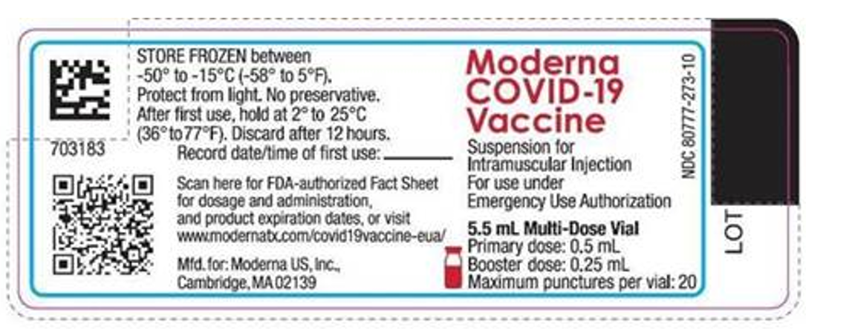
Moderna Vaccine Updates
18 years and older
Booster doses now due 5 months following the last primary dose
label updated
Primary dose listed
Booster dose listed
Max punctures per vial listed= 20

Slide 7
Janssen Update
Still authorized for use
Ensure that you educate the recipient of the risk associated with the vaccine
If after the risk has been discussed and they still want the vaccine feel free to use
Prefer an mRNA vaccine over the Janssen
Booster dose should be an mRNA vaccine if possible

Slide 8
FAQ for COVID-19 Vaccine
Should people who have COVID-19 be vaccinated?
Yes, as soon as they recover and complete their isolation vaccine is recommended
Do we administer a booster dose to someone who was vaccinated outside of the US?
A single dose of PfizerBioNTech vaccine may be administered to anyone who has completed a WHO or FDA authorized COVID-19 vaccine under the CDC issued EUI
A moderately or severely immune compromised patient received has not received their 3rd dose do I still administer it?
Administer the 3rd dose then in 5 months administer a booster dose
A vaccine error occurred (expired vaccine, BUD, incorrect age, site or vaccine brand administered)
All errors need to be reported to VAERS regarding COVID-19 vaccine

Slide 9
Highlights From Quarterly Calls
Perry county is investing in an online scheduler with built in reminder system
Pike county is reaching out to Hispanic workers in area plant nurseries
St Charles county is offering vaccination at local libraries
Columbia/Boone has a recruited a 56 volunteer Vaccine Ambassador program
Staffing ideas
Saline and Howard counties teamed up to host vaccine clinics
Randolph partnered with a nursing school
St Charles used a temp agency for mass vaccination clinics

Slide 10
Highlights From Quarterly Calls
Billing for COVID-19 vaccine
Ste Gen county has seen an income
Preventing errors
Washington County is color coding consents to COVID vaccine
If you are excelling at something share
Also make sure you are giving yourself credit for work on your monthly report
Include everything you have done regarding COVID-19 vaccination

Slide 11
Monthly reports
Making reporting a little easier
Objective 3 non traditional/ mass vaccination clinics
If you keep track on a word document, excel spread sheet or another type of document you may turn that in instead of duplicating these clinics on the monthly report simply include it in your email
Make sure it has
How many vaccinated with COVID
Location (jail, private business, high SVI zip code, church, food pantry)

Slide 12
Deloitte Reports
Every county should have received a county level Deloitte Report
Reports detail
Deep dives into demographic and behavioral characteristics of each county
What is the impact on vaccine uptake
How to use these reports
Read the report
Participate in the workgroup sessions being set up
Review your logic model to see if something needs to be changed – Change it

Slide 13
Deloitte Report
Report outlines
Structural barriers to vaccine
Transportation- biggest challenge for some
Internet access to make appointments
Language barrier
Strategies to change behavior
Increase accessibility
Strategic partnerships
Find your best messenger to reach population
Create the best message

Slide 14
Open discussion
Next meeting will be the third Thursday in February
If you have questions reach out to your regional nurse consultant or Lana Hudanick lana.Hudanick@health.mo.gov

