Slide 1
Well-Integrated Screening and Evaluation
for Women Across the Nation
Notes:
INTRO: Welcome to our WISEWOMAN presentation. My name is Kelly Palermo and I’m the program coordinator for WISEWOMAN.
Explain:
What WISEWOMAN stands for…
5 year CDC funded grant where we are awarded $900k annually to provide funding to contracted providers such as LPHA’s and FQHC’s who in turn provide WISEWOMAN services to underprivileged women in their communities.

Slide 2
True or False…
Heart disease is the second leading cause of death in the US?
False. Heart disease is the leading cause of death for both men and women. About 647,000 Americans due from heart disease each year-that’s 1 in every 4 deaths.

Slide 3
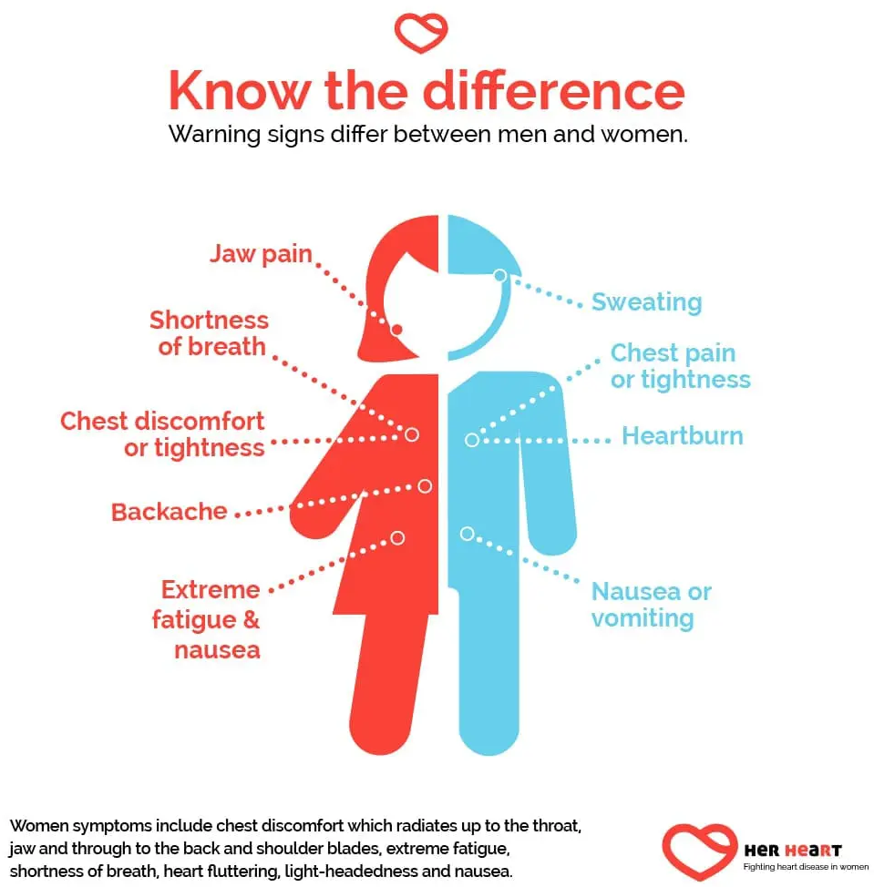
True or False…
Men and women can have different heart attack symptoms. What symptoms are more likely to happen to women than men?
Nausea, unexplained tiredness, and jaw pain
Arm pain and chest pain
Shortness of breath and shoulder pain

Slide 4
WISEWOMAN Program Overview
WISEWOMAN MISSION STATEMENT
Provide low-income, underinsured or uninsured, women ages 40-64 with the knowledge, skills and opportunities to improve their diet, physical activity and other life habits to prevent, delay or control cardiovascular and other chronic diseases.
Notes:
Sister program w SMHW
In 1993, Congress amended the National Breast and Cervical Cancer Early Detection Program (NBCCEDP) to create the WISEWOMAN Program
The Missouri WISEWOMAN Program started in 2003 and is a sister program to Missouri’s NBCCEDP Program called Show-Me Healthy Women (SMHW). Both programs are offered in various counties across Missouri.
We’re like the sister looking out for your heart!
Because we are sister programs, only women participating in SMHW are eligible to participate in the WISEWOMAN program
The WISEWOMAN Program addresses women’s risk for heart disease and stroke by providing cardiovascular disease (CVD) health screenings and risk reduction education, tools, and resources for SMHW (or NBCCEDP) participants

Slide 5
WISEWOMAN ELIGIBILITY
Active participant in DHSS’ Show Me Healthy Women program
Age 40-64 years
Uninsured or underinsured
Low income (at or below 200% of federal poverty level)
Unable to pay the premium to enroll in Medicare Part B
Notes:
INCOME REQUIREMENTS:
SMHW/WISEWOMAN participants must have an income at or below 200% of the federal poverty level
Adjusted gross income on tax return or net amount on pay stub determines income eligibility
INSURANCE REQUIREMENTS:
No health insurance
Health insurance does not cover services
Participant states she is unable to pay deductible
Have MO HealthNet with spend-down, but have not met spend-down
Income eligible for Medicare Part B, but unable to pay premium
Participants eligible to receive Medicare benefits, but not enrolled in Medicare should be encouraged to enroll
Women with full MO HealthNet (ME Code 05) Medicare Part B, POS or HMO health coverage are NOT eligible for services

Slide 6
WISEWOMAN SCREENING REQUIREMENTS
Providers must conduct a baseline screening, this includes…
Height, weight and BMI
Waist and hip circumference for waist-to-hip ratio
TWO complete blood pressure (BP) readings with an average reading
Laboratory tests – complete lipid panel and A1C or fasting glucose (fasting labs are preferred)
Review the results of the screening with the participant and provide participant-centered Risk Reduction Counseling on cardiovascular risk
Refer participants for follow-up office visits, if applicable, for abnormal screening results and/or ALERT values
Refer ALL participants who are willing and ready for change to a Lifestyle Education Program (LSP)
Notes:
Providers must conduct a baseline screening, in accordance with national clinical guidance, for all women enrolling in WISEWOMAN.

Slide 7
WISEWOMAN Lifestyle Education Programs (LSP)
Health Coaching
Missouri Tobacco Quitline
Diabetes Prevention Program (DPP)
Weight Watchers
NOOM- Pending CDC Approval
Take Off Pounds Sensibly (TOPS)
Eating Smart-Being Active (ESBA)
Self-Monitoring Blood Pressure Program

Slide 8
Self-Monitoring Blood Pressure Program (SMBP)
Self-Monitoring Blood Pressure (SMBP) is the regular measurement of blood pressure by the patient outside the clinical setting, either at home or elsewhere.
Strong scientific evidence shows that SMBP, plus clinical support, helps people with HTN lower their blood pressure.
Requires the use of a home blood pressure measurement device by the patient to measure blood pressure at different points in time
Eligible WISEWOMAN Participants:
Women starting blood pressure treatment
Any woman with RISK FACTORS for HTN or conditions related
Pre-hypertension (120-129)/(<80)
Stage 1 Hypertension (130-139)/(80-89)
Notes:
Let’s take a closer look at one of our most individualized LSP options which is the SMBP program, especially since Hypertension is a strategic focus for this month.
Can anyone tell me why SMBP is important or why it helps people to lower their BP?
SMBP is a significantly more individualized program that focuses heavily on the participant’s blood pressure, when compared to other lifestyle programs. The individualization of the program allows for it to be adapted to the needs and motivation level of each participant.
This coaching program is optimal for those who are not able to attend other programs due to barriers, such as transportation, inability to afford gas to travel and time conflicts. Telephone health coaching will be provided if that best accommodates the participant’s needs. The health coaches will help the participant use problem-solving skills to overcome barriers and will be a source of support and encouragement to the participant when working to reach goals. Health coaches will also be able to refer participants to community-based resources for assistance in overcoming barriers.

Slide 9
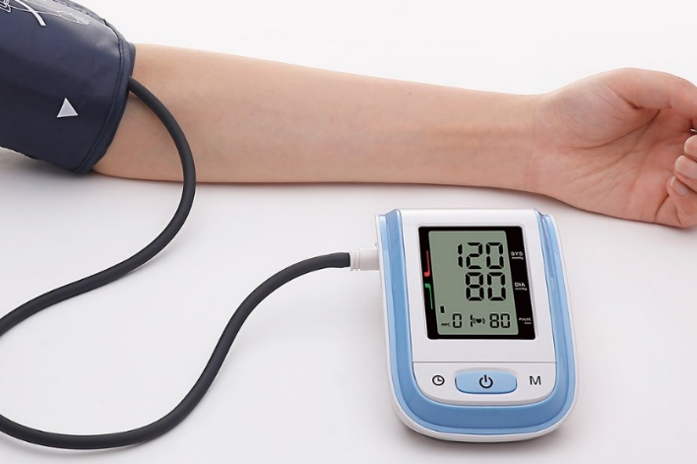
What Does WISEWOMAN Provide For SMBP Participants?
Training on appropriate home blood pressure monitoring techniques
A calibrated home monitoring blood pressure monitor and cuff
A self-monitoring packet with brochures, resources, and tracking tools to document blood pressure readings
Between visits, the participant is asked to self-monitor and record their blood pressure TWICE daily, or as prescribed, then share results at the next follow-up visit.
Participants are required to complete at least three SMBP Health Coaching sessions (via telephone) to complete the program
Notes:
Once the provider determines the participant would benefit from the SMBP program, the clinic will fill out the SMBP Referral Form and Enrollment paperwork and email/FAX to WISEWOMAN. The clinic staff will then train the participant and provide the BP cuff along with tools to document their daily readings.
The participant will be trained in appropriate home blood pressure monitoring techniques, receive a home monitoring blood pressure cuff and receive the self-monitoring packet with tracking information tools to document the readings
Participants are required to complete at least three SMBP Health Coaching sessions (via telephone) to complete the program
Participant will be asked to bring these results and the device at the BP Medical Follow-Up visits and SMBP Health Coaching sessions in order to ensure proper utilization of the blood pressure device
After the program has ended, participant will be allowed to keep the blood pressure monitor in order to continue self-monitoring
We have enrolled approximately 26 WISEWOMAN into the SMBP program, to date.
WISEWOMAN has about 26 participants and this number continues to grow every month as it is becoming a popular and convenient option for many women in our rural communities.

Slide 10
WISEWOMAN
Provider Map
2021
WISEWOMAN & SHOW-ME RPC COVERAGE
KANSAS CITY/NORTHWEST AREA | Rebecca Conway, RN: 816-404-6985
CENTRAL/NORTHEAST AREA | Lisa Graessle, RN: 573-522-2855
ST. LOUIS AREA | Vacant
SOUTHWEST AREA | Missy Rice, RN: 417-693-3409
SOUTHEAST AREA | Mary Costephens, RN: 573-418-1358
Notes:
There are 35 contracted WISEWOMAN providers with 12 satellite locations across Missouri and 93 SMHW providers with 126 satellite locations across Missouri. This map identifies the WISEWOMAN provider locations, only, however; this information can be searched on both our websites which is provided on the next slide, if interested.

Slide 11
WISEWOMAN Providers
Northwest
St. Louis
Central/Northeast
JACKSON COUNTY HEALTH DEPARTMENT
SOCIAL WELFARE BOARD OF BUCHANAN COUNTY
TRUMAN MEDICAL CENTER - HOSPITAL HILL (2*)
TRUMAN MEDICAL CENTER -LAKEWOOD (3*)
COLE COUNTY HEALTH DEPARTMENT
HANNIBAL CLINIC OPERATIONS, LLC
BETTY JEAN KERR (BJK) PEOPLE’S HEALTH CENTERS
JEFFERSON COUNTY HEALTH DEPARTMENT
Affinia Healthcare- Contract Pending

Slide 12
WISEWOMAN Providers Continued
Southwest
Southeast
ACCESS FAMILY CARE (6*)
BARTON COUNTY HEALTH DEPARTMENT
DADE COUNTY HEALTH DEPARTMENT
DALLAS COUNTY HEALTH DEPARTMENT
FORDLAND CLINIC, INC.
HICKORY COUNTY HEALTH DEPARTMENT
JORDAN VALLEY COMMUNITY HEALTH CENTER (8*)
KATY TRAIL COMMUNITY HEALTH (3*)
MISSOURI OZARKS COMMUNITY HEALTH CENTER (6*)
POLK COUNTY HEALTH DEPARTMENT
PULASKI COUNTY HEALTH CENTER
TANEY COUNTY HEALTH DEPARTMENT
BOLLINGER COUNTY HEALTH CENTER
BUTLER COUNTY HEALTH DEPARTMENT
CARTER COUNTY HEALTH CENTER
DENT COUNTY HEALTH DEPARTMENT
DUNKLIN COUNTY HEALTH DEPARTMENT
MADISON COUNTY HEALTH DEPARTMENT
MISSISSIPPI COUNTY HEALTH DEPARTMENT
MISSOURI HIGHLANDS HEALTH CARE (9*)
OREGON COUNTY HEALTH DEPARTMENT
RIPLEY COUNTY PUBLIC HEALTH CENTER
WASHINGTON COUNTY HEALTH DEPARTMENT
YOUR COMMUNITY HEALTH CENTER

Slide 13
WISEWOMAN CONTACT INFORMATION
PROGRAM MANAGER: Kelly Palermo
Kelly.Palermo@health.mo.gov
573-522-2871
EDUCATION COORDINATOR: Nicole Rea, RN, BSN
Nicole.Rea@health.mo.gov
573-526-0967
HEALTH PROGRAM REPRESENTATIVE: Roselyn Wood
Roselyn.Wood@health.mo.gov
573-522-2866
PROJECT SPECIALIST: Jackie Jung
Jackie.Jung@health.mo.gov
573-522-2859
WISEWOMAN/SMHW TOLL-FREE HOTLINE NUMBER:
1-866-726-9926
WISEWOMAN FAX: 573-522-3023
WISEWOMAN SITE: www.health.mo.gov/wisewoman

