Slide 1
PROTECTING HEALTH AND
KEEPING PEOPLE SAFE

Slide 2
6+++++
Missouri Rapid Response Team Update
Mark Buxton
Missouri Rapid Response Team Coordinator

Slide 3
What is the RRT?
Contamination of the food supply can lead to complex, large, multi-jurisdictional, multi-state emergencies.
The Rapid Response Team for Food and Feed (RRT) is designed to respond to large multi-jurisdictional emergencies regarding food.

Slide 4
Food can be grown in a different state or a different country, processed in another state, warehoused in a third state, and sold in Missouri. Every step along the way has the potential for contamination.

Slide 5
The Impact of Foodborne Illness
The United States Centers for Disease Control and Prevention (CDC) estimates that roughly one in six Americans—that’s 48 million people—will get sick from foodborne illnesses and that foodborne illness results in
128,000 people hospitalized
3,000 deaths

Slide 6
In addition to the terrible human costs, there are also huge economic losses because of foodborne illness. One study by Ohio State University estimated that the annual cost for foodborne outbreaks reaches $77.7 billion! Economic Burden from Health Losses Due to Foodborne Illness in the United States, Robert L. Scharff, The Ohio State University, Journal of Food Protection, Vol. 75, No. 1, 2012, Pages 123-131.

Slide 7
The RRT Can Help

Slide 8
It’s important to emphasize that the RRT makes the most of existing practices and partnerships without reinventing the wheel.
DHSS, FDA and the Missouri Department of Agriculture are part of the team.
http://clphs.health.mo.gov/ehcdp/

Slide 9
How Does RRT Affect You?
When the RRT is activated:
LPHA Environmental PH Specialists and Epidemiologist carry out FBI investigations as usual;
Communication with DHSS field staff and Lab does not change;
Communication flow is improved—DHSS RRT provides LPHA Administrators with daily updates.

Slide 10
Research
States
Local
Local
Lab
OUTBREAK INFORMATION
CDC
FEDS
DHSS
MDA
STATE
Reports
LOCAL
States

Slide 11
LOCAL
STATE
FLOW of OUTBREAK INFORMATION
STATE
FEDS

Slide 12
The MRRT provides a system to organize, coordinate and assure a flow of communication so we have the potential to resolve problems with greater coordination, more efficiently during large multi- jurisdiction or multi-state outbreaks.
MRRT
Missouri Rapid Response Team

Slide 13
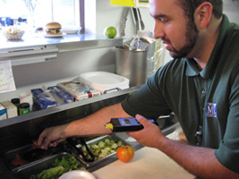
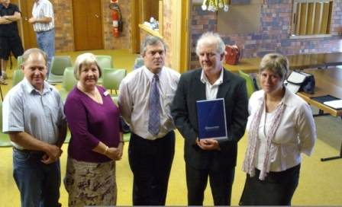
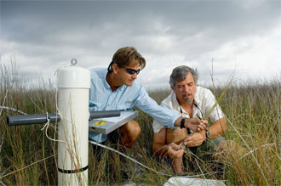
It’s All Connected !
Healthy People Living in Healthy & Safe Environments

