Slide 1

Nurses Making a Difference in Missouri’s Public Health System
New Administrator orientation July 10, 2024
Martha Smith, MSN, RN
MO MCH Director & Public Health Nursing Manager
Division of Community & Public Health

Slide 2
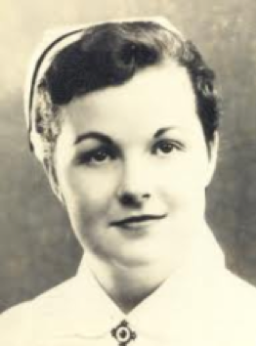
Public Health Nursing
Lillian Wald is the founder of Public Health Nursing in the U.S.
First to use the term ‘public health nursing’
Vision of nurses as guardians of the public’s health
Established the Henry Street Nurse’s Settlement
Visiting Nurse Service of New York

Slide 3
Promoting Good while preventing harm
APHA Definition of Public Health Nursing
Public health nursing is the practice of promoting and protecting the health of populations using knowledge from nursing, social, and public health sciences.
American Nurses Association Definition of Public Health Nursing
A focus on population health through continuous surveillance and assessment of the multiple determinants of health with the intent to promote health and wellness; prevent disease, disability, and premature death; and improve neighborhood quality of life.
Elements of Public Health Nursing Practice
a focus on the health needs of an entire population, including inequities and the unique needs of sub-populations;
assessment of population health using a comprehensive, systematic approach;
attention to multiple determinants of health;
an emphasis on primary prevention; and
application of interventions at all levels—individuals, families, communities, and the systems that impact their health.

Slide 6
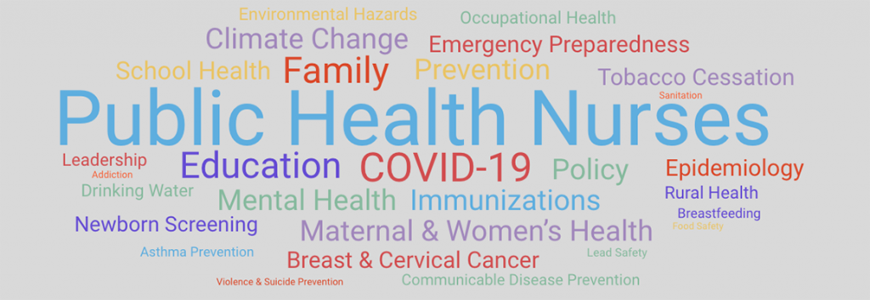

Slide 7

competent public health nursing practice
Formed in 1991
Originally known as the Quad Council of Public Health Nursing Organizations
Focused on unifying and amplifying the authoritative voice of public health nurses
Member Organizations
  American Public Health Association (APHA) Public Health Nursing Section
  Association of Public Health Nurses (APHN)
  Rural Nurse Organization
  National Association of School Nurses (NASN)
  Alliance of Nurses for Healthy Environments (ANHE)
  Association of Community Health Nursing Educators (ACHNE)

Slide 8
Community/Public Health Nursing Competencies
Community/Public Health Nursing [C/PHN] Competencies (Quad Council Coalition, 2018)
  Guide three levels of practice
    Tier one: generalist
    Tier two: management or supervisory
    Tier three: senior management or leadership
  Consistent with the APHA PHN Section definition of Public Health Nursing and the ANA Scope and Standards of Public Health Nursing
    May be used at all levels of practice and in a variety of practice settings
    Useful to guide and revolutionize practice, education, research, and policy at all levels
  Represent the continuum of evolving PHN practice roles, responsibilities, and functions

Slide 9
C/PHN Competency domains
Domain 1: Assessment and Analytic Skills
Domain 2: Policy Development/Program Planning Skills
Domain 3: Communication Skills
Domain 4: Cultural Competency Skills
Domain 5: Community Dimensions of Practice Skills
Domain 6: Public Health Sciences Skills
Domain 7: Financial Planning, Evaluation, and Management Skills
Domain 8: Leadership and Systems Thinking Skills
https://www.cphno.org/wp-content/uploads/2020/08/QCC-C-PHN-COMPETENCIES-Approved_2018.05.04_Final-002.pdf

Slide 10
Mpha section for public health nursing
Membership
  Public health nurses and students enrolled in a school of nursing
  current members of MPHA
    Individual
    Organizational
State affiliate of APHA
Annual Public Health Nursing Awards
  Public Health Nurse
  Public Health Nurse Leader
  https://www.mopha.org/scholarships-awards.php
    Trina Teacutter, Secretary, MPHA-Section for Public Health Nursing, trina.teacutter@como.gov
    Nomination deadline: August 11th

Slide 11
References
APHN
  https://www.phnurse.org/
The Future of Nursing 2020-2030 Charting a Path to Achieve Health Equity
  https://www.phnurse.org/assets/docs/FON%20Valuing%20Community%20and%20Public%20Health%20Nursing.pdf
Public Health Nursing: Key to Our Nation’s Health
  National Advisory Council on Nurse Education and Practice (NACNEP) 12th Annual Report to the Secretary of the United States Department of Health and Human Services and the Congress of the United States, Executive Summary
  https://www.cphno.org/wp-content/uploads/2020/08/2015_NACNEP-PHN-Key-to-Our-Nations-Health-1.pdf
The Public Health Nurse: Necessary Partner for the Future of Healthy Communities A Position Paper of the Association of Public Health Nurses (APHN Position Paper, 2016)
  https://www.cphno.org/wp-content/uploads/2020/08/APHN-PHN-Value-Position-P_APPROVED-5.30.2016-1.pdf
The Public Health Nurse’s Role in Achieving Health Equity: Eliminating Inequalities in Health (APHN Position Paper, 2016)
  https://www.cphno.org/wp-content/uploads/2020/08/APHN-Health-Equity-Paper-Final-v.4-8-16-Final-1.pdf

Slide 12
Questions?
For more information contact:
Martha Smith
Missouri Department of Health and Senior Services
Martha.Smith@health.mo.gov
573-751-6435

