Slide 1


PROMOTING MATERNAL and CHILD HEALTH AND SAFETY
Martha Smith, MSN, RN
MO MCH Director & Public Health Nursing Manager
Division of Community & Public Health
New Administrator orientation July 10, 2024

Slide 2

Maternal & Child Health Opportunities
Maternal Mortality
Black Women More Likely to Experience Life-Threatening Conditions like Preeclampsia, Postpartum Hemorrhage, and Blood Clots
Low Birthweight
MO Ranks 34th for
Racial Disparity (2.2)
Disparities
Prenatal Care
Inadequate for 40% with
Medicaid Coverage
Oral Health
Low-income and Minority Children Receive Less Basic
Dental Care
Delivery Care
41.7% of Counties Defined
as Maternity Care Deserts
Trauma/Mental Health
Black Children in MO More Likely than White Children to Experience Multiple ACEs
Preterm Birth
51% Higher for Black Women and Babies
Infant Mortality
Black Babies >2X as Likely to Die Before 1st Birthday

Slide 3
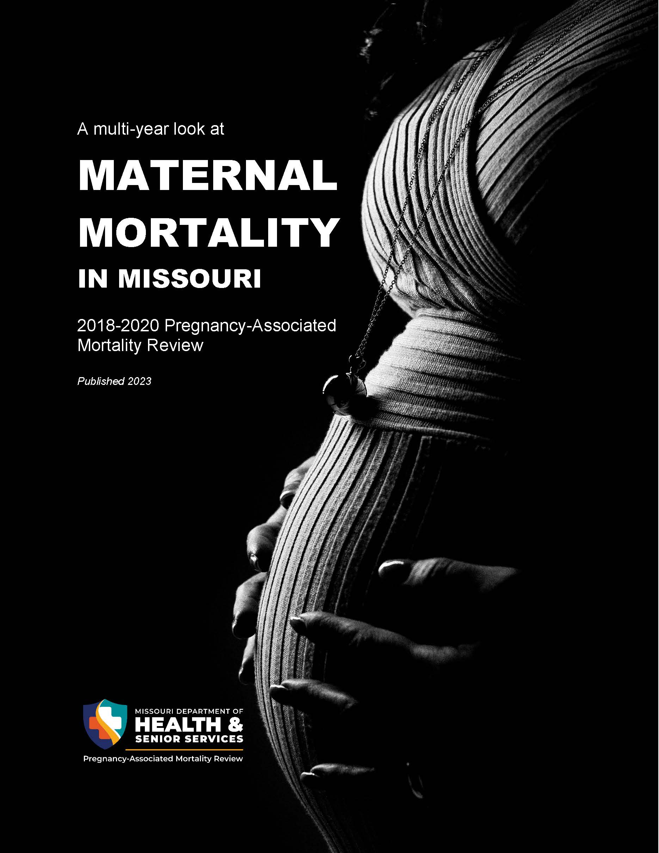
Top causes of pregnancy-related death were mental health (including substance use disorders or SUDs), cardiovascular issues and homicide.
Black women living in Missouri were three times more likely to die within one year of pregnancy than white women.
Women on Medicaid in the state of Missouri were 10 times more likely to die within one year of pregnancy than those with private insurance.
https://health.mo.gov/data/pamr/#reports

Slide 4
Maternal Mortality Prevention Plan
Compendium of best practice tools, care guidelines, a hospital-level implementation guide, and educational materials
Access to comprehensive
high-quality specialized maternal health services, including mental health services
Standardized template to plan for and optimize comprehensive postpartum care
Standardized maternal care provider trainings
Trauma-informed & responsive care
Screening, referral and treatment
Maternal Quality Care Protocols
Maternal Health Access Project
Postpartum
Plan of Care
Maternal Care Workforce
MCH Dashboard

Slide 5

Missouri Interagency
Maternal Health Collaborative
MO Department of Health and Senior Services
MO HealthNet
(MO Medicaid)
MO Hospital Association
MO Primary
Care Association

Slide 6
NGA Improving MCH in Rural America:
Policy Learning Collaborative
Project Track: Strategic Planning & Collaboration
We aim to improve health outcomes for mothers, infants and their families because individual lives matter, most maternal and infant deaths are preventable, and maternal and infant health are indicative of overall population health. We do this work because healthy and joyful experiences across the life course (inclusive of pregnancy, birth, postpartum, and beyond) are centric to a prosperous and healthy Missouri. We will do this in unity and collaboration through partnership with diverse statewide partners, including individuals with lived experience, and aim to see improved MCH outcomes, reductions in racial disparities, and systems improvements by 2030.
Priorities:
Develop a statewide maternal health strategic plan.
Develop a proposal for a state Maternal Health Innovation Program through HRSA.
Implement Medicaid reimbursement for community-based doulas.
Expand home visiting programs, including Medicaid reimbursement for home visiting for women with high-risk pregnancies.
Develop a specialized MCH training, with emphasis on perinatal health, for CHWs and increase the number of trained CWHs working in MCH.

Slide 7
Fetal Infant Mortality Review (FIMR) Network
FIMR is an evidence-based process to identify and analyze factors that contribute to fetal and infant death.
Two-tiered system
Community Review Team (CRT) to conduct case reviews
Community Action Team (CAT) charged with putting CRT recommendations into action
Based on the National Fetal and Infant Mortality Review (NFIMR) Program model
Case identification
Medical records abstraction
Home/family interviews
Case reviews
Recommendations for action
Utilizes a regional approach
State FIMR program and ten regional FIMR teams
  Contract with 10 LPHAs
    Convene diverse, multidisciplinary groups of professionals
Large statewide case load
Contributing factors for fetal and infant deaths often related to local environmental causes
  Better understood by local communities
Examine confidential, de-identified individual cases of fetal and infant deaths from 24 weeks gestation through 12 months of age.
DHSS will set standards for case review procedures, data submission, and data aggregation to ensure data reliability and allow meaningful data aggregation and analysis.

Slide 8

https://amchp.org/resources/roadmap-for-collaboration-among-title-v-home-visiting-and-early-childhood-systems-programs/

Slide 9
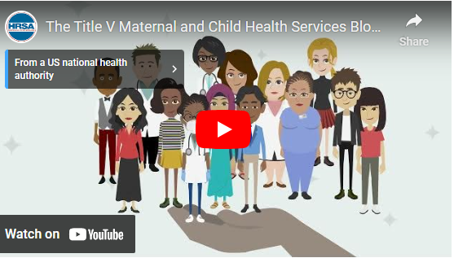
Title V Maternal and Child Health (MCH)
Block Grant to States
https://mchb.hrsa.gov/programs-impact/title-v-maternal-child-health-mch-services-block-grant
Notes:
https://www.google.com/search?safe=active&sca_esv=73d0a1271b02ef32&sca_upv=1&rlz=1C1GCEA_enUS1091US1091&q=maternal+child+health&tbm=vid&source=lnms&fbs=AEQNm0Aa4sjWe7Rqy32pFwRj0UkWd8nbOJfsBGGB5IQQO6L3J5MIFhvnvU242yFxzEEp3BfblMs7eBu5zPnhtGsrETMyhOqzWtfgc_pCzrf4BYocXLJaX0gJBEKL77s1Ay-4tHfnMqP5vC_ZT8lpSywyzIaNxlK3h27DKyjP4cAIPUhzalTbEILgzj9kP6BqoP0xWu6yYBTYByfUljVA60k5fyr5AlSneg&sa=X&ved=2ahUKEwjC9Pb9speHAxX-hY4IHbS1DfQQ0pQJegQIEBAB&biw=1920&bih=919&dpr=1#fpstate=ive&vld=cid:d4b1cb0d,vid:DMvDHW6XG3c,st:0
https://mchb.hrsa.gov/programs-impact/title-v-maternal-child-health-mch-services-block-grant
*Next Slide*

Slide 10
Missouri FFY 2021-2025 Title V MCH Priorities
National Performance Measures (NPMs)
Women/
Maternal
Health
Perinatal/
Infant Health
Child Health
Adolescent Health
CYSHCN
  Improve pre-conception, prenatal and postpartum health care services for women of child- bearing age
  Reduce intentional and unintentional injuries among children and adolescents
  Ensure coordinated, comprehensive and ongoing health care services for children with and without special health care needs
  Promote safe sleep practices among newborns to reduce sleep-related infant deaths
  Reduce obesity among children and adolescents
NPM 5
A) Percent of infants placed to sleep on their backs
B) Percent of infants placed to sleep on a separate approved sleep surface
C) Percent of infants placed to sleep without soft objects or loose bedding
NPM 7.2
Rate of hospitalization for non-fatal injury per 100,000 adolescents, ages 10 through 19
NPM 11
Percent of children with and without special health care needs, ages 0 through 17, who have a medical home
NPM 1
Percent of women, ages 18 through 44, with
a preventive medical visit in the past year
NPM 8.1
Percent of children, ages 6 through 11, who are physically active at least 60 minutes per day
Service 04

Slide 11
Missouri FFY 2021-2025 Title V MCH Priorities
State Performance Measures (SPMs)
Child
Health
Adolescent
Health
Cross-cutting
& System Building
  Enhance access to oral health care services for children
  Promote Protective Factors for Youth and Families
  Address Social Determinants of Health Inequities – Training & Health Literacy
SPM 3
Number of DCPH staff and contracted partners working with maternal and child populations who complete core MCH, Health Equity, and Racial
Justice trainings
SPM 1
Percent of children, ages 1 to 17 years, who had a preventive dental visit in the last year
SPM 2
Suicide and self-harm rate among youth ages 10 through 19

Slide 12
New Universal Title V MCH National Performance Measure
Women/
Maternal
Health
  Treat pregnancy-related complications and address chronic conditions.
  Postpartum Visit
  Opportunity to improve maternal health by providing recommended clinical services, including screening, counselling, and management of health issues.
  Decreased Postpartum Maternal Mortality
  Percent of women who attended a postpartum checkup within 12 weeks after giving birth
  Percent of women who attended a postpartum checkup and received recommended care components
  Identification, treatment, and prevention of adverse outcomes to optimize maternal health following pregnancy.

Slide 13
Overarching Principles
Promote partnerships with individuals, families, and family-led organizations to ensure family engagement in decision-making, program planning, service delivery, and quality improvement activities
Ensure Access to Care, including adequate insurance coverage, for MCH population

Slide 14

Life Course Perspective -
A Foundational Concept
of the Title V MCH Block Grant

Slide 15
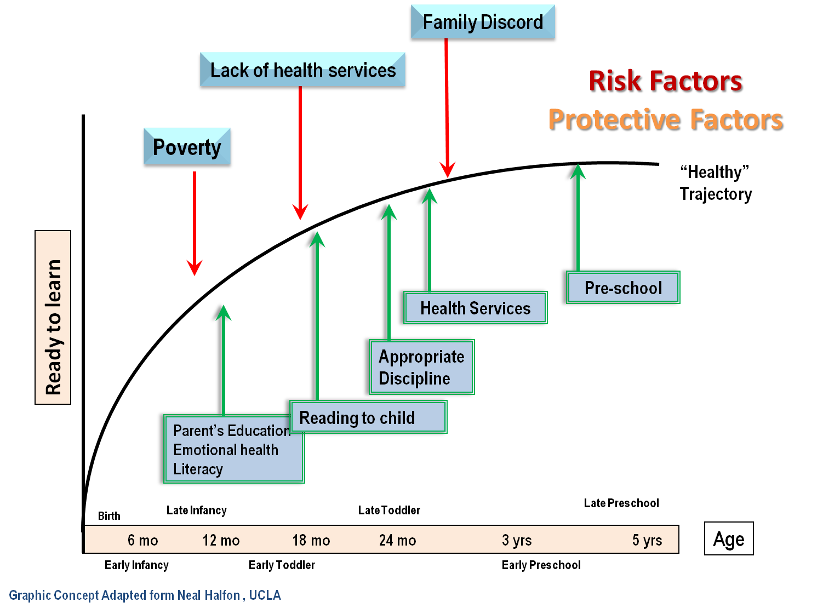
A complex interplay of biological, behavioral, psychological, and social protective and risk factors that contributes to health outcomes across the span of a person’s life.
Graphic Concept Adapted from Neal Halfon, UCLA

Slide 16
Why the Life Course Perspective?
Looking at health through a life course perspective hopes to address three key areas:
  Your health as an individual
  Your health before your conception (i.e. your mom’s health pre-conception)
  Your children’s health (intergenerational component)
Your Mother’s/Father’s Life
Your Life
Next Generation
Graphic Concept Adapted from Oklahoma State Department of Health

Slide 17
Health Outcomes are Multi-Factorial
Education
Health
Family
Neighborhood Services
Community
Policy
Family
Support
Social Welfare
Graphic Concept Adapted from Neal Halfon, UCLA

Slide 18
Key MCH Strategies
Core MCH training plan that is inclusive of the principles of justice, equity, diversity, and inclusion
Statewide action plans
Diverse multisector collaboratives
Identifying geographic areas with a disproportionate burden of maternal and child health disparities
Choosing one social determinant of health and developing concrete tools to address it that can be integrated into existing direct service programs

Slide 19

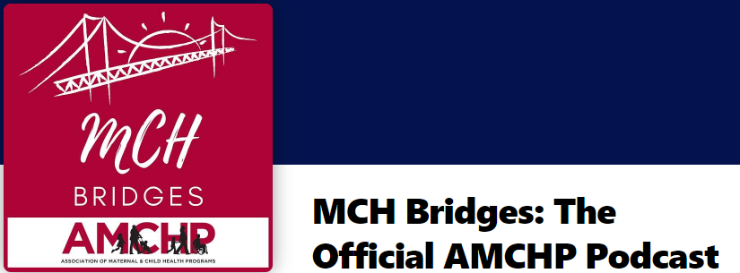
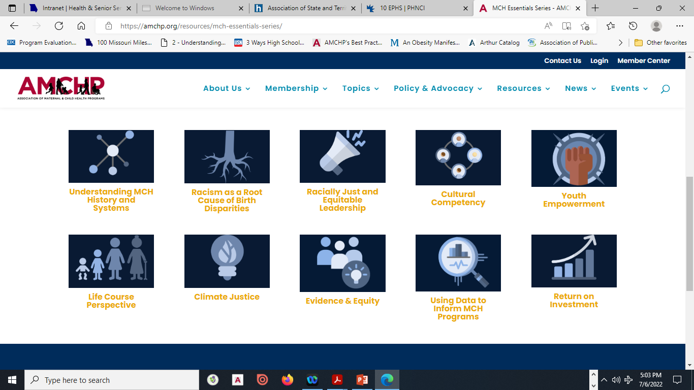
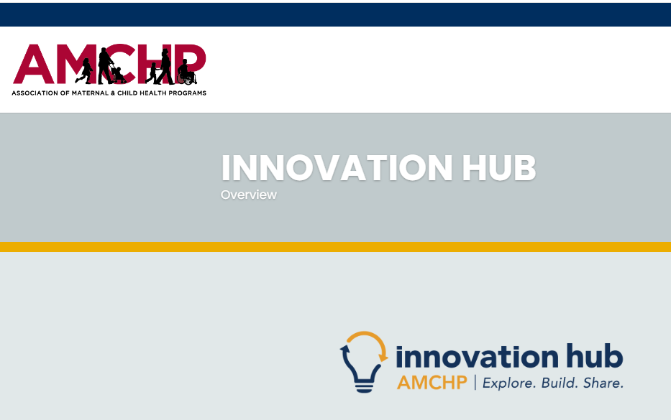
MCH Essentials Series
https://mchbridges.buzzsprout.com/
https://amchp.org/resources/mch-essentials-series/
https://amchp.org/innovation-hub/

Slide 20

Questions?

Slide 21





Together building a maternal-child public health system that addresses the needs of Missouri’s mothers, infants, children, adolescents, and families, including children and youth with special health care needs.
THANK YOU
Martha Smith, MSN, RN
Missouri Maternal Child Health Director
Martha.Smith@health.mo.gov or MCH.MCH@health.mo.gov
573-751-6435
health.mo.gov

