Slide 1
6+++++
Bureau of Immunization
Program Overview
Lana Hudanick
Nurse Manager

Slide 2
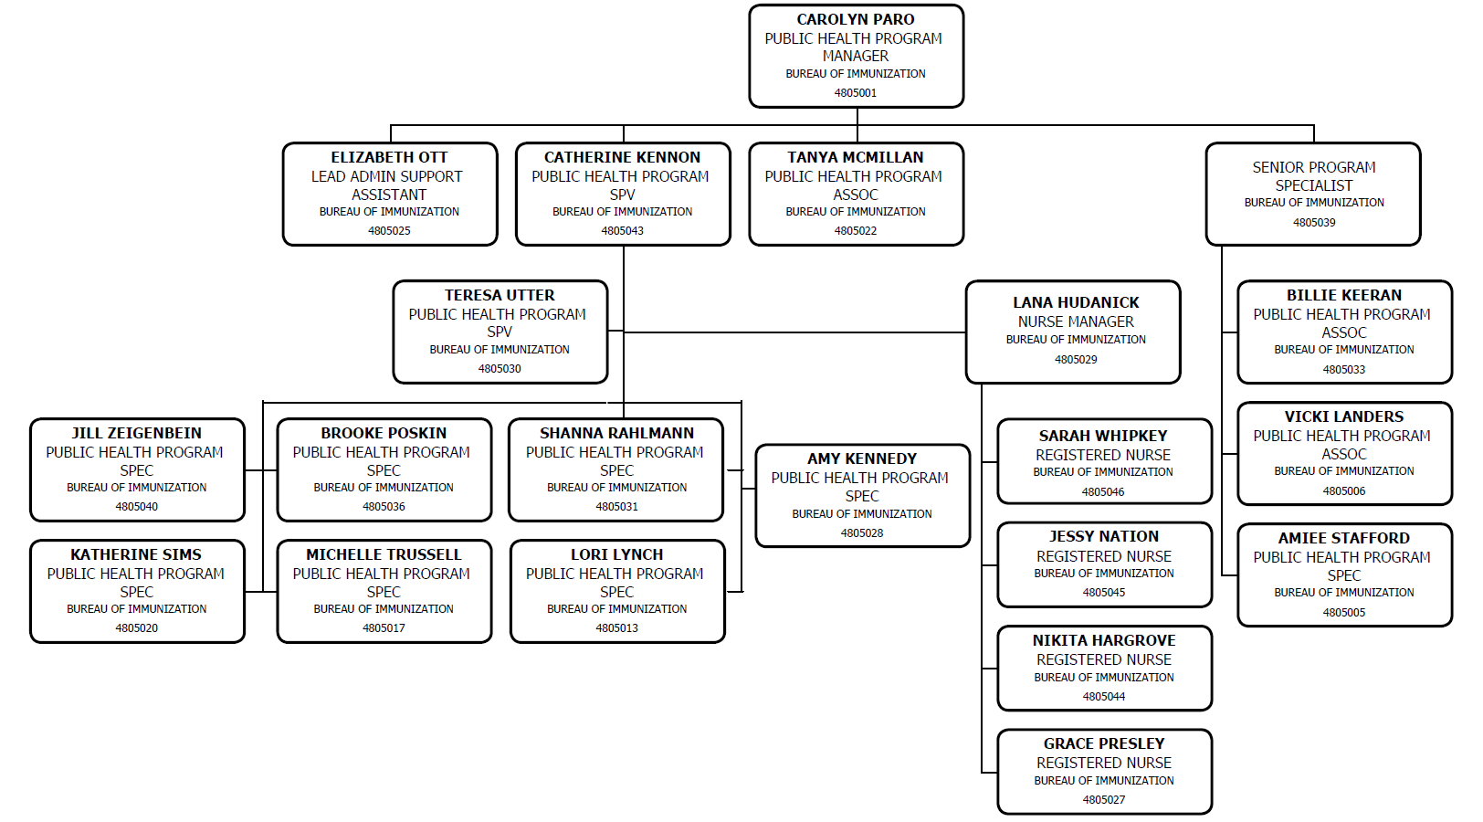

Slide 3
Vaccines for Children (VFC)
ShowMeVax
(SMV)
Bureau of Immunizations
Vaccines for Adults (VFA)
School and Child Care Program
Immunization Quality Improvement for Providers (IQIP)
Vaccine Safety
Yellow Fever

Slide 4
Program Funding
100% federally funded by the Centers for Disease Control and Prevention (CDC)
5-year cooperative agreement
Prevention and Public Health Fund (PPHF) funding
COVID-19 supplemental grant funding
Must reapply each year

Slide 5
Public Vaccine Types
VFC Vaccine
$79 million (October 1 – September 30)
Children’s Health Insurance Program (CHIP)
$2.4 million (July 1 – June 30)
Section 317 Adult (VFA)
$1.1 million (October 1 – September 30)

Slide 6
Vaccines for Children (VFC) Program
Over 670+ providers in Missouri
Private physicians
Local Public Health Agencies (LPHAs)
Federally Qualified Health Centers (FQHC)
Rural Health Clinics (RHC)
Pharmacies
Birthing centers
VFC eligibility – under 19 years of age and one of the following:
Medicaid eligible
Uninsured
Underinsured
American Indian/Alaskan Native

Slide 7
VFC Program Requirements
Annual recertification
Participate in VFC Compliance Site Visits
VFC primary and backup contacts must meet VFC education requirements every 12 months
Must participate in quality improvement activity
Keep all VFC records for 3 years
All accountabilities must be completed via ShowMeVax (SMV)
All administered doses must be reported to SMV

Slide 8
Section 317 Vaccine for Adults Program (VFA)
Who qualifies?
Adults 19 years of age and older:
Uninsured
Underinsured
Fully insured individuals may receive 317 vaccines during a public health response activity declared by DHSS. A public health response activity includes:
Outbreak response
Post-exposure prophylaxis
Disaster relief efforts

Slide 9
Immunization Quality Improvement for Providers (IQIP)
Strategies to improve immunization rates
Facilitate return for vaccination
Leverage the IIS
Give a strong recommendation
Strengthen vaccine confidence
Onsite educational training offered
Resources provided for each strategy chosen
Can be considered a quality improvement activity for the VFC program

Slide 10
ShowMeVax (SMV)
ShowMeVax is a web-based immunization registry that houses immunization records and assists in managing VFC/VFA provider inventory
Schools and child care providers use the registry to verify the immunization status of children enrolled at their facilities
78,551,611 million immunizations, administered to over 8,063,280 million individuals have been recorded in ShowMeVax through direct data entry and electronic data exchanges

Slide 11
School and Child Care Program
Schools are required to submit an annual report of vaccination status for children enrolled in Kindergarten through 12th grade
Due October 15th of each year
Child care facilities are required to submit an annual report of vaccination status for children enrolled in their facility
Due January 15th of each year

Slide 12
Other Program
Vaccine Safety Liaison to CDC/FDA
Yellow Fever Uniform Stamp Program for Missouri

Slide 13
Partnerships
Department of the Health and Senior Services
WIC
Office of Minority Health
Office of Primary Care and Rural Health
School Health Program
Department of Social Services
MoHealthNet (Medicaid & CHIP)
Others:
American Cancer Society
Missouri Hospital Association
Missouri Primary Care Association
Missouri Pharmacy Association
Missouri Rural Health Association
Missouri Immunization Coalition
University of Missouri
Care Beyond the Boulevard

Slide 14
Thank you!

