Slide 1
Update for LPHAs January 25, 2022
COVID Therapeutics
K-12 School Testing Resources
Reporting of Suspicious Test Sites
Community Testing
Antigen Test Resources

Slide 2
Therapeutics Update: What’s Available in Missouri? Where to Find Information?
https://health.mo.gov/living/healthcondiseases/communicable/novel-coronavirus/covid-therapeutics.php
Updated information about monoclonal antibodies (mAbs) and oral antivirals
Link to HHS portal depicting providers of oral antivirals and Evusheld
Will eventually list all types of therapeutics and providers
Link to DHSS map of mAb providers willing to be listed on public-facing website
Will maintain until HHS portal displays mAb providers

Slide 3
Therapeutics Currently Available:
Oral Antivirals:
Paxlovid
Mulnupiravir
Total of 105 Missouri providers for oral antivirals
Monoclonal Antibodies:
Sotrovimab (only mAb for outpatients demonstrating retained effectiveness with Omicron)
Total of 316 Missouri providers for mAbs
Example: Week of 1/17 - Sotrovimab – 9,912 doses requested; 768 doses fulfilled (Total allocation: 768)
Evusheld (pre-exposure prophylaxis mAb)
Total of 43 Missouri providers for Evusheld
Example: Week of 1/17 – Evusheld – 1,512 doses requested; 1,344 doses fulfilled (Total allocation: 1,344)
All new provider approvals for mAb and oral antivirals were suspended 1/18/2022 – posted to website and pending applicants notified. Will resume adding additional providers when mAb and oral antiviral supply warrants.
Developed 1/24/2022

Slide 4
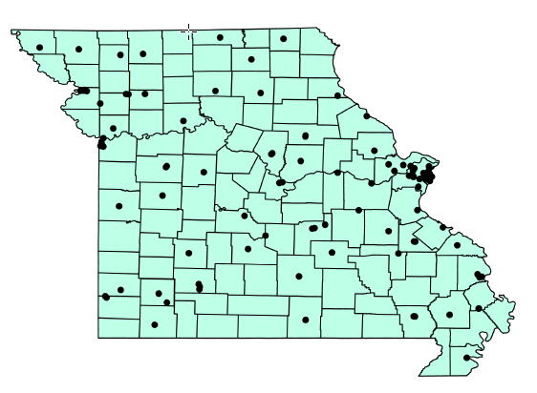
Oral Antiviral Providers (105)

Slide 5
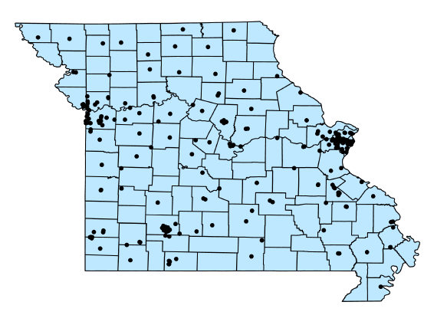
Monoclonal Antibody Infusion Providers (316)

Slide 6
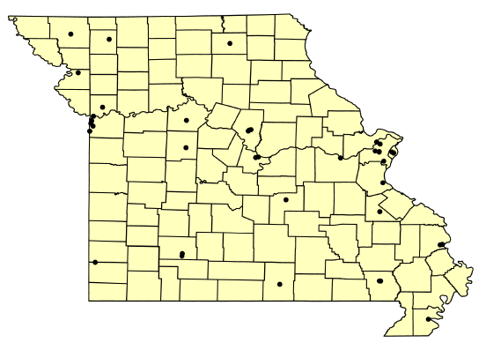
Pre-Exposure Prophylaxis (Evusheld) Providers (43)

Slide 7
K-12 Testing Options
iPCR Testing—saliva-based PCR test for symptomatic individuals
Schools receive at no cost:
Testing supplies
Access to reporting portal
Shipping to lab
Email k12screeningtesting@health.mo.gov to participate
Screening Testing Program
Pooled testing with individual follow-up testing
Onsite support
Access to results portal
Piloting new reporting tool

Slide 8
Antigen Tests
Use of OTC antigen tests
Can a school (or similar institution) purchase Over The Counter COVID home tests and administer them to staff or students without a specific CLIA certificate to do so?
No. To do so would generally be in violation of federal CLIA rules.
Additional BinaxNOW Antigen Tests from CDC
Goal is to keep students in school
Able to request tests every week for next 3 months for up to 5 districts per week
CDC Distribution of tests prioritized by social vulnerability score, readiness to use tests and geographic distribution
Notes:
When an individual is obtaining and performing an approved OTC test for themselves and making the diagnosis and/or medical decisions for themselves or their legal dependents (minor children, etc.,) then generally that usage is not covered under CLIA. However, when another individual (healthcare, school or occupational professional) is using the same OTC test on another person and providing a diagnosis or medical/healthcare decision-making on behalf of that individual being tested, then CLIA does in general apply, and the test would need to be done under a CLIA certificate. See CMS reference below.
DHSS has utilized a state-wide CLIA certificate for certain participating schools and other entities (who have agreed to follow DHSS procedures and rules) using the Abbott BiNaxNOW tests. However at this time, that specific CLIA certificate can be used ONLY for DHSS-supplied BiNaxNOW tests. Any use outside of the previously agreed-upon parameters (including use of OTC tests of a different brand/type) would not be permitted.

Slide 9
Antigen Tests
First districts receiving tests:
Springfield Public Schools
St. Louis Public Schools
Columbia 93
Independence 30 School District
St. Joseph School District
Selection based on:
District size
Participation in current antigen testing program
Test use strategy
SVI score

Slide 10
Resources
Emotional impact of COVID-19
https://www.youtube.com/watch?v=5of9-_3ZIqo Navigating Emotional impacts of COVID-19 School staff edition
http://harlemfamilyinstitute.org/wordpress/my-pandemic-story-guided-activity-workbook-for-children-and-teens-now-available/
https://www.cdc.gov/mentalhealth/stress-coping/parental-resources/pdfs/parental-res-kit-activity-book.pdf (English)
https://www.cdc.gov/mentalhealth/stress-coping/parental-resources/pdfs/parental-res-kit-activity-book-sp.pdf (Spanish)
National Associaiton of School Psychologists COVID-19 Resource Center (nasponline.org)
Vaccines
https://documentcloud.adobe.com/link/review?uri=urn:aaid:scds:US:e703f9e2-2b31-40df-8a24-44032c979242
https://www.aap.org/en/news-room/campaigns-and-toolkits/covid-19-vaccine-toolkit/

Slide 11
DHSS K-12 COVID Team
Pat Simmons
Bureau Chief
Sarah Young
K12 COVID contract--invoicing and reporting
Lesha Peterson
Program enrollment
Leslie Murphy
Screening Testing Vendor Contract Monitor
Clinton Carter
Program Analyst
Marge Cole
State School Nurse Consultant
Regional PH Nurses
Ben Pringer
KIDS TEAMS, other COVID projects
Barbara Spaw
Non-COVID related projects
Renee Falkner
Regions A, B D, H
Jessica McKee
Regions C, E, F, I, G
School LIaisons
Jayda Morris (StL-C)
Saundra Freeman (StL-C)
Cheryl Stock (F)
Beth Loethen (G, I)
School Liaisons
Tonja McCoy (KC-A)
Ashley Kempf (KC-D)
School Health Services SHS@health.mo.gov
Marjorie Cole Marjorie.cole@health.mo.gov
Renee Falkner rfalkner@cdcfoundation.org
Jessica McKee jmckee@cdcfoundation.org
CDC Foundation Staff

Slide 12
K-12 Resources
DHSS
https://health.mo.gov/living/healthcondiseases/communicable/novel-coronavirus/education.php
DESE
https://dese.mo.gov/communications/coronavirus-covid-19-information

Slide 13
Reporting Suspicious Test Sites
Division of Regulation and Licensure staff are able to assist with concerns and investigations into the authenticity of any questionable sites.
Please direct concerns regarding COVID-19 testing entities to CLIA@health.mo.gov.
Please provide the following information, if available, in the email:
Contact name, phone, email of complainant.
Physical Location/address of a suspicious test site.
Any additional Identification information of a suspicious test site: Test site name/Posted signage, contact info for the test site (phone, email, staff names, etc.)
4. Brief description of any activities/events that happened with the test site that led them to be concerned

Slide 14
Community Testing – Recent Success Story
Madison County Health Department
Contact: Becky Hunt, Administrator (Checklist for event planning)
Utilized State Public Health Lab – COVID & Influenza Result
Run by community volunteers
If wanting to use SPHL for large volume testing – must coordinate with Adam Perkins (573-751-1075, adam.perkins@health.mo.gov)

Slide 15
Antigen Test Supply Update
Missouri supply completely depleted
Still no response from Abbott regarding continuation of shipments
RFP issued for QVL – Antigen Test Vendors response due February 8
Currently seeking vendors and supply through existing state contracts
Federal Program through FQHCs – still on hold

