Slide 1
LPHA call
01/04/2021

Slide 2
Updates

Slide 3
Standing Orders Updated
Individuals who have an allergy to any component of the vaccine
Individuals with a history of anaphylaxis with any vaccine
Do not give the SARS-CoV-2 vaccine to an individual who has had an immediate allergic reaction of any severity to a previous dose of any mRNA COVID-19 vaccine or any of its components (including polyethylene glycol (PEG)**
Do not give the SARS-CoV-2 vaccine to an individual who has had an immediate allergic reaction of any severity to polysorbate (due to potential cross-reactivity hypersensitivity with the vaccine ingredient PEG**)

Slide 4
Vaccine Redistribution
You must submit an email to DHSS COVID Vaccine Redistribution at covidvaccineredistribution@health.mo.gov
A completed COVID-19 vaccine redistribution agreement found at https://covidvaccine.mo.gov/vaccinators/Supplemental-COVID-19-Vaccine-Redistribution-Agreement.pdf
Make sure the subject line states “redistribution Agreement and Transfer Request for (insert name)
Include name and PIN of the provider receiving the vaccine from your allotment
Number of doses being transferred
You will receive an email confirmation if the request is approved or denied
Move only the amount of vaccine that is needed
Once the vaccine is removed from the shipper the thawing process has started and the vaccine must be used within 120 hours or 5 days
Do not refreeze once vaccine is thawed

Slide 5
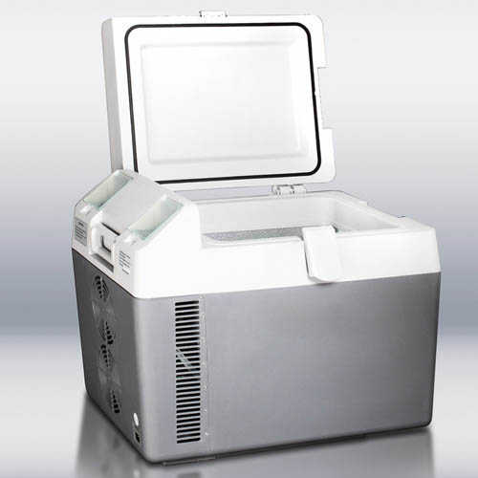
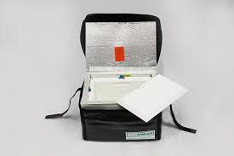
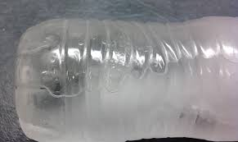
Packaging Vaccine For Transport
Equipment needed
Cooler to transport vaccines
Preference is to use a portable vaccine refrigerator if available
Qualified Containers and pack-outs
Intact cooler that the vaccine was shipped to site in – last resort
Conditioned Frozen water bottles
Filled clear plastic water bottles that have been hard frozen which have been warmed slightly until a visible amount of water can be seen in the bottle
https://www.quickmedical.com/summit-portable-medical-freezer-coolers-sprf26.html
https://www.temparmour.com/store-usa-vaccine-carrier-vc8-s4
https://www.aappublications.org/content/34/4/8.1

Slide 6
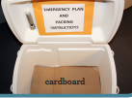
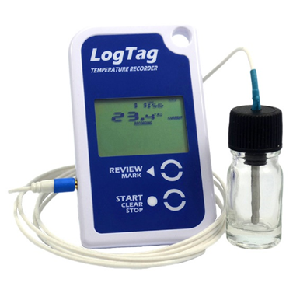
Packaging Vaccine For Transport
Equipment needed
Insulating material
Cardboard
Bubble wrap
Packing foam
Styrofoam
Vaccine
Only amount needed for the clinic that day
Diluent if needed should be transported at refrigerator temperatures
Digital Data Logger
Calibrated Certified device back up digital data logger
Not the one you are using on your refrigerator or freezer currently
Do not use loose fill or packing peanuts

Slide 7
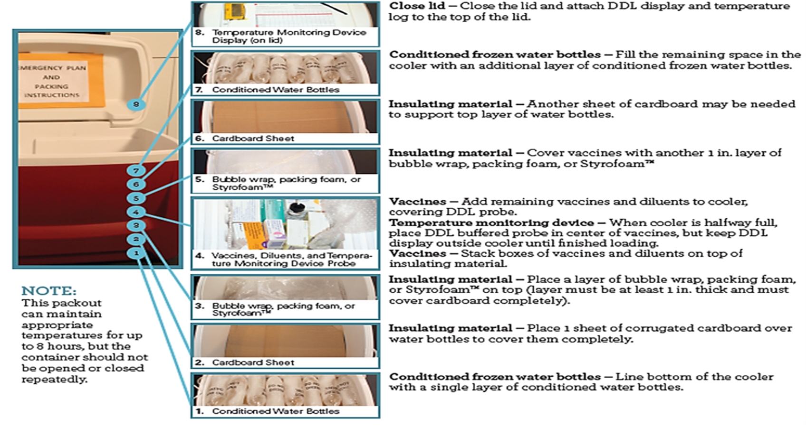
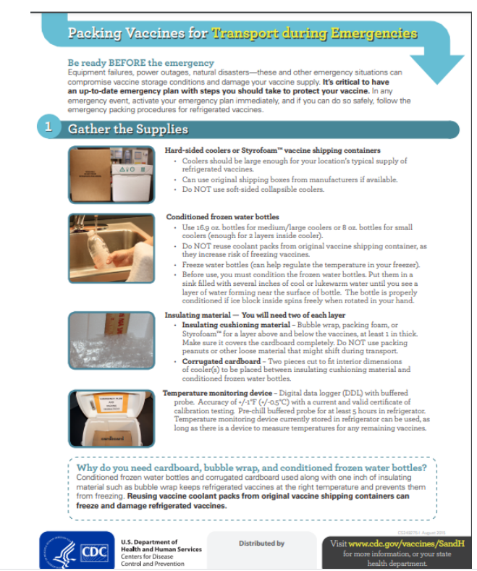
Packing vaccine for redistribution
Make sure you are transporting the vaccine in an

Slide 8
Packaging Vaccine for Transport
After packaging vaccine
Always transport vaccine in the vehicle where the occupants are sitting
Transporting the vaccine in the trunk may
Alter the temperature of the vaccine depending on the outside air temperature and the internal temperature of the trunk
Never use a service to transport the vaccine to a clinic or another provider
Call the Bureau of Immunizations, if you cannot transport it yourself

Slide 9
Packaging Vaccine for Transport
Frequently Asked Questions
May I use Freezer packs instead of water bottles
Gel packs may be used if they are thawed, Frozen freezer packs should not be used
Do I have to have a digital data logger for temperature monitoring
Yes, temperature monitoring during transport of the vaccine is crucial, once vaccine gets to warm it looses potency which cannot be recovered
May I transport vaccines in syringes
No, this is not allowed, Syringes are not meant to maintain vaccine sterility or maintain the cold-chain.
What should I do with left over vaccine at the end of the clinic.?
All vaccine that was taken out that day (diluted or opened) should be utilized. Once the vaccine has been opened you have 6 hours to use, Unopened vials may be returned for use at another clinic as long as temperature has been maintained

Slide 10
Important notes
All transfers must occur between registered COVID-19 vaccine providers
Ancillary kits must be transferred with vaccine
Resource for how to create a Vaccine transfer in ShowMeVax
ShowMeVax Vaccine Create a Vaccine Transfer video
ShowMeVax Training Accepting a Transfer
Redistribution process is a CDC requirement ”Non-compliance with the terms of this Redistribution Agreement may result in suspension or termination from the CDC COVID-19 Vaccination Program and criminal and civil penalties under federal law, including but not limited to the False Claims Act, 31 U.S.C. § 3729 et seq., and other related federal laws, 18 U.S.C. §§ 1001, 1035, 1347, 1349.”

Slide 11
Vaccine Finder
All COVID-19 vaccine providers must register with Vaccine Finder
Vaccine Inventories should be updated in Vaccine Finder every day by Midnight
You will still need to update your inventories in ShowMeVax as well
This is to start with you first shipment
You will receive and email from
vaccinefinder@auth.castlighthealth.com
This email will be sent to the providers organization email address submitted in the provider enrollment form
Please check your spam and junk mail folders
The link expires in 7 days if this has happened contact eocevent522@cdc.gov
For support with Vaccine finder contact 1-855-886-4317
Notes:
VaccineFinder is a web-based system that allows COVID-19 vaccination providers to report levels of supply. In addition, once there is widespread availability of COVID-19 vaccine,
Inventory reporting (required for all providers): COVID-19 vaccination providers will report on-hand COVID-19 vaccine inventory each day.
Increase access to COVID-19 vaccines (optional for providers): Once there is enough supply, COVID-19 vaccination providers may choose to make their location visible on VaccineFinder, making it easier for the public to find provider locations that have COVID-19 vaccine available. CDC will be directing the public to use VaccineFinder to find locations offering COVID-19 vaccine.

Slide 12
V-SAFE
A free program that offers follow-up after vaccination
Providers should be offering the program to vaccine recipients
A patient will need a smart phone or computer to access the program
Providers should make sure that patients are given the vaccine cards that are found in the ancillary kits
All checks take less than 5 minutes of a patients time

Slide 13
Priority Group Vaccination
The state is charged by Operation Warp Speed with the responsibility of establishing prioritization guidance
Vaccination at this time is recommended for phase 1A population only.
Residents and staff at long-term care facilities (SNF’s, RCF’s, ILF’s, and ALF’s)
Paid and unpaid patient facing health care workers with co-morbidities that are unable to work from home.
Remaining patient facing health care workers.

Slide 14
Second doses of Vaccine
Second doses are held back at the federal level
The state will submit your second dose order on your behalf
You will receive an email confirmation when the second dose is ordered on the facilities behalf
If you redistributed vaccine you will need to redistribute the second dose as well

Slide 15
Second dose reminders
Schedule the next dose before patient leaves
If drive through mass clinic make sure patients know when to come back for next clinic (have it already scheduled)
A free text messaging platform that you can offer patients
Patients have to opt in to receive the message
To enroll text
ENROLL to 1-833-829-8329
English and Spanish offered

Slide 16
Controlant
This is the company that will monitor temperatures using the embedded data logger in Pfizer’s ULT shipper
You will get an email from Controlant- Pfizer is automatically keeping the data logger on for providers
In that email you will get a username, password and activation link
If you will not need to use the shipper please let Controlant know otherwise
Use the activation link to
Set up the account in Google Chrome

Slide 17
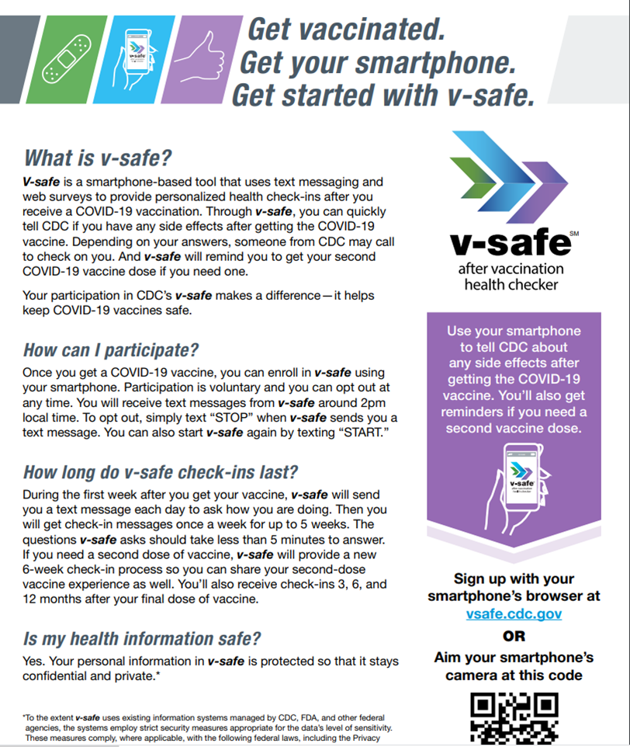
Valuable Resources
DHSS offers provider Virutal Town hall meetings on Thursdays
ShowMeVax offers videos on You-Tube for all topics
ShowMeVax Video
Pfizer Vaccine training sessions for 2021
Posted on the website for providers
V-safe flyer
Available on the website
Report to VAERS any problems following vaccination
https://vaers.hhs.gov/

