Slide 1
LPHA call
12-21-2020

Slide 2
Moderna Vaccine

Slide 3
Moderna Vaccine
For individuals 18 years and older
mRNA 2 dose vaccine separated by 28 days
Ordered in minimum quantities of 100
Ancillary kits shipped from another location should arrive around the same time as vaccine
Vaccine is shipped from McKesson in a frozen state

Slide 4
Moderna Vaccine
Upon vaccine arrival at your office:
Check the order for breakage
Keep vaccine in original package
Place the vaccine in the storage unit
Freezer
-25°C to -15°C / -13°F to 5°F
For up to 6 months
Refrigerator
2° C to 8°C / 36°F to 46°F
For 30 days
Do not refreeze once vaccine is thawed

Slide 5
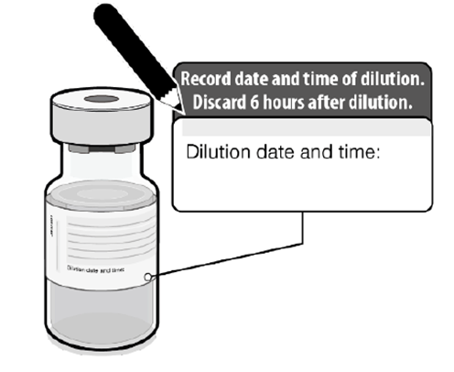
Moderna Vaccine
Vaccine vials that are intact are able to be stored at room temperature for 12 hours
Room Temperature should be between 8°C to 25°C / 46° to 77° F
Once vaccine vial’s cap is removed and stopper punctured
Must use the vaccine vial within 6 hours
Document date and time on vial
Avoid exposure to direct sunlight and ultra violent light

Slide 6
Moderna Vaccine
Preparing the Moderna Vaccine
Thaw prior to administration in refrigerator for 2 hours and 30 minutes or room temperature for 1 hour
Allow the vaccine to come to room temperature for 15 minutes before administering the vaccine
Gently swirl the vial (do not shake) Before the first dose and between each dose withdrawn

Slide 7
Moderna Vaccine
Preparing the vaccine:
Visually inspect the vaccine
Should be white or off-white
Discard if discolored
Withdraw 0.5ml
Discard the vial after 10 doses have been withdrawn or 6 hours have lapsed, whichever is first

Slide 8
Contraindications to Vaccination
Do not administer the Moderna COVID-19 vaccine to
Individuals with a known history of severe allergic reaction (e.g., anaphylaxis) to any component of the Moderna COVID-19 vaccine

Slide 9
Precautions
Those with history of an anaphylactic reaction or severe reaction following any dose of intramuscular medication or vaccine.
Due to an ingredient commonly found in these medications you will need to:
Observe the person for 30 minutes if history of anaphylaxis
Otherwise observe vaccine recipients for 15 minutes

Slide 10
Vaccination of Special Populations
Pregnancy - Breastfeeding/lactating – Immunocompromised Individuals
These populations have limited data
Belief that vaccination is beneficial as long as no other contraindication exist
mRNA vaccines are not live vaccines

Slide 11
Note
Dose is 0.5ml
If 2nd dose is greater than 28 days, administer the 2nd dose as soon as possible
Make sure the patient understands the importance of completing both doses
Make sure to counsel vaccine recipients about expected local and systemic post-vaccination side effects
Pain at injection site, fatigue, headaches, muscle pain, chills, joint pain, fever, injection site swelling or redness,
Lymphadenopathy (rare)

Slide 12
Items to Remember
Vaccine providers need to observe patients after vaccination to monitor for the occurrence of immediate adverse reactions.
If someone has been exposed to COVID-19 in a community or outpatient setting, it is recommended to defer vaccination until after quarantine ends, unless in a congregate healthcare setting or a congregate care facility.
Do not administer the Moderna COVID-19 vaccine with any other vaccines.
Wait 14 days before administering another vaccine
If someone has had antibody therapy for COVID-19, delay vaccination for 90 days.

Slide 13
Remember
If someone has had COVID-19, they can still receive the vaccine
Ideally the doses of the mRNA vaccine should be from the same manufacturer however no need to repeat a dose if this does not occur – separate the doses by 28 days
4 day grace period is allowed for these vaccines
Be prepared to handle an anaphylactic emergency

Slide 14
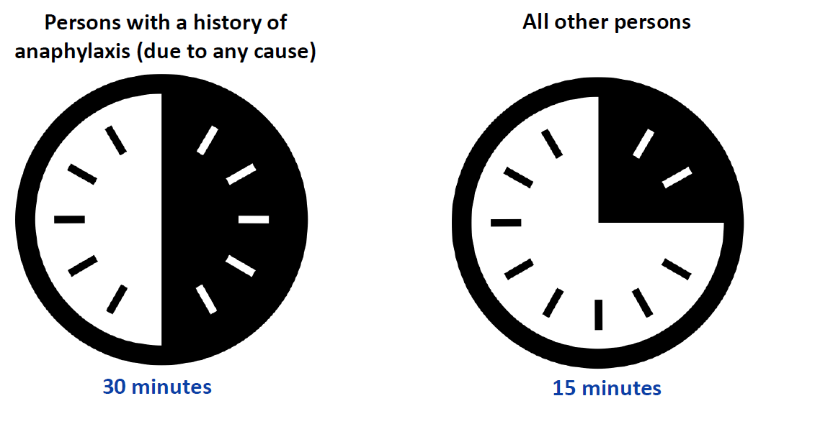
Vaccine Emergency Event
Prepare for the potential management of anaphylaxis at COVID-19 vaccination sites
Observe individuals with a history of anaphylaxis (due to any cause) for 30 minutes
Observe everyone for at least 15 minutes
Make sure clinic staff know the signs of anaphylaxis
Sensation of throat closing, stridor (high-pitched sound while breathing) shortness of breath, wheezing, cough
Nausea, Vomiting, diarrhea, abdominal pain
Dizziness, fainting, tachycardia, hypotension
Hives, itching or swelling of lips, face, throat

Slide 15
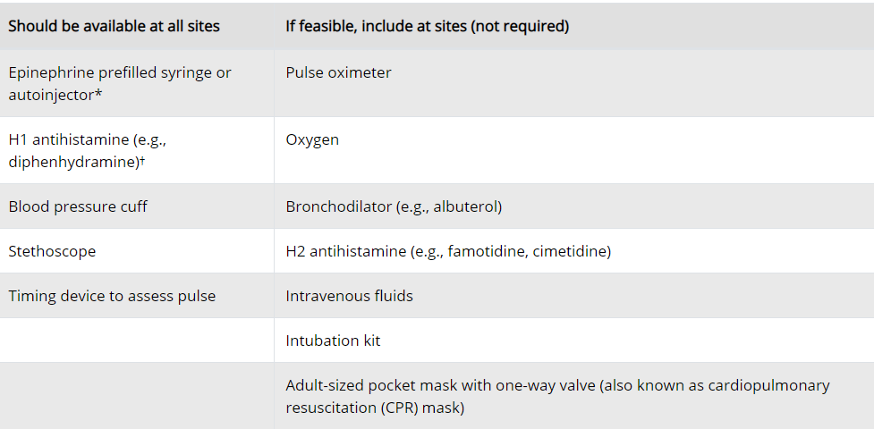
Vaccine Emergency event
All sites should have an emergency kit
At least 3 doses of epinephrine should be available
Report any event into VAERS

Slide 16
How Many Events Have Occurred
As of December 18th
6 cases reported
All recovered
1 person did have a history of anaphylaxis after a rabies vaccine

Slide 17
Questions

