Slide 1
A collaborative approach to
Community health needs assessment
Springfield-Greene County Health
Erica Little & Jon Mooney
Notes:
Jon Welcome and Introduce

Slide 2
Hospital & LPHA Partnership
Assessment Nuts & Bolts
Community Rollout & Benefit
Key points
Notes:
Purpose of Presentation

Slide 3
Pros and Cons to Partnering
Benefits
Drawbacks
Economies of Scale
  Hospital requirements
  Public health requirements
Diverse perspectives but a single process
Develops the relationships
Slower and more burdensome process
Sharing of power
Increased complexity
Notes:
A collaborative approach

Slide 4
Core Elements to Partnering
Public Health must look beyond its jurisdiction
Share the load but establish leads
Establish an agreed upon roadmap
Engage with multiple sectors the right way
Build trust through the process

Slide 5
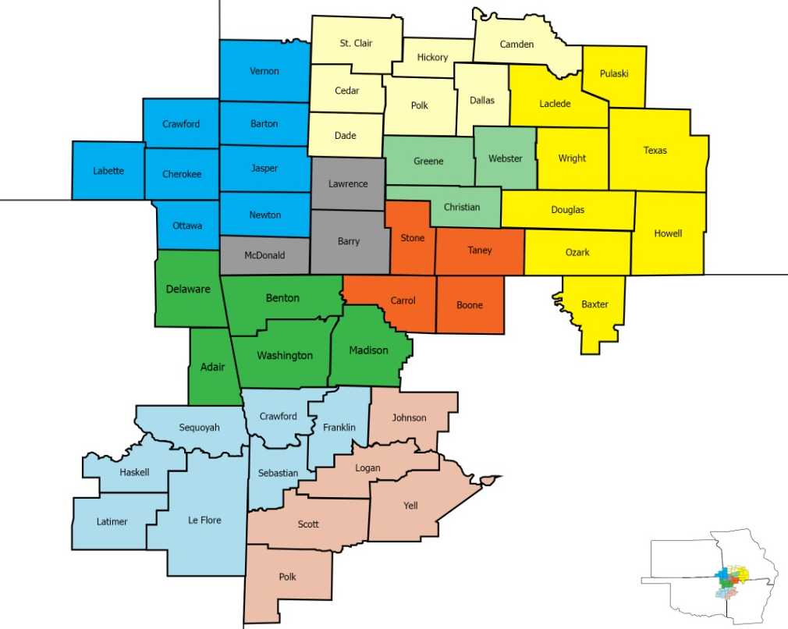



Assessment Region 2016

Slide 6
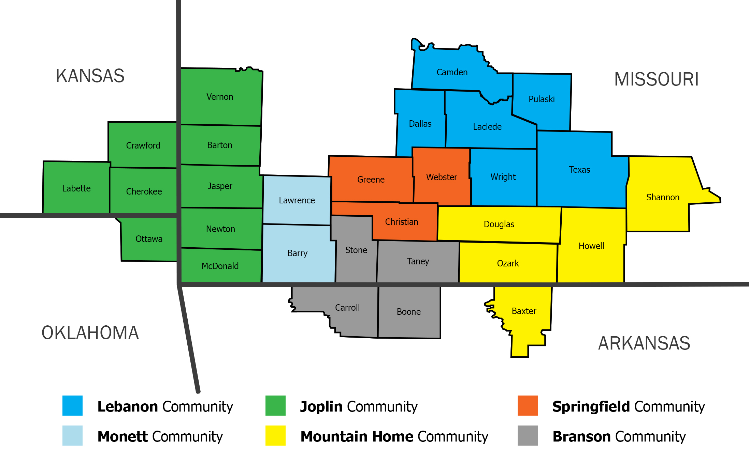
Assessment Region 2019

Slide 7
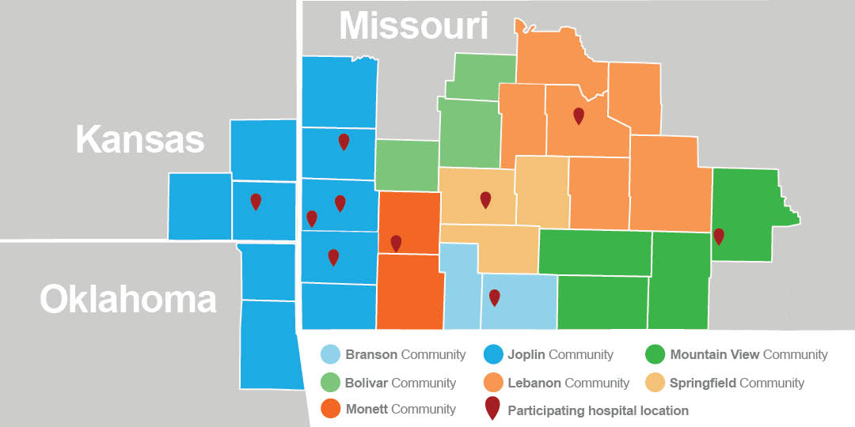
Assessment Region 2022

Slide 8
Core Components of the Assessment
Publicly available data
Hospital data
Community input

Slide 9






CHNA Timeline/Steps
May 2021
Convened steering group for Regional CHNA
June-July
August-October 2021
Collection of secondary and primary data (Hospital Data)
Collection Community Input
November-February 2021
Prioritization of AHI’s
July-August
Analyze secondary and primary data
February-May 2022
Needs Assessment Report(s)
Notes:
May 21 – convened steering group for Regional CHNA
June – July - Collection of Secondary and Primary data (Hospital data)
July – Aug – Analyze secondary data
Aug – Oct 21 – Collection Community input
Sept – Oct 21 – Analyze hospital data
Nov 21 – Feb 22 – Prioritization of AHI’s
Dec 21 – 1st draft report due (Joplin Community)
Feb – March 22 – 1st draft report due (Springfield Community)

Slide 10
Getting started
Assemble steering group
Define assessment area
Set timeline
Notes:
Where to Start....
Steps:
1. Steering committee, as Jon discussed, are members from partnering agencies (stakeholders) who have some direct work tied to the outcomes of the needs assessment and/or improvement plan (CHIP). This group is the guide and the group making the decisions through the process and keeps the work moving and on time.
2. Define assessment area: In this case I am referring to defining the community. For our instance the community was defined based on hospital service net area. Because we had multiple jurisdictions and hospitals we further broke the areas down into smaller Communities. This resulted in 7 communities in our region.
3. Set timeline for project and outline steps. Setting deadlines and point persons for milestones. Set shared goal – end product of CHNA is an actionable tool to inform CHIP and community organizations collective action toward improving health issues identified.

Slide 11








Identify the Health Issues
Collect Quantitative data – Public Health & Hospital Data
Review of health indicators
Review for themes
Collect/discuss emergent issues
Categorize into health issues
HEART DISEASE
CANCER
DIABETES
LUNG DISEASE
MENTAL HEALTH
ORAL HEALTH
COVID-19
SUBSTANCE USE & RECOVERY
Notes:
We worked to identify the health issues in our community through collecting and analyzing 3 data sets. This allowed us to develop a picture of the overall communities health to be able to highlight where needs may be greatest.
Hospital – Hospital subcommittee
Secondary – PH data – public health subcommittee
Community data.
Collection of the PH and hospital data allowed us to identify the health issues in the community. Quantitative public health data can be collected from multiple areas; such as BRFSS, CDC community health status indicators, US Census Bureau, County Health rankings, Community Commons (CARES), which we used. The committee decided that the data would be collected on collected at the county level and then combined for community-level data for comparison purposes.
We used a subcommittee of PH LPHA representatives to review all PH health data indicators that we had access to identify categories convergent health indicators into buckets. We used an approach to look at both clinical and non-clinical factors that impact health. Those indicators were put into buckets/themes.

Slide 12






Social Determinants of Health
ECONOMIC STABILITY
HEALTHCARE ACCESS & QUALITY
SOCIAL &
COMMUNITY CONTEXT
NEIGHBORHOOD & BUILT ENVIRONMENT
EDUCATION
ACCESS & QUALITY
HEALTH
BEHAVIORS
Source: Trust for America’s Health
Notes:
SDOH have a major impact on people’s health, well-being, and quality of life while also contributing widely to health disparities and inequities.
Experiences and outcomes that could be attributed to one or many AHIs
Can be used/later viewed as upstream approaches to target identified health issues when developing the later CHIP.
Indicators (similar to SDOH in Healthy People 2030; but also
Economic Stability – connection between the financial resources people have – income, cost of living, and socioeconomic status and their health. Key issues: poverty; housing stability; and employment.
Education Access & Quality – The connection of education to heath and well-being. Key issues: graduation rates; educational attainment;
Healthcare Access & Quality – The connection between people's access to and understanding of health services and their own health. Key issues: access to providers; insurance coverage
Neighborhood & Built Environment – The connection between where a person lives (housing, neighborhood and environment) and their health and wellbeing. Key issues: food insecurity; crime; air quality; quality housing.
Social & Community Context – Connection between characteristics of the contexts within which people live, learn, work and play and their health and wellbeing. Key Issues: community network; SVI; homelessness; civic participation; discrimination.
Health Behaviors – Key issues: Physical inactivity; current smokers; binge drinking; STI incidence; HIV Prevalence; Frut and Veg expenditures
Social determinants of health (SDOH) are indicators that could be included in community health improvement plans in order to move the needle on more than one assessed health issues.
Social determinants of health issues are the biggest that need to be addressed like housing and food. - Quote from Springfield Community Member

Slide 13
Analyze Data – Public Health Data
0
0
0
0
0
0
@
0
0
@
Notes:
Analyze Public Health Data.
We analyzed all data indicators based on if measure was better than the state, worse than the state or worse than the nation. Also comparing each Community to the Region. Set up ranking tables for each community. Noted Key findings for region and by community.
For hospital data, we analyzed data by grouping into the AHI's, payor types by AHI's, and AHI's by demographics (age and race) . Noted key findings for the region and by community.

Slide 14
Community Input
Interviews
Focus Groups
Community surveys
Notes:
1. Collect qualitative data – We contracted with Crescendo to collect community information via interviews, surveys and focus groups. Interviews focused on stakeholders; discussion questions were centered around AHI's and social determinants of health as well as a deeper dive into COVID. Focus groups similar. For each of the interviews and focus groups, the committee represented work to build lists of stakeholders and general groups. We also scanned to see who in the communities were doing similar needs assessments so we could work together in some fashion.
2. The community input process can be done in other ways, meaning internally if capacity exists, or partner with College and Universities, as we have done in the past.
Surveys and focus groups
Survey – 2638 total responses for region the region. Surveys were distributed by stakeholders and partners either on paper, through social media or on their websites.
75 – stakeholder interviews completed for Springfield Community
10 – focus groups completed in Community
All information collected was categorized into the AHI or SDOH buckets for analysis.
Information collected via all responses identified that the community identified the top health needs as ranging from affordable child-care to long-term care/dementia care; with mental health/substance use and coordination of care/accessibility being recurring themes. The final report is still pending, we expect further information to come.

Slide 15
Prioritization of the Health Issues
Public Health
Data
Community
Voices
Hospital Utilization
Data
Notes:
Priorization of Health issues allos us to decide the area of focus for collective impact in the community.
Discuss how we took these 3 elements and got to the AHI and SDOH. Talk about items that we know need some work.
How to go from assessed health issuse to prioritized issues.
Used 3 components to get to our Prioritized health issues to focus on in the CHIP.
How did we does thi

Slide 16
Prioritization
Score Data
Mortality rate
Morbidity
Geographic Comparison
Trend Comparison
Hospital Utilization
Convene stakeholders for input & scoring
Feasibility to change
Readiness to change
Notes:
We utilized a prioritization matrix to assist with prioritizing the health issues as these issues are complex.
Used morbidity, mortality, geographic comparisons, trend comparisons and the pervasiveness of the health issue presented in the hospital utilization data to score each health issue. I will not get into the actual scoring mechanism of the data.
Community Stakeholder meetings were held to prioritize and rank the health issues based on previously scored Public Helth and Hospital data. Scored data was provided to the groups during the prioritization process. Further community input data was provided to the group during the sessions to add context to the issues and the voice of the community. To assess feasibility and readiness to change, stakeholders participated in short surveys to assess readiness to address the issue, existing initiatives or momentum to change, clear path, leadership engagement to change, complexity of the issue, and local control. These items were then scored and included in initial data scoring to produce Prioritized Health Issues.

Slide 17
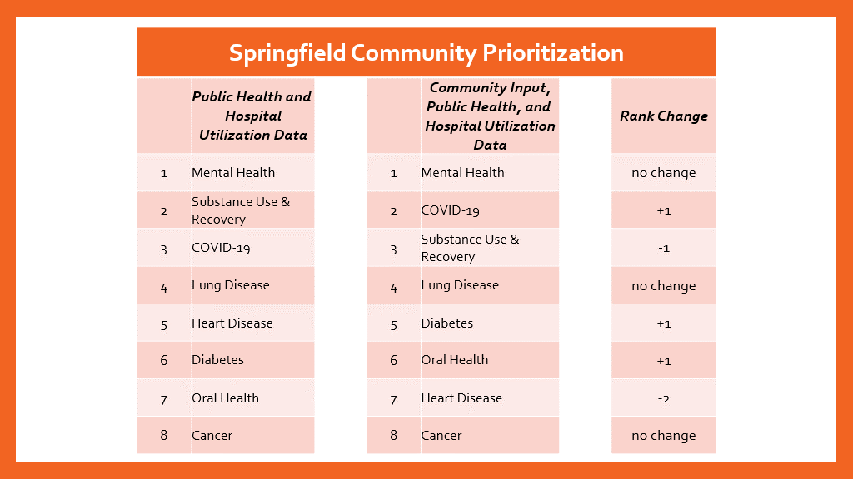
Notes:
Example of Prioritization

Slide 18




RECOMMENDED PRIORITIES
2022-2025
SPECIAL HEALTH ISSUE:
COVID-19
MENTAL HEALTH
SUBSTANCE USE
AND RECOVERY
DIABETES
Notes:
Significance – Recommended priorities are based on Data Driven approach through prioritization process.
Mental Health -
Substance Use and Recovery
Diabetes
Special Health Issue – COVID -

Slide 19
Effective Rollout of the Assessment
Publishing the report(s) - Website
Promoting the report(s)
Changing the mindset of the purpose and impact
Notes:
Discuss that this is a tool for use of how we impact the community. This is used to turn into a driver in the community.

Slide 20
Benefits Beyond the Assessment
1 set of health priorities
Improved funding for health priorities
Improved collaboration

Slide 21


Celebrating Success
Outcomes from previous assessments...
Health as a component of SGF's comprehensive plan
Advocate for MO Medicaid transformation
Prescription Drug Monitoring Program (PDMP)
Adoption of Tobacco 21
Increased smoke-free multi-unit housing
Community Mental Health Needs Assessment
Burrell Behavioral Crisis Center
Mental Health First Aid
Community Health Advocates in the Criminal Justice System

Slide 22
Partner Input & Questions
Thank you!
Erica Little – elittle@springfieldmo.gov
Jon Mooney – jmooney@springfieldmo.gov

