Slide 1
Strategies for Successful Communication
for New LPHA Administrators
Jaci McReynolds, MHA
Public Health Communication Liaison
Ozarks Public Health Institute

Slide 2
A partnership effort between
This work is supported by funds made available from the Centers for Disease Control and Prevention (CDC) of the U.S. Department of Health and Human Services (HHS), National Center for STLT Public Health Infrastructure and Workforce, through OE22-2203: Strengthening U.S. Public Health Infrastructure, Workforce, and Data Systems grant. The contents are those of the author(s) and do not necessarily represent the official views of, nor an endorsement, by CDC/HHS, or the U.S. Government.
Notes:
Introduce self and give OPHI pitch
Define partnership with DHSS for PH Communication Liaison work
Variety of pieces - we’ll talk about some during the session.
Funding for this work was provided through funds made available by CDC and HHS . . .

Slide 3
Communication Survey
More consistent, more timely communication that is easy to access
Streamline emails
Provide communication resources
LPHA Info Hub: MO-LPHA.com
Notes:
Session Goal:

Slide 4
Communication
Touches every part of our lives throughout each day.
Two-way process –
giving and receiving information.
Notes:
How many of you communicated with someone this morning, raise your hand?
How many of you thought about the science behind communication before you had that conversation, keep your hand up?
Right, so every day we are having important conversations, communication with people all around us - family, co-workers, leadership, partners, or customers.
Communication touches everything we do – every encounter through our day, and yet rarely do we stop to consider how best to communicate – to plan for communication.
We usually rely on our communication instincts and processes we’ve developed throughout life.
Sometimes that means communication doesn’t go well.
Stop and consider for a moment a recent conversation you had with an employee.... [JMc add detail here?]
Effective communication is a two-way process, a giving and receiving of information that requires thought, intention, knowing and understanding the person you are talking to, and listening skills.
It’s like a ping pong match – back and forth, serve and receive.

Slide 5
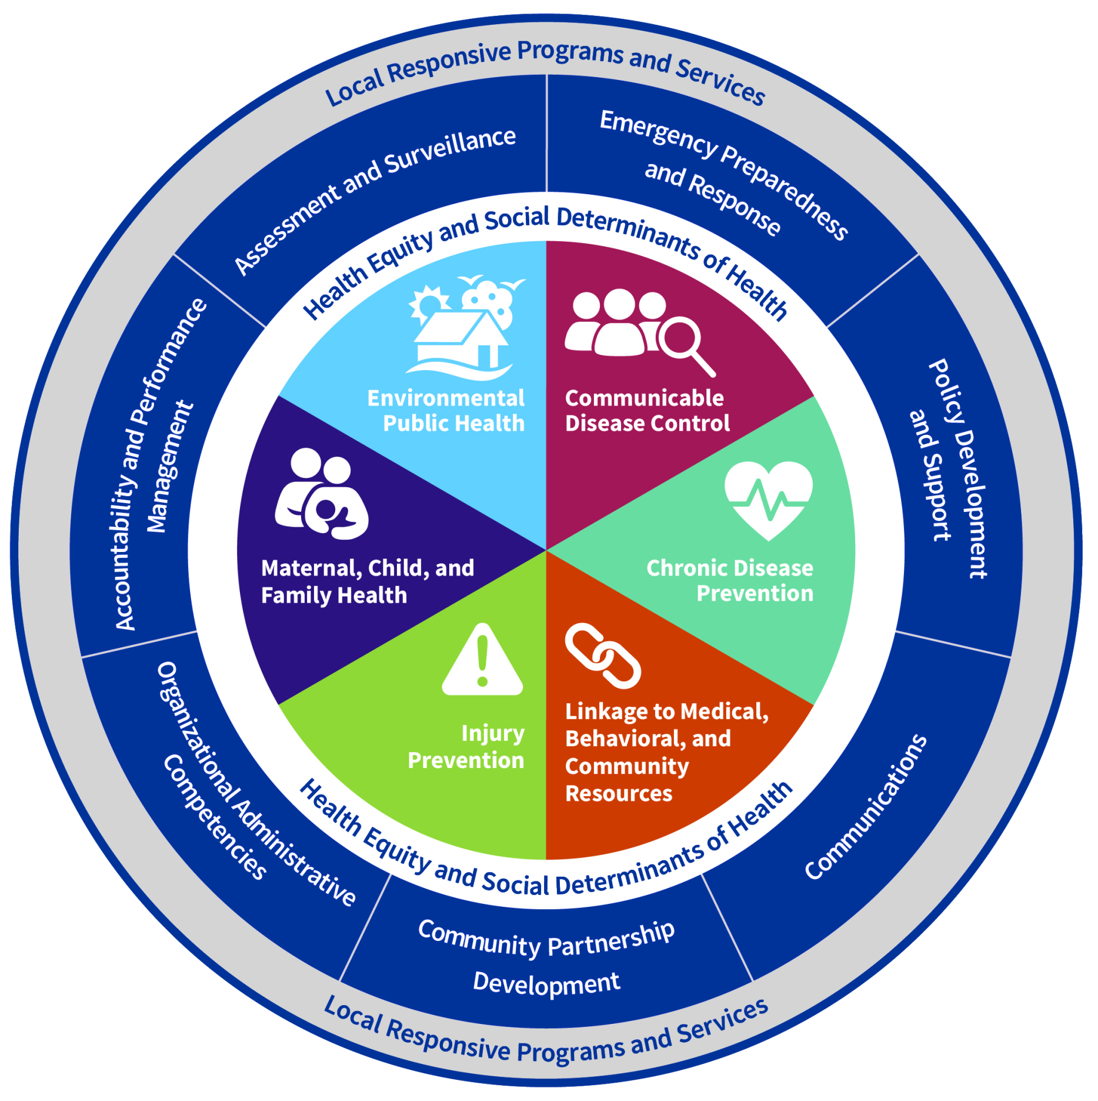
Missouri’s
Foundational
Public Health Services Model
HealthierMO.org
Notes:
And communication is a foundational public health capability - as depicted here in Missouri’s FPHS model.
It is essential to every other component in the model – both the capabilities listed in the blue ring,
and the programs and services bucketed in the colorful pie pieces the model defines as the public health areas of expertise.
Successful public health practices depends on your ability to communicate well.

Slide 6
Accreditation Standards
Overarching principle:
Communicate effectively to inform and educate populations
and subpopulations to improve community health.
Domain 3:
Provide information on public health issues and public health functions through multiple methods to a variety of audiences.
Effective communication is essential to provide timely, accurate, and reliable information about how to protect, promote, and influence community members towards healthy actions.
Notes:
Communication is also specifically called out in both MICH and PHAB accreditation standards – validating the need to ensure your organization communicates clearly and effectively.
Also, risk communication and communication with partners, stakeholders and community members.

Slide 7
Communication Strategies
Who
What
When
Where
How
Why
Notes:
So you are going to be using and depending on communication in nearly every aspect of your work as an LPHA administrator.
Communication is a science, a professional field.

Slide 8
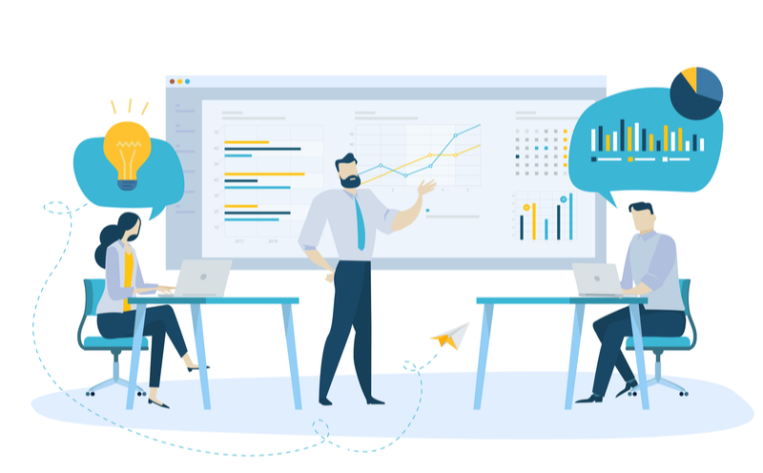
WHY: Purpose and Objectives
Purpose = Why you are communicating
Objectives = What you hope to gain from the communication
SMARTIE:
Specific, Measurable,
Achievable, Timely,
Inclusive, Equitable
Notes:
You’ll have a lot of information to communicate in your new role as LPHA administrator:
policy changes, disease threats, community events, opportunities for engagement....
But before you push out information, it is important to stop and consider why you want to communicate – to what end?
You’ll want to review data to identify the need for communication:
Quantitative data that provides hard statistics, like the rate of poverty in your community, or how many of your residents are obese or use tobacco products
and qualitative data – what people in your community think about an issue, what your partners recommend, or expertise from your employees.
All of this information will help you determine why you want to or need to communicate.
What is your purpose: Is it to inform, increase awareness, motivate behavior change?
And what are your objectives – what do you hope to gain from the communication, what outcomes do you hope to achieve:
increased enrollment in your WIC program; fewer STIs among youth; a more engaged Board of Directors; increased employee satisfaction?
And as you consider these objectives, make sure they fit the SMARTIE test
Are they specific? Can you measure them? Are they achievable with the time and resources you have available?
Are they timely? Are they inclusive for everyone in your audience? Are they equitable and fair?
[Example]

Slide 9
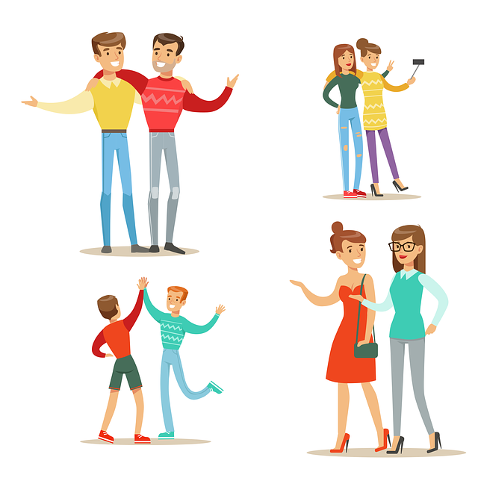
WHO: Identify Audiences
Leadership
Employees
Partners
Customers
Public
Notes:
So now that you know why you want to communicate, the next step is to identify who to communicate to - who needs this information?
Who is your audience?
Well, as an LPHA administrator, you have five main audiences:
Leadership: your Board of Directors, County Commission, City Council, or other governing body
Employees
Partners
Customers or clients
General public
Certainly we could add more audiences or split these groups out into more specific sub-sets,
like segmenting customers into WIC clients, STD patients, and food handlers, for example.
And I recommend that as you consider who to communicate to in any given situation, you be as specific as possible, because the
way you communicate with each audience, the messages you develop for them, and how you disseminate information to them will likely be very different.

Slide 10
Audience Analysis
Push out information only
Literacy level
Preferred method of communication
Baseline
Increase awareness
Baseline + demographics
Cultural information
Midline
Change behavior
Baseline, midline + motivations
Mental models (perception/beliefs)
Comprehensive
Notes:
So more than just identifying your audiences, you need to conduct an audience analysis each time you identify the need to communicate.
This allows you to better understand your audience – whether you are preparing for a Board meeting, having a one-on-one conversation with an employee,
or hosting a meeting of your local partners. It is important to consider your audience.
A baseline analysis is necessary for any communication.
This includes their literacy level and preferred method of communication, and is usually sufficient if all you are going to do is push out information, such as in a crisis.
A midline analysis is more useful when you are seeking to increase awareness with your communication efforts.
For example, if you are rolling out a new program, or if you have changed a policy in the workplace.
This communication requires a midline analysis, which includes the baseline, but also considers audience demographics like age, gender, socioeconomic status, education level, and occupation.
And if you are seeking to change behavior with your communication, you really need to do a comprehensive audience analysis.
You should consider all the factors in the baseline and midline, as well as your audience’s motivations, their perceptions, their beliefs, and their willingness to change, for example.
Some of this analysis can be done in your office looking at data online, such as from the Census Bureau and DHSS.
A midline analysis will be enhanced by talking to service providers who work with your target audience.
A comprehensive analysis will be most accurate if you actually talk to people in the target audience to get their perspective.

Slide 11
WHAT: Tailor Messages to Audience
AUDIENCE | MESSAGES NEEDED
Leadership | Processes, actions, political and financial impact
Employees | How it affects them and customers, equip them to be ambassadors
Partners | How it affects them, equip them to be advocates and messengers
Customers | How it affects them, actions they should take
Public | What you are doing, why, how (accountability)
Notes:
Now that you better understand your audience, you will need to tailor messages to each audience.
What is it they need to know or want to know?
[review table]

Slide 12
WHERE: Dissemination Pathways
Audiences get information from different sources and through unique pathways.
Employees: regular staff meetings, short briefings, posted notices
Leadership: emails, updates at regular meetings
Partners: email updates, meetings, personal visits
Public: newsletters, PSAs, events, recorded messages on phone
Customers: social media, texts, website content
Notes:
You also should have learned from your audience analysis where each audience gets their information.
Older adults like me may still be reading the newspaper, listening to talk radio, or scrolling through Facebook.
But young adults are more likely to be on SnapChat or other newer social media platforms.
It’s important to know where your audience seeks information and make sure you are placing your information there, rather than expecting them to come to you.

Slide 13
WHEN: Communication Calendar
Plan ahead for communication activities:
Social media scheduling
Community events
Data-specific communication
Targeted outreach
Regular communication with leadership, employees,
partners, and customers
Notes:
One important part of your communication plan will be to develop a communication calendar.
To communicate with a broad audience, I encourage you to plan for a regular cadence of social media posting,
as well as 2 – 3 larger communication campaigns you can do each year.
These could be based on events in your community, such as the back to school fair or the county fair.
Or they could be based on data red flags such as obesity rates, tobacco use, or diabetes incidence.
Or they could be based on audience, such as toothbrushing education to elementary students,
or STI prevention education to high school students, or blood pressure self-checks for older adults.
Also add to your calendar regular communication outreach to employees, your Board or Commissioners, and your local partners.
And consider planning ways you can interact with your customers on a regular basis, as well, so that they don’t just hear from you when they visit your office.

Slide 14
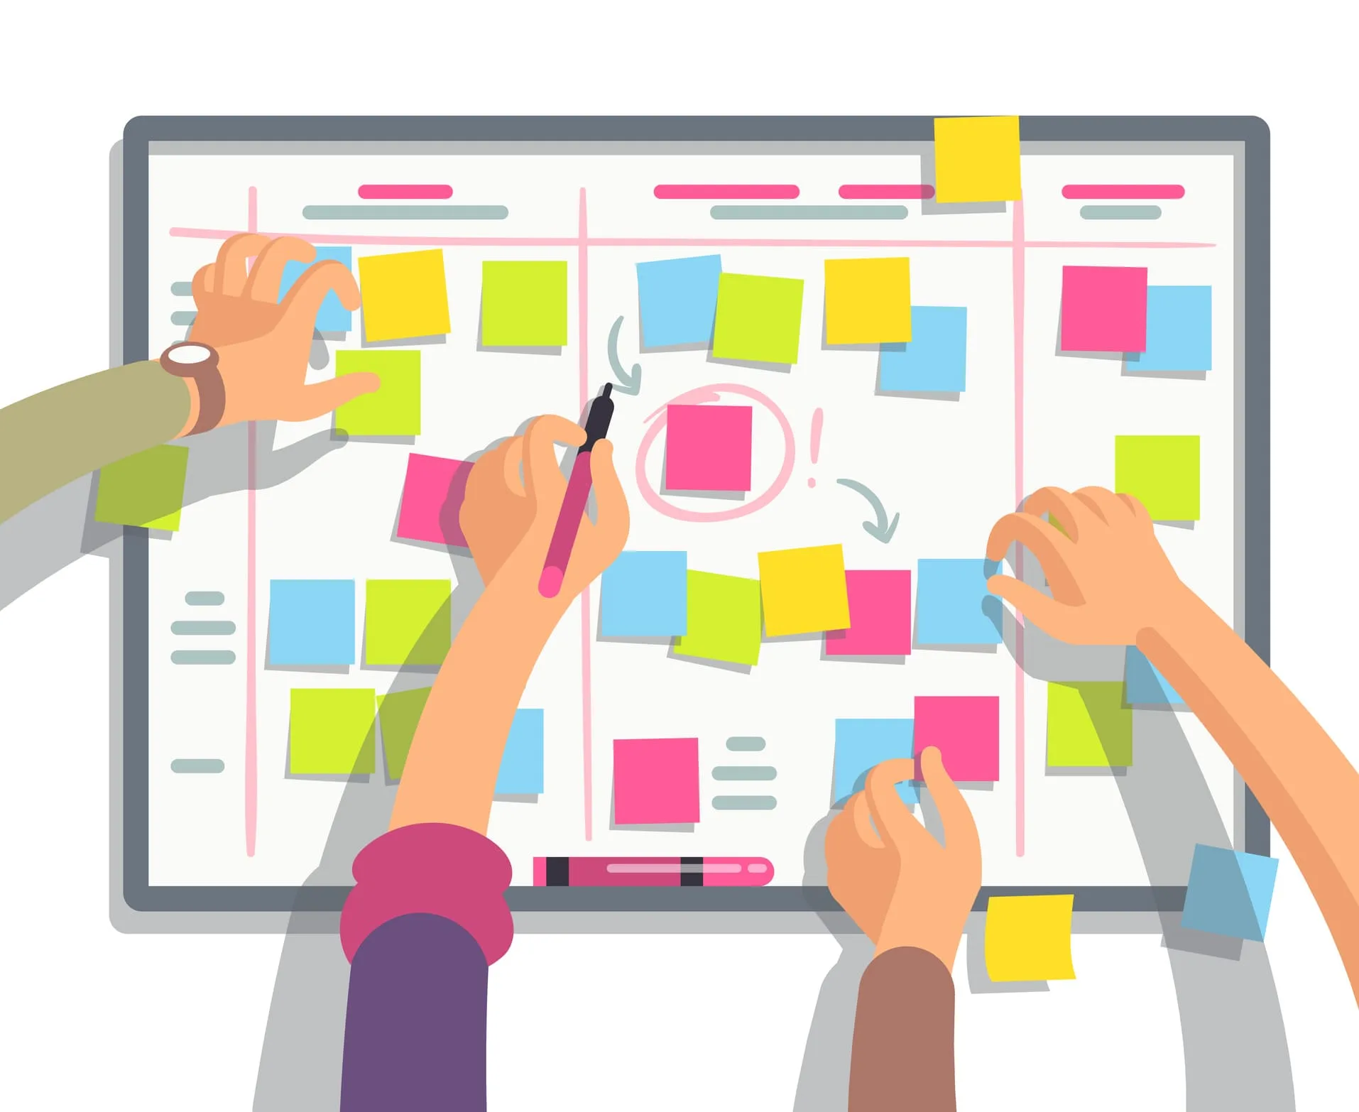
HOW: Communication Plan
Overall communication plan for your agency
Situation specific template
- Use it routinely until it becomes part of your regular process
Notes:
Plan ahead: creating a communication plan, a communication calendar, and then tapping into
existing resources to utilize content that had already been created.
So, as you go back to your LPHA after this session and consider how you will find time to make communication a priority, I encourage you to start
by developing a communication plan. There are templates available from DHSS and from the MICH website.
You can reach out to me, as well, if you need assistance locating those resources.

Slide 15
HOW: Resources
PH Communication Liaison
DHSS OPI
DHSS CLPHS
Professional Organizations
University Partners
National Partners
Platforms (Hootsuite; Canva)
LPHA Info Hub
Weekly Communication Bulletin (Thursdays)
Email Listserve (under development)
Friday Facts
DHSS Website
Emails from DHSS
Notes:
LISA:
DHSS Office of Public Information
Can assist/counsel regarding media inquiries or partner on joint public announcements
Give each other notice when our public messaging may impact one another
Assisting with social media toolkits or assets when possible (resource library)
Professional organizations
If you have dedicated PIO, NPHIC is a good resource/membership.
DHSS website
Thankfully, work is kicking off this month to begin building an entirely new digital home for health.mo.gov. Will become much more user-friendly, searchable, current, etc.
Must be done by early 2026, hoping to be complete in 2025.

Slide 16
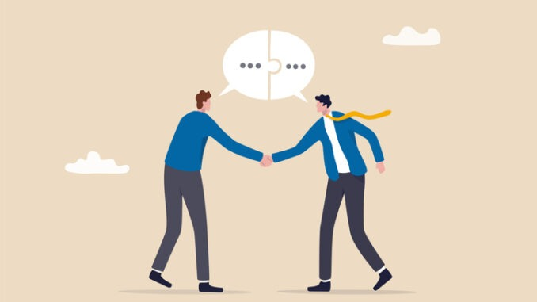
Strategies for Successful Communication
WHY: Purpose and Objectives
WHO: Audiences
WHAT: Messages
WHERE: Dissemination pathways
WHEN: Calendar / Timeline
HOW: Communication Plan & Resources
Notes:
SUMMARIZE:
So how can you make sure your communication is clear and effective?
It requires planning.
[read slide steps]

Slide 17
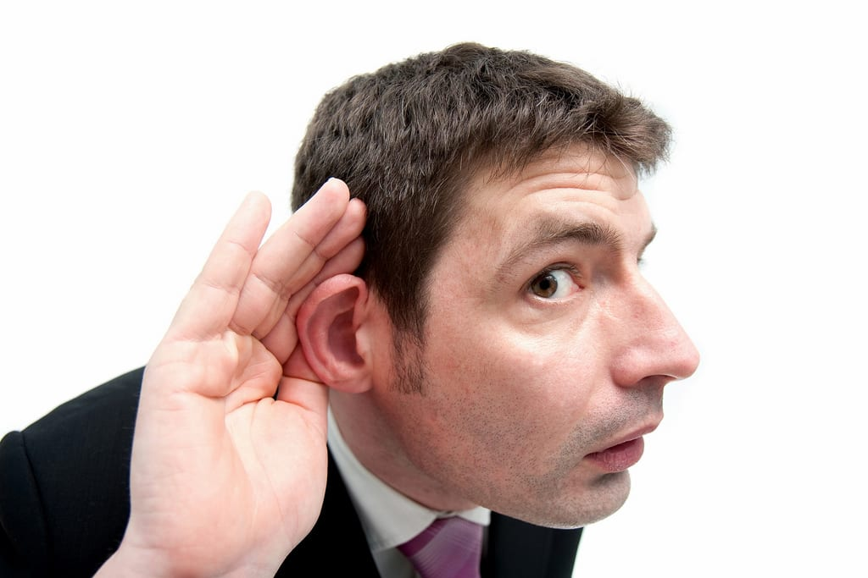
Evaluate Communication Efforts
Are your actions in alignment with your purpose?
Are you achieving your objectives?
Are the outcomes what you expected?
What adjustments are needed?
Build in feedback loops for each
audience and then LISTEN!
Notes:
Remember to evaluate communication throughout the process, including making sure there is a feedback loop for your audience.
Remember – the ping pong match – send and receive information. So give them an opportunity to send information back to you,
And LISTEN then make adjustments as necessary.

Slide 18
QUESTIONS
Jaci McReynolds, MHA
Public Health Communication Liaison
jmcreynolds@MissouriState.edu
417-836-3271 office
417-839-3579 cell
?
MO-LPHA.com

