Slide 1
April/May 2023
Next Steps in Transforming Health in Missouri
FPHS and Accreditation Support
Daniel Bogle, Health Policy Director
Brenna Davidson, Operational Excellence Leader

Slide 2
What are we talking about today?
1
Refresher on the Foundational Public Health Services Model
2
Next Steps and Timeline for Implementing the Foundational Public Health Services Model
3
Summary of Accreditation Support Options for LPHAs

Slide 3
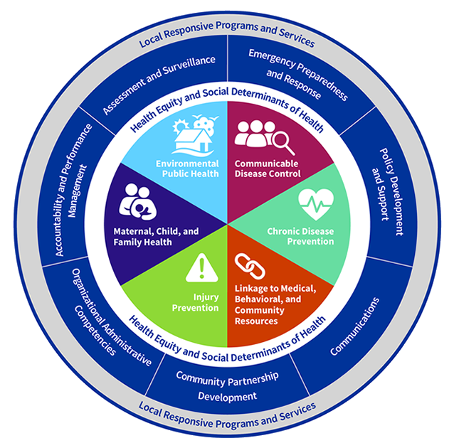
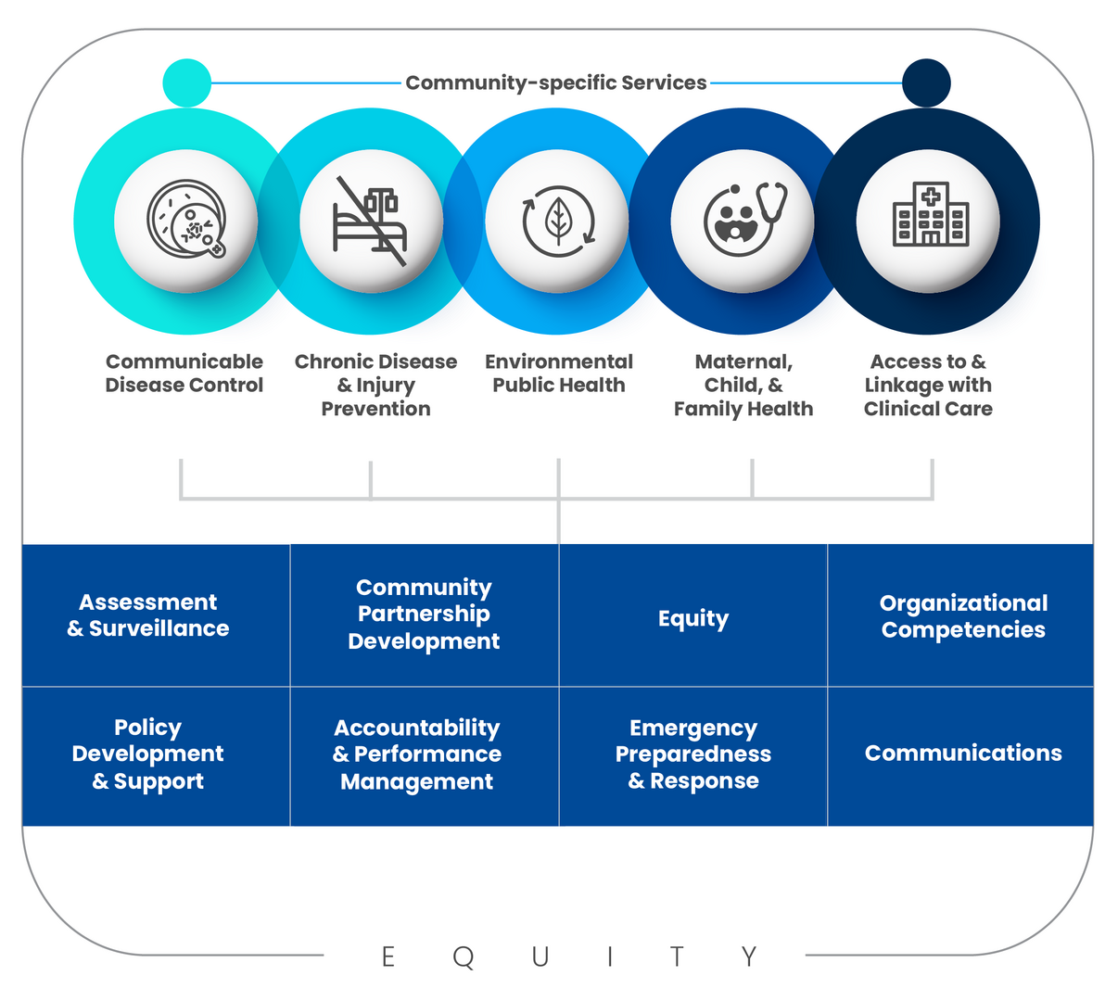
FPHS Refresher
FPHS is the suite of skills, programs, and activities that must be available in health departments everywhere for the public health system to work anywhere.
vs

Slide 4
How are other states doing it?
State
Identified Total Need
Passed Legislation
Investment History
Washington
$450 million per biennium
2019:
RCW 43.70.5123
RCW 43.70.515
2017-2019: Obtained $60M
2019-2021: Obtained $296M
2021-2023: Obtained $285M
2023-2025: Requested $324M (72% of need)
Oregon
$210 million per biennium
2015: HB 3100
2017-2019: Obtained $5M
2019-2021: Obtained $15.6M
2021-Present: Requested $60.6M (29% of need)
Kentucky
3 FTE per 15,000 people
$109,000 per FTE
2020: HB 129
2020: Obtained $116.5 million
Ohio
$121 million annually
N/A
2017-2019: Requested $3.5 m
2022-2023: Requested $6 m

Slide 5
Where are we now?
Planning Stage
Adopt a MO-Specific FPHS Framework
Adopt an FPHS Delivery Model
Set the Stage
Implementation Stage
Complete a Capacity Assessment
Complete a Costing Analysis
Create an Accountability Plan
Legislation and Impact

Slide 6
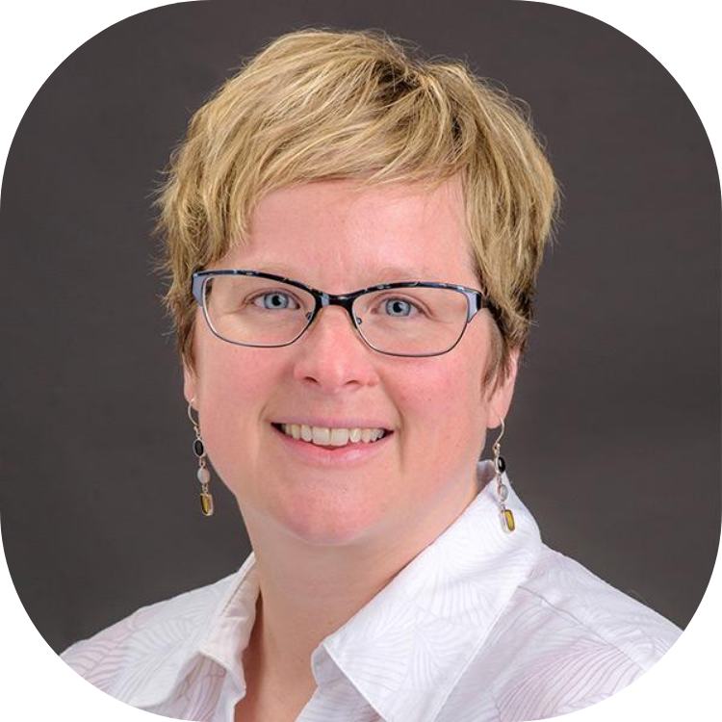
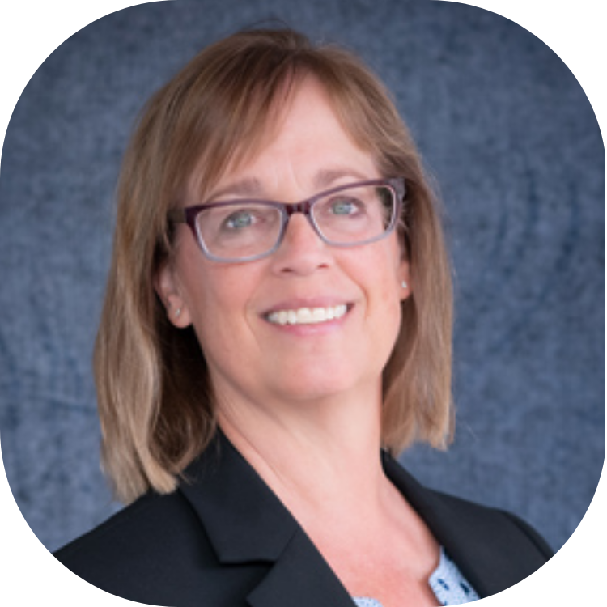
Meet the FPHS Team
Jill Lucht, MS
Sara Gable, PhD
Adrienne Ohler, PhD
Project Manager
University of Missouri
Institute for Public Policy
University of Missouri
MU Extension
University of Missouri

Slide 7
FPHS Costing Project Timeline
2024
2026
Launch costing tool
Regional webinars
Technical assistance and office hours
Complete pilot gap analysis
Conduct final gap analysis as a basis for enhanced funding requests
2023
2025
Form Steering Committee
Pilot Focus Groups
Develop user guide
Ongoing technical assistance
Pilot gap analysis with 2 years of data

Slide 8
Accreditation Support for LPHAs
Technical Assistance
Cost Reimbursement
Enhanced Core Funding

Slide 9
Accreditation Support for LPHAs
Technical Assistance
Project Type
Funding Source
Current Status
Scope of Work
Contracted
CDC Infrastructure Grant
DHSS is developing the Request for Proposal with the Office of Administration
In-person or virtual technical assistance sessions for LPHAs pursuing accreditation under PHAB or MICH
Qualified bidders will be experienced in public health accreditation and planning

Slide 10
Accreditation Support for LPHAs
Cost Reimbursement
Project Type
Funding Source
Current Status
Program Purpose
Contracted
CDC Infrastructure Grant
Program planning stage within DHSS
Cost reimbursement options available to LPHAs to support costs associated with accreditation activities such as:
Accreditation readiness assessments
Health plan development
Contractor or LPHA staff activities

Slide 11
Accreditation Support for LPHAs
Enhanced Core Funding
Project Type
Funding Source
Current Status
Program Purpose
Proposed DHSS program
State of Missouri General Revenue
New Decision Item submitted for legislative consideration for FY 25
Long-term incentive program administered by DHSS to promote accreditation and quality improvement activities within LPHAs
Included in Governor's Office approved budget
Requirements for Eligibility:
LPHAs must complete initial accreditation and/or maintain their accredited status under the accrediting body of their choice
LPHA Administrators must complete annual training courses
100% of Commissioners/Boards of Health members must complete annual training courses
DHSS is partnering with MAC to include training as part of commissioner's CEUs

Slide 12
How can we support you?
?
Do you feel able to take on an accreditation project?
?
Do you need more specialized support for accreditation activities?
?
Where do you see barriers and how can DHSS help address them?

Slide 13
Thank you for all you do for Missourians!
Daniel Bogle
Health Policy Director
Daniel.Bogle@health.mo.gov
Brenna Davidson
Operational Excellence Leader
Brenna.Davidson@health.mo.gov

