Slide 1
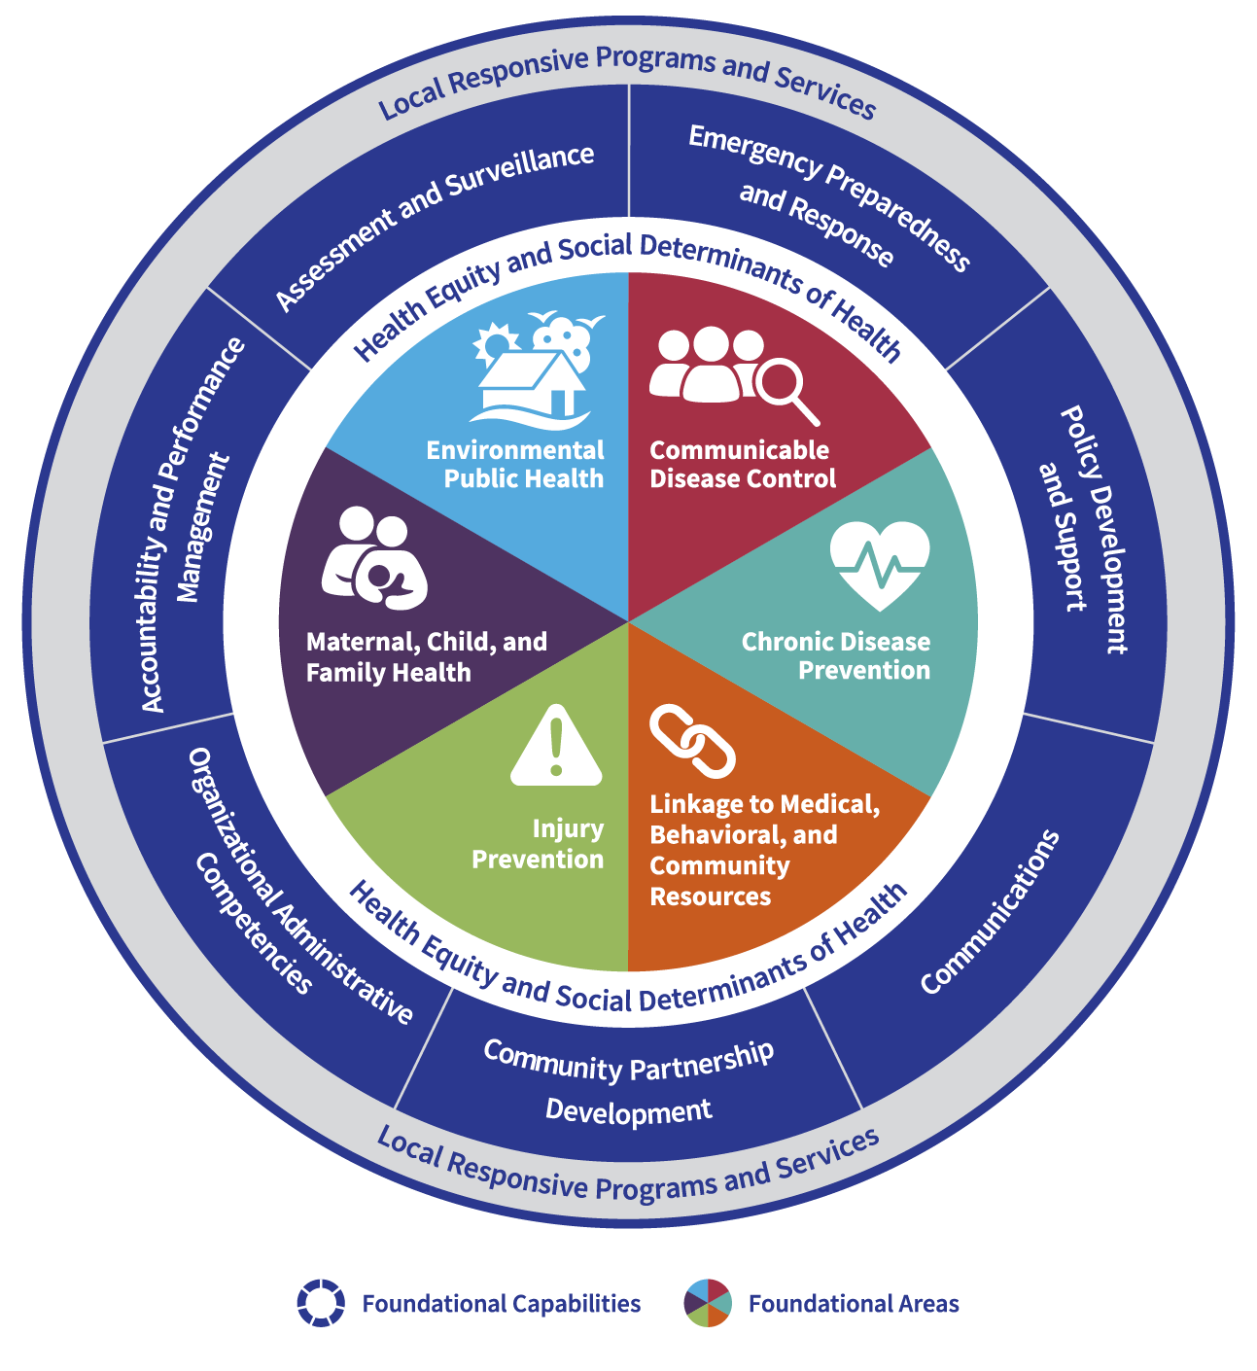
Foundational Public Health Services: The Next Step in Missouri's Transformation Journey
Daniel Bogle, MPA
Mark Bremer, MPH, MPA

Slide 2
Today's Objectives
Introduction to the Foundational Public Health
Services Model.
Walkthrough of Foundational Capabilities and
Foundational Areas of Expertise.
Future of Foundational Public Health Services
from DHSS.
Future Accreditation Opportunities.

Slide 3
FPHS is the suite of skills, programs, and activities that must be available in health departments everywhere for the public health system to work anywhere.

Slide 4
Framework
Public Health 3.0 | Public Health Forward
Accreditation
Foundational Public Health Services

Slide 5
Basics of FPHS
Foundational Public Health Services offer a shared language for Public Health no matter where you are or jurisdiction you serve.
Interconnected Parts to FPHS
6 Foundational Areas.
7 Foundational Capabilities.
Health Equity.
Local Services.

Slide 6
Missouri Model Creation
2019 #HealthierMO FPHS Workgroup
LPHA representatives from regions A-I
8 DHSS leaders
3 academic institutions
Consistent input from Public Health stakeholders and PHNCI (Public Health National Center for Innovation).
#HealthierMO unveils official Missouri Model in 2020

Slide 7
Notes:
Add in intersectional examples

Slide 9
From Present to Future

Slide 10
FPHS Development and Adoption Process
Planning Stage
Set the Stage
Adopt a State Specific FPHS Framework
Adopt an FPHS Delivery Model
Implementation Stage
Complete a Capacity Assessment
Complete a Costing Analysis
Create an Accountability Plan
Legislation and Impact

Slide 11
Operationalizing Foundational Public Health Services
Collaboration, Partnership, and Trust
Focus Groups
TA Support

Slide 12
How other States are Doing It
State | Identified Total Need | Legislation Passed | Investment History
Washington | $450M per biennium | RCW 43.70.5123 RCW 43.70.515 (2019) | 2017-2019: Obtained $60M 2019-2021: Obtained $296M 2021-2023: Obtained $285M 2023-2025: Requested $324M (72% of need)
Oregon | $210M per biennium | HB 3100 (2015) | 2017-2019: Obtained $5M 2019-2021: Obtained $15.6M 2021-Present: Requested $60.6M (29% of need)
Kentucky | 3 FTE per 15,000 people +1 per 5000 more people $109,000 per FTE | HB 129 (2020) | 2020: Obtained $116.5M Recalculated every biennium
Ohio | $121M annually | N/A | 2017-2019: Requested $3.5M 2022-2023: Requested $6M

Slide 13
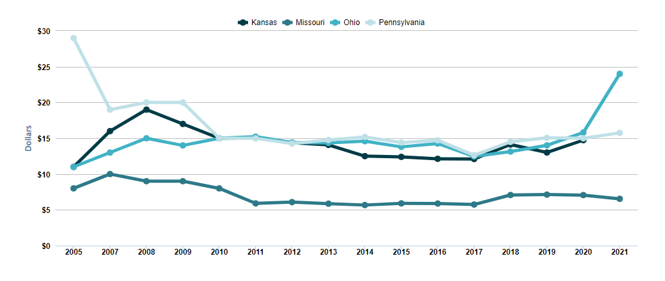
Core GR Public Health Funding Comparison
Ohio $24 | Pennsylvania $16 | Kansas $13 | Missouri $7 *per capita GR Funding
SHADAC analysis of [Public Health Core GR Funding by State], State Health Compare, SHADAC, University of Minnesota, statehealthcompare.shadac.org, Accessed [9/15/22]. A Robert Wood Johnson Funded Project

Slide 14
Public Heath Accreditation

Slide 15
How DHSS is Supporting Accreditation Activities
Public Health Accreditation Board Readiness Assessment
State-wide Accreditation Specialists
Potential Funding for Accreditation Activities

Slide 16
Questions?
Daniel.Bogle@health.mo.gov
Mark.Bremer@health.mo.gov

