Slide 1
PROTECTING HEALTH AND
KEEPING PEOPLE SAFE

Slide 2
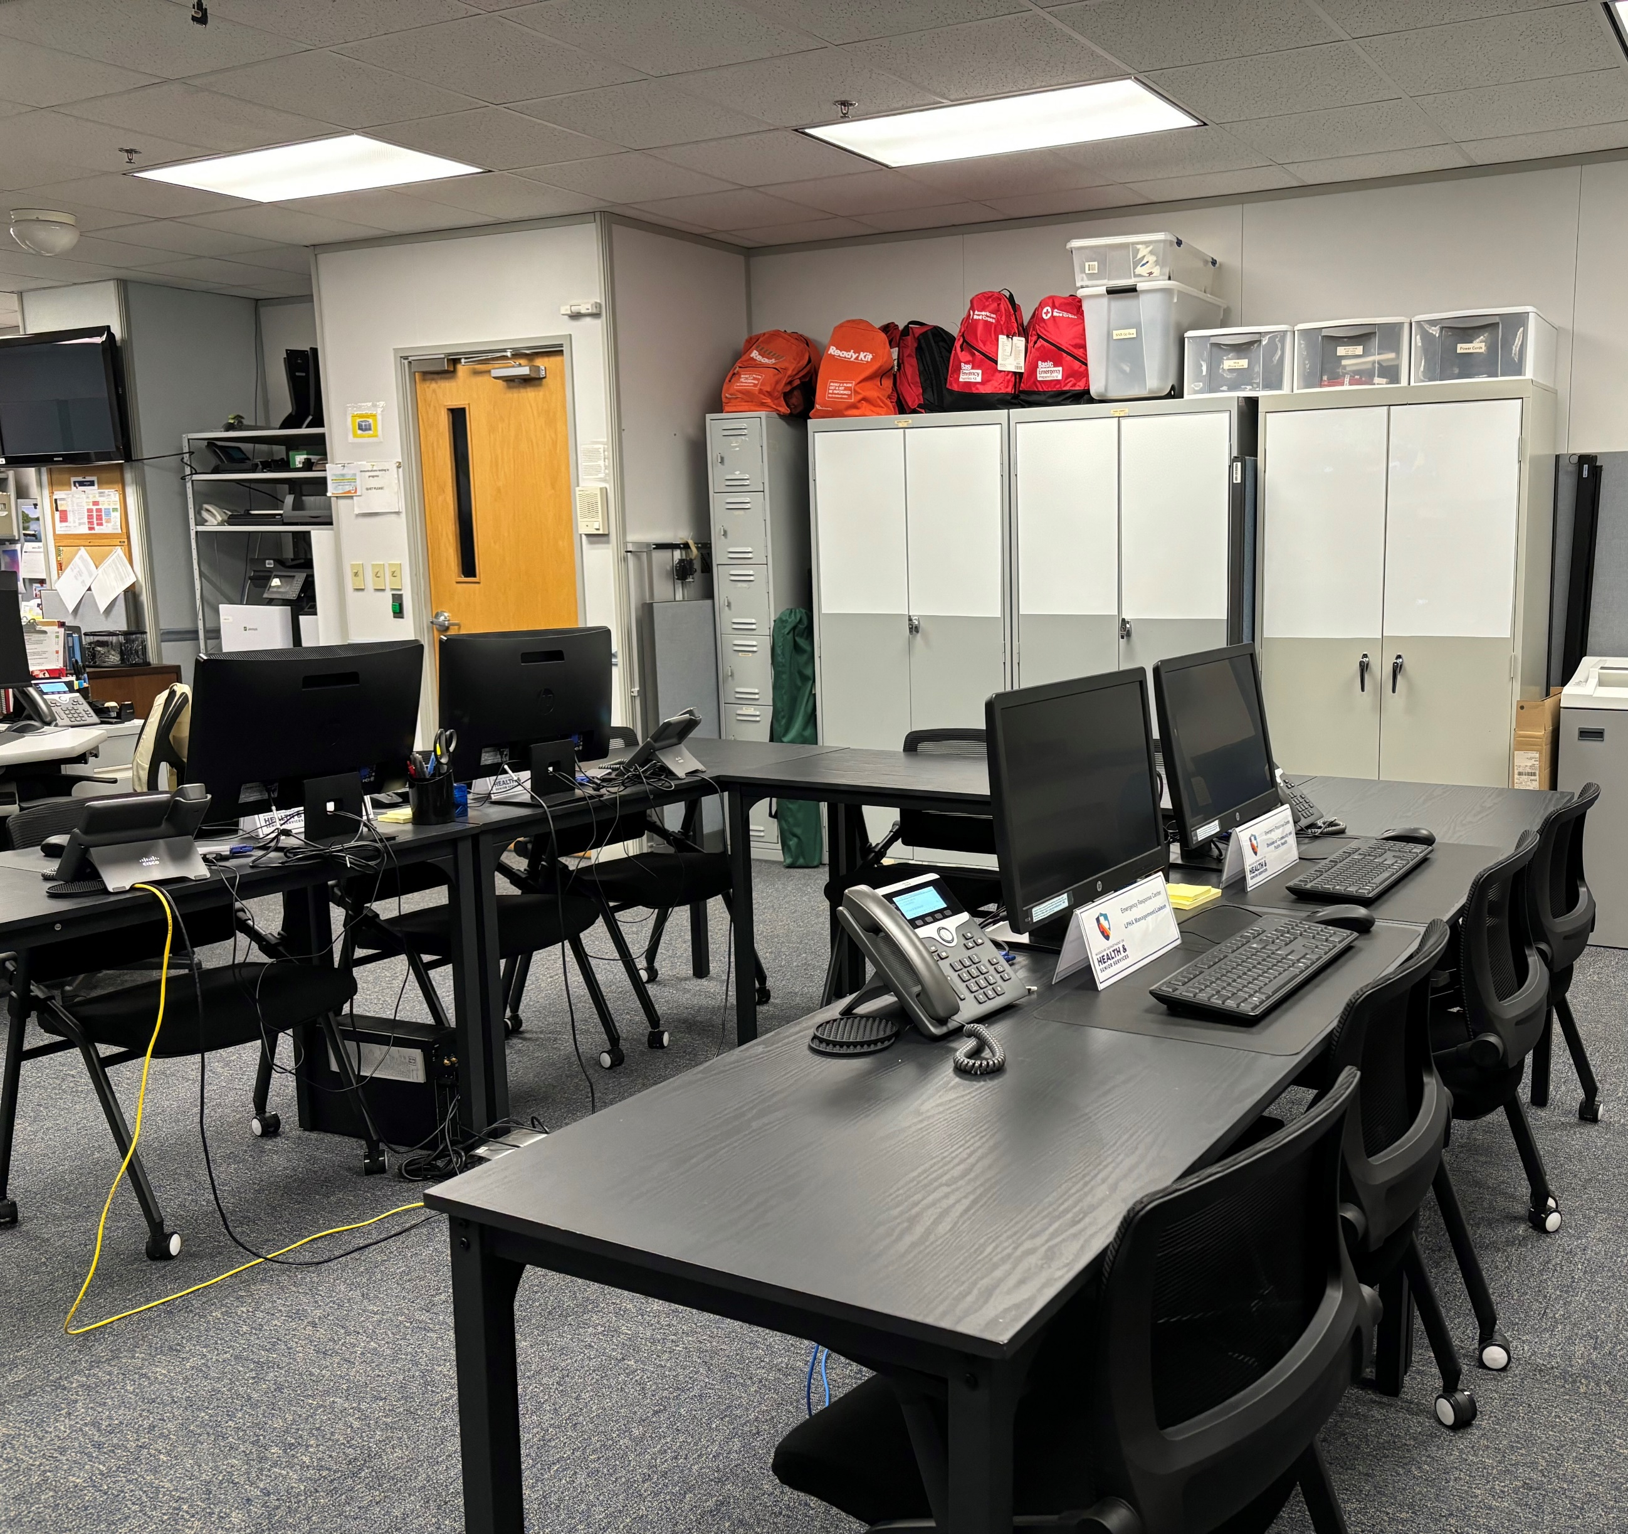
Slide title
Duty Officer Duties
Answering the public health emergency hotline,
Monitor statewide licensed hospitals’ operational status,
Monitor the DRMS email account for CDC alerts and hazardous material spills on roads or waterways,
Monitor national, state, and local news media for weather conditions and news alerts.
Ensure all equipment is operable during a public health emergency:
Conduct mass notifications (by phone and email) of situational awareness information and activation of emergency response teams,
Activate the emergency response plan and serve as the Public Health emergency response center, providing space, equipment, and support for public health emergency response teams.
ERC during Activation

Slide 3
Biological Incidents
Pandemic Influenza, Bioterrorism
Radiological Incidents
Dirty Bombs, Improvised Nuclear Devices
Terrorist Incidents/Mass Traumatic Injuries
Shootings, Bombing, Vehicles Assaults on Crowds
Chemical Incidents
Chemical Terrorism, Toxic Industrial Chemicals
What are we monitoring for?
Events of Concern
Natural Disasters
Tornadoes, Floods, Ice Storms, Earthquakes, etc.

Slide 4
Slide title
EMResource
WebEOC
MO-HNS

Slide 5
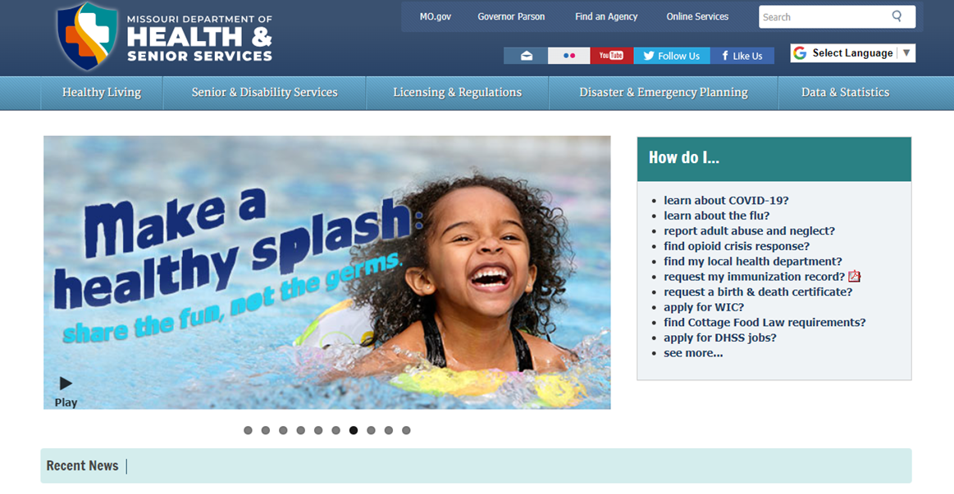
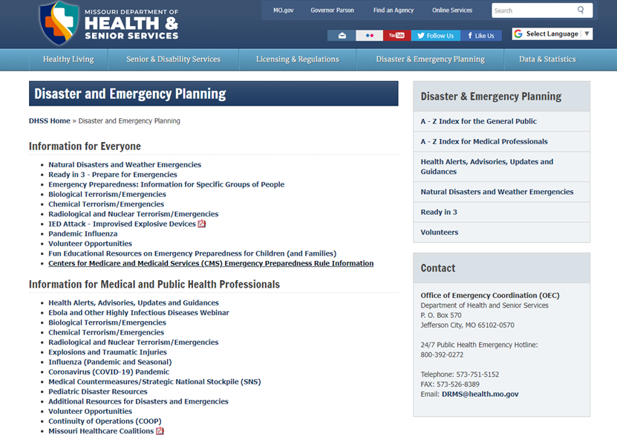
Disaster/Emergency Response
Ready in 3

Slide 6
Thank You!
QUESTIONS?
drms@health.mo.gov
800 392 0272
Health.Mo.Gov

