Slide 1
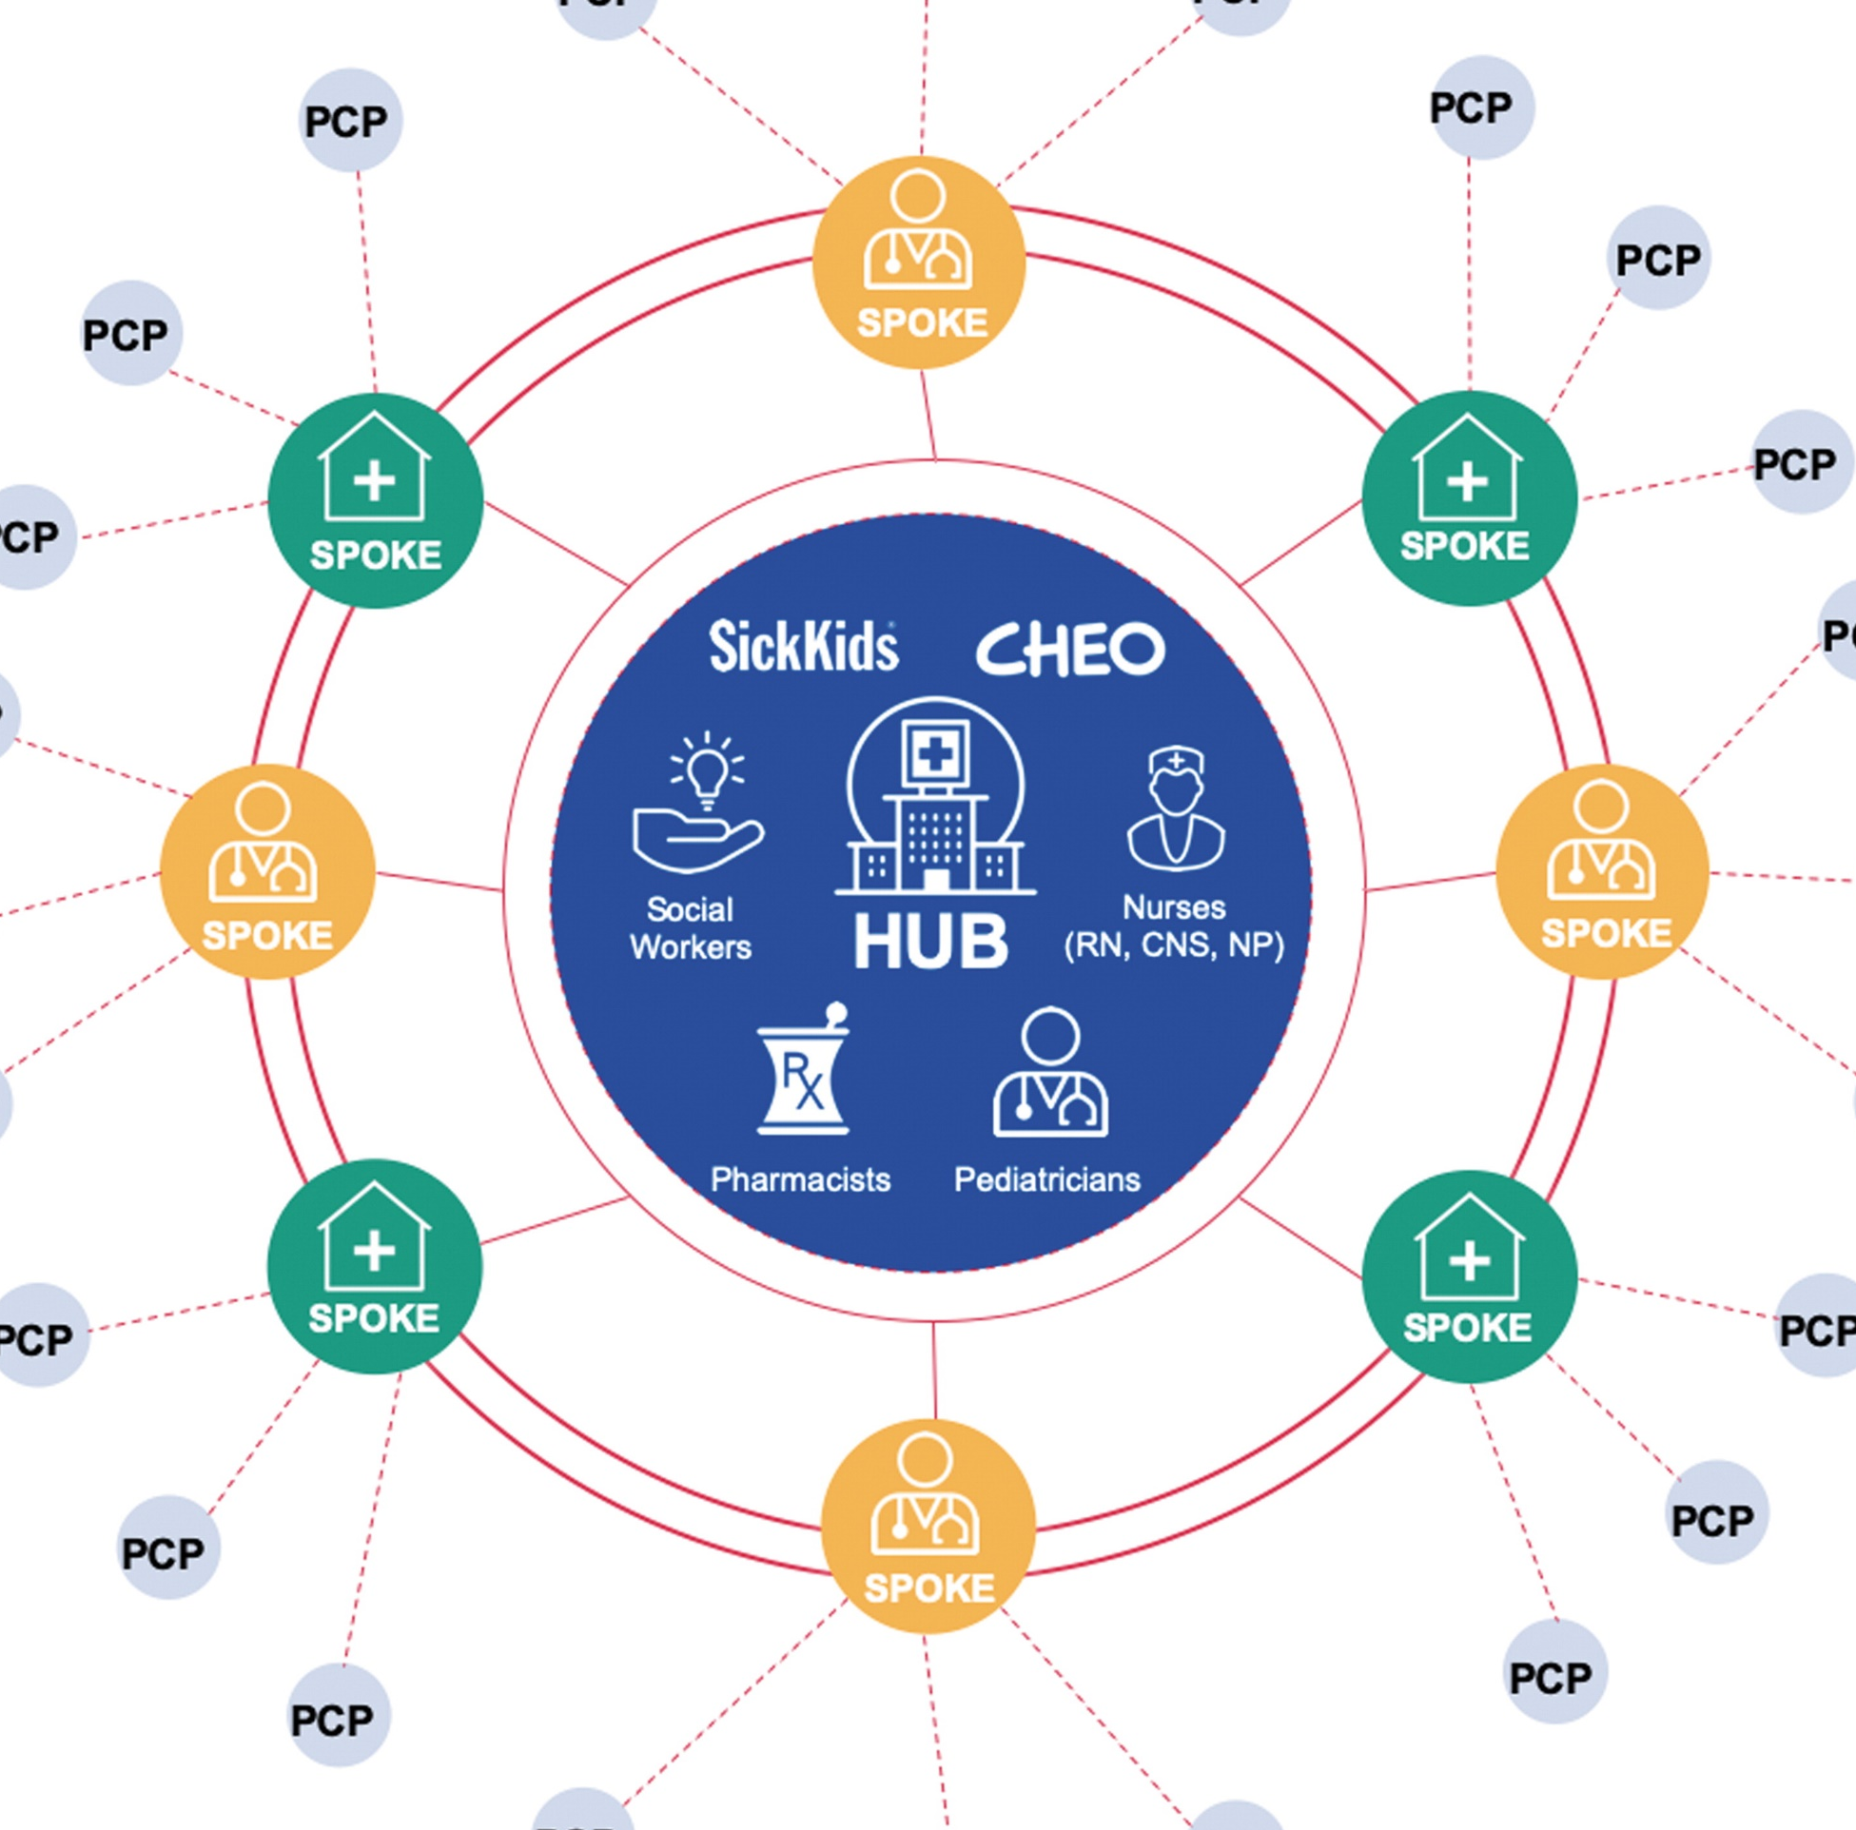
ECHO HUB AND SPOKE MODEL
ECHO CYCLE
Subject matter experts share knowledge, acquire new knowledge, facilitate learning
Participants acquire new skills and knowledge, gain confidence, join learning community
Community members receive advanced, equitable care, increase access to resources, apply best practices
When all these principles are applied, a learning community comes together called:
“ALL TEACH and ALL LEARN”
BENEFITS:
Interactive, peer-to-peer learning
Guided practice and ongoing mentorship
Collaborative problem-solving

Slide 2
SHOW-ME ECHO
EXTENSION FOR COMMUNITY HEALTH CARE OUTCOMES
CONNECTING COMMUNITIES. SHARING KNOWLEDGE & RESOURCES. CHANGING LIVES.

Slide 4
Adult Psych Asthma Autism Building Health Comm Cert Peer Specialist Child Psych Comm. Health Worker Concussion Care COVID-19 Show Me Strong Kids CPCC Positive Classrooms Dementia & Alzheimers Dermatology Developmental Disabilities Diabetes Disordered Eating Foster Care Head Start Hep C HIV Hypertension Kidney Disease MO Mom & Babies Mothers, Infants & NAS Newborn Care Oral Health Pain Management Ped Sleep Suicide Prevention in Health Care Trauma Informed Schools Vaping, Tobacco & Nicotine Treat

Slide 5
SHOW-ME ECHO : SPECIAL INTEREST
CONNECTING COMMUNITIES. SHARING KNOWLEDGE & RESOURCES. CHANGING LIVES.

Slide 6
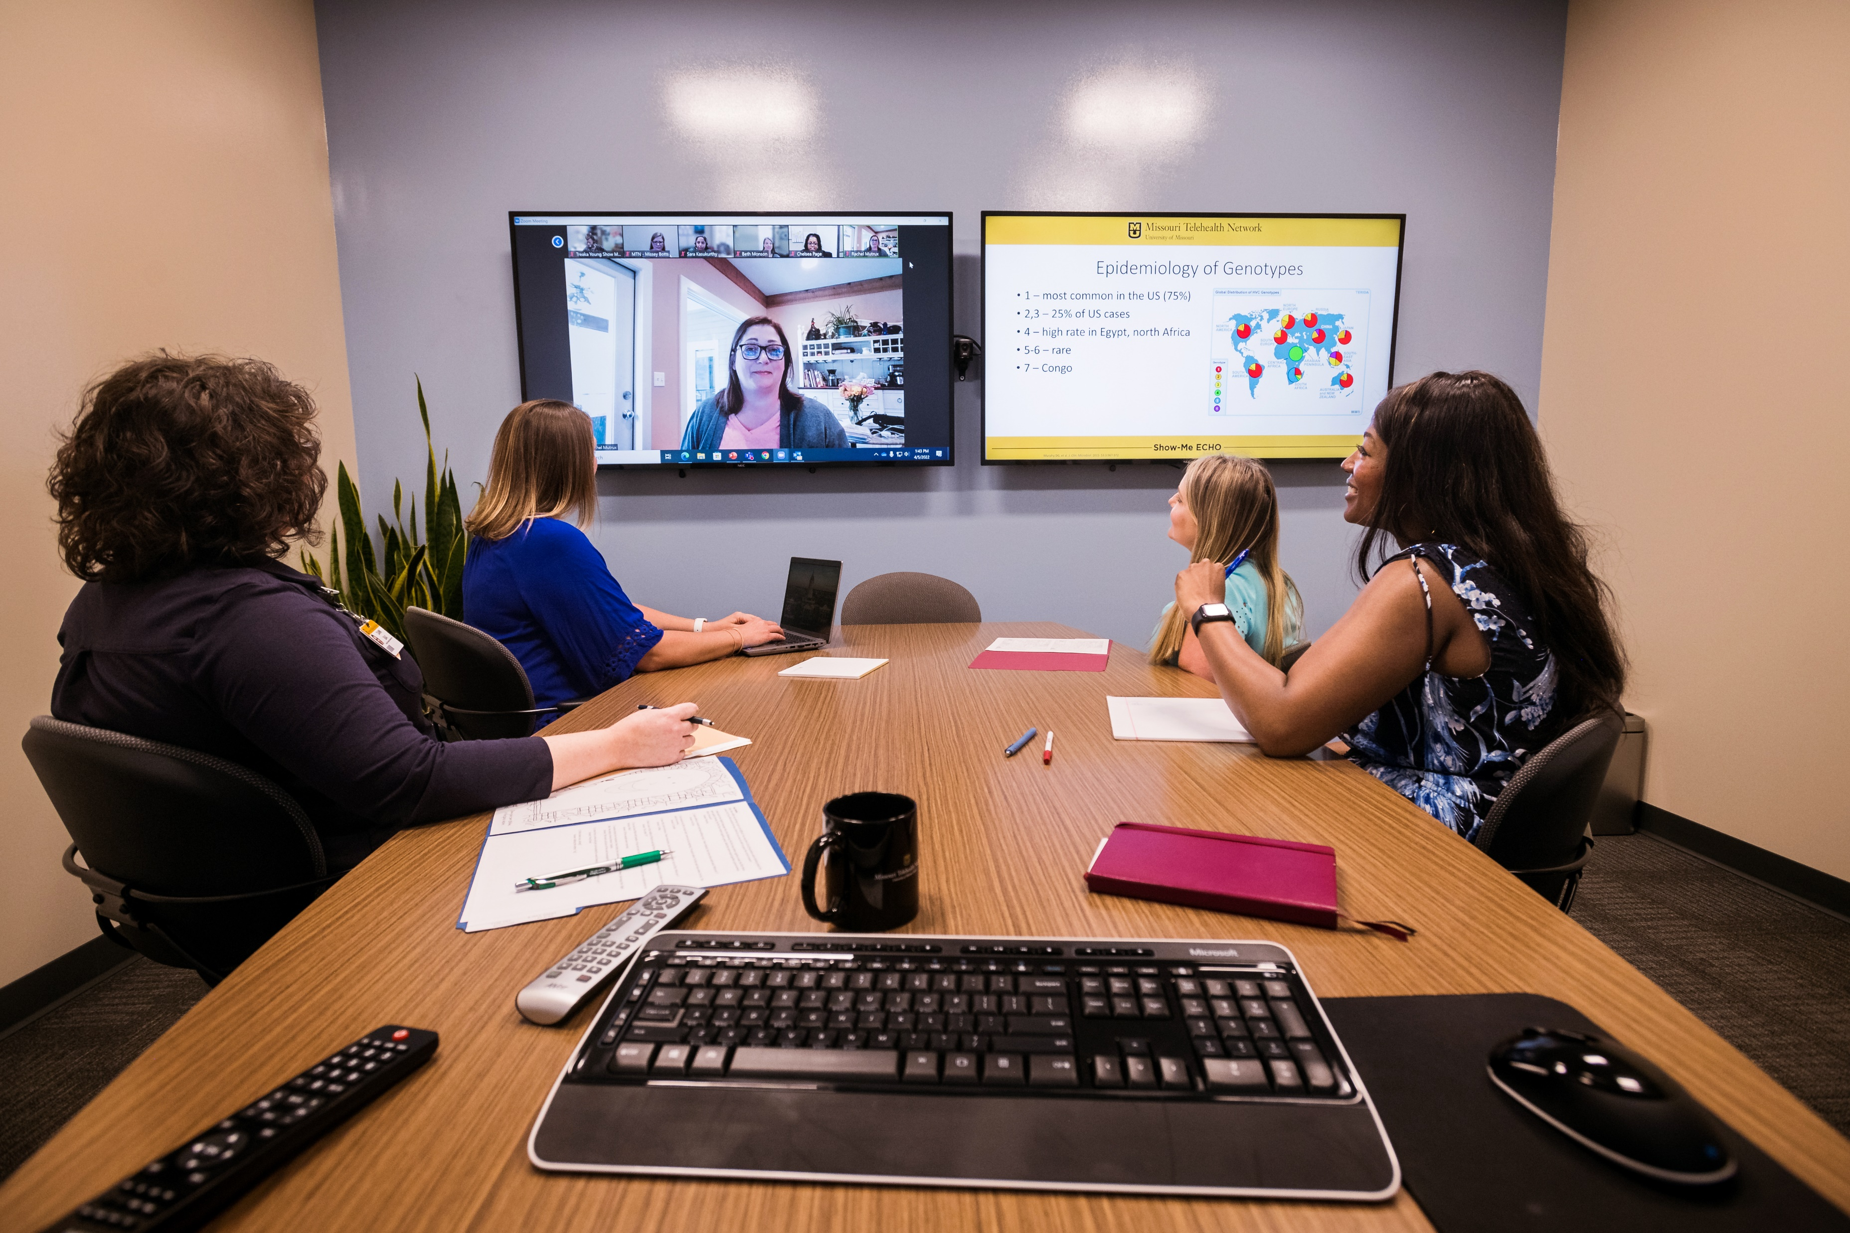
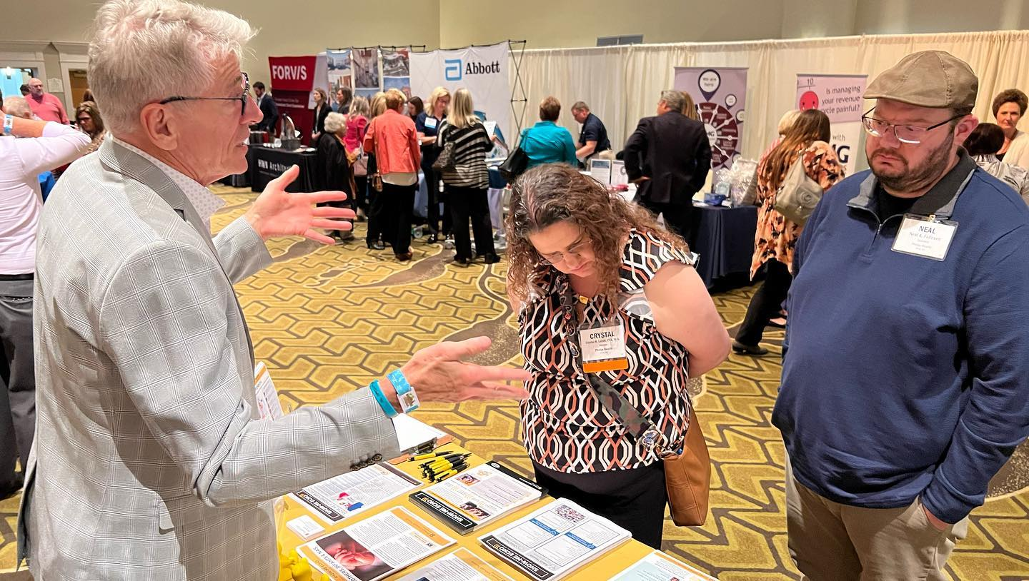
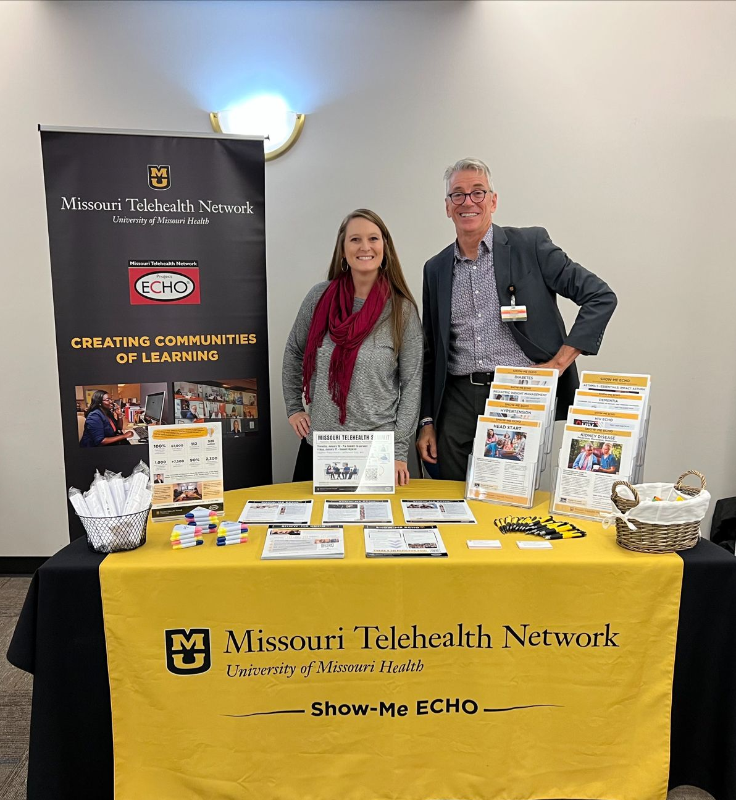

Slide 9
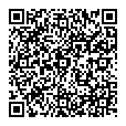
RCAT https://medicine.missouri.edu/offices-programs/missouri-telehealth-network/projects Dan Lund lunddr@health.Missouri.edu Ph: 816-387-6819
Show-Me ECHO Program www.showmeecho.org Dean Andersen Andersendc@health.Missouri.edu Ph: 573-884-9769

Slide 10
Thank you: for all you do to make your communities healthier for everyone!

