Slide 1
COVID-19 Vaccination Clinical Updates

Slide 2
Pfizer BioNTech COVID-19 vaccine
Individuals 50 years and older may receive a 2nd PfizerBioNTech COVID-19 vaccine booster dose
Individuals 12 years and older who are moderately to severely immune compromised may receive a 2nd PfizerBioNTech COVID-19 vaccine booster dose
2nd Booster dose should be spaced at least 4 months from the previous booster dose

Slide 3
Moderna COVID-19 Vaccine
Individuals 50 years and older may receive a 2nd Moderna COVID-19 vaccine booster dose
Individuals 18-49 years of age who are moderately to severely immune compromised may receive a 2nd Moderna COVID-19 vaccine booster dose
2nd Booster dose should be spaced at least 4 months from the previous booster dose

Slide 4
Janssen Vaccine Recipients
Individuals 18-49 years of age who received only Janssen COVID-19 vaccine for the primary dose and a booster dose should receive a 2nd booster dose of a mRNA (Pfizer or Moderna) COVID-19 vaccine at least 4 months from previous dose
Individuals 50 years and older may receive a 2nd booster dose of any mRNA vaccine (Pfizer or Moderna) COVID-19 vaccine at least 4 months from the last booster dose

Slide 5
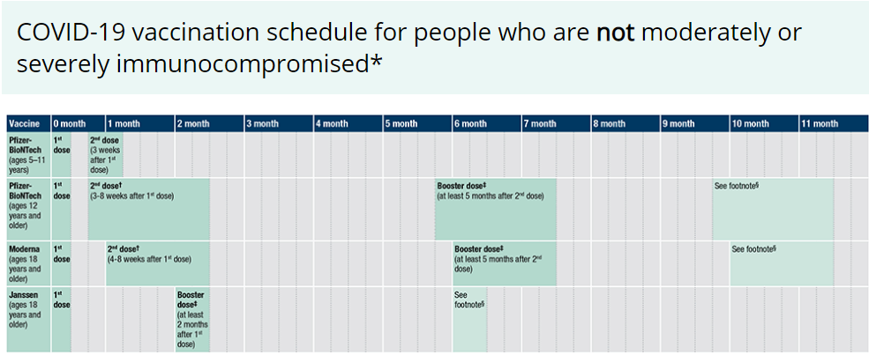
‡ A booster dose is not currently authorized for people ages 5–11 years. For people ages 12–17 years, only Pfizer-BioNTech can be used. An mRNA COVID-19 vaccine is preferred over the Janssen COVID-19 Vaccine for booster vaccination of people ages 18 years and older.
§ People ages 18–49 years who received Janssen COVID-19 Vaccine as both their primary series dose and booster dose may receive an mRNA COVID-19 booster dose at least 4 months after the Janssen booster dose. People ages 50 years and older may choose to receive a second booster dose if it has been at least 4 months after the first booster dose.

Slide 7
Vaccine presentations
Moderna Red Cap or Blue Cap can be used for Booster doses of 0.25ml or Primary dose of 0.5ml

Slide 8
Other clinical items
8-week interval for a mRNA may be optimal for people who are not immunocompromised and ages 12-64 years, especially for males ages 12–39 years
May decrease the risk for myocarditis and pericarditis in makes
Increase peak antibody response and vaccine effectiveness
Only applies to individuals (12 to 64 years of age ) who are not moderately to severely immune compromised
Completing the Primary series
For most people, a 2-dose series of an mRNA COVID-19 vaccine (Pfizer-BioNTech and Moderna) or a single dose of Janssen COVID-19 Vaccine.
For people who are moderately or severely immunocompromised, a 3-dose series of an mRNA COVID-19 vaccine or a single dose of Janssen COVID-19 Vaccine.
Up-to-Date
Person has received all recommended primary and booster doses that they are eligible for

