Slide 1
Health.Mo.Gov

Slide 2
6+++++
Accelerating Performance:
The impact of mindsets and how to shift them
John Thomas
Chief People Officer

Slide 3
Strategy A1: Workforce
Public health and health care workforce commission
Leadership academy
Internship program
Missouri healthcare workforce project
Learning and development redesign
* County commissioner collaboration

Slide 4
Health and public health taskforce advisory council
Clinic/medical office-private sector | Missouri Association of Area Agencies on Aging | Missouri DHSS | Missouri Public Health Association
Health Forward Foundation | Missouri Association of Local Public Health Agencies | Missouri DMH | MU School of Medicine
Hospital-private sector | Missouri Board of Healing Arts | Missouri Foundation for Health | University of Health Sciences and Pharmacy
Long-term care provider-private sector | Missouri Board of Nursing | Missouri Healthcare Association | Missouri Association of Rehabilitation Facilities
Gibson Behavioral Health-private provider | Missouri Center for Public Health Excellence | Missouri HealthNet
Missouri Alliance for Home Care | Missouri Council of Behavioral Health | Missouri Hospital Association
Missouri Ambulance Association | Missouri DHEWD | Missouri Primary Care Association

Slide 5
Leadership academy
200 hundred participants over 5 years
4-5 in person trainings, location(s) to be determined
Curriculum based on 8 core competencies for public health professionals
Capstone projects with each cohort
Data analytics and assessment skills | Communication skills | Community partnership skills | Management and finance skills
Policy development and program planning skills | Health equity skills | Public health sciences skills | Leadership and systems thinking skills

Slide 6
Internship program
Learning, recruitment and capacity-building tool for creating a pipeline for the next generation of public health professionals
Partner with Missouri universities
250 internships over 5 years ($6,400 stipend/320 hours)

Slide 7
Missouri healthcare workforce project
Initiative began in 2007
Collects, analyzes and reports data related to Missouri’s health care workforce
Four domains:
Infrastructure development
Emerging practices
Public health preparedness and collaboration
Analysis

Slide 8
Learning and development redesign
Secure 2,500 licenses of online learning platform for LPHA team members
Create learning paths to assist team members get started in their public health learning and development
Initial learning paths based on 8 core competencies for public health professionals
Data analytics and assessment skills | Communication skills | Community partnership skills | Management and finance skills
Policy development and program planning skills | Health equity skills | Public health sciences skills | Leadership and systems thinking skills

Slide 9
County commissioner collaboration
What made you decide to run for county commissioner? (free text)
What 3-4 county or public policy issues are most important to you? (free text)
What motivates you to make an issue a priority? (free text)
What are you responding to in making these issues a priority? (free text)
What do you think are the most important public health issues? (free text)
Ensuring a healthy community should be a local government priority. (Likert scale)
How important is public health to the citizens you serve? (Likert scale)
How aware do you feel you are of the statutory requirements governing local public health? (Likert scale)
Have you been involved in any activities with the local public health agency? If so, share some examples below.

Slide 10
County commissioner collaboration
Notes:
Question 6 – 93% agreed; 7% unsure
Question 7 – 55% very; 25% extremely; 20% moderately
Question 8 – 52.5% moderately, 22.5% very; 13% slightly; 7% not at all; 5% extremely

Slide 11
LPHA survey forthcoming
What are you currently doing to educate county commissioners?
What are your goals of this education?
What resources have you utilized in helping the board understand public health?
How have you/do you encourage your elected officials to become familiar with the Missouri Department of Health and Senior Services?

Slide 12
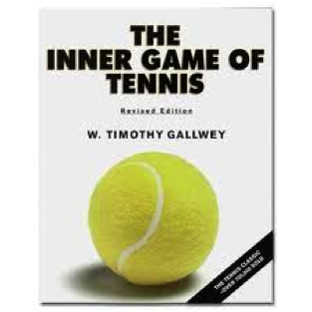
Why mindsets matter: The Inner Game
p = P - i
Notes:
Performance equals potential minus interference. One of our priorities as leaders should be to address and decrease interference. What constitutes interference? What interference does your team experience? The quickest way to increase performance is to decrease interference. Interference is often fueled by mindsets people possess.

Slide 13
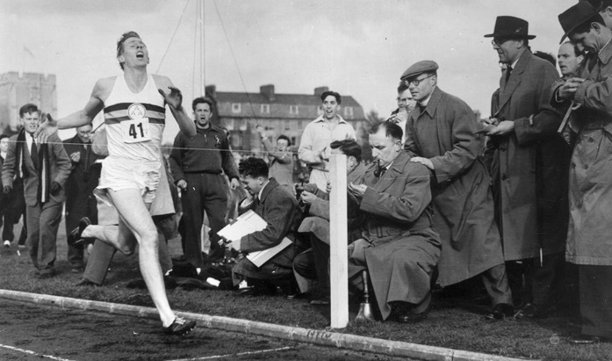
Who is this?
Notes:
Roger Bannister was the first to run a mile in less than 4 minutes. In the spring of 1954 he conquered the barrier of a 4 minute mile by recording a time of 3:59.4. People wondered if the 4 minute mile was impossible. There was this barrier. Before attending Oxford, Bannister hadn’t been a runner, but discovered he had a gift and within a month ran the mile in 4:24. In the 1952 Olympics, he placed 4th.
Getting passed the barrier wasn’t an individual accomplishment. It required a team. In fact, there were two people both named Chris who were pacesetters for Bannister. One of the remarkable facts about this feat? 45 days after Bannister broke the record by running a sub 4 minute mile, his record was broken. Today, high school kids can run a mile in less than 4 minutes. Bannister demonstrated it could be done. The mindset shifted.

Slide 14
Group behavior: The Elevator (video)
Notes:
Mindsets are contagious. Mindsets can inhibit progress.

Slide 15
How does a reset make a difference?
Who am I being?
How am I behaving?
Who am I becoming?

Slide 16
What is success?
“To laugh often and much; To win the respect of intelligent people and the affection of children; To earn the appreciation of honest critics and endure the betrayal of false friends; To appreciate beauty, to find the best in others; To leave the world a bit better, whether by a healthy child, a garden patch, or a redeemed social condition; To know even one life has breathed easier because you have lived. This is to have succeeded.”—Ralph Waldo Emerson

