Slide 1
DATE:
Logo
Breast and Colorectal Cancer Educational Webinar
Name, Title, Organization

Slide 2
Introduction
Purpose: increase breast and colorectal cancer knowledge and cancer screening rates among state employees.
Introductions
Pre-knowledge Survey

Slide 3
Overview of XX
Name of organization: Insert Mission Statement

Slide 4
Breast and Colorectal Cancer – Employees
Insert Graph of Employee Cancer Screening Rates

Slide 5
Why is important to be screened?
Catch cancers early
The earlier…the easier to treat…
Lowers risk of dying by cancer

Slide 6
Breast Cancer Screening Guidelines
Recommended Screening guidelines
Early detection is your best defense
Women aged 50-74 | A mammogram every 2 years
Women aged 40-49 | Talk to your health care professional about when to start and how often to get a mammogram
*Always talk to your physician for a risk assessment and at what age is appropriate for you based on family history and other factors.
*These are recommended ages for screenings and typically covered under preventative care, but please check with your insurance carrier to verify coverage.

Slide 7
Colorectal Cancer Screening Guidelines
Recommended Screening guidelines
Early detection is your best defense
Adults aged 45-75 (choose one option) | Colonoscopy every 10 years Fecal Immunochemical Test (stool test) every year Cologuard (stool test) every 3 years Other options include Flexible sigmoidoscopy every 5 years, CT Colonography every 5 years
Adults over 75 | Talk to a doctor about whether or not screening for colorectal cancer would be beneficial
Adults over 85 | Screening for colorectal cancer is not recommended
*Always talk to your physician for a risk assessment and at what age is appropriate for you based on family history and other factors.
*These are recommended ages for screenings and typically covered under preventative care, but please check with your insurance carrier to verify coverage.

Slide 8
Employee Cancer Screening Ambassadors
Insert pictures and quotes from employees who encourage cancer screenings

Slide 9
What to Expect with Cancer Screenings – Breast
Breast –
About 10 minutes total
2 pictures of each breast
Wear two-piece outfit (shirt and pants/skirt)
Expect pressure but not pain
Technologists are typically women and gown taken off for minimum amount of time

Slide 10
What to Expect with Cancer Screenings – Colorectal
Colorectal –
Easy at-home test
Takes 5 minutes or less
Need only a small sample of stool after a bowel movement

Slide 11
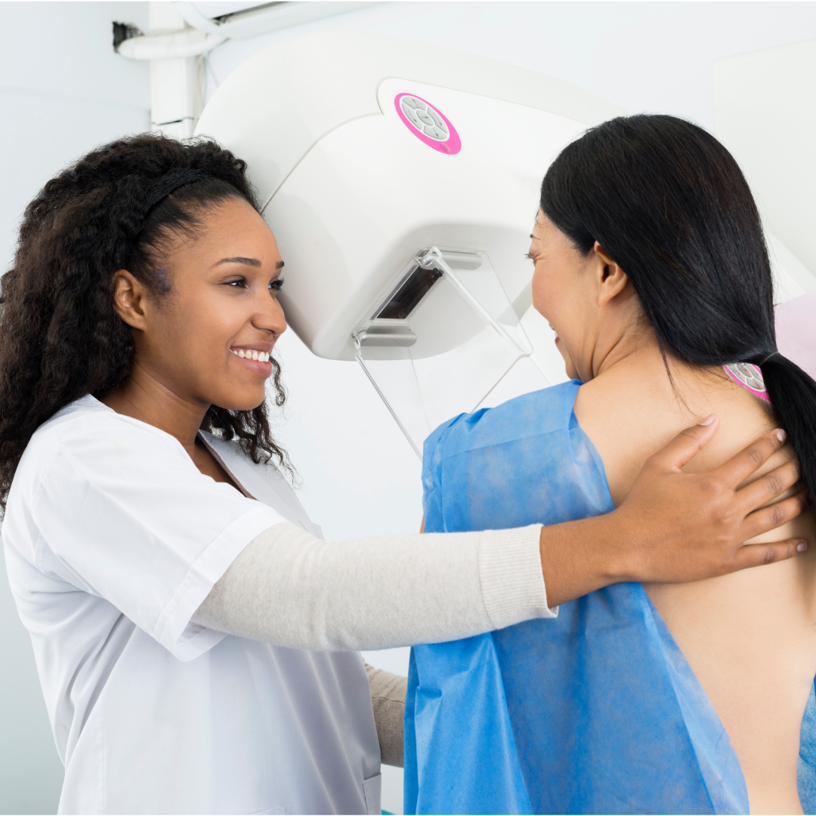
Cancer Screening Event:
Mammogram Van (Breast)
FIT KITS (Colon Cancer Stool Test)
Additional Cancer Screening Materials
Date: (insert)
Location: (insert)
For questions about the screening event please email (insert email) or for
more information visit (insert website)

Slide 12
Expected Outcomes
Increased Productivity
Health-care Cost Savings
Most importantly…
SAVING LIVES
Serving as a model for other organizations
Improving Health Behaviors
Increased Knowledge of Cancer
Less Employee Time Off Work (reduced sick leave)
Increased Awareness of the Importance of Cancer Screenings
Increased Screening Rates
Increased Knowledge of How to Access Care

Slide 13
Learn during a panel discussion with our experts
Insert pictures of speakers
Insert name, title, and organization of expert
Cancer Screening MamVan Registration – (insert link)

