Slide 1
Medication administration a Missouri guide for training unlicensed school staff
Adapted from:
North Dakota Department
of Health,
Division of
Healthy and Safe Communities
October 2023

Slide 2
These Guidelines have been reviewed by
Marjorie Cole, MSN, RN, FASHA, State School Nurse Consultant
Missouri Department of Health and Senior Services
Deb Funk, BSN RN, Director of Practice
Missouri State Board of Nursing
School Nurse Leaders:
Angela Anderson, BSN RN, NCSN
Natalie Botkin, BSN, RN, NCSN
Angie Bulmahn, MSN, RN,NCSN
Deb Cook, RN
Teri Hansen, BSN, RN, NCSN
Ardith Harmon, MSN, RN
Peggy Karleskint, BSN, RN
Katherine Park, MSN, RN, NCSN
Stacey Whitney, MSN, RN, NCSN

Slide 3
purpose
To provide guidance to aid in training non-licensed school personnel in medication administration.
A student’s safety when administering medications is always the MAIN priority.

Slide 4
objectives
Participants will have an understanding of the Missouri State Statutes regarding medication administration in schools.
Participants will be able to verbalize the standard precautions and rights of medication administration.
Participants will understand documentation needed to safely administer medications in school and record the delivery of these medications.
Participants will know best practices of storing, handling, and disposing of medications in the school setting.
Participants will understand responsibilities in assessment and monitoring students, and recognizing adverse reactions in medication response.
Participants will successfully complete a return demonstration of medication administration.

Slide 5
Medication in Schools: Missouri Statutes
Chapter 167 of Missouri Revisor of Statutes addresses students and special services
https://revisor.mo.gov/main/OneChapter.aspx?chapter=167

Slide 6
Missouri statutes
167.621. Authorization of parent or guardian, prerequisite — administration of medicine, first aid, immunity.
This statute establishes that persons providing health services under sections 167.600 to 167.621 shall obtain authorization from a parent or guardian of the child before providing services.
The statute further describes that no employee of any school district may be required to administer medication or medical services for which the employee is not qualified according to standard medical practices, and no unqualified employee who refuses to administer medication or medical services shall be subject to any disciplinary action for such refusal. Nothing herein shall be construed to prevent any employee from providing routine first aid, provided that any employee shall be held harmless and immune from any liability if such employee is following a proper procedure adopted by the local school board.
The statute continues to state that any qualified employee shall be held harmless and immune from any civil liability for administering medication or medical services in good faith and according to standard medical practices.

Slide 7
Missouri Statutes
167.627. Possession and self-administration of medication in school.
Addresses the authorization of students to have medications at school, either to self-carry the medication or maintain at school; and outlines criteria guiding school policy.
167.630. Epinephrine prefilled auto syringes.
Addresses the authorization for schools to have stock epinephrine auto syringes available. Allows for the use on any student the school nurse or trained employee believes is having a life-threatening anaphylactic reaction.
167.635. Asthma-related rescue medications.
Addresses the authorization for schools to have stock albuterol available. Allows for the use of asthma-related rescue medications on any student the school nurse or trained employee believes is having a life-threatening asthma episode.

Slide 8
Missouri Practice
School districts must establish policies and implement protocols that meet all legal requirements for administration of medication required during school hours. The procedures must be consistent with standards of medical, nursing, and pharmacy practice guidelines.

Slide 9
What does this mean?
School administrators are responsible for designating someone within the school to be trained in medication administration.
Education and training must be completed by the designated staff member.
Details regarding this training are not specific:
Who trains
What the training should include
How often the training is required
Schools cannot opt out of medication administration if:
Student is on an IEP (Individualized Educational Program)
Student has a 504 Health Care Plan
If a student has an IEP or 504 plan and receives federal funding, the school MUST comply with the plan and provide the means for medications to be administered

Slide 10
Training and Delegation: Missouri State board of nursing
https://pr.mo.gov/nursing.asp
The Missouri State Board of Nursing recognizes that unlicensed health care personnel may be employed in school health offices. Registered professional nurses (RN) may teach, delegate, and supervise licensed practical nurses (LPN) and unlicensed health care personnel in the performance of certain nursing care tasks. Under RN supervision, LPNs may teach, delegate, and supervise unlicensed health care personnel in the performance of specific nursing care tasks.
RNs and LPNs must make reasonable and prudent judgments regarding the appropriateness of delegating selected nursing care tasks to unlicensed health care workers. Licensed nurses must ensure that unlicensed health care personnel have documented and demonstrated evidence of appropriate training, skills, and experience to accomplish the task safely. Carrying out responsible and accountable supervisory behavior after specific nursing care tasks are delegated to unlicensed health care personnel is the responsibility of the licensed nurse.

Slide 11
Delegation
National Council of State Boards of Nursing identifies
Five Rights of Delegation:
Right Task
Right Person
Right Direction and Communication
Right Circumstances
Right Supervision
Was the delegation appropriate?
Was the education/training and evaluation process documented?
Are there policies for this task in your school district?

Slide 12
First things first…
If a medication can be given at home and not brought into the school at all, this is ideal.
For example, medications prescribed to be taken three times a day (TID) could be given at home before school, after school, and in late evening/bedtime.
Discuss options with parents before making the decision to store and administer a medication in school.
Home before school if possible!
(We know this isn’t always possible.)

Slide 13
Medications in school
Prescription (ordered by a health care provider…MD, dentist, nurse practitioner, physician assistant)
ADHD meds: most are a controlled substance (oral, transdermal patch)
Antibiotics (oral, ear drops, eye drops)
Anti-seizure meds (oral, nasal, rectal-Diastat™)
Diabetic meds: insulin, Glucagon® (injections)
Asthma meds (inhaled, oral)
EpiPen® (auto injector)
Others
OTC (over the counter) medications
Acetaminophen (Tylenol®)
Ibuprofen (Advil®, Motrin®, etc.)
Cetirizine (Zyrtec®)
Diphenhydramine (Benadryl®)
Others
Some schools choose not to administer OTC meds
Your school district should have a written policy on medication administration. Be familiar with that policy, as each district may be a little different.
All prescription medications require a health care provider’s order. Check your district policy.

Slide 14
Bringing meds into school
Medications must be brought in by parents/guardians. Students cannot have the responsibility of bringing a medication to school.
First, determine…
Option 1: Is this a medication that is to be stored in a locked cabinet (office or nurse’s office) that staff need to help administer?
Option 2: Is this a medication that the student carries and self-administers?
Examples: Inhaler for asthmatic reactions, epinephrine for severe allergic reactions, and others.
Providers will often write a note stating child should have their rescue inhaler or Epipen® with them.
This should also be part of the student’s emergency action plan.
Self-carry meds are generally those used in life-threatening situations where the student needs immediate access to them!

Slide 15
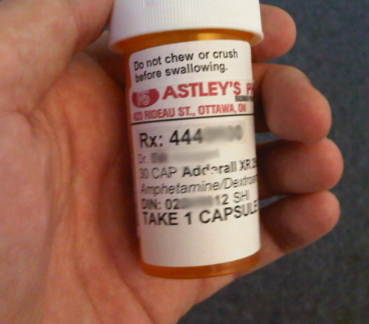
Documentation and Paperwork
When receiving medication, make sure proper paperwork is completed.
Medication Administration Consent Form
Name of medication (as it appears on the medication
bottle/container) and strength
Dose
Route
When to give
What the medication is to be given for
Parent’s signature
Special instructions…i.e. please call parent before administering medication
Physician order—the prescription label is considered the physician order for all prescription medications
For OTC medications (check district’s policy)…especially if “off-label” or different dose than recommended
Notes:
Change statement to say not to exceed PDR??

Slide 17
Know your District policies and protocols for managing medications

Slide 18
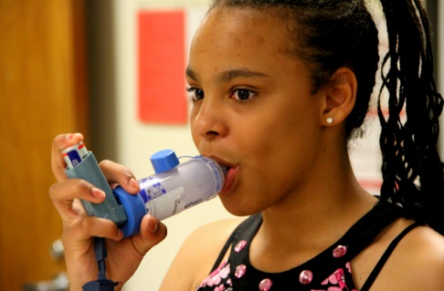
Forms and Documentation
Self-Carry/Self-Administer Consent Form
Signed by parent
Signed by student (some schools require this)
Medication Administration Log
Each medication should have its own form; if a student is on two medications, that student should have two log forms.
All paperwork must match medication label. If the paperwork does not match, you will need to redo it and get the appropriate signatures again.
Any changes in dose or medication require a new written order.
Each school district usually has forms that they have developed and implemented. If your district does not have something in place, develop forms that work best for you.

Slide 19
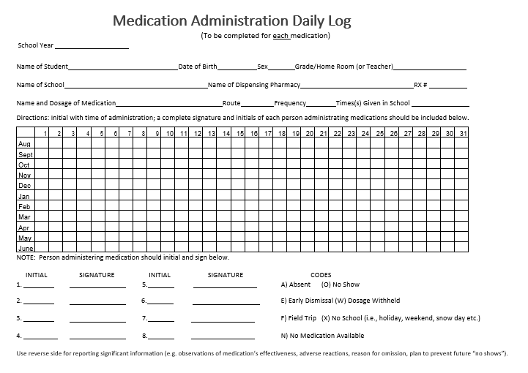
Notes:
Insert new form

Slide 20
How to read a prescription (rx) label

Slide 21
Medications
Medication must be in the original container whether it’s prescribed or OTC.
Do not accept medications in plastic bags, spice bottles, or other containers.
Why? You need to be sure the medication is really what they say it is. You need to know the lot number, expiration date, and strength.
Document the quantity brought in.
Count and document the quantity of the medication or if an unopened bottle, take note of the quantity in the bottle. For liquids, document how many mL’s are present when brought in.
Controlled substances should be counted, logged (both in and out), and recounted regularly per your district policy and protocols to make sure there is no drug diversion.
Drug diversion is when legal drugs are used for illicit purposes. Basically,
the medication is being used in an illegal manner.
It is not uncommon for people to steal medications, especially controlled substances. You need to keep tight control of these types of medications!

Slide 22
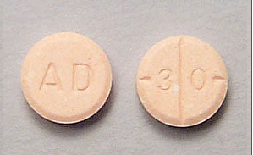
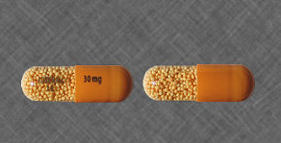
What is a controlled substance?
Definition: a controlled substance is a drug or other substance that comes under the jurisdiction of the Federal Controlled Substances Act of 1970. Narcotics, depressants, stimulants, hallucinogens and anabolic steroids are regulated by the Controlled Substances Act (CSA) and are listed in one of five schedules
https://health.mo.gov/safety/bndd/doc/practitionersguidelines.doc
Adderall 30 mg
Adderall XR 30 mg
Ritalin 10 mg

Slide 23
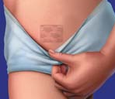
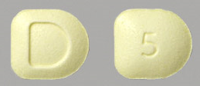
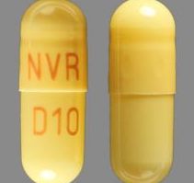
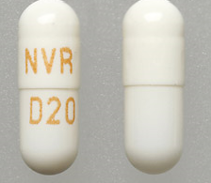
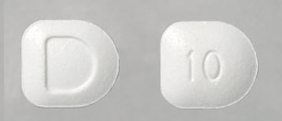
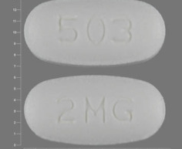
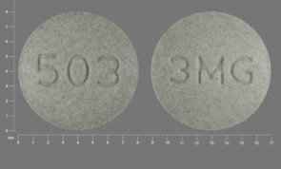
Controlled substances in schools
Ritalin 20 mg
Daytrana Patch
Focalin 5 mg
Focalin XR 10 mg
Focalin XR 20 mg
Focalin 10 mg
Intuniv 2 mg
Intuniv 3 mg
All medication pictures from www.drugs.com.

Slide 24
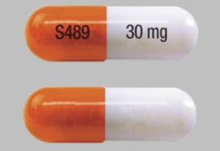
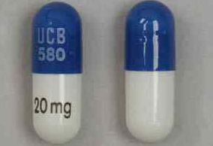
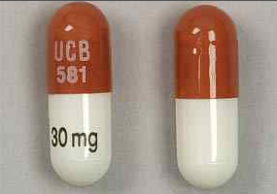
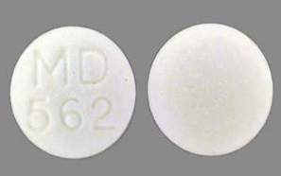
Controlled substances in schools
Vyvanse 50 mg
Vyvanse 30 mg
Metadate CD 20 mg
CD=controlled delivery
CR=controlled release
ER=extended release
LA=long acting
SR=sustained release
TR=time release
XR=extended release
XL=extended release
https://www.riverprofessionalgroup.com/faq/what-do-the-acryonyms-cd-cr-la-sr-tr-xl-and-xr-stand-for
Metadate CD 30 mg
Metadate ER 20 mg
All medication pictures from www.drugs.com.

Slide 25
Medication storage
Locked cabinet
Locked office/room
Organized
Many different ways to do this….use what works best for you
Alphabetical
Time of day meds are given
Oral medications separated from topical medications
Clean
Away from light/sun
Better organization lessens chance for mistakes
Refrigerators
Medications in fridges—insulin, certain antibiotics
Designated medication fridge (no personal food/drinks)
Generally store between 36º - 46º Fahrenheit
Colder or warmer temps can change medication’s effectiveness
Double locking is best practice

Slide 26
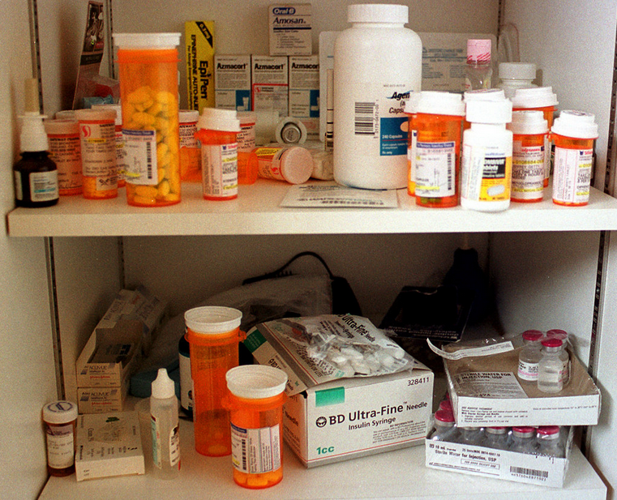
Medication storage cont.
All medications (both prescription and OTC) should have the student’s name on them.
You will need to hand write this on the bottle for OTC medications.
SHOULD BE:
Organized, clean, and easy to read
Labeled with student’s name
Messy, mixed together

Slide 27
Before giving a medication
Medications are serious business…even OTC ones.
Before giving any medication, know and follow the 6 RIGHTS of medication administration.
Right person (student)
Right medication
Right dose
Right route (oral, ear drops, topical, etc.)
Right time (this does make a difference)
Right documentation (after med is administered)
Always verify the correct student prior to giving a medication.
Picture of student attached to paperwork or bottle is especially helpful for a sub nurse.
If something doesn’t seem right, or you have questions, do not give the medication!! Call the nurse, doctor, parent, or pharmacy!

Slide 28
Infection control
Prior to giving a medication, follow these steps:
Wash hands thoroughly with soap and water or use alcohol-based hand foam or gel.
If using alcohol-based hand sanitizer, be sure to let hands dry completely before doing anything else.
Wear disposable gloves if necessary.
If risk of coming in contact with blood or other bodily fluids.
If you have any open sores or cuts on your hand.
If you will be touching a transdermal patch as medication is absorbed through the skin.
Do not use latex gloves as some people have latex allergies. There are many vinyl glove options.

Slide 29
setting
Medication administration should be conducted in a quiet, private place.
Privacy of student
No distractions

Slide 30
Be familiar…
Always be familiar with the medication you are administering:
Read package insert. You can also find detailed information on http://www.nlm.nih.gov/medlineplus/druginformation.html or www.drugs.com.
Speak with parent(s)/guardian(s) about previous experience with the medication. How has the child reacted at home?
Know the side effects and what serious adverse reactions to watch for.
Adverse drug reactions:
Harmful, unintended reactions to medicines that occur at doses normally used for
(World Health Organization, https://www.who.int/docs/default-source/medicines/safety-of-medicines--adverse-drug-reactions-jun18.pdf?sfvrsn=4fcaf40_2)
School staff CAN become an Unlicensed Assistive Person (UAP) and administer parenteral meds under the direct supervision of a nurse.

Slide 31
Oral medications
By mouth: swallowed, chewed, or dissolved under tongue.
Sometimes you have to check student’s mouth to make sure they are not hiding their medication (cheeking).
Absorption: from stomach or intestine to bloodstream and then to other parts of the body.
Different oral medications absorb at different rates/speeds.
Type: liquid or tablet
Taken with food or on an empty stomach
Special coatings
Taken at the same time as other medications
Doctors and pharmacists will specify the way medication should be taken.
Do NOT crush, break, or chew any capsule or tablet before swallowing unless directed to do so by a doctor, pharmacist, or per package insert.
If unsure, ASK!
If student has trouble swallowing a pill, talk with the doctor or pharmacist for other options.

Slide 32
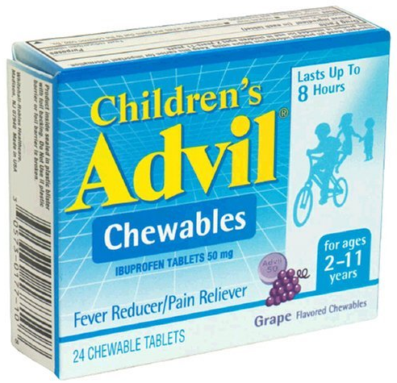
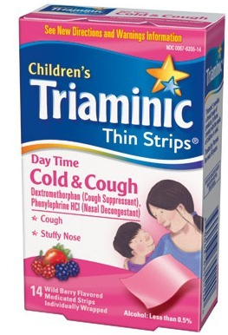
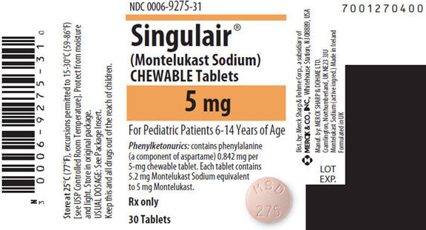
Tablets & Capsules
Most oral tablets and capsules should be taken with water.
Rule of thumb: give with water unless otherwise directed.
Chewable tablets should be chewed until they are dissolved completely. They are not meant to be swallowed.
Some “soft chew” medications are meant to melt in your mouth or be chewed.

Slide 33
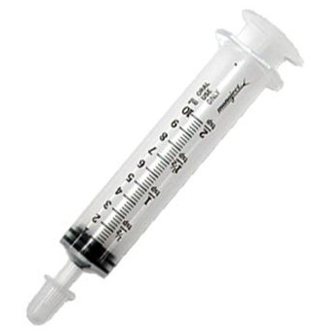
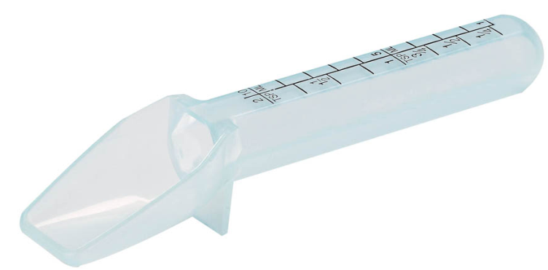
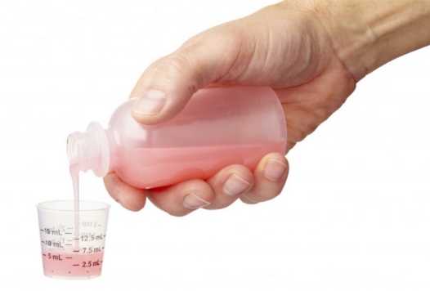
Liquid medications
Only use measuring devices made for medications.
Household teaspoons are not an accurate method to measure meds.
Shake bottle if indicated as some medications settle to the bottom.
Measure at eye level.
Place on flat surface and crouch down so eye level with the measuring device.

Slide 34
Know your conversions
Be sure you know the correct dose. Don’t guess!

Slide 35
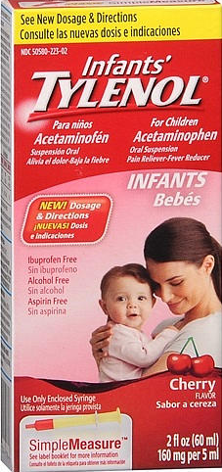
Know difference in strengths
The same medication can come in different strengths. For example, let’s look at Tylenol…
160 mg per 5 mL

Slide 36
strength
80 mg per tablet

Slide 37
strength
325 mg per tablet

Slide 38
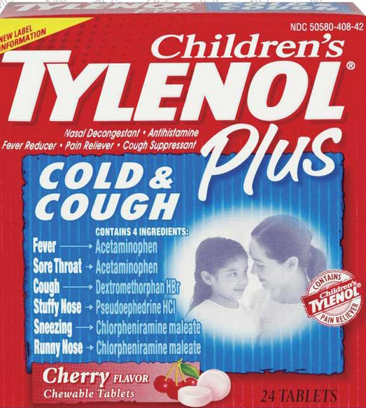
strength
Many cold medicines have acetaminophen (Tylenol®) in them also. Be careful not to double up.
Giving regular Tylenol® along
with Tylenol® cold medicine
could lead to an overdose!
This is why it is a good idea to speak with parents before giving a PRN (as needed) medication…to make sure nothing was given at home earlier in the morning.

Slide 39
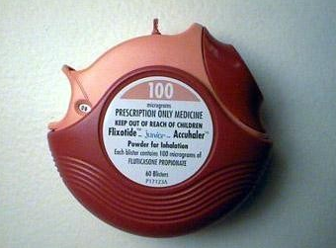
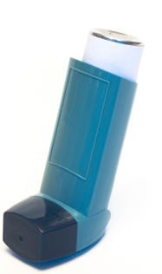
Inhaled medications
Inhaled medications are generally those used to treat asthma.
Inhalers:
Dry Powder Inhaler
Metered Dose Inhaler with Spacer
Metered Dose Inhaler

Slide 40
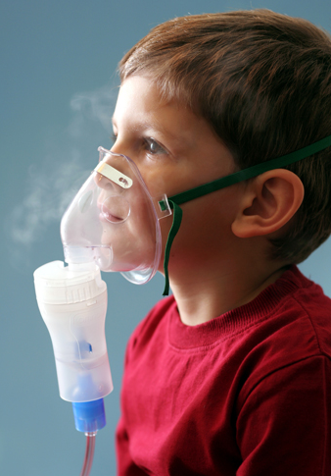
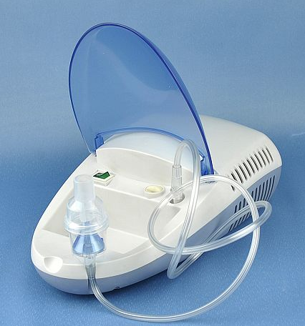
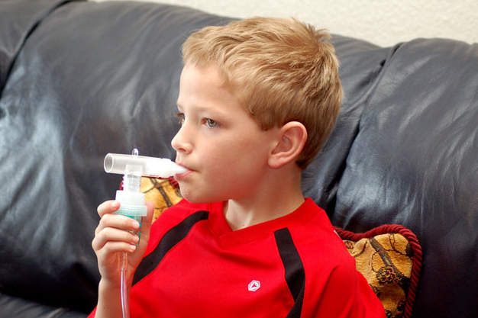
Inhaled medications
Nebulizers:
Mask
Nebulizer
Machine
Mouthpiece

Slide 41
Metered dose inhaler with Spacer
If you have trouble getting the video to play, copy and paste
this link in your internet browser:
https://showmeschoolhealth.org/resources/inhaler-with-spacer/

Slide 42
Dry Powder inhaler
If you have trouble getting the video to play, copy and paste this link in your internet browser:
https://www.youtube.com/watch?v=_Sc7j9iW9TM

Slide 43
Nebulizer with mouthpiece
For more resources on this topic:
https://showmeschoolhealth.org/resources/nebulizer/

Slide 44
Nebulizer with mask
If you have trouble getting the video to play, copy and paste this link in your internet browser:
https://www.youtube.com/watch?v=9ezTnY00rI4

Slide 45
Ear drops
Warm medication to room temperature.
Fill dropper with prescribed amount.
Turn student’s head so that affected side is uppermost.
Straighten auditory canal.
a. Infant - pull down and back on earlobe.
b. Children/adults - pull up and back.
Rest dominant hand on student’s head to stabilize area.
Administer medication toward walls of canal rather than directly into eardrum.
Unless instructed otherwise, insert a small piece of cotton loosely into external canal.
If possible, allow student to keep affected ear uppermost for 10-15 minutes to retain solution.

Slide 46
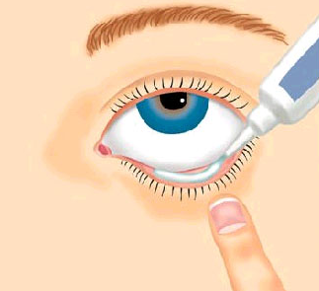
eye medications
Eye Ointment
Student should be sitting or lying flat, head tilted back slightly.
Remove any secretions, wiping from inner to outer canthus with sterile gauze pad or cotton ball.
Instruct student to look up as you instill medication to reduce chance of stimulating corneal reflex.
Expose lower conjunctival sac by gentle traction on area distal to center of eye to form a pocket.
Gently squeeze a 1-2 cm strip of ointment along the lower conjunctival border moving from the inner canthus outward.
Release lower lid and instruct student to close the eyelid and move the eye around to distribute ointment.
Remove excess ointment by gently wiping from inner canthus outward with sterile gauze or cotton.

Slide 47
eye medications
Eye Drops
Same as ointment, but drop medication into center of lower conjunctival sac.
Instruct student to close eyelid and move eye while you apply pressure to inner canthus to minimize possible systemic absorption via tear ducts.

Slide 48
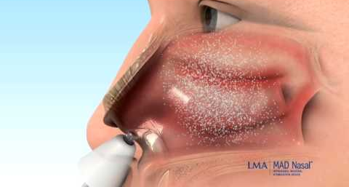
Intranasal medication
Intranasal
Instruct student to gently blow nose.
Position student lying down. May use small pillow or rolled towel under shoulders.
Press gently on tip of nose to open nares.
Insert dropper just inside nostril and instill the prescribed amount of medication.
Encourage student to remain in this position for a few minutes to allow time for medication to drain through nasal passage.
Student may wish to expectorate solution that drains into nose and mouth.

Slide 49
Remember…
THE 6 RIGHTS…
RIGHT STUDENT (PERSON)
RIGHT MEDICATION
RIGHT DOSE
RIGHT ROUTE
RIGHT TIME
RIGHT DOCUMENTATION

Slide 50
Emergency situations
Sometimes, medications that are not normally given by non-licensed personnel, need to be given. Examples…
Diabetic hypoglycemia—low blood sugar (Glucagon, injection)
Signs and symptoms; must have emergency care plan
Anaphylactic reaction—severe allergic reaction (EpiPen®, injection)
Signs and symptoms; must have emergency care plan
Non-stop seizures—acute repetitive seizures (Diastat®, rectal)
Signs and symptoms; must have emergency care plan
Acute severe asthma—respiratory emergency (albuterol)
Signs and symptoms; must have emergency care plan
Opioid overdose--respiratory emergency, unconscious (Narcan®, nasal)
These are all emergency situations and the administration of these medications can and will save lives!
Do or Die

Slide 51
emergency medications
Examples
Albuterol for asthma
Epinephrine for anaphylaxis
Diastat®, midazolam for seizure
Glucagon®, Basqimi®, G-Voke® for hypoglycemia
Narcan® for opioid overdose
Emergency action plan must be in place.
Emergency procedures need to be in place.
School staff should be trained.
Nurses can provide training; NOT considered delegation.

Slide 52
epipen®
Epinephrine—used for anaphylactic reaction.
How to administer an EpiPen®.
Automatic 911 call.
Give medication first and then call 911 if you are by yourself.
For more resources:
https://showmeschoolhealth.org/resources/epipen-administration/

Slide 53
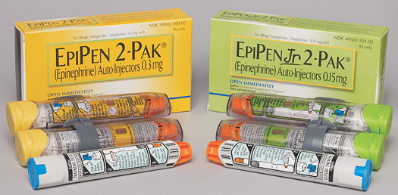
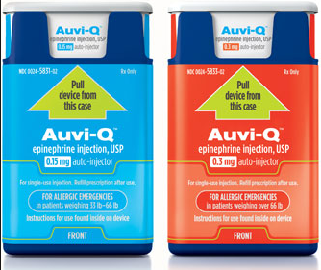
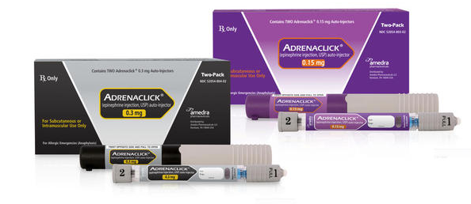

Slide 54
Auvi-q®
Epinephrine—used for anaphylactic reaction.
Automatic 911 call.
Give medication first and then call 911 if you are by yourself
(find Auvi-Q administration at 3:44 in the video)
For more resources:
https://showmeschoolhealth.org/resources/auvi-q-administration/

Slide 55
adrenaclick®
Epinephrine—used for anaphylactic reaction.
Automatic 911 call.
Give medication first, and then call 911 if you are by yourself
(find Adrenaclick administration at 3:44 in video)
For more resources:
https://showmeschoolhealth.org/resources/adrenaclick-administration/

Slide 56
Glucagon® via injection
Peptide (hormone)—used for severe hypoglycemia.
How to administer Glucagon®
Automatic 911 call.
Give medication first and then call 911 if you are by yourself
For more resources:
https://showmeschoolhealth.org/resources/administration-of-glucagon-via-injection/

Slide 57
baqsimi®
Peptide (hormone)—used for severe hypoglycemia.
How to administer Basqimi®.
Automatic 911 call.
Give medication first and then call 911 if you are by yourself
For more resources:
https://showmeschoolhealth.org/resources/nasal-administration-of-glucagon/

Slide 58
Gvoke HypoPen®
Gvoke HypoPen™ is an auto-injector for very low blood sugar. It stores at room temperature, is premixed and ready-to-go.
For more resources:
https://showmeschoolhealth.org/resources/gvoke-administration/

Slide 59
diastat™ (rectal Diazepam)
Diazepam rectal gel—used for acute repetitive seizures.
Automatic 911 call.
Give medication first and then call 911 if you are by yourself
For more resources:
https://showmeschoolhealth.org/resources/administration-of-rectal-diastat/

Slide 60
ValtoCO® (NASAL DIAZEPAM)
Valtoco – used for acute repetitive seizures
Automatic 911 call.
Give medication first according to Emergency Care Plan and then call 911 if you are by yourself
For more resources:
https://www.valtoco.com/how-to-use
https://showmeschoolhealth.org/resources/administration-of-rectal-diastat/

Slide 61
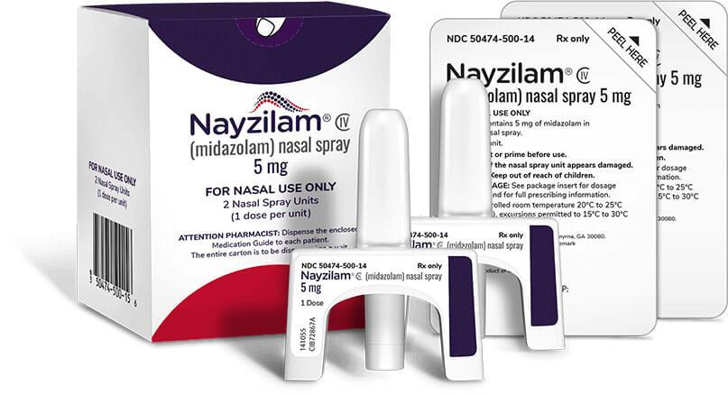
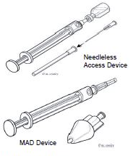
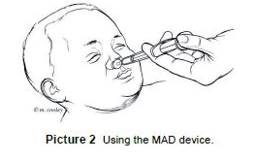
Nayzilam (nasal midazolam)
Intranasal midazolam to stop seizures may be administered from a single-use prefilled device (Nayzilam®) or may use a vial and mucosal atomization device with a syringe. OR
Be familiar with the medication delivery devices.
Store all supplies in one place for easy access in an emergency.
Follow the student emergency action plan.
https://showmeschoolhealth.org/resources/administration-of-ready-to-use-intranasal-seizure-medication/
https://showmeschoolhealth.org/resources/administration-of-intranasal-seizure-medication-using-atomizer/

Slide 62
Narcan®
Opioid overdose—follow your school district’s protocol.
Narcan® (naloxone) is an opioid antagonist used for the complete or partial reversal of opioid overdose, including respiratory depression.
HOW TO USE NARCAN® NASAL SPRAY:
Gently insert the nozzle into one nostril until your fingers on either side of the nozzle are against the bottom of the person's nose.
Once in place, press the plunger firmly to spray the entire dose of Narcan into one nostril. There is no need to spray into both nostrils.

Slide 63
Narcan® Resources
What is Narcan: https://www.narcan.com/#section-why-choose
338.205 RSMo. Opioid antagonist, storage and dispensing of without a license.
Naloxone Toolkit: https://health.mo.gov/living/families/schoolhealth/pdf/naloxone-toolkit.pdf
Naloxone Administration Handout: https://health.mo.gov/living/families/schoolhealth/pdf/naloxone-admin.pdf
How to use Narcan (video): https://vimeo.com/151191919
Have policy in place and follow it!

Slide 64
Medication errors
There are many different types of medication errors.
Giving too much medication (overdose)
Giving too little medication (under dosing)
Giving the wrong medication
Incorrect route
Incorrect time
Incorrect patient
Missed dose
If a student doesn’t show up to get their medication, you need to track him/her down and administer the medication. It is not ok to just not give it.
If a medication error occurs, you must contact the parent/guardian immediately. You may also need to contact the doctor, pharmacy, or in some cases, poison control.

Slide 65
Poison control

Slide 66
Medication error report form
When a medication error occurs, a medication error report form or variance report should be completed.
Examines how this error occurred and what could have been done or can be done in the future to prevent it.
Documents what the error was, who was notified, if there were adverse effects on the student, etc.
It can be very difficult to admit that you made a mistake. When it comes to medication, you have no choice but to notify the correct people…parent, doctor, pharmacist, school administrator, etc. There can be serious adverse reactions and those need to be addressed.

Slide 67
*Sample school policy dictates notifications and records management.
Complete in ink as it is a legal record. Do not use white out, correction tape, eraser, etc. to correct recording errors. Draw a single line through the error, record the correct information, and initial the corrected entry.

Slide 68
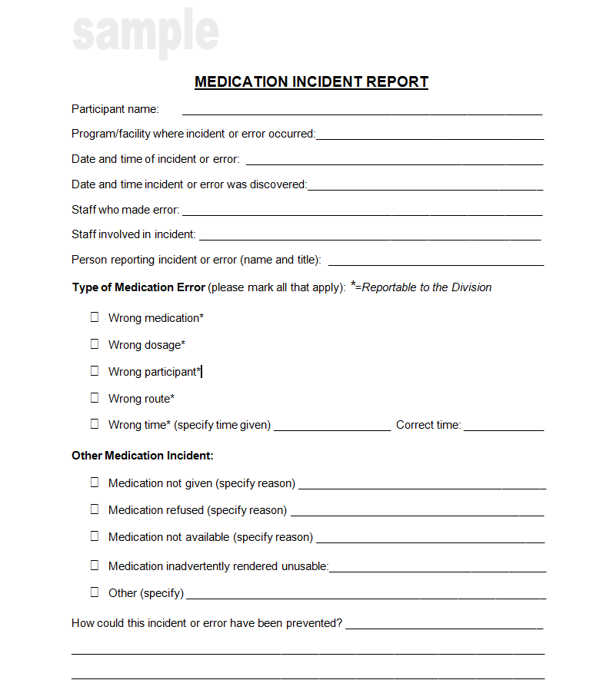
This sample form has check boxes to choose the type of error.

Slide 69
Do’s and don’ts
DON’T…
Give a student somebody else’s medication
Skip a dose
Crush or break pills unless instructed to by a medical provider/pharmacist
Change the dose or timing
Give medication that is not in original package, bottle, or container
DO…
Know the medication you are giving
Give the medication exactly how it’s prescribed
Have a written order from a medical provider
Follow the 6 Rights
Use two student identifiers
Monitor expiration dates
Lock medication storage
Give in private, non-distracting setting

Slide 70
documentation
Factual information, no opinions.
Never white out, scribble over, cover up, or erase what has already been written.
If error in documentation, draw single line through incorrect information and initial.
Don’t use abbreviations.
Write legibly so it is easy to read.
Black or blue ink is best, if handwritten. No pencil.
Computerized: nothing that has been a part of the student’s medical file should ever be deleted.
RULE OF THUMB…
IF IT’S NOT DOCUMENTED, IT’S NOT DONE!

Slide 71
Privacy acts
Family Education and Privacy Rights Act of 1974.
FERPA: http://www2.ed.gov/policy/gen/guid/fpco/ferpa/index.html
Health Insurance Portability and Accountability Act of 1996.
HIPAA: https://aspe.hhs.gov/reports/health-insurance-portability-accountability-act-1996
Comparison Infographic: https://www.cdc.gov/phlp/docs/hipaa-ferpa-infographic-508.pdf
Health information should only be shared for purposes such as continuation of care, to protect the health or safety of the student, emergency situations, etc.
NEED TO KNOW BASIS

Slide 72
Returning Medications Home
ALL medications must be picked up by the parent/guardian at the end of the year.
Do not send meds home with the student
Proper notice about medication pick-up procedures should be given
Any medications not picked up should be destroyed or taken to an appropriate disposal place
Utilize drug take-back programs (many times these are conducted by local law enforcement in conjunction with U.S. Drug Enforcement Administration or a local pharmacy)

Slide 73
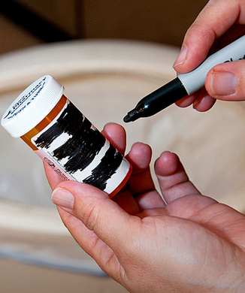
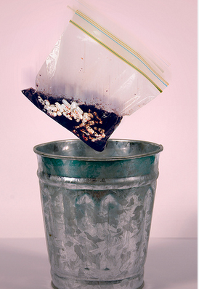
Drug disposal
See the U.S. Food and Drug Administration (FDA) website for further details on drug disposal.
http://www.fda.gov/ForConsumers/ConsumerUpdates/ucm101653.htm#guidelines
Check prescription drug label to see if there are specific disposal instructions.
Otherwise, follow these instructions:
Do Not flush meds down the sink or toilet unless you are specifically instructed to do so
Remove med from original container and mix with an undesirable substance…e.g. coffee grounds, kitty litter
Place mixture in a sealable bag, container, or can and throw in garbage
Make sure any personal information is not visible on the prescription bottle and throw in garbage

Slide 74
Questions?
Contact your district’s school nurse.
Contact your local public health department.
Contact the Missouri School Health Program:
MISSOURI DEPARTMENT OF HEALTH AND SENIOR SERVICES
Division of Community and Public Health
Bureau of Community Health and Wellness
PO Box 570
Jefferson City, MO 65102-0570
Phone: 573-522-2822
Email: SHS@health.mo.gov

Slide 75
Post Test
A student brings a baggie of Tylenol® to the school secretary stating that his mom said to drop it off at the office because he has been struggling with headaches. Mom told him if he needs it throughout the day, the secretary can administer it. What is incorrect about this scenario?
Student brought medication in. Medications should always be brought in by parent or guardian.
Medication was not in original container.
Parent did not sign a medication administration consent form.

Slide 76
Post test
A guardian brings in a prescription bottle of Metadate ER 20 mg. All appropriate paperwork, including a written order, was completed. The guardian states that the child has trouble swallowing the pill and it should be crushed and mixed with pudding so that the student can swallow the medication better. What is incorrect about this scenario?
ER means extended release and these types of pills should never be crushed (unless ordered by a medical provider or pharmacist). By crushing the pill, it will disrupt the timing that the medication is supposed to be released throughout the body.

Slide 77
Post test
A student presents to the school office at 10 a.m. complaining of a bad headache. The school principal, who is the trained medication administration staff member, looks and sees that the student does have ibuprofen and all of the completed paperwork for this medication. The parent signed the consent form and the student is to receive one tablet or 200 mg. The principal gives the student the ibuprofen tablet after confirming it was the correct student, medication, and dose. What is incorrect about this scenario?
The principal did not call the parent or guardian to determine if the student had received any medications earlier in the day. By failing to do this, there is potential that the student could be getting too much ibuprofen (overdose).

Slide 78
Post test
A fourth grade boy with ADHD has run out of his Intuniv. The school secretary has contacted his dad and dad is in process of getting a prescription refill, but it won’t be ready until the next day. In the meantime, the boy is really struggling and so is his teacher. There is another student who takes Intuniv and has plenty of medication at school. The secretary decides she can borrow one days worth of Intuniv from this other student and re-pay him as soon as the boy gets his new prescription. That way the boy and the teacher will have a better day. What is incorrect about this scenario?
The secretary gave the student another student’s medication. You can NEVER give somebody else’s medication to a student.

Slide 79
Post test
A student, who is severely allergic to bee stings, was stung while at recess. The school nurse is not at that school that day so the student is brought to the office. There is an emergency action plan for the student. It states that an EpiPen Jr. is available and should be administered immediately if the student is stung…even if there aren’t any immediate symptoms. But, the secretary remembers that she is not supposed to give injections. Should she give the EpiPen Jr.?
YES!! This is one of those emergency situations and an exception for administering parenteral (injectable) medications. The secretary SHOULD administer the epinephrine then call 911 immediately.

Slide 80
Post test
A parent brings in some regular strength Tylenol® for her 9 year old daughter. She completes the appropriate paperwork with the school secretary. According to the label on the Tylenol®, the correct dose for the girl is one tablet or 325 mg. Mom states that she always gives her daughter two tablets or 650 mg because that works better for her. Can you give the girl the 650 mg (two tablets)?
NO, you cannot administer medication off label. This means not following the recommended directions. If mom insists on two tablets, she will have to administer the medication or you will have to get a written order from the girl’s healthcare provider stating that that dose is appropriate. You cannot administer the increased dose until the written order from the health care provider is returned.

Slide 81
Post test
The school nurse suddenly got the stomach flu and had to leave for the day. A diabetic student is just finishing lunch and needs her insulin. The school secretary has been trained in medication administration. Can she give the insulin?
Depends on the DMMP plan.
Depends on who is trained at the school.

Slide 82
Post test
A student is scheduled to come to the office for his ADHD medication, Ritalin®, at lunchtime. He doesn’t show up so the trained medication administration staff member thinks to himself, “I guess missing one day won’t hurt, I will make sure he gets his dose tomorrow.” Is this ok?
No, it is not ok to let a student skip their medication dose. The student will need to be tracked down so that he can receive his medication.

Slide 83
Post test
A student is on Keppra, a seizure medication, for epilepsy. The student has a medical care plan, the medication, and all of the appropriate paperwork for that medication in the front office. The student is to get 125 mg in the morning and 125 mg in the afternoon for a total of 250 mg per day. The trained medication administration staff member realizes that today she accidentally gave 250 mg each time, so 500 mg for the day. What should she do?
Admit the mistake right away.
Call the parent immediately.
Call the medical provider (who prescribed the medication) or pharmacist to get instructions as to what needs to be done.
Complete a medication error form and document everything that happened.

Slide 84
Post test
A student is in the front office to receive his Metadate from the school secretary. There are two other students sitting by the principals office, a parent waiting to talk to the secretary, and a custodian fixing a burned out lightbulb in the same area. The meds are stored in the vault. The secretary unlocks the vault and the student is handed a medicine cup with his medication. Suddenly, a teacher yells down the hall asking the secretary for help. She takes off down the hall to help the teacher. What is wrong with this scenario?
Busy area—medication administration should be in a quiet, non-distracting environment.
This area does not provide privacy for the student who is taking the med.
Other students, parents, and staff could see exactly where the medications are stored.
The secretary ran off without locking the vault again. Other people now have access to the medications.
The secretary didn’t observe the student taking his medication. Did he really take it? Did he pocket it? Did he give it to another student?

Slide 85
