Slide 1
Unit 5:
Injection Exercise

Slide 2
Vaccination Station
Know your supplies
Sharps Containers
No obstacles between a dirty needle and the sharps container
Clients can not reach syringes or medication/vaccines
Be cognizant of waste disposal (both biohazard and regular waste)
Have cotton balls, gauze ready
Notes:
Review slide and supplies that will be utilized during the group exercise. Have attendees place all items in front of them to assure they have all necessary supplies. DO NOT OPEN ANY PACKAGING until they are ready to give repeat demonstration to trainer.

Slide 3
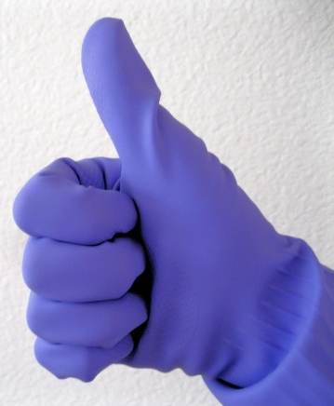
What items do I need to give an injection?
Two Alcohol Wipes
Disposable gloves
One Cotton Ball
One Band-Aid
New needle and syringe make sure to pick proper size)
Notes:
Emphasize one needle, one patient, one time ONLY – discard used needle and syringe in the Sharps container.

Slide 4
Select the Correct Needle Size
Notes:
Immunize.org HANDOUT 1M
Emphasize one needle, one patient, one time ONLY – discard in Sharps container
Review slide
These needle size options may not be available in the SNS inventory.

Slide 5
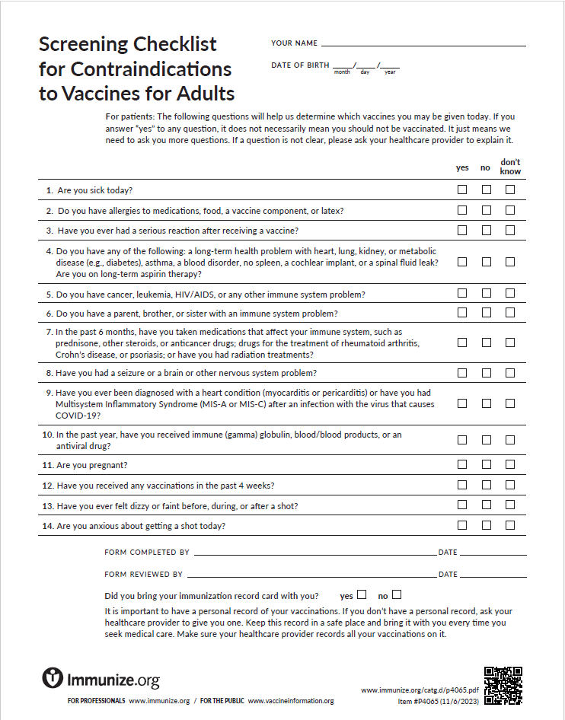
Patient Screening
Ask if the patient has:
Allergies
Medical Conditions
Pregnancy
Previous Vaccines
Illness
Notes:
Vaccine screening – this is an example of general adult screening questions for immunizations. You may receive specific vaccination screening guidance for vaccine administration at the time of the event.
Common screening questions include:
Allergies to vaccine components (i.e., prior anaphylaxis to any component in the vaccine)
Medical Conditions (i.e., pregnancy, immunocompromised)
Previous Vaccines (i.e., Intervals: anthrax is a series, where are they in the series?)
Illness (fever of 101 F or greater)
Handout 2M

Slide 6
Patient Education
Vaccine Information Statements (VIS) are required by US Law
They are provided for patient education
Notes:
HANDOUT 14 Review components of what is important patient education information is available in each VIS as standardized.
All VISs have the same standardized order:
1) Why get the vaccine
2) Vaccine specific information
3) Who should NOT get the vaccine
4) Risk of vaccine reaction
5) What if there is a serious problem
6) Injury Compensation Program – Anthrax – Counter Measures Injury Compensation vs. Flu - National Vaccine Injury Program
7) How to Learn More
HANDOUT 15 anthrax VIS
HANDOUTS 16 and 17 for influenza live and inactivated
Vaccine information statement: Immunize.org, www.cdc.gov/vaccines/hcp/vis/about/facts-vis.html.

Slide 7
Vaccine Contraindications
Previous, life-threatening, reaction
Minimum interval between vaccines
Severe illness
Notes:
Immunize.org HANDOUT 2m
Vaccine contraindications and precautions should be included in any standing orders to vaccinate.
Review most commonly encountered contraindications and precautions related to attendees – i.e., Tdap/Td for emergency responders, anthrax, influenza include VIS information
In the Resources, the following have been included for your review:
“Medical Management of Vaccine Reactions in Adults”
“Medical Management of Vaccine Reactions in Children and Teens”

Slide 8
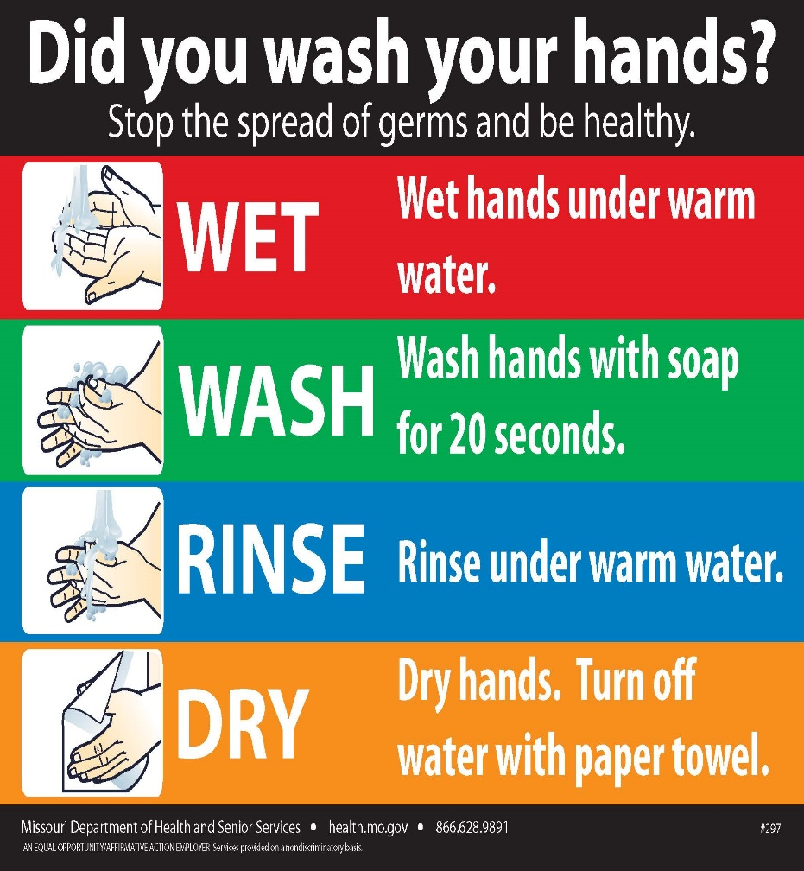
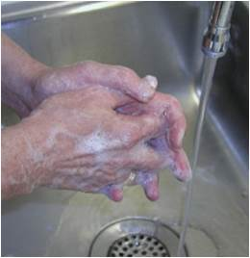
Handwashing
Hand washing is the #1 way to prevent the spread of diseases!

Slide 9
Vaccine Administration Documentation
Notes:
The importance of Vaccine Administration Documentation to prevent patient safety errors:
-Fully document each vaccination on vaccine administration log: date, lot number, manufacturer, site, VIS date, name/initials
This is an example of how what MUST be recorded CAN be recorded.
HANDOUT 3M – State of Missouri Immunization Consent and History

Slide 10
Site Selection for an IM Injection for an Adult
Completely expose the upper arm (picture on next slide)
Feel for the bone (acromion process) that goes across the top of the upper arm
Find the injection site in the center of an upside-down triangle
The injection will go into the Deltoid muscle
The bottom of the acromion process bone form the base of the triangle, the point of the triangle is about the level of the armpit
The center is 1-2 inches below this bone
The site should not be used if the person is very thin or the muscle is very small

Slide 11
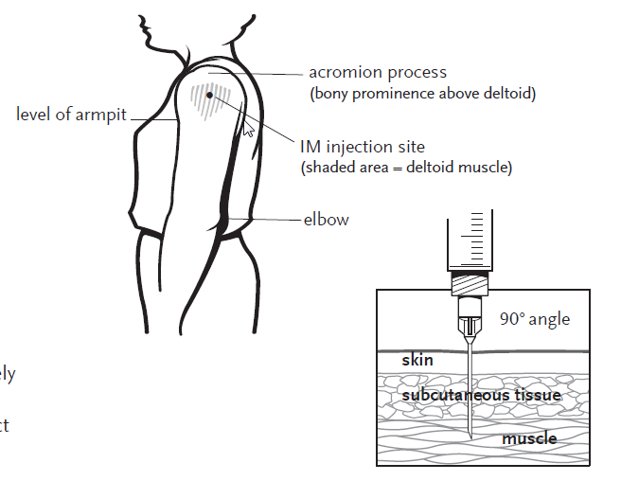
Know the Site – Get it Right!
Notes:
Know the Site, Get it Right (visual of previous narrative slide)
For visual learners
Physically have attendees locate the correct site (acromion process and armpit)
Emphasize one needle, one patient, one time ONLY – discard in Sharps container

Slide 12
Vaccine Administration
Wash hands with soap, dry them completely then put on gloves
Open alcohol wipe and wipe area where you plan to give an injection then let the area dry
Prepare the needle – hold the syringe with your writing/dominant hand, pull cover off with other hand, place syringe between your thumb and first finger
Hold skin around where you will give the injection and gently press on and pull skin so its slightly tight
Insert the needle into the muscle, hold syringe and use wrist to inject the needle through the skin and into the muscle at a 90 degree angle
Notes:
Review slide
There is no requirement for gloves, however, according to OHSA if you anticipate blood exposure gloves can be used. Remember even if you use gloves you MUST change them between each patient and practice good hand hygiene.
Poster Know the site, Get it Right
Emphasize one needle, one patient, one time ONLY – discard in Sharps container

Slide 13
Vaccine Administration
Use a quick motion, the quicker you put the needle in the less it hurts
Inject the medicine, push down on the plunger to inject the entire contents of the syringe
Remove the needle once medicine is injected at the same angle it went in
Place band-aid over the injection area
Dispose of retractable needle into sharps container
Notes:
Review Slide
11. If possible, monitor the client for a possible reaction(s) for 15 minutes. Observation can be done with patient while documentation is being completed.
Emphasize one needle, one patient, one time ONLY – discard in Sharps container
Attendees will be demonstrating this technique with oranges in the group exercise portion of the presentation
The group exercise will bring together the completion of the Medication Assessment Form, landmarks for the right site, medication administration “RIGHTS” and medication administration safety.

Slide 14
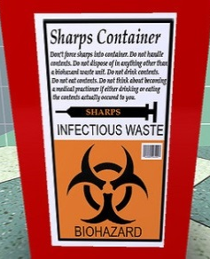
How do I get rid of used needles and syringes?
Sharps containers are the best and safest way to dispose of needles
DO NOT DISPOSE THEM IN THE TRASH!!!
Notes:
ALL SYRINGES AND NEEDLES ARE ONE USE ONLY!!!! Emphasize one needle, one patient, one time ONLY – discard in Sharps container
This prevents transmitting diseases, and
Prevents contaminating vaccine
ALWAYS DISCARD THE SYRINGE AND NEEDLE INTO A SHARPS CONTAINER!
If no sharps container is available then use a sturdy container like a plastic bottle with a screw lid
ensure it is big enough for the syringe and needle to fit in
ensure the syringe and needle cannot break through the sides

Slide 15
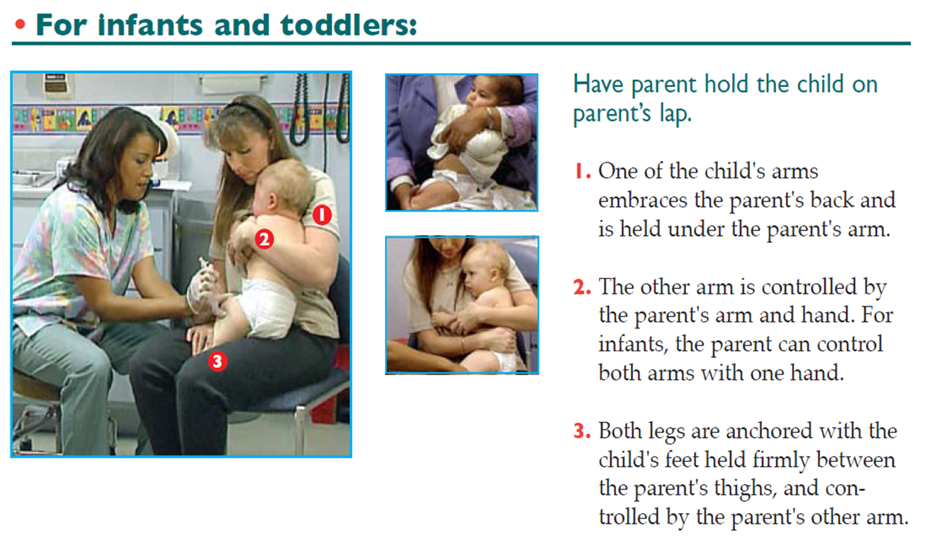
Site Selection: Infants and Toddlers
Notes:
Other age appropriate site selections and parent holds
Review Slide
Have attendees physically identify anterolateral site (group exercise)
Discuss the value of instructing the parent hold

Slide 16
Site Selection: Kindergarten and Older
Notes:
Other age appropriate site selections and parent hold
Review Slide
Have attendees physically identify deltoid site (group exercise)
Discuss the value of instructing the parent hold

Slide 17
Resources
Information on medication dispensing and vaccine administration are available on the Resource Handout and Include:
Centers for Disease Control and Prevention
Immunication Action Coalition
State of Missouri
DHSS
Bureau of Immunizations
SEMA
SNS/MCM Program
Notes:
A list of resources that help you gain further information. Briefly review availability, highlighting:
https://www.cdc.gov/vaccinesafety/index.html
http://www.immunize.org/guide/
Watch video on immunization techniques and review CDC’s Vaccine Administration eLearn, available at www.cdc.gov/vaccines/hcp/admin/resource-library.html.
https://www2.cdc.gov/vaccines/ed/shvideo/shvideo.asp for vaccine storage and handling

Slide 18
Group Exercise
Notes:
Any questions on Medication Assessment, Dispensing Algorithm or Vaccine Administration before we begin the Group Exercise?
Then, Medication Assessment review and immunization techniques practicum.

