Slide 1

Make Life Better
Be a Public Health Nurse

Slide 2

What Is Public Health Nursing?
A specialty in nursing
Medical care
Reaching out to many people
Notes:
Lillian Wald is the founder of public health nursing, in the United States. Working out of the Henry Street Settlement, she began public health nursing in 1893, putting medical care into the reach of many poor people. She also began the first public school nursing service in the world.
Since that time, public health nursing has been a critical component of the country’s health system. However, many people do not know much about public health nursing or what public health nurses do.
This presentation provides information about the specialty of public health nursing
.

Slide 3

A Public Health Nurse Is…
A Generalist
Notes:
In 1996, the Public Health Nursing Section of the American Public Health Association developed this definition of public health nursing.
A PHN is a generalist who is competent in several different fields or activities. (Oxford dictionary)

Slide 4
Nurses Impact the Health of Individuals One at a Time
However….
Notes:
The impact public health has on entire communities or groups of people makes public health nursing a unique specialty.
The emphasis on health promotion an prevention of disease is a critical aspect of public health nursing.
You may want to share a story of example here of how you have impacted the health of the community through your work.
Nurses caring for an individual focus on that person and their response to illness by taking vital signs and physical assessment
Public Health nurses focus on a community or a group of individuals sharing a common characteristic (eg senior citizens) and do a community assessment

Slide 5
Public health nurses impact the health of…
ENTIRE COMMUNITIES

Slide 6
Public Health Nurses work…
in many areas within the community
is varied, flexible and autonomous
Be a Public Health Nurse

Slide 7
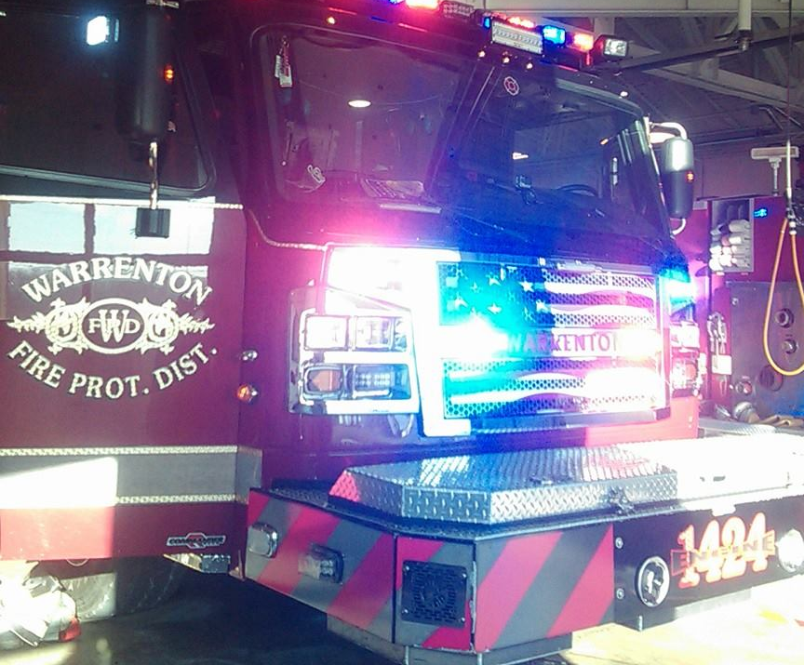
Public Health Nurses…
Respond to emergencies including infectious diseases and natural/man-made disasters
Teach groups of people about how
they can be healthy
Respond, teach
Notes:
Give examples for each item from your experience.
Emergencies-Flu vaccine clinics, tetanus shots after flood, work in shelters,
Prevention
Health Education to groups and individuals
Screening for chronic disease
Surveillance for communicable disease
Teaching
Nutrition Classes
Education to Child Care Providers
Senior Citizen Centers

Slide 8
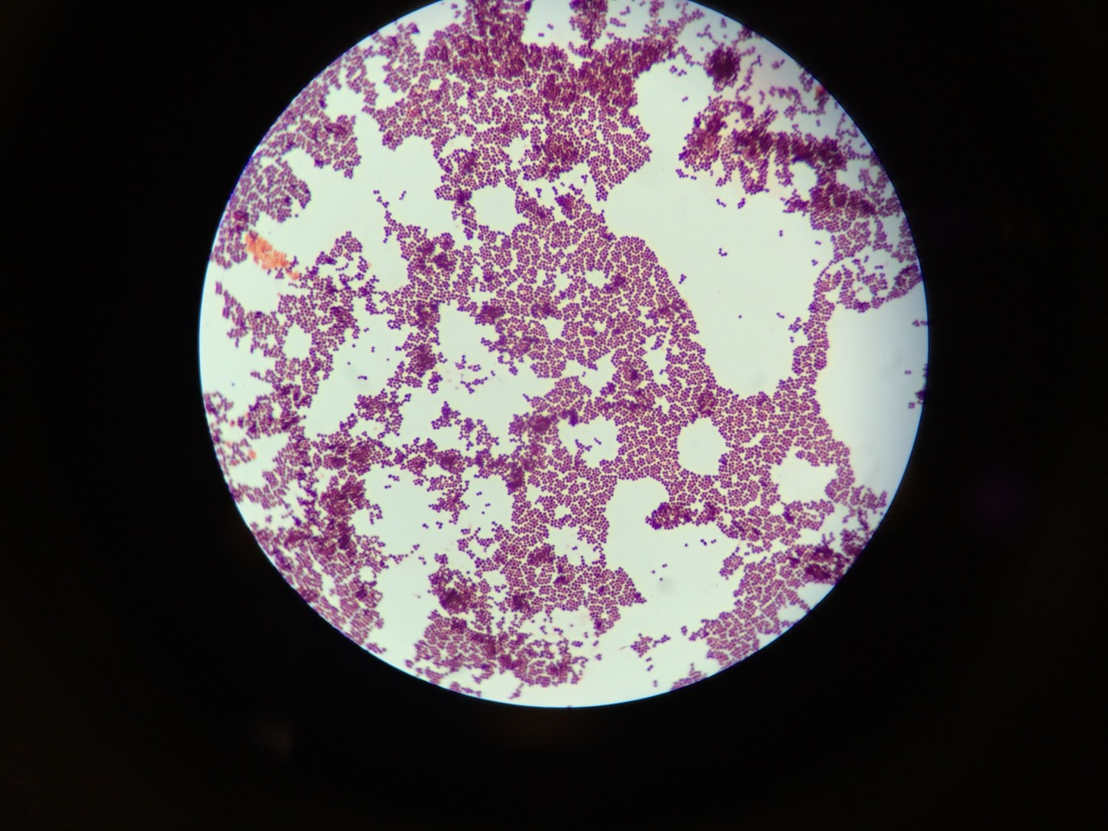
Public Health Nurses…
Track occurring communicable disease and help people get treatment
Organize health fairs and preventative health screening
Collect data, organize, screen

Slide 9
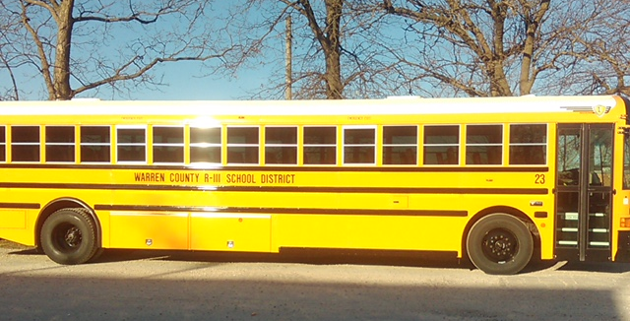
Public Health Nurses …
work with schools with a focus on the health and development of students
educate the community about environmental issues such as food safety, lead, and clean air and water
Educate
Notes:
Give examples from your community
School Health
In some communities the local public health agencies work in the schools and provide health services. Public health nurses often work closely with school nurses
Environment
Give examples of environmental issues your community focuses on such as
lead prevention, pesticide exposure, restaurant inspections, food handlers classes etc.
Explain the role of the state health department-more information is available on the DHSS web site www.dhss.mo.gov

Slide 10
Public Health Nurses…
Collaborate with advisory boards and coalitions to promote health
Participate in monitoring health care institutions to assure quality care is provided
Collaborate, participate
Notes:
Coalitions
Share examples of coalitions in your community such as school health advisory councils, stop smoking groups
Monitoring
Nurses working for the DHSS participate in licensing of hospitals, home health agencies and nursing homes.

Slide 11
Public Health Nurses…
connect people to community programs and services
Advocate for people who need assistance
contribute in developing policies and quality assurance activities
Connect, contribute
Notes:
Tell stories or examples from your community
Linking
Public Health Nurses often provide case management services. They help find services for children and adults with disabilities or chronic health conditions. They help elderly find services so they can remain in their home. They help individuals find medical care providers and also make referrals to other agencies that provide assistance. Public health nurses know the resources available in the community.
Advocate
Nurses often interpret medical information and help people understand about their health care. They also participate in investigations of elder abuse and advocate as needed
Public health nurses participate in review and analysis of data. They also write grants, propose policies, procedures and standards, facilitate workgroups; create quality improvement plans; participate in contract monitoring, provide consultation and evaluate programs and projects.

Slide 12
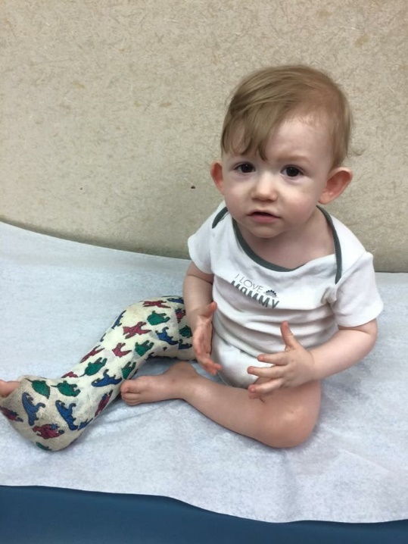
Public Health Nurses…
Work with business and industry to promote their employees be healthier
Assist individuals with special needs such as the elderly, disabled and children
Promote, assist
Notes:
Add examples from your agency
Employee Health
Public health nurses often work collaboratively to provide occupational health. They participate in worksite wellness screening, health promotion and health education
Assist Individuals
Public Health nurses provide case management services for children and adults with special needs such as chronic illness, head injuries and other disabilities. They also work with elderly citizens to help them stay out of long term care facilities.

Slide 13
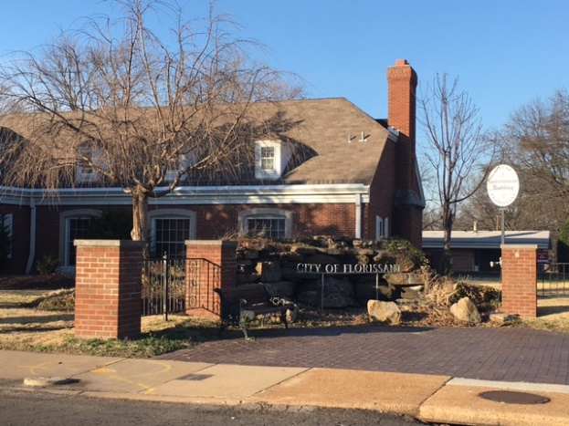
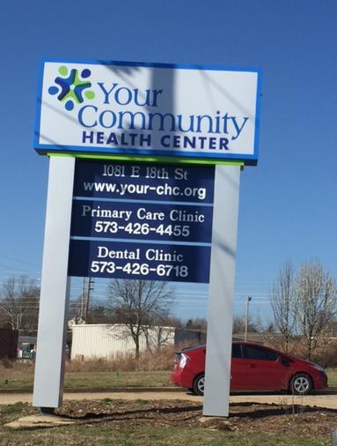
Where Do Public Health Nurses Work?
The Missouri Department of Health & Senior Services (MDHSS)
and City or County Agencies in the Community.
Promoting good while preventing harm
Notes:
Public health nurses are usually defined as nurses who work in governmental agencies. However, there are also nurses doing many of the same types of work who work in other agencies such as not-for-profit organizations, churches, and community health clinics. These nurses may be called community health nurses

Slide 14
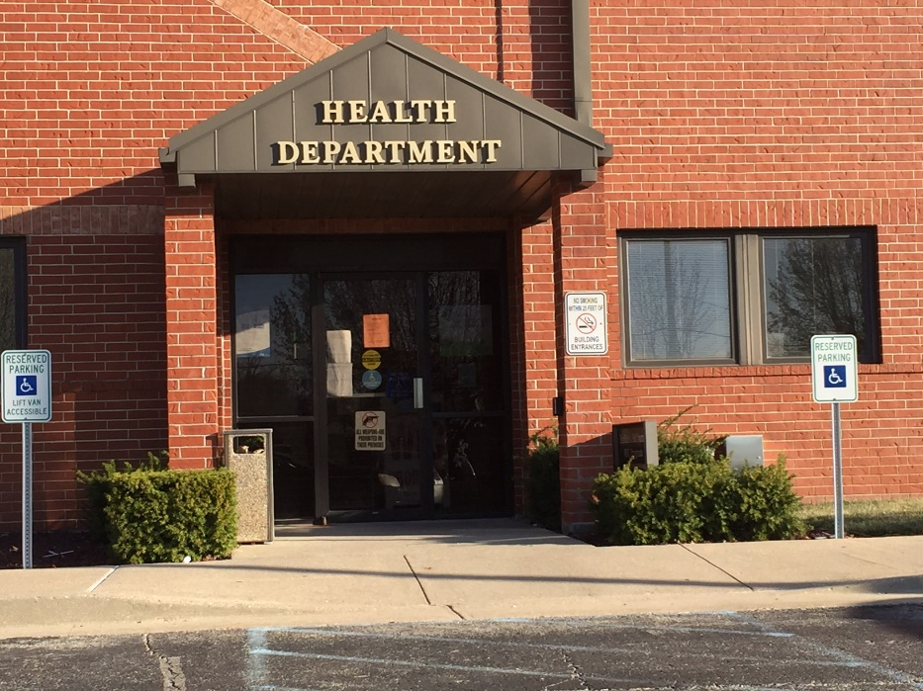
Where Do I Find Information About Becoming a Public Health Nurse?
The Local Public Health Department in Your Community
Community Health Department
Notes:
The official government agencies employing public health nurses are at the federal, state, and local level.
At the federal level, nurses work for the US Public Health Service
At the state level they work for the Missouri Department of Health & Senior Services and at the local level at city county health departments.

Slide 15
CONTACT…
The Department of Health & Senior Services at:
www.dhss.mo.gov
573-751-6170
OR
The Local Public Health Department

Slide 16
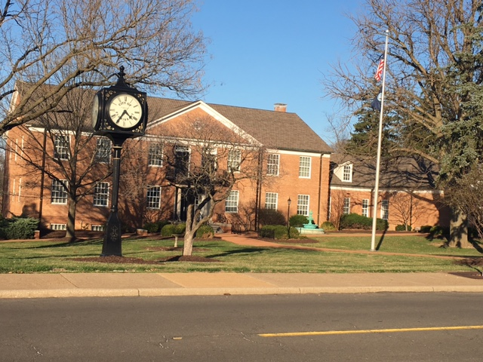





Public Health
Make lives better!

