Slide 1
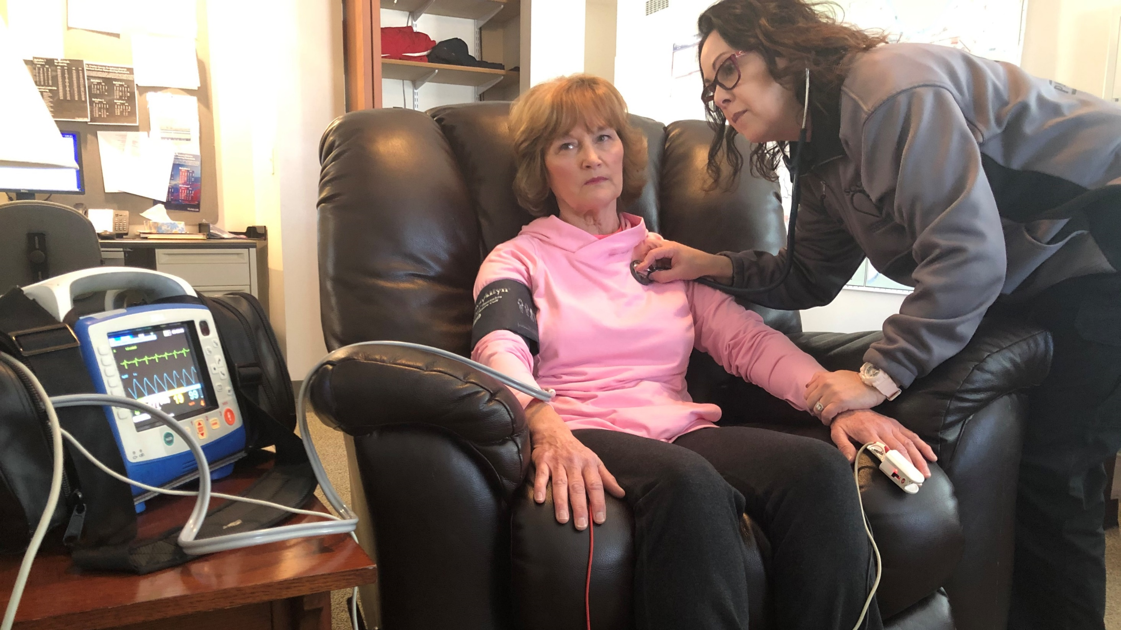
St. Charles County Ambulance District
Mobile Integrated Health

Slide 2
Community Paramedics
Solving EMS problems in non-traditional ways
Collaboration with stakeholders & community partners is key
Fill in gaps utilizing a community needs assessment

Slide 3
FALL DATA
2022 Falls
Total dispatch calls 48,710
Falls 7,039 14.5% total calls
YTD 2023
Total dispatch calls 42,126
Falls YTD 6,464 15% total calls

Slide 4
What does MIH do for your patient?
Needs assessment- ability perform ADLS, self-care, medical literacy, PEAT, cognitive needs.
Gap analysis
Monitor 911 usage flag address
Connect patients community-based/social services
Notes:
MIH works closely with DHSS.
Connect patients to resources for food shelters, home pharmacy delivery, navigate health through PCP
Physical environment assessment tool (peat)
Social or financial resources access to?
Gap- services in home? PT, OT, RN, Aid
Health insurance? Veteran?

Slide 5
Safety Plan
Is the patient safe in their home?
Engage PCP.
Collaborate with DHSS
Is there a capable and available caregiver in the home?

Slide 6
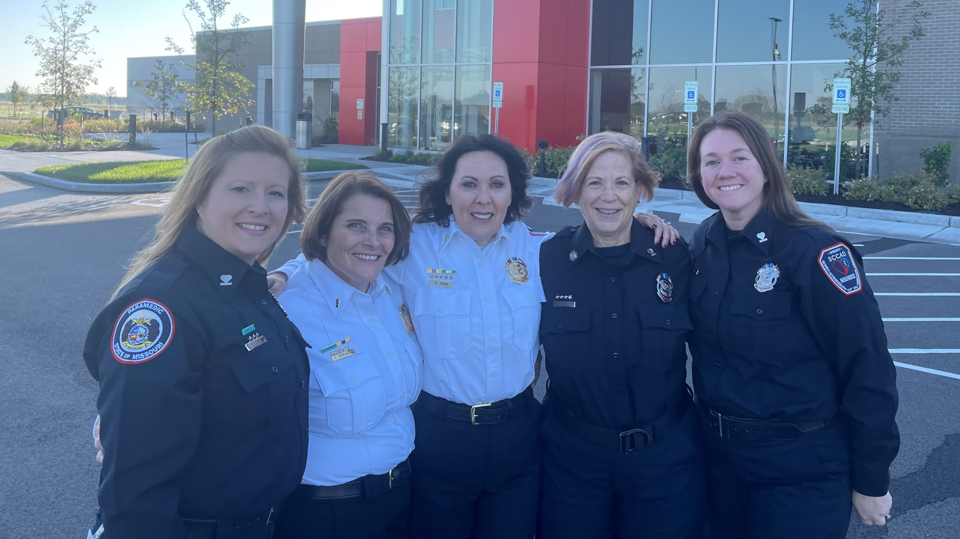
QUESTIONS

