Slide 1
Developing a Vision for Daily Life and Employment
Master Plan on Aging
Daily Life and Employment Subcommittee
February 22, 2024

Slide 2
What is a vision statement?

Slide 3
Vision vs. Mission
Vision statements are future-based, and they are meant to inspire and give direction internally. Mission statements are based in the present and convey to stakeholders and community members why an entity exists and where it currently stands.
A vision is aspiration; a mission is actionable
A vision statement is a written declaration clarifying your meaning and purpose for stakeholders, particularly internal stakeholders. It describes the desired long-term results of your efforts.

Slide 4
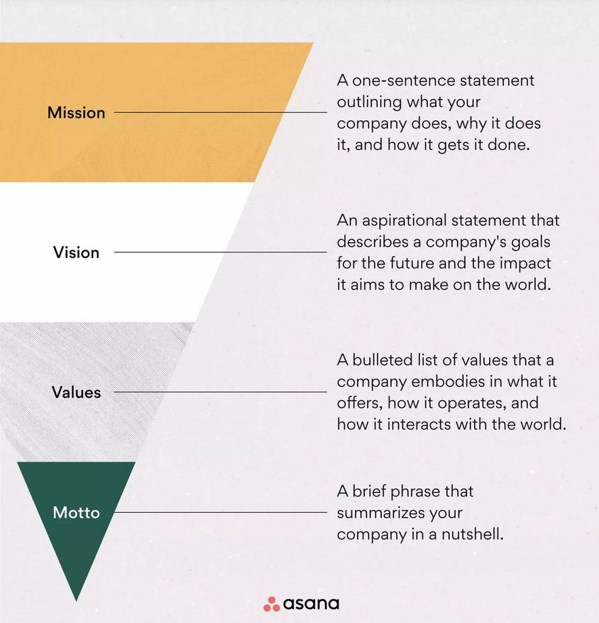
Mission-Vision Hierarchy

Slide 5
What does a vision statement look like?
Don’t be afraid to dream big once you gather all the information and get down to writing.
Your vision statement should constantly remind you and your team of the end goal.
A vision statement should be concise – no longer than a sentence or two. You want your entire organization to be able to repeat it quickly and, more importantly, understand it.

Slide 6
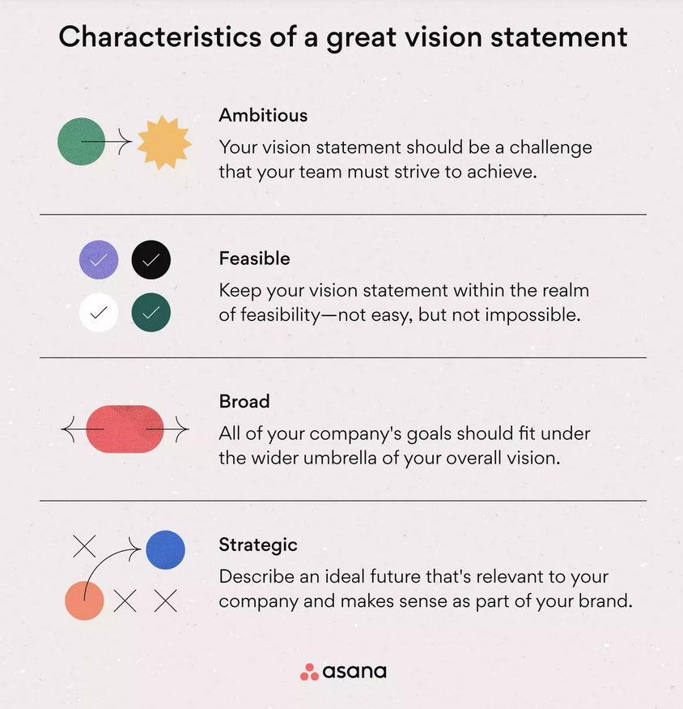

Slide 7
Components of a good vision statement
Project five to 10 years into the future.
Dream big and focus on success.
Use the present tense.
Use clear, concise, jargon-free language.
Infuse it with passion and make it inspiring.
Align it with your values and goals.
Prepare to commit time and resources to the vision you establish.

Slide 8
Things to avoid
Don’t mix up your mission statement and vision statement
Don’t overthink the wording
Don’t start writing right away
Don’t use vague terms, be as specific as possible
Don’t set an unachievable vision

Slide 9
Examples of vision statements
Amazon: “Our vision is to be earth’s most customer-centric company; to build a place where people can come to find and discover anything they might want to buy online.
Habitat for Humanity: “A world where everyone has a decent place to live.”
IKEA: “To create a better everyday life for the many people.”
TED: “We believe passionately in the power of ideas to change attitudes, lives, and, ultimately, the world.”
DHEWD: “Every Missourian empowered with the skills and education needed for success.”

Slide 10
Start with Brainstorming

Slide 11
Brainstorming
Start with a list of keywords
  Identify the product or service
  Highlight mission and values
  Identify audacious goals and initiatives
  Linkage to long-term strategic plan
  Adjectives that describe the ideal future (expert, innovative, affordable, inspiring)
  Adverbs that describe how we operate (flexibility, sustainably, cooperatively, fearlessly)

Slide 12
More Brainstorming
Foundational questions
  What is our main purpose?
  What are our main strengths?
  What are our values?
  Why does what we are building matter?
  How do we make a difference?
  What are our most ambitious goals?
  What impact do we want to have?
  How would the world be different if we succeed?

Slide 13
Next Steps
Based on the outcomes from the brainstorming session, develop an initial draft vision statement.
Distribute draft statement to committee for feedback
Develop updated statement for consideration at the March subcommittee meeting.

Slide 14
Questions/Comments

