Slide 1
Self-Measured Blood Pressure (SMBP) Training
Part One
Train-the-Trainer:
Benefits and Techniques
Notes:
Elena

Slide 2
Objectives
Outline the purpose of SMBP and identification of eligible patient populations
Review techniques for accurate measurement
Examine strategies for talking to patients about SMBP
Address patient barriers to SMBP through Motivational Interviewing (MI) techniques

Slide 3

Blood Pressure Scavenger Hunt
This is a scavenger hunt you can do from your seat!
Periodically throughout the training, we will ask you to notice things about yourself in your environment, and we will tell you how to score them appropriately.
HINT: Just like golf, lowest score wins

Slide 4

Scavenger Hunt – Item #1
Are your feet on the ground and ankles uncrossed?
If your feet are NOT on the ground and supported,
or if your ankles ARE crossed. . .
give yourself +10 points for item #1

Slide 5
Background and purpose of SMBP
Notes:
Elise

Slide 6
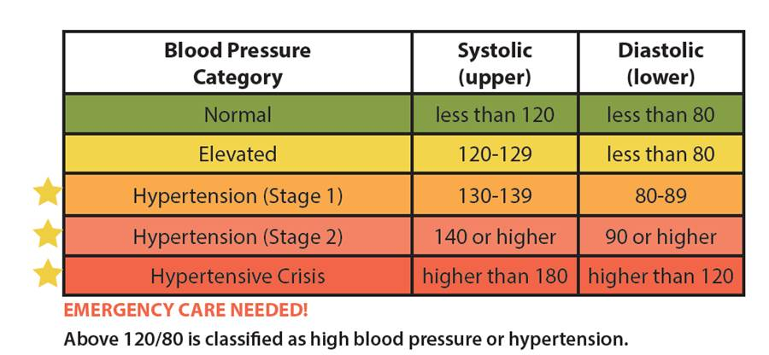
High Blood Pressure
High blood pressure is a pressure of 130 systolic or higher, or 80 diastolic or higher, that stays high over time.
https://www.heart.org/-/media/data-import/downloadables/f/9/8/pe-abh-what-is-high-blood-pressure-ucm_300310.pdf

Slide 7
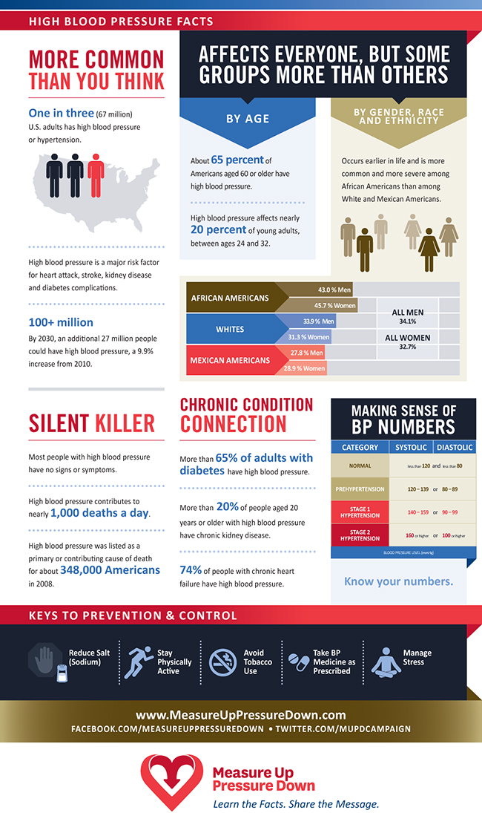
Blood Pressure Facts
Source: http://www.measureuppressuredown.com/PR/highBPStats_pr.asp
Notes:
One in three Americans has high blood pressure (also called hypertension, or HTN), and it is more common among some population groups, including African Americans and adults older than 60.

Slide 8
Blood Pressure Facts
Source: http://www.measureuppressuredown.com/PR/highBPStats_pr.asp
Notes:
High blood pressure is the second most common reason for U.S. adults to visit their doctors, and it is responsible for more than 34 million office visits each year. In 2016, the estimated direct and indirect cost of high blood pressure in the United States was $48.6 billion. Chronic high blood pressure can cause heart disease, stroke, kidney disease, and blindness. In 2016, the economic costs of heart disease and stroke were estimated at $316.6 billion, including $193.1 billion in direct medical expenses, and another $123.5 billion annually was attributed to lost productivity due to premature death from cardiovascular disease (CVD).

Slide 9
What Is Self-Measured Blood Pressure (SMBP)?
Patient measurement of his/her own blood pressure (BP) outside of the clinical setting
SMBP readings are used for diagnosis / management of hypertension (HTN)
Patients receive training from their clinical team on how to properly self-measure
Patients share their BP readings with their healthcare providers
Feedback and clinical support
Source: https://targetbp.org/blood-pressure-improvement-program/patient-measured-bp/

Slide 10
What Are the Benefits of SMBP?
More precise initial diagnosis of HTN
More accurate titration of antihypertensive medication treatments
Confirms elevated office readings
(2017 ACC/AHA Guideline recommendation)
Differentiates between white coat and sustained HTN
Detects patients with masked HTN
Parati G, Stergiou GS, Asmar R, et al. European society of hypertension practice guidelines for home blood pressure monitoring. J Hum Hypertenss 2010; 779-785
Notes:
*titration – adjustment of medication
Measurements are taken in the patient’s usual environment. Provides multiple BPs over a longer period (more representative of patient’s true BP).

Slide 11
What Are the Benefits of SMBP?
Better understanding of the patient’s medication need (use, dose, etc.)
Decrease in resistance to treatment
Improvements in systolic (SBP), diastolic (DBP) and mean blood pressure
In a 527-patient trial, home BP monitoring plus self-titration and telemonitoring cut average SBP by 12.9 mm Hg.
Agarwal R, Bills JE, Hecht TJW, Light RP. Role of home blood pressure monitoring in overcoming therapeutic inertia and improving hypertension control; A systematic review and meta-analysis. Hypertension. 2011; 57: 29-38.
Notes:
*Decrease in [therapeutic inertia] –resistance to treatment for an existing medical condition

Slide 12
CPT Codes for SMBP
The 2020 list of Current Procedural Terminology (CPT) codes includes SMBP
  Codes 99473 and 99474 will be used for SMBP monitoring
  This will enable clinicians to better track their SMBP patients

Slide 13
Uses of SMBP
Out-of-Office Self-Monitoring of BP
Out-of-office BP measurements are recommended to confirm diagnoses of HTN and for titration of BP-lowering medication
Improve Control of BP in Patients on Drug Therapy
Follow-up and monitoring after initiation of drug therapy for HTN control should include systematic strategies to help improve BP, including use of SMBP, team-based care
Whelton PK, Carey RM, Aronow WS, et al. 2017 ACC/AHA/AAPA/ABC/ACPM/AGS/APhA/ASH/ASPC/NMA/PCNA Guideline for the Prevention, Detection, Evaluation, and Management of High Blood Pressure in Adults: A Report of the American College of Cardiology/American Heart Association Task Force on Clinical Practice Guidelines. Hypertension. 2017. doi:10.1161/HYP.0000000000000065

Slide 14
Why Use SMBP?
SMBP can assess BP control
Provides reliable estimate of effectiveness of antihypertensive treatment
Assesses control at different times across 24-hour period
Supports better, timely treatment decisions
Sharman JE, Howes FS, Head GA, et al. Home blood pressure monitoring: Australian expert consensus statement. Journal of Hypertension 2015; 33: 1721-1728
Parati G, Stergiou GS, Asmar R, et al. European society of hypertension practice guidelines for home blood pressure monitoring. J Hum Hypertenss 2010; 779-785

Slide 15
Why Use SMBP?
SMBP can increase precision in HTN diagnosis
Confirms elevated office readings (USPSTF recommendation)
Differentiates between white coat and sustained HTN
Helps identify patients with masked HTN
Parati G, Stergiou GS, Asmar R, et al. European society of hypertension practice guidelines for home blood pressure monitoring. J Hum Hypertenss 2010; 779-785
Notes:
SMBP is more predictive of cardiovascular outcomes than traditional office BPs
1. Target organ damage
2. Risk of future cardiovascular events
3. Mortality
USPSTF – U..S Preventive Services Task Force

Slide 16
Why Use SMBP?
SMBP improves adherence to therapy
Empowers patients to be more involved in their care and to self-manage
Improves medication adherence with clinical support
Sharman JE, Howes FS, Head GA, et al. Home blood pressure monitoring: Australian expert consensus statement. Journal of Hypertension 2015; 33: 1721-1728
Parati G, Stergiou GS, Asmar R, et al. European society of hypertension practice guidelines for home blood pressure monitoring. J Hum Hypertenss 2010; 779-785

Slide 17
Which Patients Benefit from SMBP?
Patients with a diagnosis of HTN:
Increase engagement, adherence to treatment or improve BP control
Assess the effect of treatment on BP control
  Including titration of antihypertensive medications and non-pharmacological therapies
Determine whether treatment-resistant HTN is present when BPs are difficult to control
Whelton PK, Carey RM, Aronow WS, et al. 2017 ACC/AHA/AAPA/ABC/ACPM/AGS/APhA/ASH/ASPC/NMA/PCNA Guideline for the Prevention, Detection, Evaluation, and Management of High Blood Pressure in Adults: A Report of the American College of Cardiology/American Heart Association Task Force on Clinical Practice Guidelines. Hypertension. 2017. i:10.1161/HYP.0000000000000065

Slide 18
Which Patients Benefit from SMBP?
Patients without a diagnosis of HTN/at risk patients:
Patients with elevated office BPs who are suspected of having HTN (to make a diagnosis)
Suspected white coat HTN – adults with untreated:
  SBP >130 mm Hg but <160 mm Hg, or
  DBP >80 mm Hg but <100 mm Hg
Suspected masked HTN – adults with untreated office BPs:
  SBPs consistently 120–129 mm Hg, or
  DBPs consistently 75–79 mm Hg
Whelton PK, Carey RM, Aronow WS, et al. 2017 ACC/AHA/AAPA/ABC/ACPM/AGS/APhA/ASH/ASPC/NMA/PCNA Guideline for the Prevention, Detection, Evaluation, and Management of High Blood Pressure in Adults: A Report of the American College of Cardiology/American Heart Association Task Force on Clinical Practice Guidelines. Hypertension. 2017. i:10.1161/HYP.0000000000000065
Notes:
*white coat- where people exhibit a blood pressure level above normal range due to anxiety experienced in the clinical setting
*masked hypertension is opposite of white coat hypertension, where the patients blood pressure reading is within normal range in the clinical setting but higher when measured at home

Slide 19
Which Patients Benefit from SMBP?
  Uncontrolled HTN patients
  Newly diagnosed HTN patients
  Patients with potential undiagnosed HTN
  HTN patients with medication adherence challenges
  HTN patients with office visit barriers

Slide 20

Scavenger Hunt – Item #2
Are your legs uncrossed?
If you have your legs crossed. . .
give yourself +6.5 points for item #2

Slide 21
Training patients to self-measure
Techniques for Accurate Measurements
Notes:
Elena

Slide 22
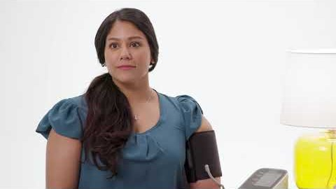
SMBP Video
https://www.youtube.com/watch?reload=9&v=S1esBNGtfJc&feature=youtu.be
Notes:
Patient-facing video to train on how to properly self-measure your blood pressure
SMBP training video by the American Medical Association (AMA): https://www.youtube.com/watch?reload=9&v=S1esBNGtfJc&feature=youtu.be

Slide 23
Training Patients to Self-Measure
Discuss what SMBP is and its importance
Teach how to use the device and assist
Educate on hypertensive emergency
Help the patient prepare to measure BP
Guide patient to correct position to measure BP
Teach patient how often to measure BP
Show patient how to document BP data
Prepare patient for dealing with errors
Check understanding
Complete home device accuracy check

Slide 24
1. Discuss what SMBP is and why it’s important
Explain SMBP and importance of BP control
Inform patient of positive benefits of SMBP
Share educational SMBP resources
Notes:
Find out what they know about SMBP and if they have any concerns about it
Provide general information about hypertension

Slide 25
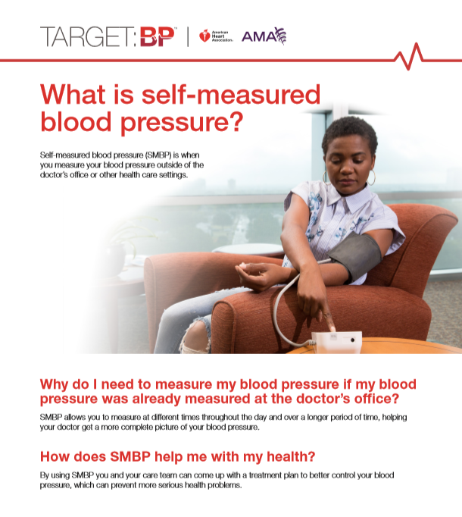
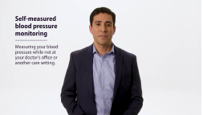

1. Discuss what SMBP is and why it’s important
https://targetbp.org/wp-content/uploads/2018/08/What-is-SMBP.pdf
https://targetbp.org/tools_downloads/self-measured-blood-pressure-video/
https://targetbp.org/tools_downloads/self-measured-blood-pressure-video-spanish/
Notes:
Examples of patient education on importance of BP control and benefits of SMBP

Slide 26
2. Teach patients how to use the device and assist
Ensure the loaner device or patient’s personal device has the correct cuff size.
A good-fitting cuff is essential
  Too large → underestimates BP
  Too small → overestimates BP
Train staff to measure patients’ arms to ensure appropriate cuff sizes are used
  While patient is standing, measure from acromion process of scapula to olecranon process at elbow
  Note midpoint and measure circumference of arm there
Photo source: National Health and Nutrition Examination Survey (NHANES) Physician Examination Manual September 2011.
Notes:
Using a measuring tape, place one end on bony prominence at the shoulder (acromion process) and measure length of arm to bony protuberance at the elbow (olecranon process). Divide this distance in half -- that is the mid-upper arm where you should measure arm circumference to determine cuff size.

Slide 27
Acceptable BP Cuff Bladder Dimensions
Cuff Size | Bladder Width (cm) | Bladder Length (cm) | Arm Circumference Range at Midpoint (cm)
Newborn | 3 | 6 | <6
Infant | 5 | 15 | 6−15
Child | 8 | 21 | 16−21
Small adult | 10 | 24 | 22−26
Adult | 13 | 30 | 27−34
Large adult | 16 | 38 | 35−44
Adult thigh | 20 | 42 | 45−52
Notes:
Make sure the bladder of the cuff can encircle at least 80% of the upper arm in adults and 100% in children.
A cuff that’s too short or too narrow will result in a mistakenly high measurement
A cuff that’s too large will result in a mistakenly low measurement

Slide 28
2. Teach patients how to use the device and assist
Suggest a validated, automated upper arm BP device (preferably with memory and averaging)
Do not recommend/use wrist cuffs (unless brachial readings are impossible)
Finger devices should never be used
If a patient is purchasing a device, have him/her bring it into your office for accuracy testing

Slide 29
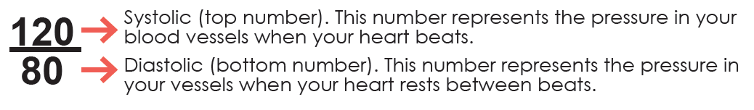
2. Teach patients how to use the device and assist
Show patients:
  How to position the cuff correctly on their upper arm on bare skin
    Refer to manufacturer’s user manual for instructions on placement of tubing
  How to turn the device on and begin measurement
Explain to patients:
  When the cuff completes the deflating process and a reading is displayed, explain which numbers represent the SBP and DBP and what these mean

Slide 30
3. Educate the patient on hypertensive emergency
What does a patient do with an abnormal BP reading?
At what point does the patient call 911?

Slide 31
Hypertensive Urgency vs. Hypertensive Emergency
Hypertensive Urgency:
  BP of 180/120 or greater, rechecked with similar results but no symptoms – call PCP
Hypertensive Emergency:
  BP reading of 180/120 or greater with chest pain, shortness of breath, back pain, numbness/weakness, change in vision, or difficulty speaking – call 911
https://www.heart.org/en/health-topics/high-blood-pressure/understanding-blood-pressure-readings/hypertensive-crisis-when-you-should-call-911-for-high-blood-pressure

Slide 32
4. Help the patient prepare to measure BP
Tell the patient to use the bathroom, if needed.
Have the patient rest and sit in a chair for 5 minutes before starting.
Inform the patient not to talk, use the phone, text, email, or watch TV during the measurement. Explain that no one else should talk either.
Ask the patient to measure his/her BP prior to taking antihypertensive medication in the morning and evening.
Remind the patient to wait at least 30 minutes after eating before measuring BP.
If the patient smokes, ask him/her not to smoke within 30 minutes of measuring BP.

Slide 33
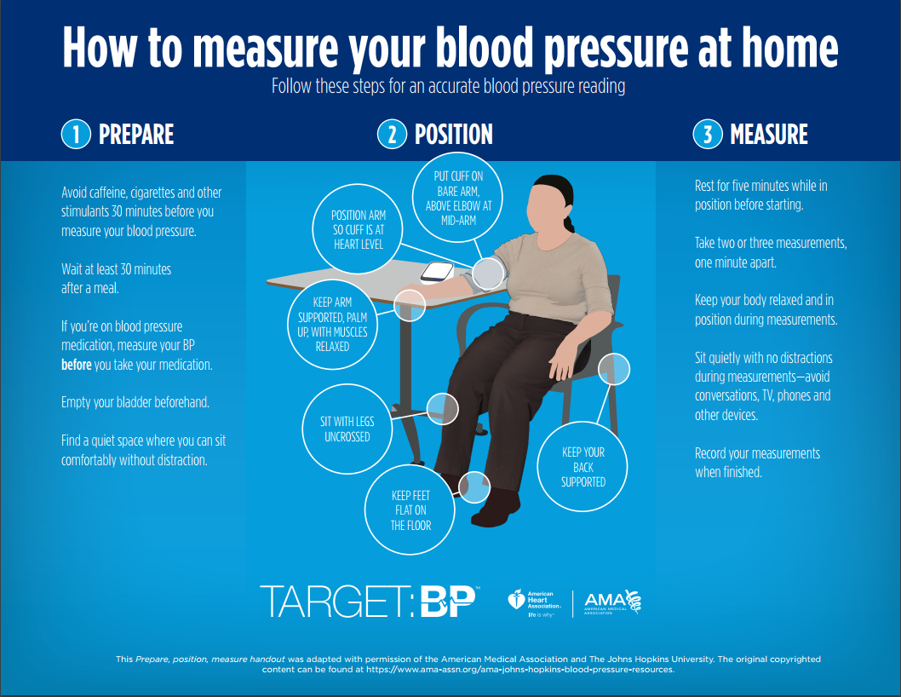
5. Guide the patient to correct position for taking BP measurements
Notes:
Teach the patient proper positioning:
• Seated in a chair with back supported
• Legs should be uncrossed
• Feet flat on the ground or supported by a footstool
• Arm supported (suggest pillows if patient doesn’t have a table high enough) with the BP cuff on bare upper arm and at heart level.

Slide 34
5. Guide the patient to correct position for taking BP measurements
Factors That Impact BP
Patient Factors
Nervousness, stress, anger, illness, pain, long waiting time
Demographics: age, sex, race and ethnicity
Lifestyle: diet, exercise, substance use (smoking, alcohol, etc.)
Recent caffeine, decongestant, OTC medication, or nicotine use
Talking during measurement
Measurement Factors
Air in BP cuff before measuring
Correct BP cuff size
  Too large → underestimates BP
  Too small → overestimates BP
Unevenly wrapped cuff

Slide 35

Scavenger Hunt – Item #3
Is your back supported?
If you are seated but your back is NOT supported. . .
give yourself +5 points for item #3

Slide 36
6. Teach the patient how often to measure BP
Two sets of measurements per day
  One set in the morning and one in the evening, before taking antihypertensive medications
  Each set consists of two measurements performed 1 minute apart
This should be done for 7 consecutive days (minimum of 3 days or 12 readings)

Slide 37
7. Show the patient how to document BP data
Teach patients what to do if their BP is too high, too low, or if they are having associated symptoms
Work with patients on how they will communicate their results back to the practice after a full week of measurements are complete (more on this in Part Two)
  Electronically through the portal?
  Paper form?
  Phone call to the office?

Slide 38
8. Prepare the patient for dealing with errors or problems
If an error reading occurs on the device, show the patient how to start over.
Provide the patient with instructions on what to do (including a number to call if possible) if readings show abnormal BP.

Slide 39
9. Check that the patient understands how to correctly measure BP
Ask the patient to “teach back” what he or she has learned and correct any mistakes
Provide a second demonstration if needed
Offer printed reminders or tips to help the patient remember what to do at home

Slide 40
10. Complete At-Home-Device Accuracy Check
SMBP devices should be tested in the office for accuracy if home readings are suspected to be inaccurate (despite use of a validated device)
Complete home device accuracy check:
  If there is <5 mm Hg difference between the two methods when the readings are averaged – the device is safe to use
Accuracy checks should be done after purchase and then annually
Muntner P, Shimbo D, Carey RM, et al; on behalf of the American Heart Association Council on Hypertension; Council on Cardiovascular Disease in the Young; Council on Cardiovascular and Stroke Nursing; Council on Cardiovascular Radiology and Intervention; Council on Clinical Cardiology; and Council on Quality of Care and Outcomes Research. Measurement of blood pressure in humans: a scientific statement from the American Heart Association. Hypertension. 2019;71:e1-e32. DOI: 10.1161/HYP.0000000000000087.
Notes:
Even devices that have passed an accepted validation test may not provide accurate readings for every patient – and may not have the correct cuff size for the patient
SMBP devices should be tested in the office for accuracy if home readings are suspected to be inaccurate (despite use of a validated device)
To check a home device for accuracy:
Device is brought in and multiple readings are taken using the office standard method of testing & alternated with the patient self-measuring with their device
If there is <5 mm Hg difference between the two methods when the readings are averaged – the device is safe to use
Accuracy checks should be done after purchase and then annually

Slide 41
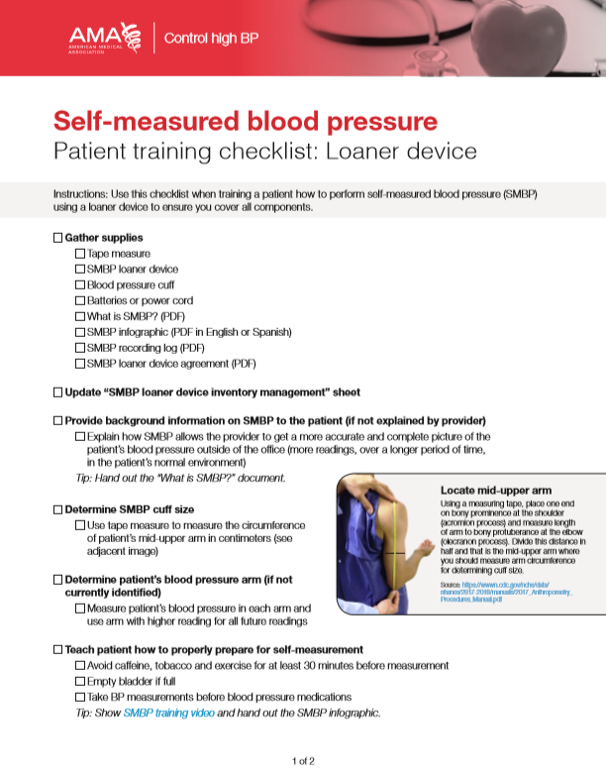
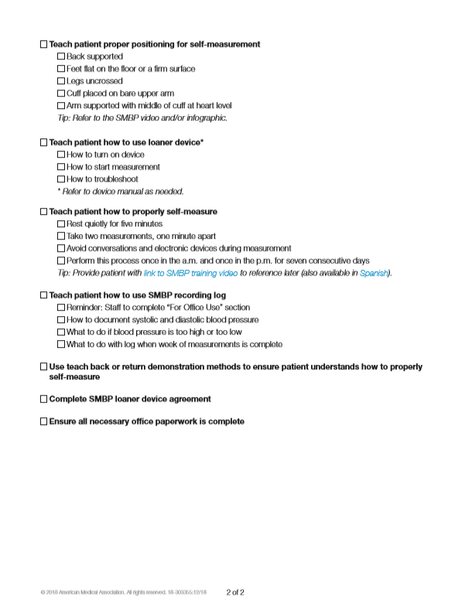
Patient Training Checklist
Source: https://www.ama-assn.org/system/files/2019-01/smbp-patient-training-checklist-loaner-device_0.pdf
Notes:
https://www.ama-assn.org/system/files/2019-01/smbp-patient-training-checklist-loaner-device_0.pdf

Slide 42
Activity – Device accuracy check
Notes:
Elise

Slide 43
How to use your device
BP O200 (blue monitor)
BP O300 (black monitor)
Bluetooth

Slide 44
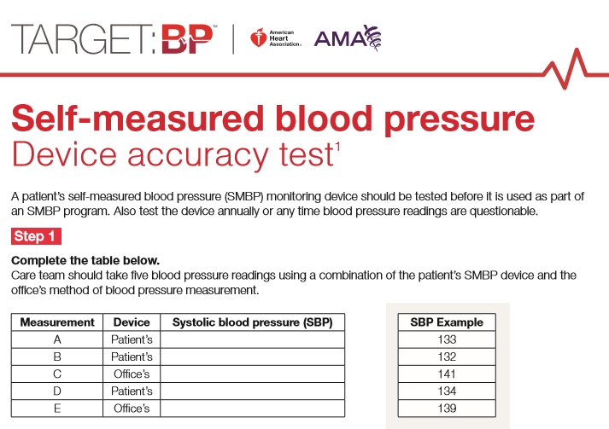
Notes:
SUGGESTED ACTIVITY − Print handouts to practice: go through a device accuracy check.
If patients are purchasing and taking a device home for self-measurement, the AMA and AHA recommend testing it.
After this, devices should also be tested annually, and any time readings are questionable.
To do this, the AMA and AHA developed a three-step device accuracy test: Step 1 is to take five BP measurements (combo of patient’s device and office’s) and record SBP.

Slide 45
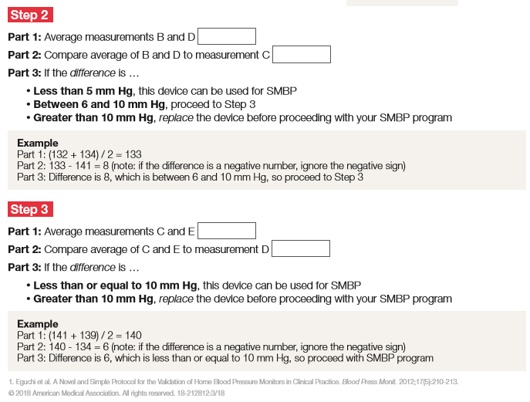
Notes:
Step 2 is to average two patient readings (B and D) and compare it to a measurement you’ve taken with your equipment (C).
If the difference is <5mmHg, the device can be used.
If 6−10 mmHg different, go to step 3, which is another average comparison.
If >10 mmHg, replace the device.
Step 3 is to average your measurements (C and E) and compare it to the patient’s measurement (D).
If the difference is <10 mmHg, the device can be used.
If >10 mmHg, replace the device.

Slide 46

Scavenger Hunt – Item #4
Are your arms supported at heart level?
If one or both of your arms are NOT supported at heart level. . .
give yourself +10 points for item #4

Slide 47
Addressing patient barriers To SMBP Through motivational interviewing techniques

Slide 48
Discussion
What reasons do you hear from patients for why they aren’t managing their high BP?

Slide 49
What Is Motivational Interviewing?
Expressing empathy through reflective listening
Developing discrepancy between the individual’s goals/values and current behavior
Avoiding arguing and direct confrontation
Adjusting to resistance rather than directly opposing it
Supporting self-efficacy and optimism
Notes:
Motivational Interviewing (MI) − Attempts to move an individual away from a state of indecision or uncertainty and toward finding motivation to make positive decisions and accomplish established goals.
Empathy − Building an understanding of the patient’s issues, struggles, and barriers to improvement. If you do this, the patient becomes more open, with accurate disclosure, since there is a lack of judgment and criticism.
Discrepancy − Having the patient point out the disparity between what he/she is doing and what his/her goals are. Do this by asking questions.
Avoid arguing − See the situation from the patient’s point of view (POV): No one understands it better than the patient, but act as a supporter rather than persuader.
Roll with resistance − Understand the patient’s POV and avoid the desire to correct his/her behavior.
Self-efficacy − Illustrate strengths and compile a number of instances where the client was able to accomplish his/her goal.

Slide 50
When to use MI
Pre-SMBP initiation
  To get a patient to start SMBP
Post-SMBP initiation
  Prior to taking device home for first time
  At next visit after SMBP initiation
  When/if patient calls to provide SMBP results
  Patients who have difficulty keeping up with SMBP
  After patient completes SMBP program
Notes:
Just some ideas ☺

Slide 51
Pre-SMBP Initiation
Getting a patient to start SMBP
It can be difficult understanding your BP readings. We have plenty of resources to help you understand them. When you’re monitoring at home, you can use the resources to recognize when you’re in a good range.
I understand it can be scary not knowing whether you have high BP. What I’m hearing from you is that you’re concerned that if you are diagnosed with HTN, it will impact your life in a negative way.
MI Tip #1: Empathetic Replies. Show you are listening by summarizing what the patient explained to you.

Slide 52
Post-SMBP Initiation
Prior to taking home device for the first time
Although it can be scary at first, unmanaged HTN can create more problems later on, so it’s important we address it as early as possible.
What can we do together to help you feel comfortable monitoring at home?
MI Tip #2: Reply to develop discrepancy and empower the patient.

Slide 53
Post-SMBP Initiation
At next visit, after SMBP initiation
What are some challenges you’ve had with SMBP?
If the patient hasn’t monitored: How can I help you create a plan to monitor your BP at home?
MI Tip #3: Use terms that reinforce positive change.

Slide 54
Post-SMBP Initiation
When/if patient calls to provide SMBP results
What are some benefits/challenges you’ve found so far with SMBP?
What do you notice about your results?
MI Tip #4: Support Self-Efficacy. Encourage the patient by asking questions that support confidence.

Slide 55
Post-SMBP Initiation
Patients who have difficulty keeping up with SMBP
How can I help you remember to follow the SMBP protocol?
When are you most likely to sit down and measure your BP?
MI Tip #5: Roll with Resistance. Work together to form a solution − see what will work for the patient.

Slide 56
Post-SMBP Initiation
After patient completes SMBP program
What were the good things about SMBP, and what were the not-so-good things about SMBP?
What do you want to do next?
MI Tip #6: Leave the door open for more positive change behaviors.

Slide 57
Stages of Change (Prochaska/DiClemente)
Pre-contemplation
No interest at this time in change
No recognition of problems or consequences
Contemplation
Ready to make change in next 6 months
Recognition of problem and consequences
May still remain ambivalent
Preparation
Ready to make change in next 30 days
Small steps toward behavior change
Begin to believe the change will result in better health
Notes:
Pre-contemplation – No intention of taking action in the foreseeable future (next 6 months), unaware his/her behavior is problematic or has negative consequences. People in this stage often underestimate the pros of changing behavior and overestimate the cons.
Contemplation – Intend to start healthy behavior in the foreseeable future (next 6 months), recognize their behavior may be problematic, and give more thoughtful and practical consideration to the pros and cons of changing behavior, with equal emphasis placed on both. Even with this recognition, people may still feel ambivalent toward changing their behavior.
Preparation (Determination) – Ready to take action in the next 30 days, take small steps toward the behavior change, and believe changing their behavior can lead to a healthier life.

Slide 58
Stages of Change
Action
Recent behavior change
Intend to keep moving forward
Maintenance
Continued behavior change of at least 6 months
Work to prevent relapse to previous stages
Termination
Have no desire to return to unhealthy behavior
Certain they will not relapse
This stage rarely achieved in real life
Notes:
Action − Recently changed behavior (within last 6 months) and intend to keep moving forward with that behavior change.
Maintenance − Sustained behavior change for more than 6 months and intend to maintain the change going forward. People in this stage work to prevent relapse to earlier stages.
Termination − No desire to return to the unhealthy behavior and are sure they will not relapse. Since this is rarely reached, and people tend to stay in the maintenance stage, this stage is often not considered in health promotion programs.
Relapse – A return to the unhealthy behavior after any period of success. This is especially true with tobacco cessation. Multiple psychososocial variables contribute to tobacco relapse. These include:
Social influences such as friends, family, and acquaintances; strong conditioned responses to consume tobacco − eating, drinking, socializing; lack of healthy alternatives to occupy time and focus, such as exercise and hobbies; desire for the physiological effects of tobacco cravings.

Slide 59
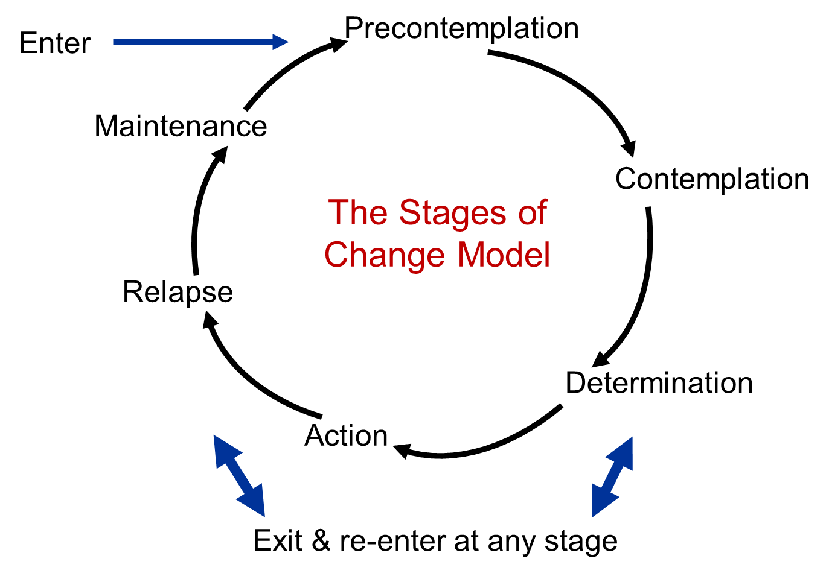
Stages of Change – A Visual Map

Slide 60

Notes:
https://www.youtube.com/watch?v=PvN6QHpEwnA – MI video for patient with HTN not taking meds.

Slide 61
Activity – open-ended questions
Notes:
Elena

Slide 62
Turn these closed-ended questions into open-ended questions:
“Do you foresee any issues measuring your BP at home?”
“Will you need reminders to measure your BP at home?”
“Is measuring your BP at home going well?”
“Are you measuring your BP like we talked about?”

Slide 63
Turning a closed-ended question into an open-ended one:
“What kind of issues might you have with measuring your BP at home?”
“What kind of reminders will you need to remember to measure your BP at home?”
“Tell me about some successes and challenges you have faced with measuring your BP at home?”

Slide 64
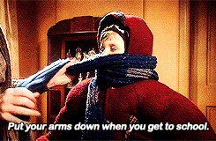
Scavenger Hunt – Item #5
Are you dressed in layers?
If you are wearing layers that can’t be removed from one or both arms…
give yourself +27.5 points for item #5

Slide 65
Key Takeaways
Prior to initiating SMBP, always remember:
Educate patients on what SMBP is
10 steps for training patients to self-measure
Use MI techniques when encountering patient barriers to SMBP

Slide 66
Missouri department of health and senior services resources
Kris Kummerfeld, MHA
Notes:
Kris

Slide 67
Missouri’s Urgency for Changing the Health System
Cardiovascular Disease Burden in Missouri:
  Heart disease continues be the leading cause of death (14,818 in 2017; 3,640 MIS) heart attack is 24.56% of all heart disease deaths. Essential hypertension is 11th leading cause of death in the African-American community.
  Stroke is the fifth leading cause of death (3,159 in 2017).
  Hypertension prevalence is 32.0% in the adult population and 38.5% in African-American adults. 58.5% using SMBP (2017).
Behavioral Risk Factor Surveillance System (BRFSS) Data: Prevalence of smoking, physical inactivity, inadequate fruit and vegetable consumption, obesity, hypertension, high cholesterol and diabetes - generally higher than US.
Notes:
Kris

Slide 68
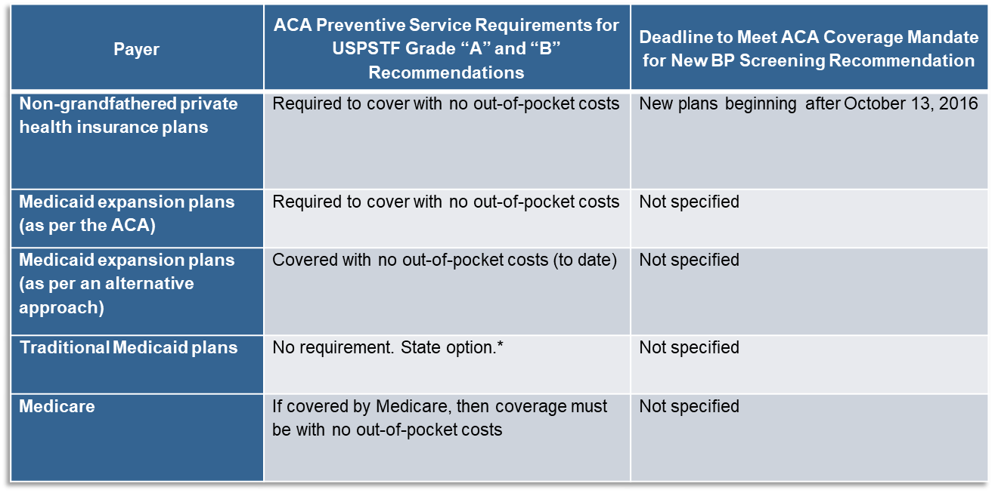
What payers are held to the ACA preventive services coverage requirement?
*Incentive of 1% increase in federal medical assistance percentage is made available if all USPSTF and ACIP recommended services are covered with no out-of-pocket costs. As of May 2018, the following 15 states opted for this coverage for their traditional Medicaid enrollees: CA, CO, DE, HI, KY, LA, MT, NH, NJ, NV, NY, OH, OR, WA, WI
For more information about how the preventive services coverage requirements relate to different payers go to https://www.cdc.gov/nchhstp/preventionthroughhealthcare/preventiveservices/index.htm

Slide 69
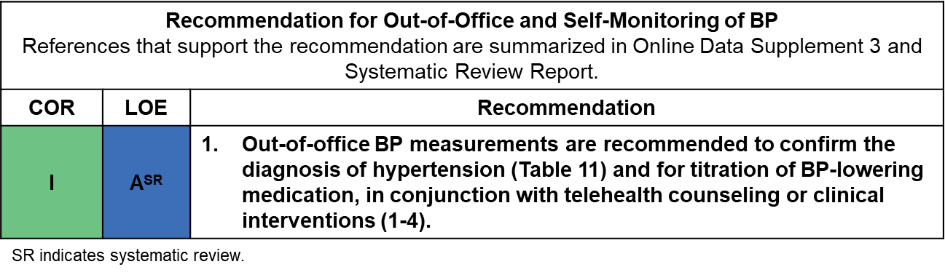
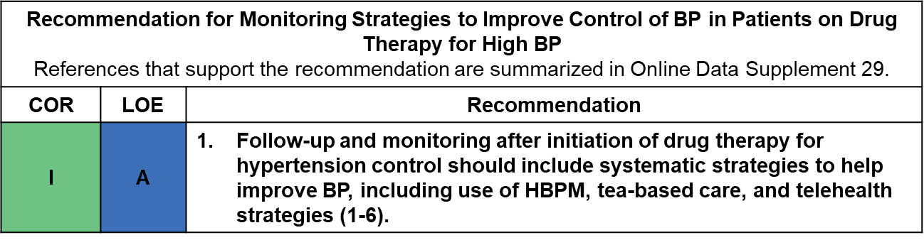
SMBP in the 2017 Hypertension Clinical Practice Guidelines

Slide 70
Hypertension Prevalence
National Hypertension Prevalence Rate (2015-2016)
  29%
Missouri Hypertension Prevalence Rate (2017-2018)
  32%
https://www.cdc.gov/nchs/products/databriefs/db289.htm#targetText=During%202015%E2%80%932016%2C%20the%20prevalence,or%20Hispanic%20(27.8%25)%20adults.

Slide 71
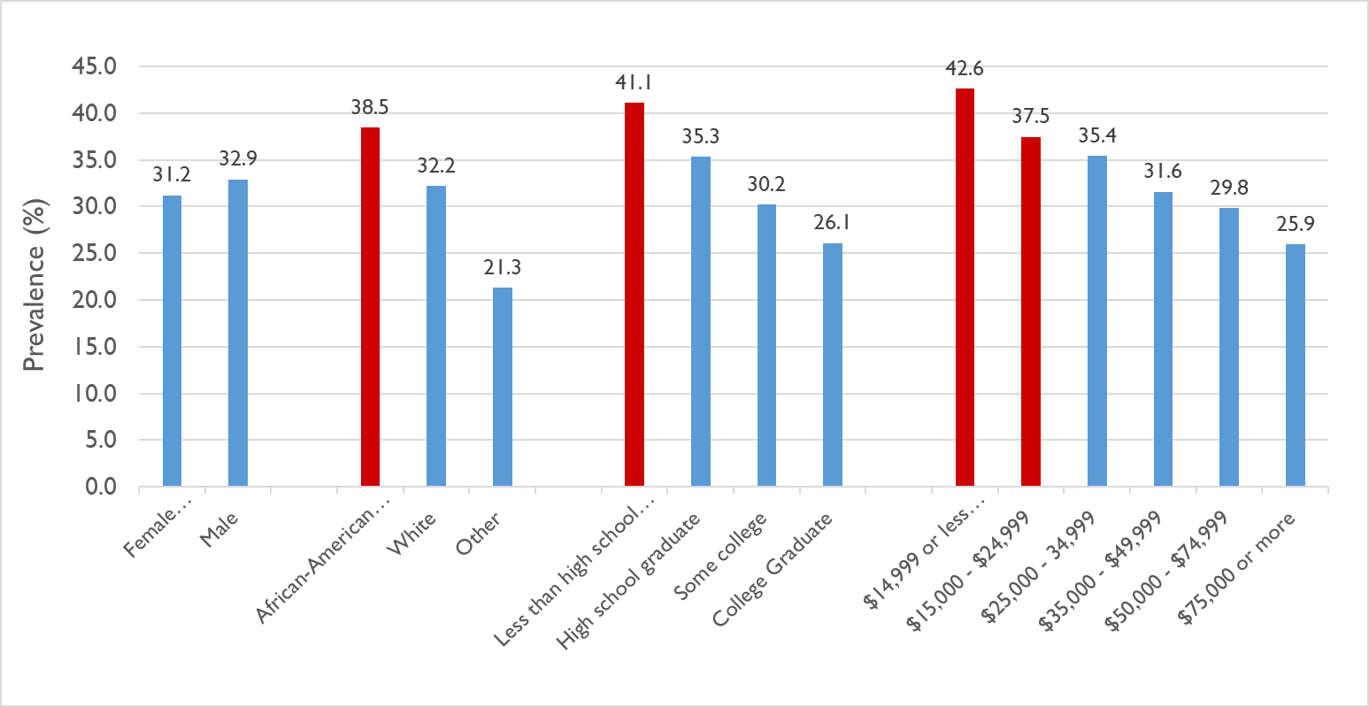
Prevalence of High Blood Pressure by Demographic Characteristics, Missouri, 2017
Red bars indicate HBP prevalence is significantly higher than one or more groups
Notes:
Red Line is Healthy People 2020 Target Goal of 26.9%. This slide demonstrates disparities by gender, race, education and income. Only those with a household income of more than $75,000 in Missouri are closing to the Healthy People 2020 Target.

Slide 72
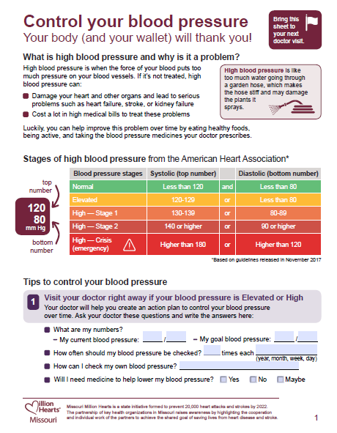
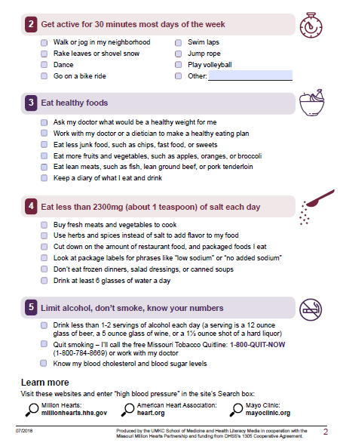
Patient Engagement Resources
Notes:
Kris to go over resources

Slide 73
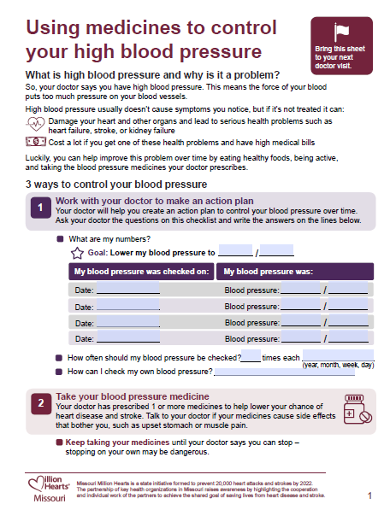
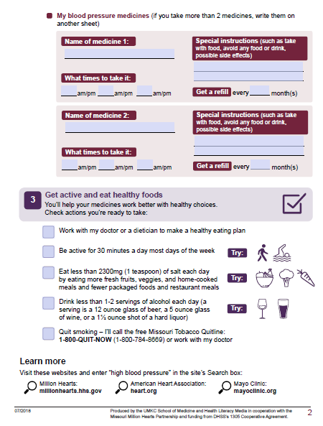
Patient Engagement Resources

Slide 74
Break!

Slide 75
Self-Measured Blood Pressure (SMBP) Training
Part Two
Operationalizing At-Home Measurements
in Practice
Notes:
Elena

Slide 76
Objectives
Develop an SMBP model for clinical practice
Identify staff members to provide SMBP education to patients, and a point-of-contact for patients’ questions
Assess technology available to individual clinics for transmitting data back to providers
Establish BP cuff loaner programs
Establish a resource repository on SMBP (e.g., device validation test, proper patient positioning)
Expand on the Million Hearts protocol; include SMBP in standardized HTN treatment protocols
Record and submit BP measurements

Slide 77
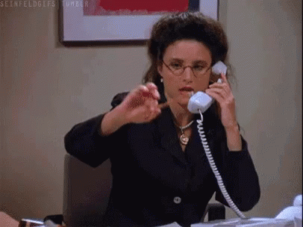
Scavenger Hunt – Item #6
Are you talking?
If you are having a conversation. . .
give yourself +6 points for item #6

Slide 78
Care team roles for smbp
Notes:
Elena

Slide 79
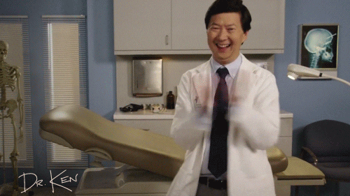
Activity – Provider/Patient Conversation Training
Notes:
Find common myths/questions – Divide up the questions and have partners play both the patient and provider.

Slide 80
Patient and Provider Scenario
Get into pairs, switch being the patient and provider
Use open-ended questions and motivational interviewing techniques to address patient barriers

Slide 81
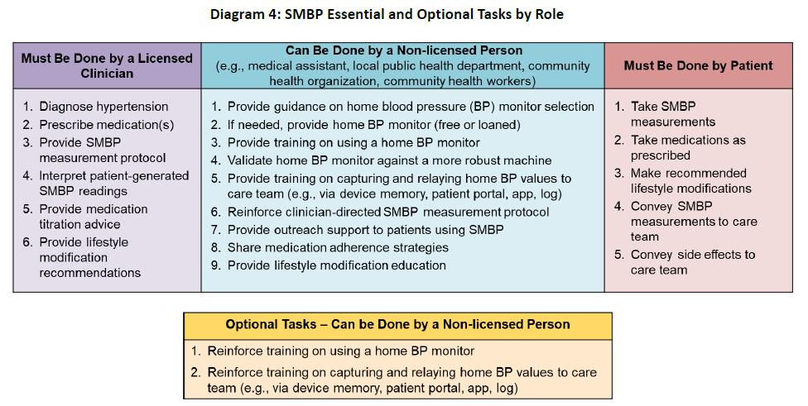
Scope of Practice for SMBP Support
https://www.nachc.org/wp-content/uploads/2018/09/NACHC-Health-Care-Delivery-SMBP-Implementation-Guide-08222018.pdf
Notes:
This resource is from the National Association of Community Health Centers SMBP Monitoring Implementation Guide. You can find the link to the guide at the bottom of the slide.
Print handout with information instead of on the slides?
ADD Chart in printout

Slide 82
Scope of Practice for SMBP Support
Medical Assistants (MAs)
  Measure and record BP
  Provide patients with information and instructions as authorized by physician
  Non-triage communication
Community Health Workers (CHWs)
    Empower and coach patients
      Social support, goal setting, barrier identification
    Serve as liaison with patient, clinical care team, and community partners (care coordination)
    Engage patients in preventive care, chronic disease management, and self-management
Notes:
Sources:
MAs –
https://www.rchc.net/wp-content/uploads/2017/08/MA-Scope-of-Practice.pdf
http://www.aama-ntl.org/docs/default-source/legal/delegable-duties-missouri.pdf?sfvrsn=4
CHWs – as of 2017, MO has no laws/regulations for CHW training/certification standards
https://www.mo-pca.org/chw
https://health.mo.gov/professionals/community-health-workers/
http://www.astho.org/Public-Policy/Public-Health-Law/Scope-of-Practice/CHW-Certification-Standards/

Slide 83
Scope of Practice for SMBP Support
Registered Nurses (RNs)
  Measure and record BP
  Teach patients and families about care and prevention of illness
  Administer medications and treatments as prescribed by a person licensed by state regulatory board
  Coordinate and help deliver a plan of care with all members of a health team
Notes:
Sources: contact your state association for your position***
NPs –
https://www.midlevelu.com/blog/nurse-practitioner-scope-practice-missouri
RNs –
https://health.mo.gov/living/lpha/phnursing/scope.php
http://www.pr.mo.gov/boards/nursing/MODecision%20Making%20Model.pdf
http://revisor.mo.gov/main/OneSection.aspx?section=335.016

Slide 84
Scope of Practice for SMBP Support
Pharmacists
  Administer medications consistent with medical prescription order
  Patient education as authorized by MO state law
    20 CSR 2220-2.190 – Non-Dispensing Activities
  Medication review with patients
  Consultation with other healthcare professionals
  Medication therapy management (Chapter 338, RSMo, and rules of the board)
    Medication therapy services – “designing, initiating, implementing, or monitoring of a plan to monitor the medication therapy or device usage of a specific patient” – Code of State Regulations
    “. . . selecting a new, different, or additional medication or device, discontinuing a current medication or device” – Code of State Regulations
Notes:
Sources:
Pharmacists –
https://www.sos.mo.gov/cmsimages/adrules/csr/current/20csr/20c2220-6.pdf

Slide 85
Scope of Practice − Sources
MA
https://www.rchc.net/wp-content/uploads/2017/08/MA-Scope-of-Practice.pdf
http://www.aama-ntl.org/docs/default-source/legal/delegable-duties-missouri.pdf?sfvrsn=4
CHW
https://www.mo-pca.org/chw
https://health.mo.gov/professionals/community-health-workers/
http://www.astho.org/Public-Policy/Public-Health-Law/Scope-of-Practice/CHW-Certification-Standards/
RN
https://www.midlevelu.com/blog/nurse-practitioner-scope-practice-missouri
Pharmacist
https://www.sos.mo.gov/cmsimages/adrules/csr/current/20csr/20c2220-6.pdf

Slide 86
Building your smbp program
Notes:
Elise

Slide 87
Before You Start Your SMBP Program
Identify at least one provider and one care team member to serve as champions; these individuals will learn about SMBP and train others
Allocate appropriate time for:
  Training patients on SMBP (5−6 minutes per patient)
  Ensuring device accuracy, if the patient is using his/her own device (5 minutes)
  Averaging and documenting patient’s SMBP readings (5 minutes)
  Preparing the device for the next patient, if implementing a loaner program (5 minutes)
Notes:
*Make cheat sheet for manuals

Slide 88
Before you start your SMBP Program
Design processes to include:
How will patients be identified as candidates for SMBP?
Who will train the patients on self-measurement?
How will you get the readings (and the device, if using a loaner program) back from the patient? Is an appointment required? With whom?
Who will be responsible for averaging, documenting, and notifying the physician of the SMBP average?
How will follow-up occur?
Notes:
Start brainstorming these processes and define gaps for future TA.

Slide 89
Before you start your SMBP Program
If you will use a loaner program:
Who will track the distribution and return of the devices?
Who will be responsible for disinfecting the returned loaner devices?
Where will the loaner devices be stored?
Notes:
Tracker screenshot for loaner program.

Slide 90
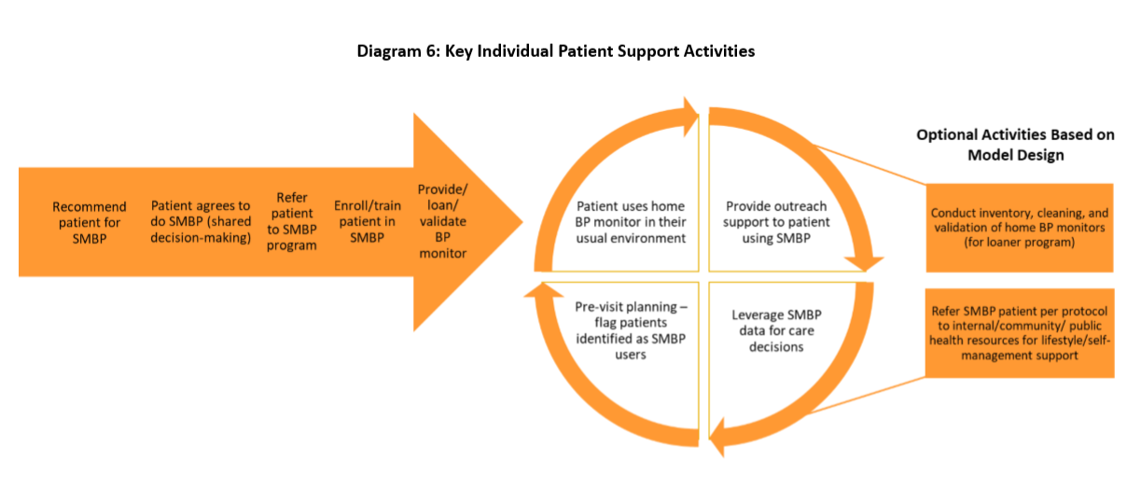
Notes:
Workflow example to visualize a simplified version of what the SMBP process would look like in your office.

Slide 91
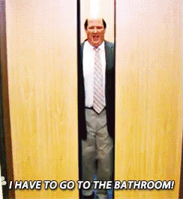
Scavenger Hunt – Item #7
(Pardon the inquiry, but…)
Do you need to use the restroom?
If you have a full bladder. . .
give yourself +10 points for item #7

Slide 92
Identifying Eligible Patients for SMBP
Patients with a confirmed HTN diagnosis
  Encourage these patients to get their own validated SMBP device
  Patients who cannot afford their own device should be offered a loaner if available
Patients without a confirmed diagnosis but at risk should perform SMBP
  Masked
  White coat
**Patients must be willing and able to self-measure their BP at home.

Slide 93
Methods for Obtaining Patient Readings
Telephone
Secure fax
Online through secure patient portal or telemedicine website
Follow-up office visit
  Written tracker cards, review of device measurements or download if measurement history is available
Average all readings taken by the patient into a single SBP/DBP
Notes:
Suggested SMBP Measurement Protocol“Multiple international guidelines 47–51 suggest that the optimal protocol for obtaining an accurate picture of a patient’s blood pressure using SMBP includes Taking two or three measurements, each 1 minute apart, in the morning and again in the evening. Monitoring blood pressure preferably for 7 days and at least for 3 days. Recording an average of these measurements. “

Slide 94
Tracking Resources
BP tracker cards
Patient portal
Options from HoMedics devices
Notes:
HoMedics devices have tracking within the device

Slide 95
Interpreting Patient Readings
In-office BP Average | SMBP Average | Classification | Management
Less than 120/80 | Less than 120/80 | Normal BP | Recheck BP in office in 1 year
120−129/less than 80 | 120−129/less than 80 | Elevated BP | Healthy lifestyle changes and recheck SMBP every 3−6 months
Less than 130/80 | Greater than or equal to 130/80 | Masked HTN | Manage as sustained HTN due to increased cardiovascular risk or consider 24-hour ambulatory BP monitoring
Greater than or equal to 130/80 | Less than 130/80 | White coat HTN | Recheck SMBP every 6 months
Greater than or equal to 130/80 | 120−129/less than 80 | White coat HTN and elevated BP | Healthy lifestyle changes and recheck SMBP every 3−6 months
Greater than or equal to 130/80 | Greater than or equal to 130/80 | Sustained HTN | Manage per current HTN guidelines

Slide 96
Providing Feedback
SMBP is associated with better BP control with added clinical support
  Web-based feedback
  Telephone feedback
  Counseling in person or via telephone
  Adherence-enhancing strategies
    Use of nurse case managers
    Electronic reminders
    Behavioral management teams
Muntner P, Shimbo D, Carey RM, et al; on behalf of the American Heart Association Council on Hypertension; Council on Cardiovascular Disease in the Young; Council on Cardiovascular and Stroke Nursing; Council on Cardiovascular Radiology and Intervention; Council on Clinical Cardiology; and Council on Quality of Care and Outcomes Research. Measurement of blood pressure in humans: a scientific statement from the American Heart Association. Hypertension. 2019;71:e1-e32. DOI: 10.1161/HYP.0000000000000087.
Notes:
Behavioral management teams educating patients focusing on improving HTN management, covering topics like HTN knowledge, resources, salt intake, stress management, smoking cessation, diet, exercise, etc.

Slide 97
SMBP with Clinical Support Examples
One-on-one counseling
Telephone calls from nurses or pharmacists to manage medications
Counseling sessions in person with pharmacists
CHWs who relay information to the clinical team
Patient Education
Nurses providing telephone-based education on lifestyle changes to lower BP
Small group classes on SMBP and lifestyle changes in clinical OR community settings
Centers for Disease Control and Prevention. Self-Measured Blood Pressure Monitoring: Actions Steps for Clinicians. Atlanta, GA:Centers for Disease Control and Prevention, US Dept of Health and Human Services; 2014.
Notes:
Patient engagement tools can be used for patient education

Slide 98
SMBP with Clinical Support Examples
Web-based or telephone support based on patient-reported SMBP readings
Computer or telephone-based feedback system
Secure patient website training plus pharmacist care management via web communication
Access to web-based tools for med refill requests
Text and e-mail reminders to measure BP or for appointments
Secure messaging with clinician or staff
Centers for Disease Control and Prevention. Self-Measured Blood Pressure Monitoring: Actions Steps for Clinicians. Atlanta, GA:Centers for Disease Control and Prevention, US Dept of Health and Human Services; 2014.

Slide 99
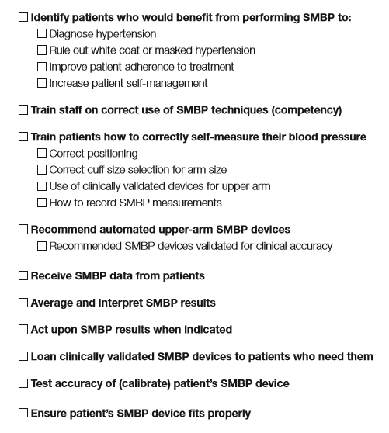
SMBP Workflow
Notes:
https://www.ama-assn.org/system/files/2019-01/smbp-pre-assessment_0.pdf
*Print

Slide 100
Sustainability
Champion
Resources
Loaner program
Health insurance coverage for at-home devices
  Aetna & Cigna provide coverage for at-home monitors for the purpose of confirming HTN diagnosis
  Molina & WellCare Medicare Advantage – over the counter benefits that could apply to purchase a monitor
  Care First – may provide home monitors to select patients enrolled in their enhanced monitoring program

Slide 101

Bonus Item #1
Have you had caffeine in the last half hour?
If you have consumed a caffeine product within the last 30 minutes. . .
give yourself +5 points for bonus item #1

Slide 102
Tools and resources
Notes:
Elena

Slide 103
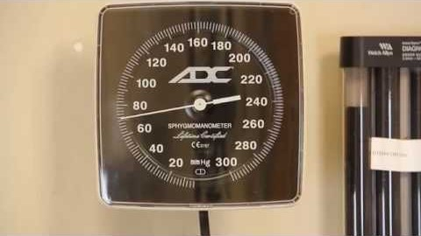
Mercy Blood Pressure Video
https://www.youtube.com/watch?v=i5GeivOJd5Q&feature=youtu.be
Notes:
This resource was shared with us from MDHSS and Mercy. A great tool to send to those taking patients’ BP and training patients as a quick, 6-minute review of how to accurately measure BP

Slide 104
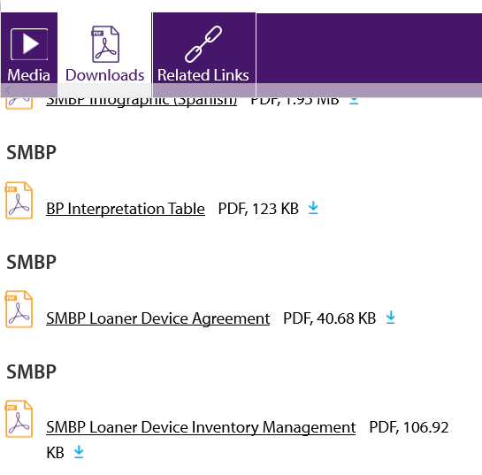
M.A.P. BP Improvement Tools and Resources
Measure Accurately
Act Rapidly
Partner with Patients
https://www.ama-assn.org/delivering-care/public-health/about-improving-health-outcomes
Notes:
Saved several resources to the Resources folder under “Extra Resources.”

Slide 105

Bonus Item #2
Have you smoked in the last half hour?
If you have smoked a tobacco product within the last 30 minutes. . .
give yourself +5 points for bonus item #2

Slide 106

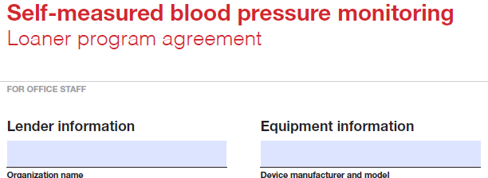
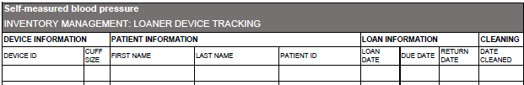
SMBP Tools
Loaner device tracking
Loaner agreement
Source: https://millionhearts.hhs.gov/tools-protocols/smbp.html#RR

Slide 107
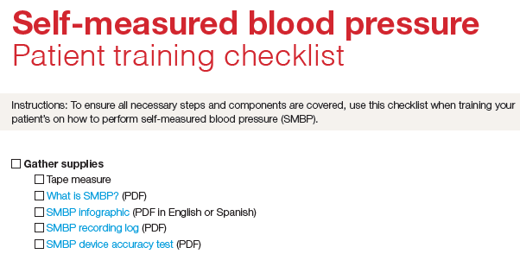
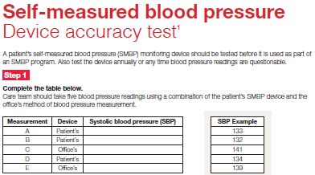
SMBP Tools
Review device accuracy test
Patient training checklist
Staff competency
SMBP research articles
Source: https://millionhearts.hhs.gov/tools-protocols/smbp.html#RR

Slide 108
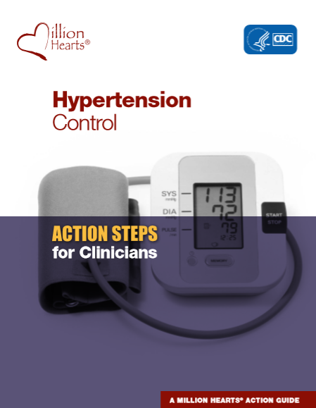
Million Hearts BP Protocol
Evidence-based strategies to aid efforts at HTN control:
Source: https://millionhearts.hhs.gov/files/MH_HTN_Clinician_Guide.pdf

Slide 109
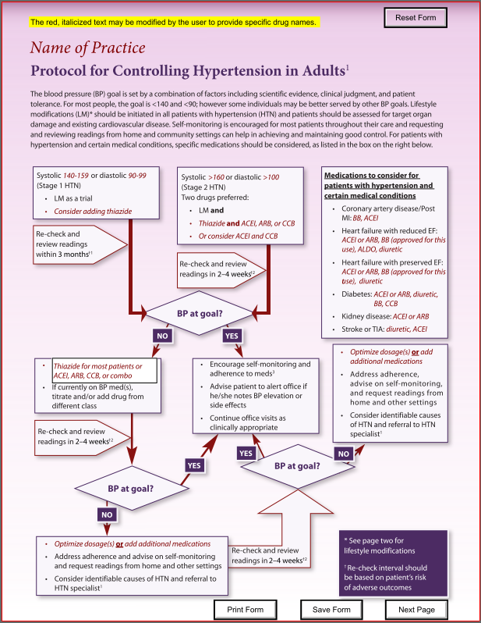
Blood Pressure Protocol
Flowchart actions to manage patients with Stage 1 and Stage 2 HTN
  Systolic and diastolic thresholds
  Follow-up time periods
  Recommended medications
  Prompts to advise patients on self-monitoring and adherence
Instructions for use
  Identify medications and starting dosages
  Decide follow-up intervals
https://millionhearts.hhs.gov/files/Hypertension-Protocol.pdf
Notes:
Million Hearts resource

Slide 110

Bonus Item #3
Were you just doing moderate or high-level
physical activity?
If you were physically active immediately before this item. . .
give yourself +5 points for bonus item #3

Slide 111
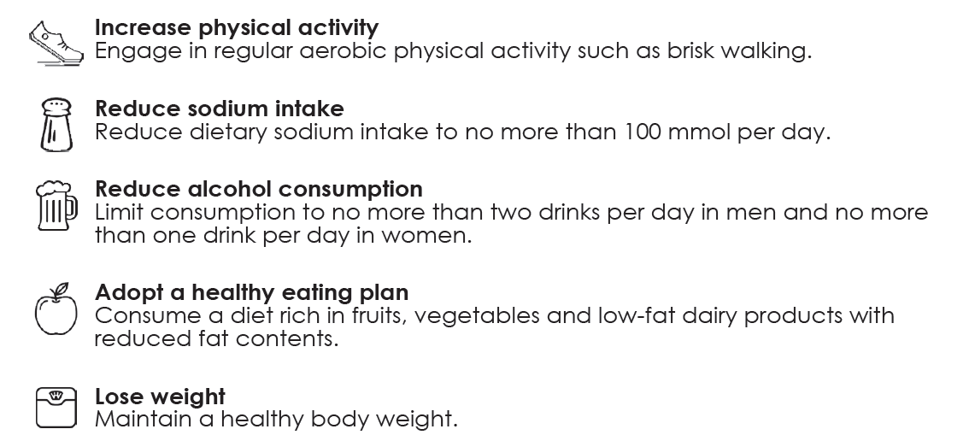
Lifestyle Changes to Manage High Blood Pressure
Notes:
Alcohol can temporarily raise BP due to caloric consumption and physiological responses to alcohol. Long-term consumption can have damaging effects on the liver, digestive tract, and vascular system, which leads to elevated blood pressure levels. Heavy drinkers who cut back to moderate drinking can lower their SBP by 2-4 mm Hg and their DBP by1-2 mm Hg.
(https://www.mayoclinic.org/diseases-conditions/high-blood-pressure/expert-answers/blood-pressure/faq-20058254)

Slide 112
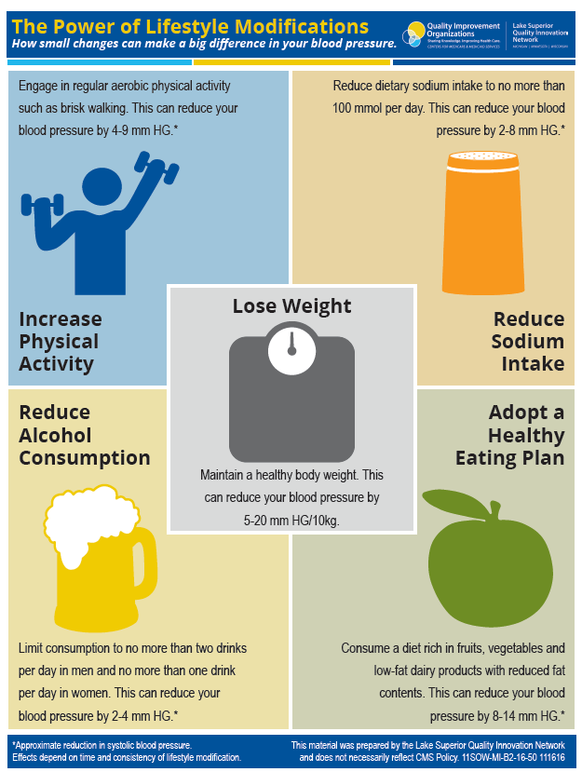
The Power of Lifestyle Modifications Poster
Notes:
**change resource from LSQIN

Slide 113
Time to add up your score!
Add your points for each of the 7 Scavenger Hunt Items
Now add your points for each of the 3 bonus items
What’s your total score?

Slide 114
So what do these numbers mean?
If during BP measurement, a patient . . .
Doesn’t have his/her feet supported
  This can elevate BP by 5−10 mm Hg (average points = __)
Has his/her legs crossed
  This can elevate BP by 2−8 mm Hg (average points = __)
Has an unsupported back
  This can elevate BP by 5−10 mm Hg (average points = __)
Does not have arm supported at heart level
  This can elevate BP by 10 mm Hg (points = 10)
Can’t remove arm from sleeve and the cuff is placed over clothing
  This can elevate BP by 10−40 mm Hg (average points = __)
Is talking
  This can elevate BP by 10−15 mm Hg (average points = __)
Has a full bladder
  This can elevate BP by 10−15 mm Hg (average points = __)

Slide 115
So what do these numbers mean?
If before BP measurement, a patient...
Has consumed caffeine within 30 minutes
  This can falsely elevate BP (average points assigned = 5)
Has smoked within 30 minutes
  This can falsely elevate BP (average points assigned = 5)
Has done physical activity immediately before
  This can falsely elevate BP (average points assigned = 5)
Look at your total score.
If you were having your BP measured and these issues went unaddressed,
this is how much your BP could be elevated.
Would this qualify you for a diagnosis of HTN?
Would hypertensive medications need to be started or changed?

Slide 116
WWYD?
What would you do? Given the following situations, how would you address each patient?

Slide 117
WWYD?
A patient takes her blood pressure at home and gets a measurement of 182/124. She retakes her BP, gets a similar reading, and notes she has shortness of breath. What should the patient do?
This is a hypertensive emergency − the patient should call 911.

Slide 118
WWYD?
Your patient identifies as a current smoker. You are about to show him how to self-measure his BP at home. What do you do?
Ask the patient whether he has smoked in the last 30 minutes. If he has, educate him on factors that impact BP and the need to refrain from smoking 30 minutes prior to taking his BP at home.

Slide 119
WWYD?
The patient, a 25-year-old white male, has just run up five flights of stairs – what action should be taken?
Continue with patient visit, and after 30 minutes, complete BP check – educate him on factors that impact BP and advise him not to exercise or do any other strenuous activity before taking his BP at home.

Slide 120
Questions?

Slide 121
References and Resources
All references and resources are included on the slides. At the end of this training, we will email you the digital version of the training so you have access to all the links.

